Slide 1
Drone Mission Planning Software
David Klingenberg
Taylor Trabun
Notes:
11/11/14
<number>

Slide 2
Problem Definition
Specific Component Design
Communications Design
Drone Design
Graphical User Interface Design
Timeline
Questions/Concerns
Overview
Notes:
11/11/14
<number>

Slide 3
The goal of this project is to design and develop a graphical user interface (GUI) for drone mission planning.
Requirements:
A user-friendly interface
Allow 3-dimensional mission planning
Upload the flight plan using XAPI and XBee
Allow manual override
Implement drone hardware for flight control
Problem Definition
Notes:
11/11/14
<number>

Slide 4
The communication system for this project must allow for commands to be sent from a computer to a drone.
Requirements:
XAPI and XBee hardware
Specific TUN packets:
Manual drone instructions (altitude, direction, takeoff, etc..)
Settings
Acknowledgement of packet received
Heartbeat/status updates
Override (manual, land)
Flight plan protocol
Initialize for upload
Get instructions
Echo instructions
Terminate upload
Communication Design
Notes:
11/11/14
<number>

Slide 5
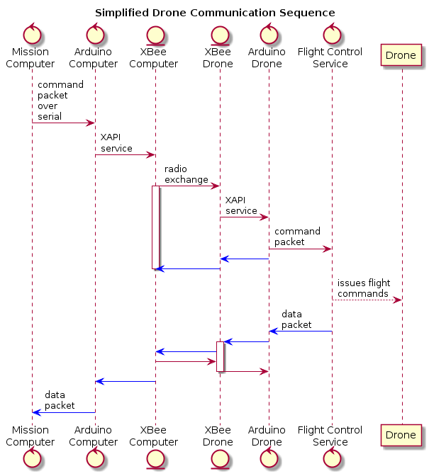
Notes:
11/11/14
<number>

Slide 6
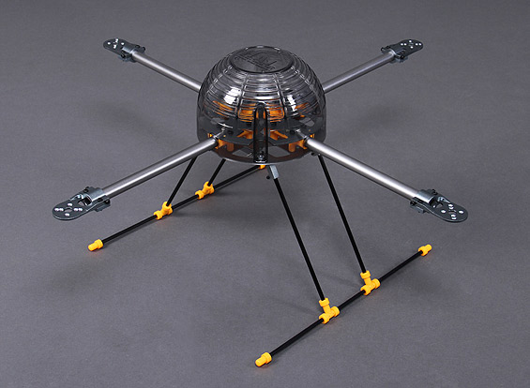
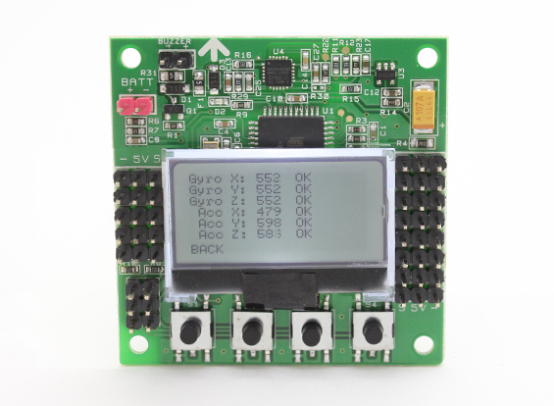
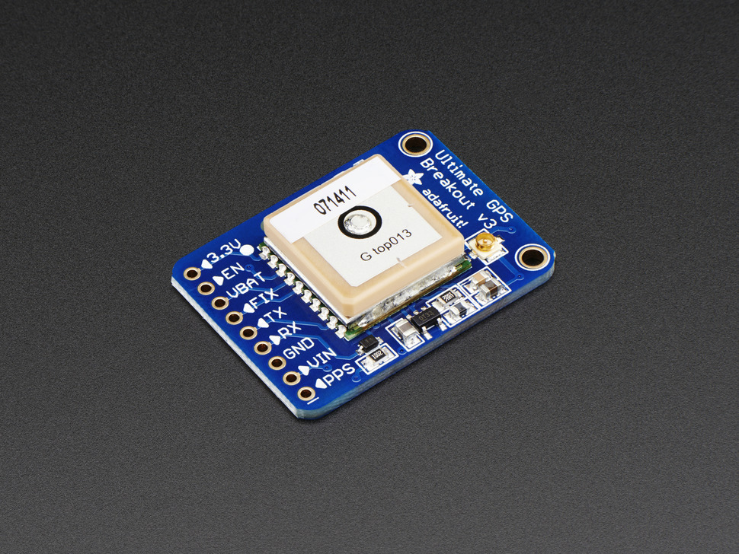
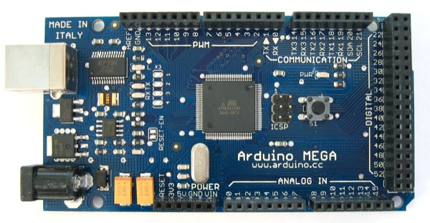
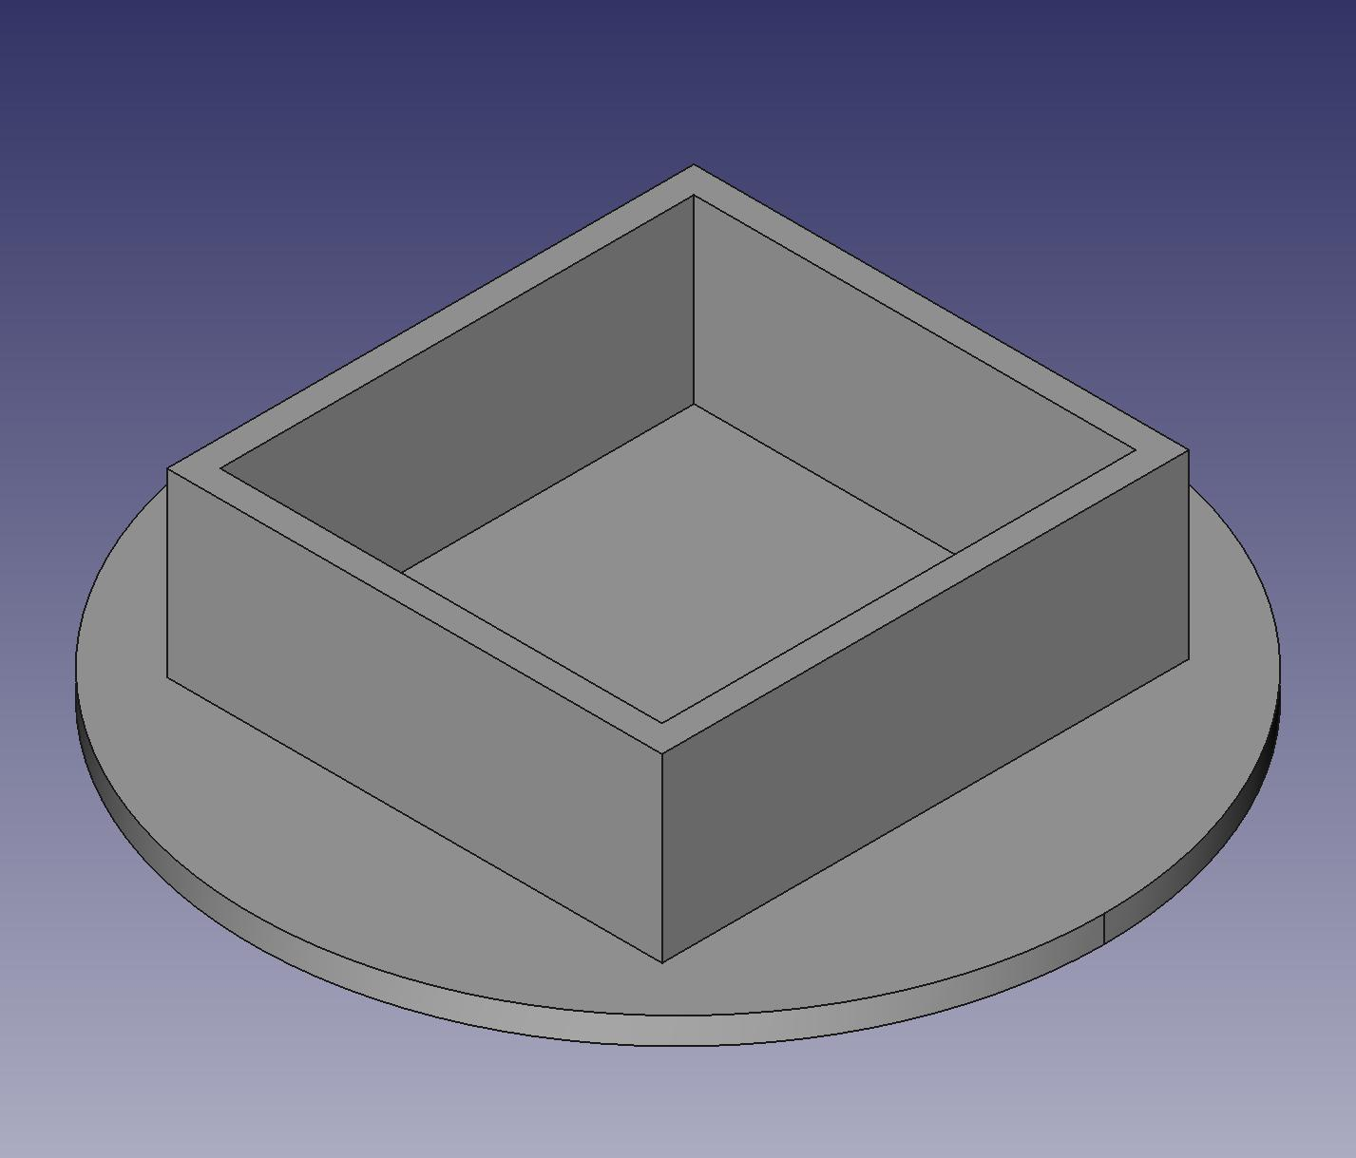
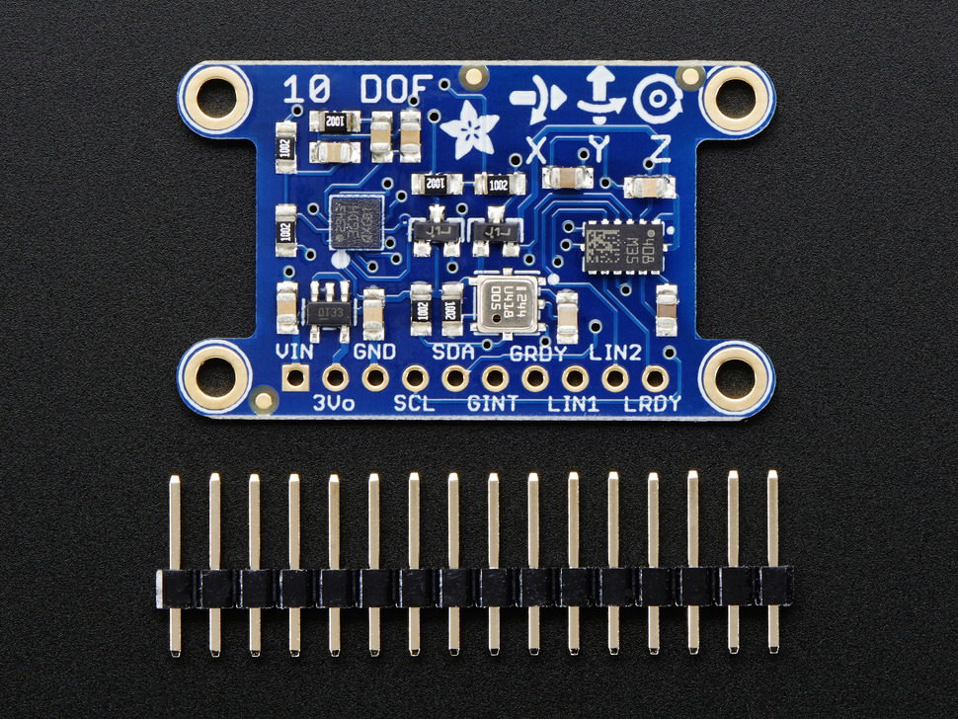
Drone Design
Notes:
11/11/14
<number>

Slide 7
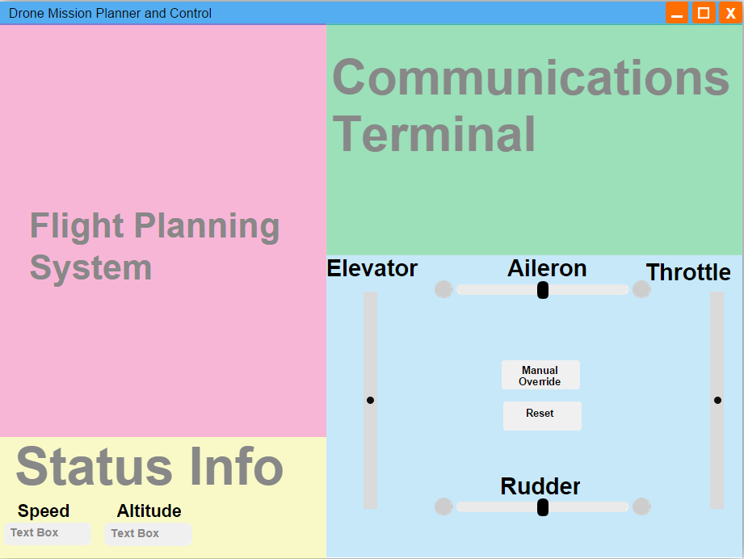
Graphical User Interface Design
Notes:
11/11/14
<number>

Slide 8
Timeline
Notes:
11/11/14
<number>

Slide 9
Questions or concerns?
Thank You
Notes:
11/11/14
<number>

