Slide 1
DRONE MISSION PLANNING SOFTWARE
Taylor Trabun David Klingenberg
Emeth Thompson Joe Higley
University of Idaho – Moscow, ID

Slide 2
Overview
Problem Definition
Project Status
Goals & Plans
Hardware
Communications
GUI
Demo
Q & A

Slide 3
Problem Definition
The goal of this project is to design and develop a graphical user interface (GUI) for drone mission planning.
Requirements:
User friendly interface
Allow 3D mission planning
Upload the flight plan using XAPI and Xbee
Allow Manual Override during flight
Implement Drone Hardware for flight control

Slide 4
Project Status
Work on the GUI has begun.
The drone flys!!!
Packet types have been identified.

Slide 5
GOALS & plans
Goal
Design a basic flight plan (i.e. take-off and land) using the Mission Planning Software, send the mission plan to the drone, and then have the drone carry out the mission.
Plan
David is working on the hardware so the drone is capable of testing.
Taylor is focusing on developing a packet and the format of the messages.
Emeth and Joe are on GUI.

Slide 6
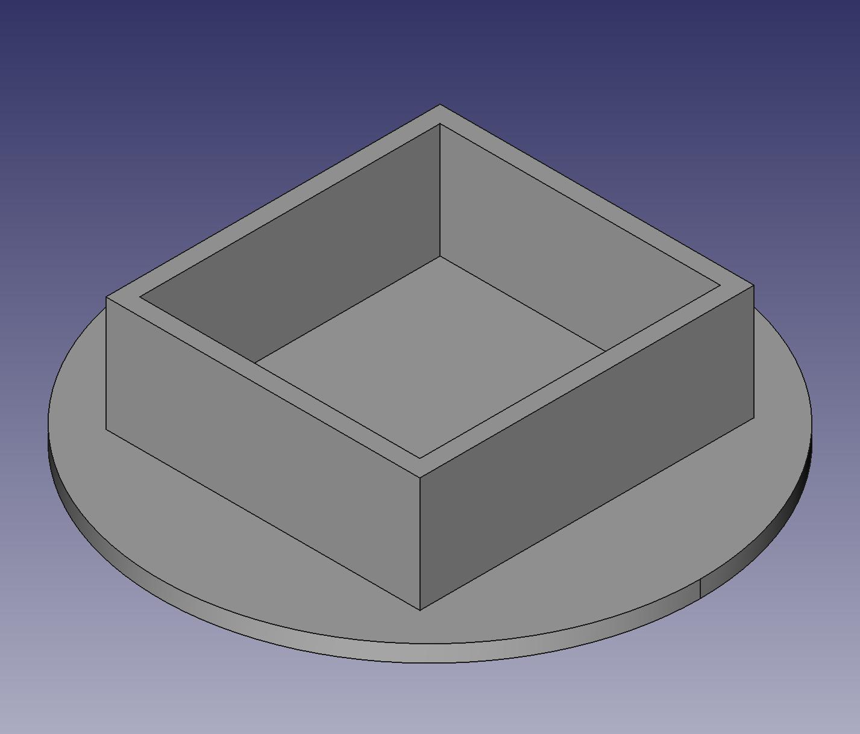
hardware

Slide 7
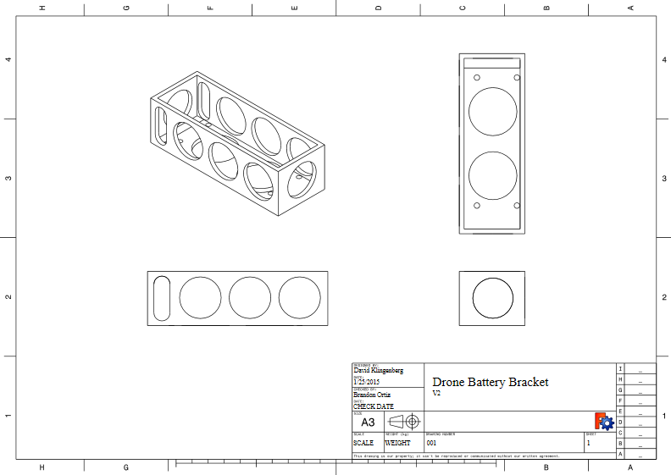
hardware

Slide 8
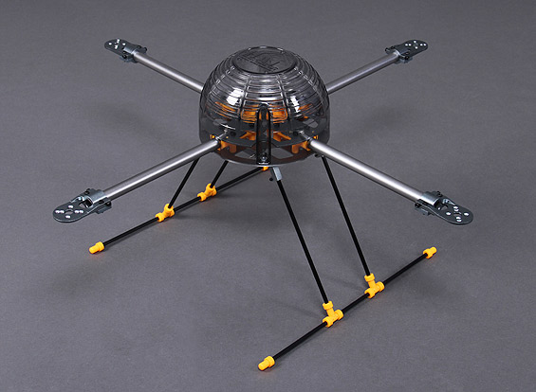
hardware

Slide 9
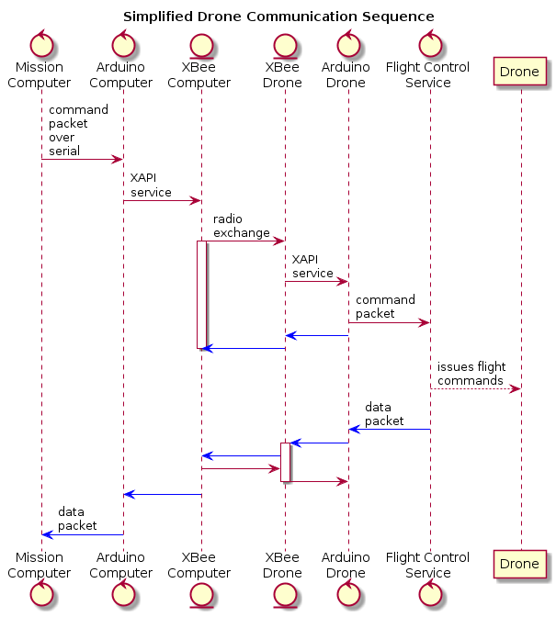
Communications

Slide 10
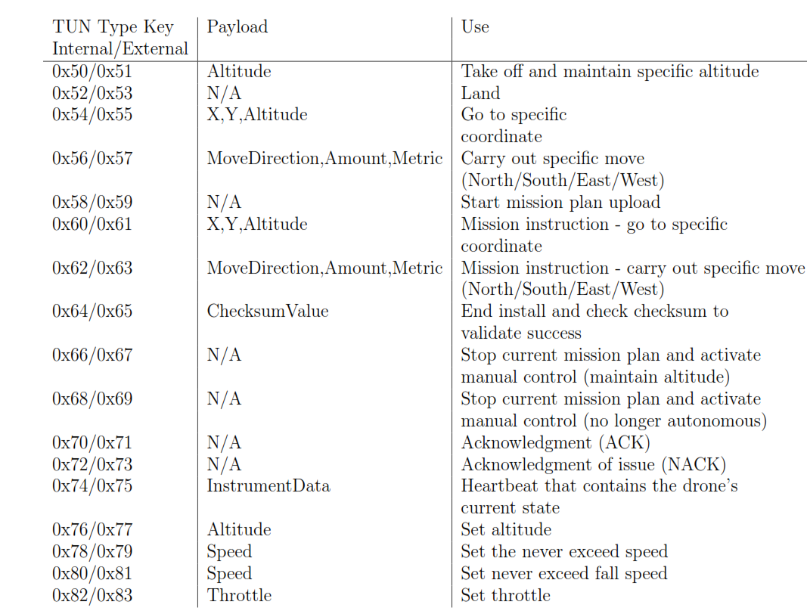
Communications

Slide 11
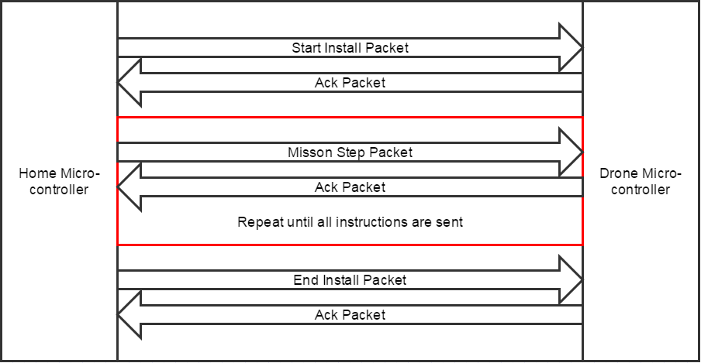
Communications

Slide 12
Mission Control Software
goals
have topographical data available for mission planning
Real time controls
Emergency land button
Pause mission and hover button

Slide 13
Mission Control Software
Goals
Instrument Panel – provides real time information about drone in flight
Artificial horizon
Vertical speed indicator
Dial compass
Two minute turn coordinator

Slide 14
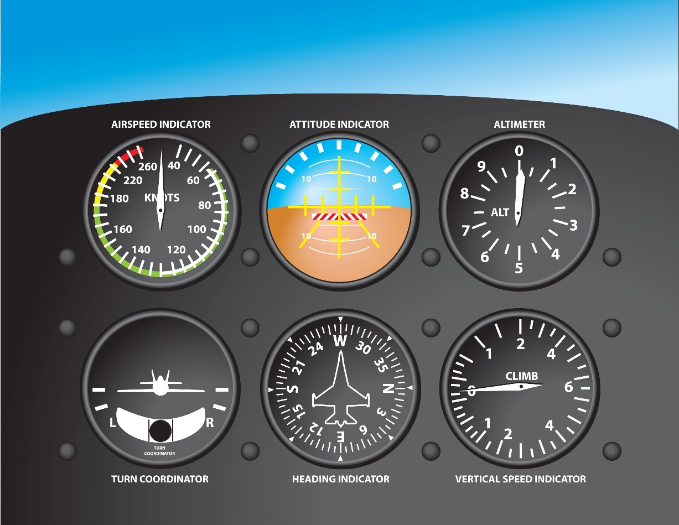
Mission Control Software
Instrument Panel

Slide 15
DEMO

Slide 16
Questions?

