Slide 1
Drone Mission Planning Software
David Klingenberg
Taylor Trabun

Slide 2
Overview
Problem Definition
Specific Component Design
Communications Design
Drone Design
Graphical User Interface Design
Timeline
Questions/Concerns

Slide 3
Problem Definition
The goal of this project is to design and develop a graphical user interface (GUI) for drone mission planning.
Requirements:
A user-friendly interface
Allow 3-dimensional mission planning
Upload the flight plan using XAPI and XBee
Allow manual override
Implement drone hardware for flight control

Slide 4
Communication Design
The communication system for this project must allow for commands to be sent from a computer to a drone.
Requirements:
XAPI and XBee hardware
Specific TUN packets:
Manual drone instructions (altitude, direction, takeoff, etc..)
Settings
Acknowledgement of packet received
Heartbeat/status updates
Override (manual, land)
Flight plan protocol
Initialize for upload
Get instructions
Echo instructions
Terminate upload

Slide 5
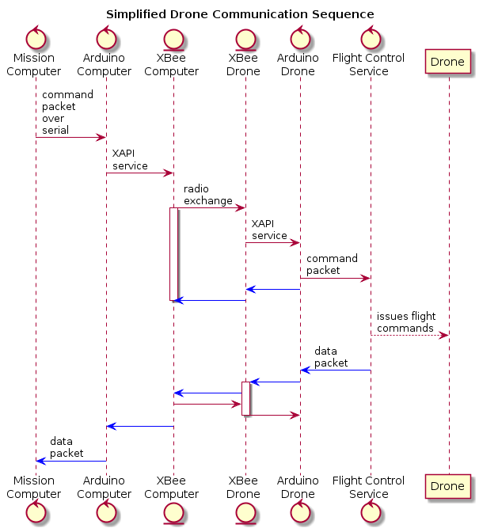

Slide 6
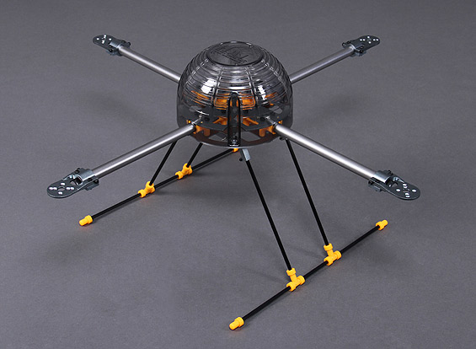
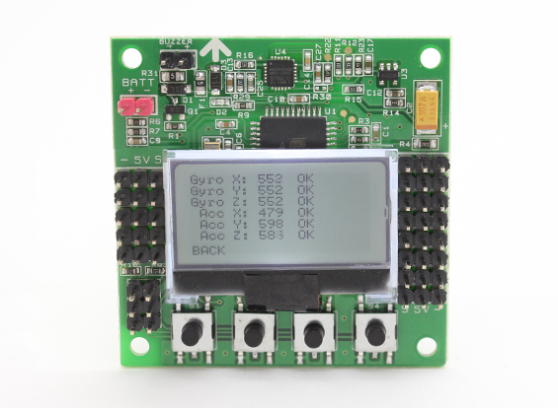
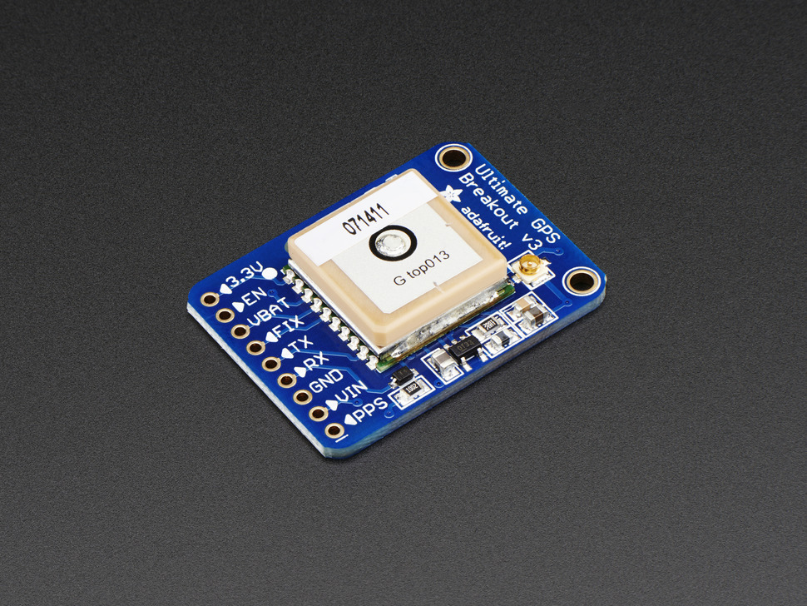
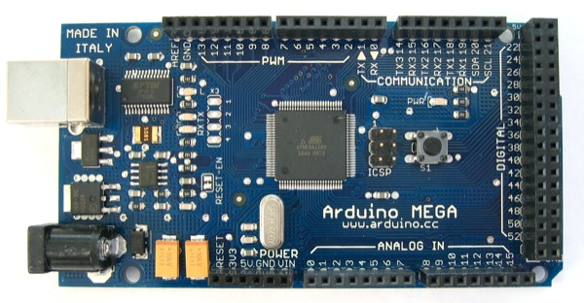
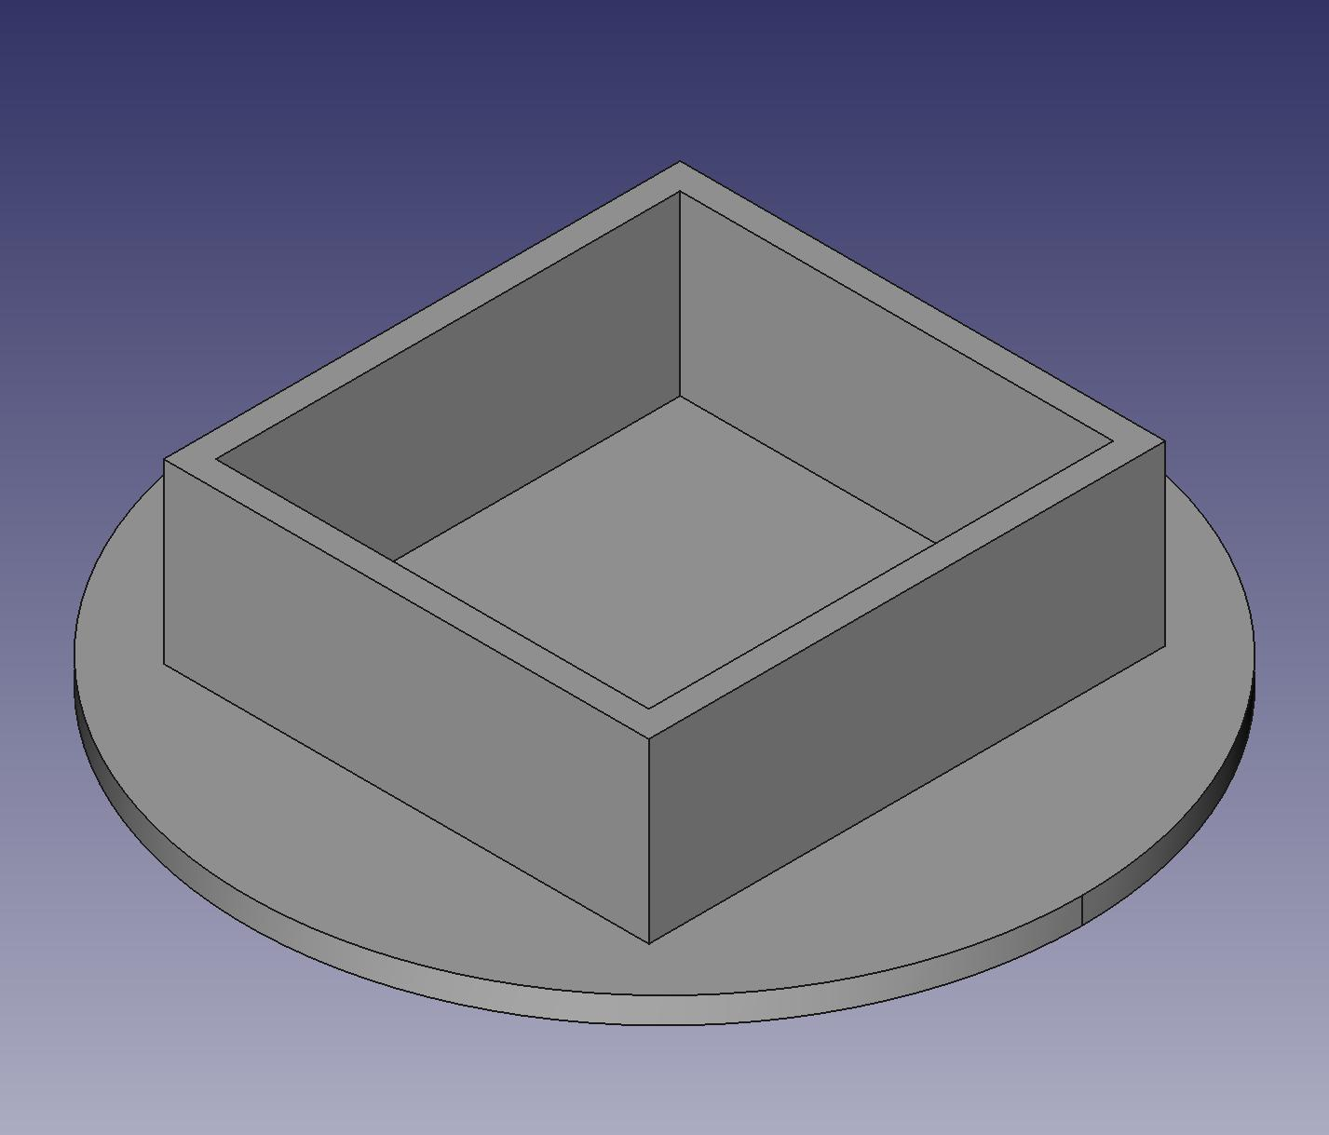
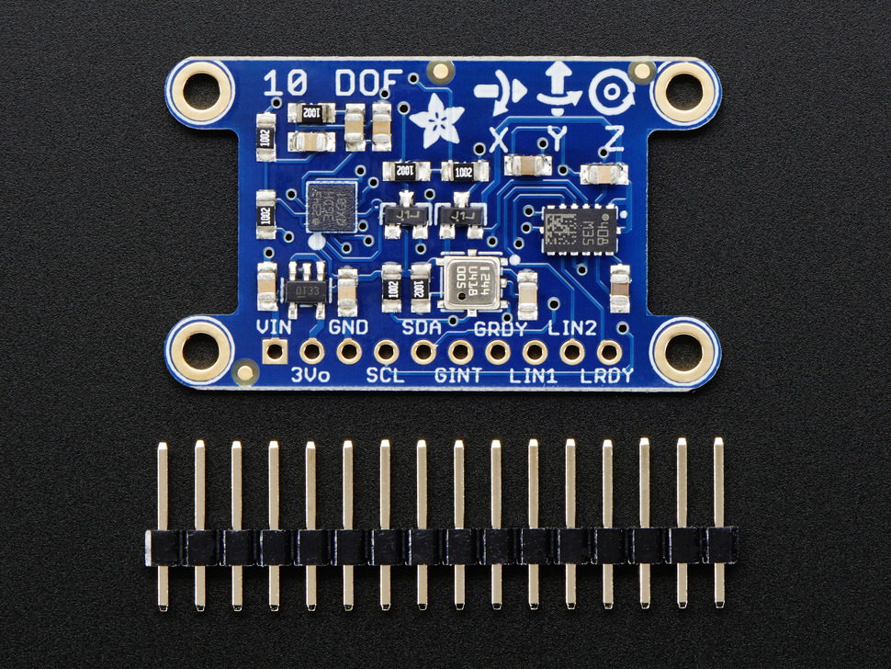
Drone Design

Slide 7
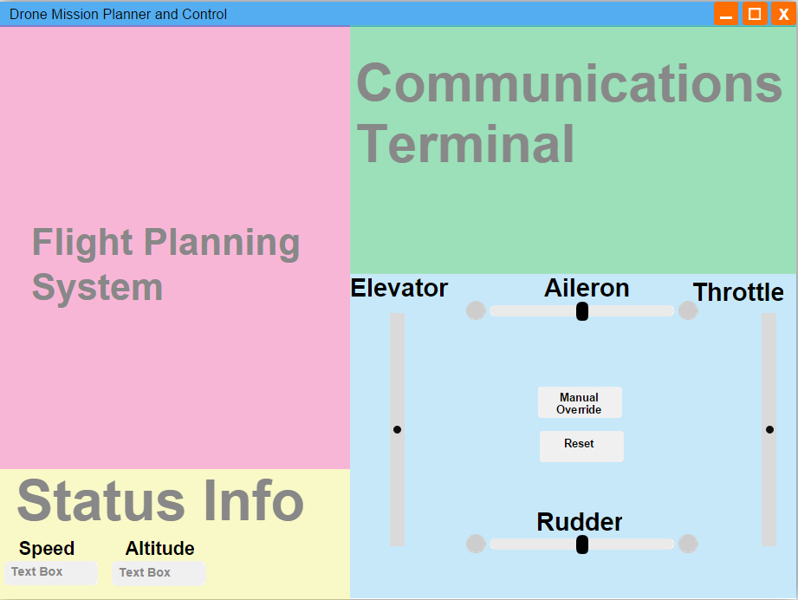
Graphical User Interface Design

Slide 8
Timeline
Re-design drone for reliable flight
Finish designing all needed packet types for drone control, status, ACK, and override.
Implement service on Arduino to send commands to flight computer
Finish implementing communications between two Arduino boards over XBee using XAPI
Finalize GUI design, implement communications system, design mission planning sub-system

Slide 9
Thank You
Questions or concerns?

