Slide 1
Bulk-RNA Sequencing on Unstimulated & LPS-Stimulated Macrophages
Bigy Ambat

Slide 2

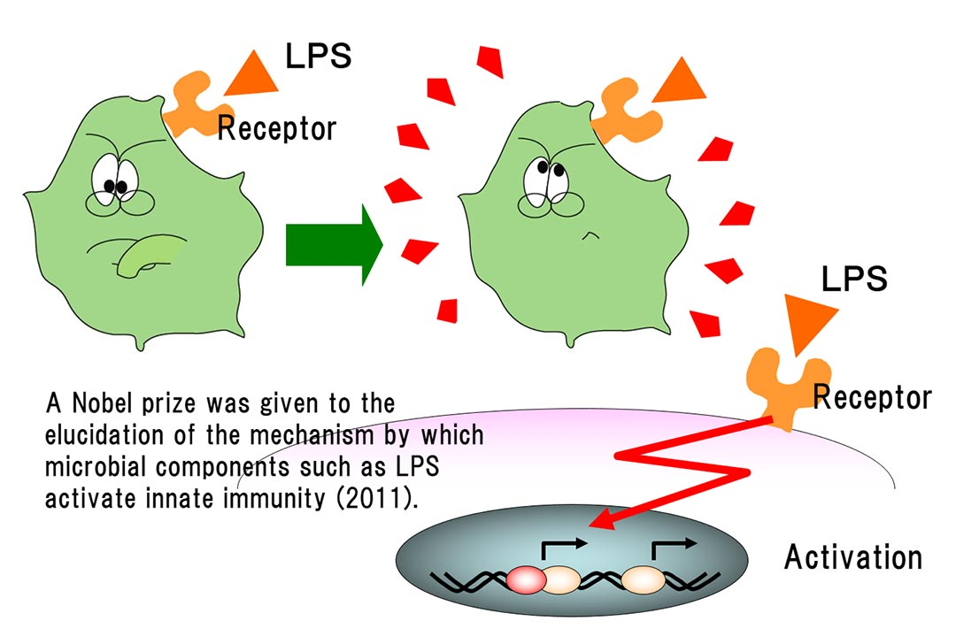
Biology of Macrophages and LPS Stimulation
Macrophage Function: Innate Immunity, Protection against infection, & Initiate Immune Response
Lipopolysaccharide (LPS) stimulates an immune response in macrophages by activation of the CD14 receptor (Citation)
LPS is predominantly released by gram negative bacteria upon infiltration into the body
Structure and function of LPS / what's LPS / Macrophi Inc.: LPS material: Innate immunity: R&D. Structure and Function of LPS / What's LPS / Macrophi Inc. | LPS material | innate immunity | R&D. (n.d.). Retrieved November 30, 2022, from https://www.macrophi.co.jp/english/lps/1-1.html

Slide 3
LPS Stimulation and Study Methodology
Human blood monocytes were isolated from blood donations from the Sanofi in-hours blood donor service
Monocytes were differentiated into macrophages using 50ng/ml of human macrophage colony-stimulating factor
Macrophages were cultured in 10% heat inactivated fetal bovine serum to induce growth
Macrophages were stimulated with 50 ng/ml of lipopolysaccharides (LPS) from E. Coli for 24 hrs
Testing to see immune function response to bacterial infiltration in macrophages
A Priori Hypothesis: LPS stimulation will have a significant effect on the gene expression of macrophages and their subsequent immunological processes

Slide 4
Sequencing Data
Sequencing Data from NCBI Gene Expression Omnibus (GEO) dataset (GSE193336)
Paired End FASTQ Data from 8 Samples
FASTQ files acquired using SRR numbers on GEO
Control | LPS-Stimulated
Donor 1 Unstimulated | Donor 1 LPS
Donor 2 Unstimulated | Donor 2 LPS
Donor 3 Unstimulated | Donor 3 LPS
Donor 4 Unstimulated | Donor 4 LPS

Slide 5
Pre-Alignment Sequencing Metrics
Sample | SRR | Reads
Donor1_Unstim | SRR17518178 | 59,239,503
Donor1_LPS | SRR17518177 | 52,621,338
Donor2_Unstim | SRR17518176 | 41,980,448
Donor2_LPS | SRR17518175 | 48,501,521
Donor3_Unstim | SRR17518174 | 52,801,963
Donor3_LPS | SRR17518173 | 49,103,782
Donor4_Unstim | SRR17518172 | 44,489,884
Donor4_LPS | SRR17518171 | 48,328,282
Mean | Minimum | Maximum
49,633,340 | 41,980,448 | 59,239,503

Slide 6
Tophat2-Alignment, Counting, and Stats
FASTQ Files
Unaligned Reads from GEO using SRA Toolkit (fasterq –dump command)
FASTA & GTF Reference Genome
Align to Reference Genome Build 38 from Ensemble
Build Index files using Bowtie2
Make index files for samples and reference genome
Test Tophat2 Alignment to create BAM File
Align Donor 1 Unstimulated and Donor 1 LPS to both Transcriptome & Genome as test
Tophat2 Alignment to make BAM File
Align rest of samples to transcriptome only
Cuff-diffs with Statistics On & Off
Converts BAM file to differential expression data txt files (STATS ON) or FPKM values txt files (STATS OFF)

Slide 7
Alignment Metrics & Statistics
Sample Name | % Alignment | % of Multiple Alignments | # of Aligned Reads
Donor 1_Unstim | 73.4 | 19.9 | 86949435
Donor 1_LPS | 66.4 | 19.9 | 69867617
Donor 2_Unstim | 75.2 | 14.1 | 63100474
Donor 2_LPS | 66.6 | 16.9 | 64566295
Donor 3_Unstim | 82 | 13.1 | 86595307
Donor 3_LPS | 81.6 | 14.5 | 80106183
Donor 4_Unstim | 86.3 | 15.1 | 76799978
Donor 4_LPS | 89.2 | 20.2 | 86260161
Mean | 77.5875 | 16.7125 | 76780681.25
Minimum | 66.4 | 13.1 | 6310047
Maximum | 89.2 | 20.2 | 86949435

Slide 8
Alignment Metrics & Statistics

Slide 9
Cuff-diff Results
Cuff-Diff STATS
Differential Expression data from gene_exp.diff txt file
P Value and log2(fold-change) Cutoffs
P Value < 0.001
Log2(fold-change) >= 5 or <= -5
190 Genes ( 21 Down and 169 Up)
Cuff-Diff No STATS (Comparison of LPS vs Unstimulated)
FPKM Values of All 8 Samples from genes_fpkm.tracking file
62,638 Genes

Slide 10
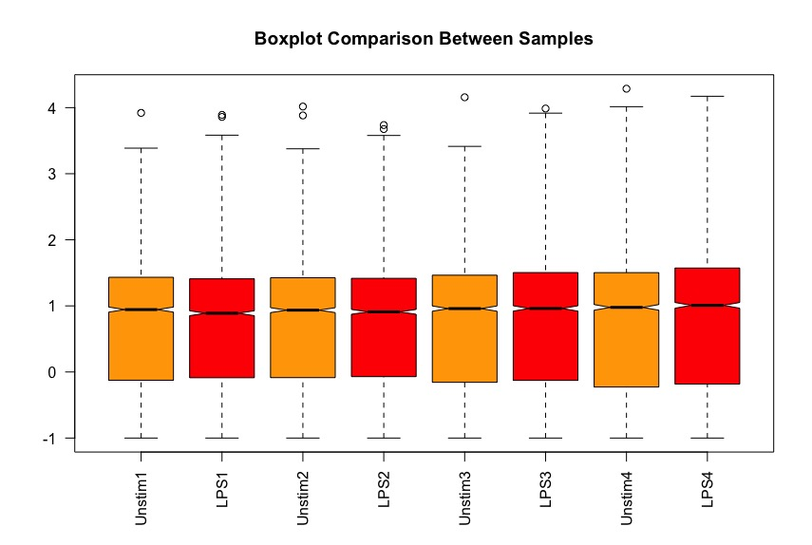
Boxplot of All Samples
Removed FPKM values that contained 0 in all samples for each gene
Removed NA values from dataset
Added psuedocount of 0.1
Log10 scaled all remaining Data
4086 Genes Remaining
Log10(FPKM+0.1)

Slide 11
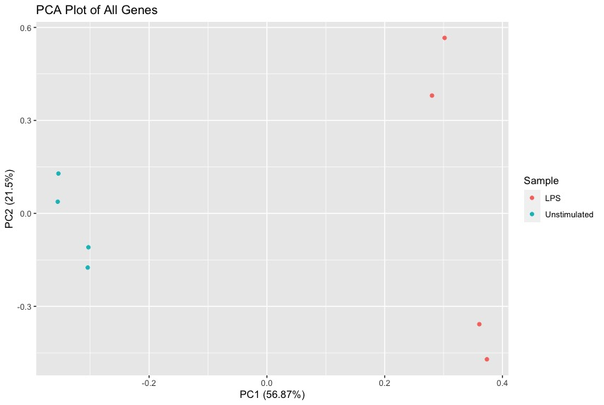
PCA Plot of All Genes by Group
Clear separation between LPS-Stimulated Samples & Unstimulated Samples
56.87% Variance across PC1
4086 Genes

Slide 12
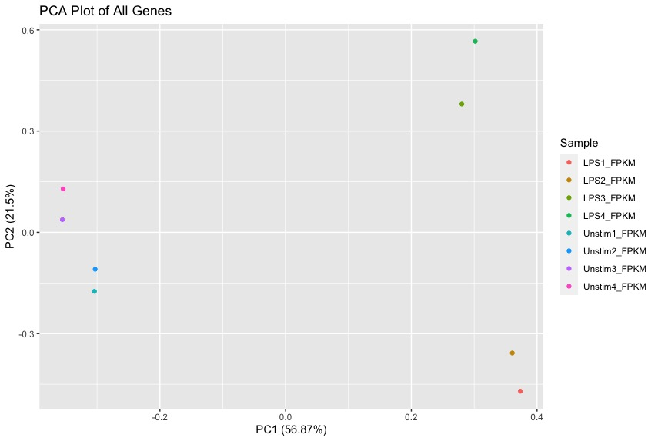
PCA Plot of All Genes per Sample
Clear separation between LPS-Stimulated Samples & Unstimulated Samples
56.87% Variance across PC1
PC2 Separates LPS3 and LPS4 from LPS1 and LPS2

Slide 13
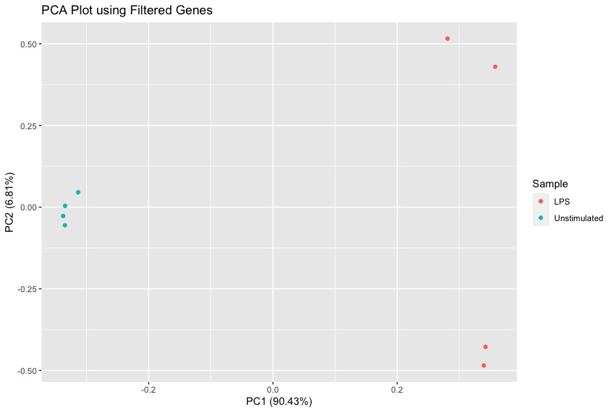
PCA Plot of Filtered Genes by Group
Even more pronounced separation between LPS-Stimulated Samples & Unstimulated Samples
90.43% Variance across PC1
190 Genes

Slide 14
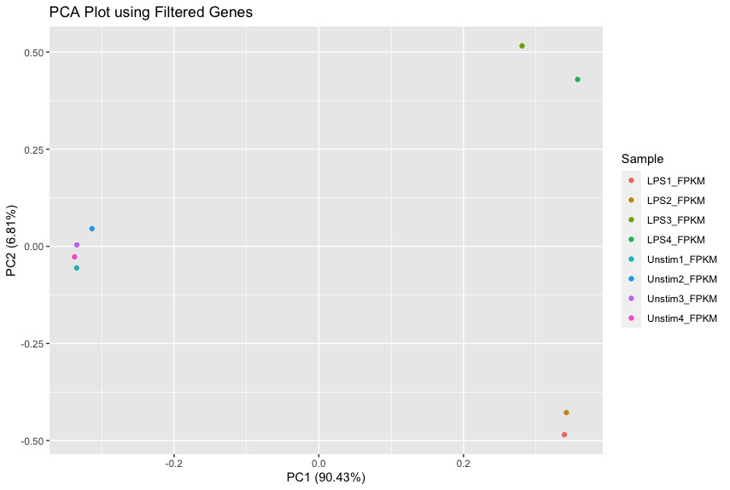
PCA Plot of Filtered Genes per Sample
Even more pronounced separation between LPS-Stimulated Samples & Unstimulated Samples
90.43% Variance across PC1
PC2 Separates LPS3 and LPS4 from LPS1 and LPS2

Slide 15
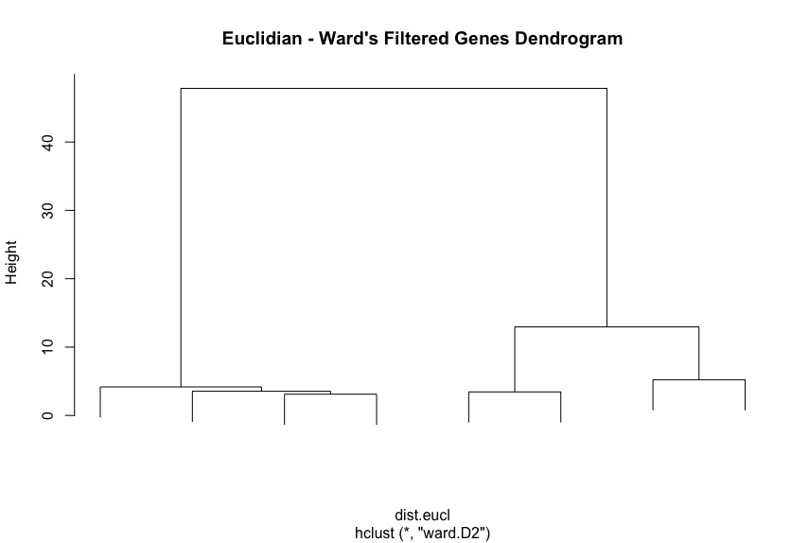
Filtered Genes Dendrogram
Separation of LPS and Unstimulated Groups
Subclustering of LPS_1 and LPS_2 & LPS_3 and LPS_4
LPS_1
LPS_2
LPS_3
LPS_4
Unstim_2
Unstim_4
Unstim_3
Unstim_2

Slide 16
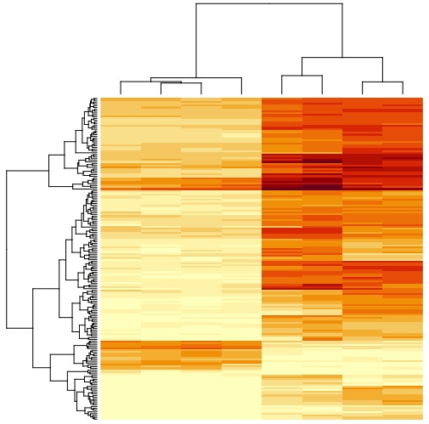
Heatmap of Filtered Genes
Huge expression of genes upon LPS-Stimulation
Suggests the activation of multiple Immune response pathways
LPS_3
LPS_1
LPS_4
LPS_2
Unstim_1
Unstim_3
Unstim_4
Unstim_2

Slide 17
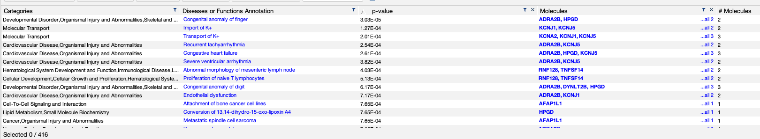
IPA Downregulated Genes
21 Downregulated Genes
Very random pathways are downregulated
Prioritizing of inflammatory pathways when infection is detected

Slide 18
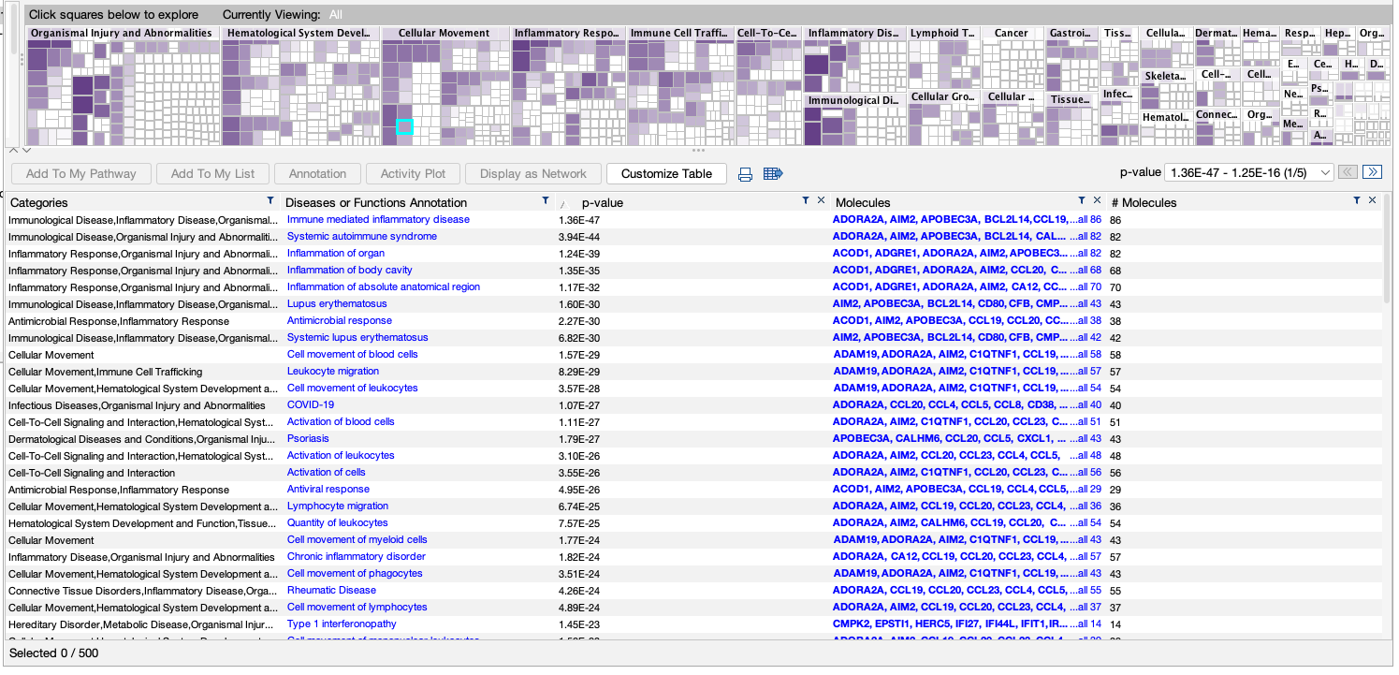
IPA Upregulated Genes

Slide 19
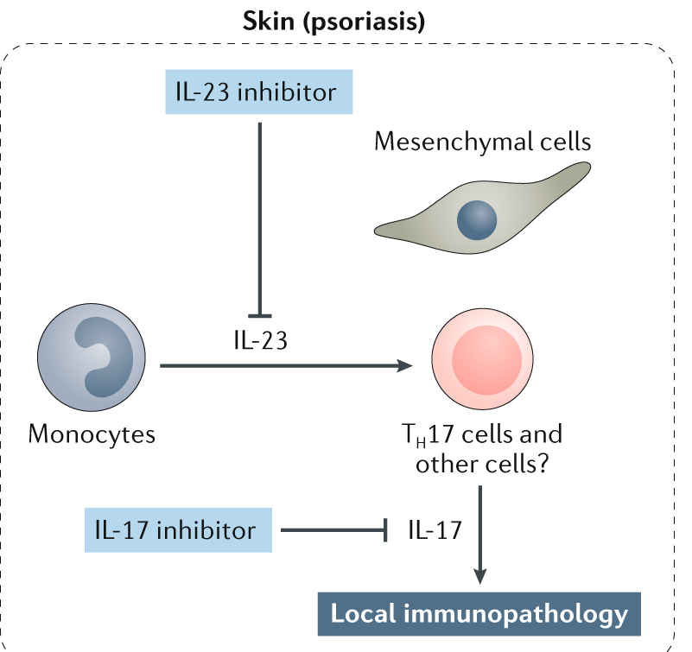
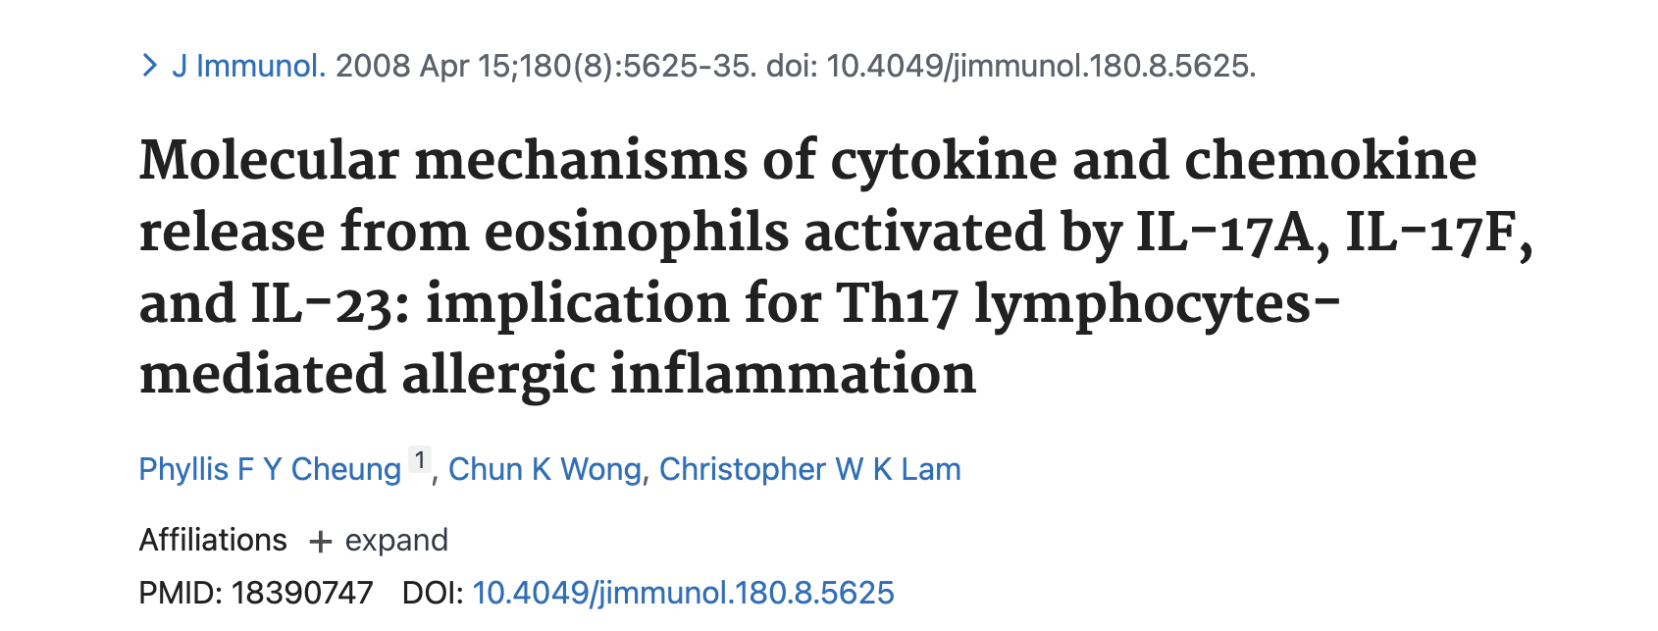
IL-23 Cytokine Activation
IL-23 produced by dendritic cells and macrophages in response to microbial stimuli and has pro-inflammatory properties
IL-23 expression is positively correlated to the IL-17 family
IL-17A is released from Lymphocytes upon activation
Leads to the activation of Eosinophils
Eosinophils are activated by bacterial infection
Inhibition of IL-23 can slow or limit the activation of Eosinophils
Useful as a therapeutic target for autoimmune conditions such as:
Rheumatoid Arthritis or Psoriasis
Sieper, J., Poddubnyy, D., & Miossec, P. (2019, September 24). The IL-23–il-17 pathway as a therapeutic target in axial spondyloarthritis. Nature News. Retrieved November 30, 2022, from https://www.nature.com/articles/s41584-019-0294-7

Slide 20
Future Studies
Confirmed of A Priori Hypothesis
A significant expression of inflammatory pathways is required to contain infections
However, an over-expression of inflammatory pathways leads to autoimmune conditions
Future Steps
Compare the macrophage differentiation of LPS1 & LPS2 vs LPS3 & LPS4 Samples
Analyze the downstream affects of neutrophil activation in various autoimmune conditions
Compare neutrophil activation in parasitic and bacterial infections

Slide 21





Special Thanks to Dr. Hjelm & My Fellow Classmates for their Guidance
Time For Questions

