Slide 1
Alzheimer’s Classification using MRI Images with Neural Network Models
TRGN 515
Bigy Ambat

Slide 2
General Motivation for Project
Honors Project in Undergrad on Neural Network ML algorithms and application in the Healthcare Industry
Examined the inner workings of ML Diagnostic Models using statistics and philosophy of logic material to explain the “black box” problem
I wanted to develop a Clinical Diagnostic ML Model utilizing a computational approach
Neural Networks are a very advanced form of Machine Learning that have emerged fairly recently and have proven to be very successful in clinical diagnostic contexts

Slide 3
Alzheimer Dataset from Kaggle
Data consisted of MRI Imaging JPGs of 4 classes
Mild Demented
Moderate Demented
Non Demented
Very Mild Demented
JPG Files were 208 x 196 size
Objective => Predict the severity of Alzheimer’s Disease
Data was already split into Train and Test Datasets
Scikit-Learn Module will be used to develop ML Model

Slide 4
Workflow
Data Collection and Aggregation
Data Pre-Processing
Building Test and Train Datasets
Standardization
Random Oversampling
Initializing ML Model
Analyzing ML Model Metrics
Cross Validation and Hyperparameter Tuning

Slide 5
Structure of Dataset
Data was already split into Train and Test Datasets
1279 JPGs for Test Dataset
5120 JPGs for Train Dataset

Slide 6
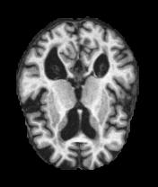
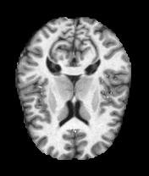
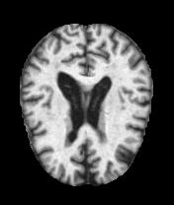
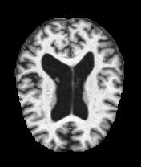
Example JPGs from Each Class
Mild Demented
Non Demented
Very Mild Demented
Moderate Demented
Grayscale JPG Files with 255 maximum white value

Slide 7
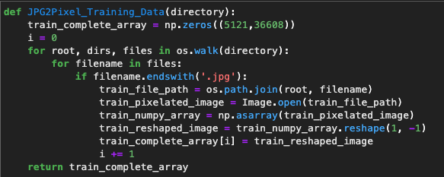
Converting JPG Images to Pixels
JPG files were converted to pixels using a JPG2Pixel function
Developed a JPG2Pixel Function
JPG2Pixel Function is independently called on the train and test datasets and outputs in 2 arrays of data
Each image was 208 x 176 pixel dimensions = 36607 Pixel Data per Image
Arrays are converted to a pandas dataframe object

Slide 8
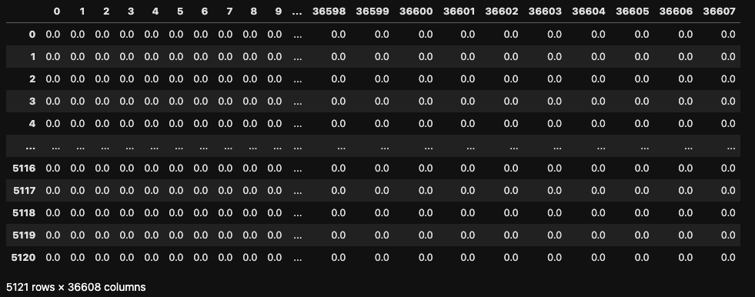
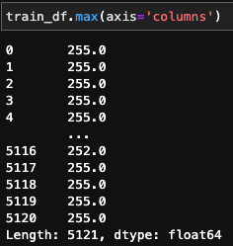
Dataframe Example

Slide 9
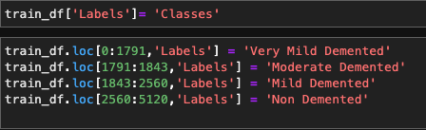
Adding Labels to Data
The JPG2Pixel functions above iterated through the test and the train class folders in the following order:
1. Very Mild Demented
2. Moderate Demented
3. Mild Demented
4. Non Demented
Based on these classes (and the number of files for each class), I can deduce the labels for each row of the train and test dataframes

Slide 10
Standardization
ML Models based on pixel data are highly sensitive to feature scaling
Scaling methods such as StrandardScalar from Sklearn would be sufficient
A simpler method:
The Maximum Pixel Value for both the train and test dataset is 255
Divide all pixel values of the train and test dataset by 255
All pixel values will range form 0-1
The train and test datasets are now standardized

Slide 11

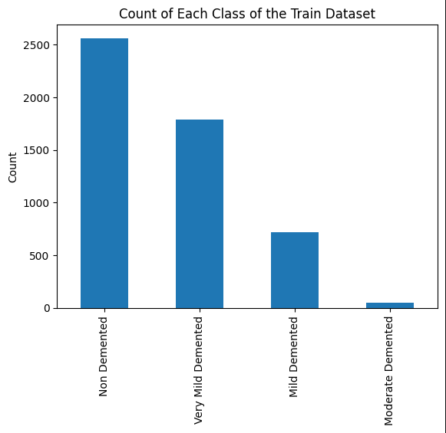
Initial Look at the Data
Imbalanced Classification Issue
Moderate Demented Class has an order of magnitude lower data
Oversampling is a possible solution (will be addressed later)
Note:
There are too little datapoints for the Moderate Demented Class
Oversampling from such this class may induce learning problems in the ML model
Solution => Remove the Moderate Demented Class from the train and test datasets
ML Model will now be trained for the following 3 Classes:
1. Non Demented
2. Very Mild Demented
3. Mild Demented

Slide 12
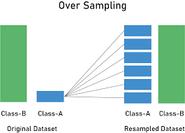
Random Oversampling
Used to correct for an imbalanced dataset
An imbalanced dataset can cause the ML model to learn improperly
Synthetic Minority Oversampling Technique => Duplicates examples from the minority classes. Random samples from the minority class are added (with replacement) to the train dataset. The process is repeated until the dataset classes are equal
Oversampling works even for multi-class classification
[1]

Slide 13
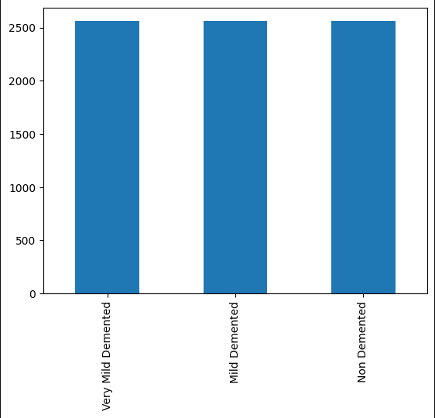
Random Oversampling
Before Oversampling
After Oversampling

Slide 14
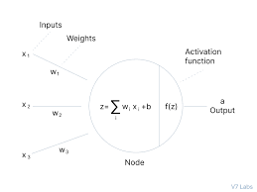
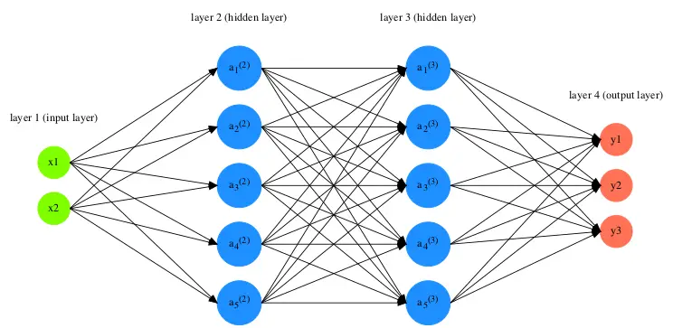
Basic Introduction to Neural Networks
Input Layer => Each note represents a feature of data
Output Layer => Each node represents an outcome (classification)
Hidden Layers
The lines represent weights
Activation Function => A sum of the weight and input values of the previous node
Analogous to action potential and function of neurons in biology
[2]
[3]

Slide 15
Neural Network Animation
[4]

Slide 16
Backpropagation
The error is propagated backwards through the network and the error for each neuron is calculated
Adjust the weights and biases of each neuron to minimize error
This process is repeated for each datapoint until the error for the training data is below a certain threshold
Weights and Biases for each neuron will eventually converge to a value
This is analogous to “learning”
[4]

Slide 17
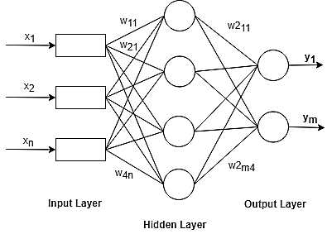
MLP Classification Model
I will be using an MLP (Multi-Layer Perceptron) based model from Scikit-learn
Generally, MLPs are a great model for pixel data since the individual pixel values can be fed directly into the input layer
MLP based Models tend to ”Overfit”

Slide 18
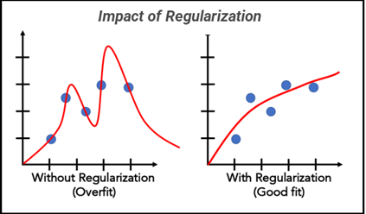
Hyperparameters for MLP Classifier
Parameters set by the user to initialize the model (are not affected by the training of the model)
Control the learning behavior of the model and impact model accuracy and versatility
Common Hyperparameters for Neural Networks:
Learning Rate
Number of Hidden Layers (10,10)
Indicates 10 hidden layers with 10 neurons each
Number of Epochs (number of times dataset is fed through the model)
Optimization Algorithm Setting (”Stochastic Gradient Descent”, “Adam”, “lbgfs”)
Alpha (Strength of L2 Regularization)
(Regularization => A value that penalizes “overfitting”)
[5]
[3]

Slide 19
Initializing Instance of MLP Model
The default hyperparameters did not work since the model’s weights and biases failed to converge
I initialized the model using the following hyperparameters through trial and error

Slide 20
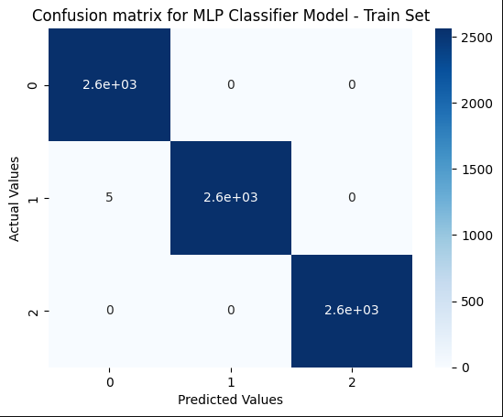
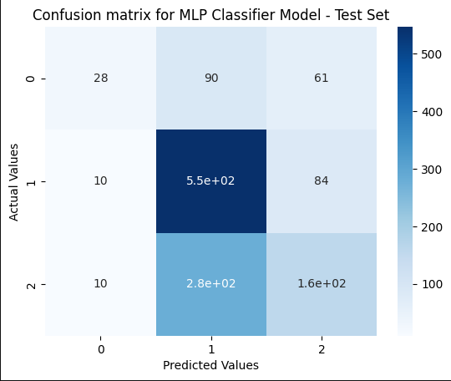
Metrics
Value | Class
0 | Mild Demented
1 | Non Demented
2 | Very Mild Demented
100% Accuracy on Training and 50% Accuracy on Testing Data
The training and testing confusion matrices indicate that the model is significantly overfitting with these hyperparameters
Clearly the MLP Model needs some fine tuning

Slide 21
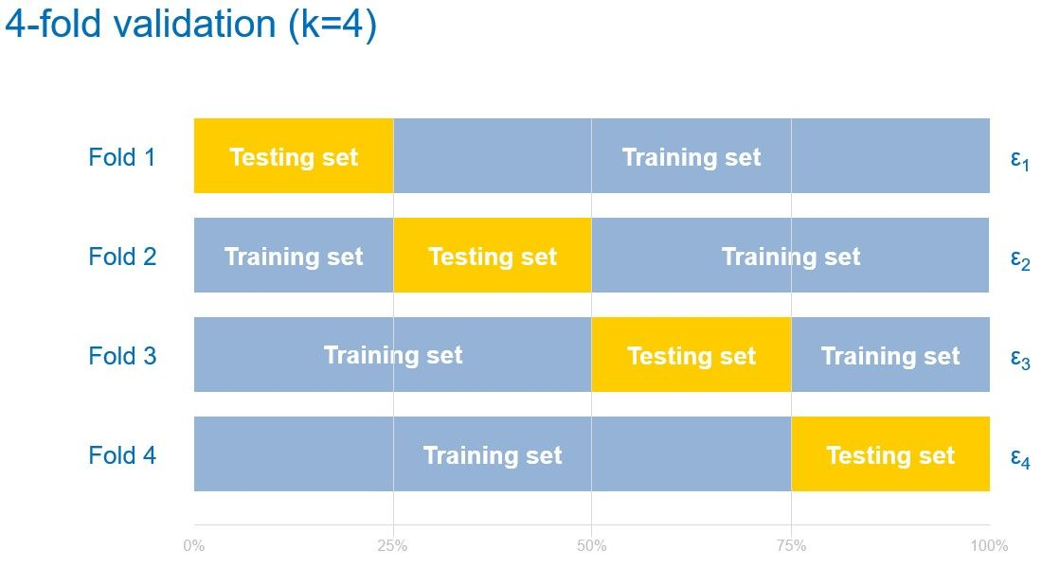
Hyper Parameter Tuning and Cross-Validation
Hyperparameter Issue
Hyperparameter combinations play a huge role in model accuracy and generalizability to new data
The combinations that are optimal can be vastly different depending on the model architecture and the dataset
Metrics Issue
Due to the large dataset, its difficult to assess accuracy
Cross-Validation splits the dataset randomly into a training and validation sets
Outputs average accuracy from different splits of the data
Called k-fold validation
[6]

Slide 22
MLP Hyperparameter Intuitions
According to sk-learn documentation, “lbgfs” weight optimizer is quite good to converge the weights of the model
Need to increase the hyperparameter alpha to penalize overfitting
Hidden Layer Size is too shallow for the dataset
Max Iterator Value needs to increase to allow model convergence even though this cause overfitting

Slide 23
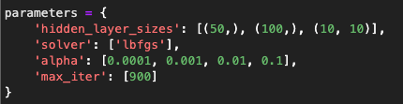
GridSearchCV
An Scikit-learn method to perform hyperparameter tuning and cross-validation simultaneously
You can select a specific of hyperparameter values and the program will try each possible combination
Performs k-fold cross validation with a variable k-value
Challenge: Very Computationally Intensive
Best hyperparameters: {'alpha': 0.1, 'hidden_layer_sizes': (50,), 'max_iter': 900, 'solver': 'lbfgs'}

Slide 24
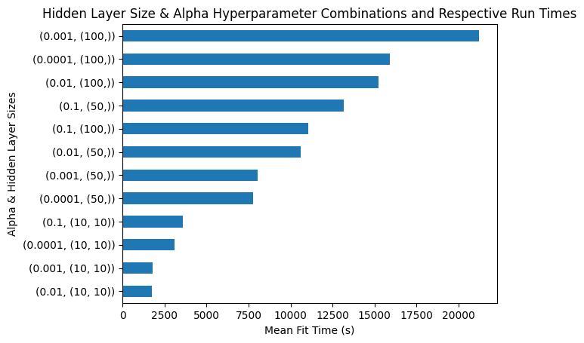
GridSearchCV Run Times

Slide 25
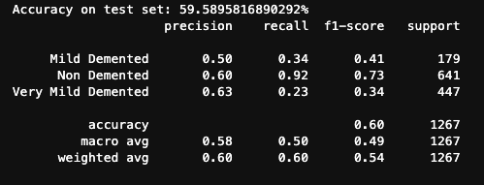
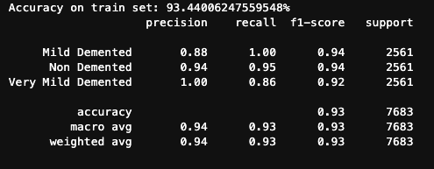
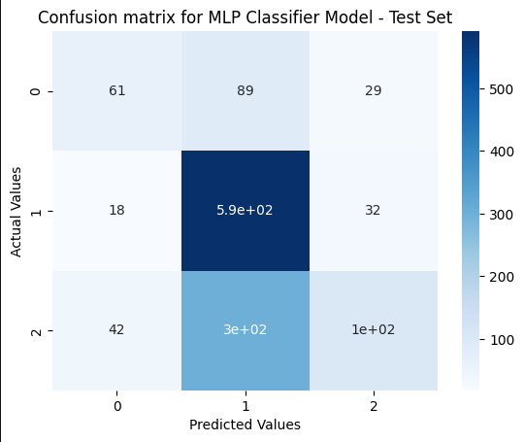
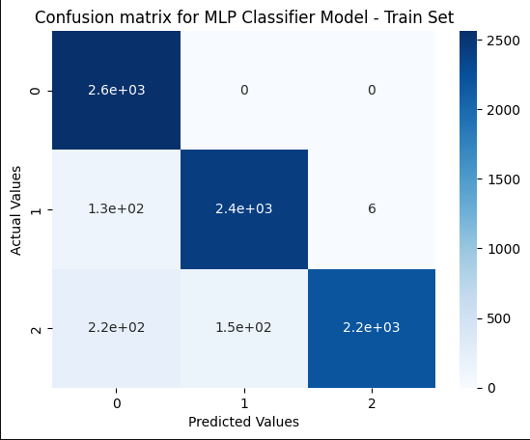
Post-Hyperparameter Tuning Metrics
Value | Class
0 | Mild Demented
1 | Non Demented
2 | Very Mild Demented

Slide 26
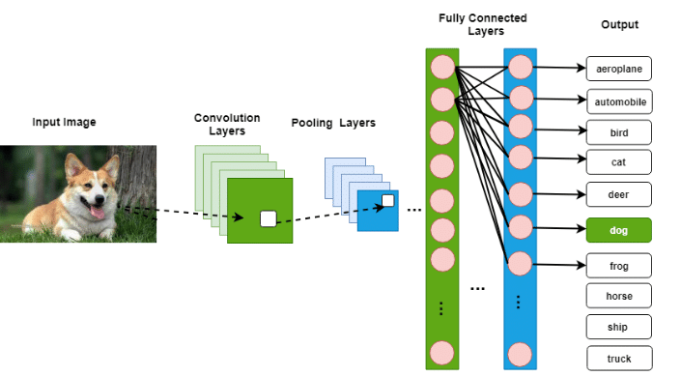
Challenges and Improvements
Require more computational power for Hyperparameter Tuning and Cross validation
Possibly subset into smaller training and test datasets for faster run time
Try various ML Models like Random Forests
Develop a Convoluted Neural Network Model (CNN) for real world versatility in healthcare environments
[7]

Slide 27
References
[1]Al-Serw, N. A.-R. (2021, February 21). Undersampling and oversampling: An old and a new approach. Medium. Retrieved April 25, 2023, from https://medium.com/analytics-vidhya/undersampling-and-oversampling-an-old-and-a-new-approach-4f984a0e8392
[2] Activation functions in neural networks [12 types & use cases]. V7. (n.d.). Retrieved April 25, 2023, from https://www.v7labs.com/blog/neural-networks-activation-functions
[3]What is a neural network? TIBCO Software. (n.d.). Retrieved April 25, 2023, from https://www.tibco.com/reference-center/what-is-a-neural-network
[4] Gfycat. (n.d.). Best neural network gifs. Gfycat. Retrieved April 25, 2023, from https://gfycat.com/gifs/search/neural+network
[5]Pandian, S. (2022, September 27). Study of regularization techniques of linear models and its roles. Analytics Vidhya. Retrieved April 25, 2023, from https://www.analyticsvidhya.com/blog/2021/11/study-of-regularization-techniques-of-linear-model-and-its-roles/
[6]Cross-validation. MATLAB & Simulink. (n.d.). Retrieved April 25, 2023, from https://la.mathworks.com/discovery/cross-validation.html
[7]A simplified CNN Architecture for Dog Classification. (n.d.). Retrieved April 25, 2023, from https://www.researchgate.net/figure/A-simplified-CNN-architecture-for-dog-Classification_fig1_336304381

Slide 28
Special Thanks to Dr. Baloglu and my Classmates

Slide 29





Questions

