Slide 1
cBioPortal Dataset on Oligoastrocytoma, Oligodendroglioma, and Anaplastic Astrocytoma
Bigy Ambat

Slide 2
Database Information
Total Samples | 376
Oligoastrocytoma | 134
Anaplastic Astrocytoma | 130
Oligoastrocytoma | 112
Data was collected from the Brain Lower Grade Glioma (TCGA Firehouse Legacy) repository
Selected Clinical Information for Oligoastrocytoma, Oligodendroglioma and Anaplastic Astrocytoma with represented 376 total samples
Selected the genetic information for the IDH1 Gene Information (expressed in 77.6% frequency throughout the 3 cancer types)
IDH1 Gene information phenotypic data
Overall Goal => Demonstrate differences between the 3 cancer types both genotypic and phenotypic data using MongoDB queries

Slide 3
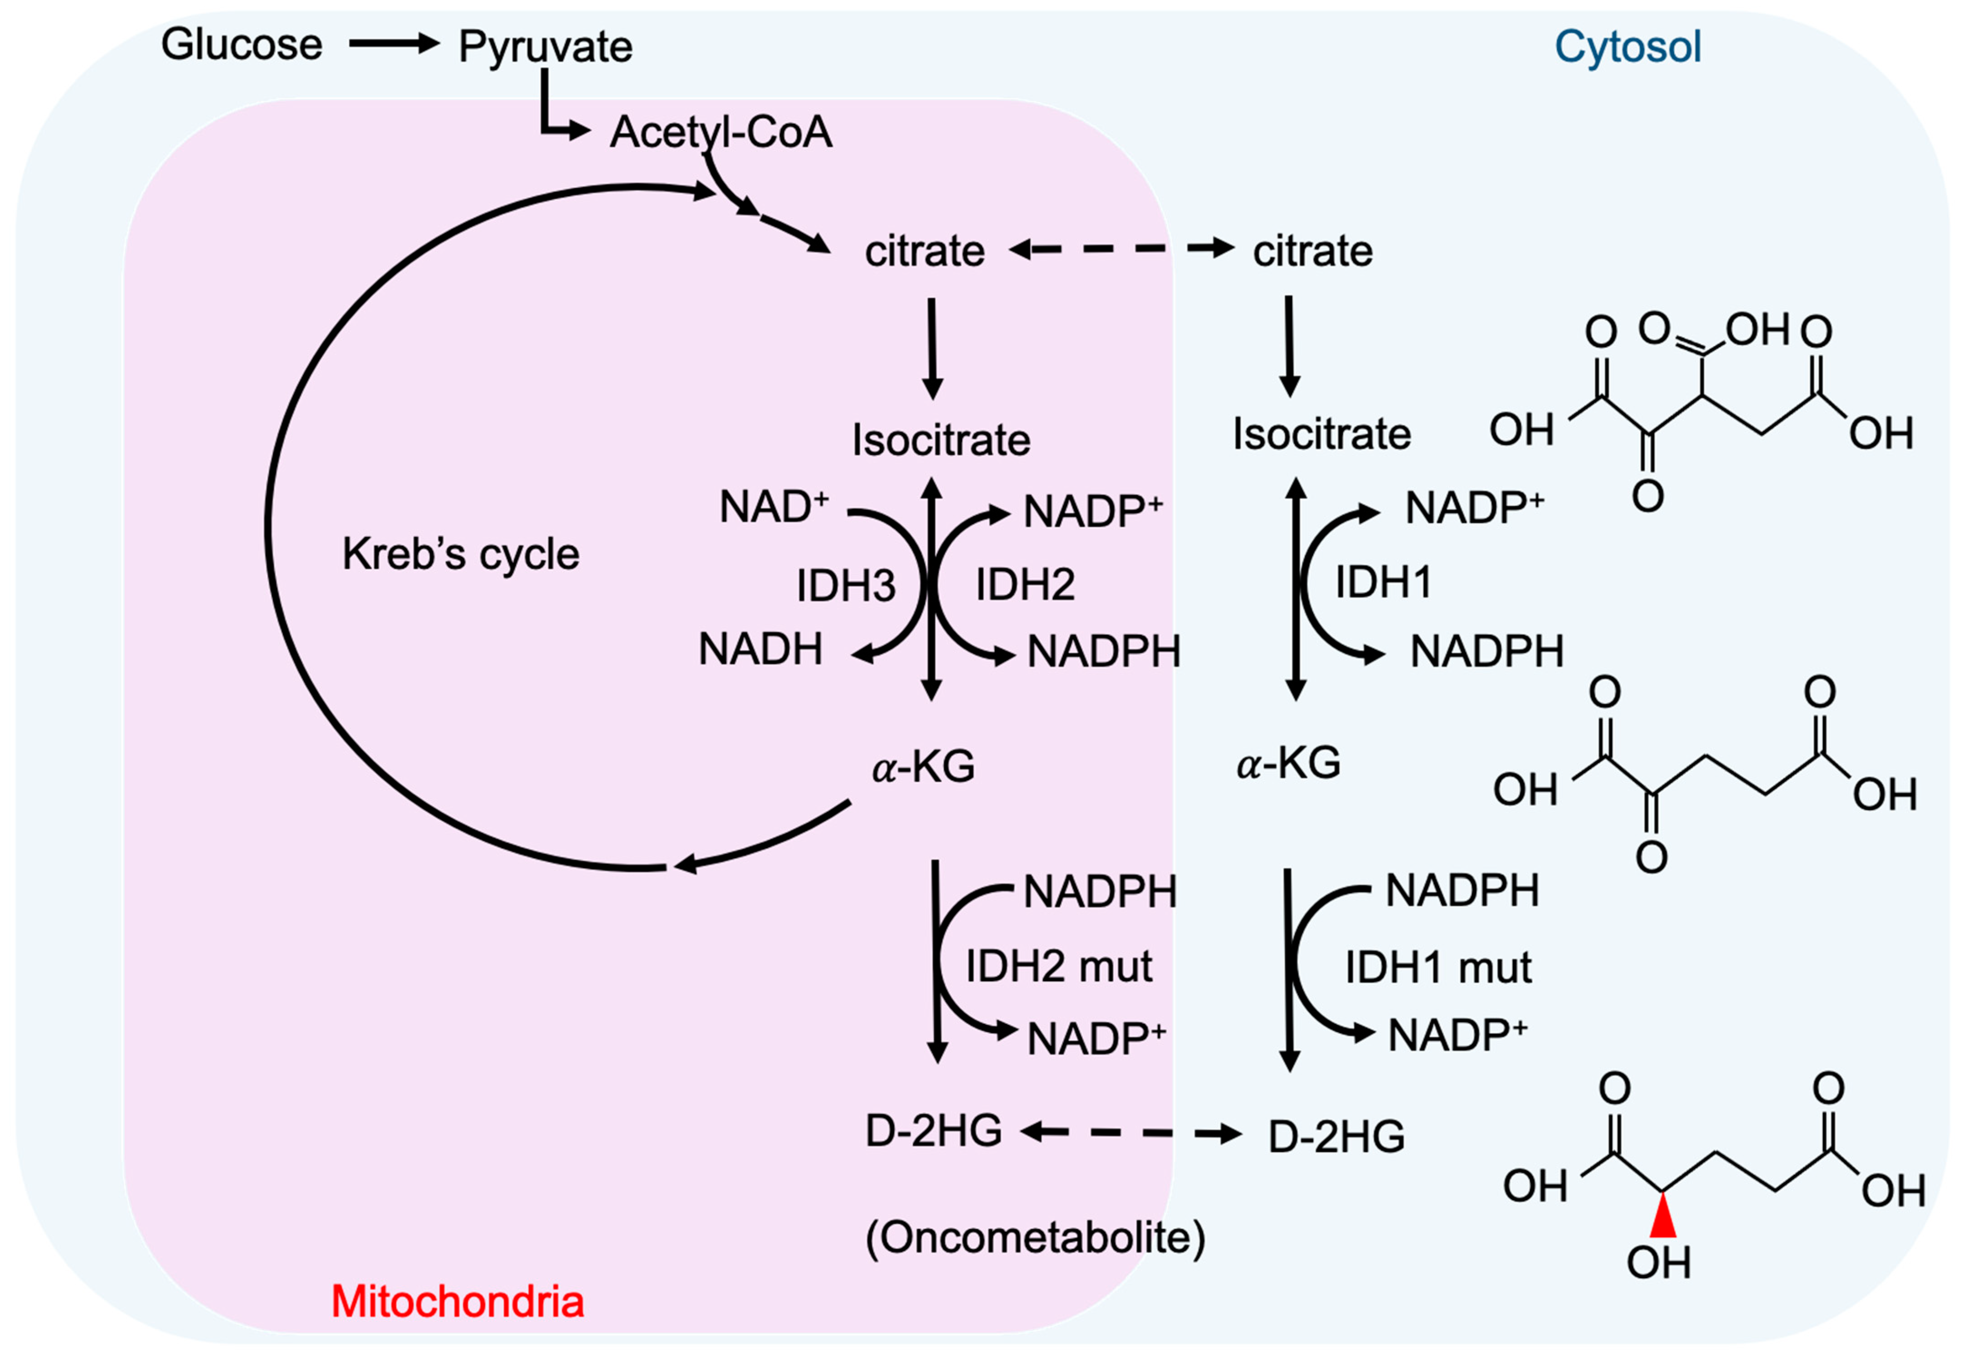
IDH1 Gene Information
IDH1 codes for the Isocitrate Dehydrogenase Enzyme
Involved in a rate limiting step for Citric Acid Cycle
Catalyzes Isocitrate to alpha-KG
Mutations lead to new enzymatic function that converts alpha-KG into D-2HG (a known oncometabolite)
Mutation leads to epigenetic alterations and allows tumor proliferation in low oxygen conditions [1]

Slide 4
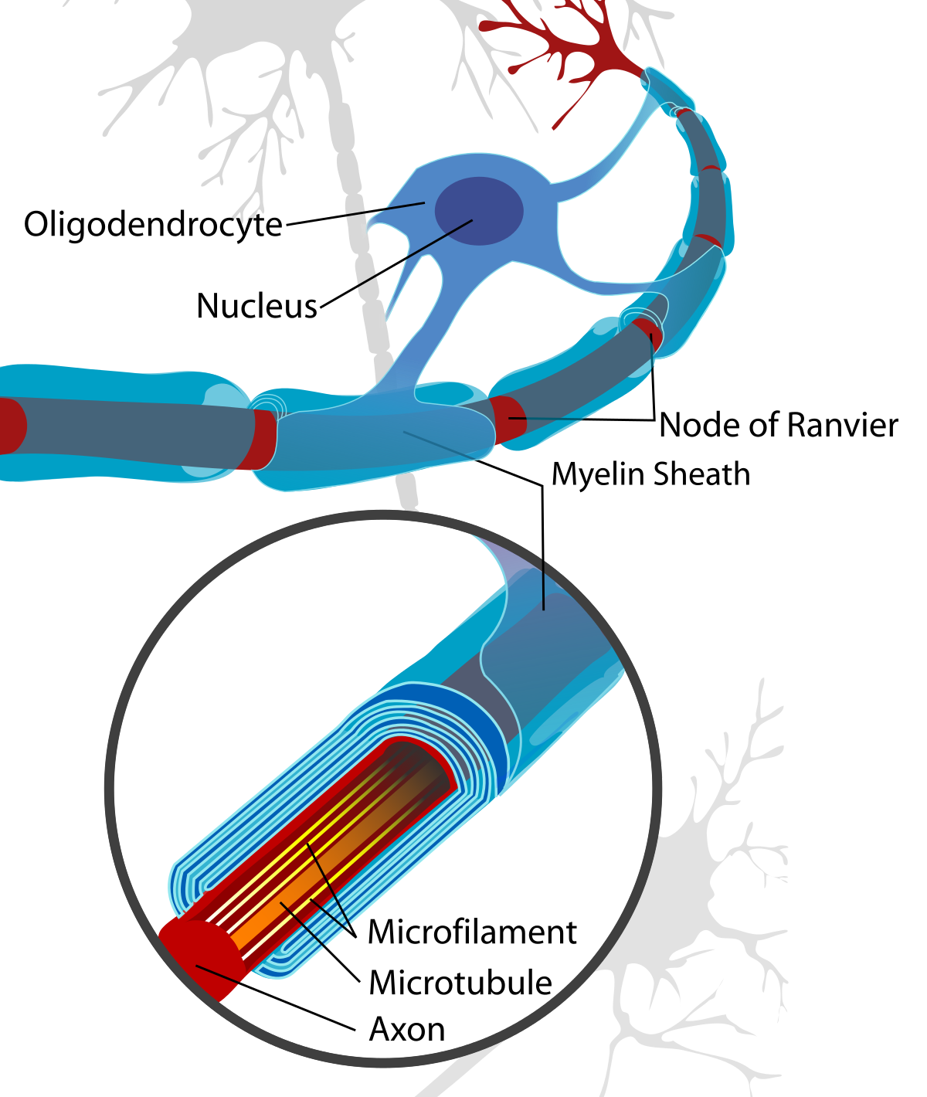
Oligodendroglioma
Cancer that affects the Oligodendrocytes (Myelin sheaths of the brain and spinal cord)
Diagnosed by an IDH1 mutation and co-deletion of chromosome arms 1p and 19p [1]
All Oligodendroglioma samples from the TCGA dataset were considered at or below Stage II

Slide 5
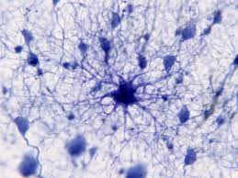
Anaplastic Astrocytoma
Astrocytes Function => Regulate blood flow, transfer mitochondria to neurons, and supply nutrients to neurons
Anaplastic = Cells that have little to no resemblance to normal cells
Aggressive form of glial cancer that presents poor prognosis and high recurrence [2]
IHD1 mutation is common and often unique specifically localized to Anaplastic Astrocytoma tumors [3]
TCGA Dataset defined Anaplastic Astrocytoma with Stage III or above

Slide 6
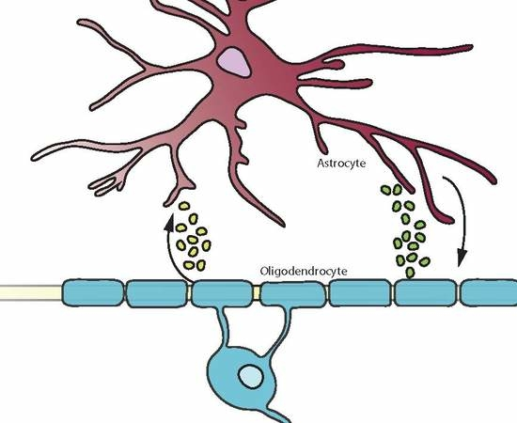
Oligoastrocytoma
Emerges from both astrocyte and oligodendrocyte cell lines
Considered a mixed glioma
IDH1 mutations were found in 79% of Oligodendroglioma and 94% of Astrocytoma[4]
TCGA Dataset samples were considered Stage II or below

Slide 7
Data Wrangling
Downloaded tsv files from cBioPortal
Converted tsv to JSON format
Created a collection for Clinical Data and for IDH1 Data
Used the following command to import JSONs directly into respective collections:

Slide 8
Query 1: Is there a difference in incidence of Anaplastic Astrocytoma between Males and Females?
Anaplastic Astrocytoma is especially difficult to treat due to its advanced stage
Curious about a sex differences in Anaplastic Astrocytoma
A male: female ratio 1.18:1 in low-grade astrocytomas is there. In anaplastic astrocytoma, there is a substantial male dominance, with a male: female incidence being 1.87:1” [5]
There is a slightly increased male:female ratio but it is not at the same ratio as predicted

Slide 9
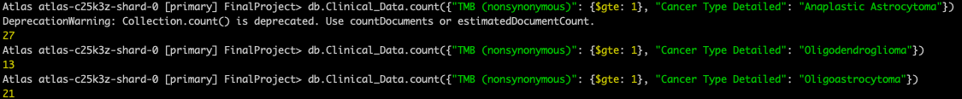
Query 2: What is the number of patients with Anaplastic Astrocytoma, Oligodendroglioma, and Oligoastrocytoma with a "TMB (nonsynonymous)" of greater than or equal to 1?
“Defective DNA repair leads to higher tumor mutational burden (TMB) which is defined as the total number of nonsynonymous mutations per megabase (Mb) of coding regions of a tumor genome” [7]
“TMB was higher for the group of mutant genes that are frequently mutated in glioblastomas (GBMs) and lower for the group of mutant genes that are frequently mutated in lower-grade gliomas (LGGs). Patients with a higher TMB exhibited shorter overall survival” [8]
Anaplastic cancer should have the highest TMB value since they are a higher grade and likely contain more mutations

Slide 10
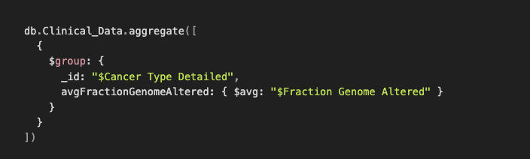
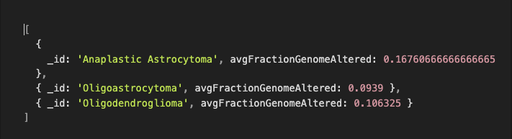
Query 3: For the cancer types (Oligoastrocytoma, Oligodendroglioma, and Anaplastic Astrocytoma), what is the average value for the “Fraction Genome Altered” column for each of the cancer types?
“In this [cancer stage] system, oligodendrogliomas and oligoastrocytomas are usually grade II or grade III tumors. Grade II tumors are considered low-grade tumors, which generally grow at a slower rate than grade III tumors. Grade II tumors may evolve over time into grade III tumors. Grade III tumors are anaplastic, or malignant tumors”[6]
Hypothesis: Anaplastic Astrocytoma would have the highest fraction of genome altered

Slide 11


Query 4: What are the average allele frequencies for Anaplastic Astrocytoma for those that had a diagnosis age above or below 50?
Age plays a significant role in many cancers. I wanted to see if there is a difference in the minor allele frequency for Anaplastic Astrocytoma with respect to age
Results were unexpected

Slide 12
Query 5: What are the counts for each option in the First Symptom Longest Duration field for each of the 3 cancer types?
Interested to see if there are differences in symptom duration between the 3 types of cancers
First Symptom Longest Duration has the following options: 0-30 Days, 31-90 Days, 91-180, and greater than 181 Days

Slide 13
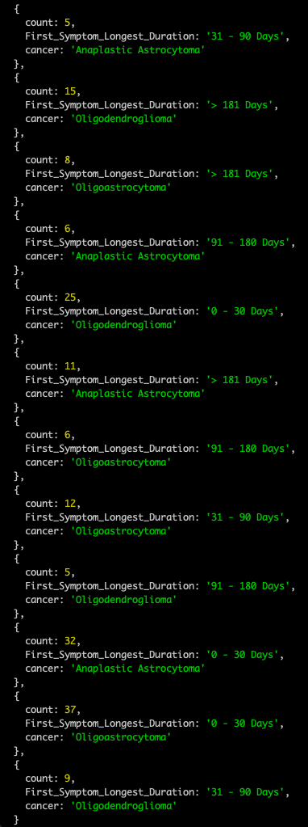
Query Results
Overall, all 3 cancer types had the highest count of First Symptom Longest duration in the 0-30 Day range. Also, it seems that the Anaplastic Astrocytoma and Oligoastrocytoma had the highest counts from 0-30 Days and 31-90 Days.
First Symptom duration often appears mostly commonly in the 0-30 range regardless of Cancer Type

Slide 14
Rshiny App
Goal => Combine data from Queries 3 and 5 into a useful graph since those would be interesting to visualize
Selected First_Symptom_Longest_Duration and Allele Frequency (T)
Separated Data by Cancer Type using a dropdown menu

Slide 15
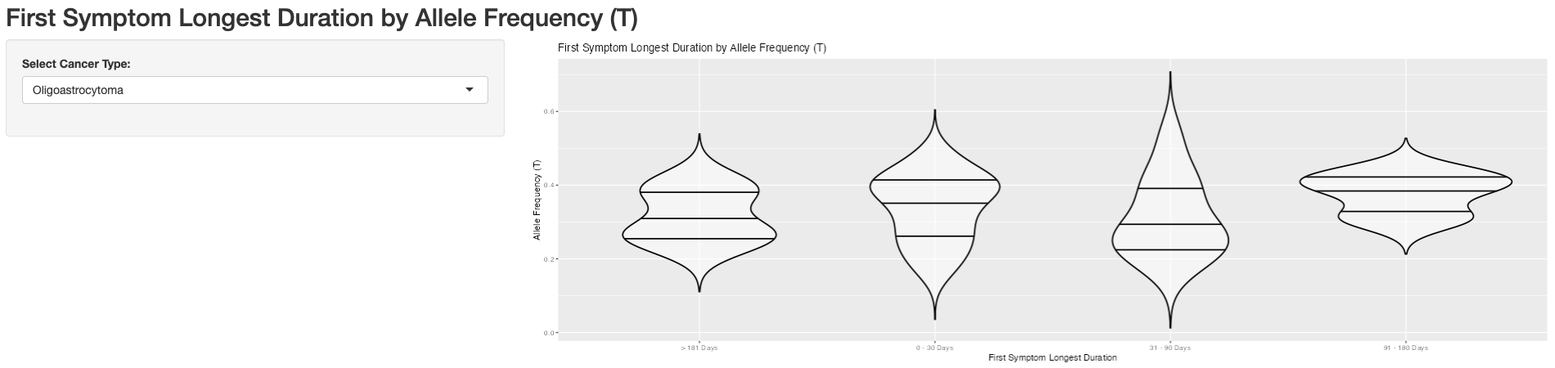
Oligoastrocytoma

Slide 16
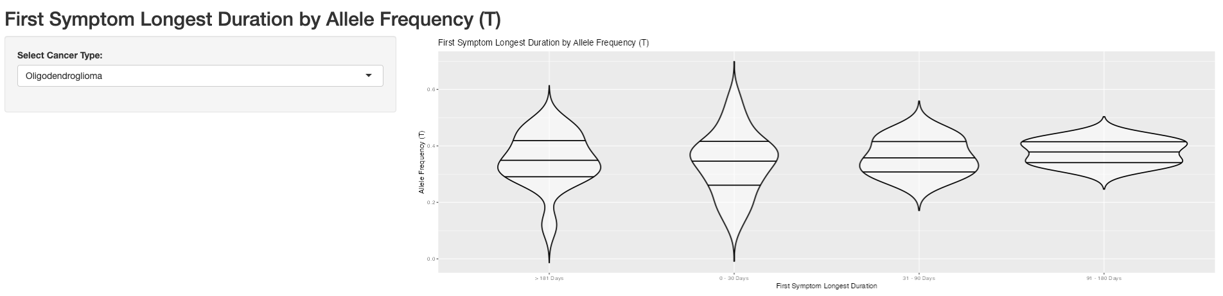
Oligodendroglioma

Slide 17
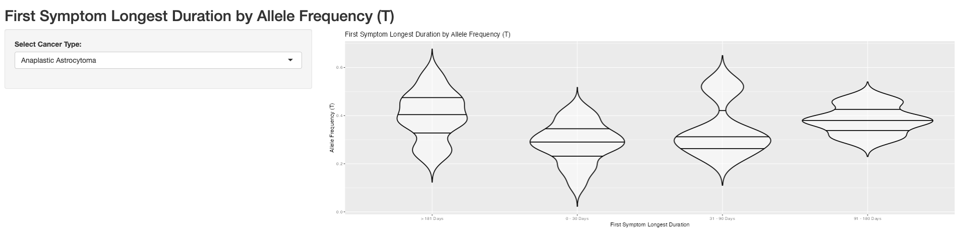
Anaplastic Astrocytoma

Slide 18
References
[1] Bou Zerdan, M., & Assi, H. I. (2021, September 15). Oligodendroglioma: A Review of Management and Pathways. Frontiers. Retrieved April 26, 2023, from https://www.frontiersin.org/articles/10.3389/fnmol.2021.722396/full
[2] Lee, S., Kambhampati, M., Almira-Suarez, M. I., Ho, C.-Y., Panditharatna, E., Berger, S. I., Turner, J., Van Mater, D., Kilburn, L., Packer, R. J., Myseros, J. S., Vilain, E., Nazarian, J., & Bornhorst, M. (2019, December 16). Somatic mosaicism of Idh1 r132h predisposes to anaplastic astrocytoma: A case of two siblings. Frontiers. Retrieved April 26, 2023, from https://www.frontiersin.org/articles/10.3389/fonc.2019.01507/full#:~:text=Anaplastic astrocytomas are aggressive glial,and young adult anaplastic astrocytomas.
[3] U.S. Department of Health and Human Services. (n.d.). Anaplastic oligoastrocytoma - about the disease. Genetic and Rare Diseases Information Center. Retrieved April 26, 2023, from https://rarediseases.info.nih.gov/diseases/10637/anaplastic-oligoastrocytoma
[4] Watanabe T, Nobusawa S, Kleihues P, Ohgaki H. IDH1 mutations are early events in the development of astrocytomas and oligodendrogliomas. Am J Pathol. 2009 Apr;174(4):1149-53. doi: 10.2353/ajpath.2009.080958. Epub 2009 Feb 26. PMID: 19246647; PMCID: PMC2671348.
[5] Kapoor M, Gupta V. Astrocytoma. [Updated 2022 Oct 3]. In: StatPearls [Internet]. Treasure Island (FL): StatPearls Publishing; 2023 Jan-. Available from: https://www.ncbi.nlm.nih.gov/books/NBK559042/
[6] Oligodendroglioma oligoastrocytoma 200526 - American brain tumor ... (n.d.). Retrieved April 26, 2023, from https://www.abta.org/wp-content/uploads/2018/03/Oligodendroglioma_Oligoastrocytoma_2020_web_en.pdf
[7] Asmann, Y.W., Parikh, K., Bergsagel, P.L. et al. Inflation of tumor mutation burden by tumor-only sequencing in under-represented groups. *npj Precis. Onc.*5, 22 (2021). https://doi.org/10.1038/s41698-021-00164-5
[8]Wang, L., Ge, J., Lan, Y. et al. Tumor mutational burden is associated with poor outcomes in diffuse glioma. BMC Cancer 20, 213 (2020). https://doi.org/10.1186/s12885-020-6658-1
Cerami et al. The cBio Cancer Genomics Portal: An Open Platform for Exploring Multidimensional Cancer Genomics Data. Cancer Discovery. May 2012 2; 401. PubMed.
Gao et al. Integrative analysis of complex cancer genomics and clinical profiles using the cBioPortal. Sci. Signal. 6, pl1 (2013). PubMed.

Slide 19

Thanks for Listening
Time for Questions

