Slide 1

Can an LLM replace the IDS analyst?
Automated generation of intrusion detection rules using generative AI in a rule-based IDS deployment
Group 13 · Bigyan Siwakoti · Binay Siwakoti · Irab Baral · Shashwat Acharya
Supervisor: Prof. Bharanidharan Shanmugam · Charles Darwin University · October 2026
Notes:
PRESENTER: Bigyan (≈0:30). Introduce the team and the question in one sentence: we tested whether a large language model can do the job of the analyst who sits between an intrusion detection system and its rules — investigating alerts and writing new detection rules — without replacing the rule-based engine itself.

Slide 2

Detection is only as good as its rules
Signature-based IDS: deterministic and inspectable, but blind to anything without a rule
No rule, no detection — however capable the engine
Turning an observed attack into a tested rule is manual work: investigate, identify invariants, write, validate, deploy
Scarfone & Mell (NIST SP 800-94) describe this cycle as taking hours to days of scarce expertise
Investigate
Identify
Write rule
Validate
Deploy
Today a human analyst performs every step, for every new attack
52,647 community rules in ET Open, and still whole attack categories went undetected
Notes:
PRESENTER: Bigyan (≈0:50). The bottleneck is not the detection engine, it is the human loop around it. Emphasise that we keep detection rule-based and inspectable on purpose — the supervisor's constraint was no machine-learning detector. The AI's job is to do the analyst's work: investigate and author rules the engine then evaluates.

Slide 3



Research question
Can a large language model take over the analyst's role in the alert-handling loop of a rule-based IDS — and what context does it need to do that job well?
Build
Measure
Test context
An agentic triage engine that investigates Suricata alerts, writes detection rules and validates them by replay
Every AI-authored rule against ground-truth labels, on two datasets — one the system was never tuned for
Experiment 1: triage with alert events only versus full sensor context
Constraints: open-source only · no machine-learning detection · the model authors rules, it never classifies traffic
Notes:
PRESENTER: Bigyan (≈0:45). Read the question, then the three aims. Stress the second half of the question — 'what context does it need' — because Experiment 1 answers it later.

Slide 4



Keep the engine, automate the analyst
Three stages — detection stays deterministic, the model works around it
1 Detection
2 Triage
3 Output
Suricata 8.0.6 replays pcap files
ET Open ruleset, 52,647 rules
Benign Monday baseline: 80 documented suppressions → 0 alerts
LLM agent investigates eve.json
Six-step procedure: big picture → categorise → investigate → deep-dive → act → report
8 tools, no free shell access
Threat → write rule → validate by replay → auto-deploy
Benign noise → propose suppression → human approval
Design decisions: alert-only rules (a Suricata 'pass' rule would stop inspecting the whole flow); offline pcap replay; all tuning in threshold.config
Notes:
PRESENTER: Bigyan (≈0:50). Walk left to right. Detection: stock community rules plus a baseline built on the benign Monday capture, like a real SOC would tune a sensor. Triage: the model does the analyst's investigation. Output: two exits — detection rules deploy automatically, suppressions need a human (explained shortly). Hand over to Binay for how the system is built.

Slide 5
Tech stack and architecture
new rules are loaded into the next replay
pcap captures
CIC-IDS2017 · UNSW-NB15
Suricata 8.0.6
+ ET Open + AI rules
eve.json (NDJSON)
alerts · flows · app-layer
Stack
Suricata 8.0.6 (IDS engine)
ET Open ruleset
jq over NDJSON
Python 3 triage engine
Anthropic + DeepSeek APIs
FastAPI + Server-Sent Events
Ubuntu on WSL
Provider adapter
identical prompt + tools
Triage engine
(Python, agentic loop)
Web UI
FastAPI + SSE stream
Claude Opus 5
DeepSeek V3 / V4 Pro
rules/generated/
replay-validated
Notes:
PRESENTER: Binay (≈1:00). Follow the arrows: pcap → Suricata → eve.json → triage engine. The provider adapter lets Claude and DeepSeek run the identical loop with identical tools, so models can be swapped. Rules the model writes go to rules/generated and are loaded into the next Suricata replay (dashed line) — that is how the model validates its own rules. The web UI streams every tool call live.

Slide 6
Giving the model agentic capability
A tool-calling loop: the model chooses actions, the engine executes them through validated tools
count_alerts
count_by
1
2
alerts per signature
aggregate any field
Engine sends history + tool schemas
Model replies with a tool call (JSON)
query_eve_json
read_file
jq query, capped output
configs, rules, logs
write_file
append_to_file
4
3
rules/generated only
rules/generated only
Result appended; model reads it and decides next step
Engine validates path and executes
run_suricata
list_directory
replay pcap to validate
allowlisted folders
repeats until the model answers without a tool call (max 100 turns)
Tool design mattered as much as the model: DeepSeek V3 failed every run until we added count_by
Notes:
PRESENTER: Binay (≈1:05). A hosted model can only produce text. The loop turns it into an agent: each turn it can request one of eight tools; our engine checks the request (paths are allowlisted, writes only into rules/generated) and returns the result. The model decides what to investigate and in what order. Key lesson: V3 kept failing on jq aggregation over NDJSON; one purpose-built aggregation tool fixed it.

Slide 7


Safety and evaluation integrity
Safety asymmetry
Evaluation integrity
Threat
Write rule +
replay-validate
Auto-deploy
Our transcript audit found label leakage
Benign noise
Propose
suppression
Human
approval
Early runs listed the ground-truth folder — file names like '…PortScan' name the attack
One Tuesday run read the answer from our own project notes
Fix: tools can open only logs/, config/, rules/, data/pcaps/
UNSW runs: zero attempts to read labels
A bad rule over-alerts (wrong-way safe). A bad suppression blinds the sensor (wrong-way unsafe) — so a human decides.
It mattered: one UNSW run proposed suppressing rules that were catching a real Cisco heap-overflow exploit. The proposal needed approval, so the sensor stayed sighted.
Notes:
PRESENTER: Binay (≈1:00). Left: the asymmetry — the one design choice that protected us. Tell the Cisco exploit story briefly. Right: be upfront that we audited our own evaluation, found that some early runs could see answer-revealing file names and one run read our notes, and locked the tools down. This is why the Tuesday model comparison is reported as compromised. Hand over to Irab for data and results.

Slide 8

Two datasets, scored against ground truth
CIC-IDS2017
UNSW-NB15
Canadian Institute for Cybersecurity
UNSW Canberra Cyber Range Lab
14
4
per-flow
9
6
31,432
attack categories
attack days, tuned + raw passes
labels (CICFlowMeter)
attack categories
captures (12 GB), raw only
labelled attack events
Brute force, DoS (Hulk, GoldenEye, slowloris, Slowhttptest), Heartbleed, web attacks, infiltration, DDoS, port scan, ARES botnet
Never used during development — tests whether the approach transfers. No benign-only day, so no baseline tuning is possible
Notes:
PRESENTER: Irab (≈0:40). CIC-IDS2017 is the development dataset: labelled flows for every attack. The supervisor asked us to try a second dataset in Week 9 — UNSW-NB15 — which the system had never seen. Every number that follows is measured against these labels, not taken from the model's own claims.

Slide 9
CIC-IDS2017: broad coverage, precise rules
13 / 14
attack categories identified by the model (only DoS GoldenEye missed)
8 → 12
of 14 categories caught by rules: stock ET Open → stock + AI-authored rules
99.4%
of AI-rule alerts on the noisy days fell on real attack flows (stock rules: 6.1%)
Flow-level matching on 5-tuple and time; Suricata engine events excluded. The one bad rule (FTP 'data staging') fires on routine uploads.
Notes:
PRESENTER: Irab (≈1:05). Three headline numbers. 13 of 14 attack types identified. Rules: stock ET caught 8 categories, adding the AI's rules takes it to 12. Precision: on the noisy captures almost every stock alert fell on normal traffic, almost every AI-rule alert on a real attack. Be honest about the middle bars — over all four days it is 81 vs 78 because of one bad AI rule; remove it and the AI rules are 99.6%.

Slide 10




What the stock rules missed
FAKEVERB DoS
Hulk GET flood
Diagnosed that Suricata's HTTP parser hides non-standard methods, rewrote the rule on raw TCP payload
149,703-request cache-busting flood with no dedicated stock rule; wrote and validated a rate rule
463 hits (stock: none)
new detection
ARES botnet
SSH brute force
Five infected hosts beaconing to a C2 server; no stock or custom alert had fired
Paramiko client fingerprint rule for SSH-Patator
15 of 15 alerts on Bot flows
detection 1.0% → 28.4%, zero false positives
Notes:
PRESENTER: Irab (≈1:00). Four short stories. FAKEVERB shows reasoning about the engine itself. Hulk: an attack class the 52,000-rule set had no dedicated rule for. ARES: listed as undetected in our interim report — found later by the model and confirmed by labels. SSH: a precise fingerprint rule that took detection from 1% to 28% with no false positives.

Slide 11
UNSW-NB15 v1: the approach works on a second dataset
9.2% → 15.5%
event-level detection, stock → stock + AI rules (+68% relative)
8 / 9
categories identified across six runs (Analysis missed)
0
AI-rule alerts on hosts with no attacker involved
Within one replay: +5.9 pts genuine gain over stock ET Open. 13 of 15 rules written on other captures fired on capture 14.
Notes:
PRESENTER: Irab (≈1:05). Same engine, unchanged, on a dataset it never saw. Detection rises from 9.2% to 15.5%; recon and exploits roughly double. IF ASKED WHY RECALL IS LOW: it is low for the professional stock rules too — UNSW fires thousands of one-off exploit attempts, many with no signature anywhere — so the claim is the improvement over human-written rules, achieved with zero alerts on benign hosts. Rules also transferred between captures. Hand over to Shashwat.

Slide 12
Experiment 1: does context matter?
Same model and captures (UNSW 3, 1, 10) — full sensor context versus alert events only
Breadth without context.
Depth with it.
Only full context let the model answer: did the attack succeed?
Alerts only covered more categories (7 vs 6) and wrote more productive rules — broad, signature-organised reports
Full context established outcomes: '59 × PASS → 230 Login successful', '2.25 MB leaked by Heartbleed' — alerts-only reports said success 'cannot be confirmed'
Notes:
PRESENTER: Shashwat (≈1:15). This answers the second half of the research question, and the result surprised us. Without context the model was just as good — even slightly better — at spotting attacks. What context buys is depth: whether the attack actually worked, which decides the analyst's response. Caveats: one run per condition, and alert records still carry some flow counters.

Slide 13




What went wrong: confident errors
Deleted two of its best rules, claiming they were stock ET rules — they were not
Wrote three rules Suricata rejects and one that can never fire
Read routine FTP uploads from every workstation as data exfiltration
'Validated' Thursday rules against a small test file, not the Thursday capture
Same evidence, opposite verdicts across runs (5 : 1 on the Heartbleed rules)
Self-validation is only as good as the environment: CIC's config loaded 3 of 10 rule files; UNSW's loaded the model's file — and all 18 rules work.
Notes:
PRESENTER: Shashwat (≈1:00). Be candid — this is a strength of the evaluation, not a weakness of the talk. The errors are confident: the model reported success each time. The rule audit on the right covers all 50 AI-authored rules: 16 of the 32 CIC rules were proven by replay, all 18 UNSW rules. The pattern: on CIC many rules were never really tested because the configuration did not load their files; on UNSW, where it did, every rule works.

Slide 14
Part 2 — Can the agent beat a strong human baseline?
The supervisor's challenge: look at what real detection engineers do, and replicate it with the agent
Notes:
PRESENTER: Bigyan (≈0:20). Everything so far measured the AI against stock ET Open. In weeks 10-11 we asked the harder question: what happens when the human baseline is as strong as we can make it?

Slide 15
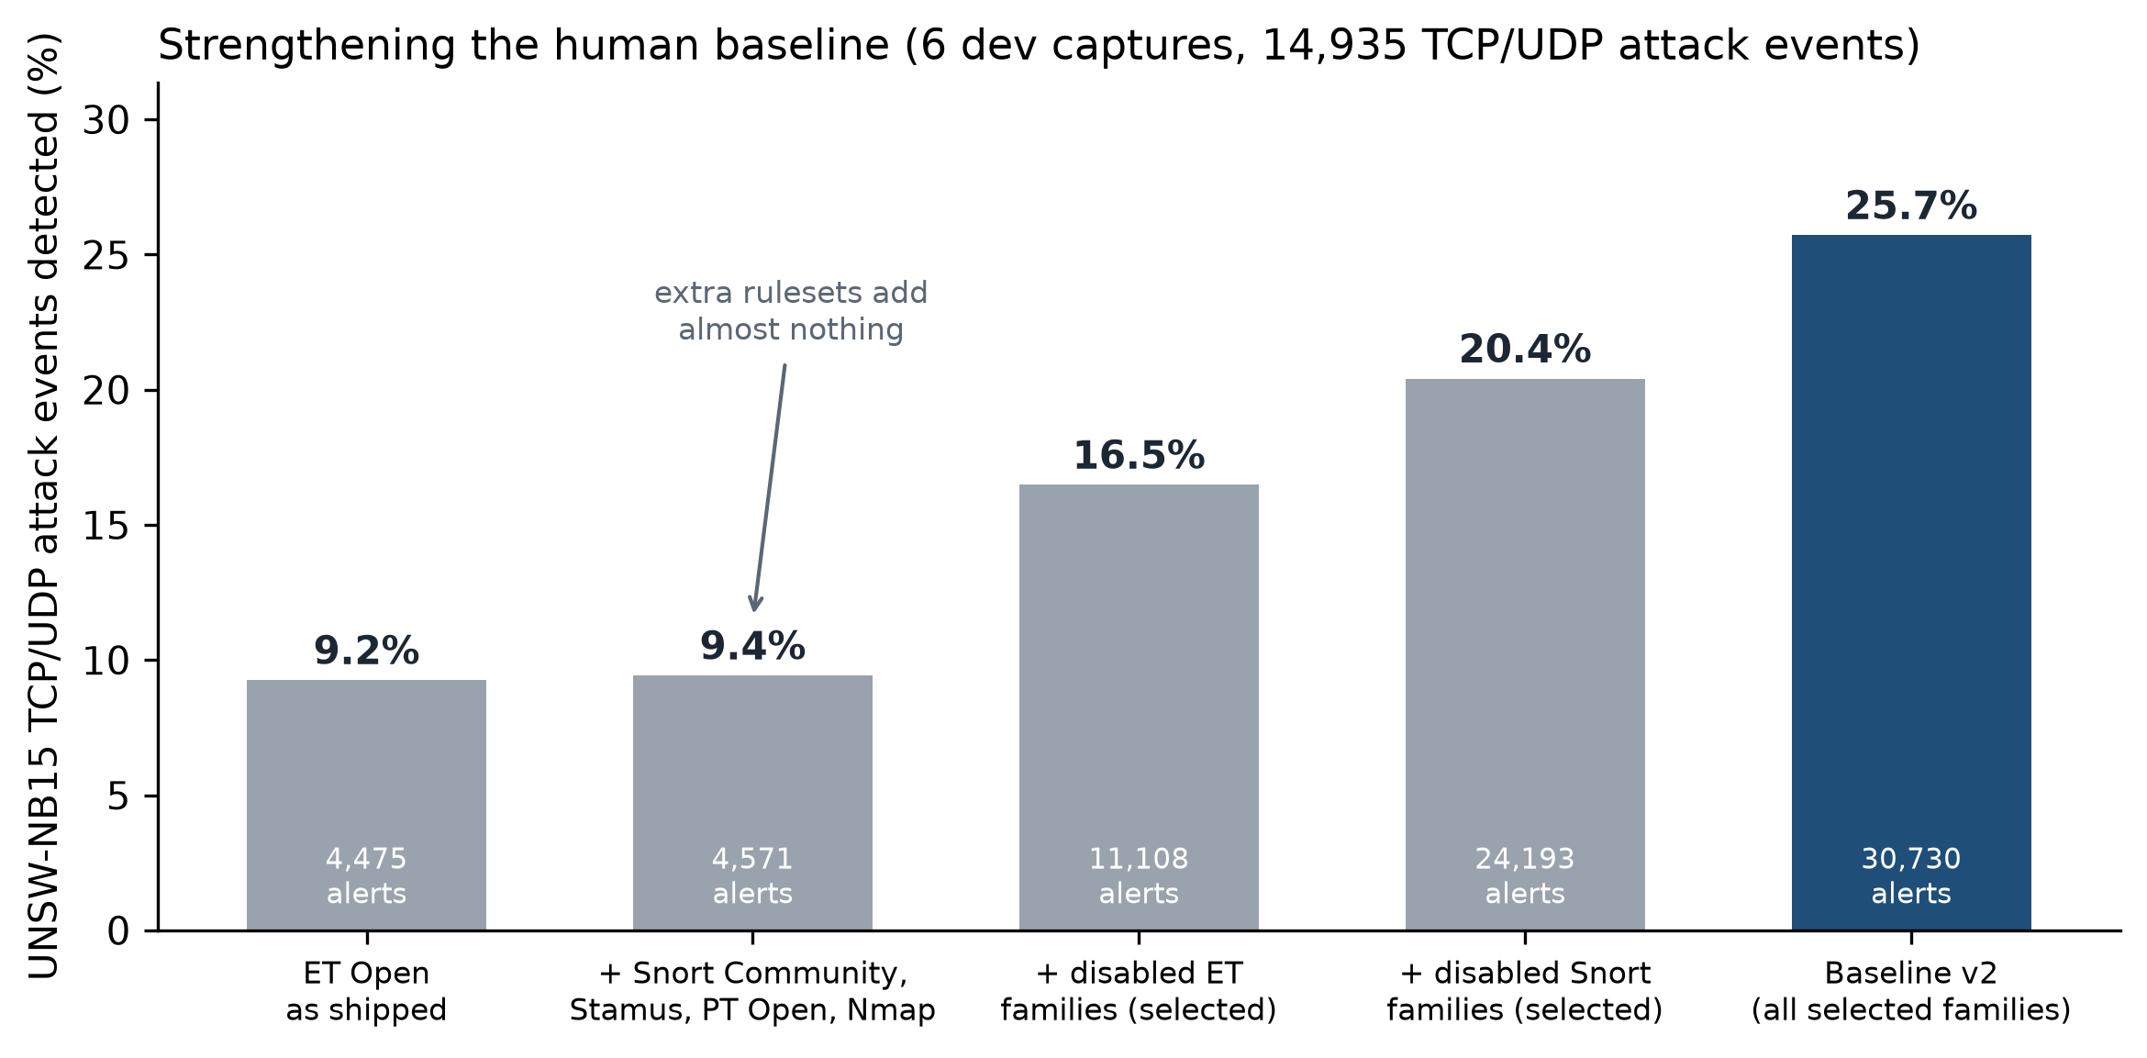
First, make the human baseline as strong as possible
Re-enabling disabled ET and Snort rule families, chosen from the services seen in the traffic — never from labels
9.2% → 25.7%
UNSW TCP/UDP attack events detected: ET Open as shipped → baseline v2
46×
more alerts on non-attacker hosts if every disabled rule is enabled (31.2% vs 24.9% detection)
This is the bar the AI now has to clear — no longer stock rules.
Six development captures (17 Feb 2015), 14,935 TCP/UDP attack events. Extra rulesets: Snort Community, Stamus lateral, PT Open, Nmap (Nmap later dropped: it wrecked CIC precision).
Notes:
PRESENTER: Irab (≈0:50). A real SOC engineer's first move is not AI, it is tuning the rules they have. Adding more rulesets did almost nothing; re-enabling the rule families that ship disabled, picked by which services are under attack, nearly tripled detection. Enabling everything gets 31% but floods non-attacker hosts with 46x the alerts — that is why we chose by service.

Slide 16
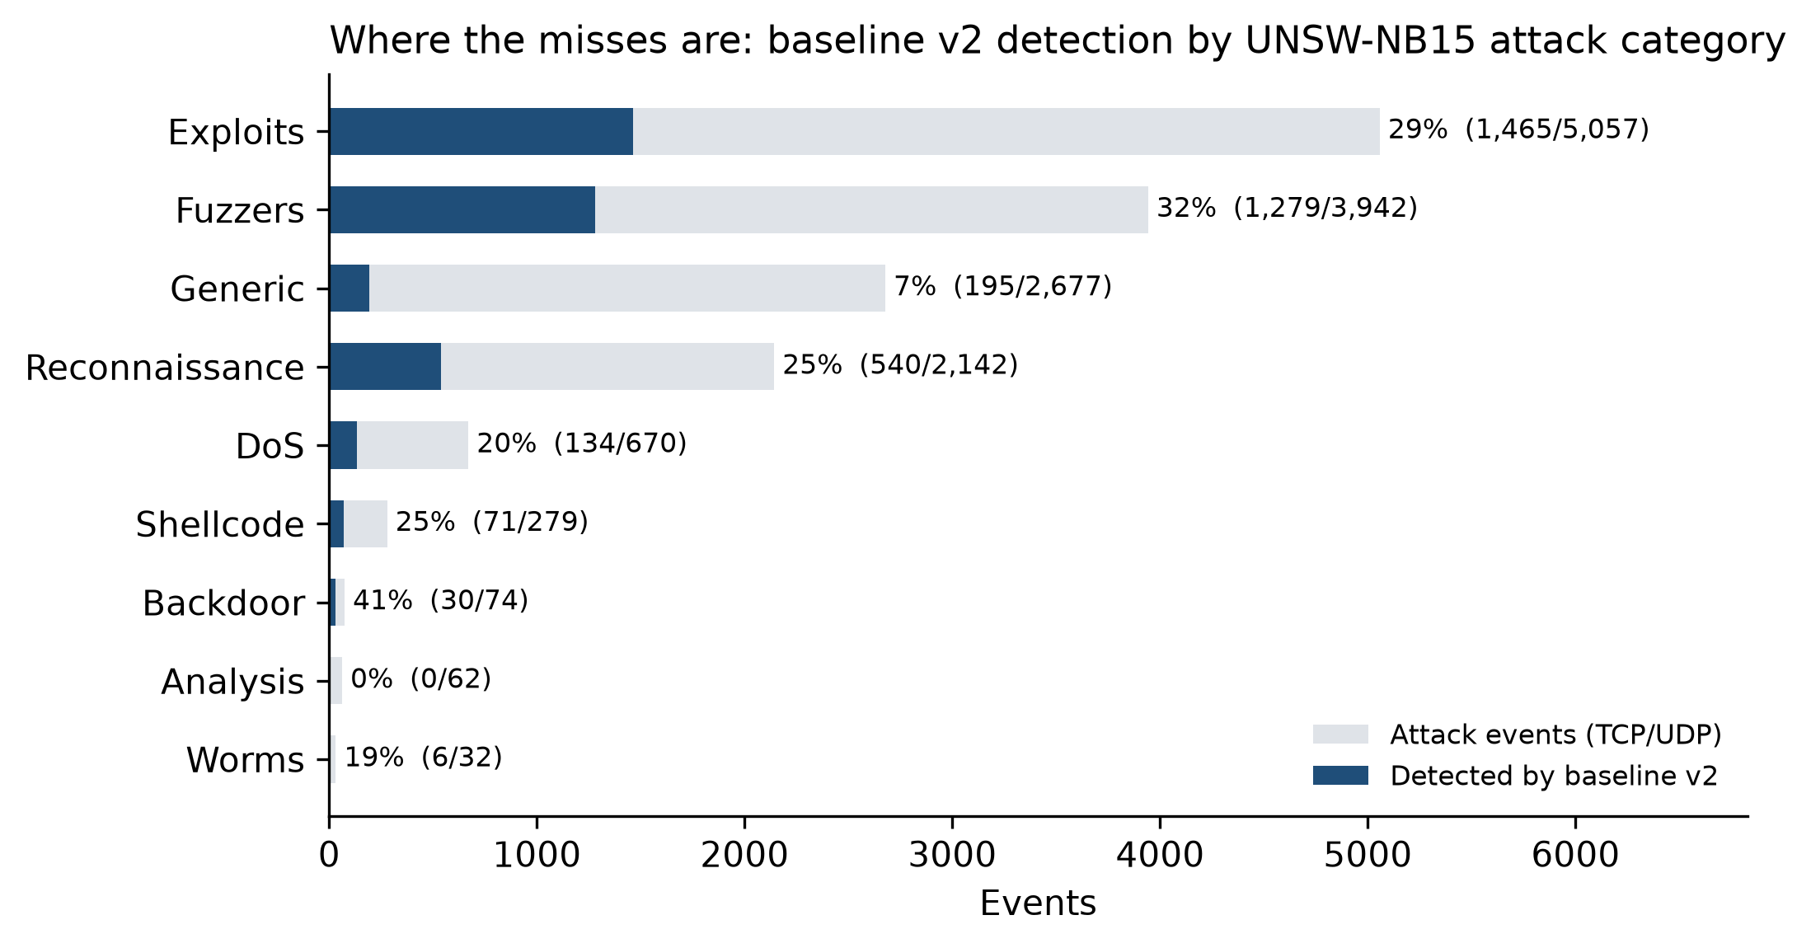
Where a signature IDS still misses
Baseline v2 detection by attack category — most attack events are still missed in every category
Roughly a quarter to a third caught in the big categories: Exploits 29%, Fuzzers 32%, Reconnaissance 25%
Weakest: Generic 7% of 2,677 events, Analysis 0%, DoS 20%
Most missed events are one-off attempts generated with varying content — a rule written for one instance rarely matches the next
Notes:
PRESENTER: Irab (≈0:40). This chart explains every result that follows. Even the best categories are only a quarter to a third detected, and Generic — almost 2,700 events — is at 7%. The traffic generator varies each attempt, so a rule for one instance rarely matches the next. Keep this in mind when we look at what the AI added.

Slide 17
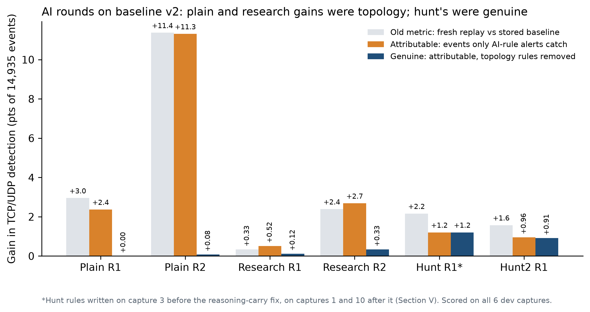
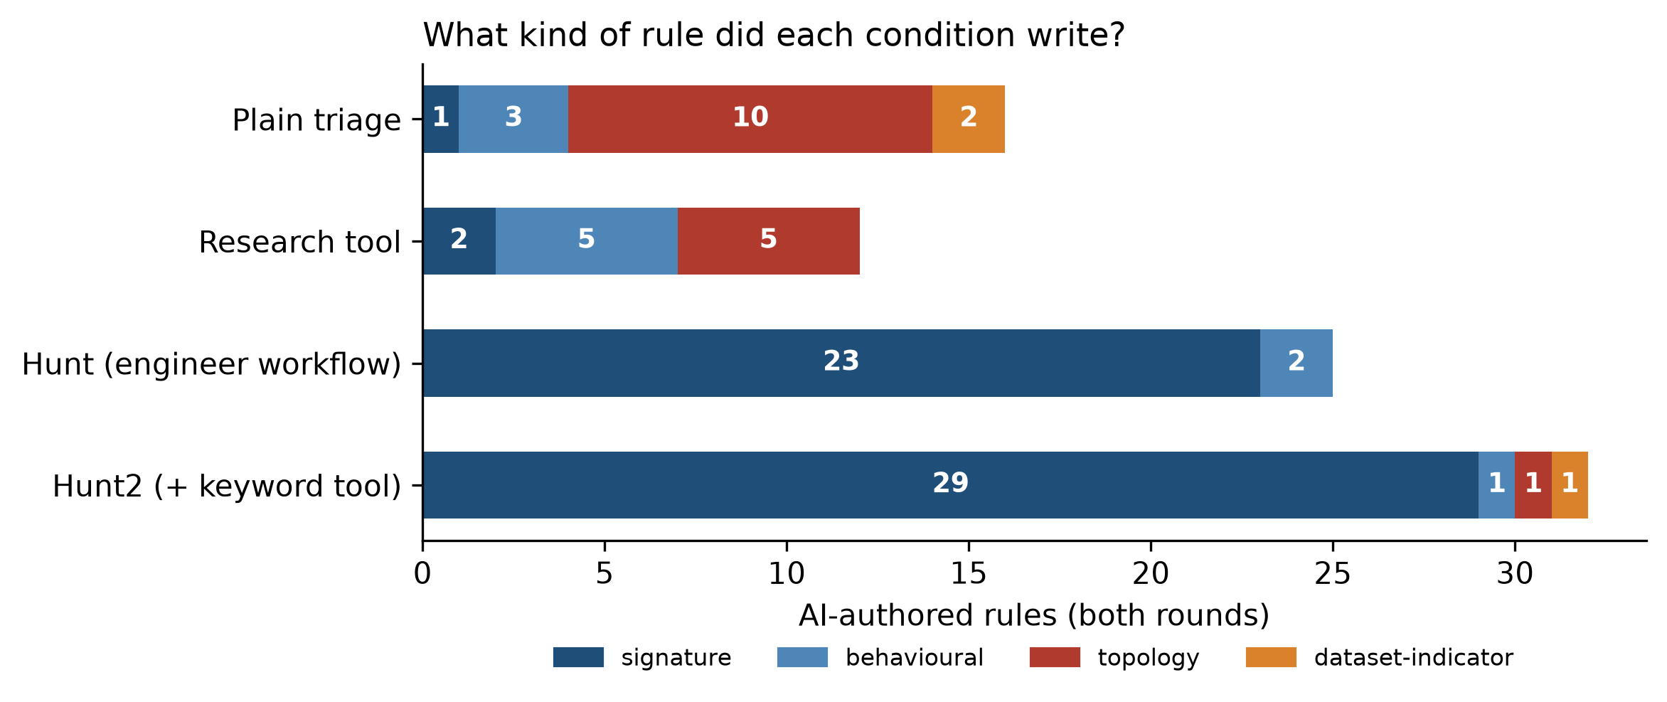
AI rounds on the strong baseline: the topology trap
Rule-writing rounds on captures 3, 1, 10; scored on all six. Gains attributed only to events no other alert caught.
Topology rule = ordinary activity from outside HOME_NET (SMTP MAIL FROM, POP3 login, SIP REGISTER). In UNSW every external host is an attacker, so these score perfectly here — and would alert on every customer on a real network.
Plain R2 looked like +11.3 pts, genuine +0.08. Research: +0.33. Hunt / hunt2: +1.21 / +0.91 — the only gains clearly above noise.
Notes:
PRESENTER: Shashwat (≈1:00). We caught ourselves here. The plain condition seemed to add 11 points. Classifying every rule by its text showed most of it was topology — 'an outsider sent mail' — which is only an attack because of how UNSW is built. We also found our scoring compared a fresh replay with an old one; Suricata's thresholds are not deterministic, so we now credit only events that the AI rules alone caught. Honest numbers: plain and research add well under half a point; only the two hunt conditions clearly add detection — next slides.

Slide 18
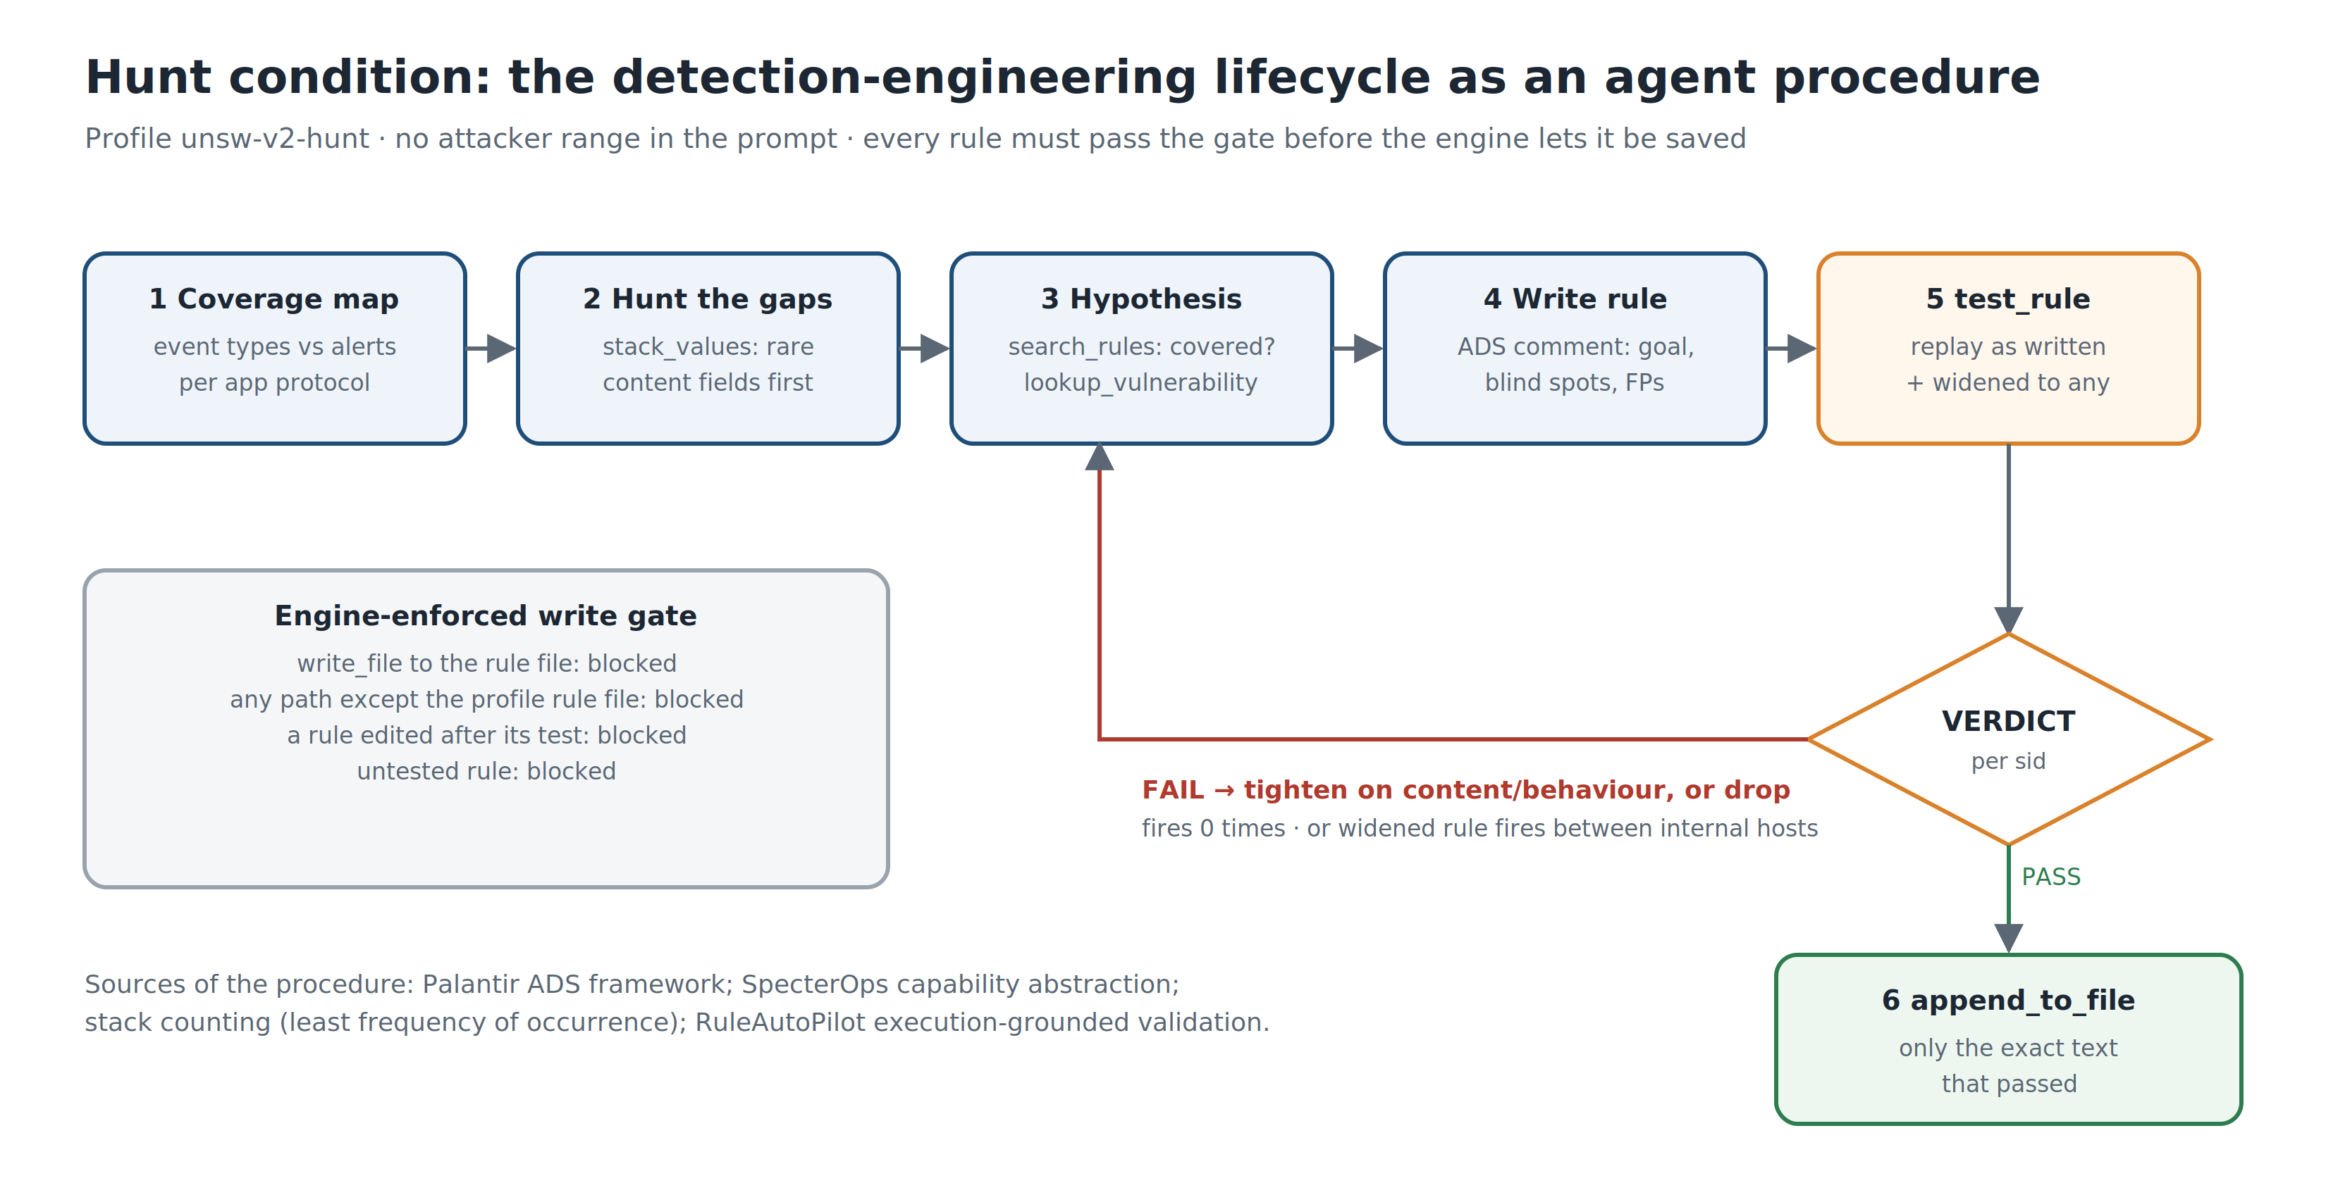
Replicating a real detection engineer
Hunt condition: the detection-engineering lifecycle, encoded as the agent's procedure
Palantir ADS
every rule documents goal, blind spots, false positives
SpecterOps
detect the technique, not the tool's surface strings
Stack counting
rare values first — no ML, no training period
RuleAutoPilot (2026)
execution-grounded validation: F1 0.443 → 0.539
No attacker range in the prompt. Two new tools: stack_values (rare-first counting) and test_rule. The engine refuses to save any rule that has not passed test_rule in exactly that form.
Notes:
PRESENTER: Binay (≈1:00). This is the supervisor's suggestion made concrete. We researched how detection engineers work — Palantir's ADS framework, SpecterOps, threat-hunting practice — and turned it into the agent's procedure. The key differences from the earlier rounds: it starts from traffic nothing alerted on instead of from alerts, it never sees the attacker range, and it cannot save a rule without passing a test.

Slide 19
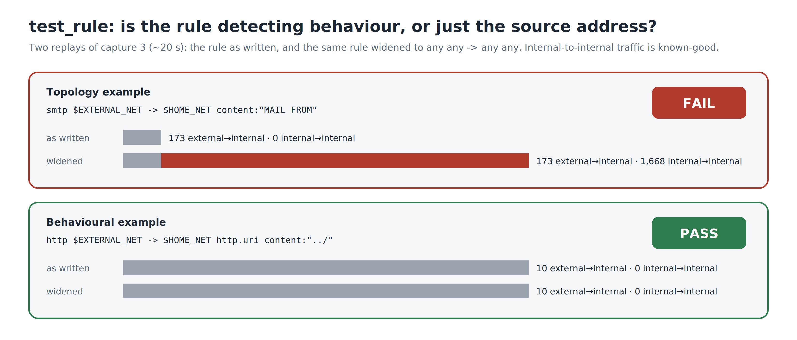
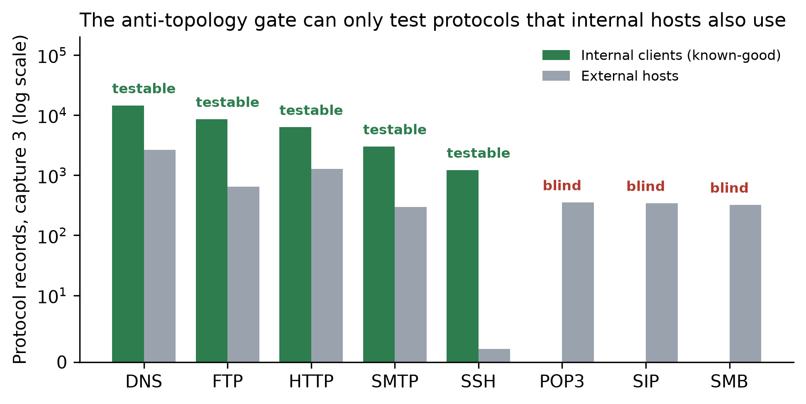
The anti-topology gate
Replay the rule as written, then widened to any → any. If it fires between internal hosts, it is matching normal activity.
Known-good = internal clients → servers (testbed documentation: servers 1 and 3 generate normal traffic)
20 s per test on a 2 GB capture — cheap enough for the agent to iterate
Limitation: blind on POP3, SIP and SMB — no internal host uses them in UNSW
Notes:
PRESENTER: Binay (≈0:50). The test is simple and checkable. The MAIL FROM rule looks perfect when written from outside — 173 hits. Remove the address constraint and it matches 1,668 normal internal emails: the rule's precision came from the IP address, not the behaviour. A directory-traversal rule passes: same hits either way. Be upfront about where the test is blind.

Slide 20
We found a bug by watching the agent fail
Capture 1, first attempt: 100 turns, 8.4M tokens, rules passed the gate — and nothing was saved
Symptom
Re-tested rules that had already passed, never saved, hit the 100-turn limit. The UI showed tool calls but no reasoning at all.
Diagnosis
Engine, server and browser all passed text through. The raw API did not: DeepSeek V4 Pro answered in thinking mode — reasoning in reasoning_content, content empty.
Root cause
Our adapter read only content. The model's reasoning was never logged and never sent back, so every turn it started again without its own plan.
Fix
Stream reasoning to the UI and transcript, and return it with each turn. Re-run: finished in 90 turns, 9 rules saved, 5.2M tokens.
Every earlier DeepSeek run carried the same defect whenever the model used thinking mode; most also wrote visible text, so they were affected less. Stated as a threat to validity.
Notes:
PRESENTER: Binay (≈1:00). This is the real-engineering story. The supervisor asked us to replicate what detection engineers do; when the agent behaved oddly we debugged it like engineers — checked each layer until the raw API showed the reasoning was arriving in a field we ignored. One fix, and the next run finished on its own.

Slide 21
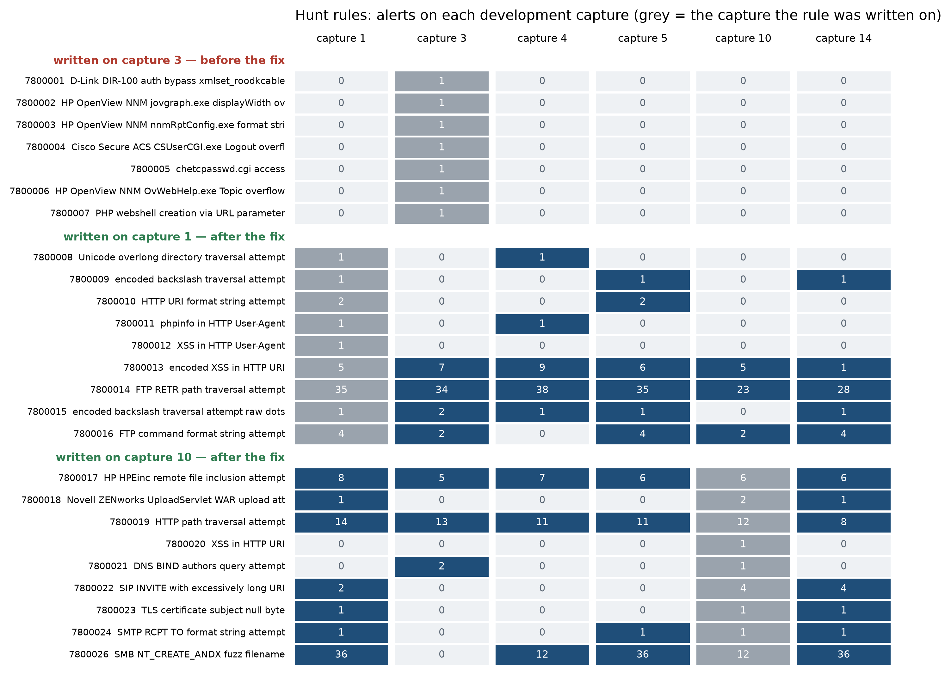
Hunt result: technique rules that transfer
25 rules from captures 3, 1, 10 — capture 3 ran before the fix, captures 1 and 10 after it
+1.21 pts
genuine detection on the 6 dev captures (+180 events no other rule caught)
74%
of hunt-rule alerts match a labelled attack; 0 on normal hosts; 0 topology rules
6 → 175
events added by rules written before the fix (instances) vs after it (techniques)
Top contributors: SMB fuzzed filenames (behavioural, +59), HTTP /../ traversal (+37), HP HPEinc file inclusion (+31), encoded XSS (+24). The SMB rule could not be gate-tested (no internal SMB); 0 alerts on benign hold-out captures.
Notes:
PRESENTER: Shashwat (≈1:00). Read the chart by group. Capture 3's rules (before the fix) each match one exploit attempt and never fire again. Captures 1 and 10, after the fix, wrote technique and behaviour rules — traversal, XSS, format strings, SMB fuzzing — and most fire on captures they were never written on. Be honest: the improvement coincides with the bug fix, so we cannot separate 'better workflow' from 'reasoning carried'. Both were needed.

Slide 22
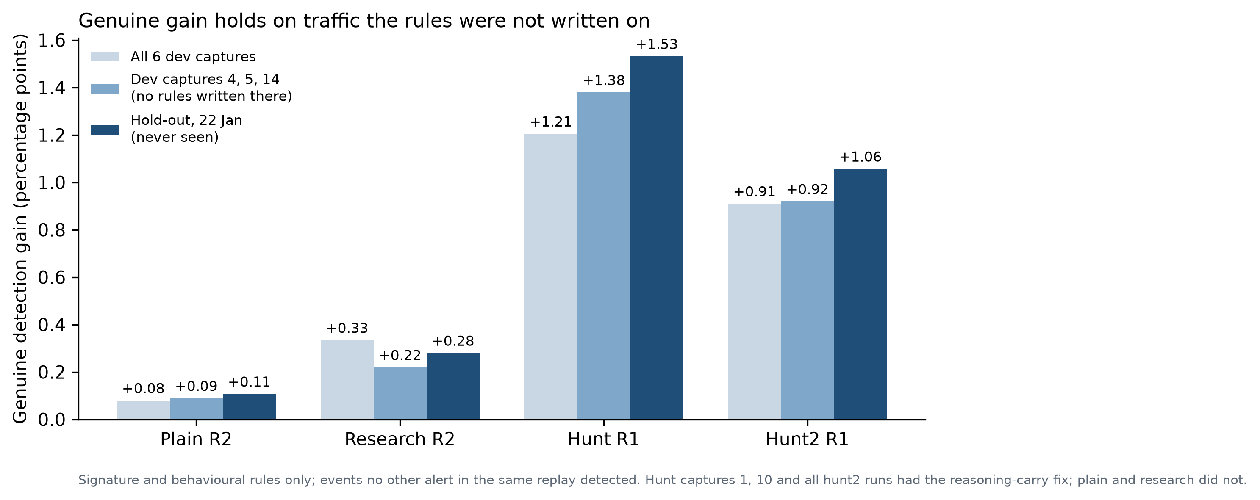
Hold-out: traffic nobody had looked at
UNSW 22 Jan 2015 — rule files frozen first, then replayed and scored once
+1.53 pts
hunt rules on the hold-out (+71 of 4,634 events) — larger than on the dev set
0
AI-rule alerts on the two benign-only hold-out captures, in every condition
29.5%
detected by the frozen human baseline v2 alone (dev: 24.9%)
Hunt2: +1.06 pts. All four conditions together: about +2.2 pts. Plain and research: +0.11 and +0.28 — their large raw gains were topology rules.
Notes:
PRESENTER: Irab (≈0:50). This is the number that matters most. We froze every rule file, then ran the untouched day once. The hunt rules' gain held — slightly larger than on the development captures — and no AI rule fired on the two captures with only normal traffic. The human baseline also generalised. Caveat: still small against the ~70% of events every ruleset misses.

Slide 23
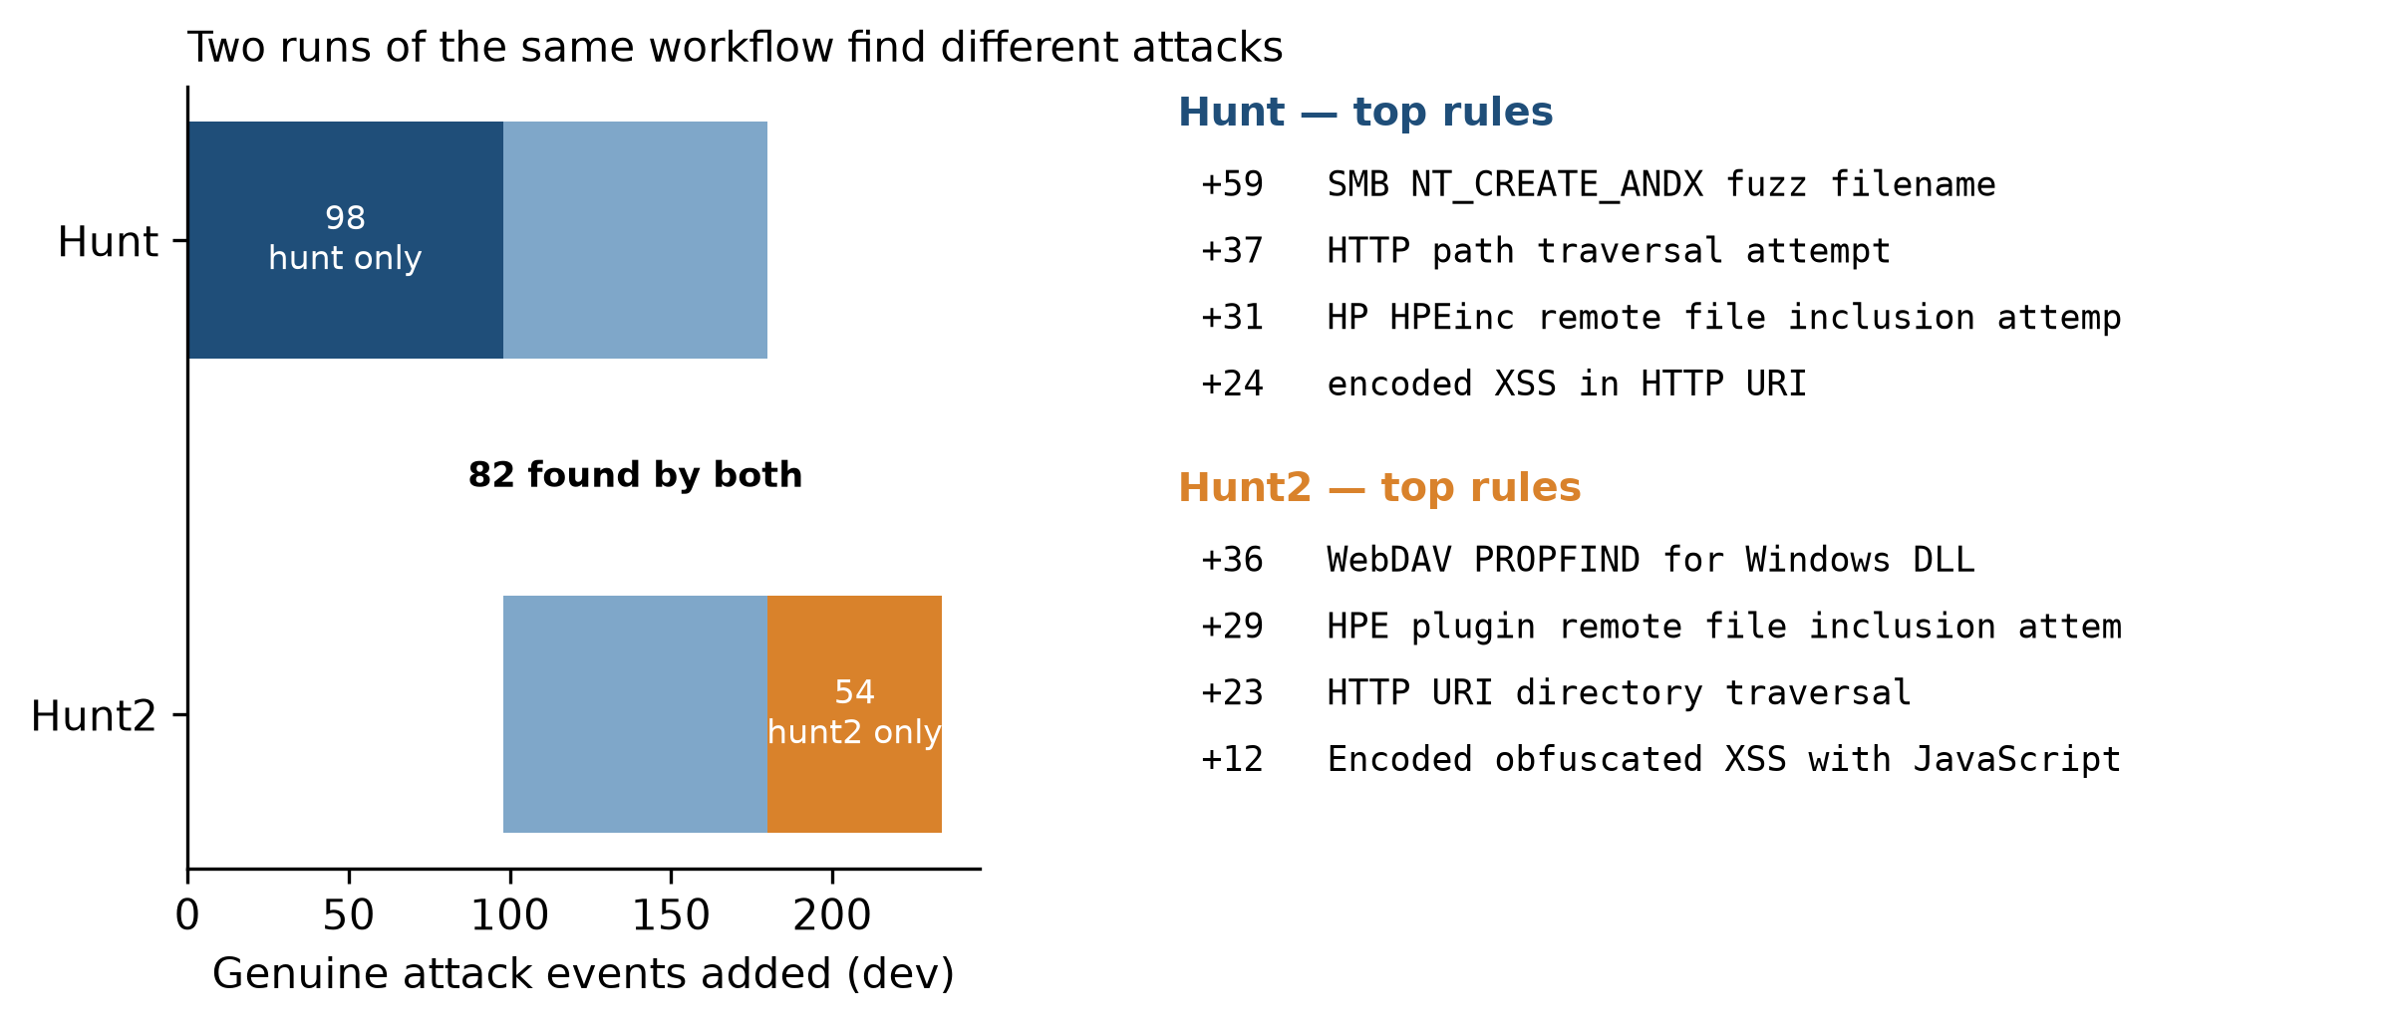
Hunt2: the keyword tool fixed errors, not detection
Same workflow plus suricata_keywords (which rule keywords this Suricata supports); all runs after the fix
0
rules that failed to load (hunt capture 10: 2); proper buffers instead of raw-byte regexes
+0.91 / +0.92 / +1.06
genuine pts: dev / dev 4-5-14 / hold-out (hunt: +1.21 / +1.38 / +1.53)
82 shared
of 180 (hunt) and 136 (hunt2) events: runs of the same workflow find different attacks
Expected beforehand: +1.2 to +2.0 pts. Got less. What a run detects depends on which attack families it chooses to hunt — run-to-run variation is larger than the tool's effect.
Notes:
PRESENTER: Bigyan (≈0:50). We predicted the keyword tool would help. It did fix what it targeted — no rule failed to load — but detection went slightly down, because this run hunted different attack families. The two runs share only 82 events. So the bottleneck is not knowing Suricata's syntax; it is which attacks the agent decides to chase. Running several times and keeping the union is the obvious next step.

Slide 24
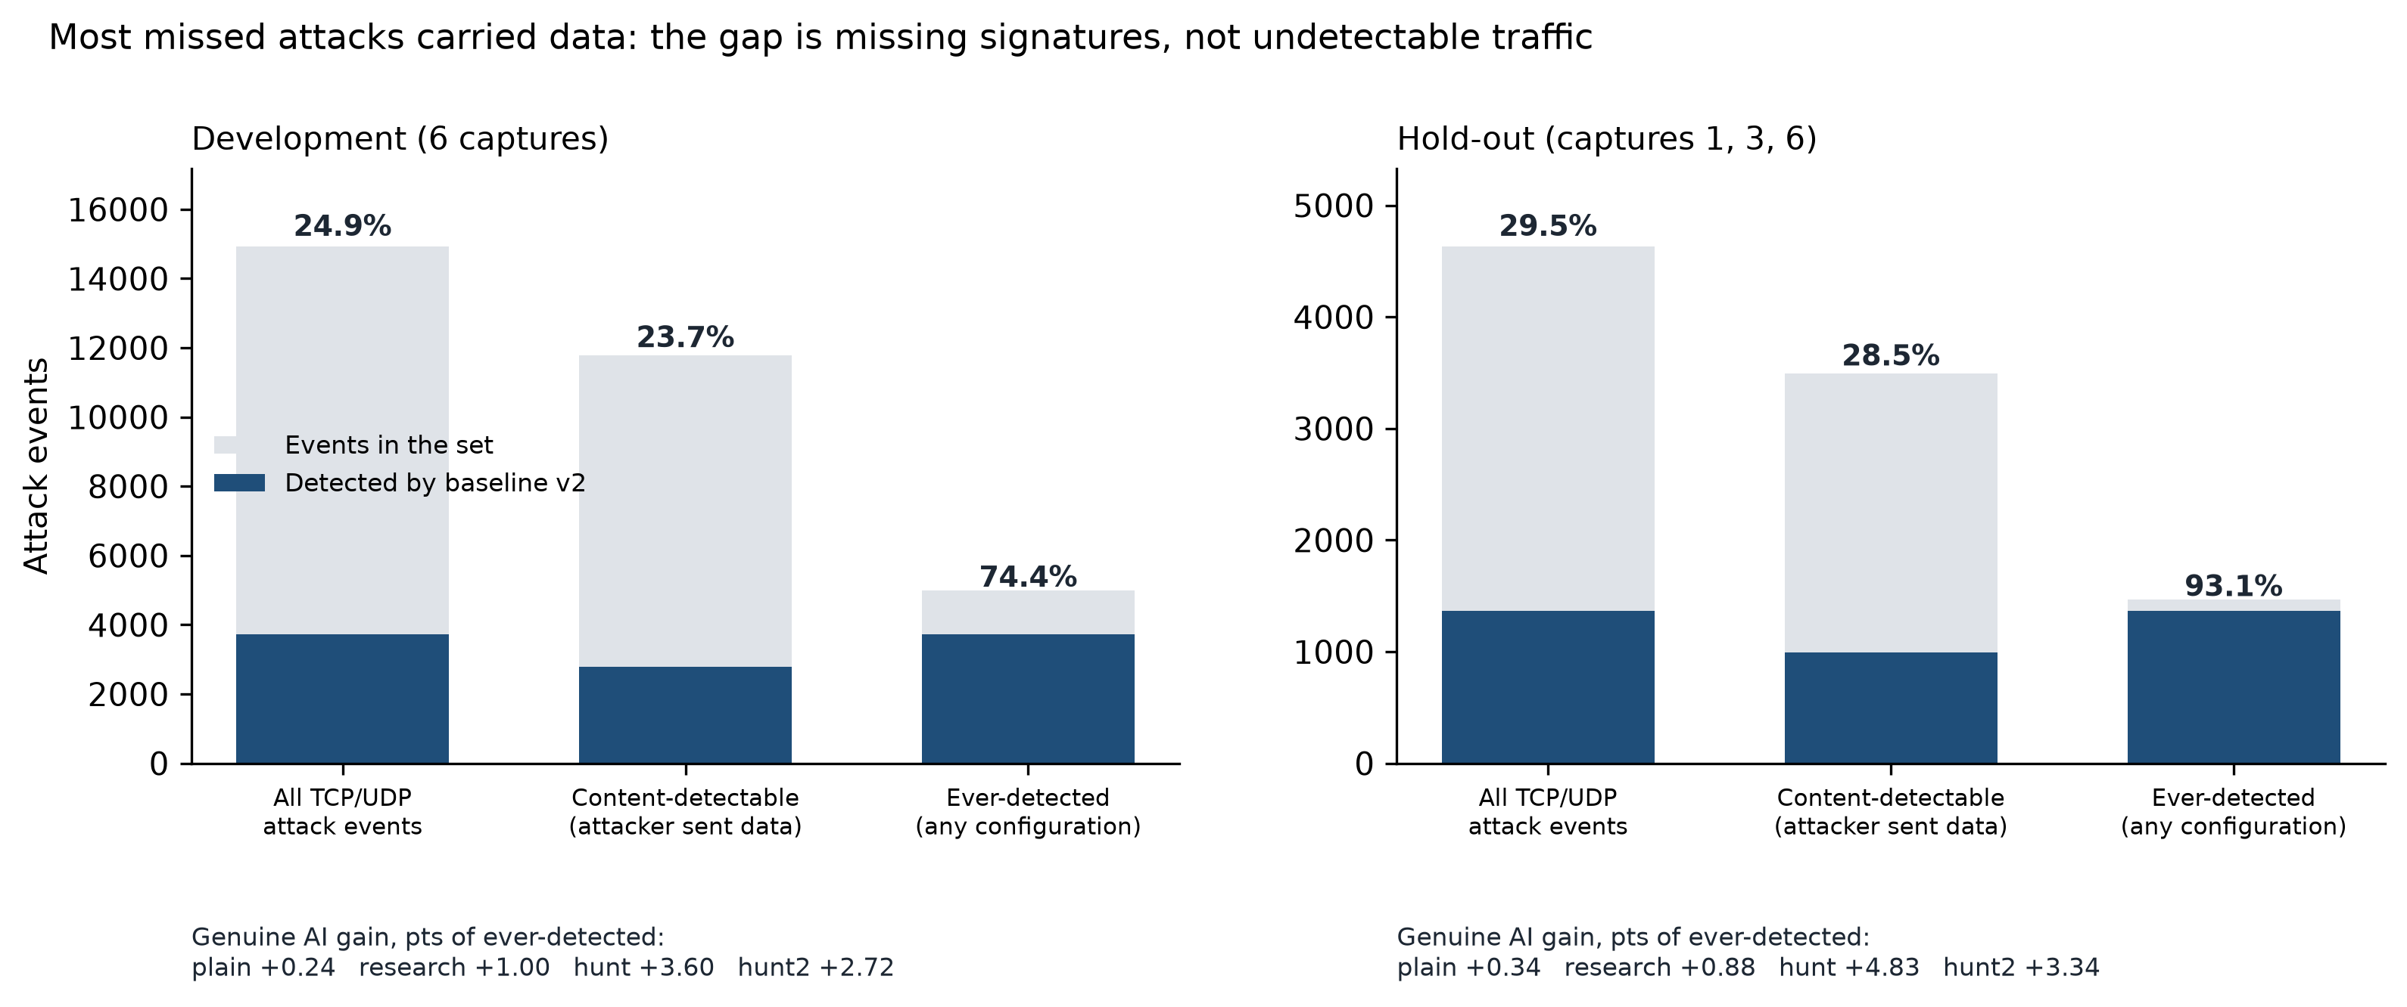
Is 25% unfair to a signature IDS?
Measured against attacks a rule could plausibly see — not every labelled event
79%
of attack events carried data a content rule could see
23.7%
of those the tuned baseline detects — the gap is unwritten signatures
+4.8 pts
hunt gain measured against everything any configuration caught (hold-out)
Content-detectable: attacker sent more bytes than headers account for (PSH flag unusable: the generator omits it). Ever-detected: caught by any configuration we ran — a circular ceiling.
Notes:
PRESENTER: Irab (≈0:45). A fair question: maybe most attacks are undetectable by signatures. They are not — three-quarters carried data, and the baseline still misses three-quarters of those. Against what anything we ran could catch, the human baseline is already at 74-93%, and the hunt adds about 4-5 points of that ceiling.

Slide 25
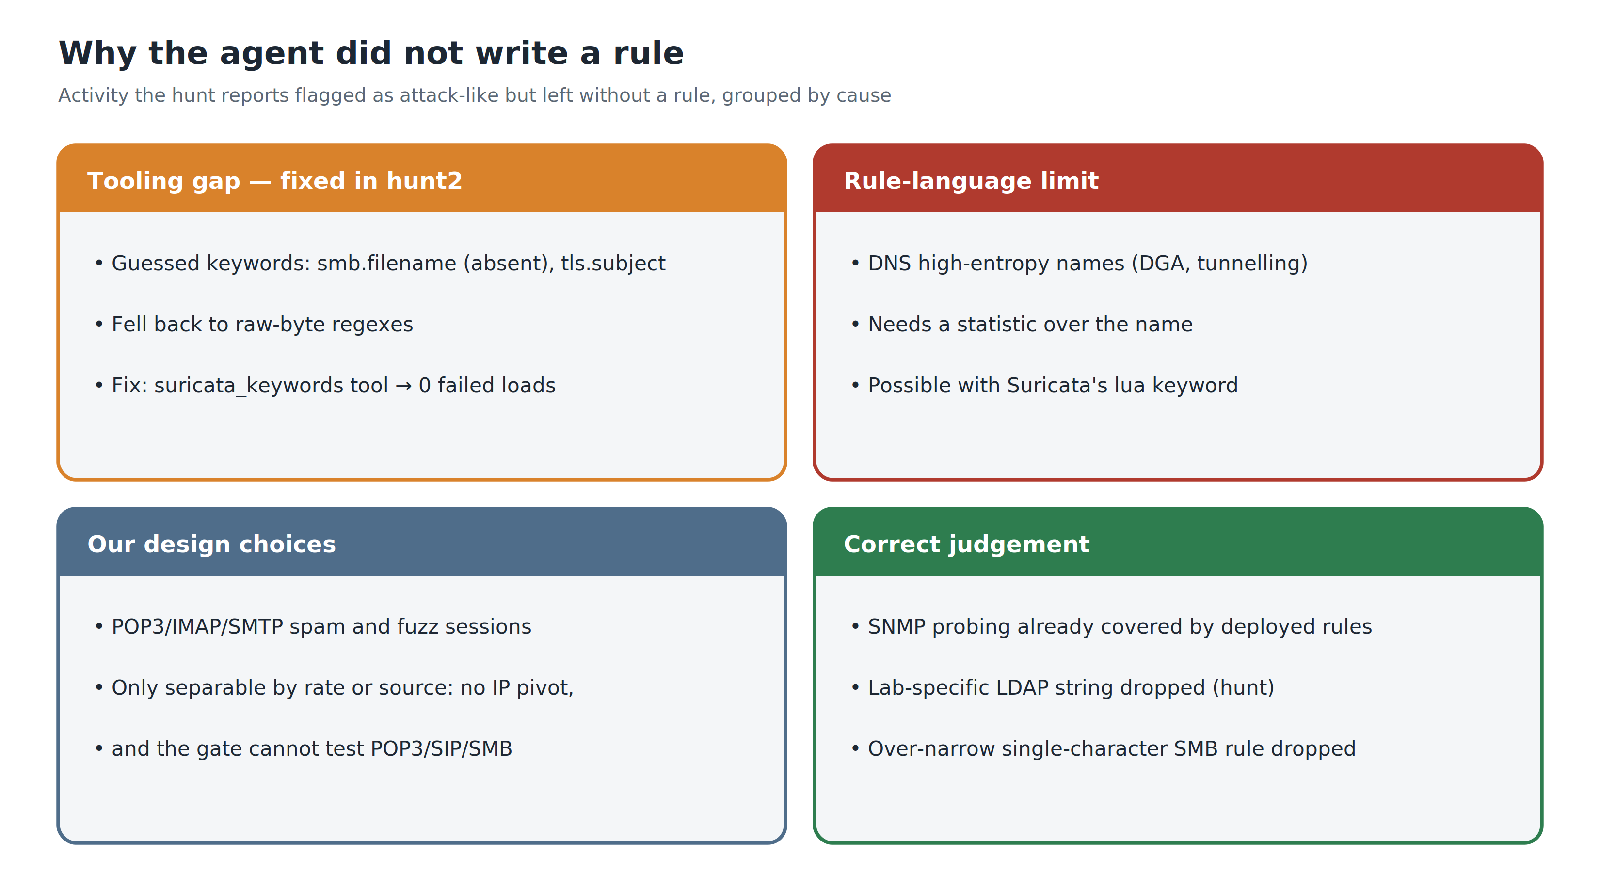
Why the agent did not write a rule
Attack-like activity the hunt reports left without a rule, grouped by cause
Notes:
PRESENTER: Shashwat (≈0:40). Four causes. The tooling gap we fixed with hunt2. The rule-language limit — DNS entropy needs Lua. Our own design: no IP pivots and a gate that cannot test POP3 or SIP mean rate rules were off the table, by choice. And some omissions were simply right.

Slide 26
Conclusions
Answer — a split claim: yes for triage: with sensor context the model investigates end to end (13/14 CIC, 8/9 UNSW categories) and establishes outcomes. Partly for detection: against a strong human-tuned baseline, triage-driven rules added a fraction of a point; the detection-engineering workflow, with the model's reasoning carried across turns, added +1.2–1.5 pts (hunt2: ~+1.0) that held on unseen traffic with no false alarms — real, but modest against the ~70% still missed.
Tools and procedure shape the agent
Carry the model's reasoning
count_by fixed a failing model; the hunt procedure removed topology rules
Dropping it made the agent loop; returning it fixed the hunt
Measure what the AI alone caught
Techniques transfer, instances don't
Replay variance and topology rules both inflated our early numbers
Per-exploit rules fired once; traversal, XSS and fuzzing rules held on the hold-out
Notes:
PRESENTER: Shashwat (≈1:00). Give the split answer, then the four lessons. Mention that model-agnosticism is a design property here, not a proven result — the Tuesday comparison was compromised by the label leakage we found.

Slide 27

Next steps
Separate workflow from fix
Re-run plain and research with reasoning carried, to isolate what the hunt workflow adds
Technique-level hunting
Require technique rules and test each on a second capture before saving
Several runs per capture
Runs find different attacks: keep the union, measure the spread
Questions?
Live deployment
Code, rules, transcripts and evaluation scripts:
github.com/bigyan-siwakoti/Intrusion_Detection_System
Time-windowed alert batches and live rule reload via the Suricata socket
Notes:
PRESENTER: Shashwat (≈0:30), then all four for questions. Likely questions: (1) Why is recall low? — low for the human-written stock rules too; we measure improvement. (2) Why DeepSeek for most runs? — cost; the adapter makes the model swappable. (3) Could the model have seen the answers? — we found and fixed that; UNSW runs had zero label access.

