Slide 1
HRIS

Slide 2
Human Resource Information Systems
The Human Resource Information Systems is introduced by presenting the various definitions, development, costs and benefits, as well as their functions and relationship with HRM.
Components of an HRIS
Input Data ---------------------Maintenance------------------- Output

Slide 3
Why HRIS is important?
Integrating the Technologies of HR
Increased Efficiency
Increased Effectiveness
Cost and benefit of HRIS

Slide 4
EMPLOYEE ENGAGEMENT

Slide 5
Employee Engagement
engagement is being characterised by employees being dedicated to the organisation, believing what is stands for and being equipped to above and beyond what is expected of them to deliver exceptional service to the customer.

Slide 6
Elaborately Employee Engagement means
Employee engagement is more psychological contract than physical one. It is something that employee has to offer from his / her own to the organisation. However, employee engagement can be summed up by how positively the employee:
Think about the organisation;
Feel about the organisation;
Is proactive in relation to achieve the organisational goals for customers, subordinate and other stake holders.

Slide 7
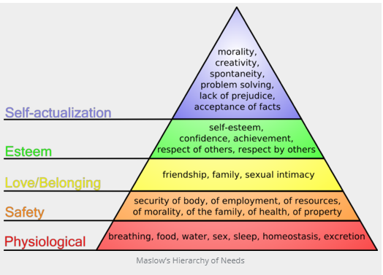
The Psychology of Engagement
This breakdown of basic, universal human needs provides a useful framework for understanding employee engagement

Slide 8

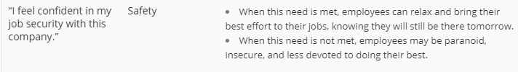
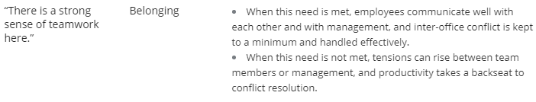
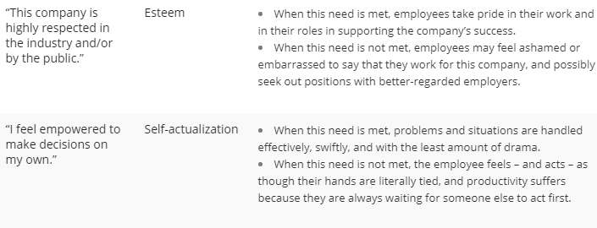

Slide 9

Employee Engagement
Regular communication through emails and intranet, team off-sites, performance management discussions, town-hall meetings by senior management, trainings, employee suggestion schemes, rewards and recognition programs key events and festival celebrations, health awareness sessions and fun-at-workplace activities.
Best-in-class technology was deployed to automate HR processes, and the internal employee portal, My Connect, was revamped to provide employees with a seamless and digitally enhanced HR experience.
The enhanced experience was extended to prospective employees as well with the Bank becoming one of the first few organizations in the country to introduce ‘faceless interviewing’.

