Slide 1

DR. BIDYA DASH

Slide 2
Contents
Concept
Objectives
Functions of HRM
Evolution of HRM
Strategic HRM
HRP
Job analysis: job description, job specification
Recruitment: concept, sources, process, and yield,
Selection: concept, process, tests and interviews
Induction and socialization

Slide 3
The relevancy of the subject
Human resource managers need to get the right people into the right place at the right time and then help tem maximize their performance and future potential.

Slide 4
Objectives
It involves procurement, development, maintenance of human resource
It helps to achieve individual, organizational and social objectives
It includes the study of management, psychology, communication, economics and sociology.
It involves team spirit and team work.
It is a continuous process.

Slide 5
Evolution of HRM
Human resource management is evolved form the Personnel management which was previous management system which used to manage employees.
One among them was Elton Mayo who was a psychologists from the Australia, did many experiments on human behavior.
He strongly believed in work life balance for improving productivity of workers.
He has emphasized on human relations influence the productivity of workers.
Finally he has been regarded as father of Human resources management.

Slide 6
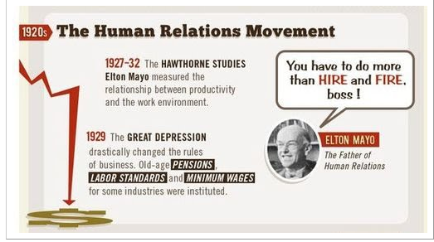
Evolution of HRM

Slide 7
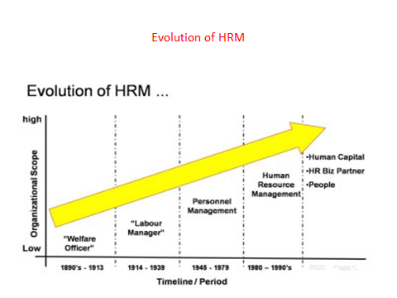

Slide 8
Evolution of HRM
Welfare officer:
It is anyone whose job is to ensure the wellbeing or survival of any distinct group of people.( under privilege individuals) ( food, shelter, employment)
Labour manager: Labour relations managers and officers, also known as industrial relations specialists, implement industrial labour relations programmes.
Personnel manager: a ​person who is in ​charge of the ​department that ​deals with the ​employment, ​training, ​support, ​records, etc. of a company's ​employees: The ​function of a ​personnel ​manager usually begins with the ​staffing ​process.
Human capital: the skills, knowledge, and experience possessed by an individual or population, viewed in terms of their value or cost to an organization or country.
HR biz partner: HR business partners are HR professionals who work closely with an organization's senior leaders in order to develop an HR agenda that closely supports the overall aims of the organization.

Slide 9
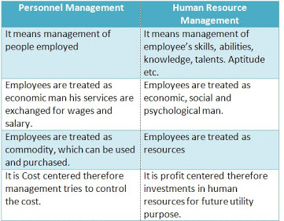

Slide 10
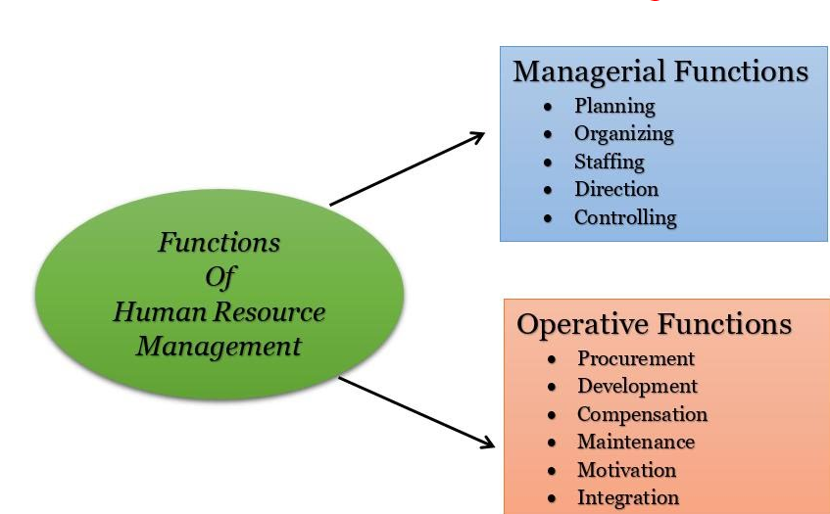
Functions of HRM

Slide 11
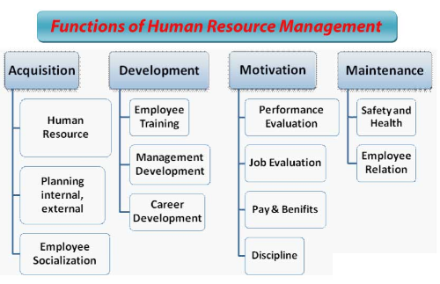

Slide 12
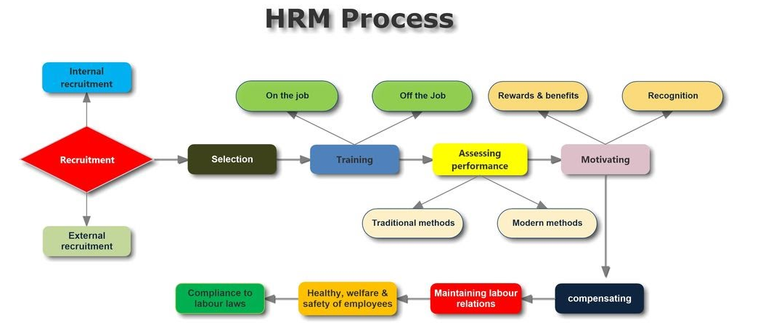

Slide 13


Slide 14
Basics about SHRM
Strategic Human Resource Management is a combination of Strategy and Human Resource Management (HRM).
Popularity of SHRM from 2000.
According to Ulrich, HR needed to become value adding – and thus more strategic.
In simple sentence : This means that HR needed to become a better fit with the business strategy in order to provide value.
HR strategy focus on – organizational specific outcomes.
SHRM focus on – future directions

Slide 15
Why HR practices need to be align with business strategy?
Because HR practices will build the critical capabilities that enable an organization to achieve its goals.
Yeung and Berman identify 3 paths through which HR framework / practices can contributed to business performance:
1. by building original capabilities
2. by improving employee satisfaction
3. by shaping customer and shareholder

Slide 16
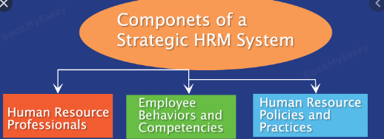

Slide 17
Sears : Department store company
Sears was one of the first organizations in the world to document the relationship between employee behavior and the firm’s performance. The company pioneered studies that defined and empirically verified the correlation between individual sales associates’ behaviors, customer satisfaction, and financial performance. Sears executives have embraced a business strategy that relies on employees as the source of competitive advantage. After much research , Sear concluded that two employee attitudes ( perceptions about their jobs and perceptions about the company) had a significant effect on employee retention and behavior toward its company.

Slide 18
The company made sure that employees received performance feedback from customers so that they could see the direct relationship between their behavior and customer satisfaction. These changed employee behaviors then had a direct and dramatic effect on customer satisfaction and retention, which ten impacted revenue growth.

Slide 19

Strategic management and strategic HRM at Colgate Palmolive
Strategic Management perspective:
Colgate Palmolive is a successful company specialising in personal care products.
In the early 1980s, the company realised that if it wants to successful in the emerging competitive environment around the world, it would have to develop more transactional and relationship orientation.
Because its rival P&G, HUL were trying to become transactional companies.

Slide 20
Strategic HRM perspective at Colgate Palmolive
Being a transactional companies, Colgate thought to develop an international cadre of executives to become compatible with different culture.
So to build such team Colgate began recruiting college graduates in1987 and put them intensive training programme. (MBA from USA university).
The company also provided management training programme international carder managers .

Slide 22
Process of strategic HRM
Five phase constitute the HRM process:
Scan the environment: (phase 1)
Identify sources of competitive(P-2)
Identify HRM strategies ( phase 3)
Implementing HR strategies (phase 4)

Slide 23
Linking business strategy to HR strategy
There are two generic routes to competitive advantage – through being the lowest cost producer, or through differentiation strategy.
2. The four generic building blocks of building a competitive advantage are
superior efficiency,
superior quality,
superior customer responsiveness and
superior innovation.
3. Companies achieve these drivers of competitive advantage through the creation of distinctive competencies.

Slide 24

Now let’s see how HR strategies can actually be aligned with firm’s business strategy
This concept of alignment is generally known as 'vertical fit‘.
Say for example, your company’s overall business objective is to achieve sustained competitive advantage in a specific market segment by constantly pumping out new products that none of your competitors currently offer;
i.e. the firm is adopting a strategy of innovation and product differentiation.
.

Slide 25

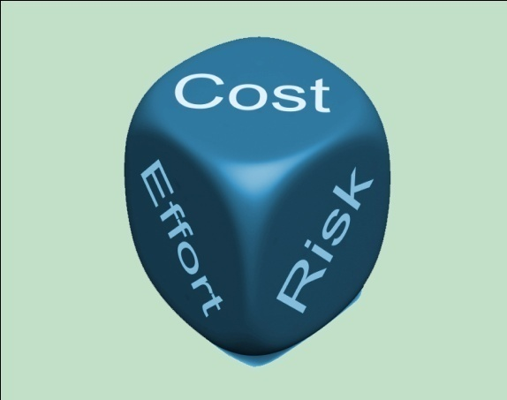
So in this case, HR’s strategy will be
to create and nurture a work culture where among others,
employees are given more discretion,
encouraged to take risks,
exercise creativity,
work collaboratively and share new ideas for which they are rewarded accordingly

Slide 26
Human resource planning

Slide 27
Concept
Human resource planning or manpower planning is essentially the process of getting the right number of qualified people into right job at the right time.
Do company adopt this process?

Slide 28
Reason to adopt HRP process
Employment-Unemployment Situation
Technological Changes
Skill Shortages
Demographic Changes
Organizational Changes

Slide 29
Factors affecting to Human Resource Planning
Internal factors:
Company Policies and Strategies
Human Resource Policies
Job Analysis
Trade Unions

Slide 30
Internal factors that affect HRP
1)Company Policies and Strategies: Company's policies and strategies relating to expansion, diversification, alliances, etc. determines the human resource demand in terms of quality and quality.
2) Human Resource Policies: Human resources policies of the company regarding quality of human resource, compensation level, quality of work life etc. influences human resource plan.
3) Job Analysis: Fundamentally, human resource plan is based on job analysis. Job description and job specification determines the kind of employees required.
4)Trade Unions: Influence of trade unions regarding number of working hours per week, recruitment sources, etc. also affects the HRP.

Slide 31
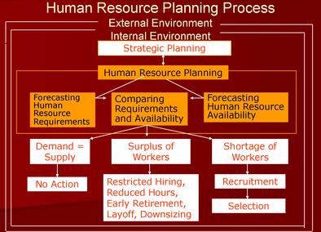
HRP PROCESS

Slide 32
Four stages of HRP process
An evaluation or appreciation of existing manpower resource.
An estimation of proportion of currently employed manpower resources which are within the firm linked with supply aspect.
An assessment or forecast of labour requirement if the organization overall objectives are to be achieved by the forecast date.
Adoption of required measures to ensure that the necessary resources are available as when required.

Slide 33
Demand forecasting methods
Analyzing, reviewing ad attempting to predict the numbers, by kind of the manpower needed by the organization to achieve its objectives.
Methods are :
Managerial judgment
Work study technique
Ratio trend analysis
Regression analysis
Delphi technique
Markov analysis

Slide 34
Example of work study procedure
1. Planned output for next year | 20,000 units
2. Standard hours per unit | 5
3. Planned hours for the year | 1,00,000
4. Productive hours per man/ year | 2000
5. Number of direct workers required (3/4) | 50

Slide 35
Trend Analysis of HR Demand
BUSINESS ÷ LABOR = HUMAN RESOURCES FACTOR PRODUCTIVITY DEMAND
YEAR (SALES IN THOUSANDS) (SALES/EMPLOYEE) (NUMBER OF EMPLOYEES)
2002 $2,351 14.33 164
2003 $2,613 11.12 235
2004 $2,935 8.34 352
2005 $3,306 10.02 330
2006 $3,613 11.12 325
2007 $3,748 11.12 337
2008 $3,880 12.52 310
2009 $4,095 12.52 327
2010* $4,283 12.52 342
2011* $4,446 12.52 355
*Projected figures

Slide 36
SIMULATION MODEL/REGRESSION FORECAST
TARGET STORES STAFFING FORECAST
MODEL
Y = 8 + .0011(X1) + .00004(X2) + .02(X3)
Y = Number of employees needed to staff the store
X1 = Square feet of sales space
X2 = Population of metropolitan area
X3 = Projected annual disposable income in millions of dollars
Y = 8 + .0011(50,000sq ft) + .00004(150,000popul) + .00000002($850 million)
Y = 8 + 55 + 6 + 17
Y = 86 employees needed at this store

Slide 37
Markov analysis
This model company count the annual movement (flows) among states for several time period.
Loss: death, disability, absence, resignation, retirement
Gain: hiring, rehiring , transfer, movement
The model estimate the probability of transition from one state to another based on past trends.

Slide 38
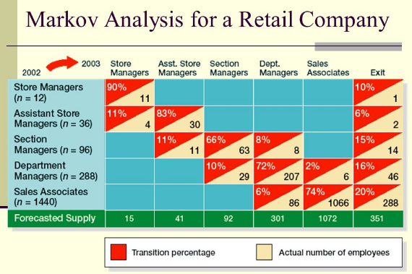

Slide 39
The supply analysis covers:
Existing human resources
internal sources of supply
External sources of supply.

Slide 40
Skill inventories – Existing human resource
Personal data--- age, sex, marital status
Skills -education, job experiences, training
Special qualification--- membership in professional bodies, special achievement
Salary and job history – present , and past, dates of pay rises, various job holds
Company data - benefit plan data, retirement information, seniority
Capacity of individual – health information.
Special preference of individual – geographic location, type of job.

Slide 41
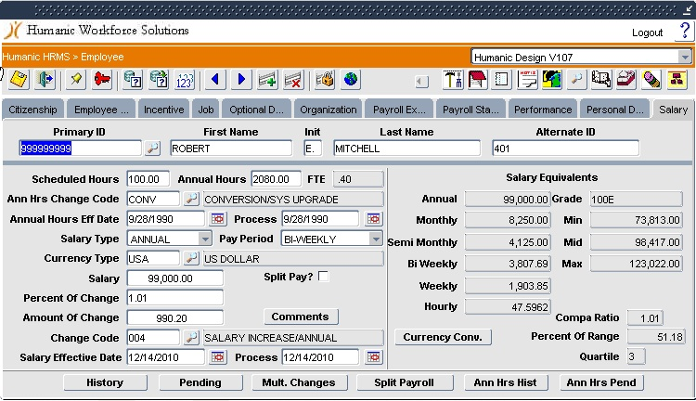

Slide 42
Internal sources of supply
Here the technique generally used for the purpose are
Inflow and outflow
Turnover rate
Condition of work and absenteeism
Movement among job.

Slide 43
External supply
External sources are important for specific reasons
New blood and new experiences will be available
Organization needs to refill lost personnel
For growth and diversification.
Sources of external supply are colleges, universities, consultancies, employment exchange.

Slide 44
Job analysis
A job is defined as a collection of duties and responsibilities which are given together to an individual employee.
Job analysis is the process of studying and collecting information relating to operations and responsibilities of a specific job.

Slide 45

4-3
Nature of job analysis
Job Tasks
Job Analysis
Job Duties
Job Responsibilities
Job Analysis

Slide 46
Job analysis
Tasks : a task is an identifiable work activity carried out for a specific purpose.(typing letter)
Duty: a duty is a larger work segment consisting of several tasks that are performed by an individual.( pick up, sort out and deliver incoming mail)
Job responsibility: it is an obligations to perform certain tasks and duties.

Slide 47
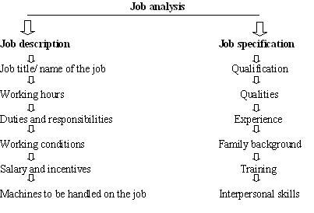
Job analysis

Slide 48
JD and JS
Job description describe what the job is all about, throwing light on job content, environment and condition of employment to differentiate from one job to other job.
Job specification summaries the human characteristic needed for satisfactory job completion.

Slide 49
Specimen of Job Description
4-21
Title Compensation manager
Code HR/2310
Department Human Resource Department
Summary Responsible for the design and administration of employee compensation programmes.
Duties v Conduct job analysis.
v Prepare job descriptions for current and projected positions.
v Evaluate job descriptions and act as Chairman of Job Evaluation Committee.
v Insure that company’s compensation rates are in tune with the company’s philosophy.
Cont…
Job Analysis

Slide 50

4-23
Specimen of job specification
Education v MBA with specialisation in HRM/MA in social work/PG Diploma in HRM/MA in industrial psychology.
v A degree or diploma in Labour Laws is desirable.
Experience v At least 3 years’ experience in a similar position in a large manufacturing company.
Skill, Knowledge, Abilities v Knowledge of compensation practices in competing industries, of job analysis procedures, of compensation survey techniques, of performance appraisal systems.
v Skill in writing job descriptions, in conducting job analysis interviews, in making group presentations, in performing statistical computations
v Ability to conduct meetings, to plan and prioritise work.
Work Orientation Factors v The position may require upto 15 per cent travel.
Age v Preferably below 30 years.
Job Analysis

Slide 51
Who should conduct job analysis?
4-9
Job incumbents themselves
Supervisors
External analysts
Job Analysis

Slide 52
The process of Job analysis
4-10
The major steps involved in job analysis are:
Organizational analysis
Selection of representative positions to be analyzed
Collection of job analysis data
Preparation of job description
Preparation of job specification
Job Analysis

Slide 53
4-8
Important benefits / uses of Job Analysis
Job Analysis

Slide 54

Recruitment

Slide 55
Definition of Recruitment
Recruitment is a positive as the objective is to attract a larger pool of applicants in order to increase the selection ration.
Selection is negative as the attempt is to eliminate applicants and select only the best suitable for the job required.

Slide 56
Recruitment process
Requisition of manpower after HRP
Sources
Communication of information
Identifying prospective candidates
Encouraging and attracting applicants
Candidates assessment

Slide 57
Sources of recruitment
Internal sources:
person who are already working in an organization constitute the internal sources.
retired employees the internal sources.
someone from within the organization is upgraded, transferred, promoted or even demoted.

Slide 58
Sources of recruitment
External sources: external sources lie outside an organization.
Here the organization can have the services:
Employees working in other organization.
Job aspirants registered with employment exchanges.
Candidate referred by unions, friends, relatives and existing employees.
Candidate through advertisement .
Unsolicited application/ walk-in

Slide 59
Methods of recruitments are
Internal methods:
Promotion & transfer
Job posting and job bidding
Employee referrals
Direct methods
Indirect methods
Third party methods

Slide 60
Promotion & transfer
Promotion involves movement of an employees from a lower level position to a higher level position accompanied by changes of duties, responsibilities, status and values.
HLL’s Lister programme tracking star performers at an early stage and offering stimulating opportunities to grow vertically.
A transfer, involves a lateral movement within the same grade, from one job to another. It lead to changes in duties and responsibilities, working condition, but not necessarily salary.
Job posting method : the organization publicize job openings on bulletin boards, electronic media and similar outlets.
Mostly software companies typically reply on intranet or the internet for informing employees that job opening exist.

Slide 61
Cont…………………………………
Job bidding is a procedure that allows employees who believe that they possess the required qualifications to apply for a posted job.
Employee referrals:
It means using personal contacts to locate job opportunities.
It’s a recommendation from a current employee regarding a job applicants.
Logical is “ it take one to know one”.
Ex- Polaris software labs, CT solution, cisco system, intel, IBM give incentive on employee referral system.

Slide 62
Direct methods
Campus recruitment: it is a method of recruiting by visiting and participating in college campus and their placement centers.
WIPRO, Infosys, Tata Motors, Intel, Convergys have an excellent relationship with leading technological institutes and universities to recruit fresher's , who posses skill and knowledge in online testing programmed.
Companies like HLL, Pantaloons retail, Reliance Retail Industries, have joined hands with leading management institute in creating specialized courses required by the retailing and logistic business.

Slide 63
Indirect methods
Advertisement: the add generally give a brief outline of the job responsibilities, compensation package, prospects in the organization.
Condition:
When the organisation intends to reach a large target group .
The organisation wants a fairly good number of talented people who are geographically spread out.
News paper adds
Television and radio adds

Slide 64
News paper adds
Easy to place job adds without much of a lead time.
Blind box ads in news paper especially for filling the lower level positions.
Television and radio adds
These ads are more likely to reach individuals who are not actively seeking employment.
Situations where hiring need are urgent, these ads give quick result.

Slide 65
Third Party Methods
Private employment search firms
Employment exchange (1959)
Get hiring and contractors
Unsolicited applicants/ walk in
Internet recruiting

Slide 66
New approach to recruitment
Employer branding: The image of the company must be good, really good. Company itself selling its name .Ex- American express, Starbucks., Intel, Amazon, Southwest Airlines
HCL ----- promotes itself as idea factory.
HSBC----- nursery for talent
Marriott Hotel India ------ caring institution.
Canon India-----teamwork and team spirit
Mind tree-----honest communication with employees
J&J—retain talent

Slide 67
Other sources of recruitment
Nepotism : relatives will be an inevitable components of recruitment programs in family owned business.
Leasing: to adjust short term fluctuation in workforce requirement, the possibility of leasing or temporary leasing for few days or weeks for a specific task is at time considered.

Slide 68
Evaluating recruiting cost and benefit
Cost: direct cost and indirect cost
Direct cost: advertisement, recruiter's salaries, travel agency fees, fax, postage
Indirect cost; involvement of operating mangers, public relations, image.
Cost benefit--- each source can be calculated comparing the length of time applicants from each source stay in the organisation.

Slide 69
Selection
The select means to choose.
Selection is the process of picking individuals who have relevant qualifications to fill jobs in an organization.
Don’t buy bad apple.

Slide 70
Process
Step1 | Reception
Step 2 | Screening interview
Step 3 | Application blank
Step 4 | Selection test
Step 5 | Selection interview
Step 6 | Medical exam
Step 7 | Reference checks
Step 8 | Hiring decision

Slide 71
Selection test
Selection test are:
Intelligence test
Aptitude test
Personality test
Projective test
Interest test
Preference test
Achievement test
Simulation tests
Assessment center
In basket- exercise
Business games
Individual presentation
Graphology tests
Polygraph test.
Integrity test

Slide 72
Selection test
Intelligence tests:
mental ability tests.
measure the incumbent’s learning ability.
basic objective of this test is pick up employees who are alert and quick at learning.
Aptitude test:
measure an individual’s potential to learn certain skills- clerical, mechanical, mathematical.
Personality test:
measures the relationship between personality trait and job criteria
personality trait - (motivation, emotional balance, self-confidence, interpersonal behavior,.

Slide 73
Selection test
The ,most used personality tests are the Minnesota Multiphasic personality inventory(MMPL). Some of the items in personality inventory run thus:
Personality inventory and items | True | False
Evil spirits possess me at times
I believe I am being followed
I am fascinated by fire
i am a special agent of god
I day- dream very little

Slide 74


Selection test
Projective test: interpret the picture or situation based.
Measure the attitude, motives and values.
Thematic appreciation test(TAT):
asked to make up a story based on the picture.
Measure the emotional attitudes, motives, frustration, aspiration, and ideas about life.

Slide 75
Selection test
Achievement test:
measure what the applicant can do on the job currently.
Whether the testee actually knows what he or she claims to know.
This proficiency is also called as work sampling test.
These are two types:
1. motor:- involving physical manipulation of things( carpenter, plumbers, electricians)
2. verbal:- involving problem situations that are primarily language oriented (supervisory jobs) Simulation test: it is a test which duplicate many of the activities and problems an employee faces while at work.
Such exercise are commonly used for hiring managers at various level.

Slide 76
Selection test
Assessment centers:
group and individual exercises. exercises are designed to assess the candidates will be expected to do.
1. In basket exercise: here the candidate is faced with an accumulation of reports, memos, letters and other materials collected in the in-basket of the simulated jobs .
action within a limited amount of time
Measure oral, written, skills, planning, Decisiveness., initiative and organizing skills.
Business games: solve a problem
Decision might include how to advertise and produce, how to penetrate the market, how much to keep in stock,etc.
Measure planning and organisational abilities, interpersonal skills and leadership abilities.

Slide 77
Selection test
Individual presentation:
Testee prepare the content and present to the interviewer. Measure: communication skill, self-confidence and persuasive abilities.
Graphology test: trained evaluator to examine the lines, loops, curves and flourish in handwriting to asses the personality and emotional make-up.
Polygraph (lie-detector): record the physiological changes in the examine as the examiner puts questions that call for an answer of yes or no.

Slide 78
Selection test
Integrity tests: (measure employee honesty to predict those who are more likely to steal from an employer)
have you ever told a lie?
do you report to your boss if you know of another employee stealing from the store?
Do you carry office stationary back to your home for occasional use?
Do you mark attendance for your college also?

Slide 79
Selection interview (types of interview)
Non- directive interview
Directive or structural interview
Situational interview
Behavioural interview
Stress interview
Panel interview

Slide 80
Non- directive interview
These interview questions are open-ended and give you the opportunity to decide what direction you will take in answering them.
Tell me about yourself?
What are your long-term goals?
How do you define success?
What is your philosophy of life?
What are your strengths and weaknesses? Please give examples.
Why do you want this job?

Slide 81
Directive or structural interview
These interview questions are usually based on your resume.
What kinds of work have you done which would prepare you for the duties of this position?
What kinds of machines/equipment can you operate?
How does your education equip you for the job at hand?

Slide 82
Situational interview
advice on a challenge the organization is facing.
For example, "Our company's technology solutions are fast becoming obsolete and we'd like to integrate cloud computing into our network to expand our capabilities and capacity for information.
Tell me about organizations you've dealt with that are having the same issues and the advice you've provided.
This is a situational, nondirective interview question because it requires the candidate to demonstrate an area of functional expertise.

Slide 83
Behavioural interview
Focuses on actual work incidents in the applicant’s past.
Ex- how he disciplined an employee who was smoking inside the factory premises.

Slide 84
Stress interview (aggressive, embarrassing, rude & insulting questions)
Stress interviews are used by employers to put candidates under intense pressure, to find out how they perform.
What do you look for in a job?
Why are you leaving your present position?
What kind of salary are you worth?
What do (did) you think of your boss?
Tell me what your subordinates/manager would say of you.
Have you fired people before? How did you prepare for it?

Slide 85

Panel interview
A panel interview follows the same rules as a conventional interview, but is conducted by more than one interviewer.

Slide 86
Reference check
By conducting reference checks, the company can avoid costs associated with failed probation periods and poor performance, which can impact on image or reputation.
Job title
Job description
Period of employment
Pay and allowance
CTC
Benefit provided
Rate of absence
Willingness of the previous
Employer to employ the employee again
Regularity at work
Character

Slide 87
Selection practices of global giants
Example : LG electronics India: LG electronic uses 3 psychometric tests to measure a person’s ability as a team player, to check personality of the candidate for the ascertain a person’s responsiveness and assertiveness.

Slide 88
Induction
Induction also called orientation, and it is design to provide a new employee with information which he or she needs to function’s comfortably and effectively in the organization.

Slide 89
Induction conveys three types of information: -
⇒ General information about the daily work routine.  A review of the organization’s history, founding further objectives, operations-product and employee contribution.  A detailed presentation in broacher’s of the organization and policies, work rules and employee benefits.

Slide 90
Contents of induction programme
1. Brief history and operations of the company. 2. Products and services of the company. 3. The company organization structure. 4. Location of department and employee facilities. 5. Policies and procedure of the company. 6. Rules, regulations and daily work routines. 7. Grievance procedure. 8. Safety measure. 9. Standing order and disciplinary procedure. 10. Terms and conditions of the service including wages, working hours, overtime holidays etc. 11. Suggestion schemes. 12. Benefits and services of employees. 13. Opportunities for training, promotion and transfer.

Slide 91
How to make induction effective
Make the new employee aware the specific work situation and requirements. Determine how to present information. Completion of paper work. Answer any questions and clarify any doubt that the employee may have about the job and the organization. Keep in close touch with new employee to check back how he is doing and offer help if required. Allow reasonable time to adopt to the new work environment and job demands.

Slide 92
Evaluation of induction programme
This programme will be evaluated from the feedback through questionnaire, follow-up interview, group discussion, that could help them to improve their performance.

Slide 93
Placement
After an employee has been hired and oriented, he or she must be placed in the right job.
Placement is understood as the allocation of people to jobs. It is the assignment or reassignment of an employee to a new job.
Placement include initial assignment of new employee promotion, transfer or demotion of present employees.

Slide 94
Socialization
It is the process of adaptation.
It is the process by which new employees attempt to learn and inculcate the norms and values of work roles in an organization.
Learning and inculcating the norms and values of work group are necessary for proper adjustment and job performance. 1. Socialization is based on several assumptions 2. New employee suffer from anxiety and require adjustment. 3. socialization strongly affects employee programme and stability of organization.

Slide 95
Pre arrival stage expectations and learning. Encounter stage When the new employees join the organization, he encounter the realities of the situation in term of his job, work culture, subordinates and peer’s. if the expectations of the individual are in the tune with the organizational realities, he adapt organization quickly. On the other hand, if there is a marked difference between expectations and realities, socialization is essential to replace his previous assumptions with realities. Metamorphosis stage In this stage, the new employee acquire the skills require to adjust with the values and norms of the organization. He brings necessary change in his attitude and role behaviour to suit the organization’s culture. Such changes make the employee self confident and he feels accepted by other member’s of the organization. The completion of socialization process .

