Slide 1
OCB

Slide 2
Organizational citizenship behaviors
Founder of OCB: Dennis Organ
OCB defined as the behavior that:
Goes beyond the basic requirement of the job,
Benefited to organization
So we can further say that willingness to engage in extra-role behavior is indicative of high OCB.
OCB is the product of Motivation + commitment

Slide 3
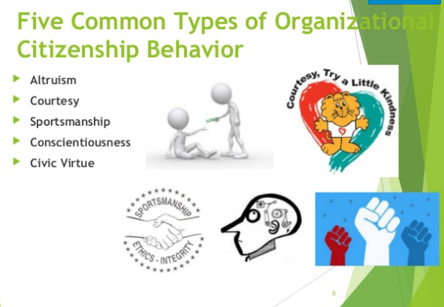
Types of OCB
There are various ways the employees can show organizational citizenship

Slide 4
Altruism
It is defined as the desire to help or assist another individual, while not expecting a compensation reward.
Example: An employee who drives his colleague to work when his car has broken down, while not expecting any compensation.
Volunteering work in special project
Voluntarily doing additional work

Slide 5
Courtesy
It is defined a polite and considerable behavior towards other people.
Sportsmanship defined as exhibiting no negative behavior when something does not go planned or when something is begin perceived annoying, difficult .
Conscientiousness is a behavior that suggest a reasonable level of self-control and discipline, which required in expected situation. Ex- coming to meeting on time, completion of project
Civic Virtue: how well an individual represent his organization with which he / she is associated, how well he / she support the organization.

