Slide 1
WAGE
Wage is fixed regular payment earned for work or services, typically paid on a daily or weekly basis.

Slide 2
Is there any difference between wage and salary?
Wage is best associated with employee compensation based on the number of hours worked multiplied by an hourly rate of pay.
Salary is best associated with employee compensation quoted on an annual basis.

Slide 3
TYPES OF WAGES
Subsistence wage: The wage that can meet only bare physical needs of a worker and his family.
Minimum wage: Minimum wage is the wage that is able to provide not only for bare physical needs but also some measure of education, health and other things.
Fair Wage: Fair wages is an adjustable step that moves up according to the capacity of the industry to pay, and the prevailing rates of wages in the area of industry.
Living wage: living wage is that which workers can maintain the health and a measure of comfort for his rest of life.

Slide 4
Classification of labourers
Unskilled
Semi skilled
Skilled
Highly skilled
Both central and state government issues notifications for minimum wages to be implemented in various sector of industry/work under their jurisdiction.
The wages constitute two components (Basic & VDA).
While the basic remains fixed for a defined period, the VDA gets on revising time to time on the basis of the average Consumer Price Index for the agriculture sector.

Slide 5
What are the nature of their jobs?
An unskilled worker is one who does operations that involve the performance of simple duties. It involves no independent judgment His work may thus require in addition to physical effort familiarity with variety of articles or goods.
A semiskilled worker is one who does work generally of defined routine nature wherein the major requirement is not so much of the judgment, skill. His work is thus limited to the performance of routine operations of limited scope.
A skilled worker is one who is capable of working efficiently of exercising considerable independent judgement and of discharging his duties with responsibility. He must posses a thorough and comprehensive knowledge of the trade, craft or industry in which he is employed.
A highly skilled worker is one who is capable of working efficiently and supervises efficiently the work of skilled employees.

Slide 6
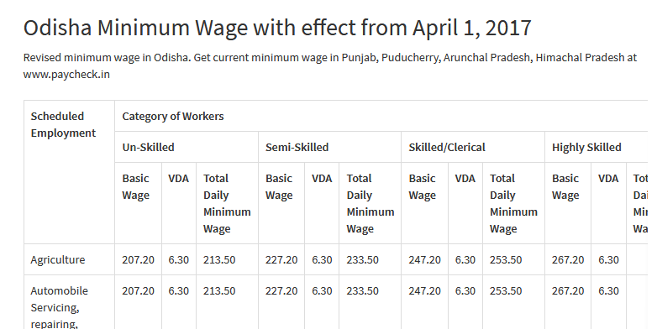
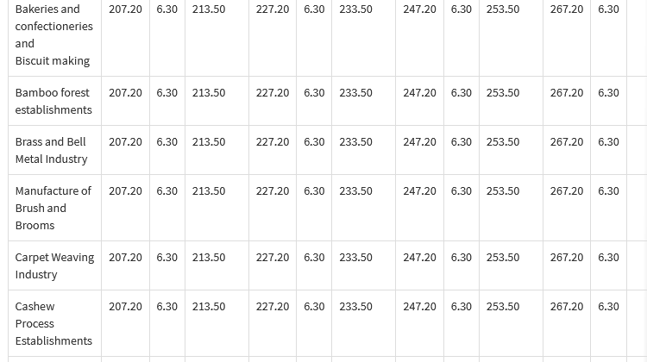

Slide 7
WAGE DIFFERENTIAL
These wage differentials are mostly the result of differences in worker ability and the workers' effort in performing the job.
Other reasons for wage differentials
Wage differential | reasons
Interpersonal differentials | Differentials in gender, age,skill,knowledge, experience.
Inter-occupational differentials | Varying requirements of skill, knowledge, demand-supply situation.
Inter-area differential | Cost of living, ability of employers to pay, demand and supply situation, extent of unionisation
Inter-firm differential | Ability of employer to pay, employees’ bargaining power, degree of unionisation, skill needs.

Slide 8
PAY STRUCTURE
Internal and external pay
Fixed vs. variable pay
Job vs. Individual pay
Below market vs. above market compensation
Open vs. secret pay

Slide 9
Job vs. Individual pay
Job: it decide the minimum and maximum values of each job independently of individual workers ignoring their abilities, potential and the ability to take up multiple job.
Individual pay: ( knowledge based pay)( skilled based): in this case employees are paid on the basis of the jobs they can handle.
Open Vs Secret pay
Open pay- equal pay- for equal work.
Secrecy pay serves to cover up inequities prevailing within the internal pay structure. Secrecy pay occurs when employer thin there is no link between pay and performance.

Slide 10
Below market vs. above market
Above the market: in high tech firms R & D workers might be paid better than their counterparts in the manufacturing division.
Blue chip firms such as HLL, Nestle, P&G, might pay above market compensation to certain group in order to attract the “ the cream of the crop”.
Below the market: firms paying below market tend to be small, young and non- unionized.

Slide 11
Types of Wage Payment
1) Time wage system,
2) Piece wage system, and
3) Balance or debt method:
Balance or debt method:
This a combination of time and piece wage system.
In this method, a worker is paid a fixed wage based on the time rate with a provision of piece wage method.
Suppose, the time wage is Rs. 500 per week and the piece wage rate is Rs. 10 per unit. As per his production, his wages during the 4 weeks in a month is….

Slide 12
Wage fund theories
CLASSICAL THEROIES OF WAGES
Subsistence theory
Wages fund theory
Residual claimant theory
Taussig ‘s theory

Slide 13
Subsistence theory was developed by Adam Smith- Father of Economics. According to Subsistence Theory Wages the level where a worker can satisfy his / her own needs as well as the needs of his / her family.
In case, the level of wage rises beyond the subsistence level, then the size of population would increase the supply of labour.
As a result, the wage level would again come down to the subsistence level. So, subsistence wage happens when increase in supply of labour.

Slide 14
Wage fund theory
Developed by J.S. Mill
Wage level depend on the quantity of the wage fund the number of people who are employed.
Level of wage = wage fund/ number of employees.
Level of wage increase when wage fund increase by keeping constant or decreasing no. of employees and vice versa.

Slide 15
Residual Claimant Theory
Developed by Walker – American economist.
Wages are the residual part of the capital left after paying to the factor of production.
According to residual claimant theory, wages are paid from the residual amount of total output left after paying for the three factors of production rent, interest and profit.

Slide 16
Tausig's Theory
Developed by Tausig – American economist.
Manufacturing of a product takes time and labour needs wages during the manufacturing process.
Wage given by the employer in this duration is called Taussig’s theory. Because the employer pay from his own capital.

Slide 17
According to wage law in India
Two governing body decide the wages of labourers
1. Wage Boards: it is a set up made by Government of India for fixation and revision of wages..
It consist chairman, two independent members, two-three representative of workers and each management.
Factors wage consider while fixing wage:
1.job evaluation
2.Wage rates in other industries
3.Employee’s productivity
4. Firm’s ability to pay.
2. Pay Commission: wages and allowances of Central and state government employees are determined through pay commission appointed by approximate government.

