Slide 1
Theories of International Trade and Investment

Slide 2
Contents
Theory of international trade and investment;
Implications of international trade and investment theories;
Existing status of global trade- volume and directions;
Nepal's foreign trade-an overview;
Foreign direct investment and portfolio investment-current status and global trends;
FDI and multinationals;
Contemporary issues in international trade, FDI and multinational companies.

Slide 3
India's Pharmaceutical Industry
One of the great success stories in international trade in recent years has been the strong growth of India's pharmaceutical industry. The country used to be known for producing cheap knockoffs of patented drugs discovered by Western and Japanese pharmaceutical companies. This made the industry something of an international outsider.
Since they made copies of patented products, and therefore violated intellectual property rights, Indian companies were not allowed to sell these products in developed markets. With no assurance that their intellectual property would be protected, foreign drug companies refused to invest in, partner with, or buy from their Indian counterparts, further limiting the business opportunities of Indian companies.

Slide 4
In developed markets such as the United States, the best that Indian companies could do was to sell low-cost generic pharmaceuticals (generic pharmaceuticals are products whose patent has expired).
In 2005, however, India signed an agreement with the World Trade Organization that bought the country into compliance with WTO rules on intellectual property rights. Indian companies stopped producing counterfeit products.
 Now that companies
their patents would be respected, started to do business with their
foreign Indian
counterparts. For India, the result has been dramatic growth in its pharmaceutical sector.

Slide 5
The sector generated sales of close to $24 billion in 2010, more than double the figure of 2005. Driving this growth have been surging exports. In 2000 pharmaceutical exports from India amounted to about $1 billion.
By 2010, the figure was nearing $10 billion. Much of this growth has been the result of partnerships between Western and Indian firms. Western companies have been increasingly outsourcing manufacturing and packaging activities to India.
India's advantages in manufacturing and packaging include relatively low wage rates, an educated workforce, and the widespread use of English as a business language.

Slide 6
Theories of international trade and investment
An international business theory must look at the distribution of gains from international business activities between the firms involved and the Governments in each country and between (or among) relevant Governments
When Governments wish to redistribute the costs and benefits of international business activities, they impose policies which firms must take into account in their decision- making-and this action/reaction environment is the subject that IB theory must explain.

Slide 7
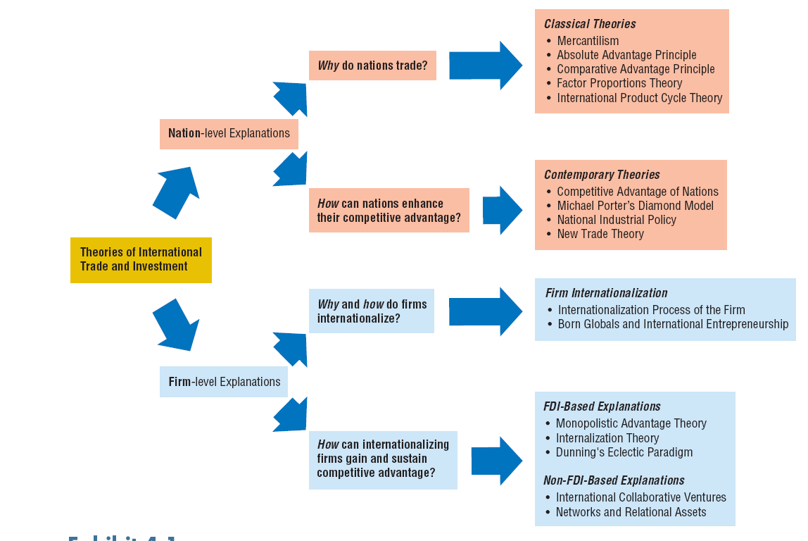

Slide 8
Mercantilism Theory
The first theory of international trade, mercantilism, emerged in England in the mid sixteenth century.
Prevailed and developed from 1400 to 1770 AD.
Systematically developed by an Italian Economist Antonio Serra.
The principle assertion of mercantilism was that gold and silver were the mainstays of national wealth and essential to vigorous commerce. At that time, gold and silver were the currency of trade between countries; a country could earn gold and silver by exporting goods.

Slide 9
The main belief of mercantilism is to maintain a trade surplus, to export more than it imported. By doing so, a country would accumulate gold and silver and, consequently, increase its national wealth, prestige, and power.
Economic assets, or capital, are represented by bullion (gold, silver, and trade value) held by the state, which is best increased through a positive balance of trade with other nations (exports minus imports).
Mercantilism suggests that the ruling government should advance these goals by playing a protectionist role in the economy, by encouraging exports through subsidies and discouraging imports, especially through the use of tariffs and quota.

Slide 10
Doctrine ( teachings)
Mercantilism, as a creator of surplus, is the means to strengthen political power by making strong nation or government.
Philosophy is that political power can be achieved by wealth.
A strong government with wealth can improve wealth of the citizen.
State intervention is an essential part of Mercantilism.

Slide 11
Criticism
The flaw with mercantilism was that it viewed trade as a zero-sum game. (A zero sum game is one in which a gain by one country results in a loss by another.)
Adam Smith and David Ricardo showed the shortsightedness of this approach and demonstrated that trade is a positive- sum game, or a situation in which all countries can benefit.
Adam Smith attempted to destroy the philosophy by introducing the concept of “free trade” saying let the people trade as they saw fit.

Slide 12
Absolute Advantage
In his 1776 landmark book The Wealth of Nations, Adam Smith attacked the mercantilist assumption that trade is a zero-sum game. Smith argued that countries differ in their ability to produce goods efficiently.
According to Smith, countries should specialize in the production of goods for which they have an absolute advantage and then trade these for goods produced by other countries.

Slide 13

Suppose Nepal and India each have two units of input to use to produce rice and clothing. Each country uses one input to produce each product. From each unit of input, the following quantities of rice and clothing can be produced.
In the above case, Nepal has an absolute advantage in rice production over India (i.e. 30: 10 or 3:1). India has an absolute advantage in clothing production over Nepal (i.e. 40:20 or 2:1)
When Nepal traders come to know that 30 units of rice can buy more than 20 units of clothing in India, they would to like to jump to exchange with Indian clothing manufactures.

Slide 14
Criticism
It is applicable only in the case of 2 goods and 2 country model.
Assumption of this theory is not practical such as Labour is only basis of cost calculation. There is no transportation cost in trade between the countries etc.
Adam could not give any solution to the countries having absolute cost disadvantage in production of both the goods.

Slide 15
Comparative Advantage Theory
A comparative advantage gives a company the ability to sell goods and services at a lower price than its competitors and realize stronger sales margins.
David Ricardo stated a theory that other things being equal a country tends to specialize in and exports those commodities in the production of which it has maximum comparative cost advantage or minimum comparative disadvantage. Similarly the country's imports will be of goods having relatively less comparative cost advantage or greater disadvantage.

Slide 16
Ricardo's Assumptions:-
There are two countries and two commodities.
There is a perfect competition both in commodity and
factor market.
Cost of production is expressed in terms of labor i.e. value of a commodity is measured in terms of labor hours/days required to produce it. Commodities are also exchanged on the basis of labor content of each good.
Labor is the only factor of production other than natural resources.
Perfect occupational mobility of factors of production - resources used in one industry can be switched into another without any loss of efficiency

Slide 17
Ricardo's Example
On the basis of above assumptions, Ricardo explained his comparative cost difference theory, by taking an example of England and Portugal as two countries & Wine and Cloth as two commodities.
As pointed out in the assumptions, the cost is measured in terms of labor hour.The principle of comparative advantage expressed in labor hours by the following table.

Slide 18
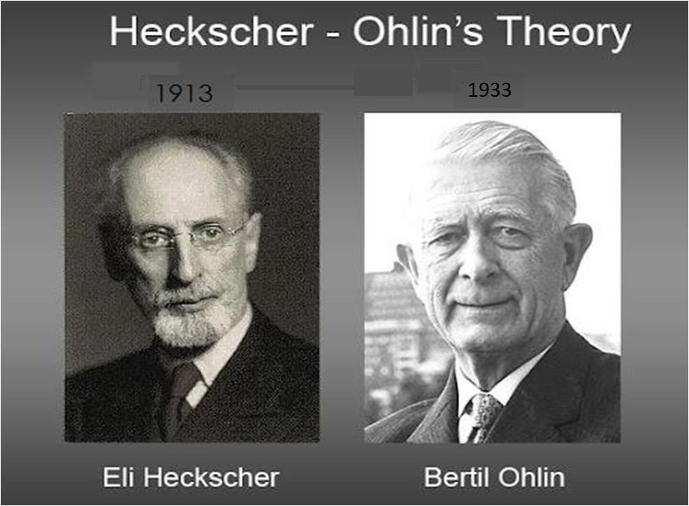

Slide 19
Heckscher-Ohlin Theory
Θ This theory is based on a different explanation of comparative advantage
put forward by Swedish economists Eli Heckscher and Bertil Ohlin.
Θ It is also called factor-proportions theory, factors in relative abundance are cheaper than factors in relative scarcity.
Θ They stated that comparative advantage arises from differences in national factor endowments.
Θ Factor Endowment:
“It is the extent to which a country is bestowed with such resources as land, labor and capital.”
Θ Countries have varying factor endowments and different factor endowments explain differences in factor costs, abundance of a factor lowers its cost.

Slide 20
Global Implication of Heckscher-Ohlin Theory
It implies that a country will export goods that use locally abundant factors intensively, and import goods that use its scarce factors intensively.
In the two-factor case, it states: “A capital-abundant country will export the capital-intensive good, while the labor-abundant country will export the labor-intensive good.”

Slide 21
Global Implication of Heckscher-Ohlin Theory
(Cont’d)
The relative abundance in capital will cause the capital-abundant country to produce the capital-intensive good cheaper than the labor-abundant country and vice versa.
Pattern of trade in world economies:
United States is the most capital-abundant country in the world by any criterion, exhibits low cost capital and imports labor-intensive products. It is also a substantial exporter of agricultural goods by virtue of its abundant arable land.
China leads the world in the export of goods produced in labor- intensive manufacturing industries, such as textile and footwear.This reflects China’s relative abundance of low cost labor.

Slide 22
Practical Examples in Purview of Factor Relationships
Land-Labor Relationship:
In Hong Kong and Netherlands land prices are very high because it is in demand, it is why neither Hong Kong nor Netherland excels in the production of goods requiring large amounts of land such as wool or wheat. Australia and Canada produce these goods because land is abundant compared to the number of people .
Labor-Capital Relationship:
In countries where there is little capital available for investment and where the amount of investment per worker is low, managers might expect cheap labor rates and export competitiveness in products requiring large amounts of labor relative to capital.
Iran, (where labor is abundant compared to capital) excels in the production of homemade carpets.
Exports of emerging economies, show a high intensity of less skilled labor.

Slide 23
Differentiating Heckscher-Ohlin Theory from Comparative Advantage
Like David Ricardo’s theory it also argues that free trade is
beneficial.
Unlike absolute concept of comparative advantage, however, Heckscher-Ohlin theory argues that the pattern of international trade is determined by differences in factor endowments, rather than differences in productivity.

Slide 24
Leontief Paradox: An extension to Heckscher-Ohlin Theory
 American economist Dr.Wassily Leontief tested H-O theory under
U.S.A conditions. He found out that U.S.A exports labor intensive goods and imports capital intensive goods, but U.S.A being a capital abundant country must export capital intensive goods and import labor intensive goods than to produce them at home.This situation is called Leontief Paradox which negates H-O Theory.

Slide 25
The Product Life-Cycle Theory
The product life-cycle theory was put forward by Raymond Vernon in the mid 1960s.
According to the PLC theory of trade, the production location for many products moves from one country to another depending on the stage in the product’s life cycle.
It was based on the observation that most of twentieth century a large proportion of world’s new products had been developed by US firms are sold in US markets first (e.g. mass-produced automobiles, televisions, instant cameras, photocopiers, PCs and semiconductor chips).
Vernon argued that wealth and size of U.S Market gave U.S firms a strong incentive to develop new products.

Slide 26
Product Life-Cycle Stages
1.Introduction:
Innovation in response to observed need
Exporting by the innovative country
Evolving product characteristics
2.Growth:
Increase in exports by the innovating country
More competition
Increased capital intensity
Some foreign production (outsourcing)

Slide 27
Product Life-Cycle Stages
(cont’d)
3.Maturity:
Decline in exports from the innovating country
More product standardization
More capital intensity
Production start-ups in emerging economies
4.Decline:
Concentration of production in emerging economies ( The term of
“Rising South”)
Innovating country becoming net importer

Slide 28
Stage 1: INTRODUCTION
Innovation, Production, and Sales in Same Country
Products are developed because there is a nearby observed need and market for them.
Once a firm has created a new product theoretically it can manufacture that product anywhere
in the world.
However early production occurs domestically to obtain rapid feedback and to reduce transportation cost.
Location and Importance of Technology
Companies use technology to create new products and new ways to produce old products,
both of which can give them competitive advantage.
50 companies worldwide that spend most on R&D are all headquartered in industrial countries. (R&D Scoreboard, Financial Times, June 25,1998)
Dominant position of industrial countries is due to competition, demanding consumers, the
availability of scientists and engineers and high incomes.

Slide 29
Stage 2: GROWTH
As sales of the new product grow, competitors enter the market.
Demand grows substantially in foreign markets, particularly in other
industrial countries.
Demand may be sufficient to justify producing in some foreign markets to reduce or eliminate transportation charges.
Rapid sales growth at home and abroad compels firms to develop process technology.
The original producing country will increase its exports in this stage but lose certain key exports markets in which competitors commence local production.

Slide 30
Stage 3: MATURITY
At the maturity stage, worldwide demand begins to level off, although it may be growing in some countries and declining in others.
Product models become highly standardized, making cost an important competitive weapon.
There are incentives to begin moving plants to emerging markets where unskilled, inexpensive labor is efficient for standardized processes. It reduces per unit cost for their output.The lower per unit cost creates demand in emerging markets.
Exports decrease from the innovating country as foreign production displaces it.

Slide 31
Stage 4: DECLINE
As a product moves to the decline stage, those factors occurring during the mature stage continue to evolve.
The markets in industrial countries decline more rapidly than those in emerging markets as rich customers demand ever-newer products.
The country in which the innovation first emerged and exported from, becomes the importer.

Slide 32
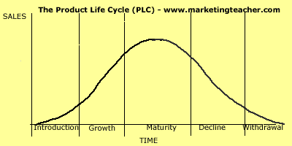
Graphical Interpretation

Slide 33
Verification of PLC Theory along Examples
The PLC theory holds that the location of production to serve world markets shifts as the production move through their life cycle.
Products such as ballpoint pens and portable calculators have followed this pattern. They were first produced in a single industrial country and sold at high price.Then production shifted to multiple industrial country locations to serve those local markets.
Finally, most production is in emerging markets, and prices have declined

Slide 34
Limitations of PLC Theory
Why shift in production location do not take place for some products?
Products that, because of very rapid innovation, have extremely short life cycles, which make it impossible to achieve cost reduction by moving production from one country to another. For example product obsolescence occurs so rapidly for many electronic products.
Luxury products for which cost is of little concern to the consumer.
Products for which a company can use a differentiation strategy, perhaps though advertising, to maintain consumer demand without competing on the basis of price.
Products that require specialized technical labor to evolve into their next generation. This seems to explain the long term U.S. dominance of medical equipment production and German dominance in rotary printing press.

Slide 35
Porter’s Diamond
Michael E. Porter is a prominent economist and a Harvard Business School fellow. His popularized works are competitive advantage and five forces model .
It explains why MNCs go worldwide.The Porter’s diamond shows the interaction of four conditions that usually need to be favorable if an industry in a country is to gain a global competitive advantage.
Porter analyzed case studies of more than 100 firms and found that the firm that succeeds in global markets first succeeded in intense domestic competition.

Slide 36
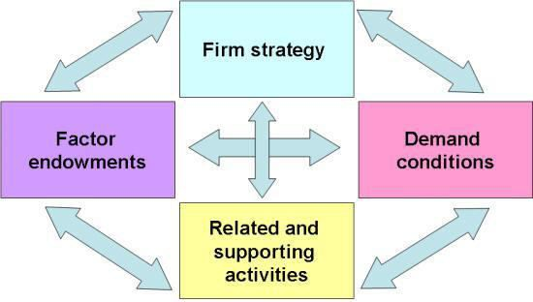
Determinants of Global Competitive Advantage

Slide 37
Demand Conditions
Demand conditions in the home market can help companies create a competitive advantage, when sophisticated home market buyers pressure firms to innovate faster and to create more advanced products than those of competitors.
Size of Market
Sophistication(superiority) of consumers
Media exposure of products
Japan’s electronic products are regarded at high value around the globe.

Slide 38
Factor Endowments
Factor conditions are human resources, physical resources, knowledge resources, capital resources and infrastructure.
Specialized resources are often specific for an industry and important for its competitiveness. Specific resources can be created to compensate for factor disadvantages.
Abundance of Natural Resources
Education and Skill Levels
Wage Rates
Netherland enjoys 59% share of the world’s cut-flower market.

Slide 39
Related and Supporting Industries
Related and supporting industries can produce inputs which are important for innovation and internationalization. These industries provide cost-effective inputs, but they also participate in the upgrading process, thus stimulating other companies in the chain to innovate
 Existence of supplier clusters
German engineering firms such as Siemens are world leaders in sophisticated engineering products.

Slide 40
Firm Strategy, Rivalry and Structure
Firm strategy, structure and rivalry constitute the fourth determinant of competitiveness.The way in which companies are created, set goals and are managed is important for success. But the presence of intense rivalry in the home base is also important; it creates pressure to innovate in order to upgrade competitiveness
More number of companies in same industry.
Intensity of competition.
Public or private ownership.
Italian shoes are in vogue(fashion) in every nook and corner of the world since decades.

Slide 41
New Trade Theory
New trade theory, developed by many theorists from the late 1970 to early 1980s, is a collection of economic models in international trade. It focuses on increasing return to scale and network effect.
Economies of scale are an important factor in some industries for superior international performance – even when the nation has no clear comparative advantage. Some industries succeed best as their volume of production increases.
Examples: commercial aircraft, automobiles, pharmaceuticals all have very high fixed costs that require high-volume sales to achieve profitability.

Slide 42
Theories of International Investment (FDI-Based Theories)
Ownership Advantage Theory
Contemporary theory explains that “FDI would not occur under perfect competition and under approximately competitive conditions.” According to market imperfection theory, the FDI is made by firms in oligopolistic industries possessing technical and other advantages over indigenous firms.
Key sources of monopolistic advantage include proprietary knowledge, patents, unique know-how, and sole ownership of other assets, economies of scale, superior knowledge in marketing, management or finance.

Slide 43
Internalization Theory
Explains the process by which firms acquire and retain one or more value-chain activities inside the firm – retaining control over foreign operations and avoiding the disadvantages of dealing with external partners
The concept of internalization theory is to transfer the superior knowledge to foreign subsidiary and obtain higher return or fee on its investment. It comes into contract and provide authority to use its competitive advantages in the form of license,
43
franchise or other form.

Slide 44
Dunning’s Eclectic Paradigm
Three conditions also known as OLI model determine whether or not a company will go abroad via FDI:
Ownership-specific advantages – knowledge, skills, capabilities, relationships, or physical assets that form the basis for the firm’s competitive advantage
Location-specific advantages – advantages associated with the country in which the MNE is invested, including natural resources, skilled or low cost labor, and inexpensive capital
Internalization advantages – control derived from internalizing foreign-based manufacturing, distribution, or other value chain activities
44

Slide 45
NON-FDI BASED EXPLANATIONS:
International Collaborative Ventures
While FDI-based internationalization is still common, beginning in the 1980s firms have emphasized non-equity, flexible collaborative ventures to internationalize.
Collaborative venture: a form of cooperation between two or more firms.Through collaboration, a firm can gain access to foreign partner’s know-how, capital, distribution channels, and marketing assets, and overcome government imposed obstacles.
Venture partners share the risk of their joint efforts, and pool resources and capabilities to create synergy.
45

Slide 46
Two Types of
International Collaborative Ventures
Equity-based joint ventures result in the formation of a new legal entity. Here, the firm collaborates with local partner(s) to reduce risk and commitment of capital.
Project-based alliances involve cooperation in R&D, manufacturing, design, or any other value-adding activity, a partnership aimed at a narrowly defined scope of activities and timeline
46

Slide 47
Implications of international trade and investment theories
It can be grouped into three concepts:
Location Implication: Disperse production activities to countries where they can be performed most efficiently. Business person go for production where the efficiency of productive forces is higher and profit is high. This is explained by comparative advantage and HO models.
First mover Implication: The first mover strategist would engage in substantial financial involvement when product is new or market is new as explained by product life cycle and ownership advantage theories.
47

Slide 48
 Policy Implication: In reality, the competitiveness can be achieved by the joint efforts of private and public participation in building competitive strength of the business community as well as nations. This is explained by Porter’s Diamond Theory. Both must invest to upgrade their production and supportive factors.
48

Slide 49
References
International Business by Charles W. L. Hill
International Business by Arhan Sthapit
International Business by Murari Prasad Gautam
Economics by Paul A. Samuelson and Nordhaus
Wikipedia - www.wikipedia.org
www. slideshare. net
49

Slide 50

50

