Slide 1


Foreign Institutional Investors
And it’s impact on India

Slide 2
CONTENTS:
SR NO. | TOPIC
1 | Introduction
2 | How FII started in India?
3 | Entry Options for FII Who can be registered How to apply Eligibility criteria Registration process
4 | Investment restrictions
5 | Policies and Regulations
6 | FII vs. FDI
7 | Advantages of FII
8 | Disadvantages of FII
9 | Current trends in market (current scenario)
10 | Impact of FII on India
11 | Conclusion and Suggestion
12 | Bibliography

Slide 3

Introduction

Slide 4
Foreign Investments
Investments made by residents of a country in another country

Slide 5

Foreign Direct Investment (FDI)
Foreign Entity wants to enter in the Indian Market
But HOW?
Portfolio Investment Scheme ( PIS)→FII

Slide 6

How FII started in India?
India opened its stock market to foreign investors in September 1992
Since 1993, received portfolio investment from foreigners in the form of foreign institutional investment in equities.
This has become one of the main channels of FII in India for foreigners.
In order to trade in Indian equity market foreign corporations need to register with SEBI as Foreign Institutional Investor (FII).

Slide 7

What Is FII?
Foreign institutional investor means “an institution
established or incorporated outside India which proposes to make investment in India in securities
It is used most commonly in India to refer to outside companies investing in the financial markets of India.

Slide 8
Who Can Be Registered As An FII?
One who propose to invest their proprietary funds or on behalf of "broad based" funds or of foreign corporates and individuals and belong to any of the under given categories can be registered for FII.
Pension Funds
Mutual Funds
Investment Trust
Insurance or reinsurance companies
Bank

Slide 9


An application for registration has to be made in form A, the format of which is provided in the SEBI(FII) regulations, 1995 and submitted with under mentioned documents in duplicate addressed to SEBI as well as to reserve bank of India (RBI) and sent to the following address within 10 to 12 days of receipt of application.
Address for application the division chief
FII division
securities and exchange board of India, 224, Mittal court, 'B' wing, 1st floor, Nariman point, Mumbai - 400 021.
India.

Slide 10

The Eligibility Criteria For Applicant
As per Regulation 6 of SEBI (FII) Regulations,1995, Foreign Institutional Investors are required to fulfill the following conditions to qualify for grant of registration
Applicant should have track record, professional competence, financial soundness, experience, general reputation of fairness and integrity
The applicant should be regulated by an appropriate foreign regulatory authority in the same capacity/category where registration is sought from SEBI. Registration with authorities, which are responsible for incorporation, is not adequate to qualify as Foreign Institutional Investor

Slide 11


The applicant is required to have the permission under the provisions of the Foreign Exchange Management Act, 1999 from the Reserve Bank of India.
Applicant must be legally permitted to invest in securities outside the country or its in-corporation / establishment.
The applicant must be a "fit and proper" person.
The applicant has to appoint a local custodian
Payment of registration fee of US $ 5,000.00

Slide 12


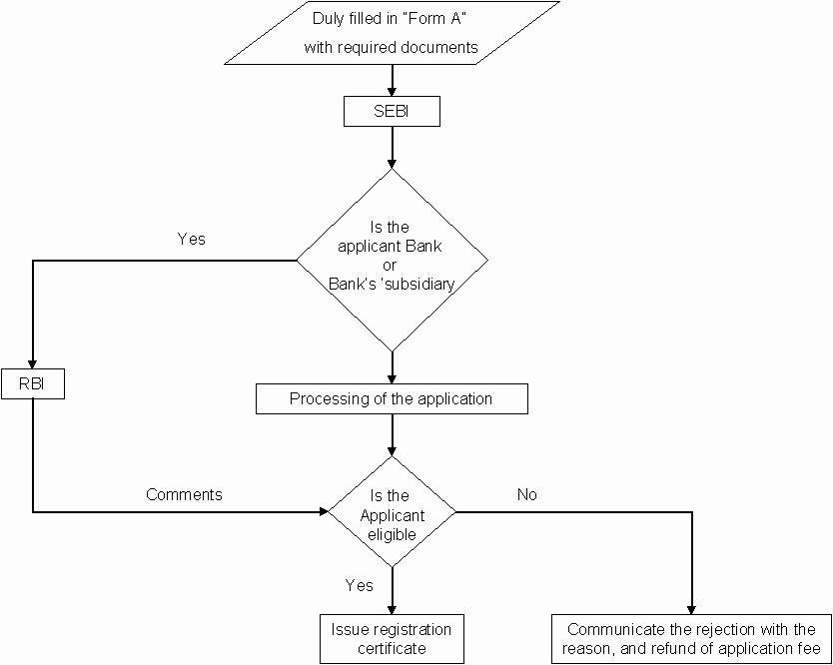

Slide 13
Where FII Can Invest?
Current financial instruments are available for FII investments
Securities in primary and secondary markets including shares, debentures and warrants of companies, unlisted, listed or to be listed on a recognized stock exchange in India
Units of mutual funds
Dated Government Securities
Derivatives traded on a recognized stock exchange
Commercial papers

Slide 14

FIIs can buy/sell securities on Indian stock exchanges, but they have to get registered with stock market regulator SEBI.
They can also invest in listed and unlisted securities outside stock
exchanges if the price at which stake is sold has been approved by RBI.
No individual FII/sub-account can acquire more than 10% of the paid up capital of an Indian company.
In addition, the government also introduces new regulations from time to time to ensure that FII investments are in order. For example, investment through participatory notes (PNs) was curbed by SEBI recently.
The opening of the Indian stock market to Foreign Institutional Investors (FII) in 1992 made way for substantial foreign funds. Since then, the number of FIIs has been increasing to 740 currently.

Slide 15

Regulation of FIIs
The regulations for foreign investment in India have been framed by the
Reserve Bank of India.
In line with the said regulations, since 2003, the Securities and Exchange Board of India (SEBI) has been registering FIIs and monitoring investments made by them through the portfolio investment route under the SEBI (FII) regulations 1995.
SEBI acts as the nodal point in the registration of FIIs.

Slide 16
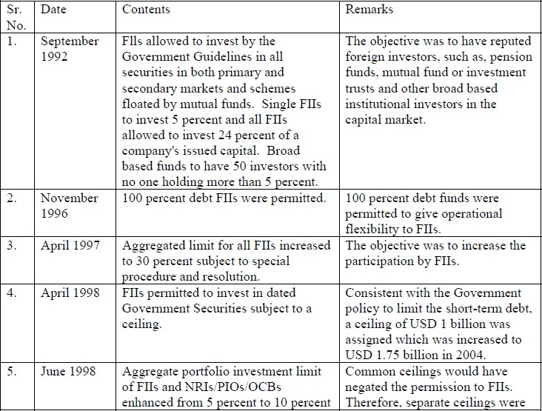

Slide 17
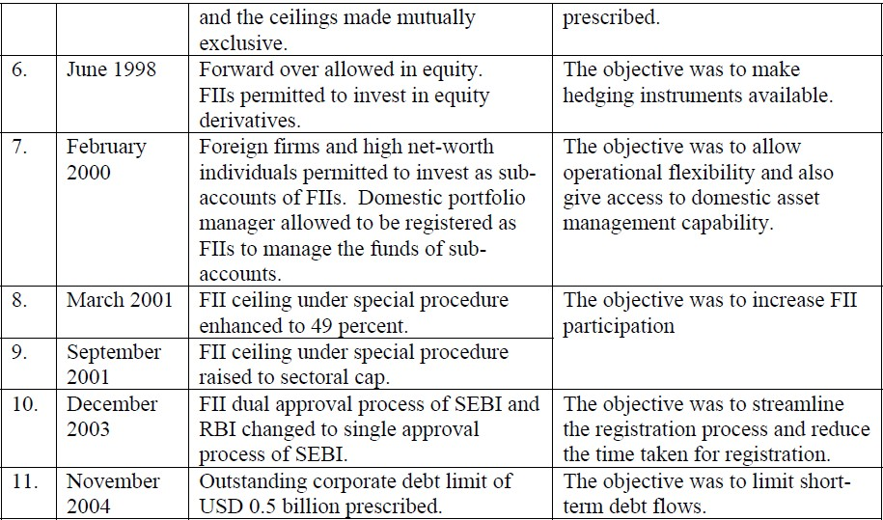

Slide 18

Where FDI is a bit of a permanent nature, FII flies away at the shortest political or economical disturbance
Entry and Exit is relatively very easy for an FII as compared to FDI. Entry difficult for FDI because of infrastructure problems. Exit more difficult because of archaic labor laws
have been blamed for exacerbating small economic problems in a country by making large and concerted withdrawals at the first sign of economic weakness.

Slide 19






FDI is more desirable than portfolio investment because the investments there under are made directly in the capital of the company and not in the secondary market
FDI helps in increasing production and employment , FII does not affect production and employment .
FII investment is frequently referred to as hot money for the reason that it can leave the country at the same speed at which it comes in, in case of FDI it does’nt

Slide 20

. FIIs would be required to obtain an initial registration with SEBI to enter the market nominee companies, affiliated and subsidiary companies of an FII will be treated as separate FIIs for registration and may seek separate registration with SEBI
Since there are foreign exchange controls in force, FIIs shall also seek various permissions under FERA from the RBI, both SEBI and RBI registration will be under a single window approach
SEBI’s initial registration would be valid for 5 years. RBI’s general permission under FERA to the FII will also hold well for five years, both will be renewable for similar five periods later on.

Slide 21

Herding and positive feedback trading
BOP vulnerability
Possibility of taking over companies or backdoor control
Money laundering

Slide 22

In the past four years there has been more than $41 trillion worth of FII funds invested in India.
This has been one of the major reasons on the bull market witnessing growth with the BSE Sensex rising 221%
The present downfall of the market too is influenced as these FIIs are taking out some of their invested money.
For long-term value investors, there’s little because for worry but short term traders are adversely getting affected by the role of FIIs are playing at the present.

Slide 23


FII do have significant impact on the Indian Stock Market but there are other factors like government policies, budgets, bullion market, inflation, economical and political condition, etc. do also have an impact on the Indian stock market.
Also FII is not the only factor affecting the stock indices. There are other major factors that influence the stock market.
Nowadays FIIs are the major contributors to the stock markets. The pros of allowing FIIs to invest in the Indian markets far outweigh the cons.
It is up to the policy makers of India to allow FIIs to operate and provide them with more opportunities and reasons to invest in Indian markets.

Slide 24
SUGGESTIONS
Simplifying procedures and relaxing entry barriers for business activities and providing investor friendly laws and tax system for foreign investors.
Allowing foreign investment in more areas.
In different industries indices the FIIs should be encouraged
We have to modernize and also have to save our culture. Similarly the laws should be such that it would protect domestic investors and also promote trade in country through FIIs.
Encourage industries to grow to make FIIs an attractive junction to invest.

Slide 25
Bibliography
www.google.com
http://rbi.org.in/Scripts/BS_FemaNotifications.aspx?Id=174
http://rbi.org.in/Scripts/BS_FemaNotifications.aspx
http:/www.sebi.gov.in/sebiweb/investment/statistics.jsp?=fii
http://www.iosrjournals.org/iosr-jbm/papers/Vol5-issue1/A0510104.pdf
http://www.nseindia.com/education/resources/download/ismr2008ch8.pdf
Foreign Institutional Investor (FII) - Arthapedia
www.arthapedia.in
The importance of FII investments for the Indian market - Business Today
http://currentaffairs-businessnews.com/category/international-business/ is not available
currentaffairs-businessnews.com
After months, liquidity edges towards surplus - Money - DNA
www.dnaindia.com
How to fix the economy, And soon - Money - DNA
Sensex falls for 2nd day on profit-booking, down 80 points - Money - DNA
Nifty surges as concerns over Fed's stimulus tapering recede - Money - DNA
Sensex rallies 601 points as Fed delays stimulus tapering - Money - DNA
scraps debt limit auction to lure FIIs to gilts - Money - DNA

Slide 26


Slide 27
GROUP MEMBERS:
ANUBHAV LAL 13007
HETANSHI DESAI 13030
HIMANI CHOWHAN 13031
ISHA AGGARWAL 13033
PALAK AGRAWAL 13047
SAYALEE DEORE 13061

