Slide 1






International Business Management
Year : II Semester : IV
Unit 2: International Trade and Investment
References:
1. International Business : K
Aswathappa
2. International Business-
competing in the global market :
Charles W L Hill and Arun K Jain
1

Slide 2
Promotion of global business
The role of WTO and GATT
Multilateral negotiations and agreements
VIII & IX, round discussions and agreements
Challenges for global business
Global trade and investment
Theories of International trade and International
investment
Need for global competitiveness
Regional trade block-Types-Advantages and
Disadvantages
RTBs across the globe-brief history
2

Slide 3

Promotion of global business
International business development evolves through the
normal processes of trade, foreign direct investment, capital flows, migration, and the advancement of technology in undeveloped nations
Huge growth opportunities created by the emerging middle class of nations such as Brazil, Russia, India, and China (the BRIC countries), many companies in the developed world are stepping in to provide goods and services to those countries'
3

Slide 4
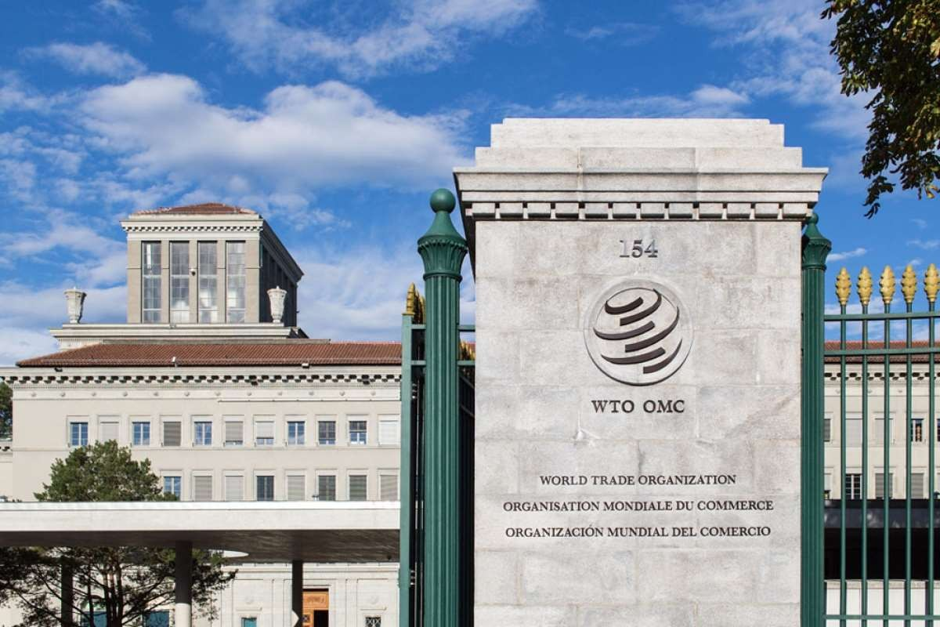





WTO – World Trade Organization, Geneva, Switzerland
4

Slide 5




WTO – World Trade Organization
₁st
 WTO established on Jan 1995 as
result of Uruguay round negotiations on 15th Dec 1993
“Marrakesh declaration” of 15th April 1994
WTO – embodiment of Uruguay round results and Successor of GATT present members stands at 153
5

Slide 6

Origin of WTO
ITO (International trade organization) was recommended by Bretton woods conference in 1944 along with World bank and IMF
ITO was not established, but instead GATT was established by US,UK and some countries in1947 (Rich men’s club)
UN appointed a committee and UNCTAD(United nations conference on trade and development) in 1964
And finally In Uruguay round negotiations, WTO setup on 1995 based in Geneva, Switzerland
6

Slide 7

Objectives of WTO
 The WTO reiterates the objectives of GATT
Promote trade flows by encouraging nations to adopt nondiscriminatory and predictable trade policies
Raising standard of living and incomes, promoting full employment, expanding production and trade and optimum utilization of world’s resources
Introduce sustainable development-a concept which envisages that development and
environment can go together
7

Slide 8


Contd…
Taking positive steps to ensure that
developing countries, especially the least developed ones, secure a better share of growth in world trade
Establish procedures for resolving trade disputes among members
8

Slide 9

 | Negotiation Rounds
Date |  | Name (Rounds) | Outcome | No. of countries
1947 |  | Geneva round | 45,000 tariff concession representing half of world trade | 23
1949 |  | Annecy round | Modest tariff reduction | 13
1950-51 |  | Torquay round | 25% of tariff reductions in relation to 1948 level | 38
1955-56 |  | Geneva round | Modest tariff reduction | 26
1961-62 |  | Dillon round | Modest tariff reduction | 26
1963-67 |  | Kennedy round | Average tariff reduction of 35 % Industry prdt, modest for Agriculture prdt and antidumping code | 62
1973-79 |  | Tokyo round | Average tariff reduction of 34 % Industry prdt, Non tariff trade barrier code | 102
1986-94 |  | Uruguay round | Tariffs, non tariff measures, rules, services, IPR, dispute settlement, Creation of WTO | 123
2001 |  | Doha round | Tariffs on goods, non-agricultural market access, trade facilitation and negotiation | 150 ₉

Slide 10

Functions of WTO
 Administering and implementing lateral trade agreements
multilateral and pluri-
Acting as a forum for multilateral trade negotiations
Seeking to resolve trade disputes
Overseeing national trade policies
Co-operating with other international agencies
Maintaining trade related database
Acting as a watchdog of international trade
Acting as management consultant for world trade
Technical assistance for developing countries

Slide 11

GATT and WTO
The GATT was a set of rules, a multilateral agreement
The WTO is a permanent institution with its own secretariat
The GATT rules applies to trade in merchandise goods
The WTO covers trade in service and trade related aspects of IPR

Slide 12

The WTO structure
WTO is entrusted to a no. of subsidiary bodies; principally the General Council
The General council also convenes in two forms – Dispute settlement body and Trade policy review body
Three bodies are established by ministerial conference who report to General council:
Committee on trade and development
Committee on balance of payment

Slide 13

Principles of WTO
Transparency
MFN(most favored nation) treatment
National Treatment: Non discrimination within a country
Free trade principle
Dismantling trade barriers
Rule-based trading system
Treatment for LDCs (Least developed countries)
Competition principle
Environment Protection

Slide 14

Key subjects in WTO
Agriculture
Health and safety measures
Helping least developed and food importing countries
Textiles and clothing
TRIPS (Trade related intellectual property rights)
TRIMS (Trade related investment measures)
GATS (General agreement on trade in
14

Slide 15


Uruguay and Doha rounds of negotiations and agreements
 The agreement fall into structure with six main parts:
The agreement establishing the WTO
Goods and investment – Multilateral agreements on trade in goods and TRIMS
Services – GATS
Intellectual property – TRIPS
Dispute settlement – DSU
Reviews of government trade policies’

Slide 16


Challenges for global businesses
Cross-cultural differences
Legal environment and government policies
Economic stability of nations
Political unrest
Tariff and non tariff barriers

Slide 17

Overview of trade theory
Free trade refer to a situation where a government doesn’t attempt to influence through quotas or duties, what its citizen can buy from another country or what they can produce and sell to another country
The theories of Smith, Ricardo and Heckscher-Ohlin help to explain the pattern of international trade

Slide 18

Trade theories
Absolute advantage
Comparative advantage
Heckscher-Ohlin theory
The Leontief paradox
The product life-cycle theory
New trade theory
National competitive advantage – Porter’s diamond

Slide 19

Mercantilism
The first theory of international trade emerged in England in the mid 16th century
The main tenet of Mercantilism was that it was in a country’s best interests to maintain a trade surplus

Slide 20

Comparative theory
Comparative advantage is an economic theory about the potential gains from trade for individuals, firms or nations that arise from the differences in their factors endowments or technological progress
David Ricardo developed the classical theory of comparative advantage in 1817

Slide 21
 Ricardo’s theory implies that comparative advantage rather than absolute advantage is responsible for
much of international trade
Hours of work necessary to produce one unit
Country | Cloth | Wine
England | 100 | 120
Portugal | 90 | 80

Slide 22





Heckscher-Ohlin Model (H-O model)
General equilibrium mathematical model of international trade, developed by Eli Heckscher and Bertil Ohlin
Builds on David Ricardo theory of comparative advantage by predicting patterns of commerce

Slide 23

2*2*2 Model
The original H-O model assumed that the only difference between countries was the relative abundances of labor and capital
The model contains two countries (homogenous factors of production) 2*2*2 model
The model has “variable factors proportions” between countries – highly developed countries have a comparatively high capital: labor ratio than developed countries

Slide 24




FDI – Foreign Direct Investment
FDI refers to the purchase of a significant number of shares of a foreign company in order to gain certain degree of management control
FDI flows:
Capital formation
Formation of new firms and factories
Increase in equity holdings in the existing firms
Mergers and acquisition of existing firms and factories

Slide 25
Factors influencing FDI
 Supply
 Demand Factors
 Political Factors
Factors
Customer access
Competitiv e advantage
Follow the clients
4. Follow the rivals
1. Productio
Economic priorities
Avoidance of trade barriers
Developmen t incentives
n costs
2. Logistics
3. Natural
resources _{3.}
4. Key
technolog y

Slide 26

FDI policy initiatives
 FDI not allowed
Retail trading except single brand retailing
Atomic energy
Lottery business
Gambling and betting sector
Business of chit fund and Nidhi company

Slide 27
FDI up to 24 percent allowed
1. Manufacture of items reserved for small sector
FDI up to 26 percent allowed
FM broadcasting
Up linking news and TV channels
Defense production with prior government approval
Insurance
FDI up to 49 percent allowed
Broadcasting
Scheduled air transport services

Slide 28
FDI up to 51 percent allowed
1. Single brand product retailing subject to prior approval
FDI up to 74 percent allowed
Private sector banking
Telecommunication services FDI up to 100 percent allowed
Trading
Courier services
Cigar and cigarette manufacture

Slide 29



RTB – Regional trade blocks
A regional trade block is the result of economic integration of various trading areas of different countries and it is also known as trade blocks, regional trade organizations and regional groupings
A trade block is a type of intergovernmental agreement, where regional barriers to trade (tariff and non-tariff) are reduced or eliminated among
the participating countries
29

Slide 30

Characteristics of RTB
It implies the reduction of trade barriers
The trade liberalization is discriminatory

Slide 31


Types of Regional Trade Blocks
Preferential trading agreement
Free trade area
Customs union
Common market
Economic union
Political union

Slide 32


Major regional trade blocks/groups
European Union (EU)
North American Free Trade Agreement (NAFTA)
South Asian Association for Regional Co- operation (SAARC)
SAARC preferential trade agreement (SAPTA)
South Asian Free Trade Area (SAFTA)

Slide 33
Associations of South-East Asian countries (ASEAN)
Asian Free Trade Area (AFTA)
Mercosur
Asian Pacific Economic Co-operation (APEC)
European Free Trade Association (EFTA)

Slide 34
Latin American Integration Association (LAIA)
Economic and social commission for Asia and the Pacific
Andean pact
Central American Common market and CARRICOM

Slide 35


Advantages and disadvantages of RTBs
FDI – Foreign direct investment
Economies of scale
Competition
Trade Effects
Market efficiency
Regionalism and Multinationalism
Loss of sovereignty
Concessions
Interdependence

Slide 36

Exam point of view
Part-A
What is MFN treatment?
Write a note on India’s foreign trade policy
What is inter-religion trade?
What are the member countries in SAARC?
List out the objective of WTO
What is trade block?
Why do firms enter international markets?
 What is foreign direct investment?
36

Slide 37
What are regional trade blocks?
Write a note on WTO ministerial conferences.
Differentiate FDI with FII.
What is green field investment by FDI?
How is WTO different from GATT?
How is FEMA different from FERA?
Why do some countries impose controls over MNCs?
What is economic integration?
What is totalarianism?
What is the main purpose of World trade organization?
What is trade block?

Slide 38



Part-B
Explain the comparative advantages theory in detail
Explain comparative cost theory
Compare and contrast the theory of absolute cost advantage and theory of comparative cost advantage.
What are the assumptions, merits and derivatives of Hecklscher-Ohlin thesis? Discuss in detail.
Explain the inter-religion trade among regional groups.

Slide 39
Discuss the regional trade blocks?
Critically examine the following theories of International trade
Theory of comparative advantage
Leontief paradox
Discuss global strategic management
Briefly discuss the nuances of regional trade blocks.
Why do firms prefer FDI over exporting or licensing?
Discuss the role of regional groups and agreements in business globalization.

Slide 40
 Explain the role of WTO in multilateral trade
negotiations
Discuss the theories of international investment
Explain WTO and mention its features.
Are regional trade blocks building blocks or hindrances for free trade? State the functioning mechanism of SAARC?
Explain the different level of regional economic integration
Explain the different level of regional economic integration
Discuss the theory of factor proportion theory.
Explain the different level of regional
economic integration
40

