Slide 1

An Analysis of Vehicle Fuel Economy
Bigyan Bhandari

Slide 2
Introduction
Factors considered when buying a new car:
Fuel Economy / Fuel Costs
CO₂ emission
Why these factors in particular?
Fuel as the most recurring cost.
Great concerns for global warming and growth of electric vehicles make customers conscious about their carbon footprint.

Slide 3
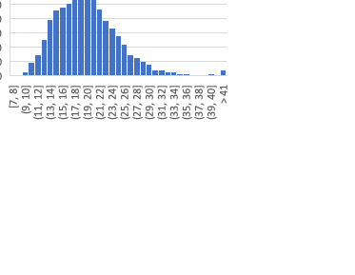

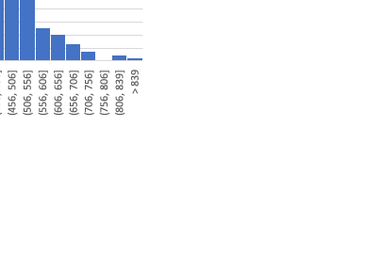
Data and variables – nitty gritty details
The database was collected by the Environmental Protection Agency
Data for car models from years 1984-2017 for a total of 38113 cars
All three variables we are interested in are approximately normally distributed.
5 year spend or save variable is rounded off to nearest $50.

Slide 4
Hypothesis
Two null hypothesis were tested:
The vehicles with higher-than-average MPG and lower-than-average MPG had
No significant difference in average Tailpipe CO2 (grams/mile)
No significant difference in average 5-year Saving or Spending on fuel costs
These hypotheses allow us to:
determine whether the MPG of a vehicle can be a reliable indicator of its CO₂ emission as well as the 5-year fuel costs of a vehicle
If these null hypotheses can be rejected, it allows us to create a crude ranking system of cars by their average MPG with cars having greater MPG also being more climate as well as budget friendly

Slide 5
Methods
One sample t-test of combined MPG to ascertain the average MPG.
Data divided into two buckets – lower than average MPG and higher than average MPG.
Two sample t-test of the two data samples performed under the null hypotheses that the average 5-year spend or save figure as well as Tailpipe CO2 ( grams/mile) is not significantly different among the two samples.
The tests however show that there is a significant difference and, thus lead us to reject null hypothesis.

Slide 6
Results of the t-tests
With 95% certainty:
The average combined MPG of the dataset is between 20.15 and 20.25 MPG ( p < 0.001 )
Among cars with lower-than-average MPG (<=20.22) and higher-than-average MPG (>20.22)
Low MPG cars, on average, cost $3800 more on fuels over 5-year period than high MPG cars ( p < 0.001 signifying high level of confidence)
For every mile driven, Low MPG cars produce 180 grams more CO₂ than the High MPG cars do ( p < 0.001 )

Slide 7
Insights and Recommendation
How do cars of a particular make and class measure against cars of another make and class and to the benchmark value for the class?
The dashboard tool developed helps us visualize such measures. As MPG values have correlation with CO₂ emission and 5-year fuel savings or costs, the dashboard makes use of such correlation to sort and recommend best vehicles in 4 categories:
Best in chosen class from all available makes for all years
Best in chosen make and class (for up to 2 different makes)
Best in chosen class from the latest year the class of cars is available

Slide 8
Dashboard Sample Screen

Slide 9
Comments on data and calculations:
Electric Vehicles have 0 carbon emission and low fuel costs.
The insights from these calculations might not apply to them all the time.
A new analysis of other variables like charge time, battery capacity, impact of battery production and carbon emission could be more relevant for electric vehicles.

