Slide 1

A Data based analysis of Premier League Season 2020/21
Bigyan Bhandari

Slide 2
Introduction
Premier League
Considered the most competitive soccer league
No supporters in the stadiums for the first time due to the pandemic
Did the 2020/21 season fundamentally differ from other seasons?
We will look to see if certain variables are significantly different
We will investigate whether such variables impact top-4 teams and bottom-3 teams equally
20 teams play against each other – once in home stadium and once away from home
4 top teams selected for Champions League; bottom 3 teams relegated

Slide 3
Data and variables – nitty gritty details
The database was scraped from the Premier League website
Hosted in Kaggle from where we downloaded it for analysis
Cleaning up of data done in Python (codes and explanations in the notebook)
‘clean_games’ table has records of goals, shots from all Premier League games to date ( from 1992/93 till 2020/21 )
‘fixed_stats’ table has records about possession, shots stats for all Premier League games from season 2006/07 onwards

Slide 4
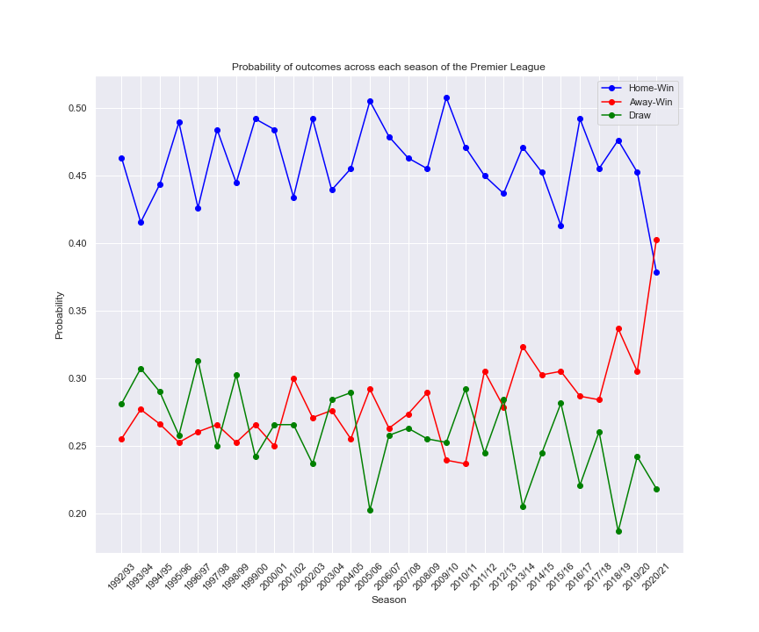
Preliminary Data Analysis
The probability of win by home team plummeted in the 2020/21 season
We will look into various hypotheses to explore what could have caused this

Slide 5
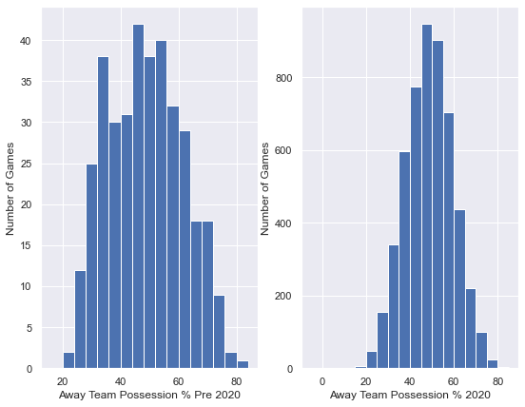
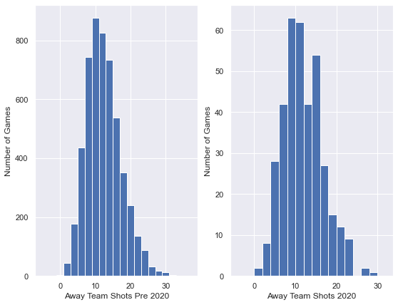
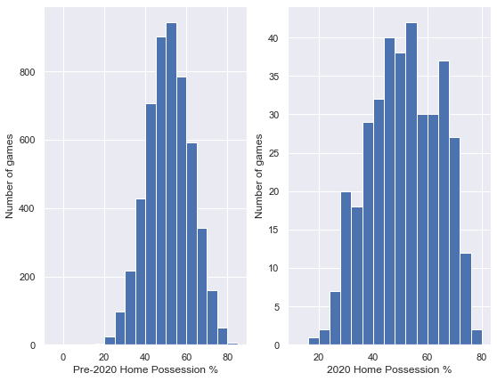
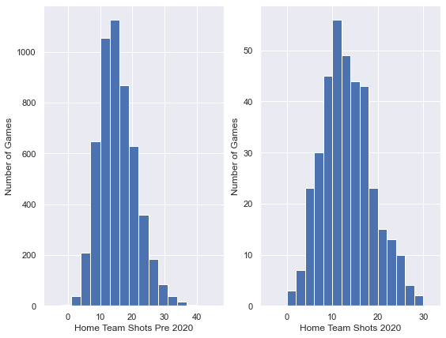
Exploratory Data Analysis
Possession and Shot stats are all normally distributed
We can proceed with inferential analysis
Histogram for ball possession by home and away teams
Histogram of number of shots per game by home and away teams

Slide 6
Hypotheses
The null hypotheses tested were:
For Home and Away teams, prior to 2020 season and during 2020 season:
1. No significant difference in average possession per game
2. No significant difference in the number of shots taken
These hypotheses allow us to:
Determine what aspect of performance has significantly changed during the 2020 season
If these null hypotheses can be rejected, it allows us to pinpoint the exact aspect of game that was impacted by the absence of supporters in stadiums
That would allow for the coaching staff to address specific shortcomings in team strategies and training sessions

Slide 7
Methods
Data divided into two buckets – all match data before the 2020/21 season and match data of the 2020/21 season
Independent sample t-test for samples with unequal variances using the scipy library was used to determine the statistical significance for the chosen variables

Slide 8
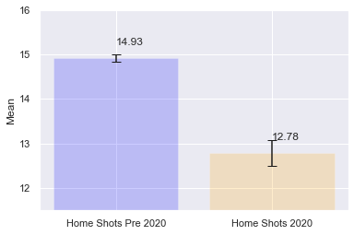
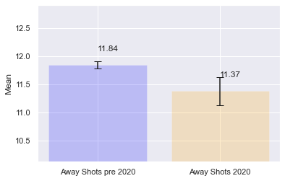
Results of the preliminary t-tests
With 95% confidence:
There is no significant change in possession statistics
There is no significant change in the shots taken by away teams
However:
There is significant decrease in shots taken by home teams
How is this impacting the goals scored by the teams?
More specifically, is there a difference in how top-4 teams and bottom-3 teams performed before and during the pandemic season?

Slide 9
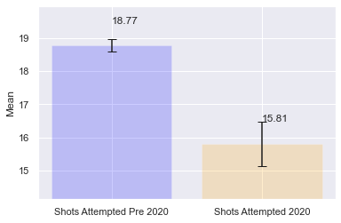
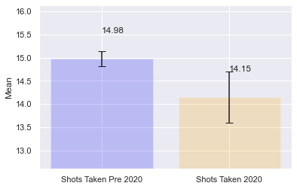
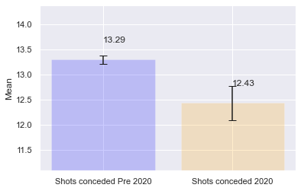
T-tests for top-4 vs bottom-3 teams
With 95% confidence:
Top 4 teams are taking less shots at home while conceding same amount of shots
Bottom 3 teams are taking less shots but also conceding less shots
This shows that top teams actually are performing worse in offense but defensively they are at similar level
Whereas, bottom teams are doing poorly in offense but slightly better in defense
Top teams at home
Bottom teams at home

Slide 10
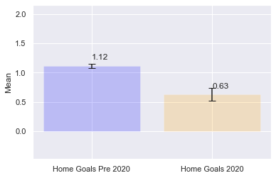
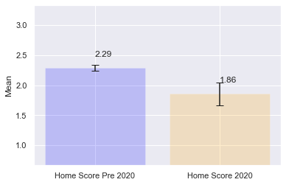
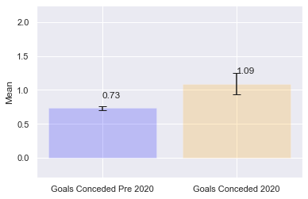
Results of the t-tests for top-4 vs bottom-3 teams
With 95% confidence:
Top 4 teams are scoring less as well as conceding more goals
This shows that top teams actually are performing worse in offense as well as defense during the pandemic season whereas bottom teams are performing worse in offense, but their defense is performing at a similar level
Goals scored vs conceded for bottom 3 teams at Home
Goals scored vs conceded for top 4 teams at home

Slide 11
Insights and Recommendation
How has the performance of teams changed in the absence of supporters? Have top and bottom teams equally impacted this past season?
The analysis helped us answer this question.:
For a team that finished top 4, they did worse both offensively as well as defensively at home. They scored fewer goals and conceded more goals.
For a team that finished towards the bottom, they did worse offensively but defensively they were at the same level as past year.
Based on this finding, a team manager or coach can design specific training drills or instructions for their team to pinpoint the aspect of the game they need to address to improve their performance.

Slide 12
Comments on data and calculations:
This analysis does not take into account specific teams which would be more suitable for individual team analysis.
The insights from these calculations might be interpreted to paint a bigger picture i.e., what is happening on a scale of multiple teams instead of single team.
But, an individual team’s statistics could also be analyzed as we have done
However, the sample size for one season where there are only 19 home, and 19 away games might not be statistically significant for that purposes.

