Slide 1
Advantage
of Computer

Slide 2

Speed

Slide 3

Accuracy

Slide 4

Reliability

Slide 5
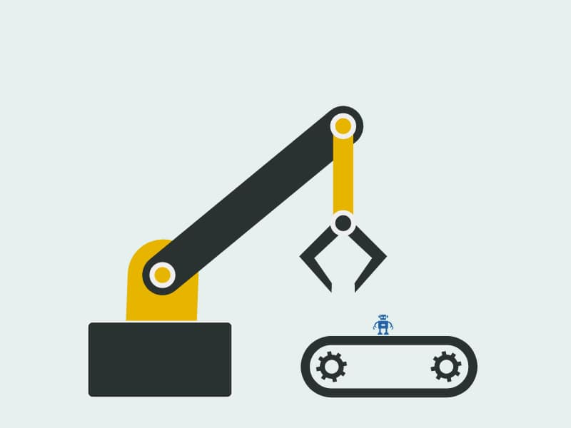
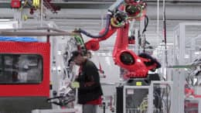
Automatic

Slide 6


Multi-Tasking

Slide 7

Security

Slide 8

Versatile

Slide 9
Dis-Advantage
of Computer

Slide 10

Physical and Mental Health Risks

Slide 11

Security and Privacy Risks

Slide 12
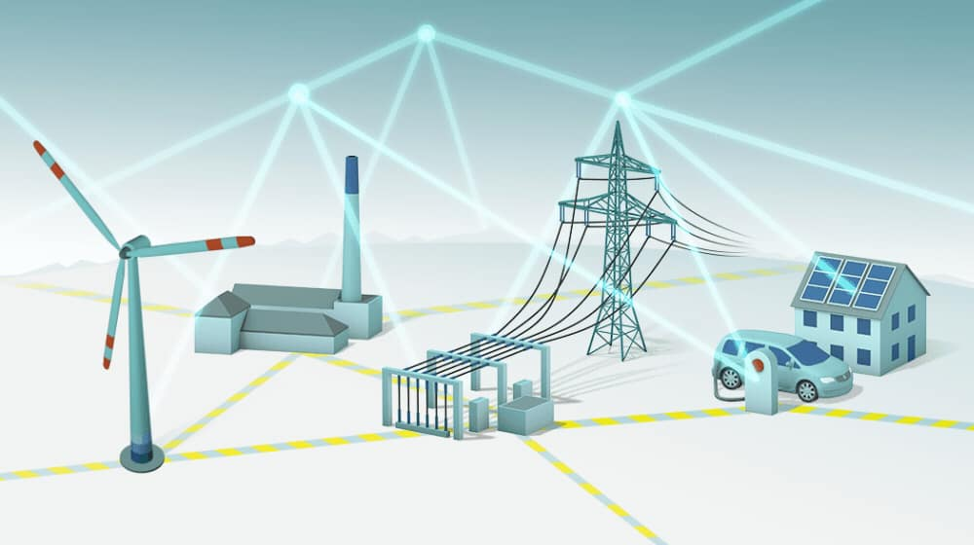
More Power Consumption

Slide 13
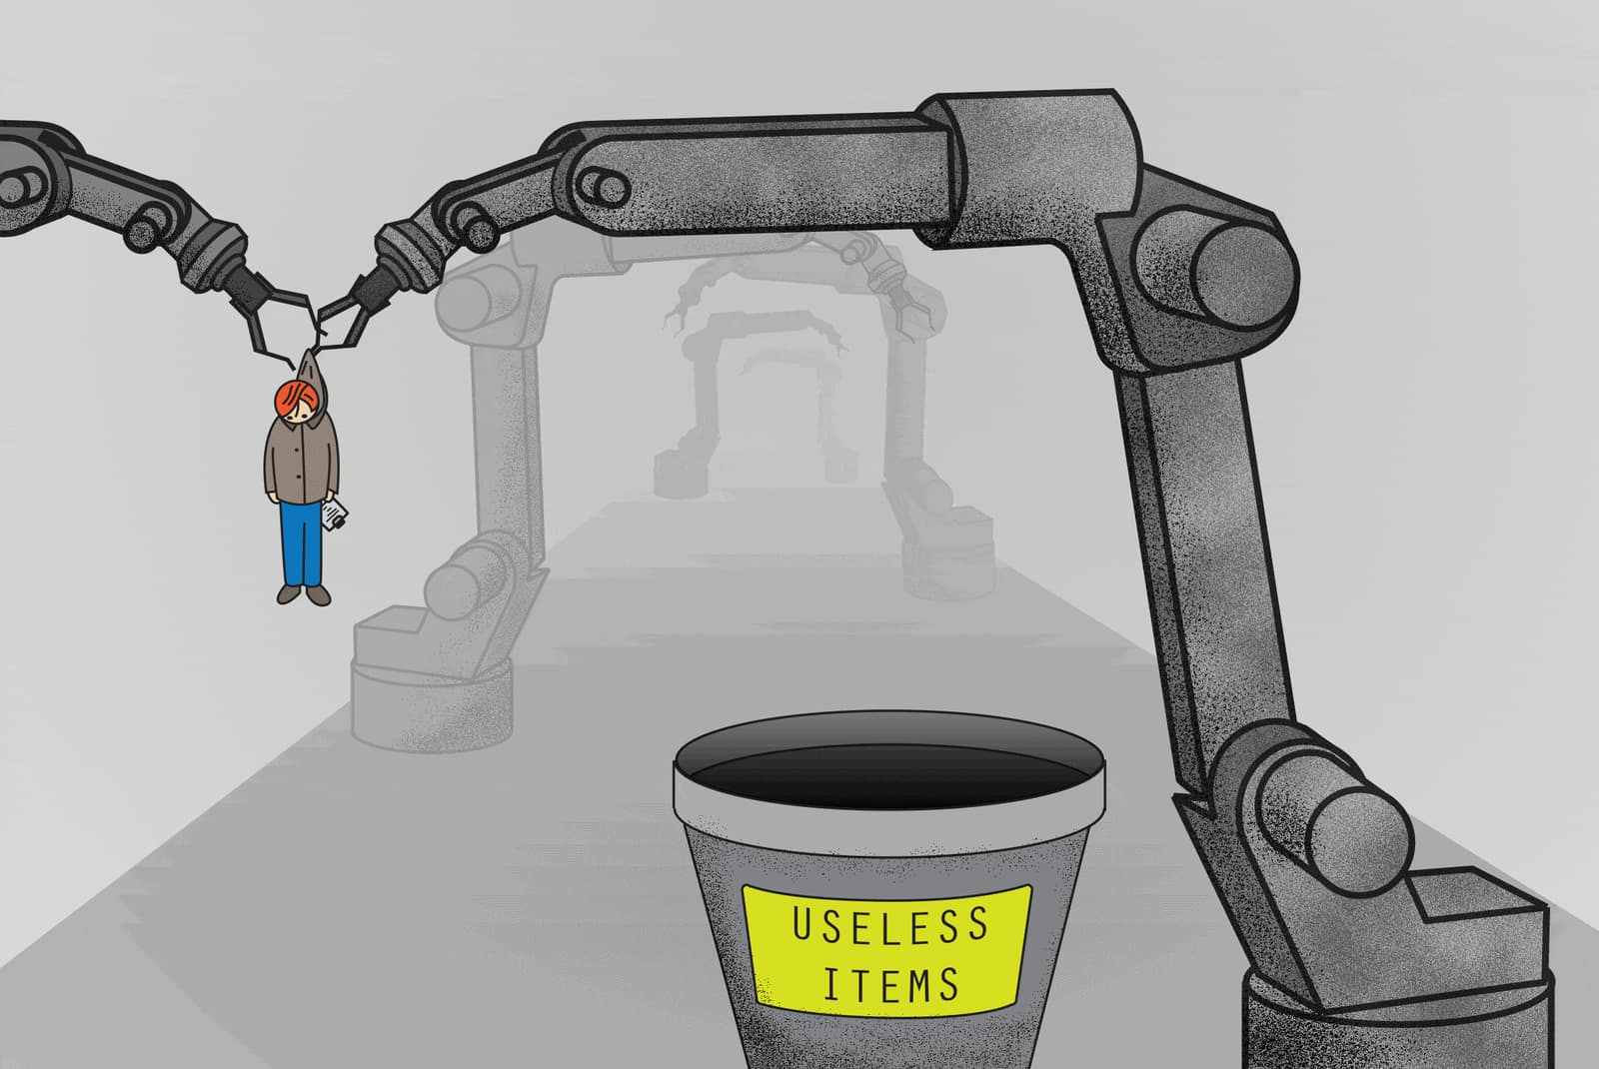
Can Reduse Jobs

Slide 14

No I.Q.

Slide 15
Types Of Computer

Slide 16



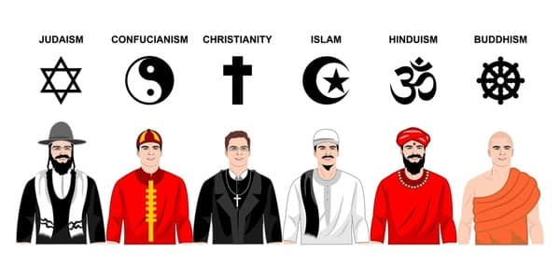

Slide 17
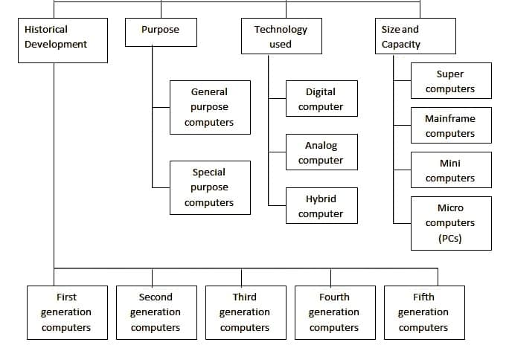
Classification of Computer = 4 types

Slide 18
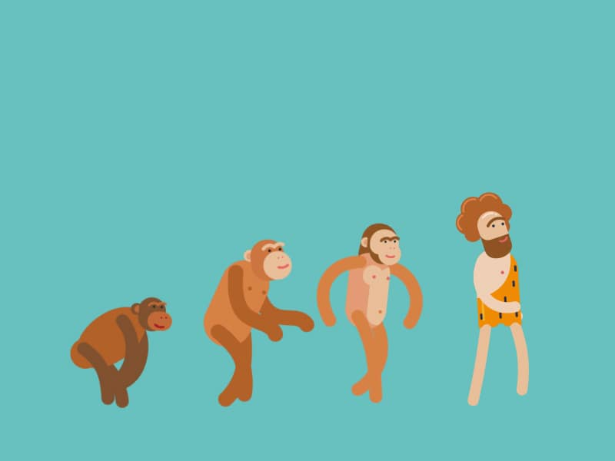
Human Evolution

Slide 19
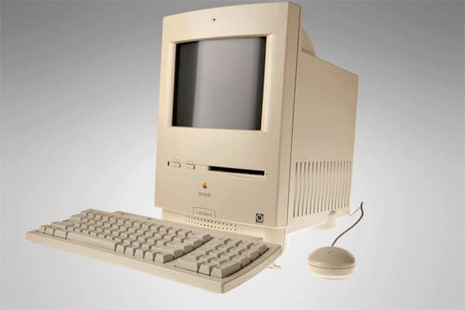
Computer Evolution (History)
Types = 5
1st Generation
2nd Generation
3rd Generation
4th Generation
5th Generation

Slide 20

World 1st Computer

Slide 21
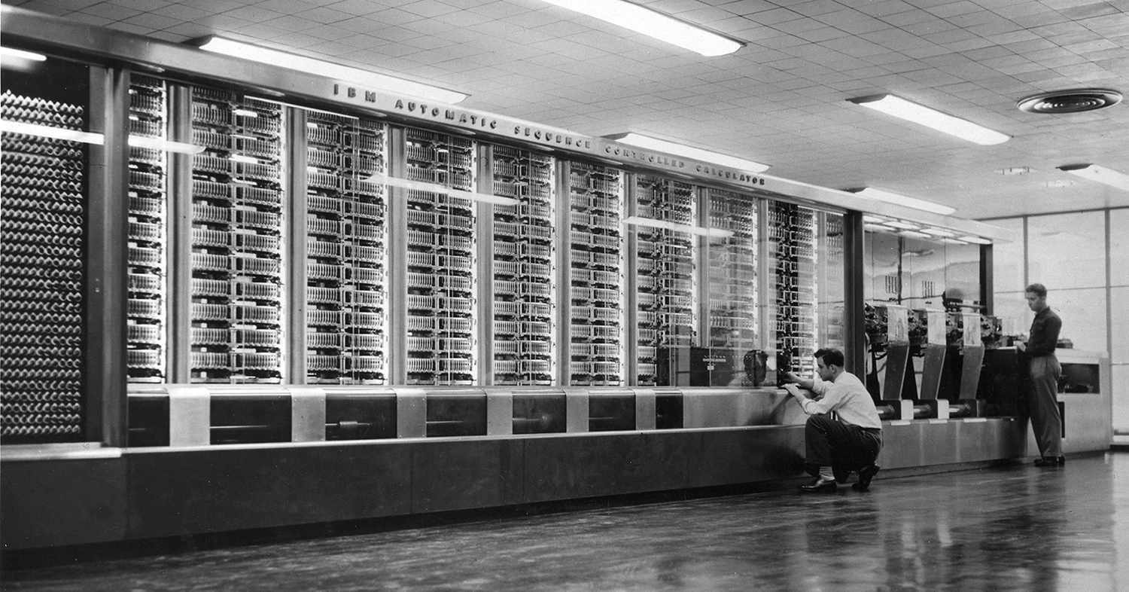
World 1st Computer -ENIAC

Slide 22
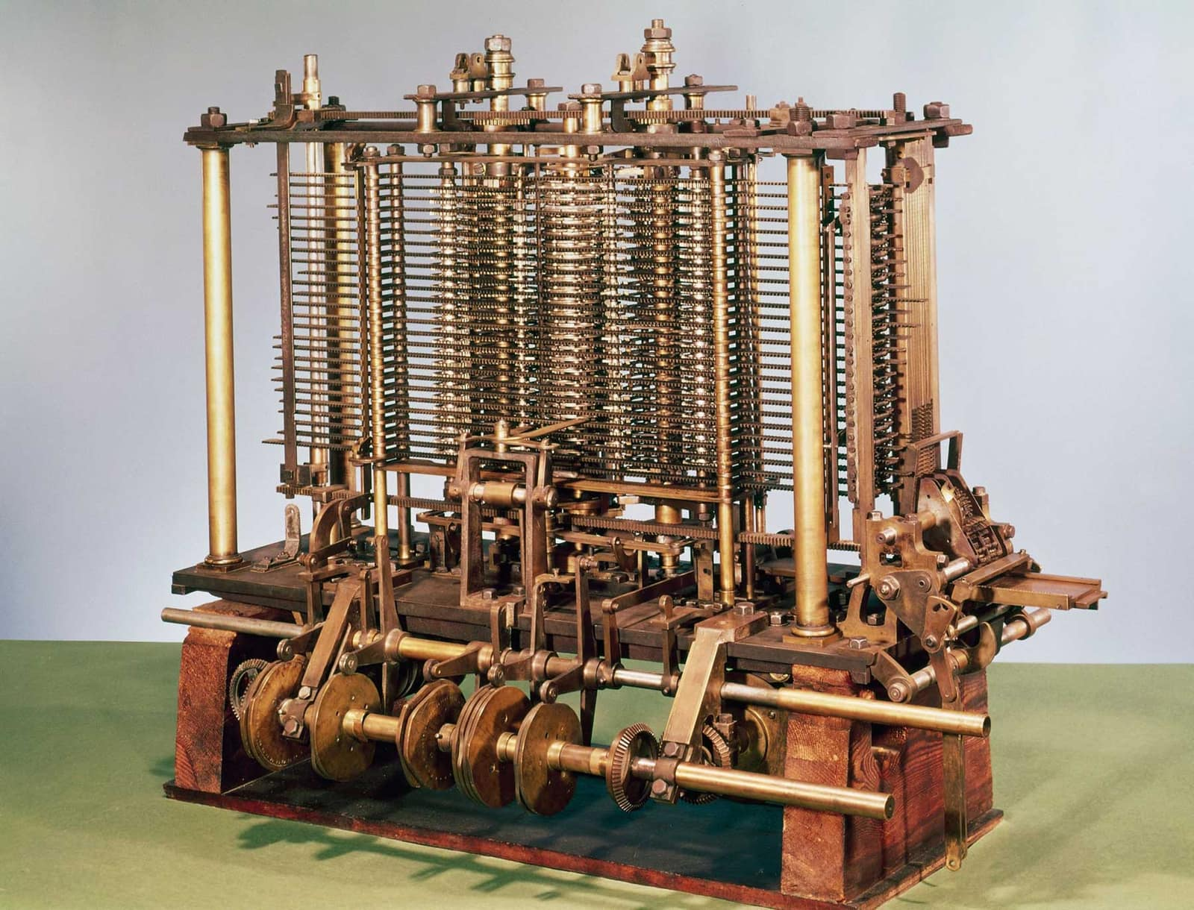
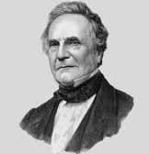

Slide 23
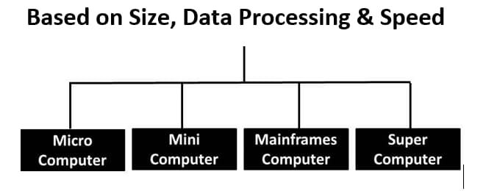

Slide 24
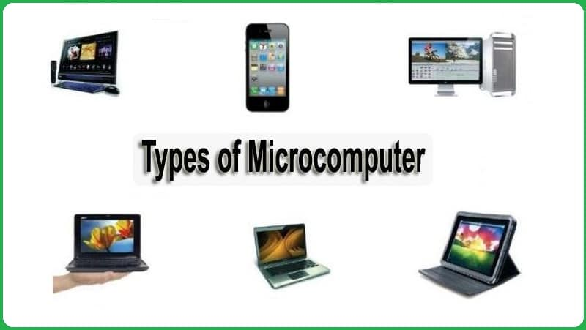

Slide 25
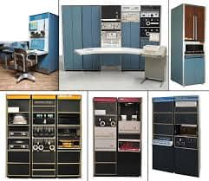

Slide 26
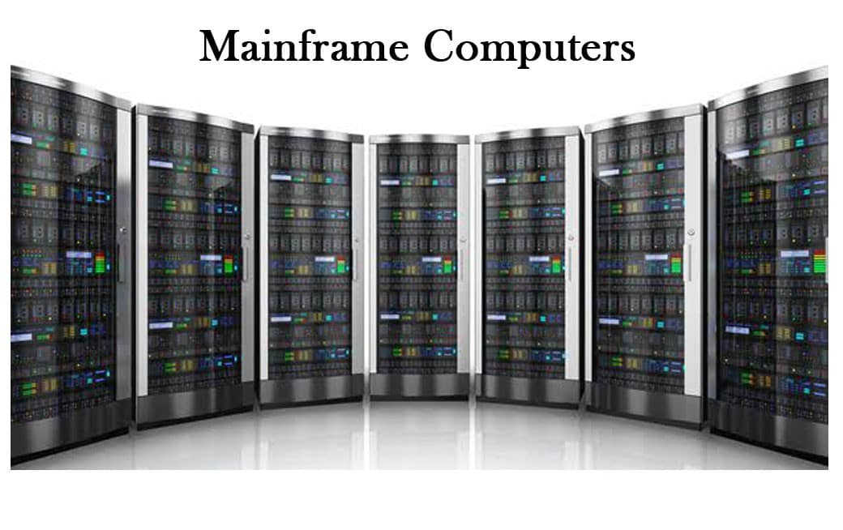

Slide 27


Slide 28
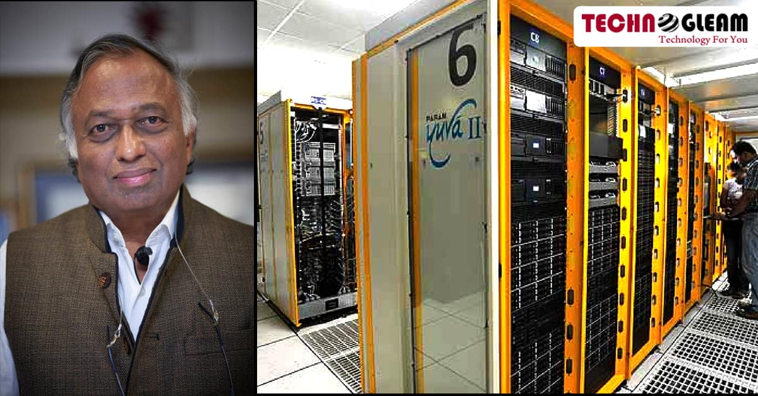
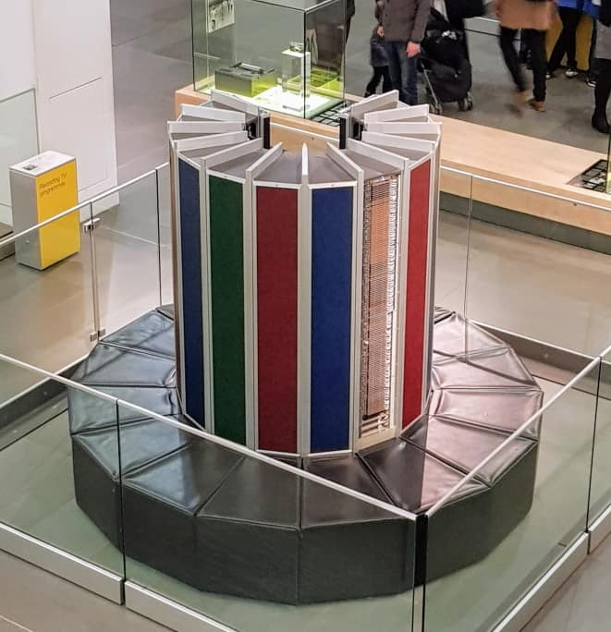
Super Computer

Slide 29
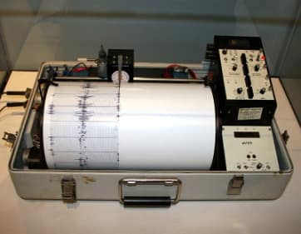
Types of Computer Based on Technology
Analog
Computer
Digital Computer
Hybride Computer
Seismograph

Slide 30
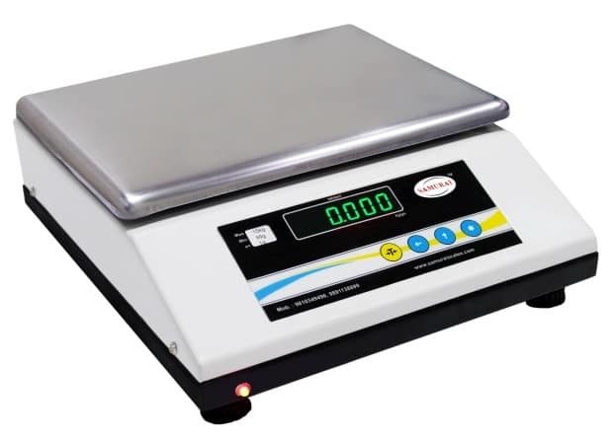

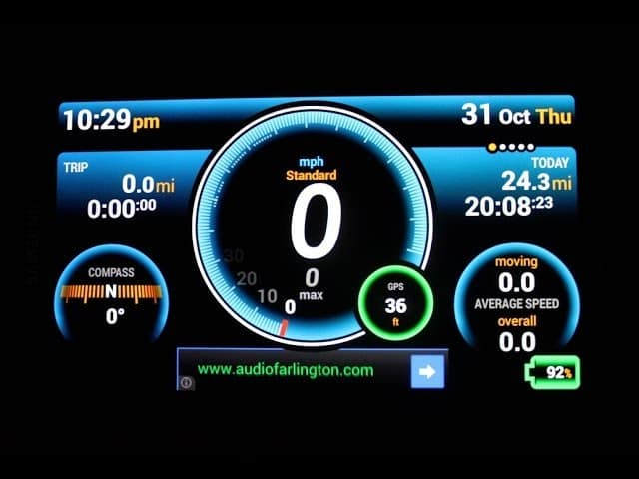
Digital Computer

Slide 31
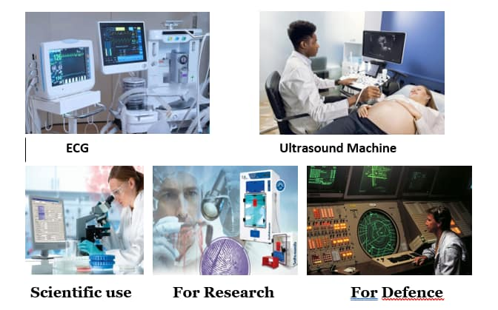
Hybride Computer

Slide 32
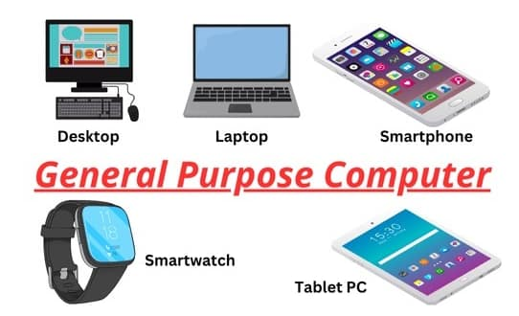
Types of Computer based on Purpose

Slide 33
