Slide 1
HEALTH ANALYSIS
Healthcare data,
turned into decisions.
Two years of patient visit and cost data
110,300 visits · $276M total cost · 7 diagnoses · 5 doctors
Open live workbook on OneDrive
Prepared by Bih Brandy · Business Intelligence Analyst

Slide 2
01 · The brief
What is the cost of care telling us
that operations alone cannot?
The question driving this work:
Where is cost concentrated, which diagnoses drive volume, how is workload distributed across doctors, and what patterns in age and gender shape the patient mix? Operations sees the schedule. Finance sees the invoices. Neither sees the full picture. Bringing the data into one model surfaces decisions that neither view can make alone.

Slide 3
02 · The data
What sits underneath the dashboard
SOURCE
CLEANED
Raw Data
Clean Data
114,000 rows of patient visit records
9 columns: visit date, patient ID, age, gender,
diagnosis, treatment, doctor, cost, age range
Mixed-case categorical values, inconsistent
date formats, missing doctor and diagnosis fields
110,300 rows after deduplication and validation
11 columns including derived Age Group and Month
3,700 rows removed for invalid dates or null IDs
(3.2 percent of source)
Unassigned doctor and Unknown diagnosis flags
kept and quarantined for review

Slide 4
03 · Headline numbers
The picture in six numbers
$276M
110,300
$2,501
Total cost across 2 years
Patient visits processed
Mean ticket per visit
5,000
7
22 visits
Unique patients seen
Diagnosis categories tracked
Average visits per patient

Slide 5
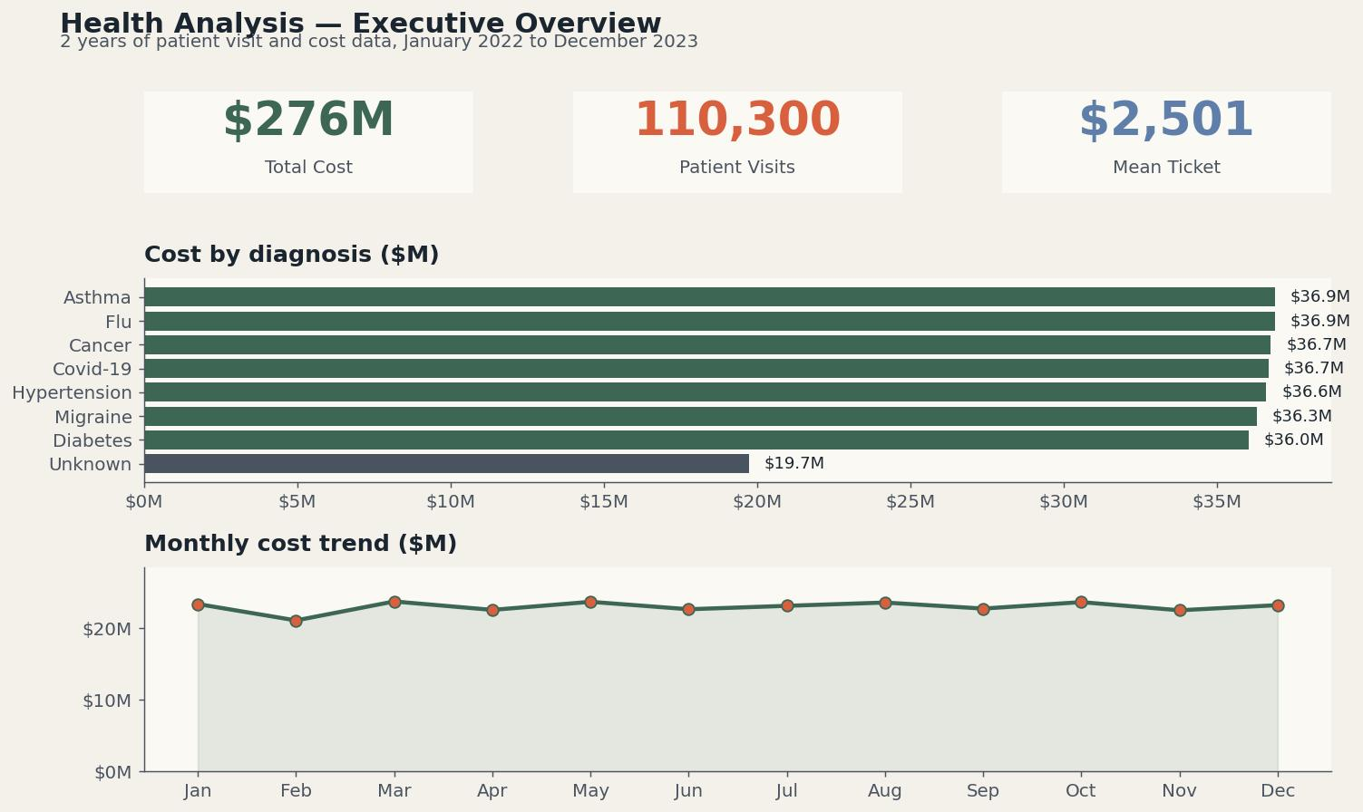
04 · Executive overview
Cost is evenly spread, with one exception
Six of seven named diagnoses sit within a $1M band. The Unknown category alone shows a $17M gap to the leaders.

Slide 6
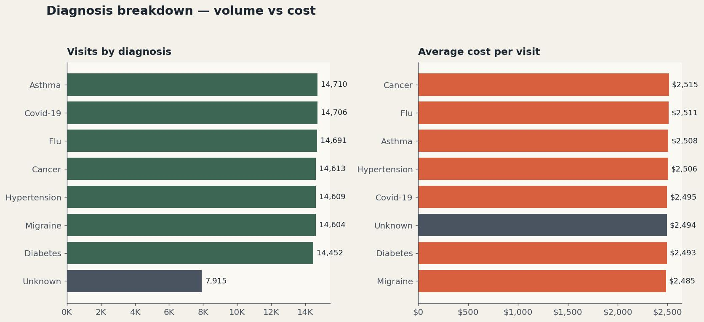
05 · Diagnosis breakdown
Volume and ticket size move together
Average cost per visit lands between $2,497 and $2,508 across diagnoses. The cost story is driven by volume, not severity.

Slide 7
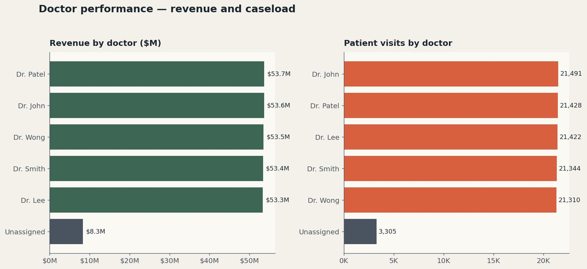
06 · Doctor performance
Caseload is balanced across the five named doctors
Each named doctor handles between $53.3M and $53.7M in revenue. The Unassigned bucket holds $8.3M that needs attribution.

Slide 8
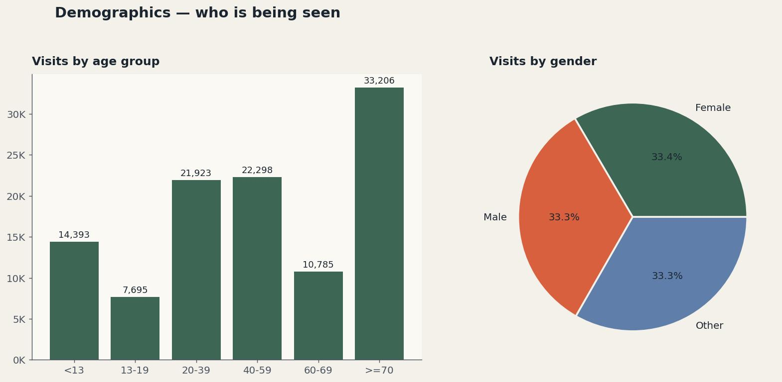
07 · Demographics
Who is being seen
The 70+ group shows the highest visit volume at 33,206. Gender split is near-even across Female, Male, and Other.

Slide 9
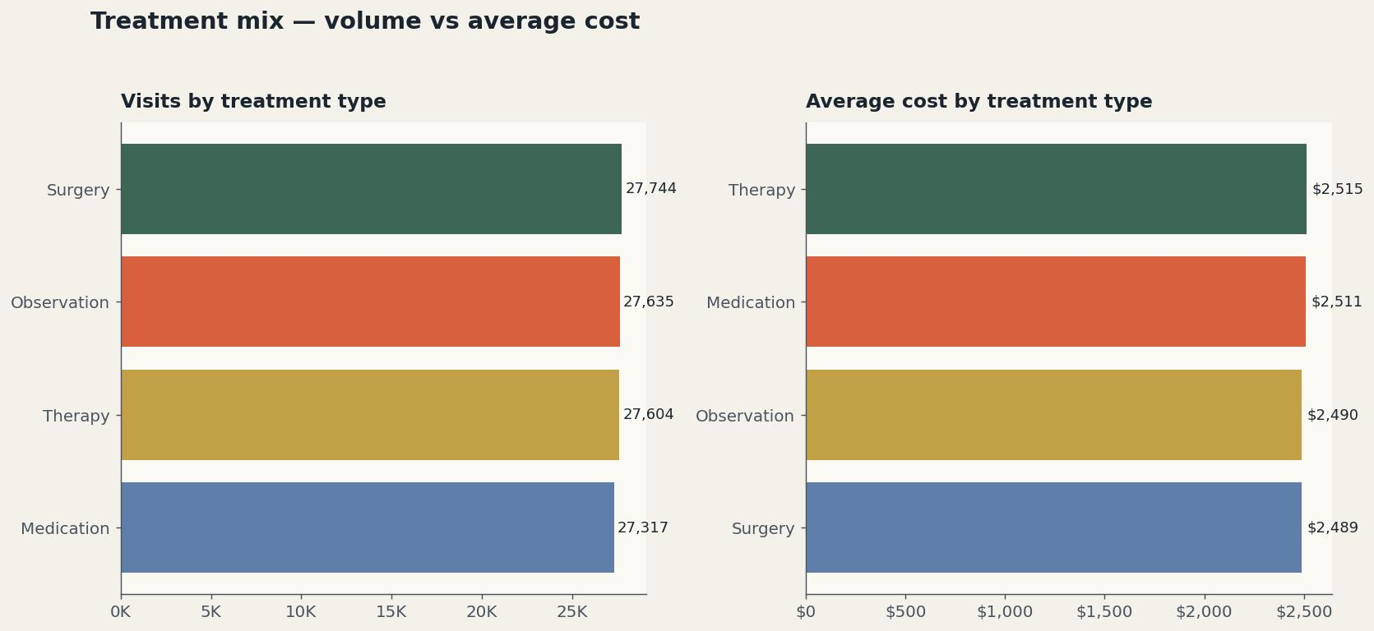
08 · Treatment mix
Four treatment types, four near-identical averages
Surgery, Therapy, Medication, and Observation all average within $30 of each other. Cost structure looks uniform, not skill-tiered.

Slide 10
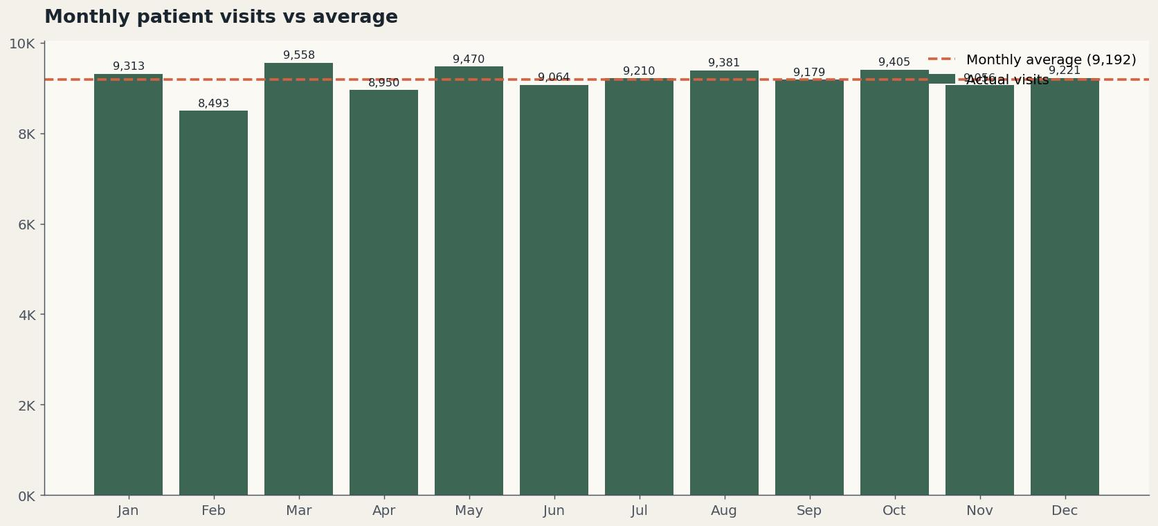
09 · Monthly pattern
No clear seasonality in visits or revenue
Monthly visits hover within 10 percent of the 9,192 monthly average. Capacity planning can run on a flat baseline.

Slide 11
10 · Key insights
What the numbers say
01
Cost spreads almost evenly across named diagnoses
Six of seven diagnoses cluster in a $36M to $37M band. Resource planning does not need to favour one disease group.
02
Unknown diagnosis is the largest data quality gap
$19.7M of cost sits against unlabelled diagnoses. Fixing intake categorization unlocks visibility into roughly 7 percent of the book.
03
Doctor workload is balanced, with one anomaly
Five named doctors carry near-equal revenue. The Unassigned bucket holds $8.3M that needs attribution to a real provider.
04
The 70+ group is the largest patient cohort
33,206 visits, the highest of any age bracket. Service capacity planning should anchor on this group.
05
Treatment type does not predict cost
Surgery and observation average within $30 of each other per visit. Cost variance lives elsewhere, likely in volume and case complexity.

Slide 12
11 · Recommendations
What to do next
01
Fix the intake categorization process
High
Unknown diagnoses are $19.7M of invisible spend. A required-field rule at intake closes the gap.
02
Resolve the Unassigned doctor records
High
Audit the 3,289 visits with no doctor. Reassign or archive to remove the $8.3M attribution gap.
03
Move from monthly to weekly cost monitoring
Medium
Monthly variance is too coarse for early warnings. Weekly tracking surfaces shifts inside the cycle.
04
Build a doctor-level utilization view
Medium
Balanced revenue does not mean balanced effort. Add hours, visit counts per shift, and patient outcomes.
05
Validate the 70+ cohort capacity plan
Low
This group drives the largest visit volume. Confirm the schedule, beds, and specialist mix match the load.

Slide 13
12 · Tech stack
How it was built
Excel
Data cleaning, pivot tables, formulas, and dashboard layout
Power Query
Date normalization and categorical standardization
Pivot Tables and Charts
Aggregation by diagnosis, doctor, age group and month
Slicers
Cross-filter dashboard by gender, diagnosis, and time period
Conditional Formatting
Visual emphasis on outliers and target comparisons

Slide 14
CLOSING
When the foundation is right,
the dashboard is the easy part.
Bih Brandy
Business Intelligence Analyst · Microsoft Fabric and Power BI Specialist
Bihbrandy15@gmail.com
Open live workbook on OneDrive

