Slide 1
SALES ANALYSIS
Sales data,
turned into decisions.
Full year 2021 sales performance review
$985K revenue · 832 transactions · 40 customers · 15 countries
Open live workbook on OneDrive
Prepared by Bih Brandy · Business Intelligence Analyst

Slide 2
01 · The brief
Where did 2021 revenue come from
and where did it fall short?
The question driving this work:
A full year of sales transactions sits in one spreadsheet. Operations knows what shipped. Finance knows what came in. Neither view alone answers the questions leadership actually asks. Which months hit target. Which customers carry the book. Which products earn their shelf space. Which countries deserve more investment and which are underperforming. This analysis brings the data into one model and gives those answers.

Slide 3
02 · The data
What sits underneath the dashboard
INPUT DATA
SUPPORTING TABLES
Transaction log
Target and Customer
832 sales transactions across full year 2021
10 fields per row: date, customer, product,
unit price, quantity, actual revenue, country,
region, month, week
Clean source data, no deduplication required
Target sheet: monthly revenue targets with
variance calculations
Customer sheet: 40 customers mapped to
15 countries across 7 regions
Used for joins and benchmark comparisons
in the dashboard

Slide 4
03 · Headline numbers
The year in six numbers
$985K
-$95K
4 of 12
Total revenue earned
Below the $1.08M target
Months that hit target
$532K
40
46%
From Export region alone
Active customers in 2021
Revenue from India alone

Slide 5
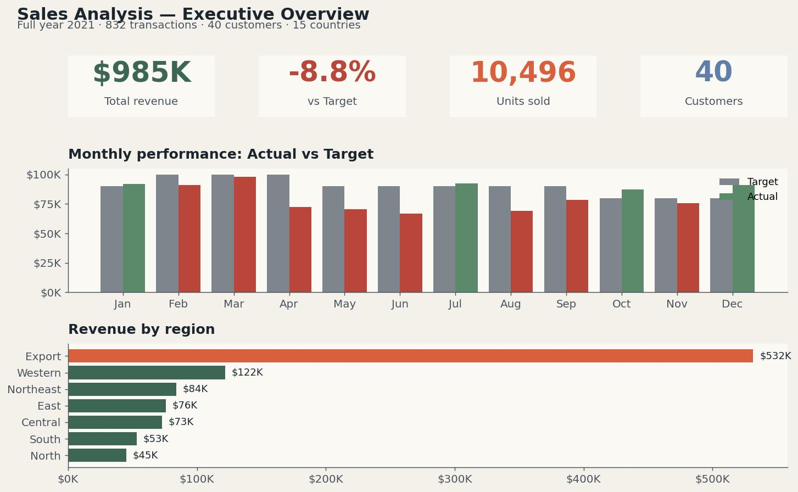
04 · Executive overview
The year missed target by 8.8%, with Export carrying the load
Export region delivered $532K, more than four times the next region. The book is geographically concentrated.

Slide 6
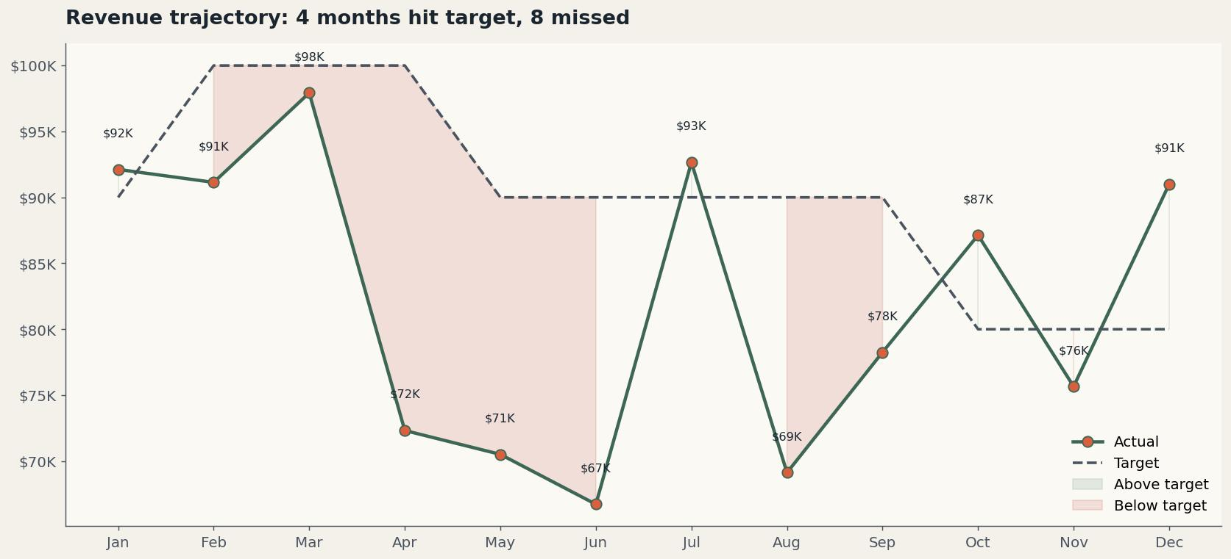
05 · Monthly trend
Strong start, midyear collapse, late recovery
Q1 hit close to target. April through September dropped 20-30% below. Q4 recovered only partially.

Slide 7
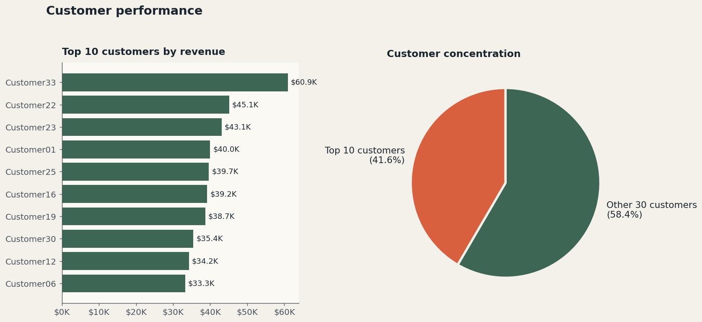
06 · Customer performance
Top 10 customers carry 53% of revenue
Customer33 alone generated $61K, 6.2% of total revenue. Concentration risk is significant.

Slide 8
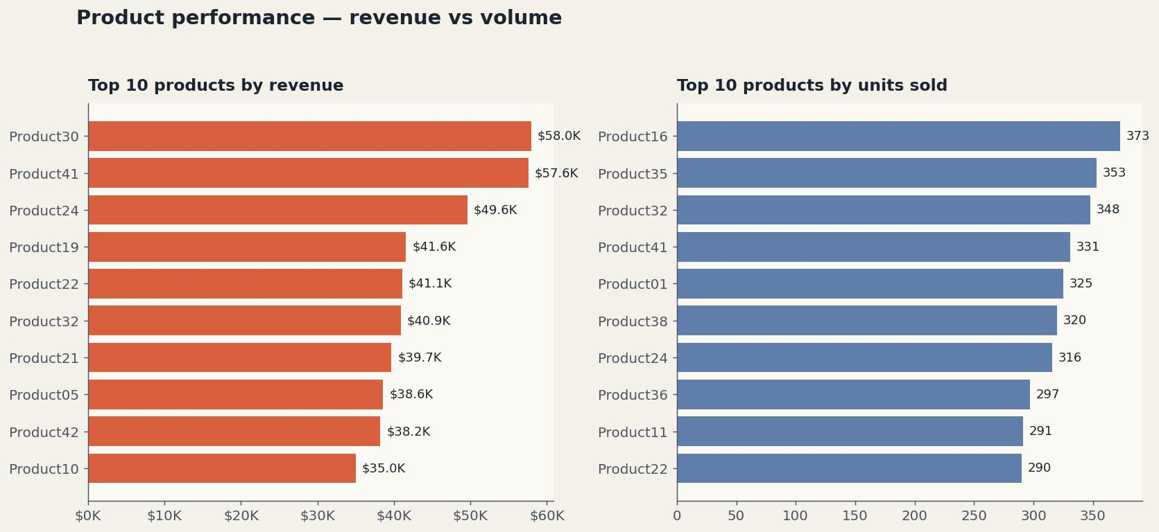
07 · Product performance
Product 30 and 41 lead, but the long tail matters
Top two products earn ~$58K each. The next 38 products combined deliver the remaining 88% of revenue.

Slide 9
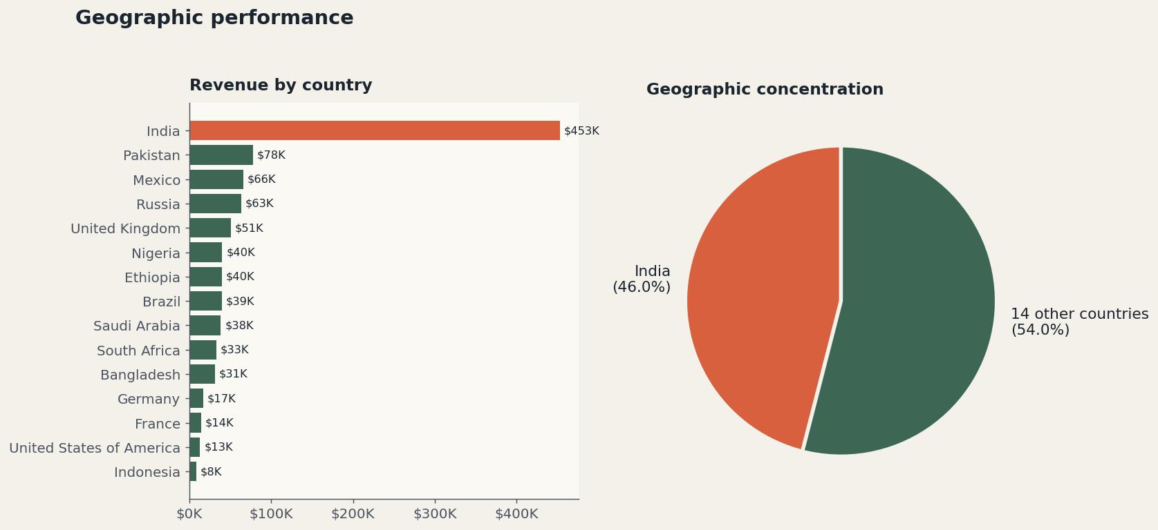
08 · Geographic performance
India dominates at 46% of revenue
14 other countries split the remaining 54%. Loss of India would cut revenue nearly in half.

Slide 10
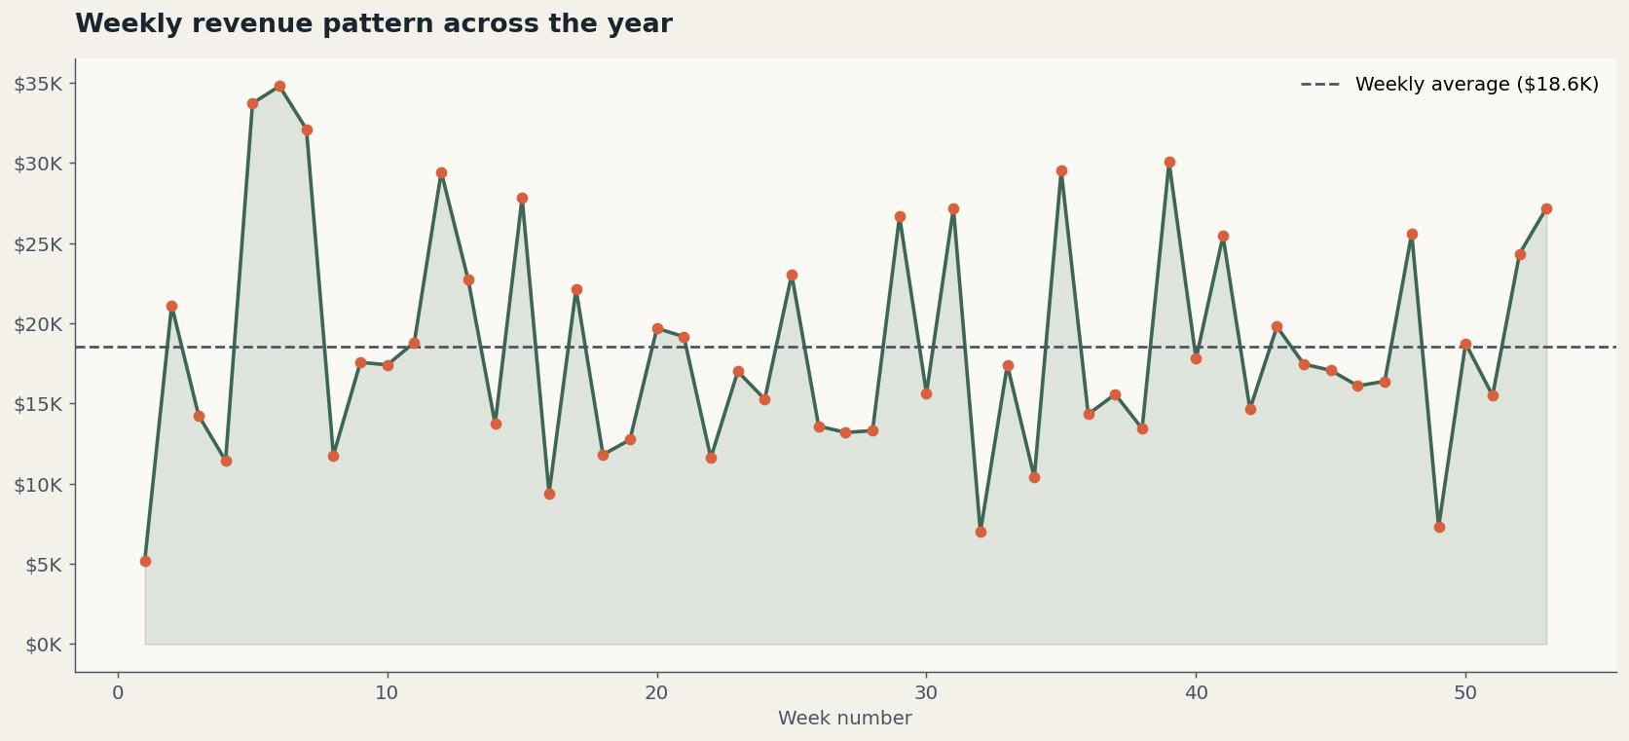
09 · Weekly pattern
Revenue swings widely week to week
No clear seasonality. Week-to-week variance suggests revenue depends on a few large transactions, not steady volume.

Slide 11
10 · Key insights
What the numbers say
01
The year missed target by 8.8%
Total revenue of $985K against a $1.08M target. Only 4 of 12 months hit their monthly number.
02
Export is the business, not a side bet
Export region alone delivered $532K, 54% of total revenue. Removing Export would gut the year.
03
India is the single biggest country exposure
India contributed $453K, 46% of revenue. The remaining 14 countries split the other 54%.
04
Customer concentration is high
The top 10 customers carry 53% of revenue. Losing any one of them moves the needle.
05
Midyear performance collapsed
April through September averaged $75K monthly against a $93K target. Something specific happened in Q2 and Q3.

Slide 12
11 · Recommendations
What to do next
01
Diagnose the Q2-Q3 revenue drop
High
Six straight months under target is not seasonality. Find the cause: sales team capacity, product issue, or a lost account.
02
Build a top-10-customer retention plan
High
53% of revenue from 10 accounts is a risk that needs active management. Set up quarterly health checks.
03
Diversify beyond India
Medium
46% concentration in one country is fragile. Set a 3-year goal to bring India under 35% of revenue.
04
Recalibrate monthly targets
Medium
Q4 targets were set 11% lower than Q1. If that was deliberate, document why. If not, fix the planning process.
05
Add customer profitability tracking
Low
Revenue tells only half the story. Pair it with margin per customer to find which big accounts are actually profitable.

Slide 13
12 · Tech stack
How it was built
Excel
Source data storage, pivot tables, dashboard layout
Power Query
Date parsing, month and week derivation
Pivot Tables
Aggregation by customer, product, region, country and time
Slicers
Cross-filter the dashboard by region, country and month
Conditional Formatting
Above and below target highlighting in monthly views

Slide 14
CLOSING
When the foundation is right,
the dashboard is the easy part.
Bih Brandy
Business Intelligence Analyst · Microsoft Fabric and Power BI Specialist
Bihbrandy15@gmail.com
Open live workbook on OneDrive

