Slide 1

Financial sales analysis
Where the money is made, and where it leaks
700 transactions | 5 countries | September 2013 to December 2014
Brandy Sango
Notes:
Thank you for having me. I'm Brandy Sango. I'm going to walk you through a financial sales analysis: 700 transactions, five countries, and one question. Where does the money stay?

Slide 2
Where does the money stay?
1
Which products, countries and segments earn the most profit?
$118.7M
2
Where is the business losing money, and why?
in sales over 16 months
14 cents
of each dollar became profit
3
When do sales peak, and which product leads?
Financial sales analysis | September 2013 to December 2014
2
Notes:
The business sold $118.7 million over sixteen months. But only 14 cents of every dollar became profit, $16.9 million in all.
Leaders need to know three things. Which products, markets and customer segments earn that profit. Where the business loses money, and why. And when sales peak, so they can stock up and plan around it. Everything in this talk answers one of those three.

Slide 3
Where the numbers come from
700
16 months
5 x 6 x 5
sales transactions
September 2013 to December 2014
countries, products and customer segments
2013 has only four months, so years are never compared as wholes. All figures in US dollars.
Financial sales analysis | September 2013 to December 2014
3
Notes:
The data is one table of 700 sales transactions, from September 2013 to December 2014. It covers five countries, six products and five customer segments. Every figure is in US dollars.
One warning before the charts. 2013 has only four months, September to December, while 2014 has twelve. So I never compare the two years as wholes. Where months are compared, I say which year they come from.

Slide 4
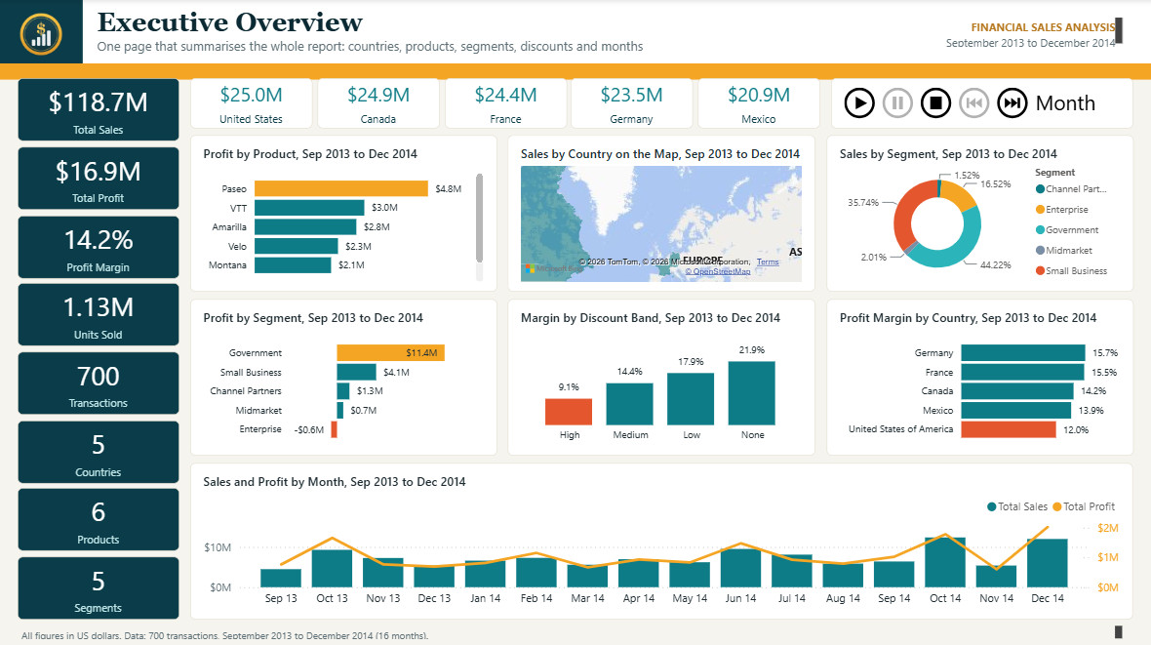
The Executive Overview
$118.7M
sales, $16.9M profit
14.2%
profit margin
1.13M
units sold
Financial sales analysis | September 2013 to December 2014
4
Notes:
This is the Executive Overview page of the report. Sales are $118.7 million and profit is $16.9 million, a margin of 14.2 percent. The business moved 1.13 million units.
The five country tiles along the top show how even the markets are. The United States leads with $25.0 million and Mexico is last with $20.9 million. That is a spread of about 20 percent. Note that the market with the most sales is not the one with the best margin. Keep that in mind for the next slide.

Slide 5
The biggest market keeps the least
Sales by country, $ millions
$25.0M
United States, the largest market
12.0%
United States margin, the lowest
15.7%
Germany margin, the highest
Financial sales analysis | September 2013 to December 2014
5
Notes:
Five markets, close in size. The United States sold $25.0 million, Canada $24.9 million, France $24.4 million, Germany $23.5 million and Mexico $20.9 million.
Profit tells a different story. Germany earns the best margin at 15.7 percent and France follows at 15.5. The United States, our biggest market, earns the lowest, 12.0 percent. It sells the most and keeps the least of each dollar.

Slide 6
Paseo carries the business
Profit by product, $ millions
28%
of all profit comes from Paseo
338K
units, twice the next product
Margins run from 12.6% (Velo) to 15.9% (Amarilla).
Financial sales analysis | September 2013 to December 2014
6
Notes:
Paseo is the product that carries the business. It earned $4.8 million in profit, 28 percent of the total, and sold 338,000 units, twice as many as the next product.
Amarilla has the best margin at 15.9 percent. Velo has the worst at 12.6 percent. There are six products and the gap between best and worst margin is only about three points, so product choice matters less than segment and discount.

Slide 7
Government earns it, Enterprise loses it
Profit by segment, $ millions
67%
of profit is Government
-$0.6M
Enterprise, on $19.6M of sales
73%
Channel Partners margin, on only $1.8M
Financial sales analysis | September 2013 to December 2014
7
Notes:
This is where the money is made, and where it leaks.
Government earns $11.4 million in profit. That is 67 percent of everything the business keeps. Small Business adds $4.1 million.
Enterprise loses money. It sold $19.6 million and lost $0.6 million, a margin of minus 3.1 percent. That is one dollar in six of all sales, and it brings in no profit at all.
Channel Partners go the other way. They earn a 73 percent margin, but they only sold $1.8 million.

Slide 8
Deeper discounts, thinner margins
Profit margin by discount level, %
$9.2M
taken in discounts, 7.2% of gross sales
58
sales lost money, all in Enterprise
33 at a high discount and 25 at a medium one.
Financial sales analysis | September 2013 to December 2014
8
Notes:
Discounts took $9.2 million, or 7.2 percent of gross sales. The deeper the discount, the thinner the margin.
With no discount, margin is 21.9 percent. At a low discount it is 17.9, at medium 14.4, and at high just 9.1 percent.
And the loss-making sales sit exactly here. There are 58 sales that lost money. Every one is in the Enterprise segment, and every one carried a medium or high discount: 33 high and 25 medium. So the Enterprise problem is a discount problem.

Slide 9
October and December are the peaks
Sales by month, $ millions
$12.4M
October 2014, the biggest month for sales
$2.0M
December 2014, the biggest month for profit
Only 16 months of data, so this is not yet a yearly pattern.
Financial sales analysis | September 2013 to December 2014
9
Notes:
December 2014 was the biggest month for profit at $2.0 million, and October 2014 was the biggest for sales at $12.4 million. Both months had 70 transactions, double the usual 35.
October 2013 also ran at 70 transactions, though December 2013 did not, so the peaks are not perfectly regular. Paseo is the top product in the busiest month, December 2014, at $4.7 million.
The caution again: 2013 covers only September to December, so I can't call this a yearly pattern. It is what sixteen months show.

Slide 10
Five things to do
1
2
3
4
5
Protect Government
Fix Enterprise
Cap deep discounts
Back Paseo and stock for Q4
Grow Mexico and Channel Partners
The first two protect or recover the most profit. None needs new customers.
Financial sales analysis | September 2013 to December 2014
10
Notes:
Five things to do, in order.
One: protect Government. It earns two thirds of the profit, so keep pricing and service strong there.
Two: fix Enterprise. Review those 58 loss-making sales and stop the medium and high discounts that push them below cost.
Three: cap deep discounts. Margin falls to 9.1 percent at the high band. Set a limit and require approval for exceptions.
Four: back Paseo and stock for the fourth quarter. It leads profit and units, and October and December are the biggest months.
Five: grow Mexico and Channel Partners. Mexico sells the least, and Channel Partners earn a 73 percent margin on only $1.8 million of sales.
I put them in this order because the first two protect or recover the most profit, and the last is the easiest to start.

Slide 11
Healthy, but leaking margin
Government carries the profit. Enterprise loses money, and deep discounts are how.
1
Fix Enterprise discounts
2
Protect Government
3
Stock up for October and December
Limits: 16 months of data, and it shows what happened, not why.
Thank you. Questions welcome.
Financial sales analysis | September 2013 to December 2014
11
Notes:
The business is healthy but it leaks margin through one segment and one habit. Government carries the profit. Enterprise loses money, and deep discounts are how it loses it. Fix Enterprise and the discounts first. Neither needs new customers.
Two limits to say out loud. The data covers 16 months, so I would confirm these trends with a longer history before committing budget. And the data shows what happened, not why, so the first step of any change is to ask the sales team why those 58 discounts were given.
Thank you. I'm happy to take questions.

