Slide 1

JustDrinks LTD
Where the money comes from, and where it slips away
80 stores | $452M in sales | 2016 financial year
Brandy Sango
Notes:
Thank you for having me. I'm Brandy Sango. I'm going to walk you through my analysis of JustDrinks Ltd.: a year of sales, purchasing and inventory for an 80-store drinks retailer, and what the leadership team should do next.

Slide 2
Three questions from the leadership team
Where does the money come from?
1
$452M
in sales over 12 months
How well is stock bought and held?
2
80
Which vendors, stores and products drive profit?
stores in 68 cities
3
JustDrinks LTD analysis | 2016 financial year
2
Notes:
JustDrinks is a retailer of wine and spirits with about 80 stores. Over the last twelve months it sold $452 million.
The leadership team asked three things. Where does the money come from? How well is the company buying and holding stock? And which vendors, stores and products drive profit?
I answered them in a Power BI report of 12 pages, which follows the questions in order.

Slide 3
Where the numbers come from
12.8M
2.4M
2
sales lines
purchase lines
stock counts, start and end of year
Gross profit here is sales minus purchases. Stock is counted only twice, so turnover can't be tracked by month.
JustDrinks LTD analysis | 2016 financial year
3
Notes:
The data comes from four sources for the 2016 financial year: sales, purchases, and the stock counts at the start and end of the year.
There are about 12.8 million sales lines and 2.4 million purchase lines, across 80 stores and 68 cities.
Two things to keep in mind. Stock is counted only twice, at the start and the end of the year, so I can't track turnover month by month. And gross profit here means sales minus purchases, so the timing of buying affects it.

Slide 4
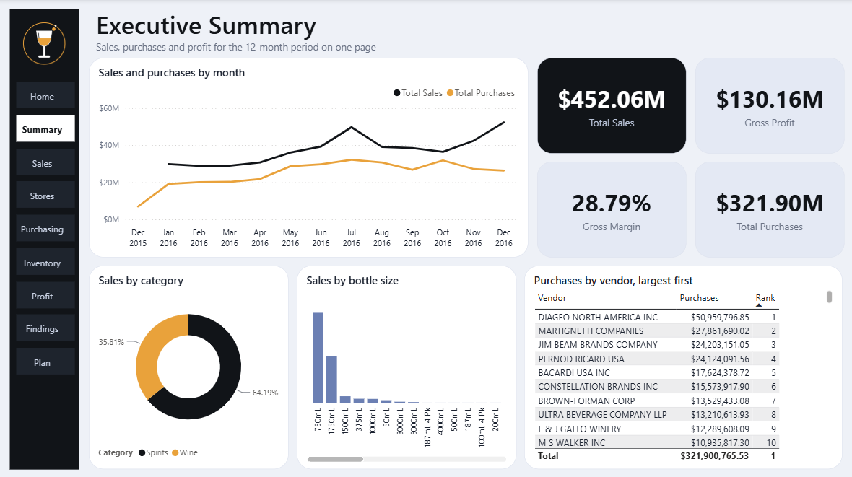
The executive summary
$452M
sales, $130M gross profit
28.8%
gross margin
$322M
purchases
JustDrinks LTD analysis | 2016 financial year
4
Notes:
This is the Executive Summary page of the report. Sales were $452 million and gross profit was $130 million, a margin of 28.8 percent. Purchases were $322 million.
The line chart shows sales in black and purchases in orange. Sales rise through the year and peak in July and December. Purchases peak in July and October, then fall.
That gap at the end of the year is the main finding, and I'll come back to it.

Slide 5
Spirits make 64% of sales
Sales by category, $ millions
64.19%
spirits, $290.2M
35.81%
wine, $161.9M
The two categories were labelled the wrong way round in the original model. I corrected them.
JustDrinks LTD analysis | 2016 financial year
5
Notes:
Spirits make 64.19 percent of sales, $290 million. Wine makes 35.81 percent, $162 million.
One technical note. The category codes were labelled the wrong way round in the original model. I checked the bottle sizes to confirm it: the group labelled wine had 50mL minis and 1750mL bottles, which are spirits sizes, and the other group had 5-litre boxes and 187mL four-packs, which are wine. I corrected it, so the report and these numbers now agree.

Slide 6
Two sizes make 85% of sales
Sales by bottle size, $ millions
$254.0M
from the 750mL bottle
$132.1M
from the 1750mL bottle
Wine sells most in 750mL. Spirits sell most in 1750mL by dollars.
JustDrinks LTD analysis | 2016 financial year
6
Notes:
Two sizes carry the business. The 750mL bottle brings in $254 million and the 1750mL bottle $132 million. Together that is 85 percent of sales.
Wine sells most in 750mL, $131 million and 10.2 million units. Spirits sell most in 1750mL by dollars, $132 million, and by units they are level across 50mL, 750mL and 1750mL, at about 6 million each.

Slide 7
Stores and cities vary widely
Sales by city, top five, $ millions
$0.4M to $25.5M
sales per store
$10 to $19
average price by store
Spirits: store 29 lowest ($10.51), store 76 highest ($18.75).
JustDrinks LTD analysis | 2016 financial year
7
Notes:
Stores differ a lot. Sales per store run from $0.4 million to $25.5 million. Doncaster is the top city at $47.2 million.
Prices differ too. For spirits, the lowest average price is at store 29, $10.51, and the highest at store 76, $18.75. For wine, store 45 is lowest at $10.23 and store 3 highest at $18.68.
The best stores are worth studying and copying.

Slide 8
Buying is concentrated
Purchases by vendor, top five, $ millions
15.8%
of purchases from Diageo
45%
from the top five vendors
Buying power for terms, and a risk if one supplier fails.
JustDrinks LTD analysis | 2016 financial year
8
Notes:
Buying is concentrated. Diageo is the largest vendor by value, $51.0 million, and by quantity, 5.5 million units. That is 15.8 percent of all purchases.
Martignetti is next at $27.9 million, then Jim Beam, Pernod Ricard and Bacardi. The top five vendors together are 45 percent of purchases.
That is useful buying power for negotiating terms, and a risk if one supplier fails.

Slide 9
Purchases lag the holiday peak
Sales and purchases by month, $ millions
$52.3M
December sales
$26.3M
December purchases, half as much
3.8M units sold against 2.8M bought: stock drawn down by about a million.
JustDrinks LTD analysis | 2016 financial year
9
Notes:
This is the finding I'd act on first. From October, sales climb and purchases fall.
In December, sales were $52.3 million and purchases $26.3 million, half as much. In units, the company sold 3.8 million bottles and bought 2.8 million. It drew down about a million units of stock in the busiest month.
December also has the highest margin, 49.6 percent, against 12.6 percent in October. Part of that is real demand, and part is buying timing, because gross profit is sales minus purchases.

Slide 10
Five things to do
1
2
3
4
5
Buy holiday stock earlier
Protect the 750mL and 1750mL sizes
Use vendor volume to negotiate
Learn from the best stores
Track profit by product
The first one closes the biggest gap in the data. None needs new customers.
JustDrinks LTD analysis | 2016 financial year
10
Notes:
Five things to do.
One: buy holiday stock earlier, so it is in place before November and December.
Two: protect the 750mL and 1750mL sizes. They are 85 percent of sales.
Three: use vendor volume to negotiate, and line up a back-up supplier.
Four: learn from the best stores and cities, and share their practices with the weakest.
Five: track profit by product, and review the slowest brands. Some take close to a year to make a first sale.

Slide 11
Strong sales, with room on timing and mix
The clearest gains are in timing, mix and store results, not new sales.
1
Buy holiday stock earlier
2
Protect the two main sizes
3
Copy the best stores
Limits: stock is counted twice a year, and the data shows what happened, not why.
Thank you. Questions welcome.
JustDrinks LTD analysis | 2016 financial year
11
Notes:
JustDrinks has a strong revenue base. The clearest gains are in timing, mix and store results, not in finding new sales.
Two limits to say out loud. Stock is counted only twice a year, so I would ask for monthly counts to track turnover properly. And the data shows what happened, not why, so the first step is to ask store managers why the best stores sell and price the way they do.
Thank you. I'm happy to take questions.

