Slide 1

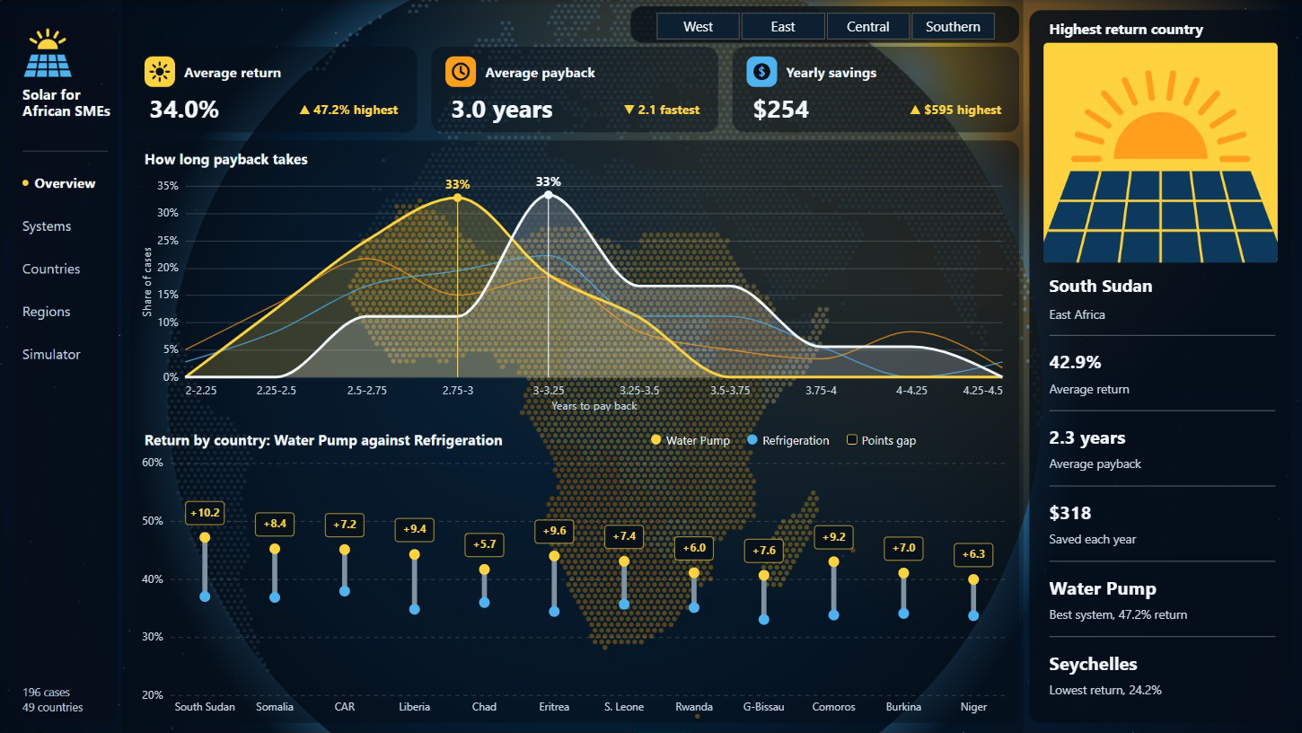
Solar for African SMEs
Does solar pay for itself for small businesses? A Power BI report on 196 cases across 49 African countries.
Bih Brandy Sango · Business Intelligence Analyst
Notes:
This deck sums up a Power BI report on whether solar systems pay back for small businesses in Africa. The data has 196 cases: 49 countries, each with four solar system types.

Slide 2
How long does solar take to pay for itself for a small African business?
THE QUESTION
196
49
4
4
cases in the data
African countries
regions: West, East, Central, Southern
solar systems, one per business type
Each case is one country and one system, with its price, yearly savings, return and payback. North Africa is not in the data.
Notes:
Every country appears four times, once for each system: a water pump for agriculture, refrigeration for cold storage, a larger home system for small manufacturing and a small home system for food retail.

Slide 3
3.0 years
The short answer
On average, an SME earns back the full cost of its solar system in about three years, a 34.0% yearly return.
103 of 196 cases pay back in under 3 years
2.1 to 4.4 years from fastest to slowest
Notes:
The average payback is 3.0 years and the average return is 34.0%, ranging from 22.8% to 47.2%. More than half the cases, 103 of 196, pay back in under three years. Even the slowest case pays back in 4.4 years.

Slide 4
The most expensive system pays back fastest
BY SYSTEM
System and business | Price | Saved a year | Return | Payback
Water Pump, agriculture | $1,261 | $472 | 37.4% | 2.7 years
Small SHS, food retail | $194 | $68 | 35.1% | 2.9 years
Larger SHS, small manufacturing | $572 | $187 | 32.6% | 3.1 years
Refrigeration, cold storage | $941 | $289 | 30.7% | 3.3 years
Price does not decide payback. The water pump costs the most, but it saves the most each year, so it earns its cost back first.
Notes:
SHS means solar home system. Each system’s price is the same in every country, so differences between systems come from how much each one saves a year. Refrigeration takes longest at 3.3 years.

Slide 5
West Africa pays back five months sooner than Southern Africa
BY REGION
West Africa
35.5% · 2.8 years
East Africa
34.3% · 3.0 years
Central Africa
33.5% · 3.1 years
Southern Africa
31.0% · 3.3 years
Average return and payback. The water pump leads and refrigeration trails in every region, so the system choice matters more than the place.
Notes:
West Africa has 16 countries, East Africa 15, and Central and Southern Africa 9 each. West Africa returns 4.5 points more than Southern Africa and pays back about 5 months sooner.

Slide 6
Even the lowest country pays back in about four years
BY COUNTRY
Highest return
Lowest return
Country | Return
South Sudan | 42.9%
Somalia | 41.6%
Central African Rep. | 40.6%
Country | Return
Seychelles | 24.2%
Mauritius | 26.2%
Angola | 26.5%
Prices are the same in every country, so these gaps come only from how much a business saves each year.
Notes:
South Sudan returns 42.9% and pays back in 2.3 years. Seychelles is lowest at 24.2%, which is still about 4.1 years to pay back.

Slide 7
Only 9 of 196 cases are rated moderate
FINANCIAL BENEFIT
81
106
9
Very high
High
Moderate
2.6 years to pay back
3.2 years to pay back
4.2 years to pay back
The rating follows payback closely: the faster a system pays back, the higher its rating.
Notes:
The counts and average payback come from the Financial Benefit Level column in the data. Very high cases average 2.6 years, high 3.2 years and moderate 4.2 years.

Slide 8
A 20% subsidy cuts payback from 3.0 to 2.4 years
WHAT IF
Subsidy needed for a two-year payback
2.4 yrs
42.5%
payback, from 3.0
return, from 34.0%
System | Subsidy
Water Pump | 25%
Small SHS | 30%
Larger SHS | 35%
Refrigeration | 39%
$148
average subsidy per system
Scenario from the report’s simulator, with savings unchanged. The subsidy is a what-if, not part of the data.
Notes:
The simulator lets you pick a subsidy from 0 to 50% and a change in yearly savings from minus 20% to plus 30%. At 30% subsidy, average payback falls to 2.1 years. The two-year figures use each system’s average price and savings: the water pump needs 25.2%, small SHS 29.9%, larger SHS 34.7% and refrigeration 38.5%.

Slide 9
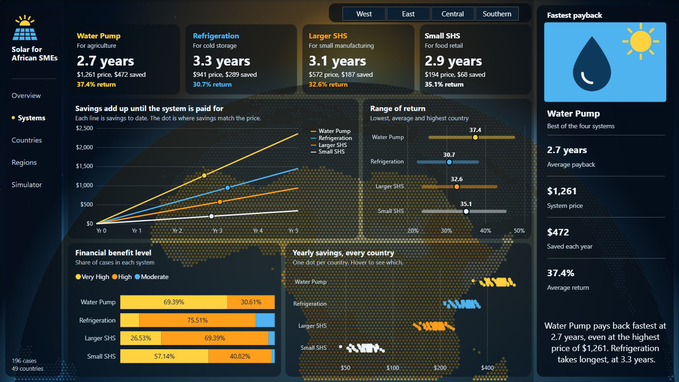
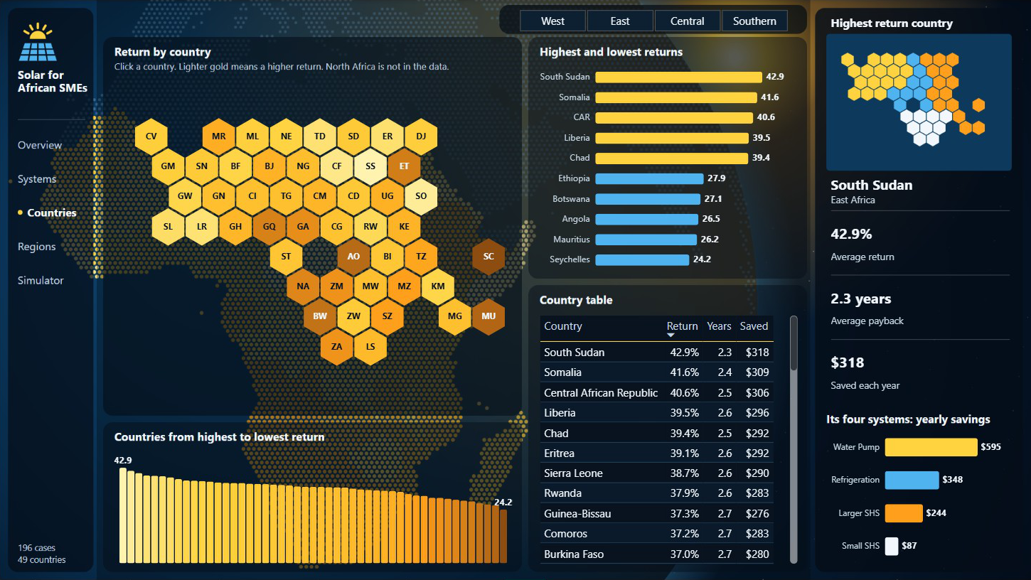
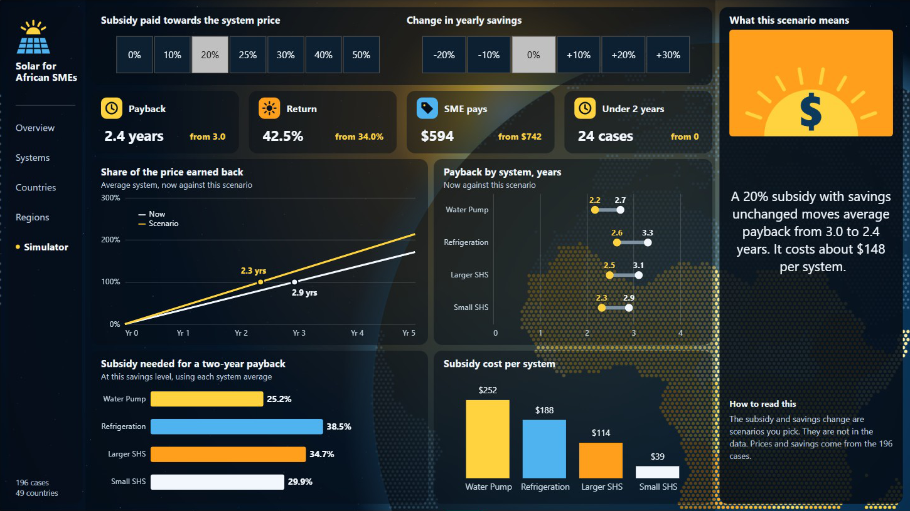
Five pages, each built on a globe of Africa
THE REPORT
Systems: click a card to see that system
Countries: a clickable map of 49 countries
Simulator: test a subsidy and see payback change
The Overview and Regions pages complete the set. A region filter carries across pages, and every chart answers to clicks.
Notes:
The report has five pages: Overview, Systems, Countries, Regions and Simulator. Each page has its own view of the globe as its background. The charts sit on top and respond to the region buttons and to clicks.

Slide 10
Where solar money goes furthest
WHAT TO DO
Lead with water pumps
Use partial subsidies
They return 37.4% and pay back in 2.7 years, the best of the four, for farms.
About 25% brings a water pump to a two-year payback. Full grants are not needed.
Support cold storage
Fill the data gaps
Refrigeration is slowest at 3.3 years and needs the largest subsidy, about 39%.
Add North Africa, local prices and dates, so the report can track change over time.
Notes:
These suggestions come from the figures in the report. Prices in the data are the same in every country, so local prices would sharpen the country comparison.

Slide 11
Power BI, DAX and Deneb
HOW IT WAS BUILT
LIMITS OF THE DATA
No dates. The report shows a snapshot, not a trend.
One price per system. Country differences come only from savings.
Part | What it does
Data model | Cases, countries, systems and benefit levels
DAX | 58 measures, including the simulator
Deneb | Custom charts and the clickable map
Background | A dotted globe drawn from the data
No North Africa. Five countries are missing.
Return is yearly savings over price, before maintenance, finance or battery costs.
Notes:
Return in the data is yearly savings divided by price, and payback is price divided by yearly savings. The data does not include running costs, so real payback may be longer.

Slide 12

Bih Brandy Sango
Business Intelligence Analyst · Power BI and Microsoft Fabric
github.com/bihbrandysango-cloud/solar-sme-financial-impact
bihbrandysango-cloud.github.io
Notes:
The full report, data and walkthrough video are on GitHub and on the portfolio website.

