Slide 1
HEALTHCARE ANALYTICS PROJECT
Vitalis
Healthcare data, transformed into decisions.
Six Power BI dashboard pages, a corrected SQL workbook, and a React web app — all built on a synthetic patient dataset of 20,000 appointments across 5 clinics.
PROJECT DOCUMENTATION

Slide 2
01 · INTRODUCTION
What this project is
Vitalis is a healthcare analytics project that analyses patient, financial, and operational data using Power BI dashboards. The objective is to understand patient demographics, service utilisation, financial performance, and operational efficiency across multiple clinic locations and medical specialties.
AT A GLANCE
$6M
Total revenue
5,000
Patients
20,000
Appointments
The project transforms raw healthcare data into meaningful insights that can support better decision-making and improved healthcare service delivery.
15,000
Diagnoses
5
Clinics
Vitalis Healthcare Project
2 / 14

Slide 3
02 · OVERVIEW
What the dashboards cover
Five comprehensive views built on the same underlying data — each one designed to answer a different question about the practice.
FINANCIAL
GEOGRAPHIC
CLINICAL
Money
Place
Specialty
Total revenue (~$6M), patient payments (~$3M), revenue by location, by specialty, by age group.
Patient distribution across Seattle, Spokane, Tacoma, Portland, and Olympia.
Appointment activity and revenue by Orthopedics, Cardiology, Oncology, Neurology, Pediatrics, General Medicine.
DEMOGRAPHIC
OPERATIONAL
People
Activity
Gender, age group, insurance provider, and city-based distributions of the patient base.
Appointments by status (Completed / Cancelled / No-show), by month, by day of week, and diagnosis counts.
Vitalis Healthcare Project
3 / 14

Slide 4
03 · DATA SCHEMA
Six tables, one fact table
Appointments is the central fact table. Billing, diagnoses, and medications all reference it via foreign keys.
patients
billing
appointments
doctors
patient_id
first_name
last_name
gender · dob
city · insurance
bill_id
appointment_id ↗
amount
insurance_covered
patient_paid
appointment_id
patient_id ↗
doctor_id ↗
date · status
visit_reason
doctor_id
doctor_name
specialty
clinic_location
medications
diagnoses
med_id
patient_id ↗
medication_name
dosage
start_date · end_date
diagnosis_id
appointment_id ↗
diagnosis_code
diagnosis_description
Vitalis Healthcare Project
4 / 14

Slide 5
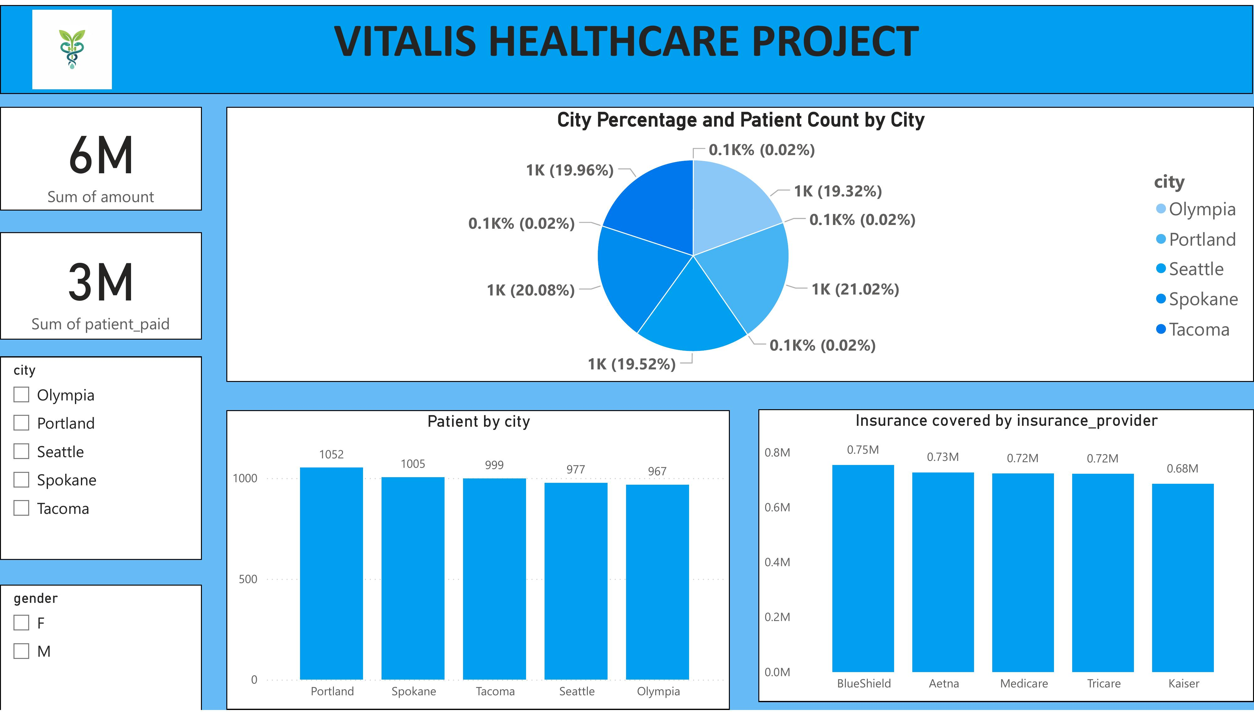
04 · DEMOGRAPHICS DASHBOARD
Who the patients are
KEY OBSERVATIONS
1
5,000 patients across 5 cities — almost evenly distributed
2
Portland leads with 1,052 patients; Olympia trails at 967
3
Insurance coverage is well-spread: BlueShield ($0.75M) just edges Aetna ($0.73M)
4
Gender split is balanced (F / M) across every city
Vitalis Healthcare Project
5 / 14

Slide 6
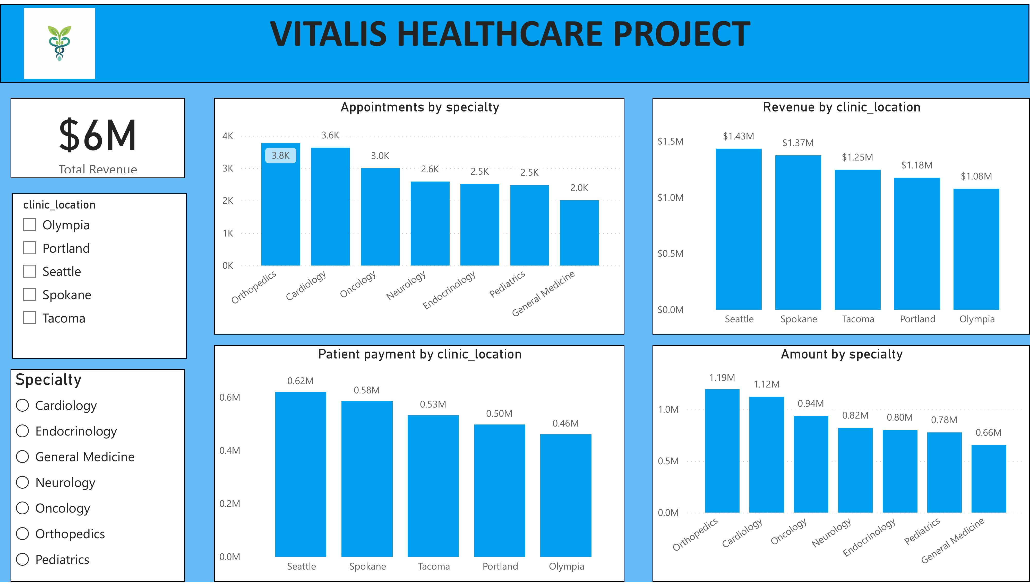
04 · SPECIALTY DASHBOARD
Where the revenue comes from
KEY OBSERVATIONS
1
Total revenue: $6M across all specialties and clinics
2
Orthopedics is the top specialty by revenue ($1.19M) and volume (3.8K appointments)
3
Seattle leads clinic revenue at $1.43M; Olympia trails at $1.08M
4
General Medicine is lowest-grossing at $0.66M
Vitalis Healthcare Project
6 / 14

Slide 7
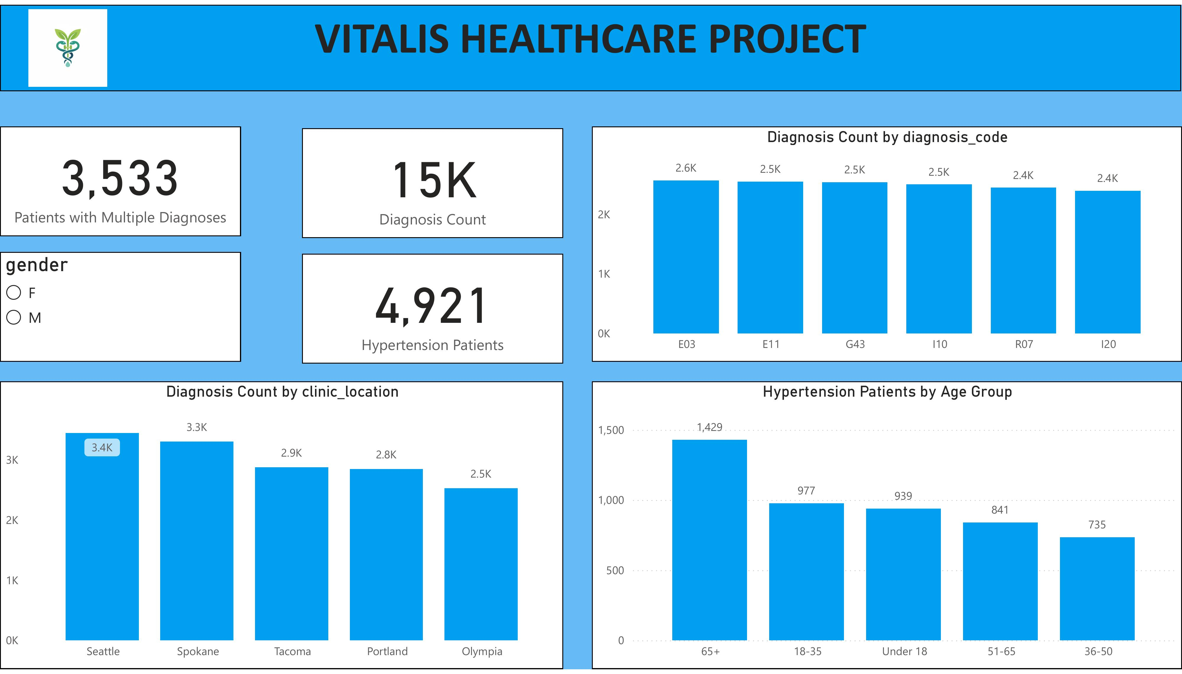
04 · DIAGNOSIS DASHBOARD
What the patients have
KEY OBSERVATIONS
1
15,000 diagnoses recorded across the patient population
2
4,921 patients carry a hypertension diagnosis (I10)
3
3,533 patients have multiple concurrent diagnoses
4
Diagnosis counts are roughly even across codes — no single condition dominates
Vitalis Healthcare Project
7 / 14

Slide 8
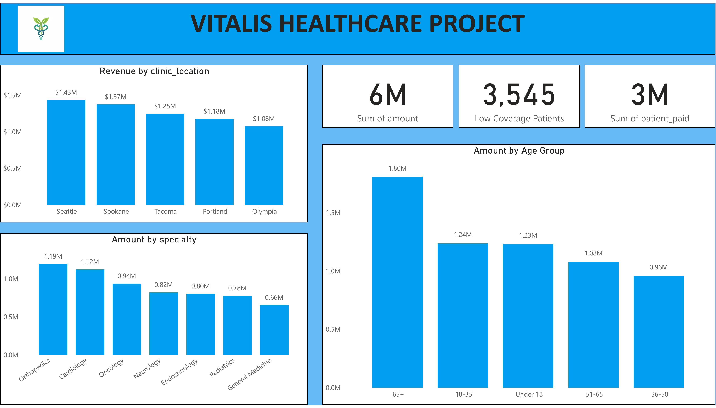
04 · FINANCIAL DASHBOARD
How the money flows
KEY OBSERVATIONS
1
$6M total billed · $3M paid by patients · 3,545 patients with low coverage
2
Age 65+ generates the highest billed amount: $1.80M
3
Orthopedics + Cardiology together drive $2.31M (39% of revenue)
4
Seattle clinic outperforms Olympia by 32% in revenue
Vitalis Healthcare Project
8 / 14

Slide 9
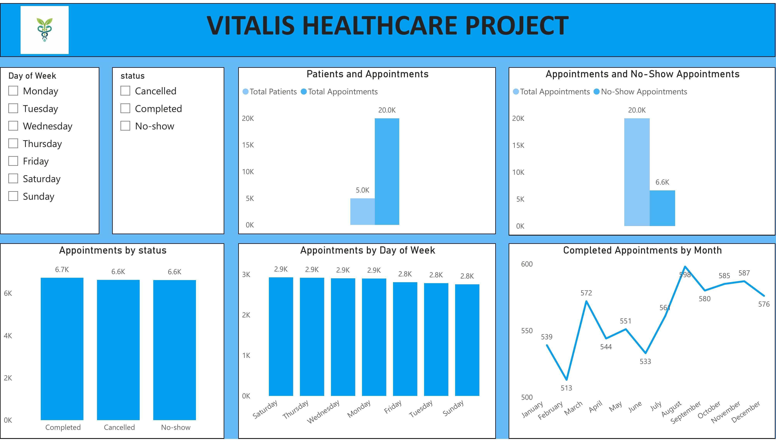
04 · OPERATIONS DASHBOARD
How the practice runs
KEY OBSERVATIONS
1
20,000 total appointments · 6.6K no-shows (33% — major operational drag)
2
Appointment volume is flat across weekdays (2.8K–2.9K) — no peak day
3
Completed appointments peaked in August at 598
4
Status distribution is nearly even: 6.7K completed / 6.6K cancelled / 6.6K no-show
Vitalis Healthcare Project
9 / 14

Slide 10
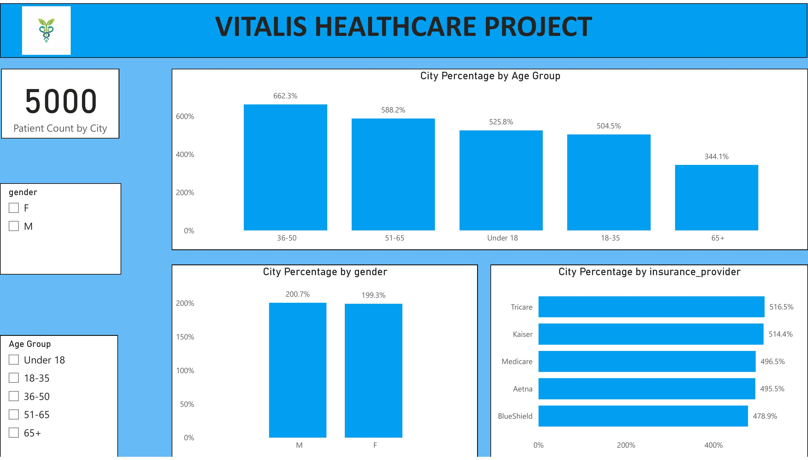
04 · PATIENT BREAKDOWN
Population distribution
KEY OBSERVATIONS
1
All 5,000 patients accounted for across cities
2
Age 36-50 is the largest cohort by city share
3
Gender distribution within cities is near 50/50 (M 200.7% vs F 199.3% summed)
4
Insurance providers split evenly — Tricare and Kaiser slightly ahead
Vitalis Healthcare Project
10 / 14

Slide 11
05 · KEY INSIGHTS
What the data tells us
$1.43M
33%
$1.19M
Seattle leads
No-show rate
Orthopedics tops
top-grossing clinic location
~6.6K missed appointments — costly
highest-revenue specialty
4,921
$1.80M
3,533
Hypertension patients
Age 65+ revenue
Multi-diagnosis pts.
98% of the active patient base
highest-spending age cohort
carry more than one chronic condition
Vitalis Healthcare Project
11 / 14

Slide 12
06 · RECOMMENDATIONS
What to do about it
Five concrete actions, ranked by expected impact.
01
Reduce no-show rates
Implement automated SMS/email reminders and easier rescheduling. Industry data suggests this cuts no-shows by ~30%, recovering significant capacity.
02
Strengthen chronic disease management
Develop targeted programs for hypertension and diabetes. 3,533 patients carry multiple diagnoses — coordinated care reduces complications and repeat visits.
03
Optimise high-revenue specialties
Invest in Orthopedics and Cardiology (the top two revenue producers): specialist staffing, equipment upgrades, throughput improvements.
04
Improve lower-revenue locations
Audit Olympia and Portland (lowest-grossing clinics): access, staffing, specialty mix. Localised improvement plans can close the gap with Seattle.
05
Enhance preventive care for 65+
Patients 65+ generate the highest treatment costs ($1.80M). Expand screening and preventive programs to manage long-term cost and improve outcomes.
Vitalis Healthcare Project
12 / 14

Slide 13
07 · COMPONENTS
How the project is built
Three pieces fit together: data layer, analytics layer, presentation layer. Each can be developed and deployed independently.
01
Data layer
02
Analytics layer
03
Presentation layer
SQL
Power BI
Vitalis Web App
PostgreSQL schema with 6 tables.
17 analytical queries answering business questions about patients, doctors, revenue, diagnoses.
Common pitfalls (integer division, name collisions in GROUP BY, lexicographic comparison) flagged and fixed.
6 interactive dashboard pages (Demographics, Specialty, Diagnosis, Financial, Operations, Patient).
23 DAX measures: counts, ratios, period comparisons, classifications.
Sort-by columns for chronologically-ordered axes (Age Group, Day of Week, Month).
React + Vite + Tailwind + Recharts.
Mirror of the Power BI dashboards with cross-filtering, light/dark mode, LocalStorage persistence.
Three pages: Dashboard, Add Record, Settings — all built on the same dataset.
Vitalis Healthcare Project
13 / 14

Slide 14
VITALIS
KEY TAKEAWAY
Summary
Healthcare data, transformed into action.
This project demonstrates how patient, financial, and operational data can be transformed into actionable insights using SQL, Power BI, and a modern web stack.
The analysis surfaces strong revenue performance in specific locations and specialties, operational inefficiencies (notably a 33% no-show rate), and the disproportionate impact of chronic disease and aging populations on healthcare costs.
Acting on these findings can improve patient outcomes, operational efficiency, and financial sustainability simultaneously — and the dashboards make those decisions easier to make.
14 / 14

