Slide 1
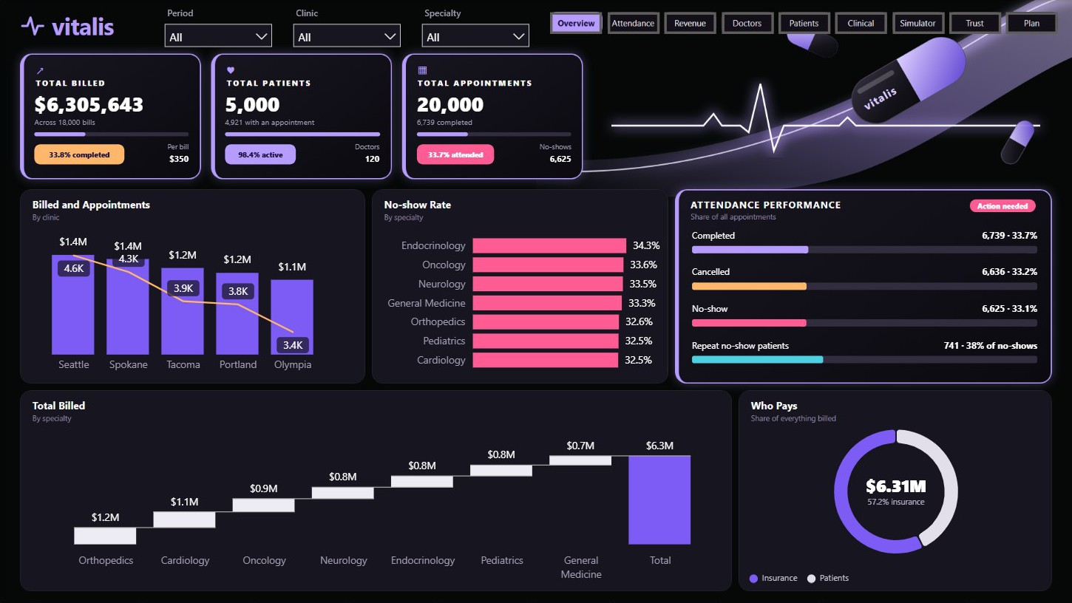
Vitalis Healthcare
POWER BI PITCH
Two in three booked visits never happen. Here is what to do about it.
Bih Brandy Sango. Based on a synthetic dataset.
Notes:
This pitch is about five clinics, 20,000 appointments and one question: where do the visits go? The data is synthetic, so treat this as a demonstration of the analysis and of how I would present it to a clinic’s leadership.

Slide 2
Two in three visits do not happen
33.7%
33.2%
33.1%
Attended
Cancelled
No-show
6,739 visits
6,636 visits
6,625 visits
20,000 appointments, 5 clinics, 120 doctors, December 2024 to December 2025
Notes:
Vitalis booked 20,000 appointments. Only about a third were completed. The other two thirds split almost evenly between cancellations and no-shows, and that pattern holds in every clinic and specialty, so this is a practice-wide problem.

Slide 3
Only a third of billing is on completed visits
$2.13M
$2.10M
$2.07M
Completed visits
Cancelled visits
No-shows
$6.31M billed
$4.18M to audit
Across 18,000 bills. I call this “billed”, not “revenue”.
Sits on visits that were cancelled or missed.
Insurers cover 57.2% of what is billed and patients 42.8%
Notes:
The practice has billed 6.31 million dollars, but only 2.13 million sits on completed visits. A real clinic would need to know why bills exist for visits that did not take place, before calling this revenue. That is why the report says billed.

Slide 4
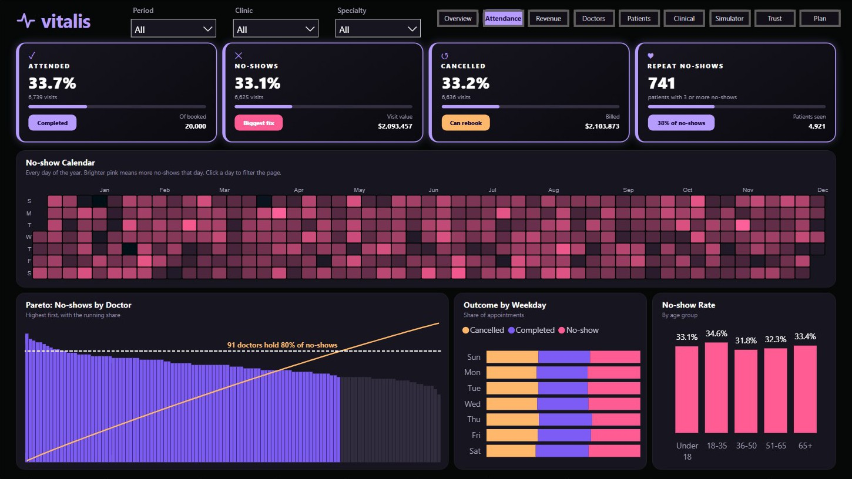
Repeat no-shows are a clear target
741
patients with three or more no-shows account for 38% of all no-shows.
It takes 91 of 120 doctors to reach 80% of no-shows, so targeting patients beats targeting doctors
Notes:
No-shows are spread across almost every doctor, so a doctor-level fix would not go far. Patients are a better place to start. 741 people, about 15% of patients seen, are behind 38% of no-shows, and reminders can start with them.

Slide 5
Clinic size follows headcount
Clinic | Doctors | Billed | Per doctor
Seattle | 28 | $1.43M | $51K
Spokane | 26 | $1.37M | $53K
Tacoma | 23 | $1.25M | $54K
Portland | 23 | $1.18M | $51K
Olympia | 20 | $1.08M | $54K
Seattle bills the most because it has the most doctors. Each doctor bills about the same everywhere.
No-show rates across clinics sit between 32.2% and 33.6%
Notes:
A simple ranking would say Seattle is the best clinic and Olympia the worst. Per doctor, the gap almost disappears, and no-show rates barely differ either. So I would not build the plan around ranking clinics.

Slide 6
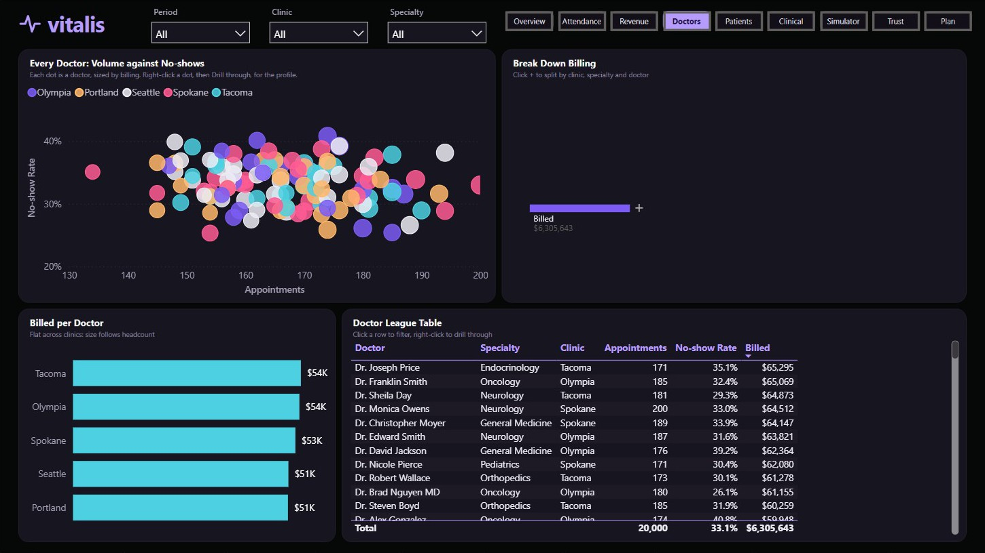
One report answers each question
Page | It answers
Overview | How is the practice doing?
Attendance | Who misses visits, and when?
Revenue | Where does billing sit?
Doctors | How does each doctor compare?
Patients | Who are the patients?
Clinical | What conditions are treated?
Simulator | What is a fix worth?
Data Trust | What should be checked?
Plan | What should happen next?
Every chart filters the page when clicked, so a manager can follow a question down to one doctor.
Watch every page: bihbrandysango-cloud.github.io/projects/vitalis
Notes:
I built the report around the questions a practice manager asks. Each page answers one, and clicking any chart filters the page, so a manager can go from the whole practice to a clinic, a specialty or one doctor in a few clicks.

Slide 7
Cutting no-shows has a clear value
Cut 10%
Cut 20%
Cut 30%
+$209K
+$419K
+$628K
663 more visits
1,325 more visits
1,988 more visits
37.0% attendance
40.3% attendance
43.6% attendance
Today’s attendance is 33.7%. Managers can change the cut and add rebooked cancellations in the report.
Assumes $316 per recovered visit, the billing per completed visit. This sizes the opportunity and is not a forecast.
Notes:
The simulator in the report sizes the opportunity. A 20% cut in no-shows brings back 1,325 visits, worth about 419 thousand dollars at 316 dollars a visit. That is an assumption, and the percentages are illustrations. They do not promise what reminders will achieve.

Slide 8
Three actions to start with
1
2
3
Audit billing on missed visits
Target repeat no-show patients
Rebook cancellations at once
Find out why $4.18M is billed on cancelled visits and no-shows.
Start reminders and a confirm-or-release rule with the 741.
Offer the next open slot when someone cancels.
Next: one bill per visit, cleaner specialty routing, and cost data so the report can show profit
Notes:
I would start with three things. First, audit the billing, because it affects every financial number. Second, aim reminders at the 741 repeat patients. Third, rebook cancellations straight away, since one in three bookings is cancelled. After that come the data fixes in the footer.

Slide 9
What to check before trusting the data
66.0%
40.2%
of bills are on cancelled visits or no-shows
of completed visits have no bill
34.0%
79.7%
of bills are extras on an already billed visit
of pediatric visits are by adults
The dataset is synthetic, so these are signs of how it was generated. In a real clinic each would need an answer.
Notes:
I put these checks in the report on purpose. They are live counts on the Data Trust page. The dataset is synthetic, which probably explains them, but I would ask the same questions of real clinic data before anyone made a decision from it.

Slide 10
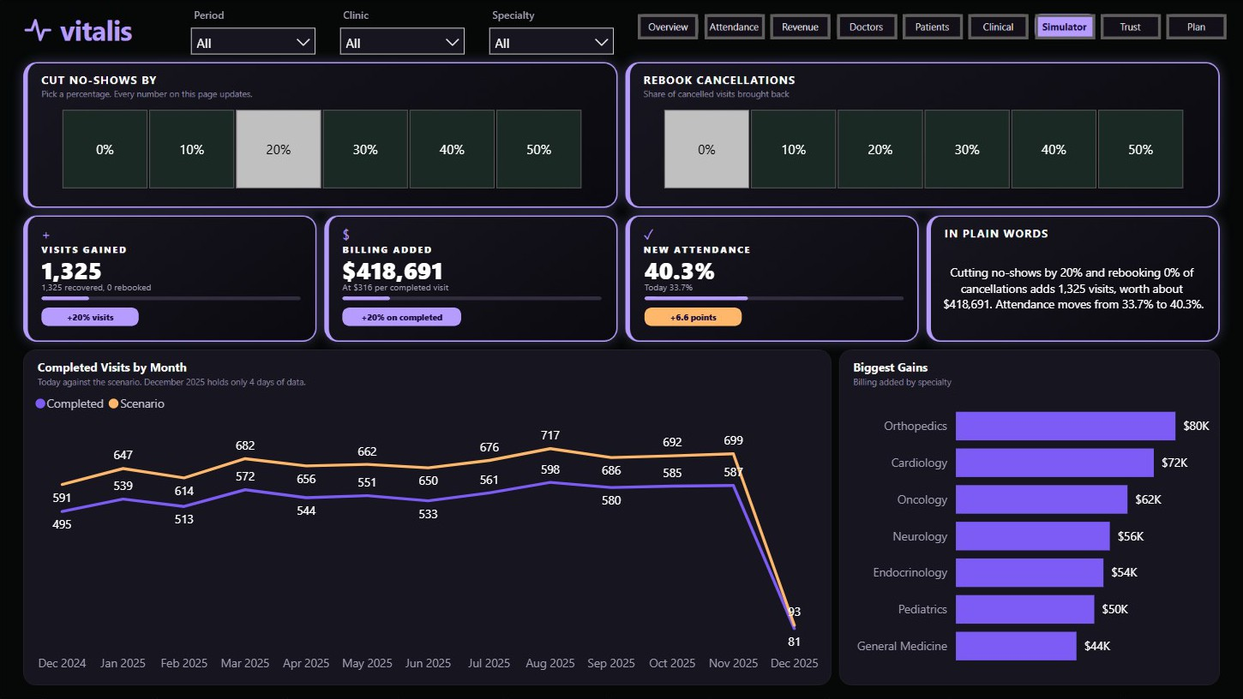
Built in Power BI from raw tables
6 source tables joined in a star-style model
61 DAX measures
Deneb for the calendar, Pareto chart and heatmap
Filters, a Play button and simulator tiles
Tools: Power BI Desktop, DAX, Power Query, Deneb
Notes:
For anyone who wants the technical side, I started from six raw tables and built the model in Power BI, with 61 DAX measures. Deneb draws the calendar, Pareto chart and heatmap, and the simulator runs on tiles that update every number on the page.

Slide 11
Start with the billing audit and the 741 patients.
A 20% cut in no-shows would bring back 1,325 visits, worth about $419K.
Bih Brandy Sango, Business Intelligence Analyst
Watch the report: bihbrandysango-cloud.github.io/projects/vitalis
Files: github.com/bihbrandysango-cloud/vitalis-healthcare
Notes:
If you take away one thing, start with the billing audit and the 741 repeat patients. The first makes the numbers trustworthy, and the second is the most direct way to get visits back. The report, its video and all the files are at these links.

