Slide 1
HERCULES 2019 Simulating beamline optics by ray-tracing using ShadowOui
Manuel Sánchez del Río
AAM, ISDD, ESRF
2019 March 27th

Slide 2
Goals Calculate main characteristics of synchrotron sources (dipoles and IDs) Simulating beamline optics by ray-tracing to obtain main parameters of beam size, energy resolution and flux Understand basic principles of x-ray optics: Reflective (aberrations, slope errors), Diffractive (dispersion) and Refractive (chromatic aberrations) A few words (only) about coherence

Slide 3



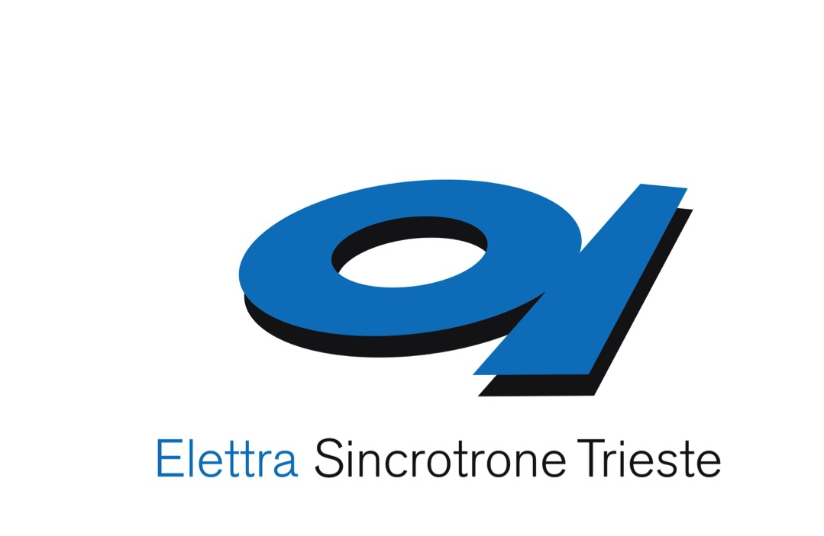
The OASYS Project
https://oasys-kit.github.io/
Manuel Sanchez del Rio
Luca Rebuffi
OASYS = OrAnge SYnchrotron Suite
A common platform to build synchrotron-oriented User Interfaces that communicate
The upper layer of the application presented to the user
Open Source & Python technology
Luca Rebuffi, Manuel Sanchez del Rio (2017)
OASYS (OrAnge SYnchrotron Suite) : an open-source graphical environment for x-ray virtual experiments
Proc.SPIE 10388: 10388-10388. http://dx.doi.org/10.1117/12.2274263
Notes:
Slide 3 – (..) : Content of the presentation
Insert a new slide: Home > “New Slide” and choose a slide Layout:
For Title & Subtitle
For text with bullet points
For Text
For Picture, graphs, visuals
Two columns
Blank
If you want Copy & paste an element from the Clip Board to the particular slide: 1. Click on a box to mark it.
2. Position the mouse pointer on the box frame: Copy! 3. Click on the particular slide: Paste!
How you intend to use the elements is your choice. You can combine the text block style with the background colour in different manner.

Slide 4
Synchrotron Virtual Experiments
Beamline Experiment Chain
Storage Ring
(e⁻ optics)
Radiation devices
(e⁻ -> γ)
Beamline
(γ optics)
Sample
(γ −matter interactions)
Suite of Add-ons
Shadow
XOP
crystal
X-ray server
WISE
WOFRY
COMSYL

Slide 5
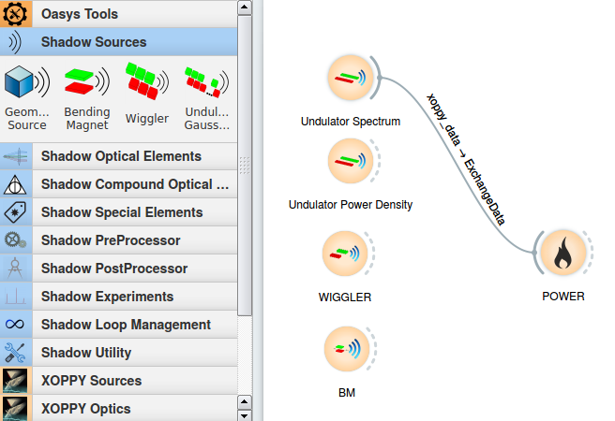
Source emission (XOPPY)
Undulator spectrum – power
Undulator power density
Wiggler spectrum
BM

Slide 6
Computer simulation of light sources and optical components is a mandatory step in the design and optimization of synchrotron and FEL radiation beamlines
different codes for numerical simulations are available, implementing different physical approaches
RAY-TRACING
WAVEFRONT
PROPAGATION
Shadow
RAY
SRW
PHASE
COMSYL
XRT
McXtrace
WISE
WOFRY
Notes:
Slide 3 – (..) : Content of the presentation
Insert a new slide: Home > “New Slide” and choose a slide Layout:
For Title & Subtitle
For text with bullet points
For Text
For Picture, graphs, visuals
Two columns
Blank
If you want Copy & paste an element from the Clip Board to the particular slide: 1. Click on a box to mark it.
2. Position the mouse pointer on the box frame: Copy! 3. Click on the particular slide: Paste!
How you intend to use the elements is your choice. You can combine the text block style with the background colour in different manner.

Slide 7
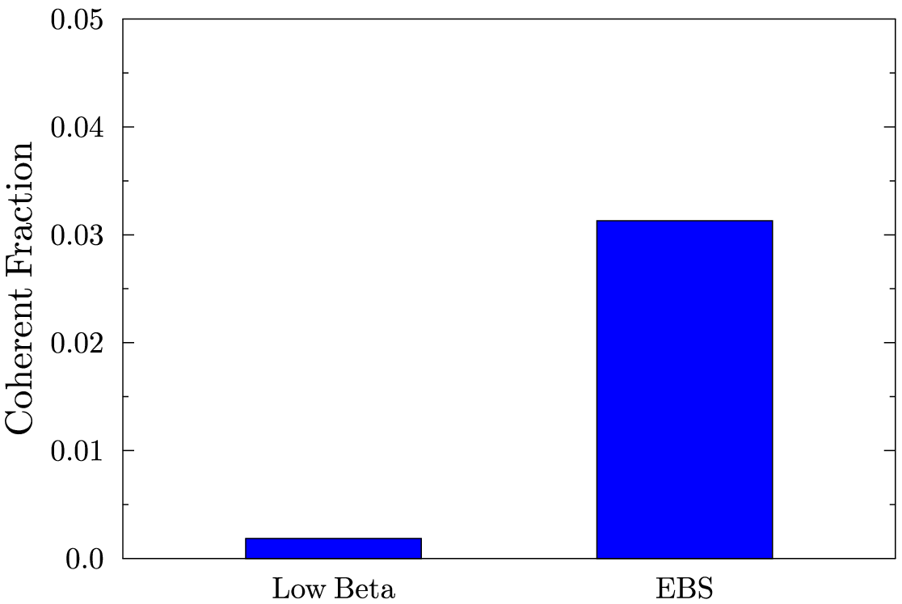
At HIGH ENERGIES, WE ARE FAR FROM DIFFRACTION-LIMIT (=FULLY COHERENCE) U17 2m @ 17 keV (K=0.4842) L=2m Coherent Fraction THEREFORE, ANY BEAMLINE SIMULATION MUST START WITH RAY TRACING (INCOHERENT BEAMS)
3.13 %
0.18 %

Slide 8
Oasys+ShadowOui
Install Oasys+ShadowOui:
https://github.com/oasys-kit/oasys-installation-scripts/wiki
Today: Use rnice.
Download Tutorials:
export all_proxy=http://proxy.esrf.fr:3128/
git clone https://github.com/srio/ShadowOui-Tutorial
Start OASYS:
oarsub –I –l nodes=1/cpu=1/core=8,walltime=10:00:00
/scisoft/XRayOptics/OASYS1_RNICE8/start_oasys.sh

Slide 9
Trace (the beamline)
z
Energy, Intensity
y
x
z
z
p
q
x
y
x

Slide 10

Compute e⁻ beam sizes
With ε the emittance (constant), and Twiss parameters:
At s (any point of the trajectory):
At waist (zero correlation, ρ=α=0, β is minimum):
ShadowOui asks for σ and ε at waist (plus distance from waist to center of device)

Slide 11
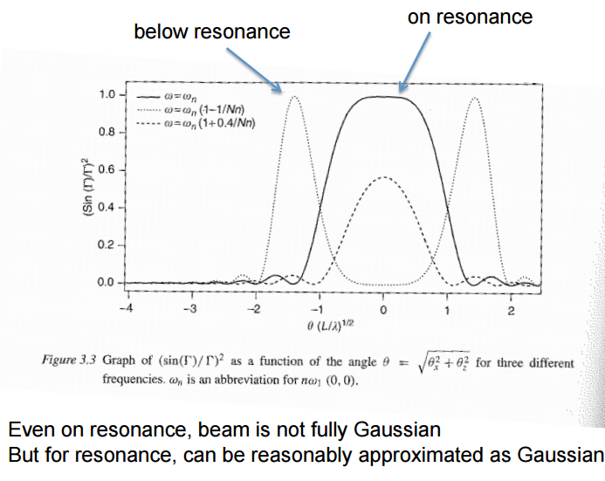
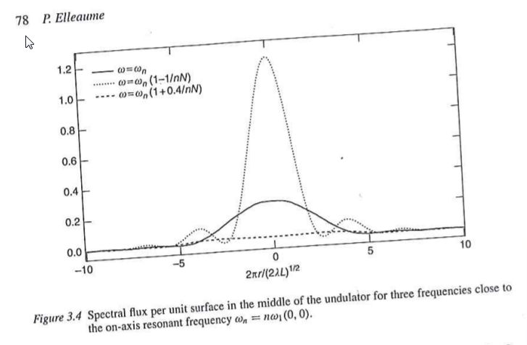
Onuki & Elleaume Undulators, Wigglers and their applications, CRC press, 2002
ex13_insertiondevices.ows
Undulator beams have not Gaussian profiles (even at resonances)
BY NOW, WE APPROXIMATE UNDULATORS BY GEOMETRIC SOURCES WITH GAUSSIAN SIZES AND DIVERGENCES

Slide 12
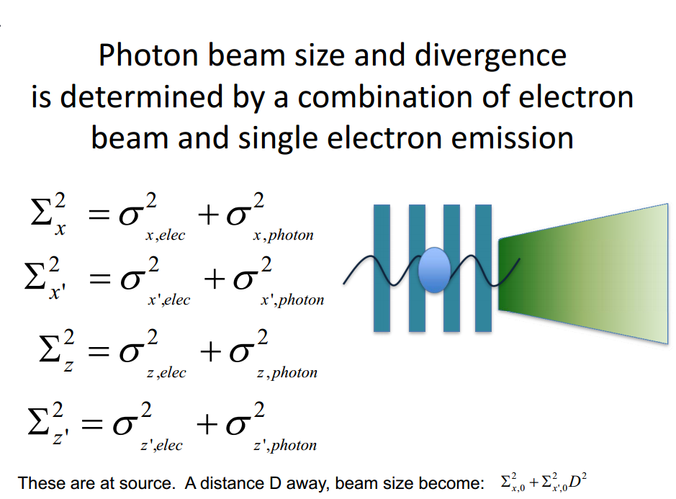
Courtesy: Boaz Nash
(FOR UNDULATORS, THESE FORMULAS ARE VALID AT THE WAIST, AT THE UNDULATOR RESONANCE, AND SUPOSSING GAUSSIAN EMISSION OF PHOTONS)
ShadowOui performs “numeric convolution” by Monte Carlo sampling of the electron beam [Gaussian] and photon emission [non Gaussian]

Slide 13
Optical elements
For each optics element SHADOW includes:
Geometrical model: how the direction of the rays are changed (reflected, refracted or diffracted)
Physical model: how the ray intensity (in fact electric fields) decreases because of the interaction
Structures along the surface =>playing with the direction
Structures in depth => playing with the reflectivity

Slide 14
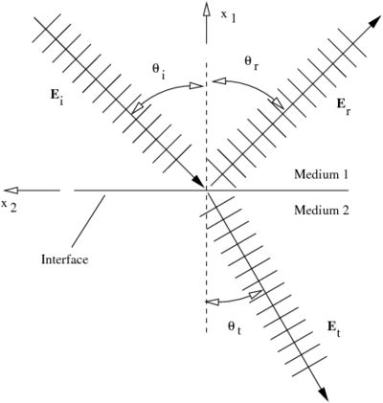
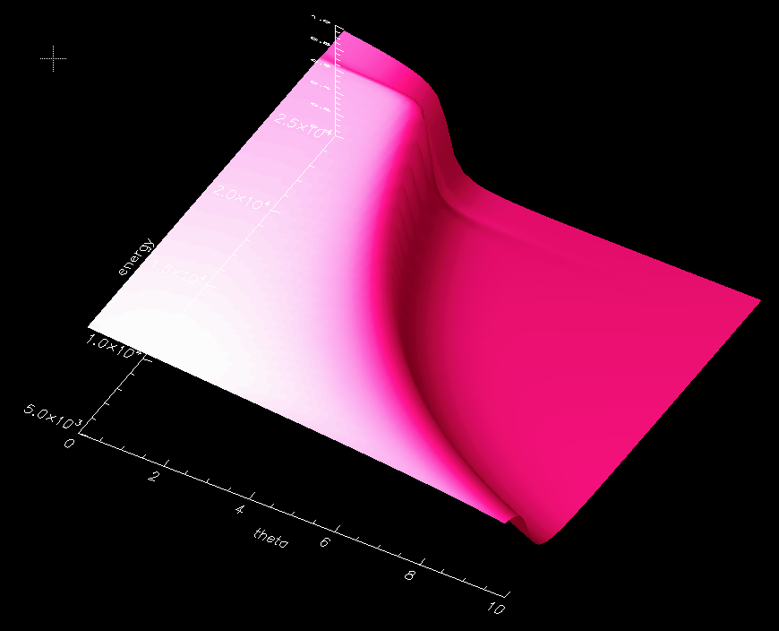

Mirrors Geometrical model Physical model
ex15_aberration.ows
Fresnel equations give the reflectivity as a function of angle and photon energy. As a consequence, one gets the critical angle:

Slide 15
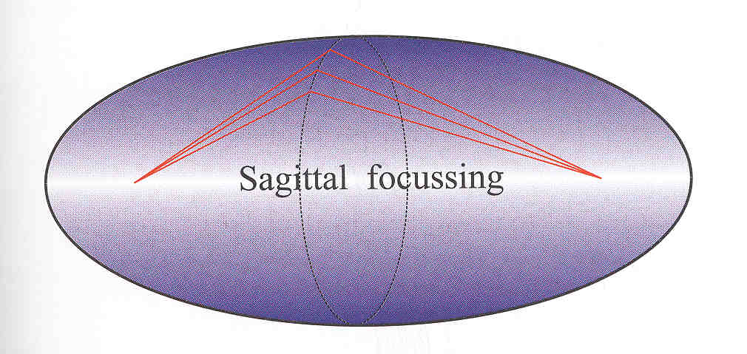
Mirror shape
ex15_aberration.ows
Point to point focusing (ellipsoid)
Collimating (paraboloid)
Focalization in two planes
Tangential or Meridional (ellipse or parabola)
Sagittal (circle)
Demagnification: M=p/q
Easier manufactiring:
2D: Ellipsoid => Toroid
Only one plane: cylinder Ellipsoid (ellipse)=> cylinder (circle)
Sagittal radius: non-linear (ellipsoid) => constant (cylinder) or linear (cone),
Aberrations
p
q
ρ
ρ

Slide 16
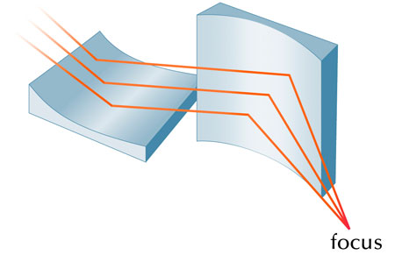
Kirkpatrick-Baez
ex16_kb.ows

Slide 17
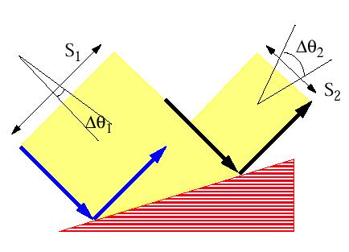
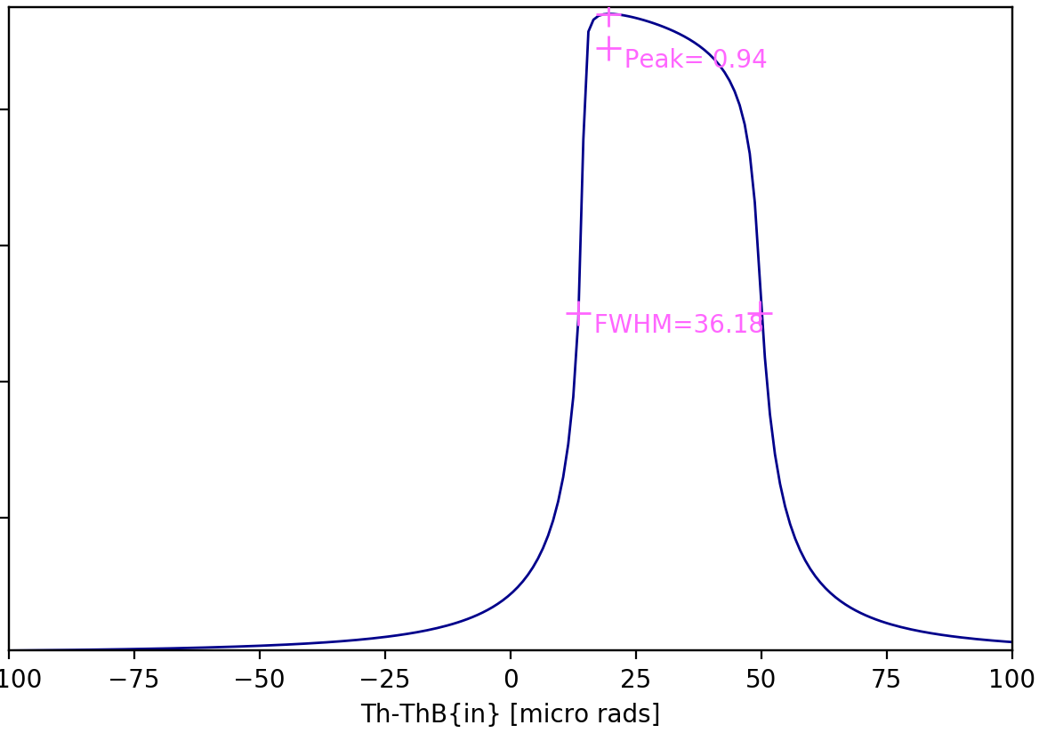
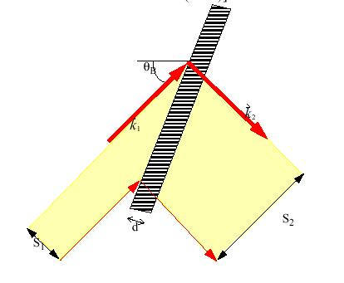
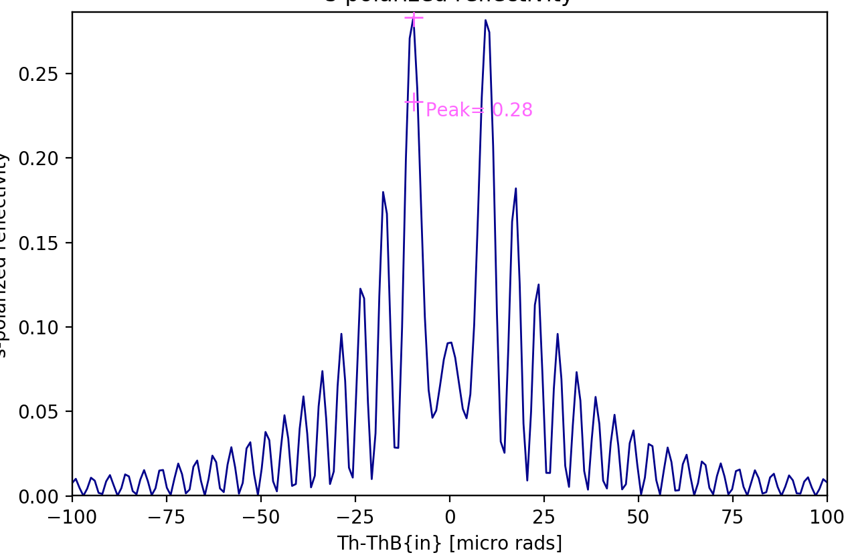
Crystals
Geometrical model
like a grating originated by the truncation of the Bragg planes with the crystal surface. Crystals are dispersive elements, except for the most used case of Bragg-Symmetric reflection.
Physical model
(crystal reflectivity) is given by the Dynamical Theory of Diffraction and gives the “Darwin width”
BRAGG or reflection
ex17_sagittalfocusing.ows
OTHER_EXAMPLES/crystal_analyzer_diced.ows
OTHER_EXAMPLES/crystal_asymmetric_backscattering.ows
LAUE or transmission
(ex23_crystal_laue.ows)

Slide 18
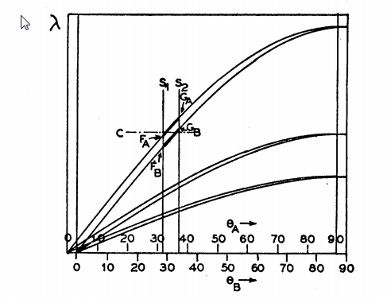
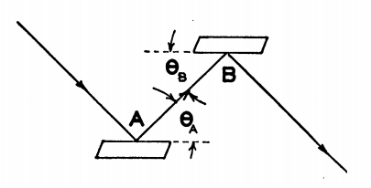
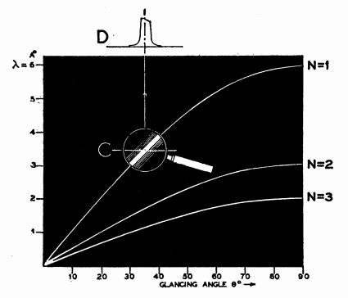
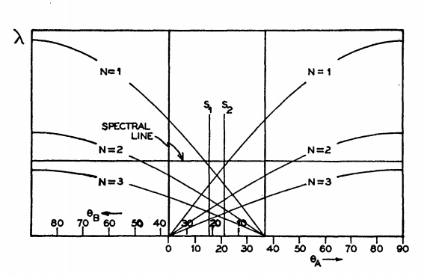
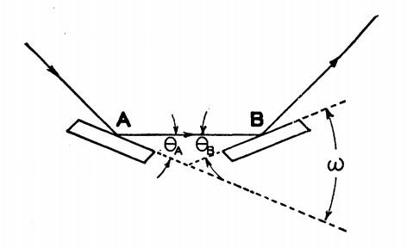
Theory of the Use of More Than Two Successive X-Ray Crystal Reflections to Obtain Increased Resolving Power J W. M. DuMond Phys. Rev. 52, 872 – (1937) http://dx.doi.org/10.1103/PhysRev.52.872
ex17_crystalmono.ows

Slide 19
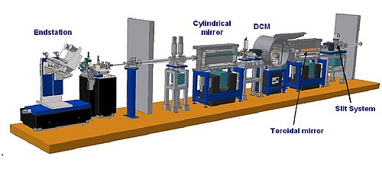
Other
ex19_beamline.ows

Slide 20

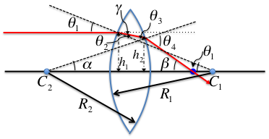
LENSE = TWO INTERFACES Geometrical model Physical model
absorption in media
I/I₀ = exp(-μ t)
(OTHER_EXAMPLES/lens_elliptical.ows)
OTHER_EXAMPLES/CRL_Snigirev_1996.ows
ex24_transfocator.ows
CRL = n identical Lenses
TRANSFOCATOR = m different CRLs

Slide 21
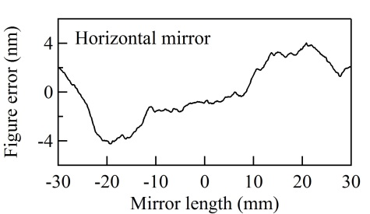
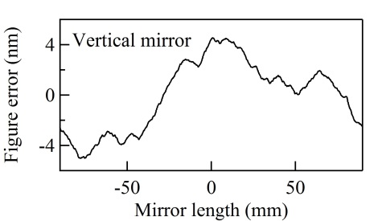
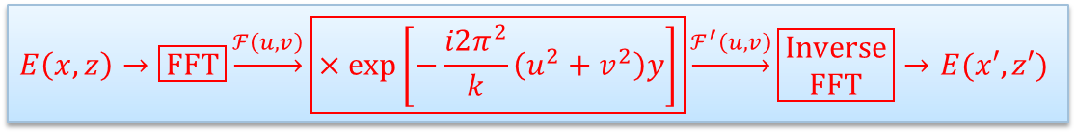
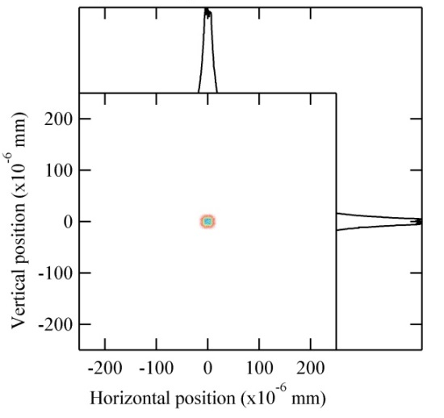
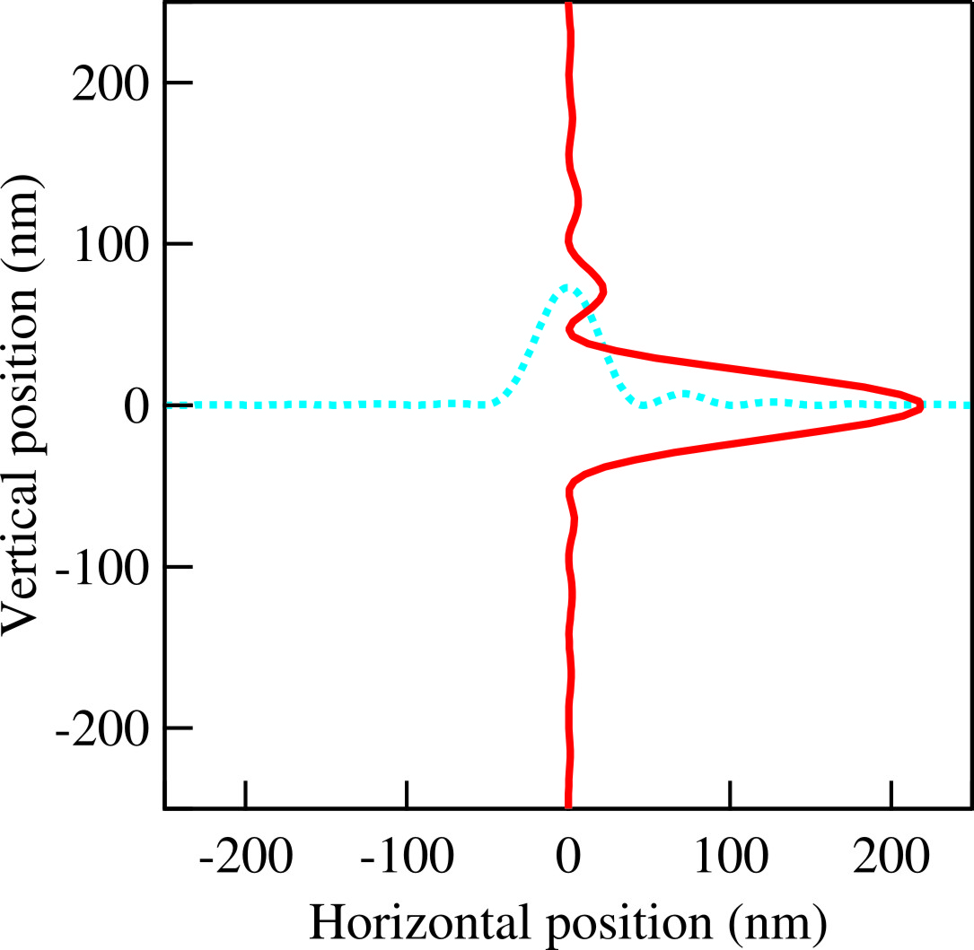
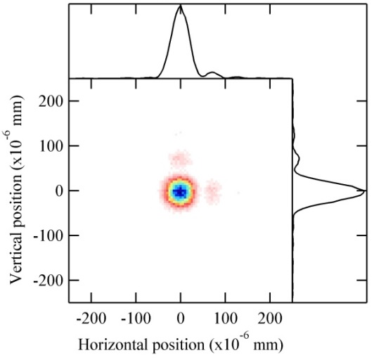


HYBRID METHOD IN SHADOW (X. Shi et al.) Combining ray tracing and wavefront propagation
Ideal lens with focal lengths of f_{x} and f_{z}
Ray tracing of the beamline

Slide 22
