Slide 1
Advances in Soft X-Ray beamlines design
Software for Optical Simulations WORKSHOP
Trieste October 3-7, 2016

Slide 2
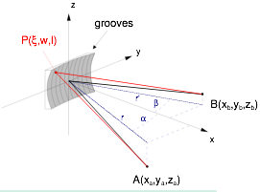
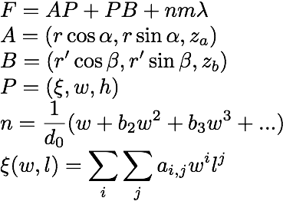
Toroidal Grating Optical Path Length
Fermat’s principle: Of all possible paths, light takes the path which requires the shortest time.

Slide 3
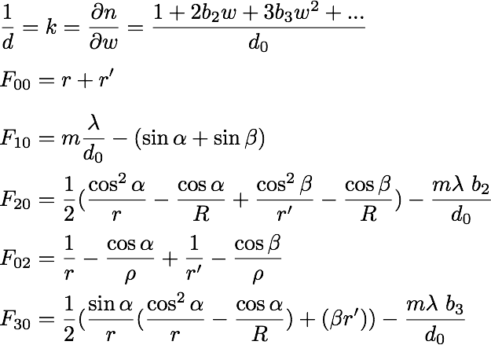
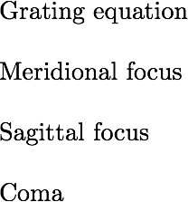
Main terms
Rowland Condition

Slide 4
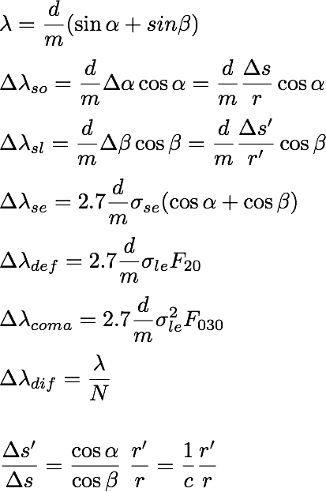
Resolution Terms and Magnification

Slide 5
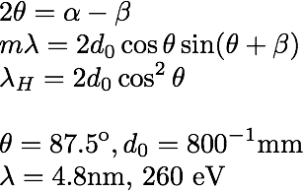
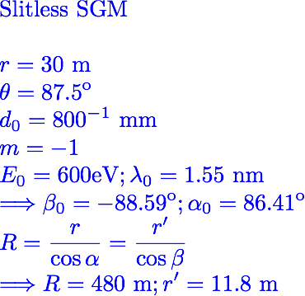
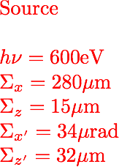
Spherical Grating Monochromator SGM
2θ
m=1 (SHADOW -1)
α
β
m=-1 (SHADOW 1)

Slide 6
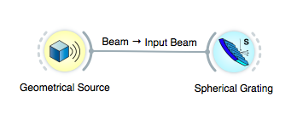
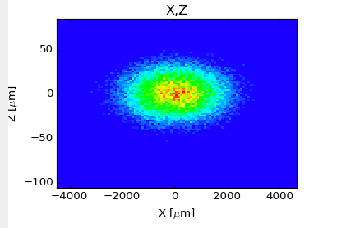
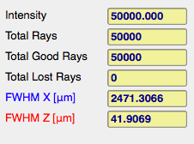
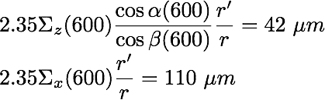
SGM Ray Tracing at 600 eV

Slide 7

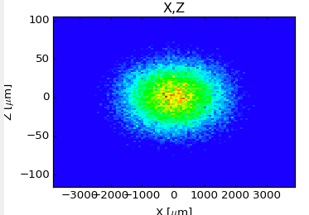
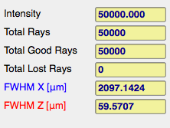
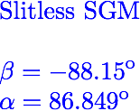
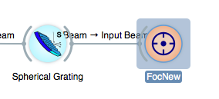

SGM Ray Tracing at 1000 eV
Not at focus

Slide 8


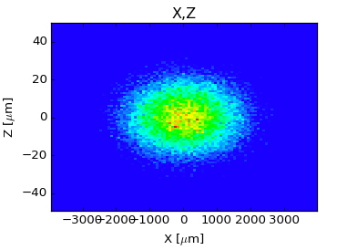
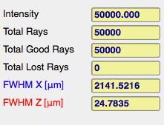
SGM Ray Tracing at 1000 eV, corrected

Slide 9
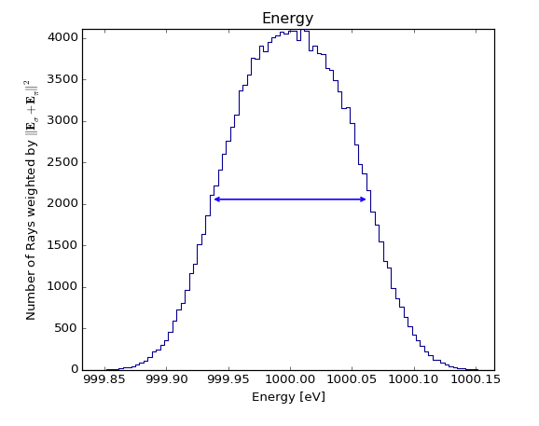
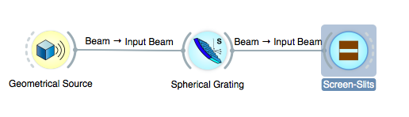

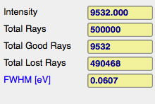
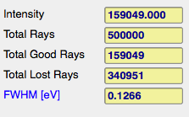
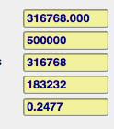
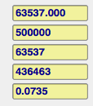
SGM Ray Tracings Resolution
3 µm
20 µm
50 µm
100 µm

Slide 10
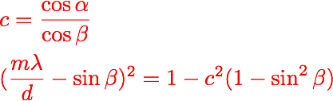

Plane Grating
Plane grating (without VLS) does not focus
Grating magnifies (or demagnifies), c factor

Slide 11
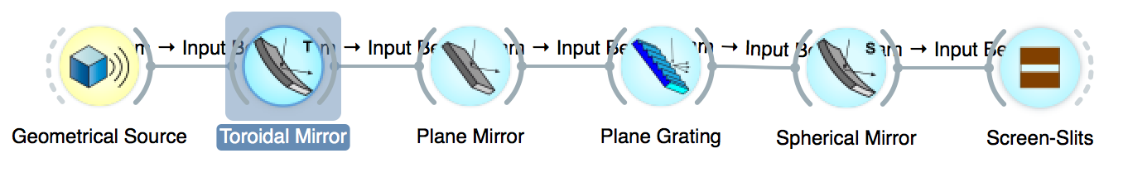
Collimated PGM, vertical plane; c=2
≈
28 m
2 m
1 m
≈
9 m
Toroidal Mirror:
Collimates beam in meridional direction (Vertically)
Focuses in sagittal direction at slit (horizontally)
Plane Mirror + Plane grating
Keeps outgoing direction
Controls grating magnification, c
Cylindrical Mirror
Focuses the collimated beam onto the exit slit

Slide 12
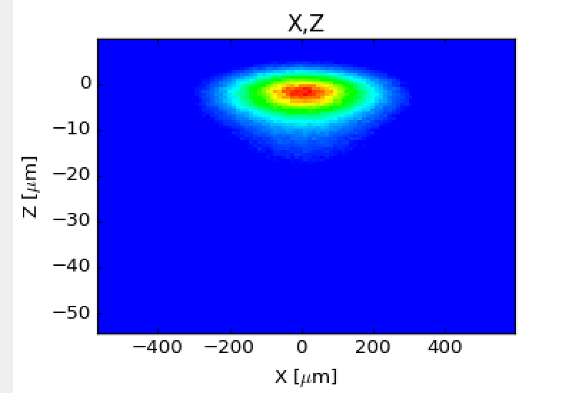
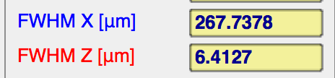
Collimated PGM, vertical plane; c=2
≈
28 m
2 m
1 m
≈
9 m

Slide 13
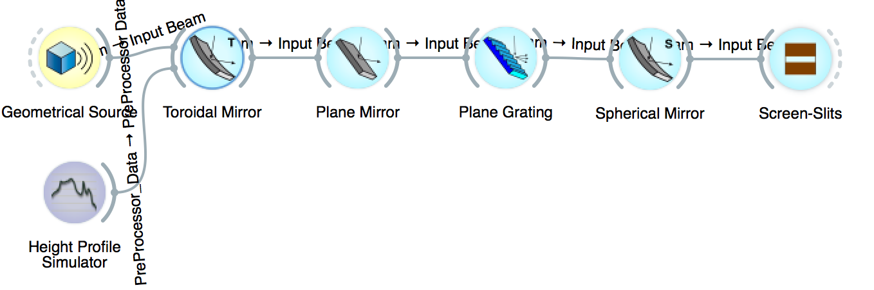
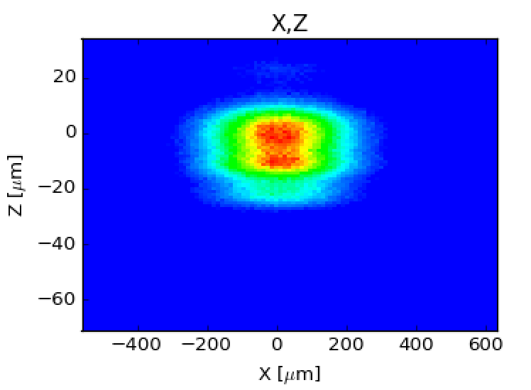
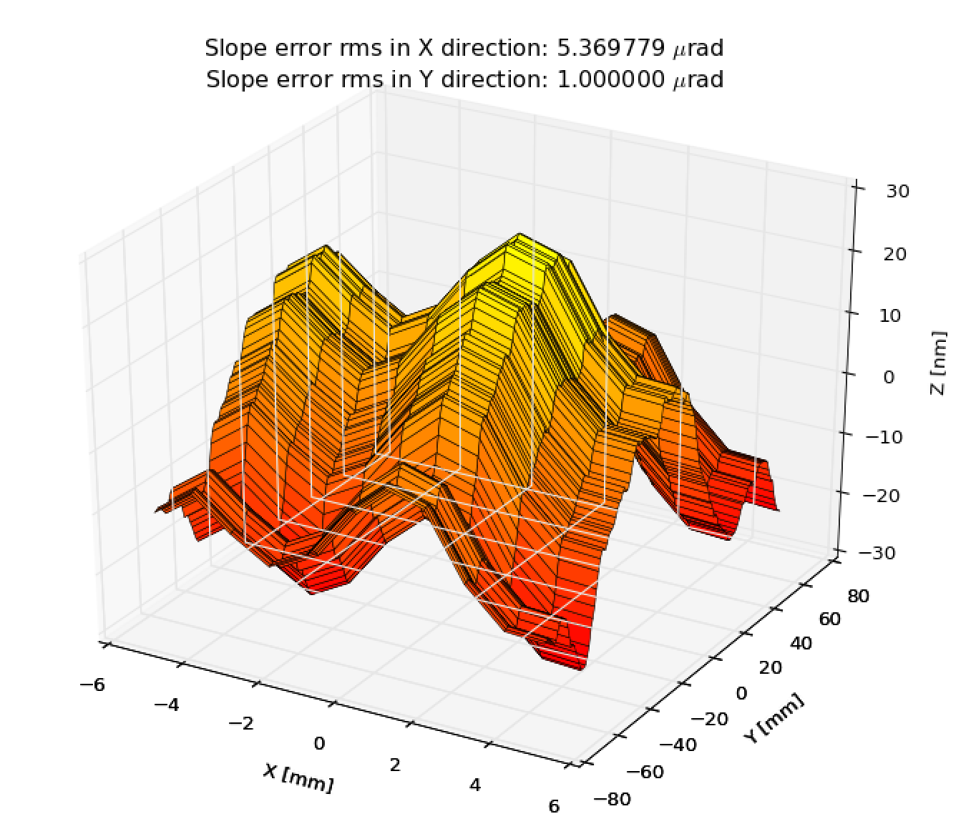
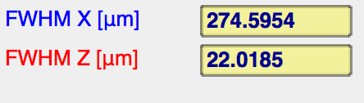
Collimated PGM, vertical plane; c=2

Slide 14
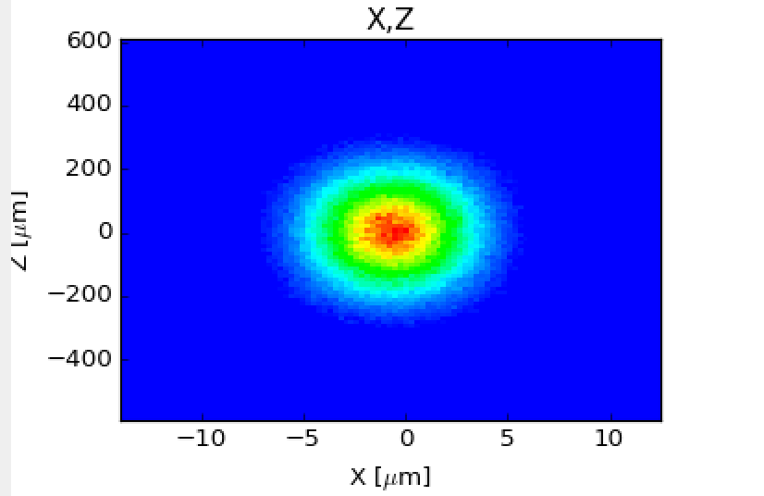
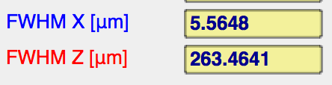
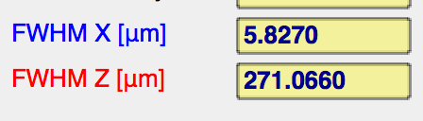
Collimated PGM, Horizontal plane; c=2
≈
28 m
2 m
1 m
≈
9 m
With slope errors

Slide 15
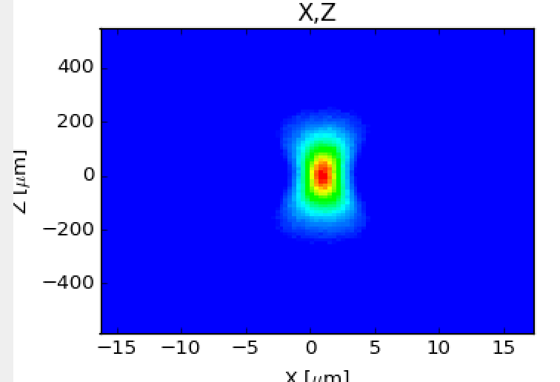
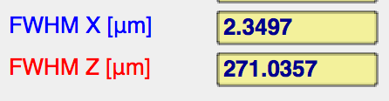
Collimated PGM, Horizontal plane; c=5
≈
28 m
2 m
1 m
≈
9 m
With slope errors
5.8/2.5=2.32

Slide 16
Why to go vertical
Why to go vertical
why an entrance slit function
Need to focus
Collimated, slope errors
SGM
PGM with ellipsoidal, slope errors
PGM collimated
VLS PGM spherical mirror
FVLSPGM
correction for bump
Follath optimized for elliptical

