Slide 1
EMPLOYEE RECRUITMENT SYSTEM
FOR GREEN LIGHT OVERSEAS
By
Binod Shrestha
Symbol No: 5466/14
T.U. Registration No. 7-2-1181-16-2014
Asian School of Management and Technology
A Summer Project Report Submitted to
Faculty of Management, Tribhuvan University
in partial fulfillment of the requirements for the degree of
Bachelor of Information Management

Slide 2
INTRODUCTION
Employee Recruitment System is the computerized system which is a web based system.
The system provides the information about the organization, the job vacancies for the foreign employment and the user can directly submit their information to apply for the job vacancies.
It is an initiative to recruit employees through the help of the system and prepare them for the foreign employment.
This will help user to know the job vacancies and can apply for the job without wasting time for visiting the organization.

Slide 3
INTRODUCTION OF THE ORGANIZATION
Green Light group of company is professional recruitment and career Development Company in Kathmandu, Nepal.
It has been at the forefront of the worldwide recruitment for over 15 years and has achieved ISO9001 certification: a reflection of its constant emphasis on quality and customer satisfaction.

Slide 4
PROBLEM DEFINITION
The company has not been able to use the computerized system to post about the organization and job vacancies for the user.
The company is taking longer time for the employee recruitment.
User need to get information through newspaper or visit the organization directly.

Slide 5
OBJECTIVES
To improve the time efficiency.
To improve performance.
To effectively recruit employees.
To eradicate manual system.
To provide user-friendly environment.
To properly manage the recruitment process of the company.

Slide 6
TASKS AND ACTIVITIES PERFORMED
Organization Selection
Getting the information about the organization
Understanding the existing system
Requirement analysis and specification
Functional Requirement
Non Functional Requirement

Slide 7
SOLUTION DESIGN
After analyzing the situation we came to know the possible solution can be to create a web based system that can recruit the employees in an effective manner:
Reduces the time taken to recruit the employees
Reduces the cost of recruitment process of the organization
Act as the advertisement factor from which people will know about the services of the organization.
It also helps to keep the record of the candidates.

Slide 8
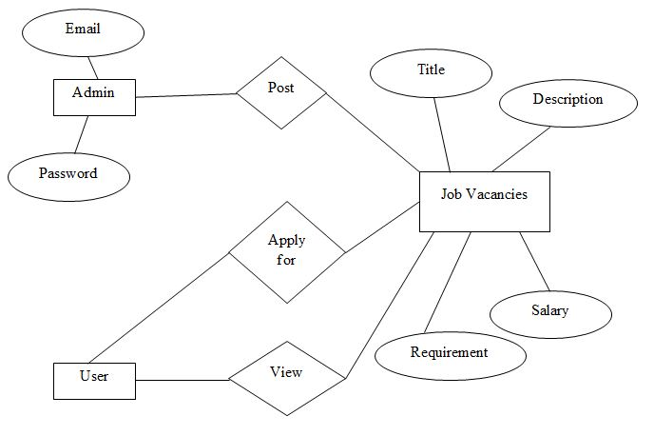
ER-DIAGRAM OF EMPLOYEE RECRUITMENT SYSTEM

Slide 9
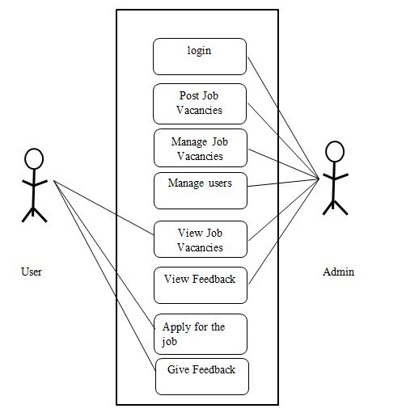
USE-CASE DIAGRAM OF EMPLOYEE RECRUITMENT SYSTEM

Slide 10
IMPLEMENTATION
The system was implemented through:
User Module
Admin Module
Validation and Testing
Client and server side validations.
Test cases for testing.

Slide 11
CONCLUSION
Project provided us practical knowledge of using open source frameworks for designing web applications.
It also taught us every steps in developing the software.
Finally the Employee recruitment system was implemented and presented in a computerized way.

Slide 12
FUTURE ENHANCEMENTS
Development and launching of Mobile app and refining existing services and adding more service.
More interactive user interface can be designed.
This system being web-based and an undertaking of Cyber Security Division, needs to be thoroughly tested to find out any security gaps.

Slide 13
BIBLIOGRAPHY
http://green-lightgroups.com/en/home_en/ [2017/06/28]
http://www.jobsnepal.com/ [2017/06/29]
https://www.merojob.com [2017/06/29]

Slide 14
THANK YOU
Demo of the Project

