Slide 1
ADAPTIVE RENDERING ENGINE
A Runtime that Selects the Optimal Web Rendering Strategy per Request
Mid-Term Project Presentation
Submitted by
Bijay Bk (220305) • Devendra Pandey (220306)
Manish Joshi (220312) • Pramod Panta (220317)
Under the Supervision of
Er. Robinhood Khadka
Department of ICT and Computer Engineering
Cosmos College of Management & Technology (Affiliated to Pokhara University)
Bachelor of Engineering in Computer • June 2026

Slide 2
Introduction
• The Adaptive Rendering Engine (ARE) is a runtime that automatically selects the best web rendering strategy for every request.
• It chooses among six strategies: SSG, SSR, Streaming SSR, ISR, CSR and simulated Edge-ISR.
• The decision is based on live context: network speed, device type, cache freshness, server load and data volatility.
• Built as technology (an engine) — not an application — using only open-source tools at zero budget.
• Runs locally on a Docker-based private server; no commercial cloud needed.
Adaptive Rendering Engine | Mid-Term Presentation
2

Slide 3
Problem & Motivation
• Frameworks like Next.js and Remix support many rendering strategies …
– but the strategy is fixed by the developer at build time.
– the same strategy is applied to every user, regardless of context.
• Poor, static choices lead to:
– high Time-to-First-Byte (TTFB) and excessive JavaScript hydration;
– increased server load and poor experience on low-end devices.
• Core problem: there is no automated system that selects the optimal rendering strategy at runtime based on real-time context.
Adaptive Rendering Engine | Mid-Term Presentation
3

Slide 4
Objectives
• General Objective:
– Design, implement and evaluate an engine that selects rendering strategies at runtime to optimise web performance.
• Specific Objectives:
– Define the contextual variables (network, load, device, cache, volatility).
– Build a pure, rule-based decision engine mapping context → strategy.
– Implement six modular strategies behind one interface.
– Measure TTFB, render time, response size, cache efficiency, resources.
– Compare adaptive vs. static rendering on a Docker private server.
Adaptive Rendering Engine | Mid-Term Presentation
4

Slide 5
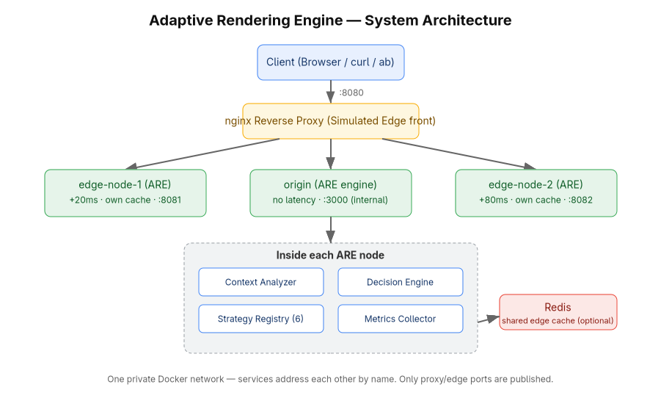
System Architecture
Origin + two edge nodes + reverse proxy + shared cache on one private Docker network
Adaptive Rendering Engine | Mid-Term Presentation
5

Slide 6
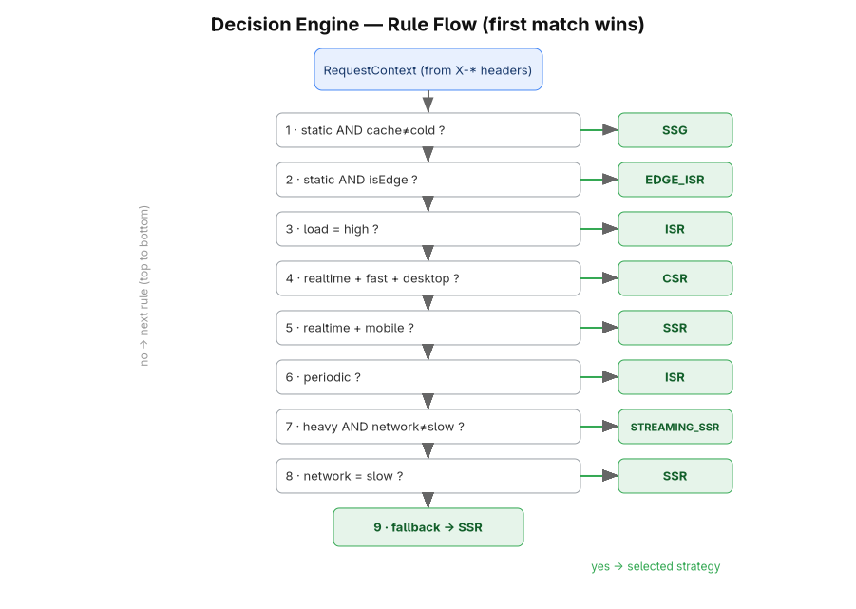
Decision Engine
• Pure, deterministic function.
• No I/O — fully unit-testable.
• Rules evaluated top-to-bottom.
• First match wins.
• Unconditional fallback → SSR.
• All 9 rules covered by tests.
Adaptive Rendering Engine | Mid-Term Presentation
6

Slide 7
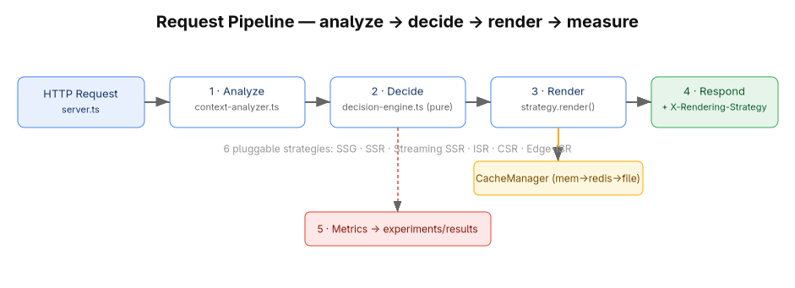
Rendering Pipeline & Strategies
• SSG – pre-built HTML • SSR – fresh per request • Streaming SSR – shell first, stream the rest
• ISR – cached + revalidate • CSR – client renders • Edge-ISR – cached at the edge
Adaptive Rendering Engine | Mid-Term Presentation
7

Slide 8
Technology Stack & Private Server
• Language & runtime: Node.js 20+ with TypeScript.
• View layer: React 18 (SSR, streaming, hydration) — used as the rendering primitive.
• Server: native Node HTTP (the engine is the runtime; no framework lock-in).
• Tooling: esbuild (client bundle), Vitest (tests), Apache Bench (load).
• Caching: filesystem + memory + optional Redis (shared edge cache).
• Private server: Docker Compose — origin + 2 edge nodes + nginx proxy + Redis.
Adaptive Rendering Engine | Mid-Term Presentation
8

Slide 9
Progress So Far
• Core runtime complete: context analyzer, decision engine, strategy registry, orchestrator.
• All six rendering strategy modules implemented behind one interface.
• Three-tier caching with stale-while-revalidate; metrics + report generator.
• React test pages + esbuild client bundle (hydration / CSR).
• Multi-stage Docker image builds and runs; compose topology defined.
• Validation scripts for strategy switching, header inspection and load testing.
• Status: compiles cleanly, 14/14 unit tests pass, runs and verified locally.
Adaptive Rendering Engine | Mid-Term Presentation
9

Slide 10
Preliminary Results — Strategy Switching
Request context (headers) | Selected | Expected
static volatility, /static | SSG | SSG
realtime + fast + desktop, /dynamic | CSR | CSR
high load, /dynamic | ISR | ISR
realtime + mobile, /dynamic | SSR | SSR
heavy payload + medium net, /heavy | STREAMING_SSR | STREAMING_SSR
static + edge + cold cache, /dynamic | EDGE_ISR | EDGE_ISR
periodic, /dynamic | ISR | ISR
Same URLs, only headers changed → six different strategies, each matching the expected rule.
Adaptive Rendering Engine | Mid-Term Presentation
10

Slide 11
Preliminary Results — Performance
Strategy | Avg TTFB (ms) | Avg Render (ms) | Cache-hit | Avg Bytes
SSG | 1.24 | 0.74 | 1.0 | 1,199
CSR | 0.31 | 0.16 | 0.0 | 401
ISR | 0.41 | 0.26 | 1.0 | 1,219
SSR | 6.45 | 0.16 | 0.0 | 1,219
Streaming SSR | 8.36 | 0.79 | 0.0 | 20,896
Edge-ISR | 1.48 | 0.20 | 1.0 | 1,234
Trade-offs confirmed: CSR ships the smallest shell (~0.4 KB), Streaming SSR the largest heavy page (~20 KB); cached strategies (SSG/ISR/Edge-ISR) hit 1.0 with very low TTFB.
Adaptive Rendering Engine | Mid-Term Presentation
11

Slide 12
Challenges & Solutions
Challenge | Solution Adopted
Non-ASCII in HTTP headers caused errors | Sanitise header to ASCII; keep full text in logs
nginx cannot inject edge latency natively | Model edges as real service replicas with latency + self-ID
Streaming SSR must not be buffered | Pipe a Node stream directly to the response
SSG selectable only when cache warm | Pre-build static pages on server startup
Docker Compose plugin missing on host | Verified via docker build/run; documented one-line install
Adaptive Rendering Engine | Mid-Term Presentation
12

Slide 13
Remaining Work & Timeline
• Install Docker Compose; run the full origin + edge + proxy + Redis stack. (Week 9–10)
• Network-condition & device experiments — 2G/3G/4G, mobile/desktop. (Week 11–12)
• Load testing with Apache Bench; cold-vs-warm cache experiments. (Week 12–13)
• Adaptive-vs-static comparative benchmarking and statistical analysis. (Week 13–14)
• Graphs, results interpretation and final report. (Week 14–16)
Adaptive Rendering Engine | Mid-Term Presentation
13

Slide 14
Conclusion
• The ARE has moved from design to a working, locally verifiable runtime.
• It analyses request context and selects one of six strategies via a pure decision engine.
• Functional correctness shown by live strategy switching and passing unit tests.
• Preliminary metrics confirm the expected performance trade-offs.
• Foundation is solid; remaining work (full experimentation & analysis) is on schedule.
Adaptive Rendering Engine | Mid-Term Presentation
14

Slide 15
Thank You
Questions & Discussion

