Slide 1




Minor Project Proposal Defence
On
E-learning platfrom
‘Innovative Online Education Solution’
Team Members
Asim Paudel- 201541
Bijaya Dulal- 201542
Bikram Khatri-201543
Department of IT Engineering
Nepal college of Information Technology
1
Balkumari ,Lalitpur

Slide 2


Introduction
Aims to revolutionize online education by offering high-quality video course
Real-time video chat for for effective doubt clearing enhanced learning engagements
It bridges the gap in online education by providing real-time interaction between students and teachers
Key Features:
1.Live Video chatting
2.Video Courses
3.Course Recomendation
2

Slide 3

Problem Statement
Lack of access to education due to geographical barriers
Lack of access to education due to physical disabilities
Low interest in traditional learning
Conventional classrooms have limited capacity
Inconveniences due to fix class schedule
3

Slide 4

Objectives
Access to education regardless of geographical location
Flexibility to learn at own pace
To enable real-time video interactions.
To offer customized, on-demand courses
Recommendation of related courses
4

Slide 5


Project Scope
Aims to offer courses in different forms(video lectures,assignment)
Real-time video interactions will enhance student engagement
Employing a recommendation system for personalized learning
Skill development across various subjects
Provision of learning in regional language
5

Slide 6

Limitations
Internet connectivity issues and device compatibility challenges
Quality and accuracy of user-generated content
Real-time video interactions have limitations compared to in-person interactions
6

Slide 7
Literature Review
Udemy: Wide range of user-generated courses, quality maintenance challenges.
Khan Academy: Free STEM content, lacks personalized learning pathways.
Vedantu: Live tutoring enhances interaction, scalability and user experience issues.
7

Slide 8
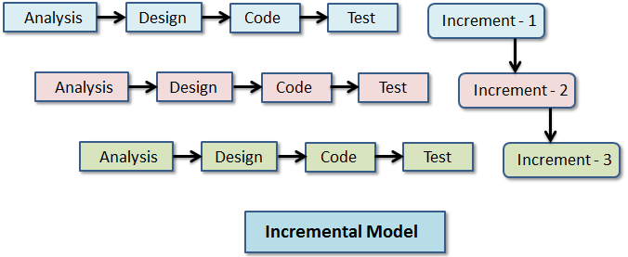
Methodology
8

Slide 9
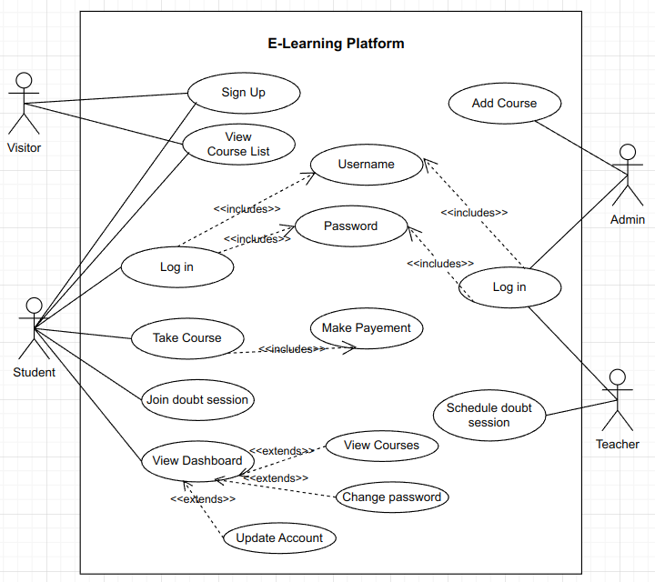
System Design
Fig: UCD
9
9

Slide 10
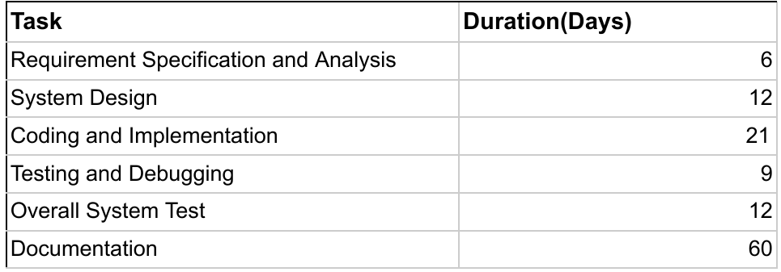
Time schedule
10

Slide 11
Proposed Deliverable
Web Application
Fully functional platform with comprehensive course management and real-time video sessions
Course recommendation System.
11
11

Slide 12







Technical Tools
STRATEGY N°1
12

Slide 13


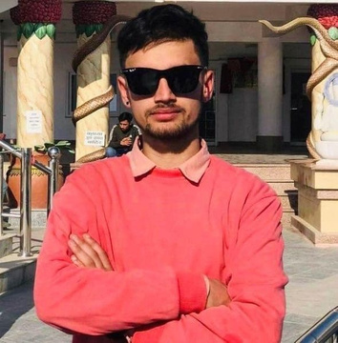

Our Team
Asim Paudel
Bikram Khatri
Bijaya Dulal
Frontend,
and
Design
Design ,
and
Backend
Backend
13

Slide 14
Thank You
"Any suggestions or feedback?”
14

