Slide 1


Fuel Economy

Slide 2
OBJETIVES
Categories
Technical specification
Vehicle types
Manufacturers
Measurements
The fuel economy
Annual Fuel cost

Slide 3
Analysis & Hypothesis Testing
Testing
Combined MPG in city and highway
Annual Fuel Cost
Variables
Engine Types
Class of Vehicles
Country of Manufacturers
Fuel Economy data

Slide 4
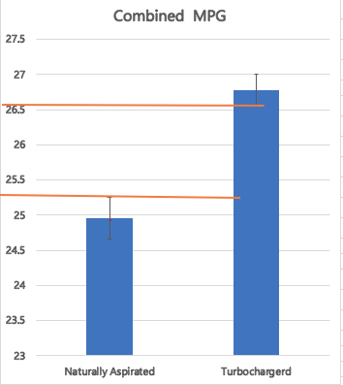
Naturally Aspirated VS. TURBOCHARGED
7%
Engine Displacement
NA 2-3.5
Turbo 1.2-2.2
Years
2015,2016 &2017

Slide 5
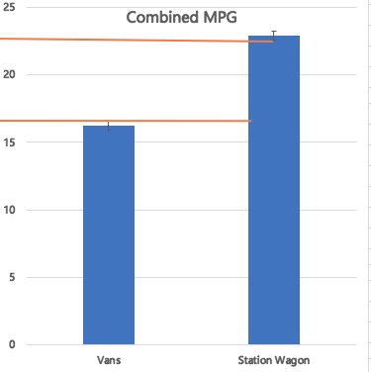
Vans VS Station Wagon
29%
Years
2008-2017
EPA updated its method in 2008 and 2017.

Slide 6
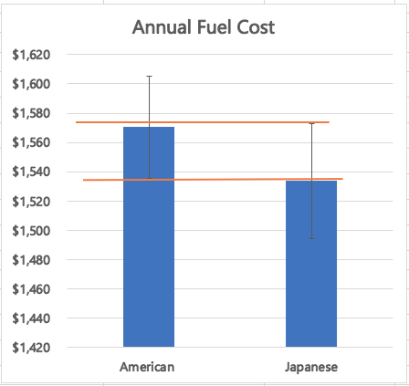
American Manufactures VS. Japanese manufactures
Class of cars
Midsize
Years
2008-2017

Slide 7

Thank you

Slide 8


