Slide 1
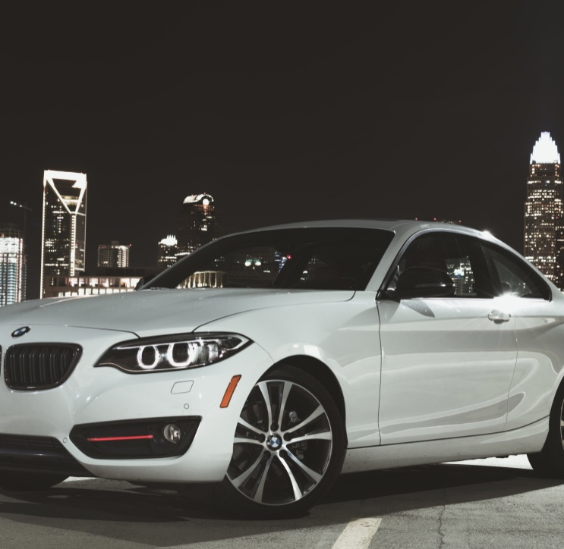
LARIAT

Slide 2
Minimize cost Maximize revenue
Business Objective

Slide 3
2018 Data/Baseline Data
Income & Expense
Revenue –> 65 M
Profit –> 32 M
Profit margin –> 46%
Cost – >33M
Driver Accidents
In different age group

Slide 4
Strategy1
Buy car models withTop10 profit margin
Strategy2
Reduction in the fleetwide insurance
Strategy3
Combination of the above two

Slide 5
Why Strategy 1? A large disparity between the profit margin of those. Recommendation to include more Top10 car models

Slide 6
Baseline & Strategy1
Top10 vs Bottom10 Increase Top10 car models Profit increases by $7.4M

Slide 7
Strategy 2
Considerable difference in the total accidents by various age group
Add additional rider insurance for age group 55-65
Reduction in the fleet wide insurance

Slide 8
Baseline & Strategy 2
Profit increases by
$ 0.24M

Slide 9
Baseline & Combination of strategies
The profit increases by $7.7M

Slide 10
My recommendation !
Choose the combined strategy because it is giving the highest profit than the other 2

Slide 11


Slide 12

Thank You

