Slide 1
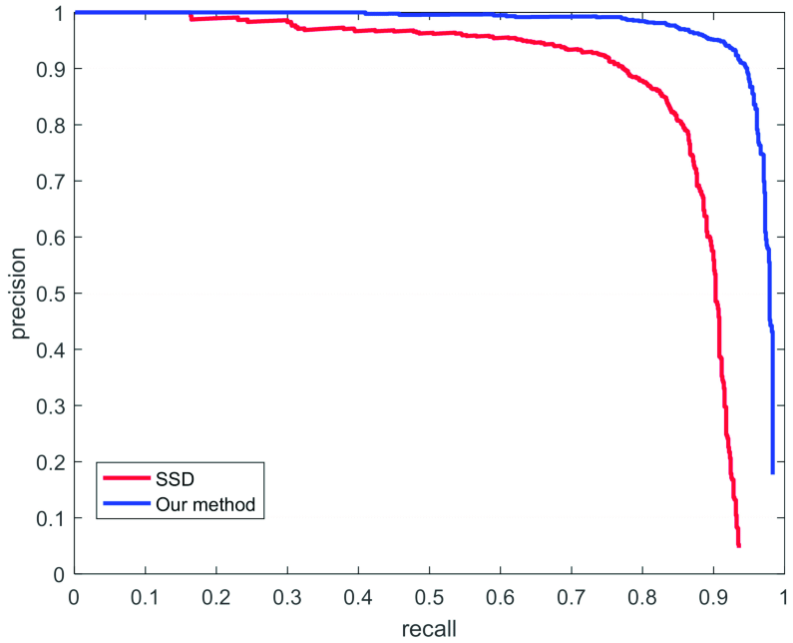
MobileNET
ResNET
ResNET

