Slide 1
Intel OCR

Slide 2
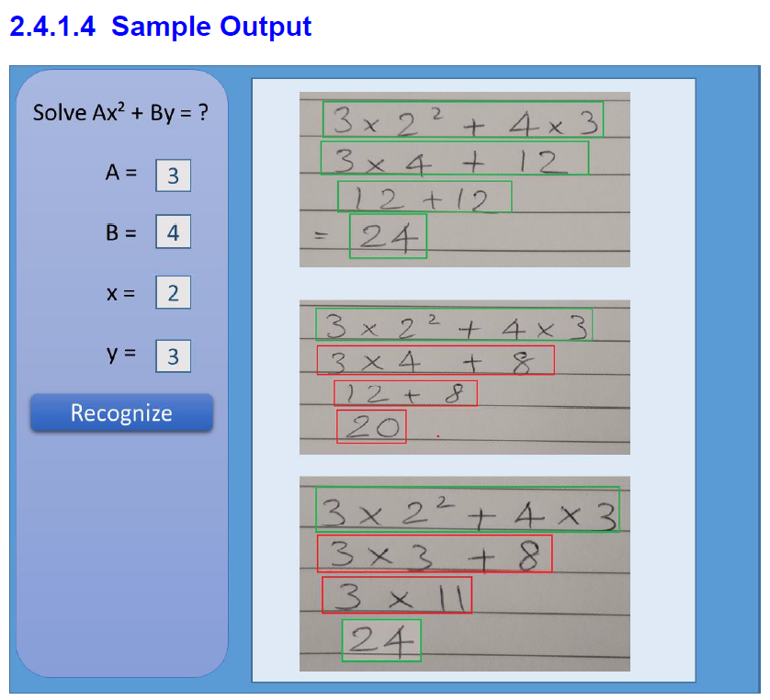
Problem Statement
The overall idea behind this project is to develop an computer vision algorithm along with solution package for recognizing and digitizing steps of solving a mathematical equation written by freehand on a paper, validating the steps and final answer of the recognized handwritten lines by maintaining the context

Slide 3
1. Tasks Completed
1.1 Workspace, Line, Character, Exponential Detection
1.2 Character recognition - Deep Learning Model Building
1.3 Computing mathematical equation value and Drawing boxes
1.4 Checking validation of equation mathematically
2. Inputs from Intel [ For tuning Parameters ]
2.1 Sample Image Testing
✔
✔
✔
✔
✔

Slide 4
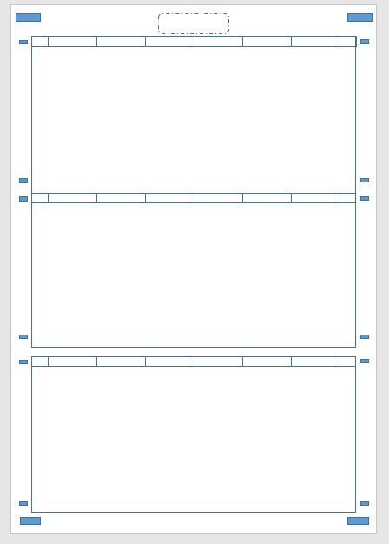
Approach
Workspace Detection
Sample Worksheet
OpenCV for finding closed object contours
Detect all the boxes
Sort them (Top-to-Bottom)
Choose the desired boxes based on the area
Assumptions :
Valid Rectangular boxes present

Slide 5
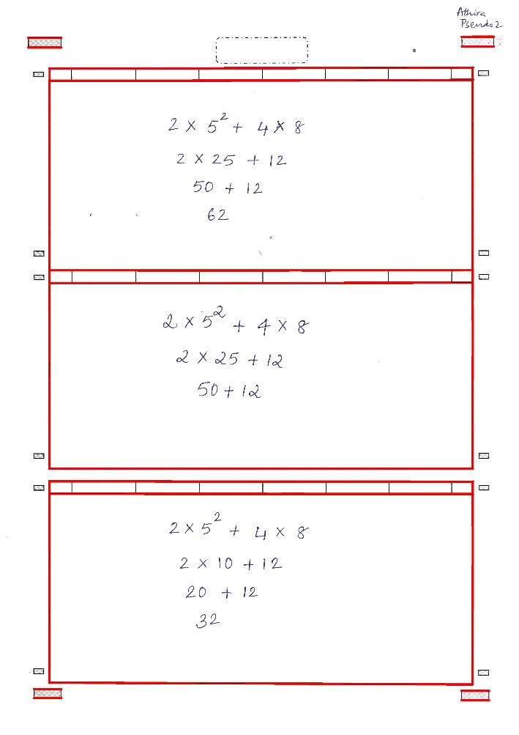
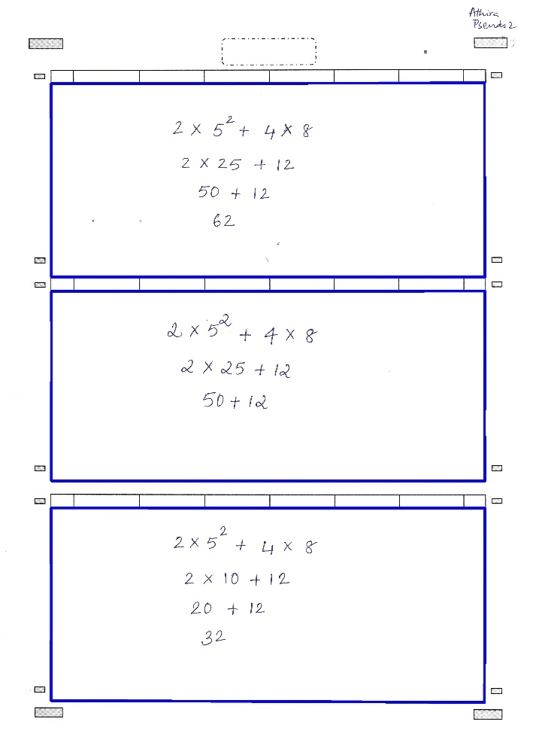
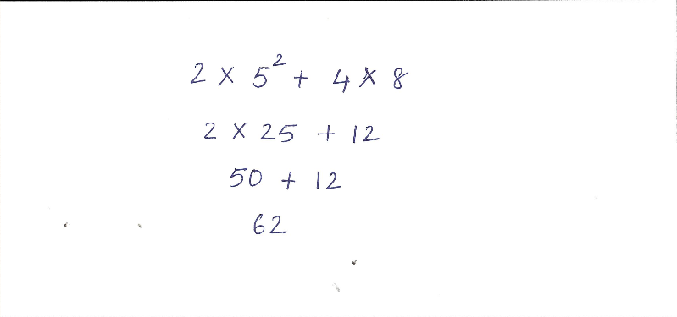
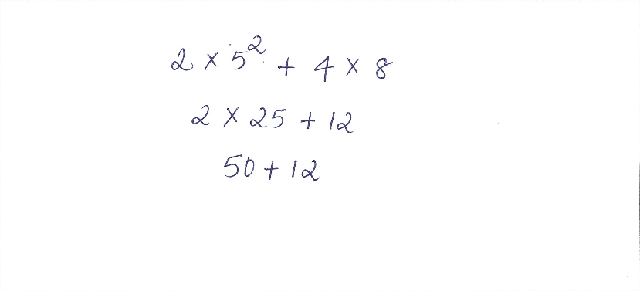
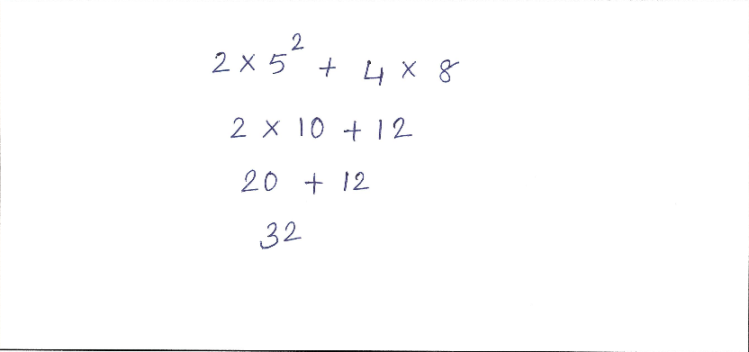
Worksheet Detection
Contours detection
Selection based on area
Cropped images

Slide 6
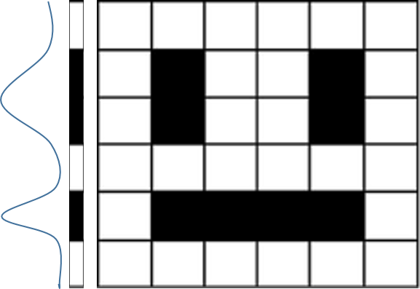
Approach
Line Detection
Compress matrix in a single array and take forward derivative
Assumptions :
1) Sufficient gap between lines is required
2) There should be at least some intersection between exponential characters and line

Slide 7
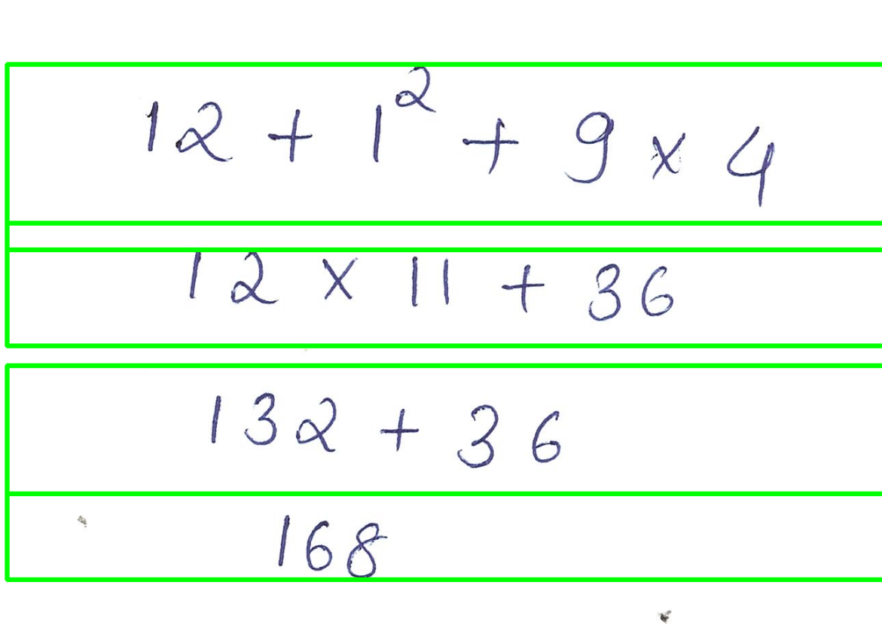
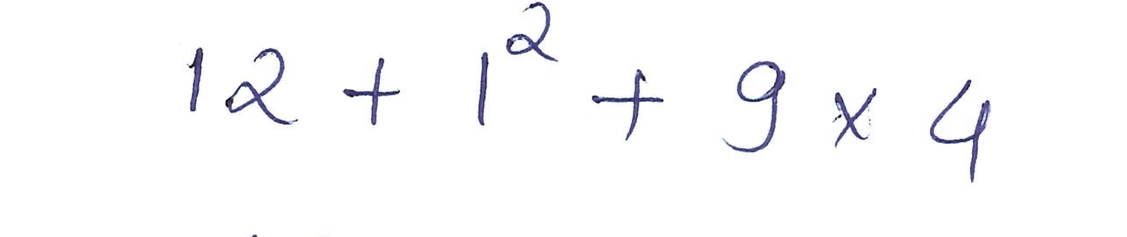


Output
Line Detection
Cropped images
Line Detection and Rotation

Slide 8


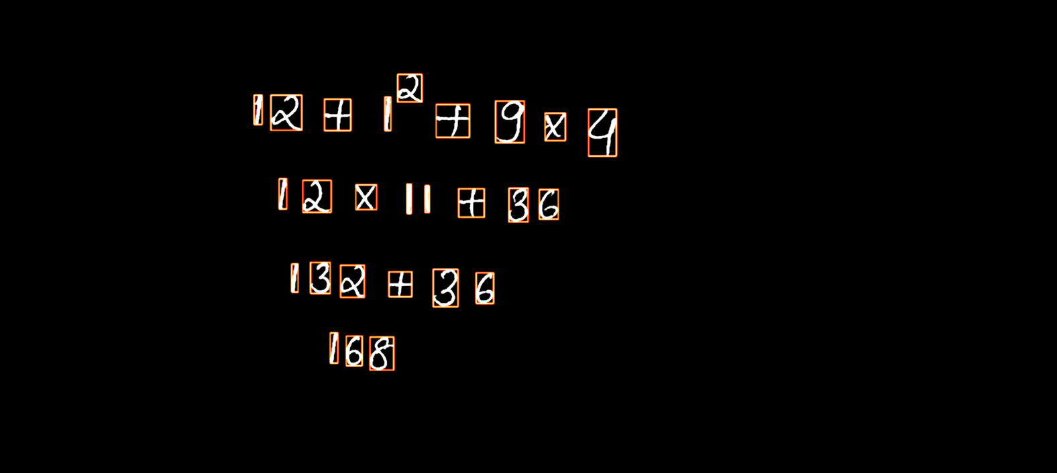
Approach
Character Segmentation
OpenCV for contour finding and bounding boxes
Find the contours and sort (Left-to-Right)
Merge bounding boxes for symbol like “=”
Output
Contours sorted left-to right

Slide 9
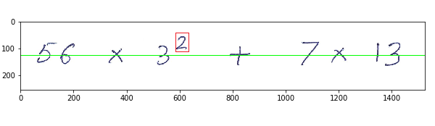
Exponents Detection
Character Segmentation
Green line divides the image in the ratio of 0.5
Any character lying above baseline and starting above previous character is taken as exponential

Slide 10
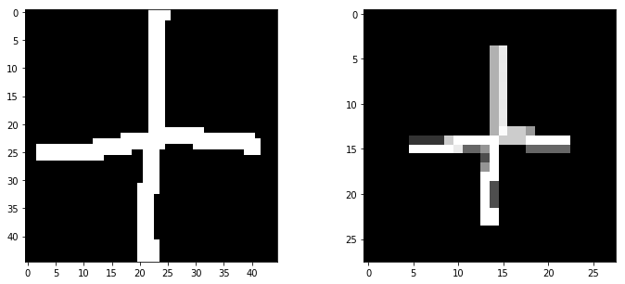
Dataset
Optical Character Recognition
Digits (0-9) : MNIST (28 * 28)
Symbols ( ‘(’ , ‘)’, ‘-’, ‘+’, ‘*’ ): Kaggle Handwritten Mathematical Symbols Dataset (45*45)
Preprocessing of symbols to match MNIST digits
Converted to Binary
Padded to 20 * 20 (preserving the aspect ratio)
Padded to 28 * 28 using Centre of mass
Crop and centered single math symbols

Slide 11
Approach
Optical Character Recognition
OpenCV for contour finding and bounding boxes
Model : Deep Columnar Convolutional Neural Network
Based on the paper "Deep Columnar Convolutional Neural Network"
Trained on > 50,000 images of digits and symbols
Classification with > 96% accuracy

Slide 12
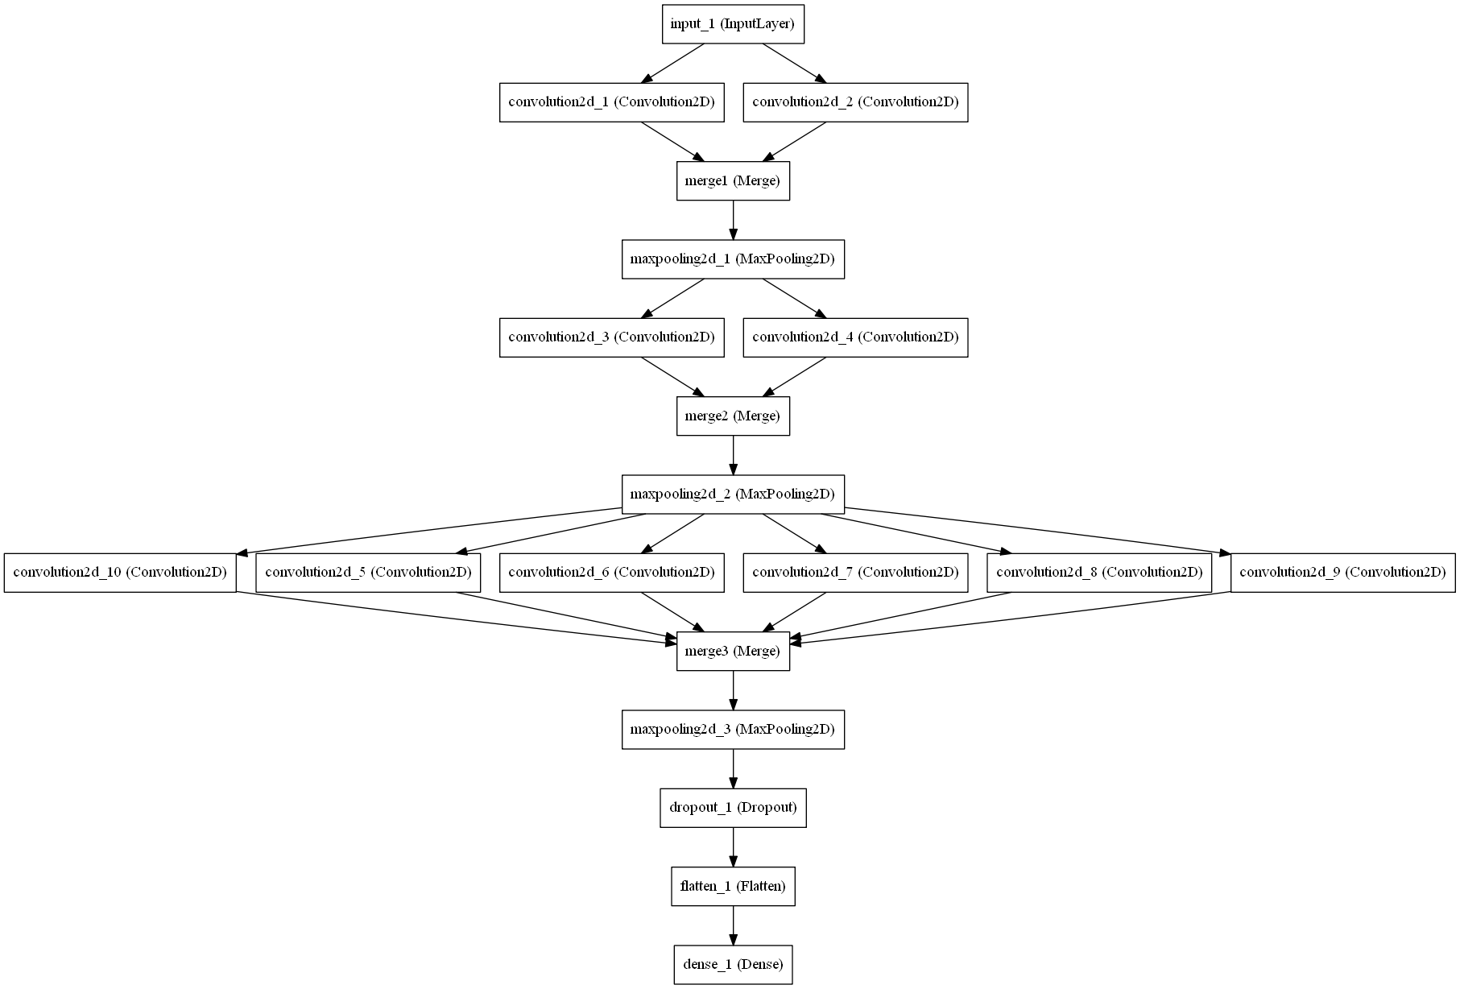
Model Architecture
Optical Character Recognition

Slide 13
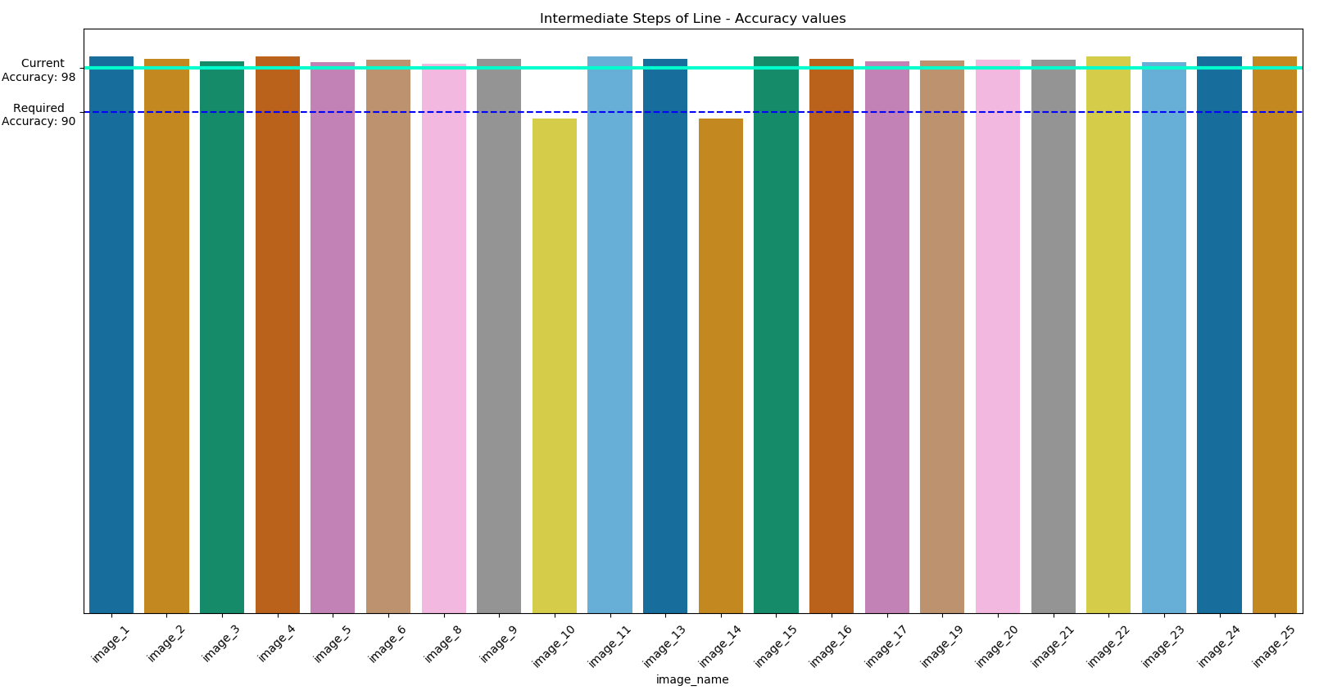
On Handwritten pages
Accuracies – Only Character Detection and Recognition

Slide 14
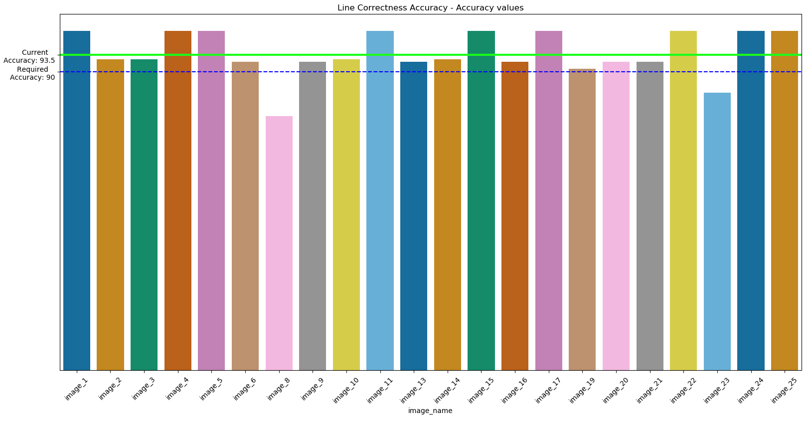
On Handwritten pages
Accuracies – Whole Line Correctness Detection

Slide 15
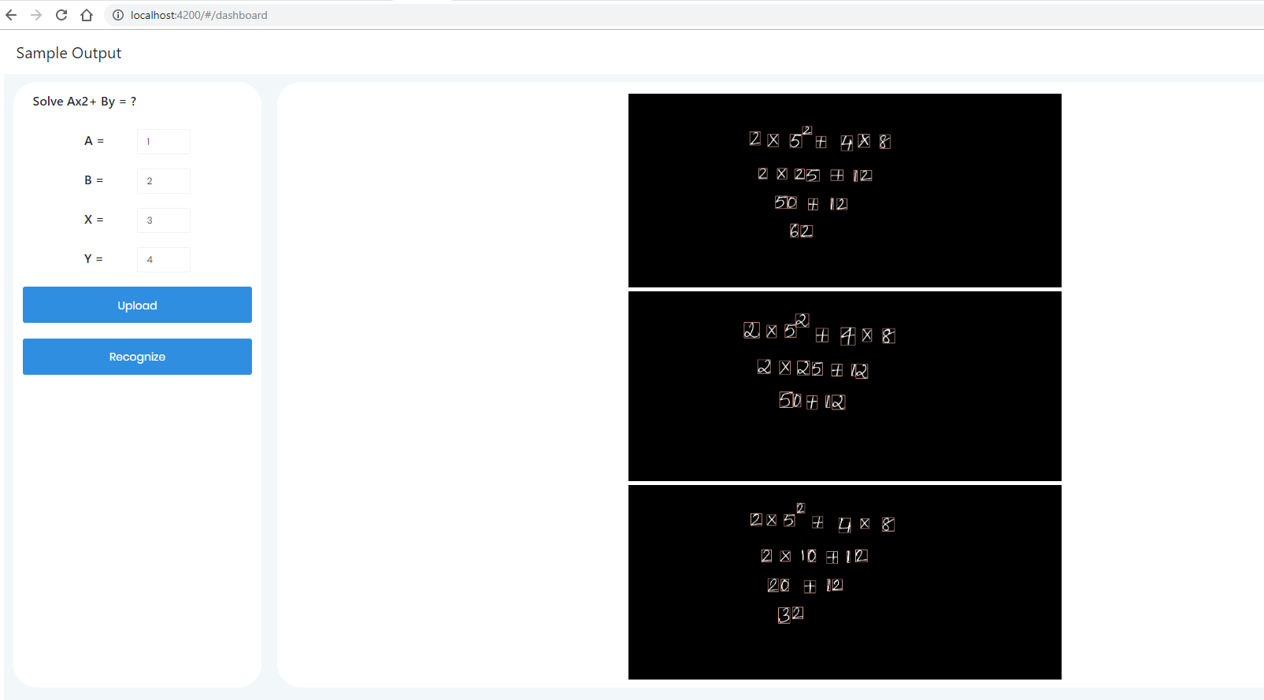
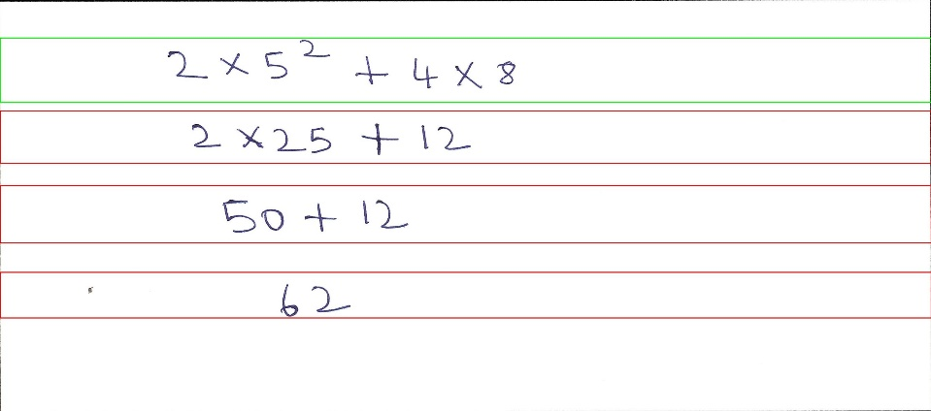
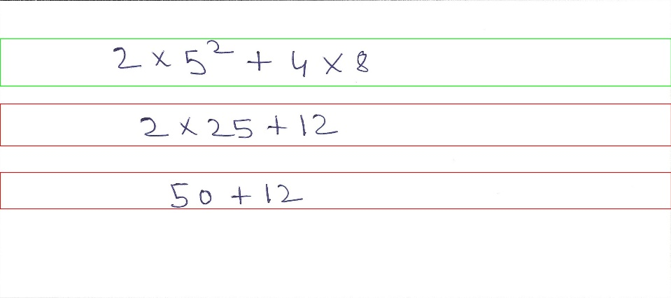
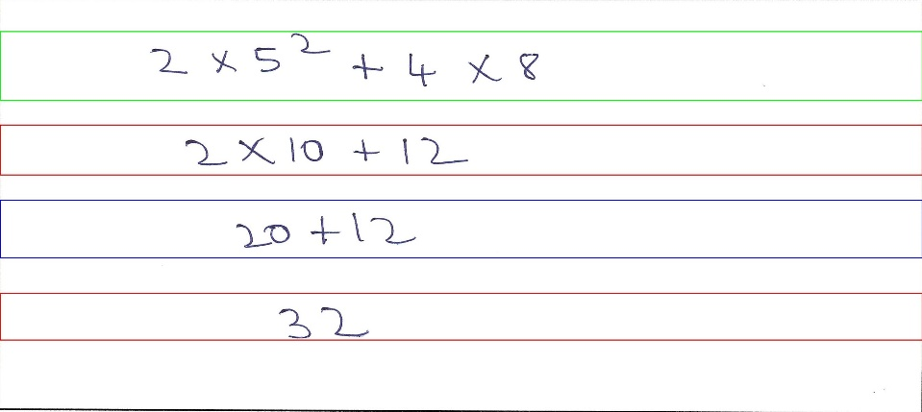
Web Application
GUI
Color Coding
Correct Line
Incorrect Line
Not Determined Line
Functionality Current:
Upload Images
Detect Characters
Display results
For new testing , upload image and click recognize

Slide 16
Possible Enhancements
POC can be scaled to recognize Chemical as well as more complex Physics and Mathematical equations
Several features like ‘fraud detection of students’ , ‘student performance index’ kind of functionalities can be implemented
Recognition of cursive kind of handwritings where character are not at all separated
‘Goodness Of Handwriting’ for any student can be analyzed during early phases when children are learning to write to correct their mistakes

Slide 17
Thank You

