Slide 1
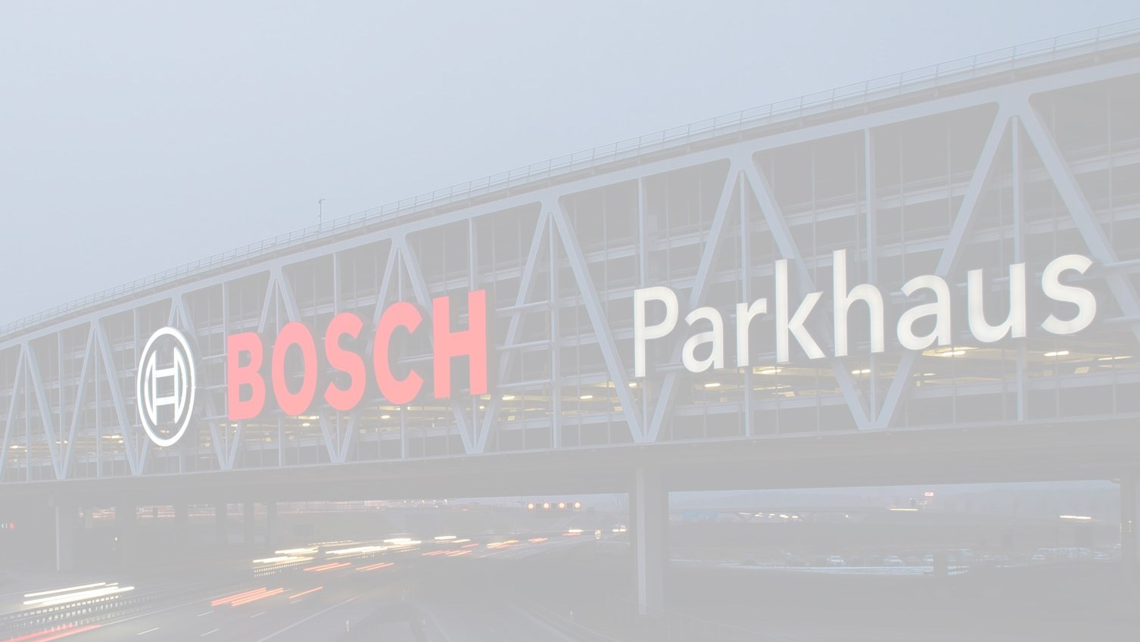
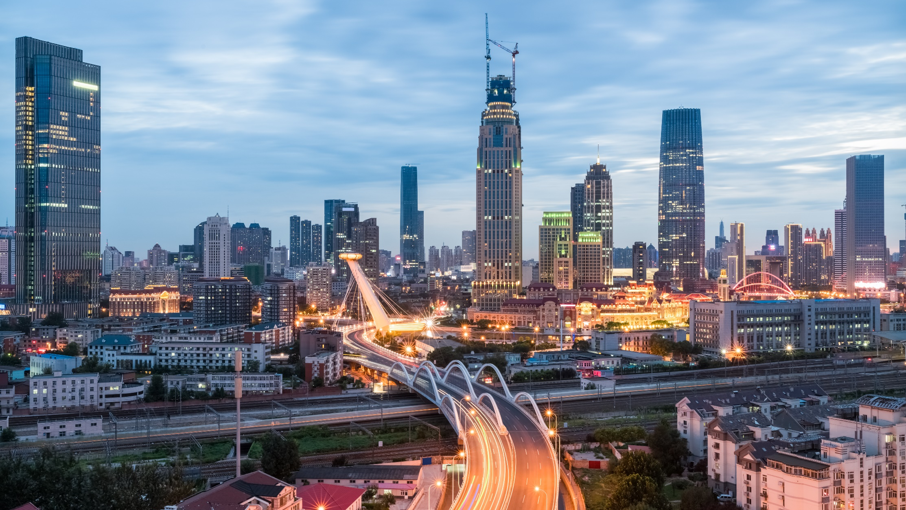
ROBERT BOSCH ENGINEERING AND BUSINESS SOLUTIONS PVT. LTD
Transformation through Sensors, Software and Services
Fascinating technologies for everyday life

Slide 2
Workflow Planned
Character Recognition
Test Data Set Creation
1. Character Segmentation
2. Recognize Characters in line correctly and return
Create Worksheet Template
Select 10 pair of values for A and B
Collect data from EDS2 team : Plain sheet – 35 (i) Use 5 different pens randomly for each workspace filling (ii) Ask 5-5 each case, people to write in max up to 10/12 degree angle (iii) suggest few people to use ‘x’ multiplication operator and some ‘()’ operator
Add noises to few images and add to them along with original image in dataset
Image Preprocessing
And Line Detection
Mathematical Analysis
Main.py
Will receive each line in an array, Compute value and return value for that line
Mathematically validate the expression as well
Try RNN based line detection
Look for other line detection techniques or use cv2.reduce based line detection
4. Try noise removal
5. Try to ‘un-rotate’ rotated lines in image
6. Make modules for all the functionalities
Module should pass in array/list to recognition module:-
Position of each bounding boxes for every line or cropped bounding boxes [yet to decide]
7. Draw rectangle at end with needed colors
Display Result
And Log Activities

Slide 3
Workflow Planned
Character Recognition
Test Data Set Creation
1. Character Segmentation
2. Recognize Characters in line correctly and return
✔
Create Worksheet Template
Select 10 pair of values for A and B
Collect data from EDS2 team : Plain sheet – 35 (i) Use 5 different pens randomly for each workspace filling (ii) Ask 5-5 each case, people to write in max up to 10/12 degree angle (iii) suggest few people to use ‘x’ multiplication operator and some ‘()’ operator
Add noises to few images and add to them along with original image in dataset
Image Preprocessing
And Line Detection
Mathematical Analysis
Main.py
Will receive each line in an array, Compute value and return value for that line
Mathematically validate the expression as well
✔
✔
Try RNN based line detection
Look for other line detection techniques or use cv2.reduce based line detection
4. Try noise removal
5. Try to ‘un-rotate’ rotated lines in image
6. Make modules for all the functionalities
Module should pass in array/list to recognition module:-
Position of each bounding boxes for every line or cropped bounding boxes [yet to decide]
7. Draw rectangle at end with needed colors
✔
✔
✔
✔
Display Result
And Log Activities

Slide 4
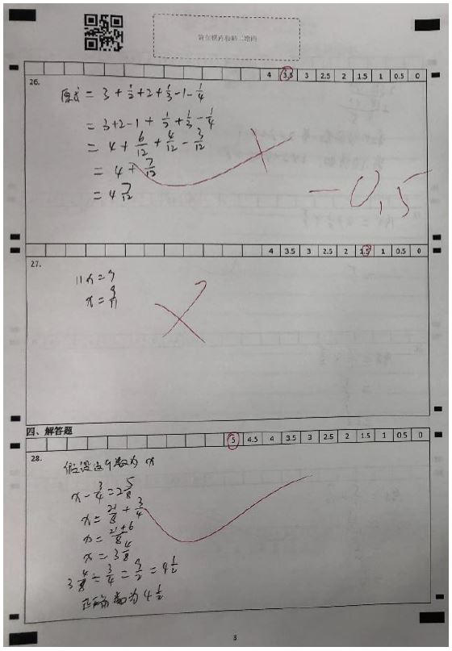
Template
As in RFP

Slide 5
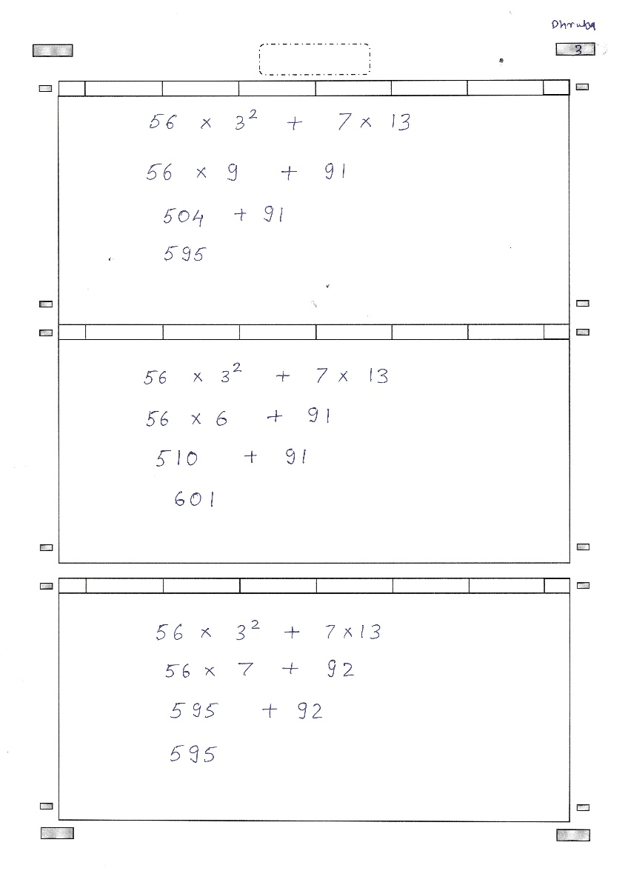
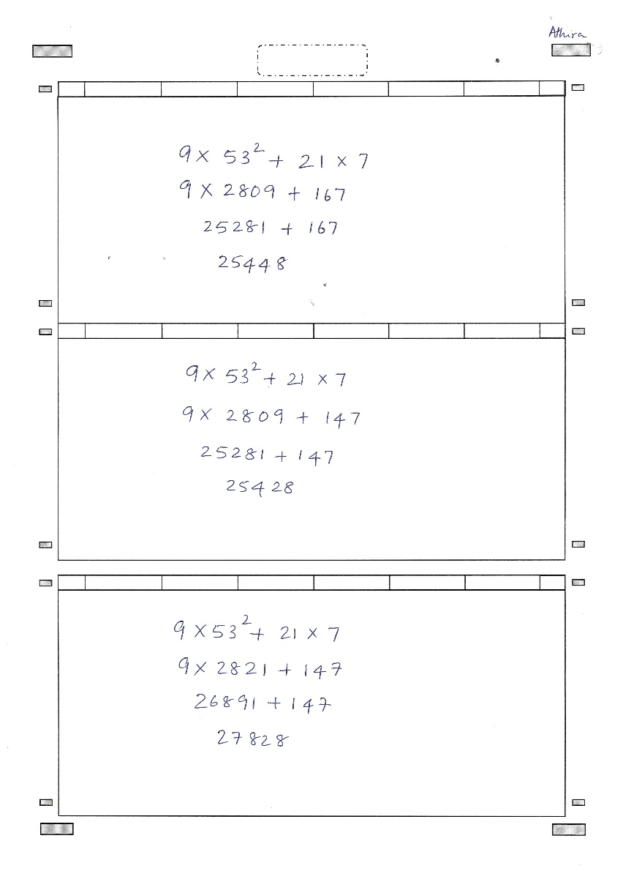
Template – Collected Samples

Slide 6
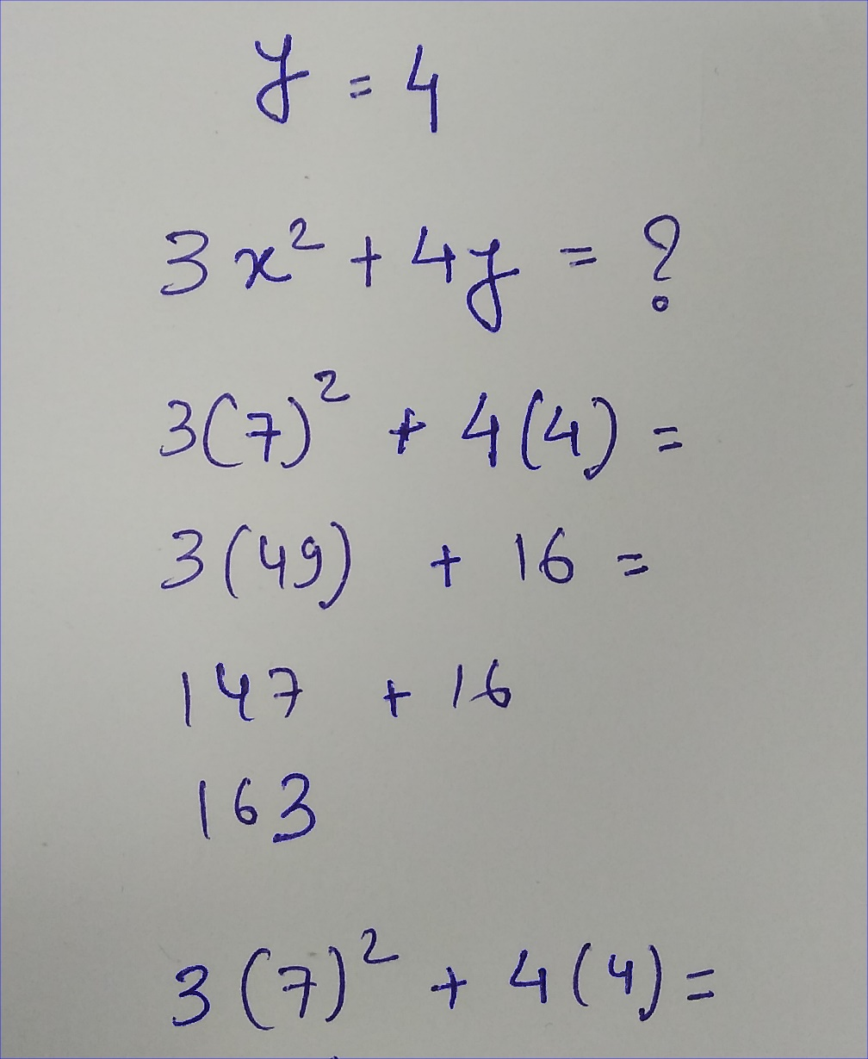
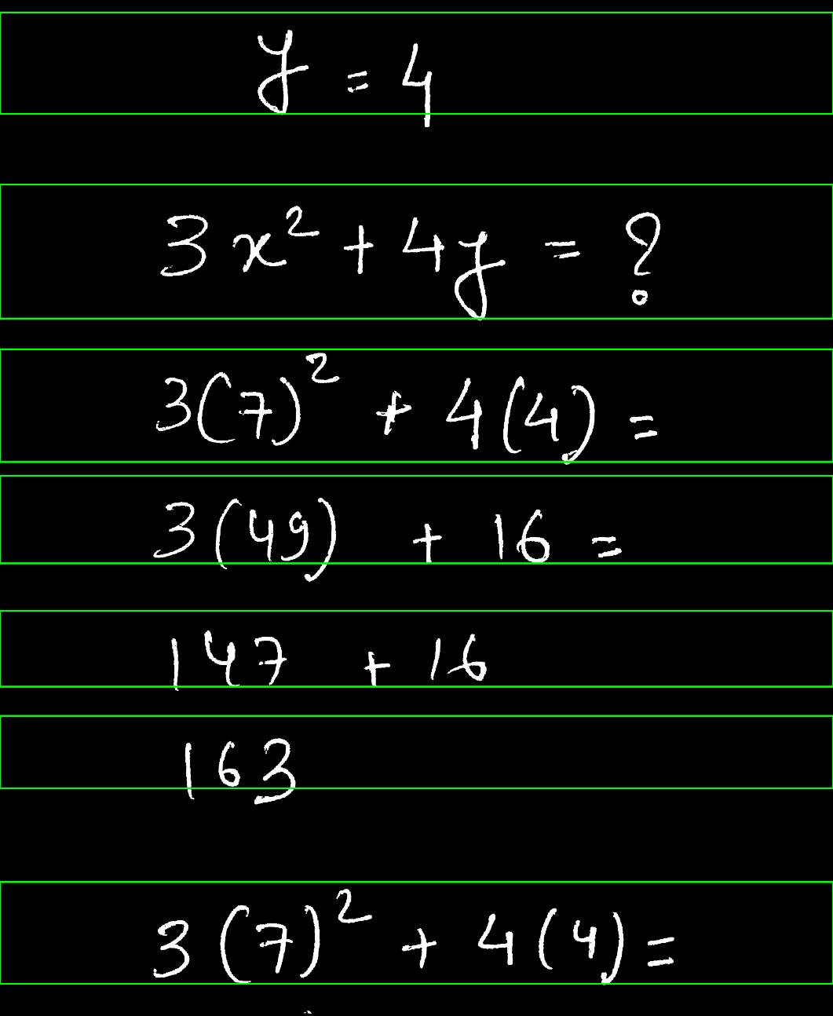
Results : Line Detection

Slide 7
Thank You !!

