Slide 1
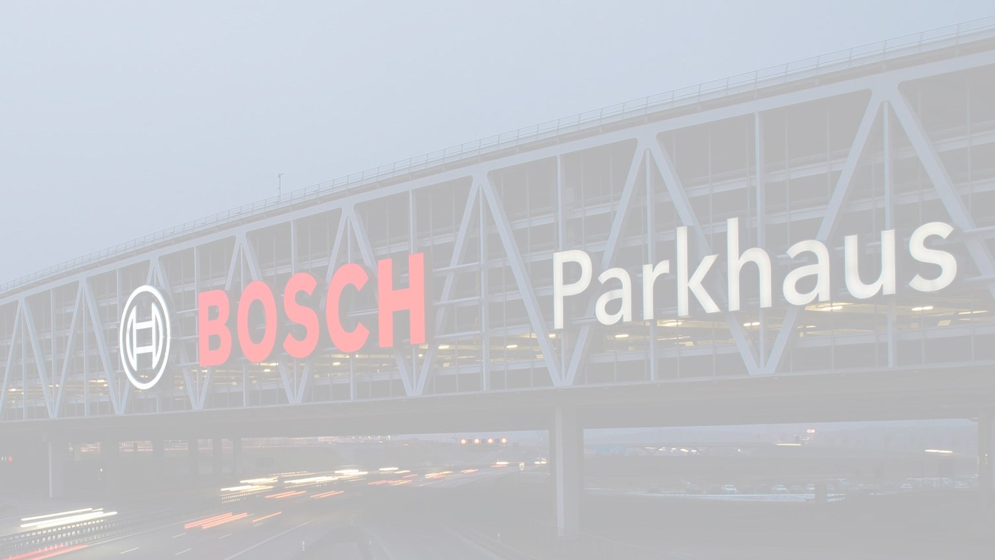
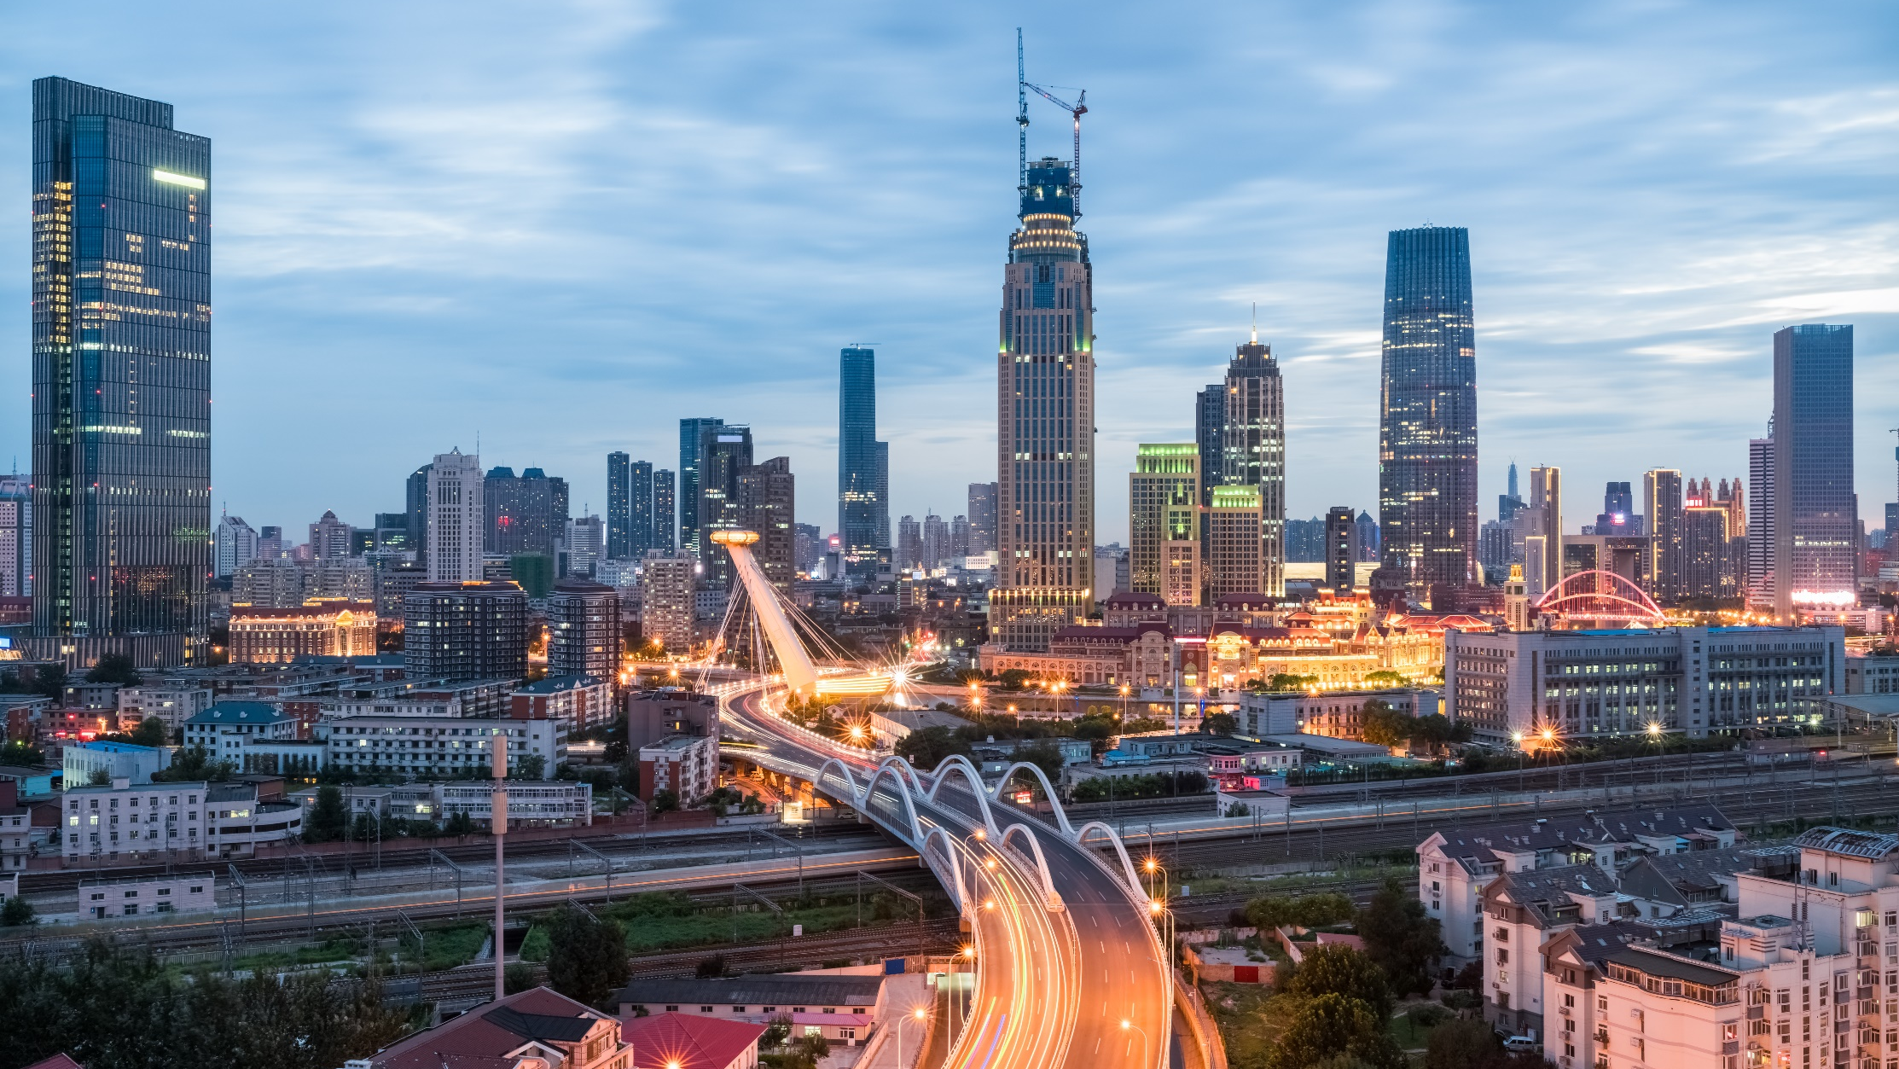
ROBERT BOSCH ENGINEERING AND BUSINESS SOLUTIONS PVT. LTD
Transformation through Sensors, Software and Services
Fascinating technologies for everyday life

Slide 2

Intel OCR

Slide 3
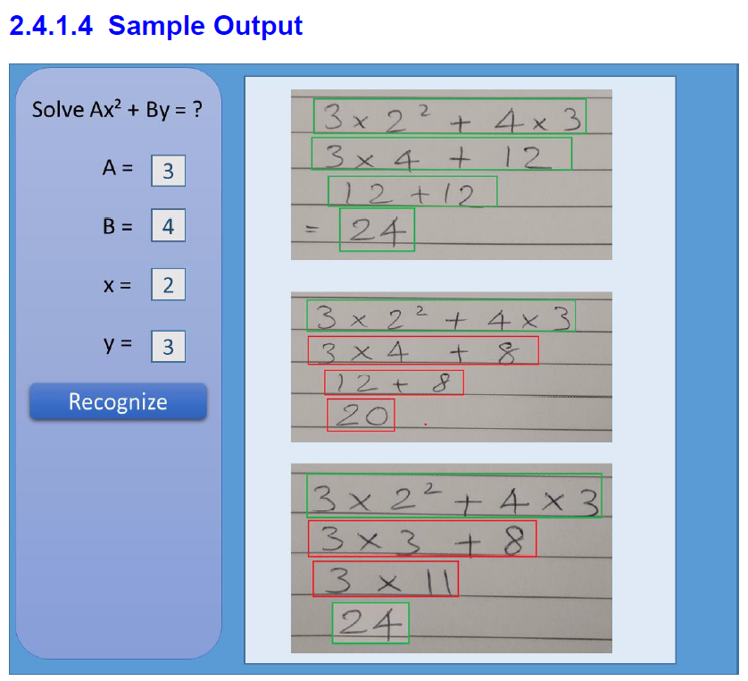
Problem Statement
The overall idea behind this project is to develop an computer vision algorithm along with solution package for recognizing and digitizing steps of solving a mathematical equation written by freehand on a paper, validating the steps and final answer of the recognized handwritten lines by maintaining the context

Slide 4
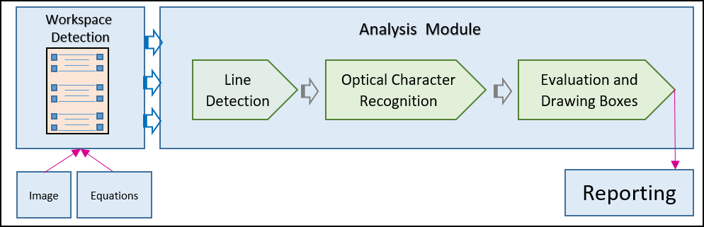
Work Flow
Solution Approach

Slide 5
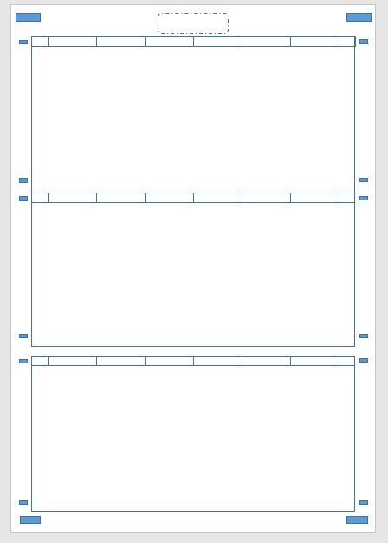
Approach
Workspace Detection
Sample Worksheet
OpenCV for finding closed object contours
Detect all the boxes
Sort them (Top-to-Bottom)
Choose the desired boxes based on the area
Assumptions :
Valid Rectangular boxes present

Slide 6
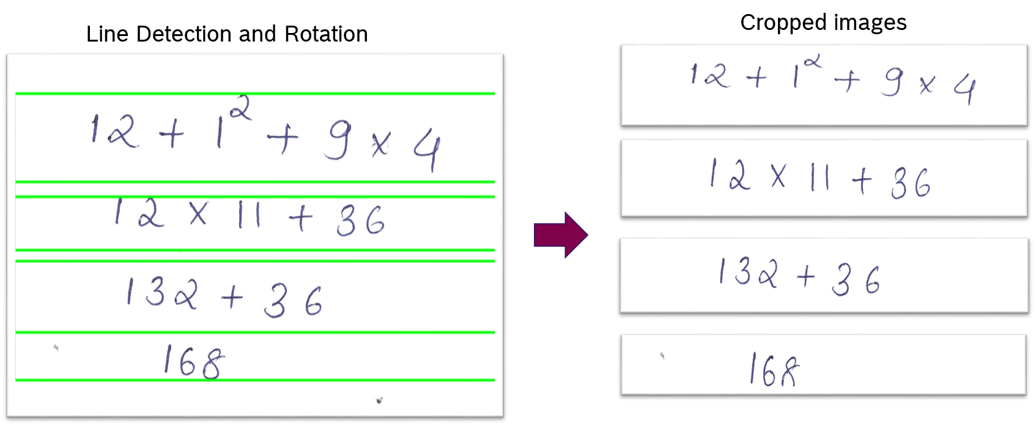
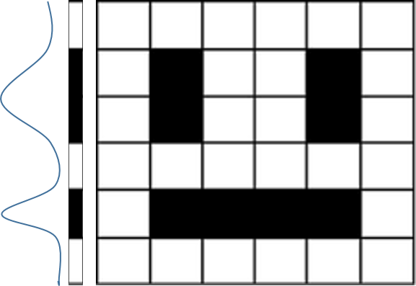
Approach
Line Detection
Compress matrix in a single array and take forward derivative
Assumptions :
1) Sufficient gap between lines is required

Slide 7

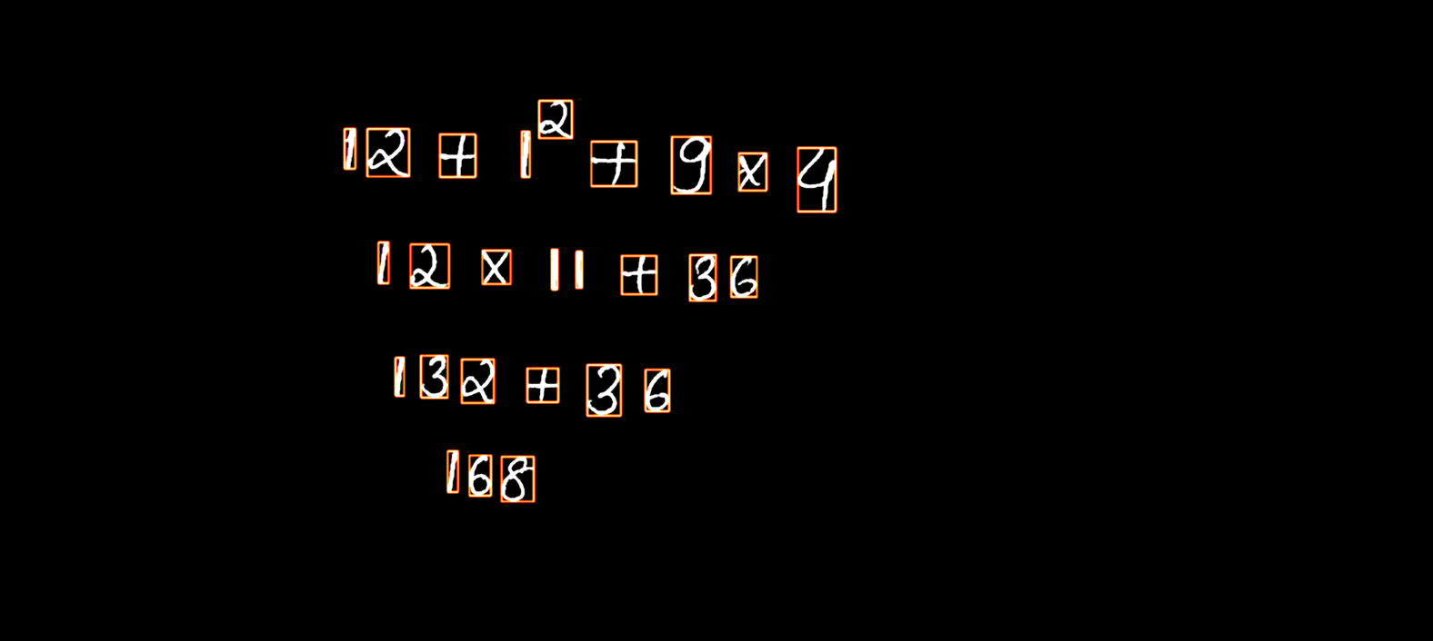

Approach
Character Segmentation
OpenCV for contour finding and bounding boxes
Find the contours and sort (Left-to-Right)
Merge bounding boxes for symbol like “=”
Contours sorted left-to right

Slide 8
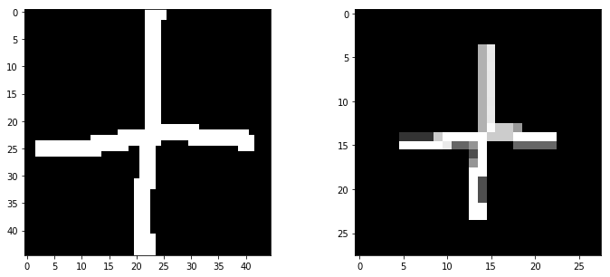
Dataset
Optical Character Recognition
Digits (0-9) : MNIST (28 * 28)
Symbols ( ‘(’ , ‘)’, ‘-’, ‘+’, ‘*’ ): Kaggle Handwritten Mathematical Symbols Dataset (45*45)
Preprocessing of symbols to match MNIST digits
Converted to Binary
Padded to 20 * 20 (preserving the aspect ratio)
Padded to 28 * 28 using Centre of mass
Crop and centered single math symbols

Slide 9
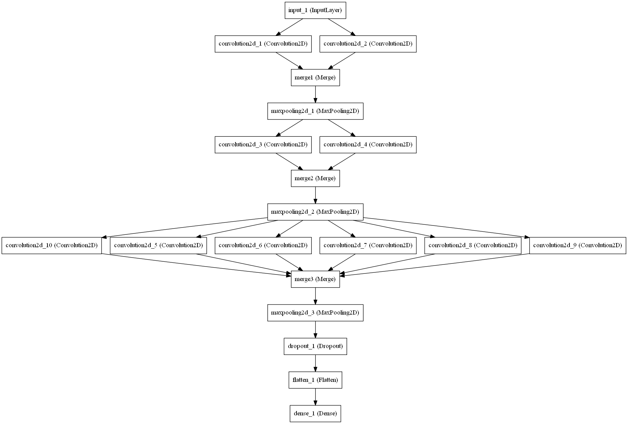
Approach
Optical Character Recognition
OpenCV for contour finding and bounding boxes
Model : Deep Columnar Convolutional Neural Network
Based on the paper "Deep Columnar Convolutional Neural Network“
[1] Somshubra Majumdar and Ishaan Jain. Deep Columnar Convolutional Neural Network. International Journal of Computer Applications 145(12):25-32, July 2016
Trained on > 50,000 images of digits and symbol
Classification > 97% accuracy

Slide 10
Evaluation of Expression
Line Box Coloring
eval() in Python
The eval() method parses the expression passed to it and runs python expression(code) within the program
Equation independent
Example:
>>Enter the function y(in terms of x):
‘x*(x+1)*(x+2)’
>>Enter the value of x:
3
>>print(y)
60

Slide 11
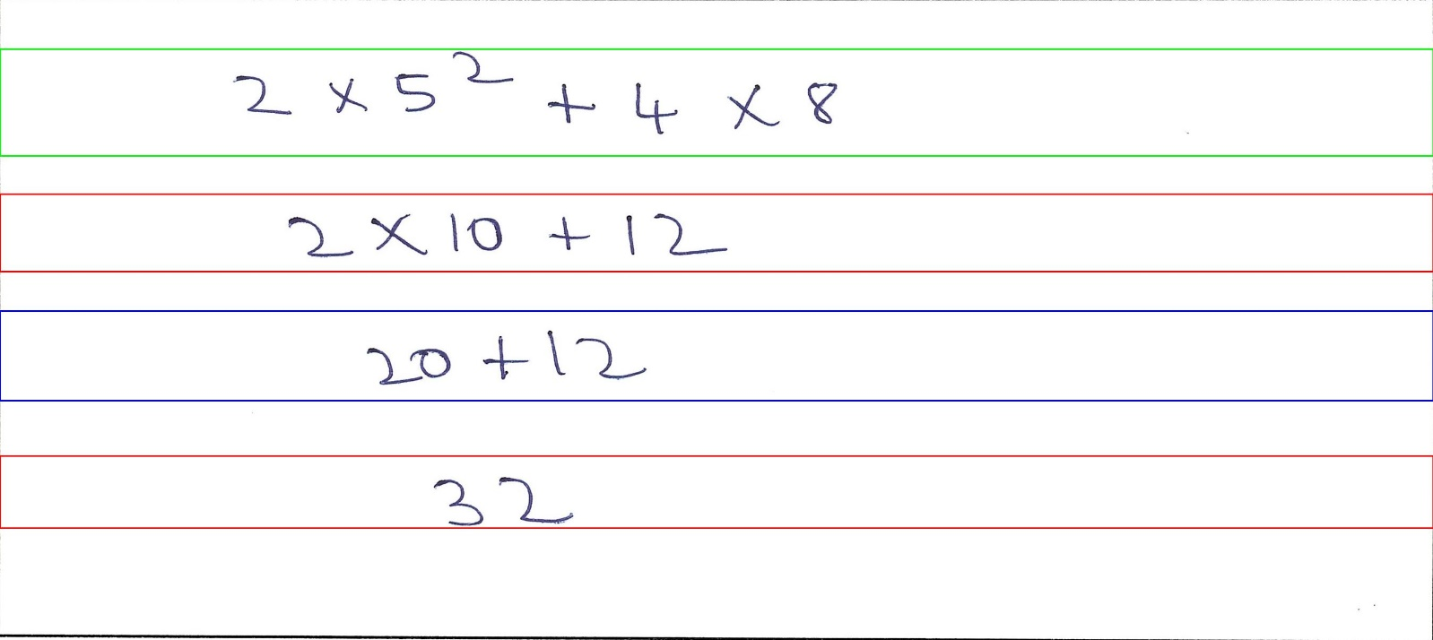
Color Code
Line Box Coloring
Green : Correct Line
Red : Wrong Line
Blue : Undetermined {Something might went wrong in evaluation of expression}

Slide 12
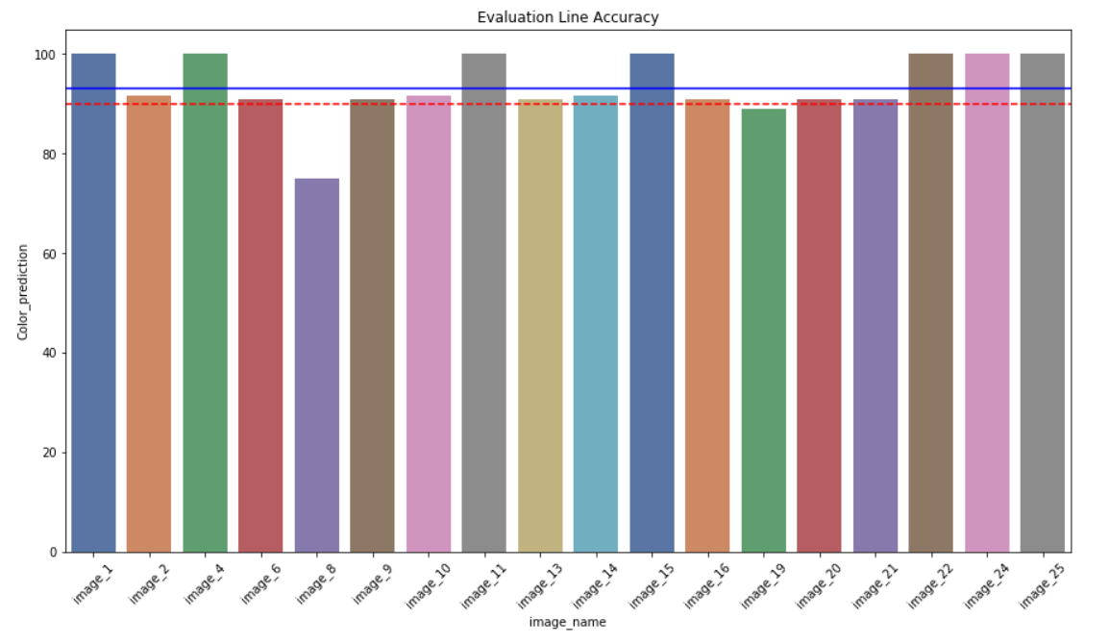
On Handwritten pages
Accuracies
 | line_det | char_det | exp_det | Color_prediction
count | 18 | 18 | 18 | 18
mean | 100.0 | 98.9 | 96.3 | 93.6
std | 0.0 | 0.8 | 10.8 | 6.5
min | 100.0 | 97.5 | 66.7 | 75.0
25% | 100.0 | 98.7 | 100.0 | 90.9
50% | 100.0 | 100.0 | 100.0 | 91.7
75% | 100.0 | 100.0 | 100.0 | 100.0
max | 100.0 | 100.0 | 100.0 | 100.0
Average run time : 1.57 +- 0.16 Secs

Slide 13
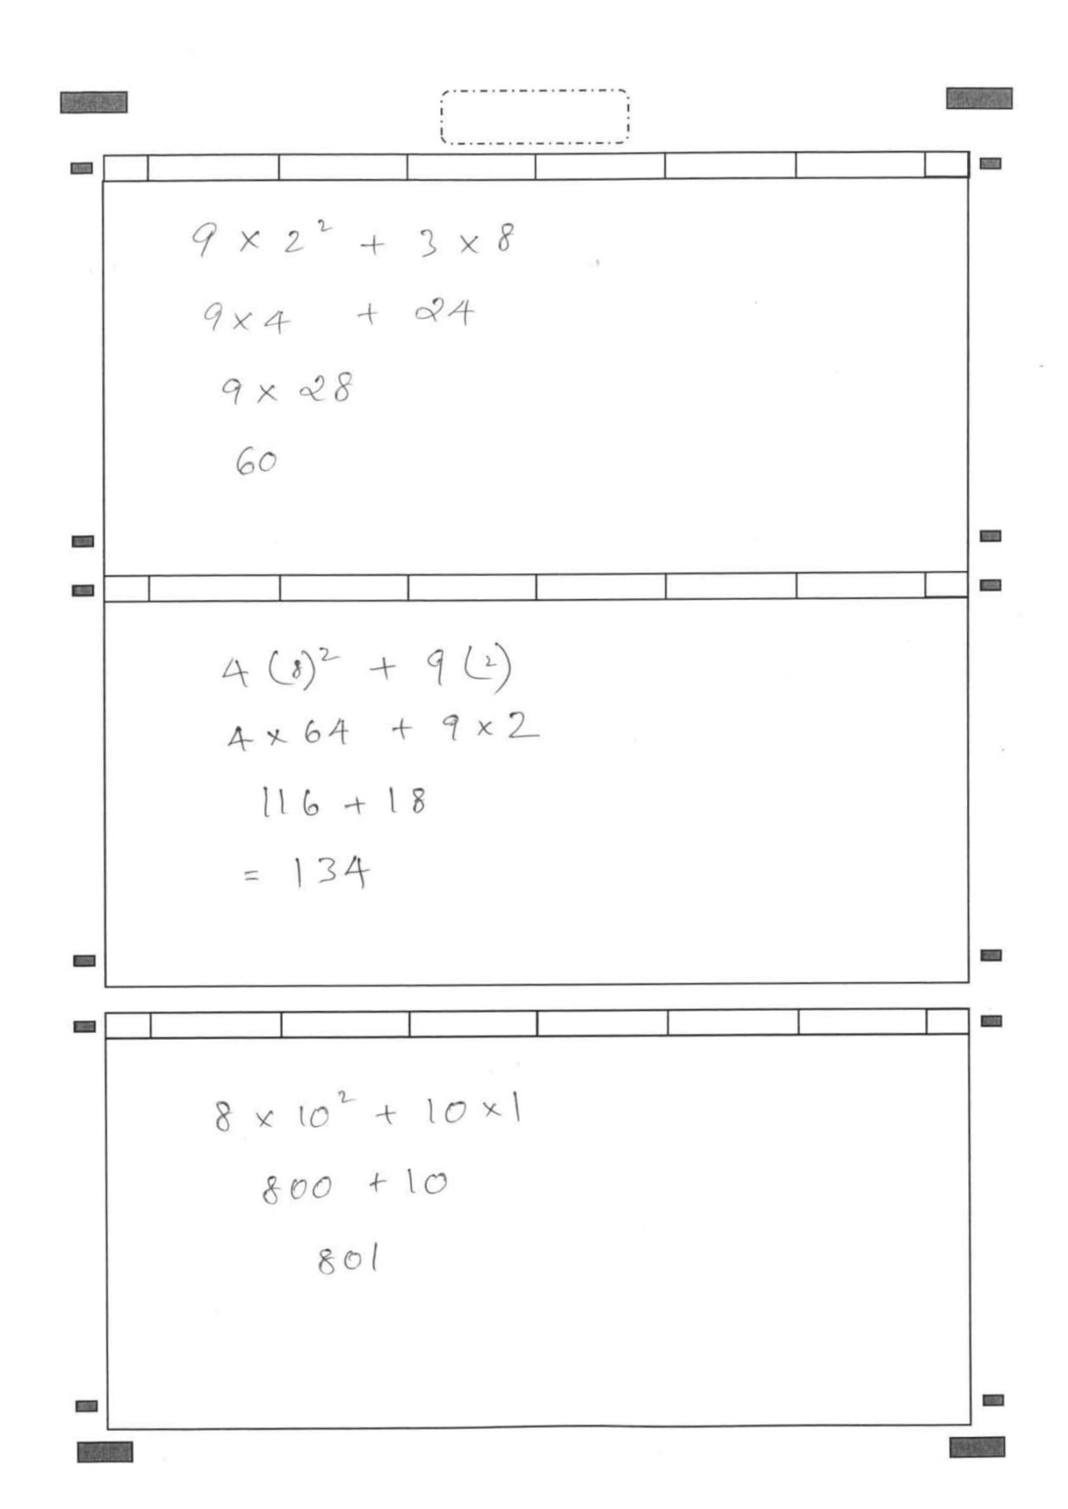
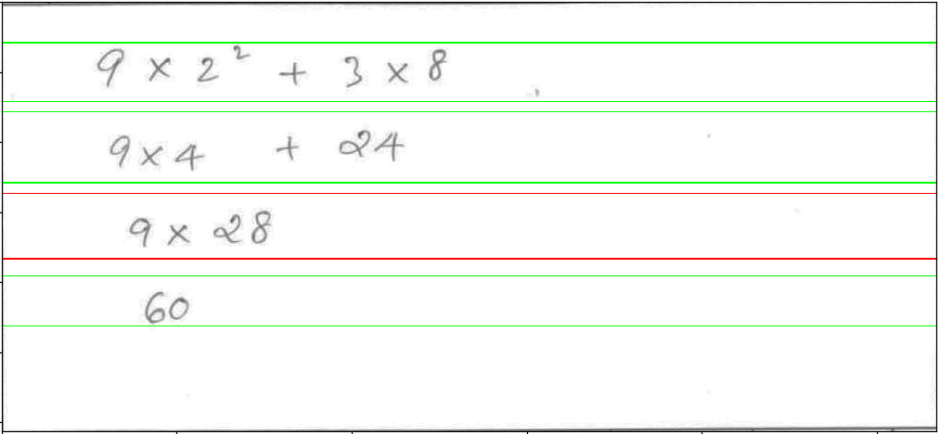
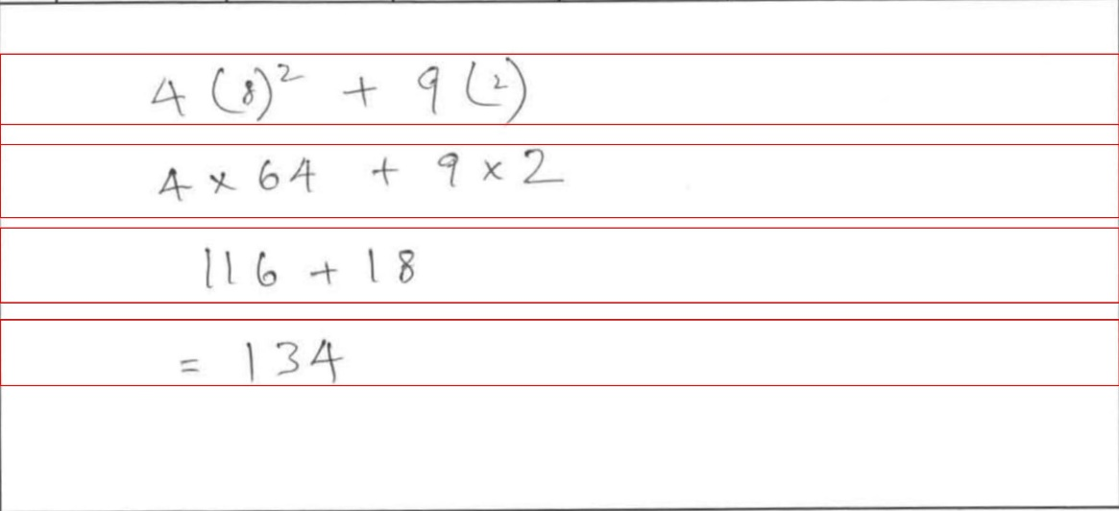
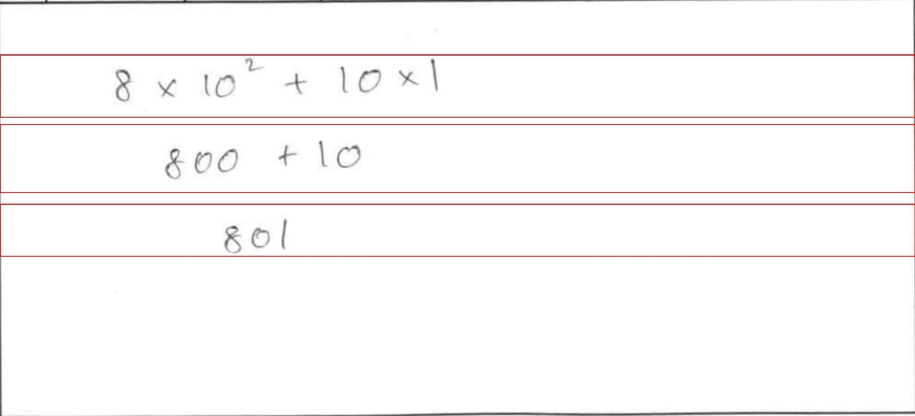
Image 1
Test Results
BOX 1
>>9*2**2+3*8
>>9*4+24
>>9*28
>>60
BOX 2
>>4*(8)**2+9*(2)
>>4*64+9*2
>>116+18
>>134
BOX 3
>>8*10**2+10*1
>>800+10
>>801

Slide 14
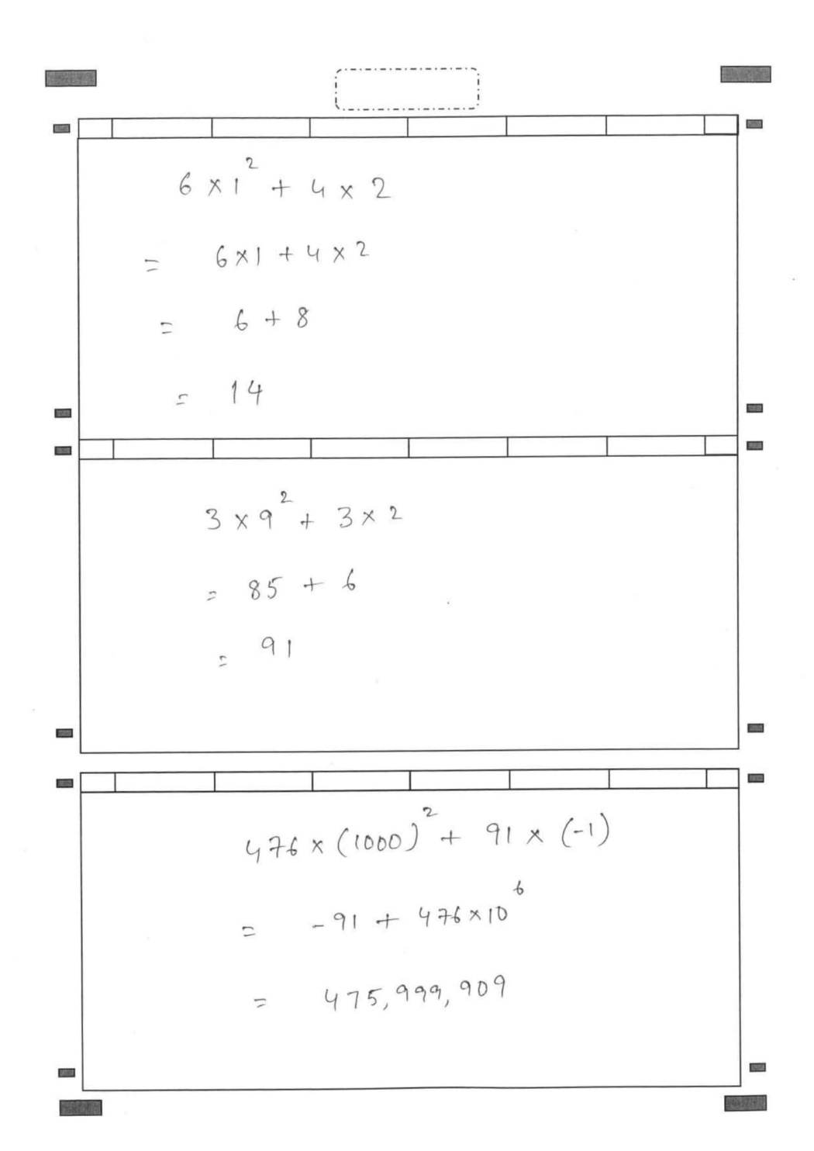
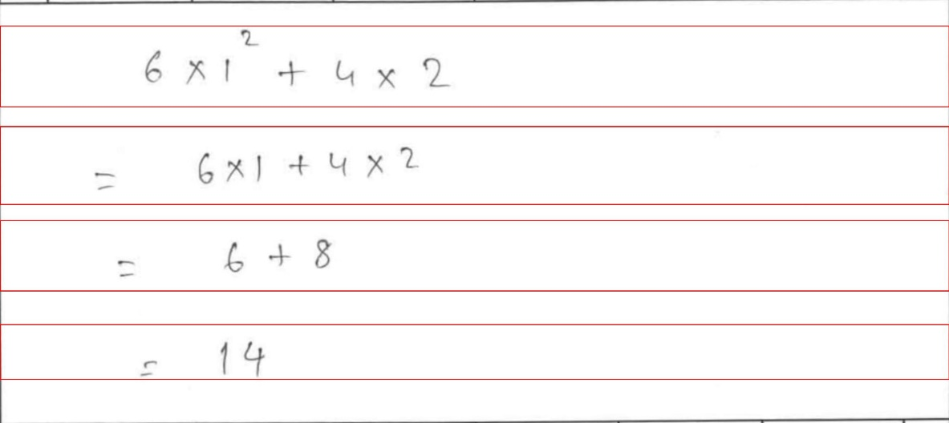
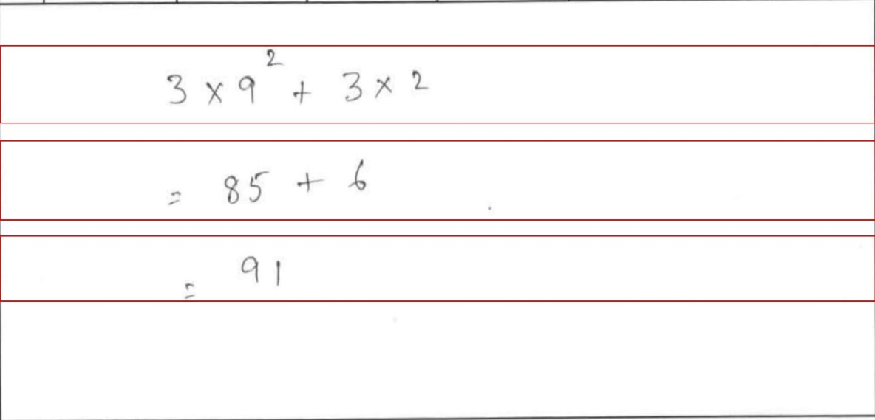
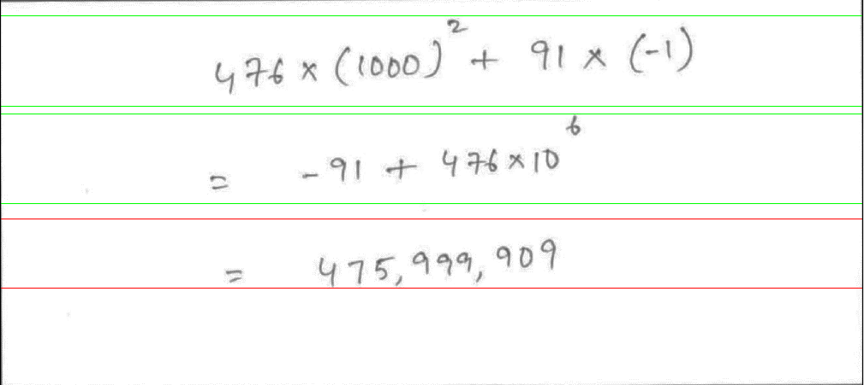
Image 2
Test Results
BOX 1
>>6*1**2+4*2
>>6*1+4*2
>>6+8
>>14
BOX 2
>>3*9**2+3*2
>>85+6
>>91
BOX 3
>>476*(1000)**2+
91*(-1)
>>-91+476*10**6
>>47519991909

Slide 15
File Structure
GITHUB - https://github.com/ocrmaths/Bosch
codes > API SERVER > UI > data > logs > models > notebooks > output >standalone_version requirement_pip.txt utils.py
docs > template.pptx > intermediate results ppts > testing results > UserGuide.docx
papers >dccnn paper

Slide 16
RFP vs Deliverables
Comparison
Requirements | Deliverables | Status
Accuracy Level > 90 % for intermediate and final steps Sample application in which take image input and provide image output with colored bounding boxes with Right or Wrong indication. Application should also generate detailed log file. Model files and weights. Training Files and Test Results User guide along with steps for integrating in a different application software. Hosting solution on github freely | Currently accuracy on handwritten images is 98 % for intermediate steps and 93.5 % for Line detection Currently Sample application takes images as a input and provides images a output with right, wrong and undetermined colored bounding boxes. Image output is being saved in ‘logs’ folder with respective image name and timestamp. Prediction logs are present in server Model file and weights is being saved into ‘models’ folder Training files and test results are present in a jupyter notebook with each steps clearly mentioned User guide with steps has been provided Hosted solution in github freely
✔
✔
✔
✔
✔
✔

Slide 17




Possible Enhancements
POC can be scaled to recognize Chemical as well as more complex Physics and Mathematical equations
Several features like ‘fraud detection of students’ , ‘student performance index’ kind of functionalities can be implemented
3. Recognition of cursive kind of handwritings where character are not at all separated

Slide 18
Thank You

