Slide 1
Intel - ocr

Slide 2
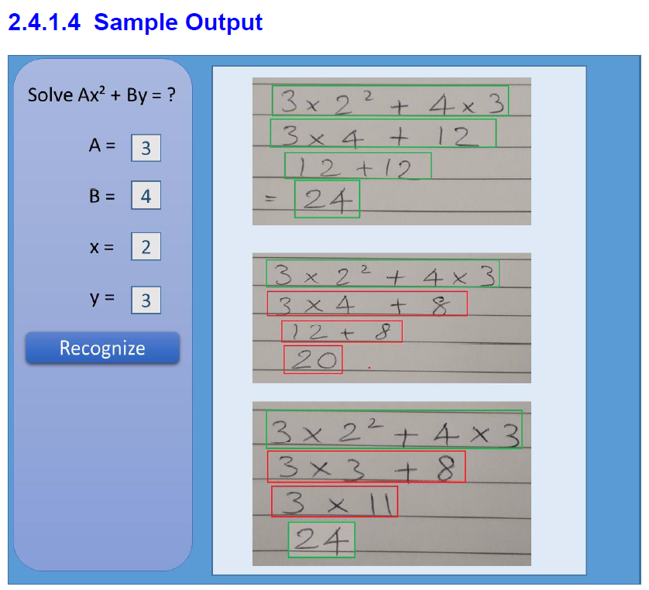
Problem Statement
The overall idea behind this project is to develop an computer vision algorithm along with solution package for recognizing and digitizing steps of solving a mathematical equation written by freehand on a paper, validating the steps and final answer of the recognized handwritten lines by maintaining the context

Slide 3

1. Tasks Completed
1.1 Workspace, Line, Character, Exponential Detection
1.2 Character recognition - Deep Learning Model Building
1.3 Computing mathematical equation value and Drawing boxes
1.4 Checking validation of equation mathematically
2. Work In Progress
2.2 Fixing bracket bug of Line Evaluation
3. Inputs from customer
3.1 Sample Image Testing
✔
✔
✔
✔

Slide 4
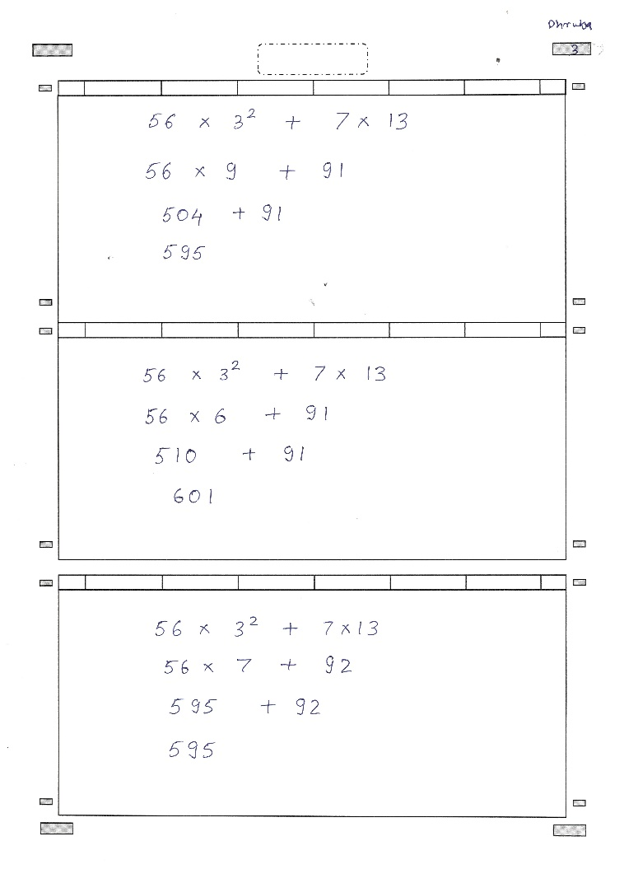
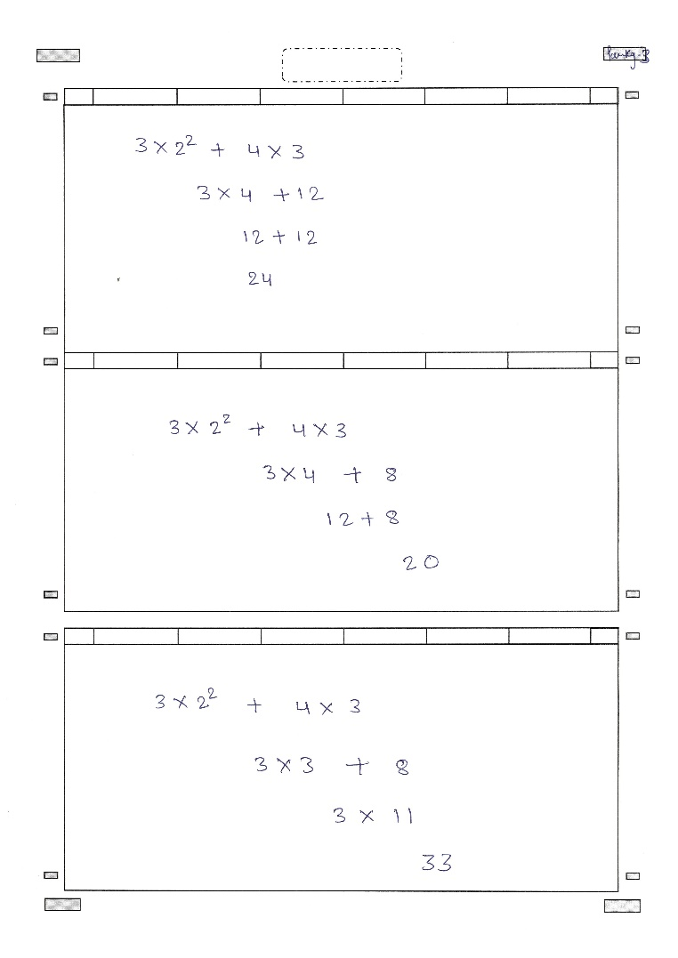
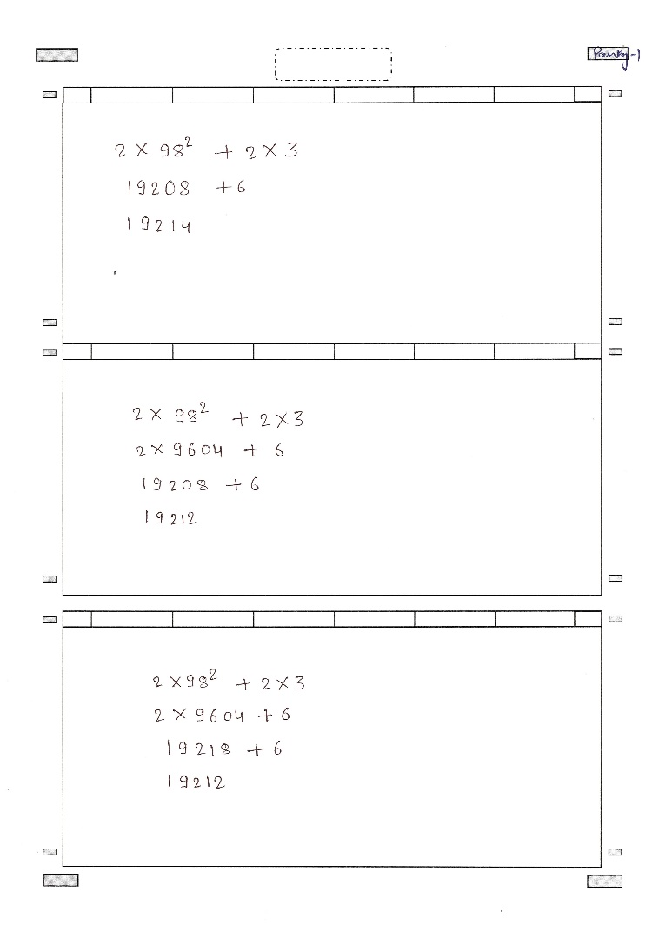
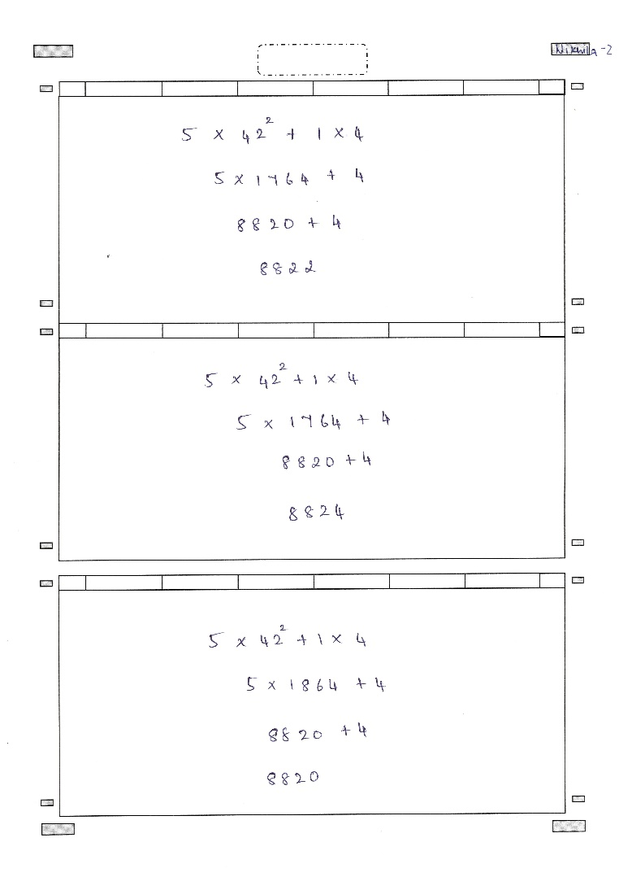
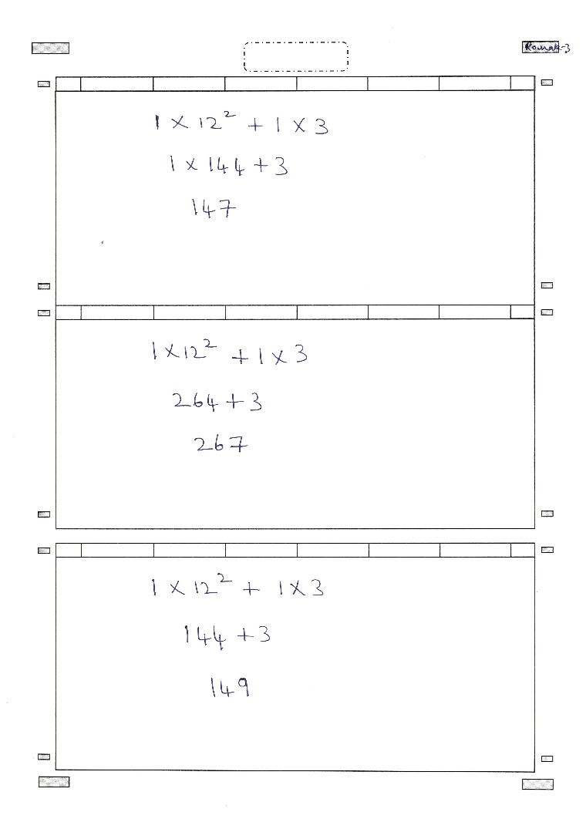
Sample Test Images
Handwritten Text Images
Variations: Different Person , Different line width, Different character style in same page, Different pen nib width, Different Character spacing

Slide 5
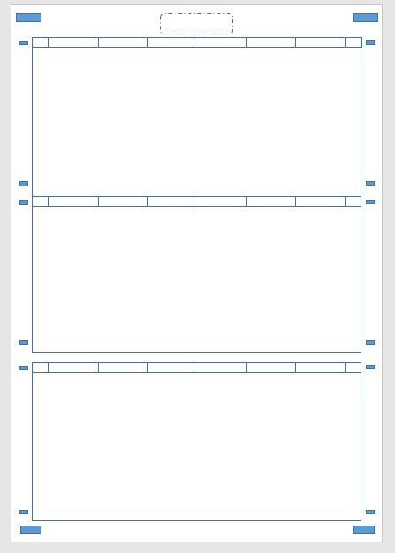
Approach
Workspace Detection
Sample Worksheet
OpenCV for finding closed object contours
Detect all the boxes
Sort them (Top-to-Bottom)
Choose the desired boxes based on the area
Assumptions :
Valid Rectangular boxes present

Slide 6
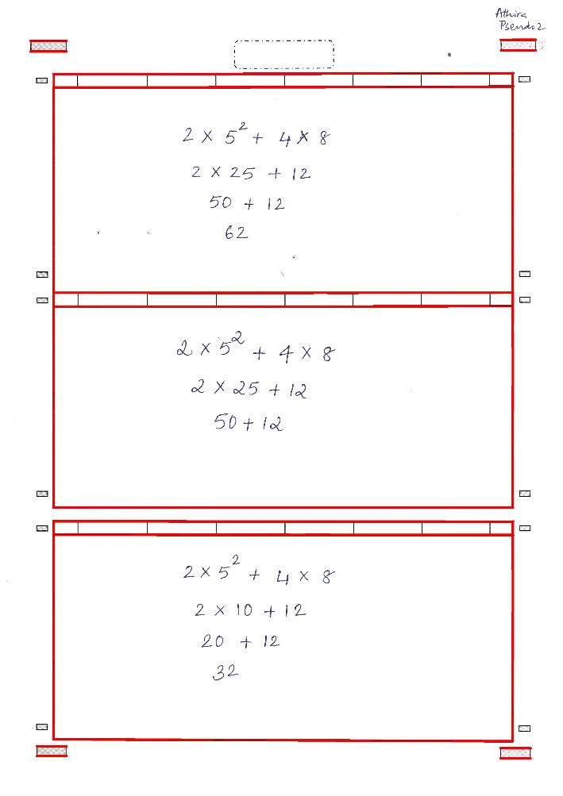
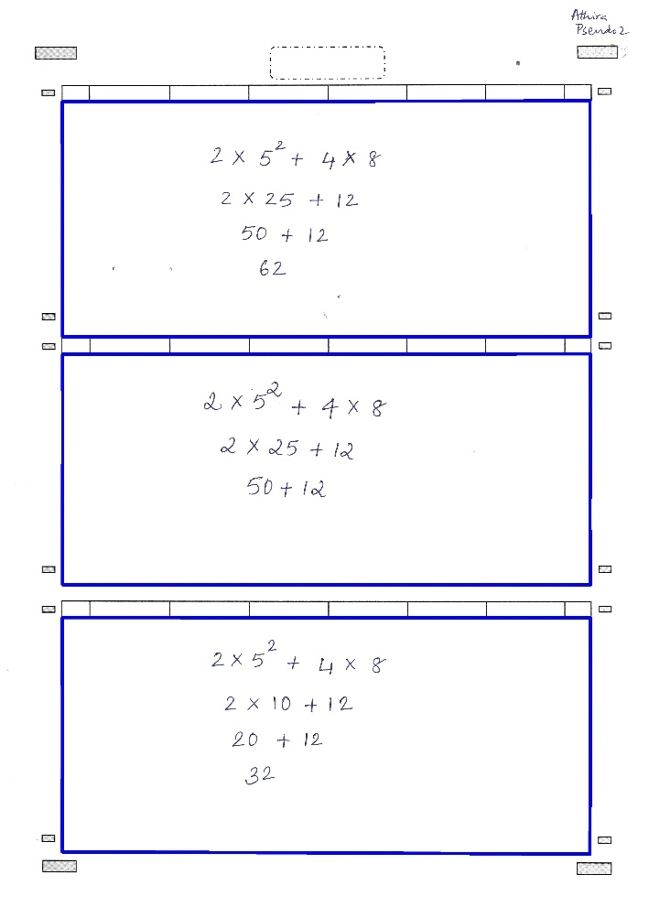
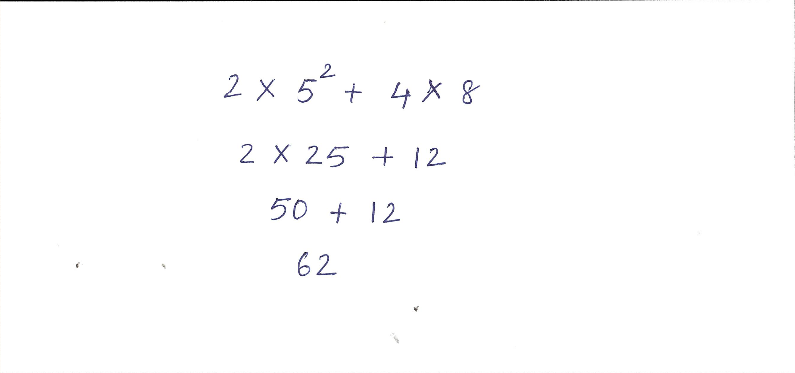
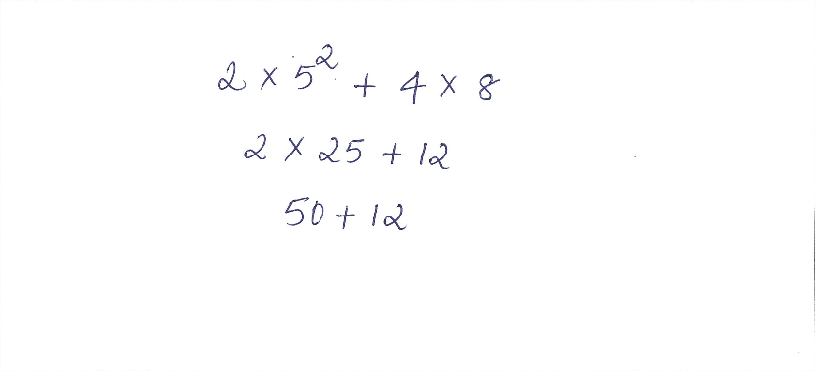
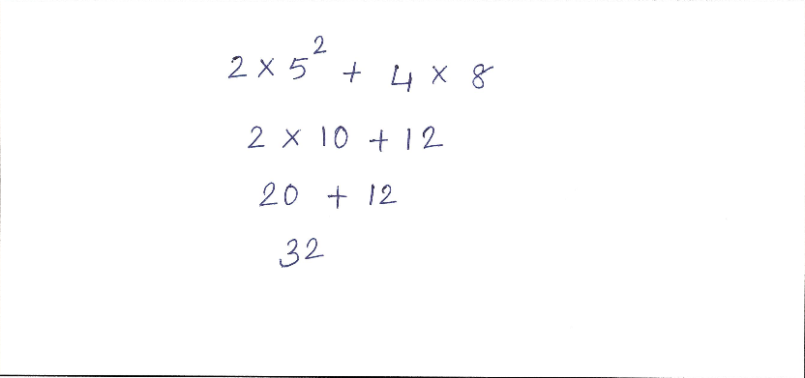
Worksheet Detection
Contours detection
Selection based on area
Cropped images

Slide 7

Approach
Line Detection
Compress matrix in a single array and take forward derivative
Assumptions :
1) Sufficient gap between lines is required
2) There should be at least some intersection between exponential characters and line

Slide 8
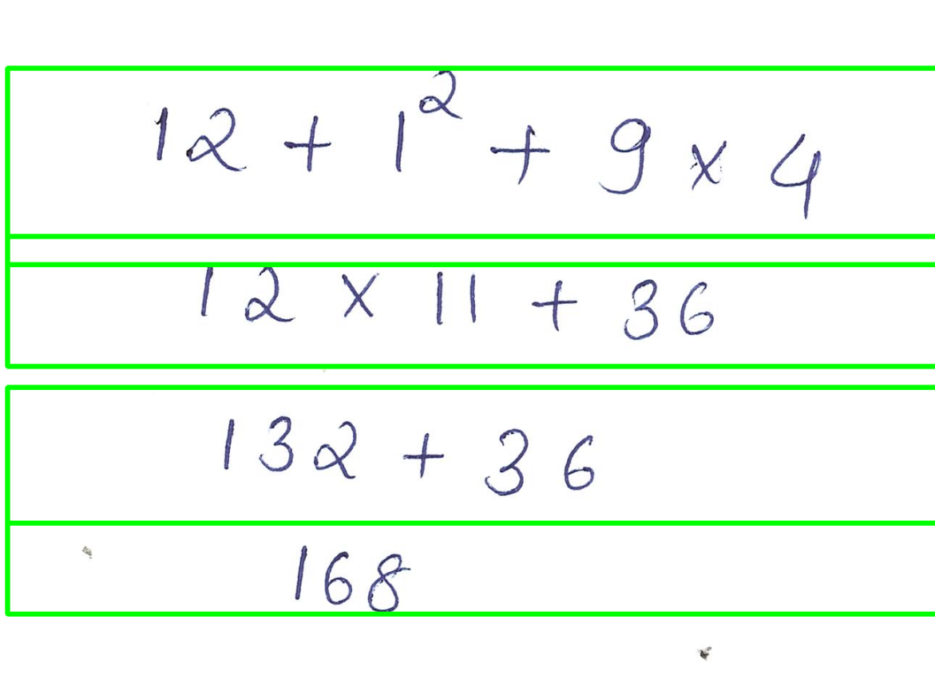



Output
Line Detection
Cropped images
Line Detection and Rotation

Slide 9


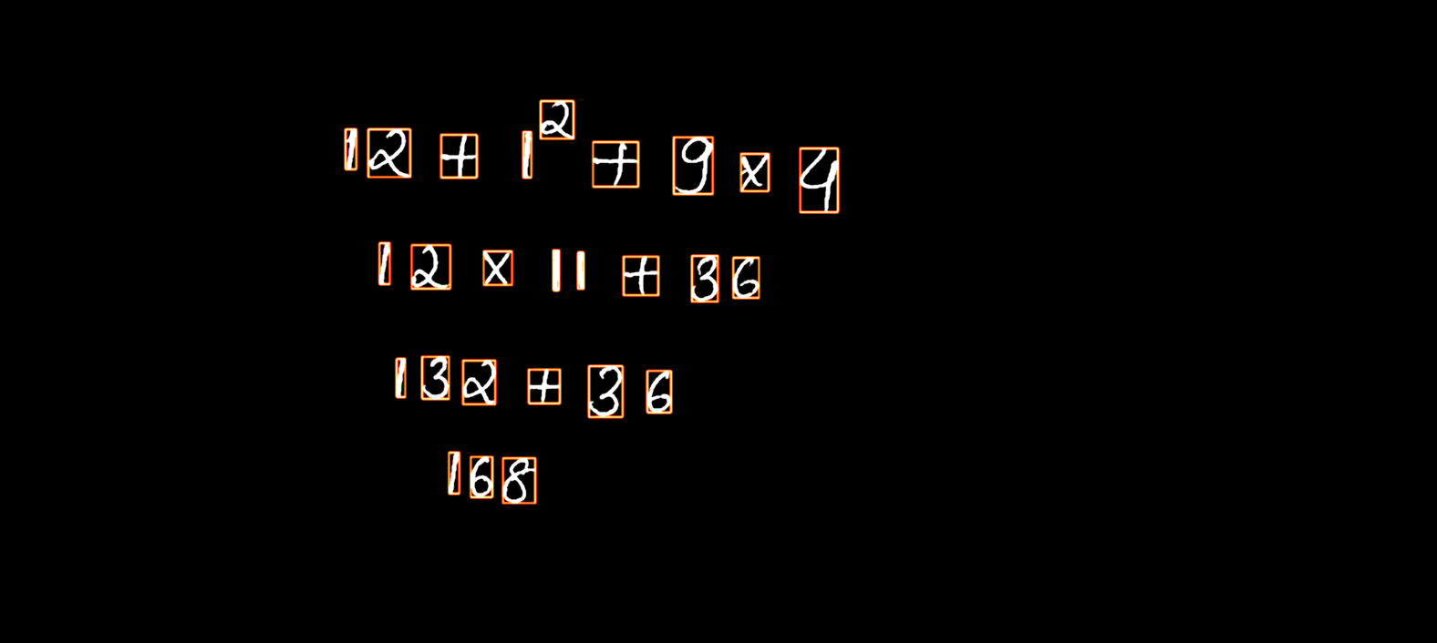
Approach
Character Segmentation
OpenCV for contour finding and bounding boxes
Find the contours and sort (Left-to-Right)
Merge bounding boxes for symbol like “=”
Output
Contours sorted left-to right

Slide 10
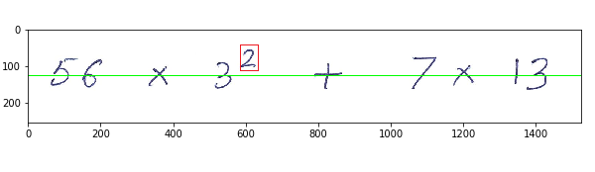
Exponents Detection
Character Segmentation
Green line divides the image in the ratio of 0.5
Any character lying above baseline and starting above previous character is taken as exponential

Slide 11
Exponents Detection
Character Segmentation
Green line divides the image in the ratio of 0.5
Any character lying above baseline and starting above previous character is taken as exponential

Slide 12
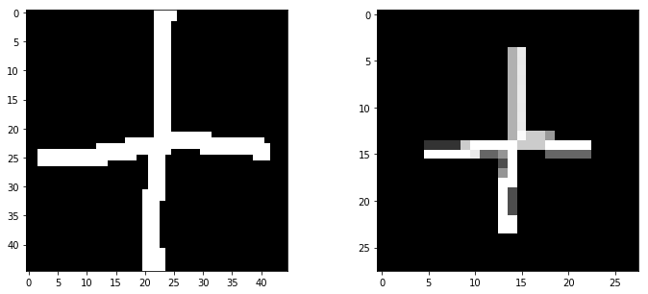
Dataset
Optical Character Recognition
Digits (0-9) : MNIST (28 * 28)
Symbols ( ‘(’ , ‘)’, ‘-’, ‘+’, ‘*’ ): Kaggle Handwritten Mathematical Symbols Dataset (45*45)
Preprocessing of symbols to match MNIST digits
Converted to Binary
Padded to 20 * 20 (preserving the aspect ratio)
Padded to 28 * 28 using Centre of mass
Crop and centered single math symbols

Slide 13
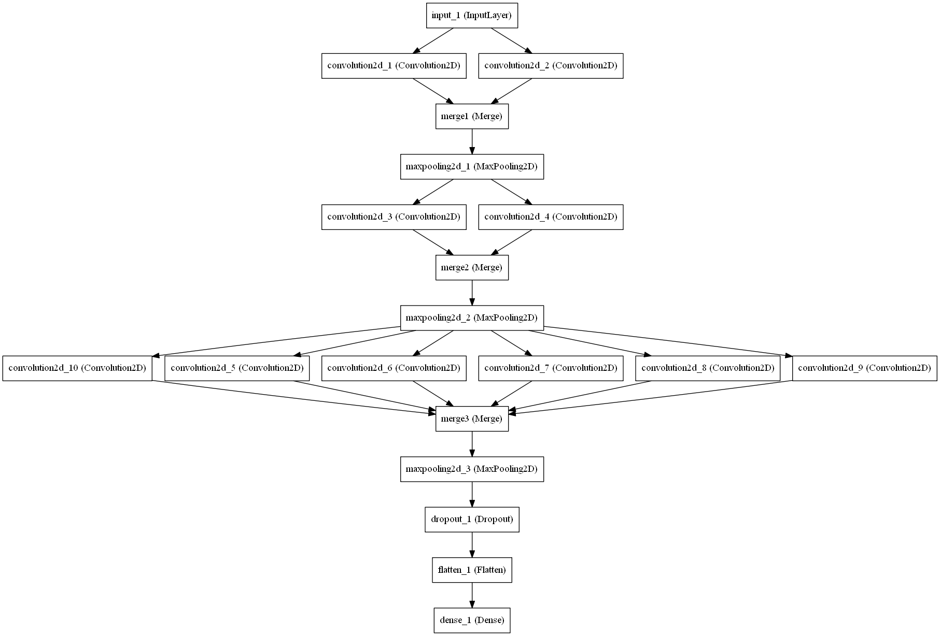
Approach
Optical Character Recognition
OpenCV for contour finding and bounding boxes
Model : Deep Columnar Convolutional Neural Network
Based on the paper "Deep Columnar Convolutional Neural Network“
[1] Somshubra Majumdar and Ishaan Jain. Deep Columnar Convolutional Neural Network. International Journal of Computer Applications 145(12):25-32, July 2016
Trained on > 50,000 images of digits and symbol
Classification > 97% accuracy

Slide 14
Evaluation of Expression
Line Box Coloring
eval() in Python
The eval() method parses the expression passed to it and runs python expression(code) within the program
Equation independent
Example:
>>Enter the function y(in terms of x):
‘x*(x+1)*(x+2)’
>>Enter the value of x:
3
>>print(y)
60

Slide 15
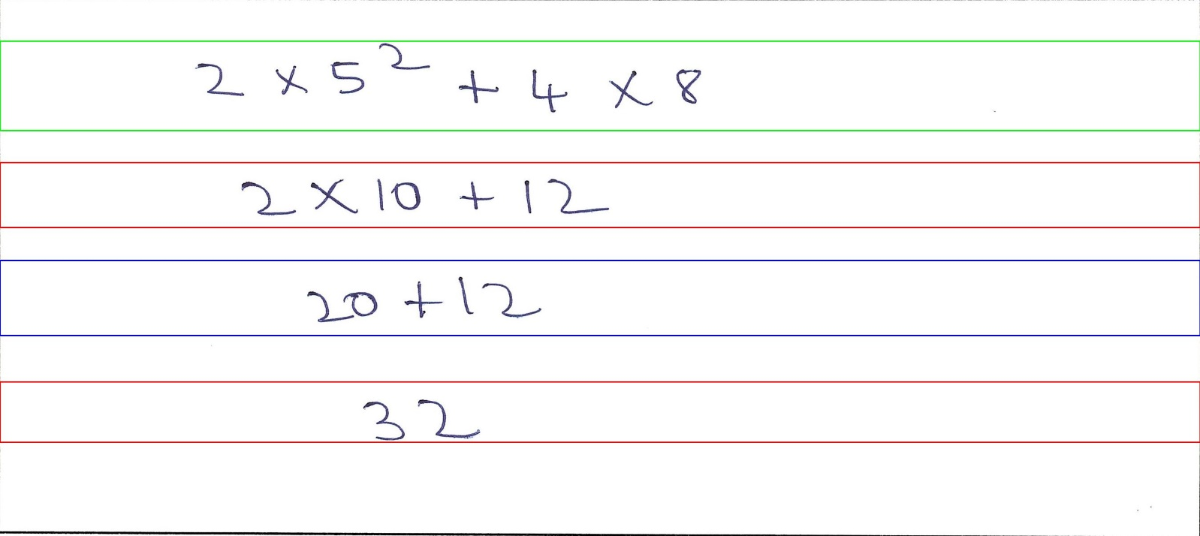
Color Code
Line Box Coloring
Green : Correct Line
Red : Wrong Line
Blue : Undetermined {Something might went wrong in evaluation of expression}

Slide 16
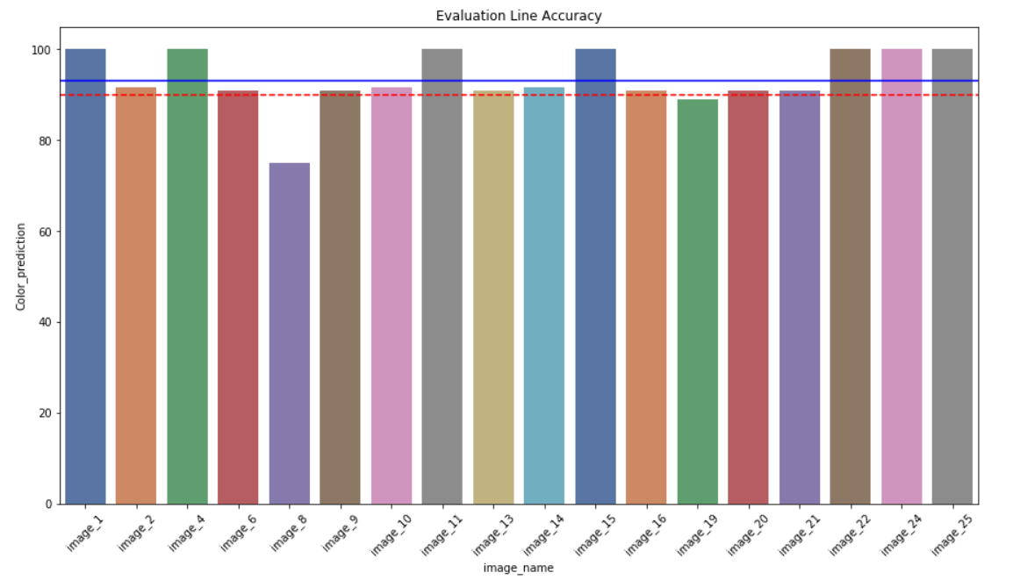
On Handwritten pages
Accuracies
 | line_det | char_det | exp_det | Color_prediction
count | 18 | 18 | 18 | 18
mean | 100.0 | 98.9 | 96.3 | 93.6
std | 0.0 | 0.8 | 10.8 | 6.5
min | 100.0 | 97.5 | 66.7 | 75.0
25% | 100.0 | 98.7 | 100.0 | 90.9
50% | 100.0 | 100.0 | 100.0 | 91.7
75% | 100.0 | 100.0 | 100.0 | 100.0
max | 100.0 | 100.0 | 100.0 | 100.0
Average run time : 1.57 +- 0.16 Secs

Slide 17
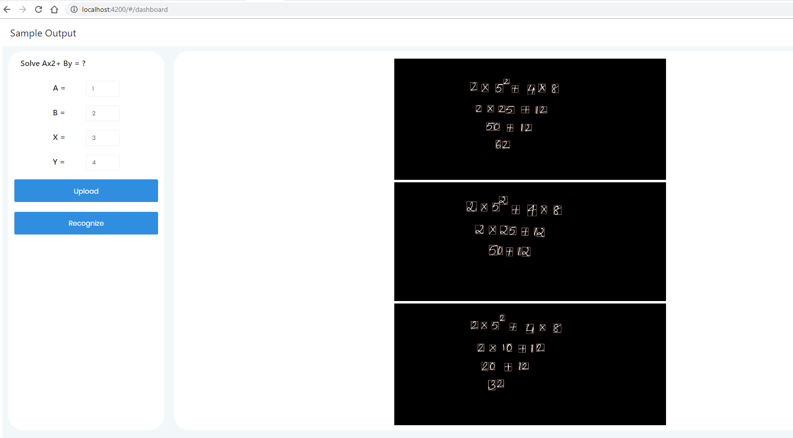
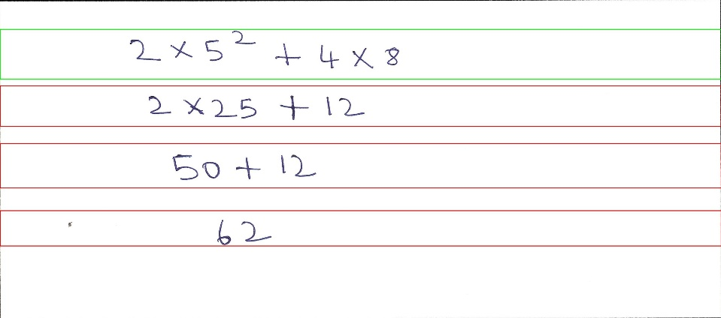
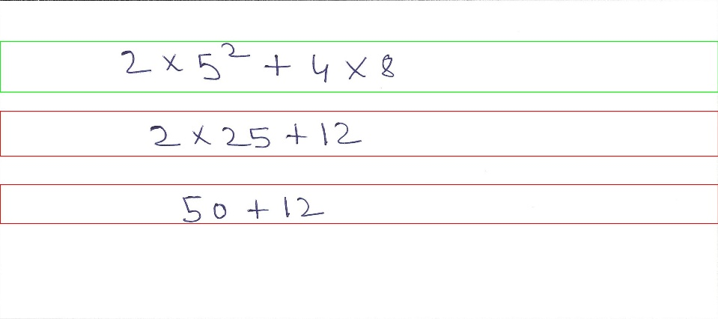
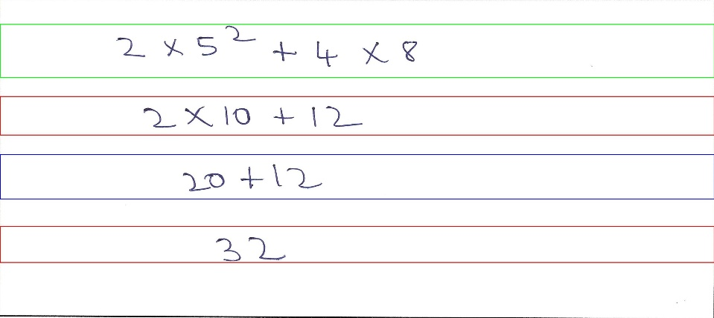
GUI
Functionality Current:
Upload Images
Detect Characters
Display results
For new test , upload image and click recognize

Slide 18
GUI
Equation 1<Static>
Output 1 Image<Dynamic>
Text1<Dynamic>
Equation 2<Static>
Equation 3<Static>
Output 2 Image<Dynamic>
Image <Dynamic>
Text2<Dynamic>
Evaluate
Output 3 Image<Dynamic>
Text3<Dynamic>

Slide 19
Thank You

