Slide 1
Intel - ocr

Slide 2
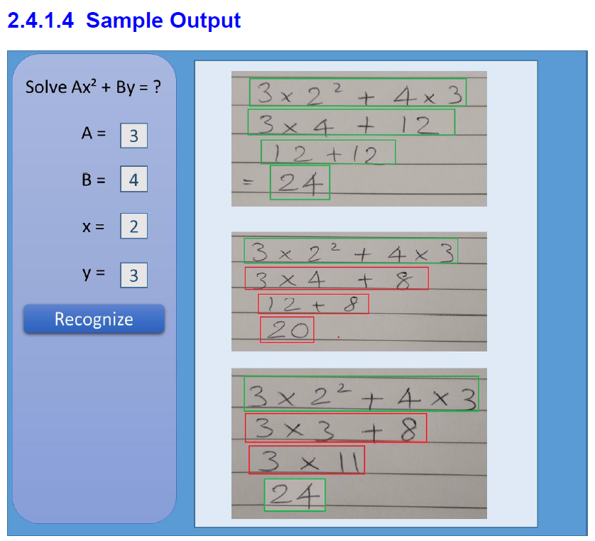
Problem Statement
The overall idea behind this project is to develop an computer vision algorithm along with solution package for recognizing and digitizing steps of solving a mathematical equation written by freehand on a paper, validating the steps and final answer of the recognized handwritten lines by maintaining the context

Slide 3
1. Tasks Completed
1.1 Workspace, Line, Character, Exponential Detection
1.2 Character recognition - Deep Learning Model Building
1.3 Computing mathematical equation value and Drawing boxes
1.4 Checking validation of equation mathematically
3. Inputs from customer [ For tuning Parameters ]
3.1 Sample Image Testing
✔
✔
✔
✔

Slide 4
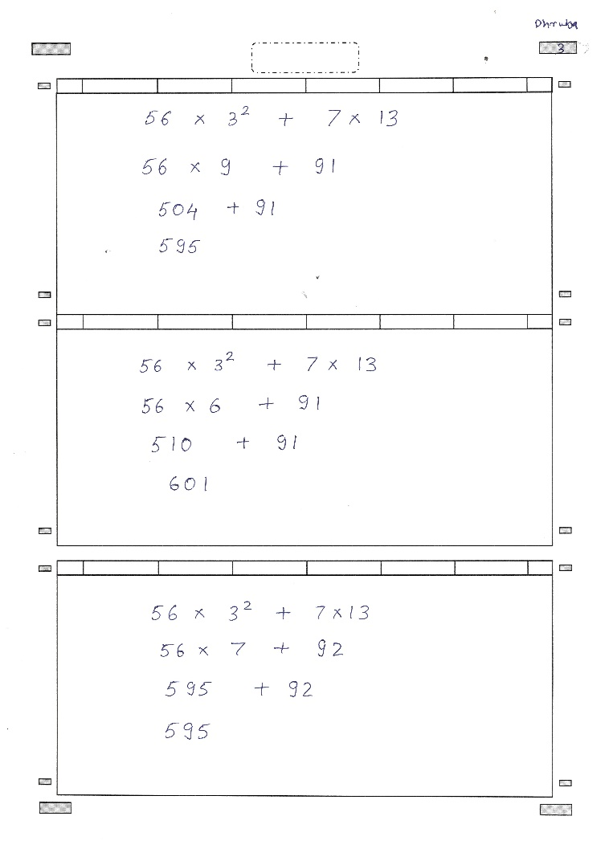
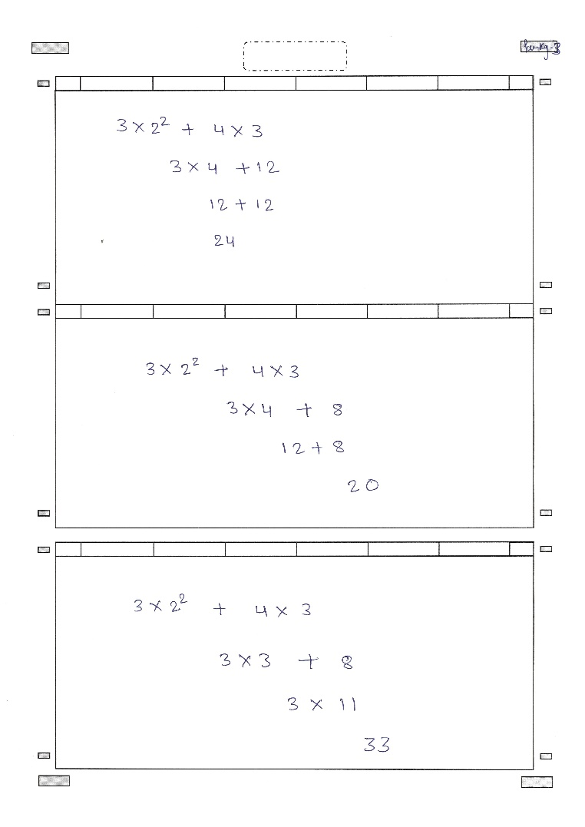
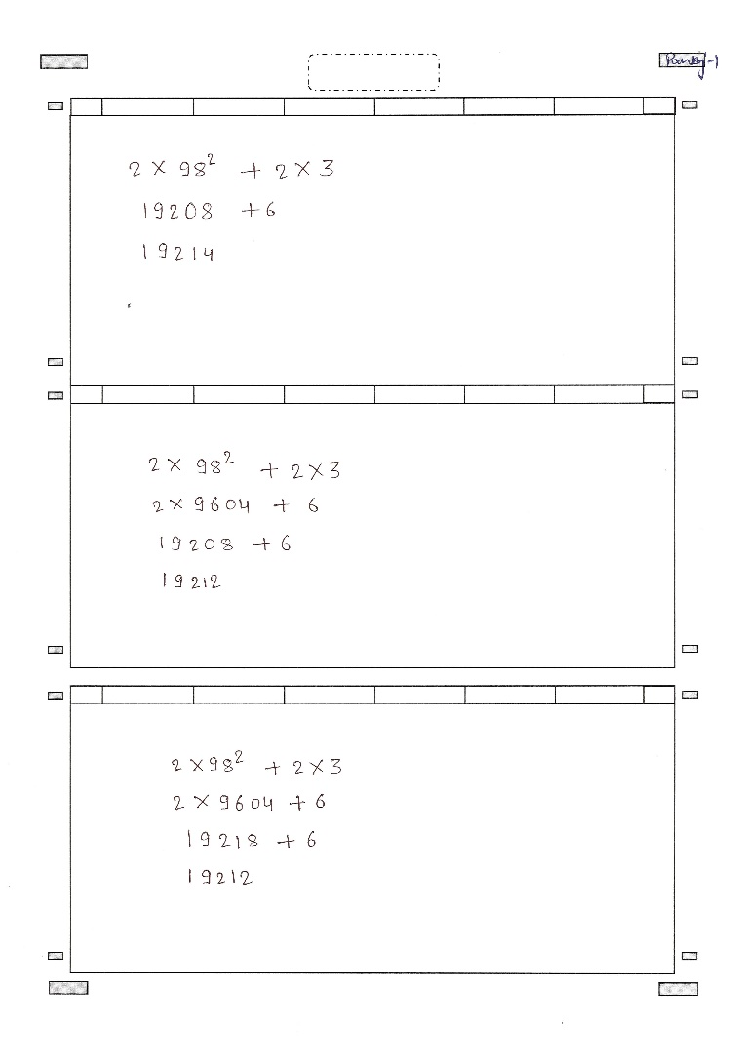
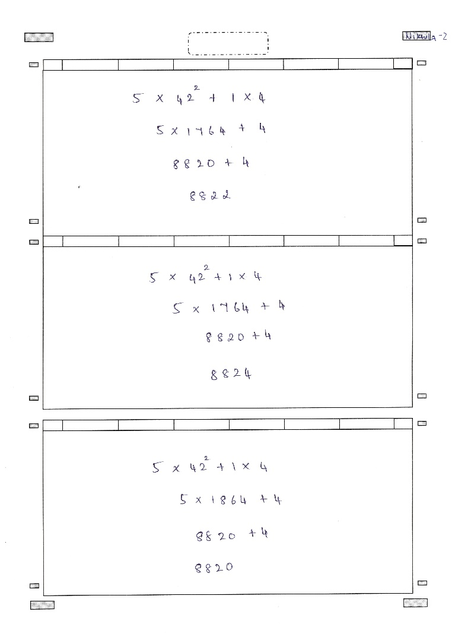
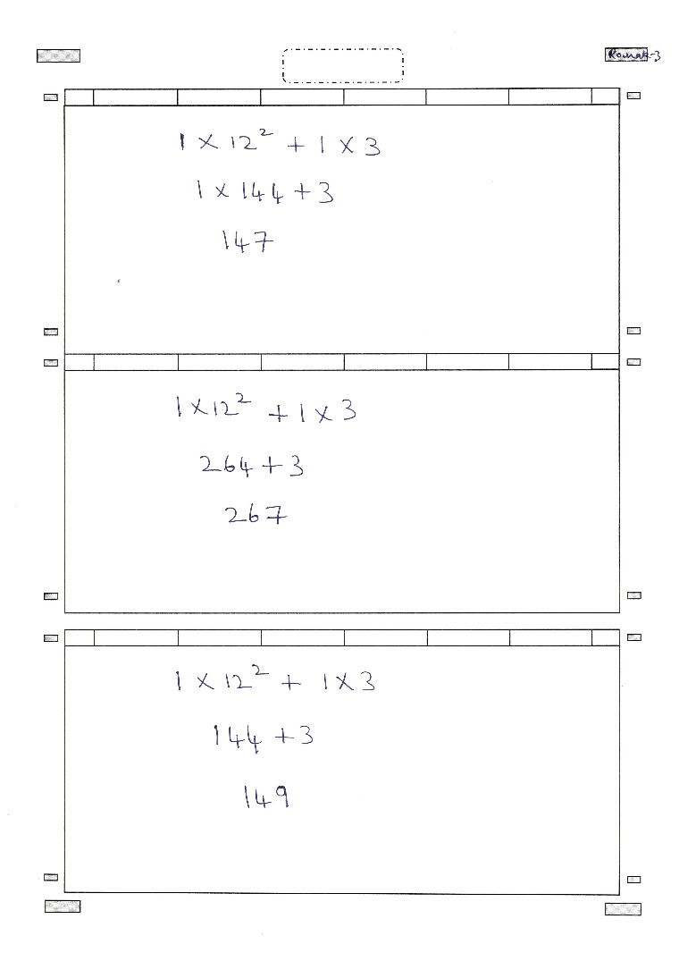
Sample Test Images
Handwritten Text Images
Variations: Different Person , Different line width, Different character style in same page, Different pen nib width, Different Character spacing

Slide 5
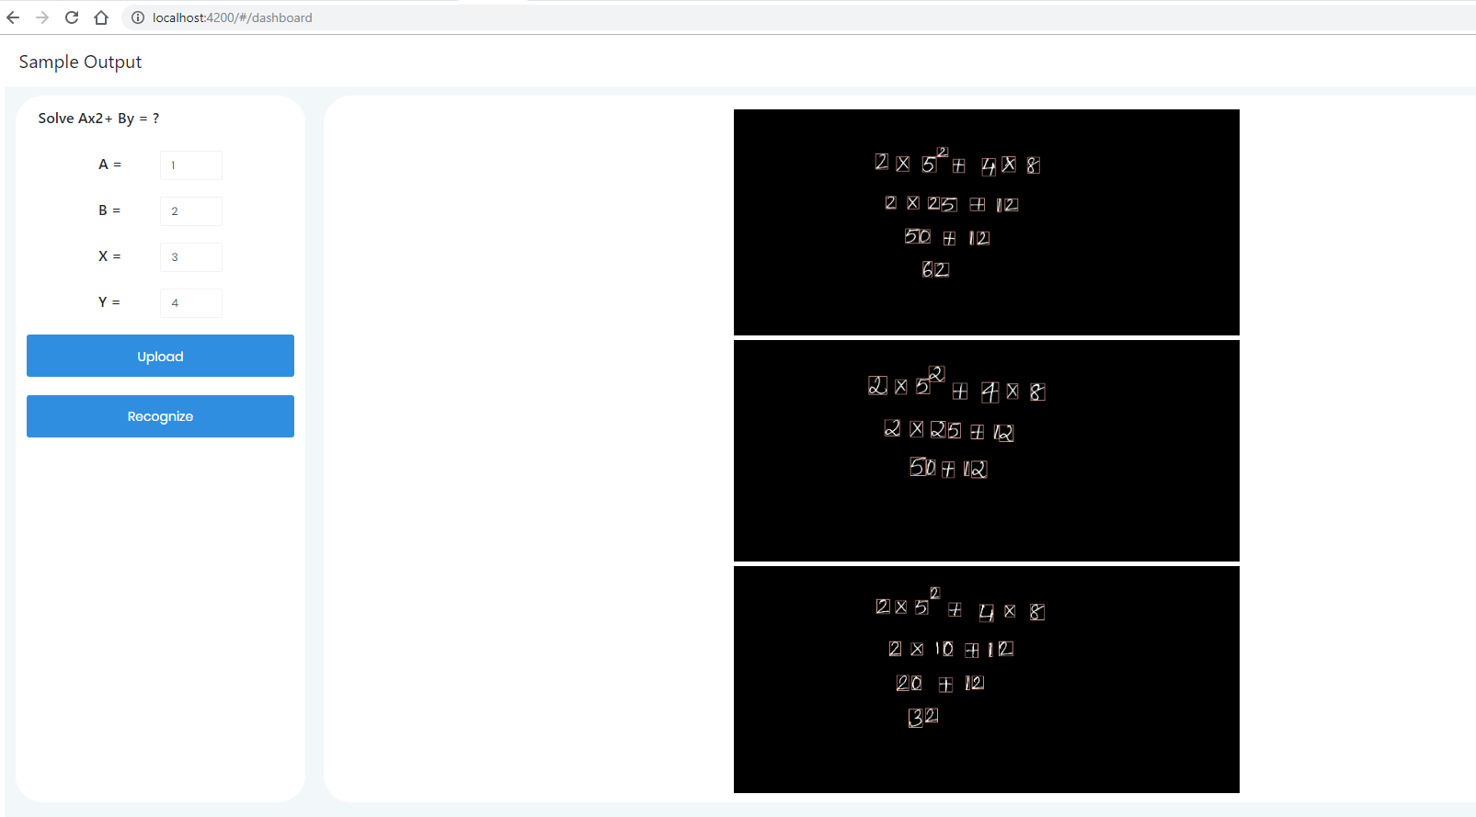
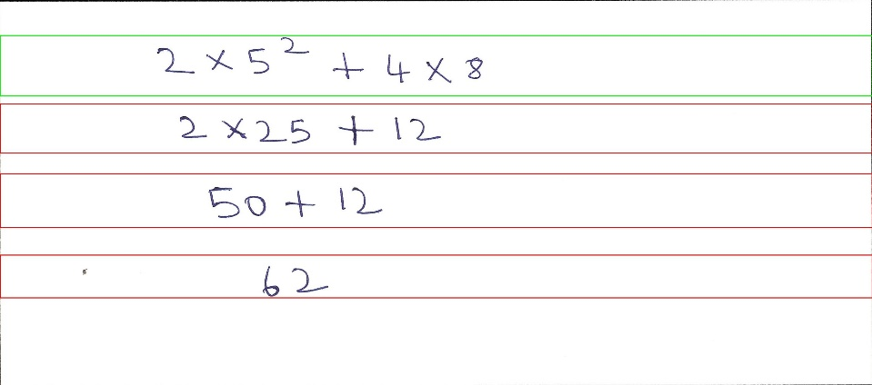
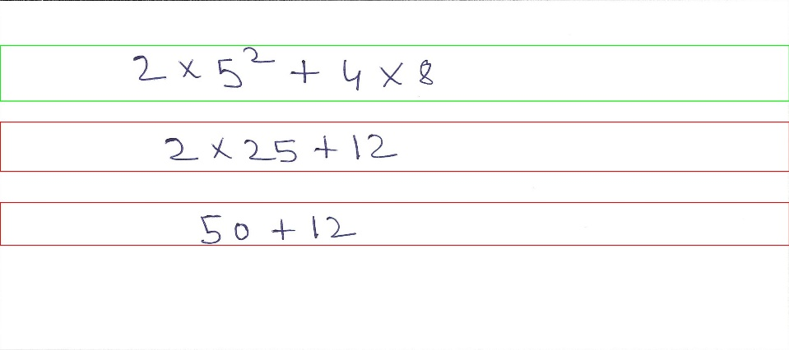
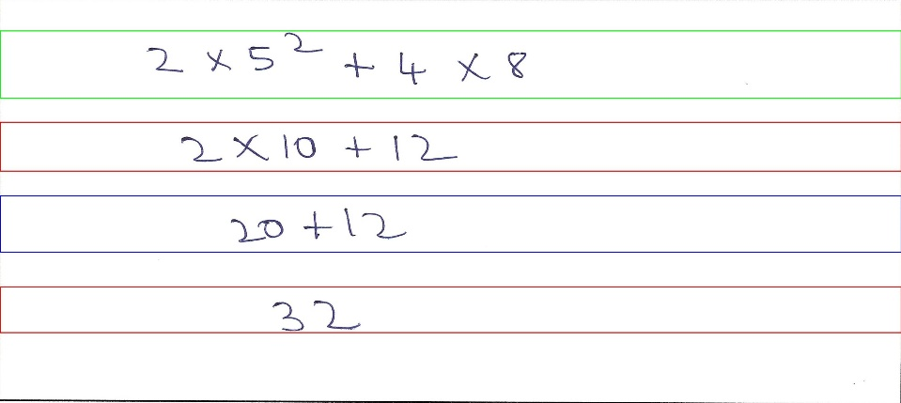
GUI
Functionality Current:
Upload Images
Detect Characters
Display results
For new test , upload image and click recognize

Slide 6
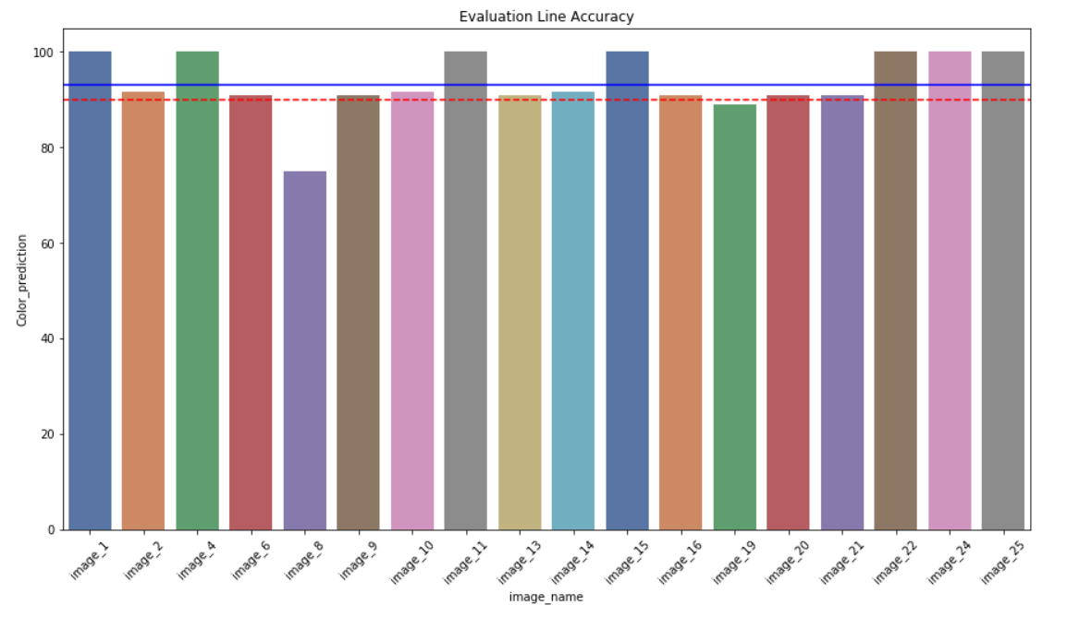
On Handwritten pages
Accuracies
 | line_det | char_det | exp_det | Color_prediction
count | 18 | 18 | 18 | 18
mean | 100.0 | 98.9 | 96.3 | 93.6
std | 0.0 | 0.8 | 10.8 | 6.5
min | 100.0 | 97.5 | 66.7 | 75.0
25% | 100.0 | 98.7 | 100.0 | 90.9
50% | 100.0 | 100.0 | 100.0 | 91.7
75% | 100.0 | 100.0 | 100.0 | 100.0
max | 100.0 | 100.0 | 100.0 | 100.0

Slide 7
RFP vs Deliverables
Comparison
Requirements | Deliverables | Status
Sample application in which take image input and provide image output with colored bounding boxes with Right or Wrong indication. Application should also generate detailed log file. Model files and weights. Training Files and Test Results User guide along with steps for integrating in a different application software. Hosting solution on github freely | Currently Sample application takes images as a input and provides images a output with right, wrong and undetermined bounding boxes with color coding. Image and Text output is being saved in ‘logs’ folder with respective image name and timestamp. Model file and weights is being saved into ‘models’ folder Training files and test results are present in a jupyter notebook with each steps clearly mentioned User guide with steps has been provided Hosted solution in github | Yes Yes Yes No Yes

Slide 8
Steps
Future
1. Generalizing for any mathematical equation
2. Recognition for more complex Mathematical equations like differential integral equations
3. Recognition of cursive kind of handwritings where character are not at all separated
4. This ideas can be scaled to recognition for chemical equations as well

Slide 9
Thank You

