Slide 1
Intel – ocr

Slide 2
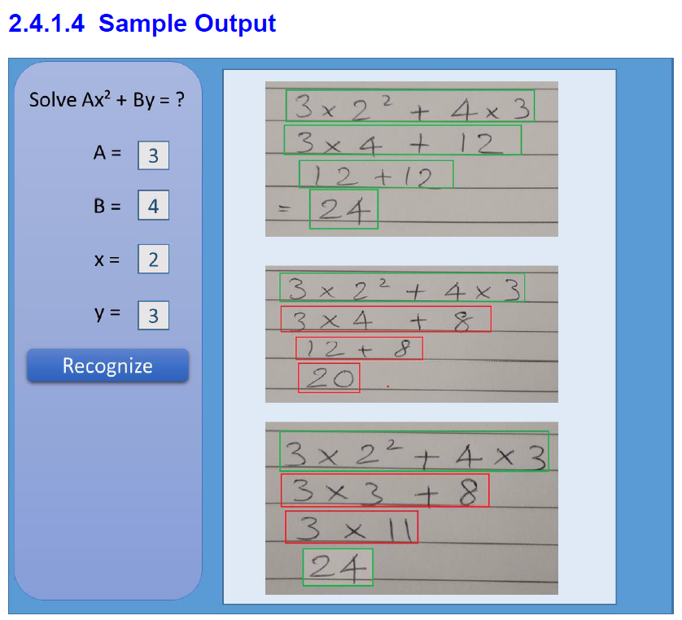
Problem Statement
The overall idea behind this project is to develop an computer vision algorithm along with solution package for recognizing and digitizing steps of solving a mathematical equation written by freehand on a paper, validating the steps and final answer of the recognized handwritten lines by maintaining the context

Slide 3
1. Tasks Completed
1.1 Workspace, Line, Character, Exponential Detection
1.2 Character recognition - Deep Learning Model Building
1.3 Computing mathematical equation value and Drawing boxes
1.4 Checking validation of equation mathematically
2. Inputs from Intel [ For tuning Parameters ]
2.1 Sample Image Testing
✔
✔
✔
✔

Slide 4
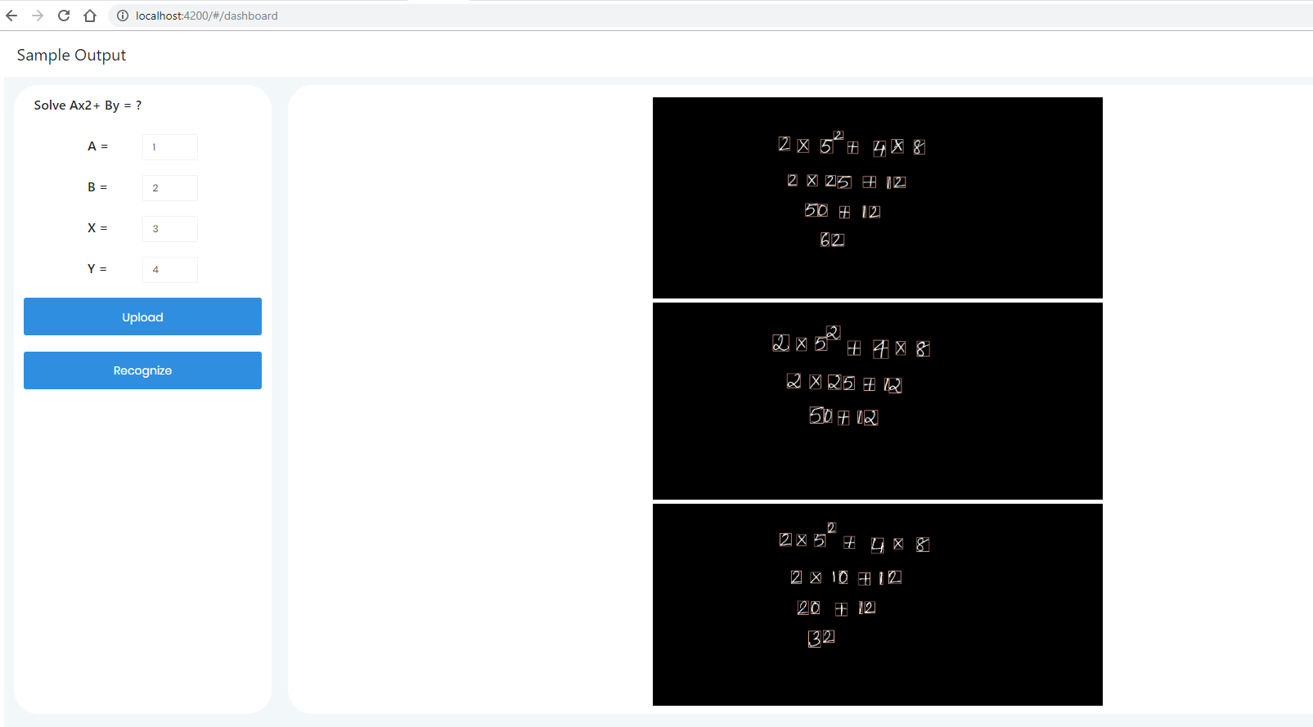
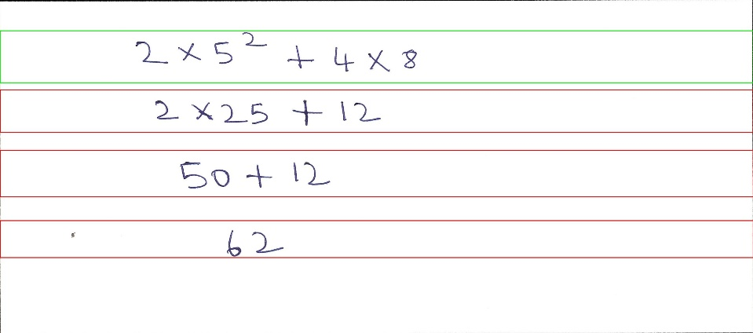
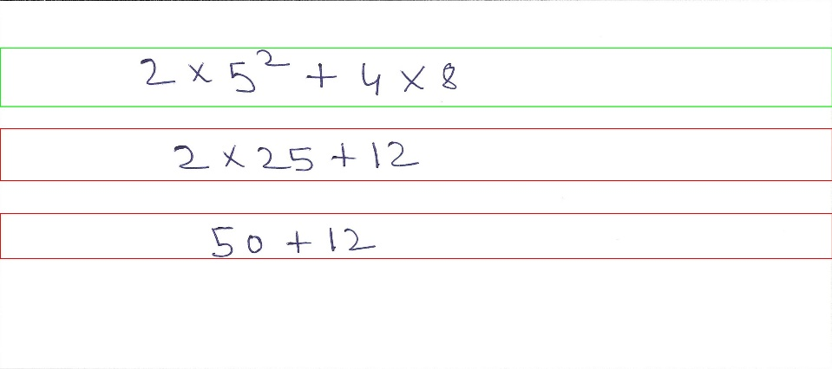
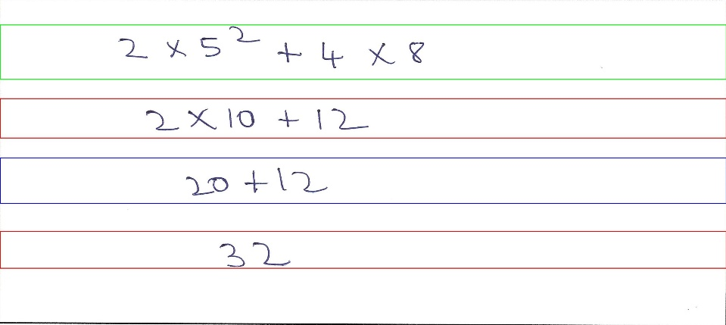
GUI
Functionality Current:
Upload Images
Detect Characters
Display results
For new test , upload image and click recognize

Slide 5
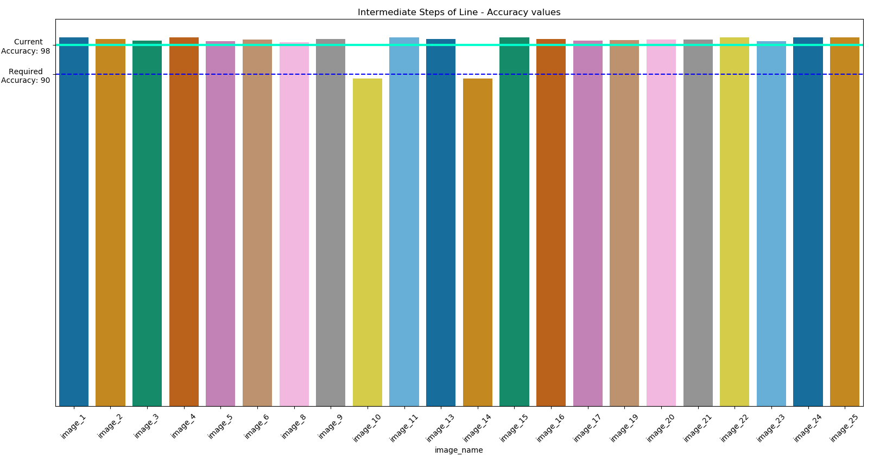
On Handwritten pages
Accuracies

Slide 6
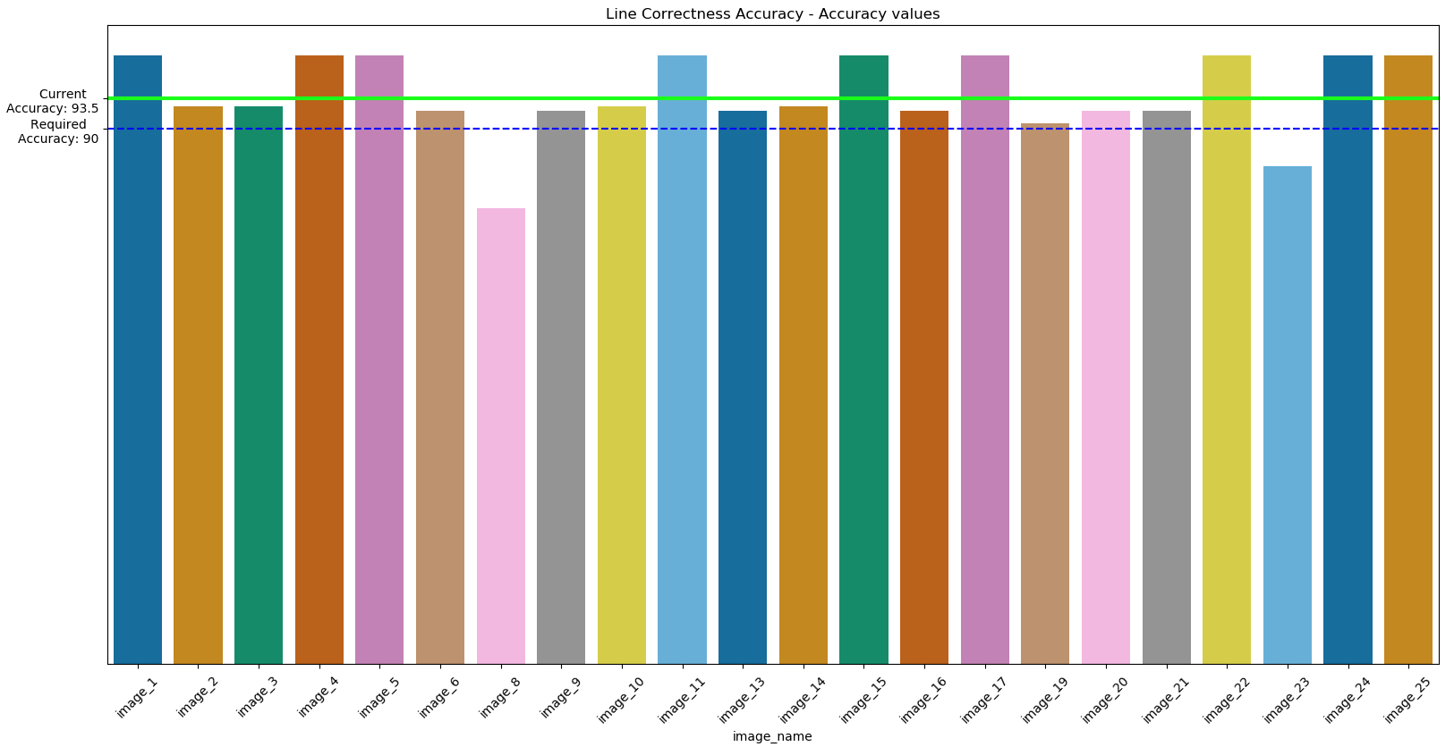
On Handwritten pages
Accuracies

Slide 7
RFP vs Deliverables
Comparison
Requirements | Deliverables | Status
Accuracy Level > 90 % for intermediate and final steps Sample application in which take image input and provide image output with colored bounding boxes with Right or Wrong indication. Application should also generate detailed log file. Model files and weights. Training Files and Test Results User guide along with steps for integrating in a different application software. Hosting solution on github freely | Currently accuracy on handwritten images is 98 % for intermediate steps and 93.5 % for Line detection Currently Sample application takes images as a input and provides images a output with right, wrong and undetermined colored bounding boxes. Image output is being saved in ‘logs’ folder with respective image name and timestamp. Prediction logs are present in server Model file and weights is being saved into ‘models’ folder Training files and test results are present in a jupyter notebook with each steps clearly mentioned User guide with steps has been provided Hosted solution in github
✔
✔
✔
✔
✔
✔

Slide 8
Possible Enhancements
POC can be scaled to recognize Chemical as well as more complex Physics and Mathematical equations
Several features like ‘fraud detection of students’ , ‘student performance index’ kind of functionalities can be implemented
3. Recognition of cursive kind of handwritings where character are not at all separated

Slide 9
Thank You

