Slide 1
Intel - ocr

Slide 2

1. Tasks Completed
1.1 Workspace Detection
1.2 Line Detection
1.3 Character Segmentation
1.4 Exponential Detection
1.5 API and GUI beta version
2. Work In Progress
2.1 Character recognition - Deep Learning Model Building
2.2 Computing mathematical equation value and Drawing boxes
2.3 API+GUI Improvisation
3. Upcoming Tasks
3.1 Checking validation of equation mathematically
3.2 Tuning parameters
✔
✔
✔
✔
✔

Slide 3
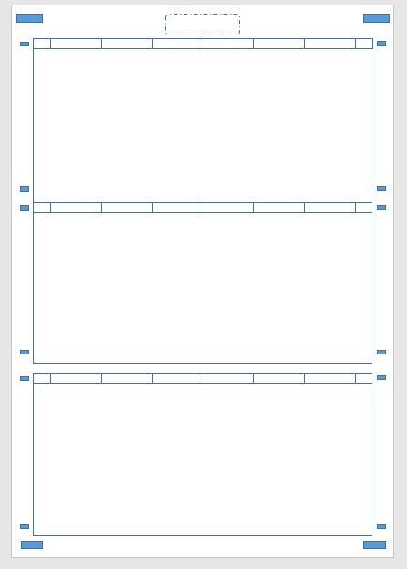
Approach
Workspace Detection
Sample Worksheet
OpenCV for finding closed object contours
Detect all the boxes
Sort them (Top-to-Bottom)
Choose the desired boxes based on the area
Assumptions :
Valid Rectangular boxes present

Slide 4
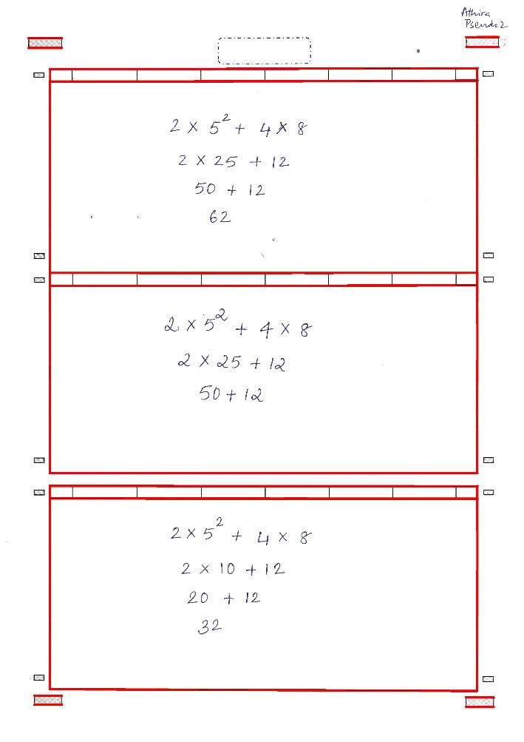
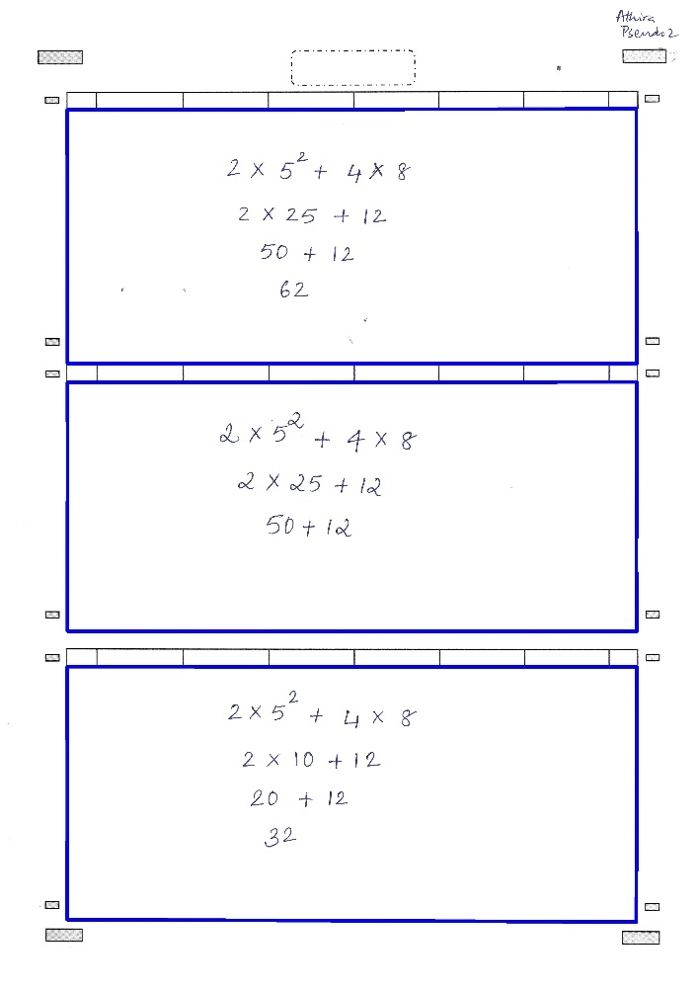
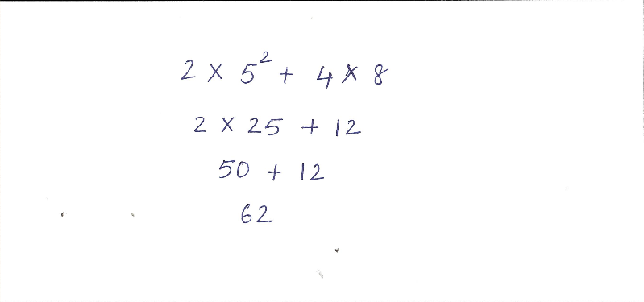
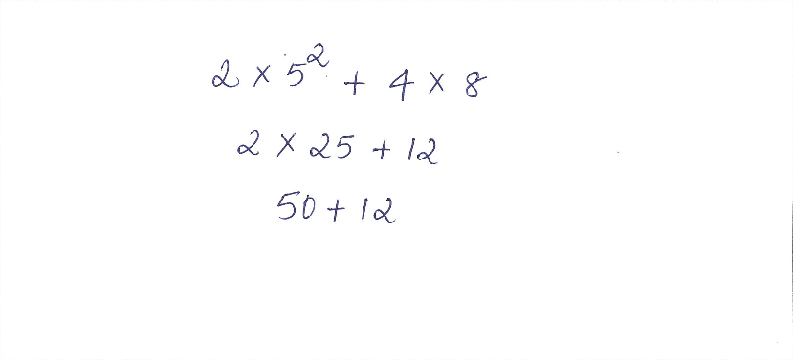
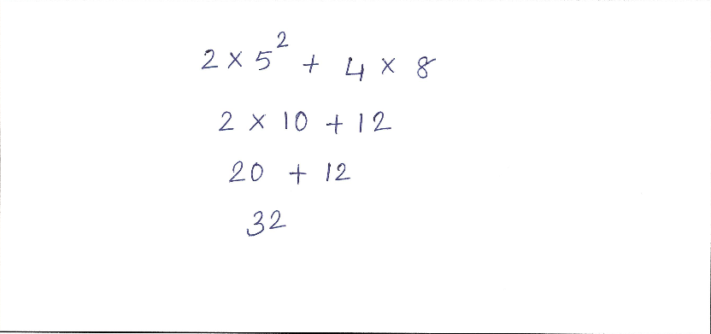
Worksheet Detection
Contours detection
Selection based on area
Cropped images

Slide 5
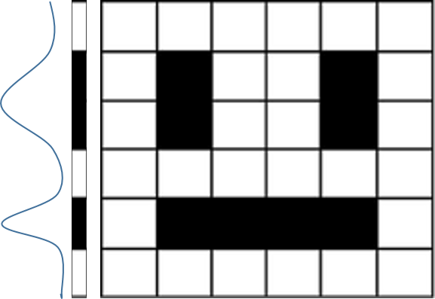
Approach
Line Detection
Compress matrix in a single array and take forward derivative
Assumptions :
1) Sufficient gap between lines is required
2) There should be at least some intersection between exponential characters and line

Slide 6
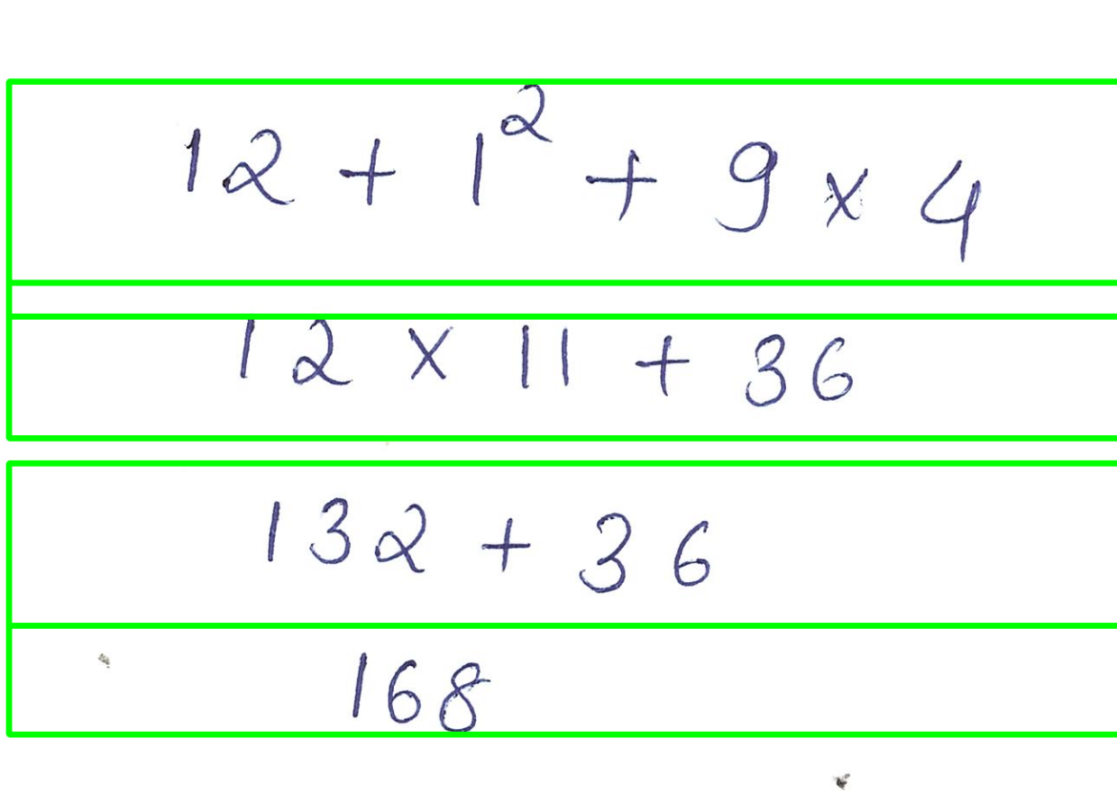
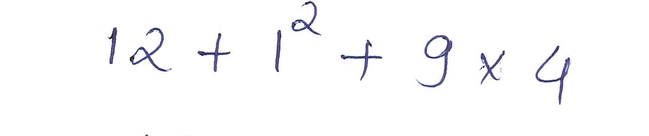


Output
Line Detection
Cropped images
Line Detection and Rotation

Slide 7


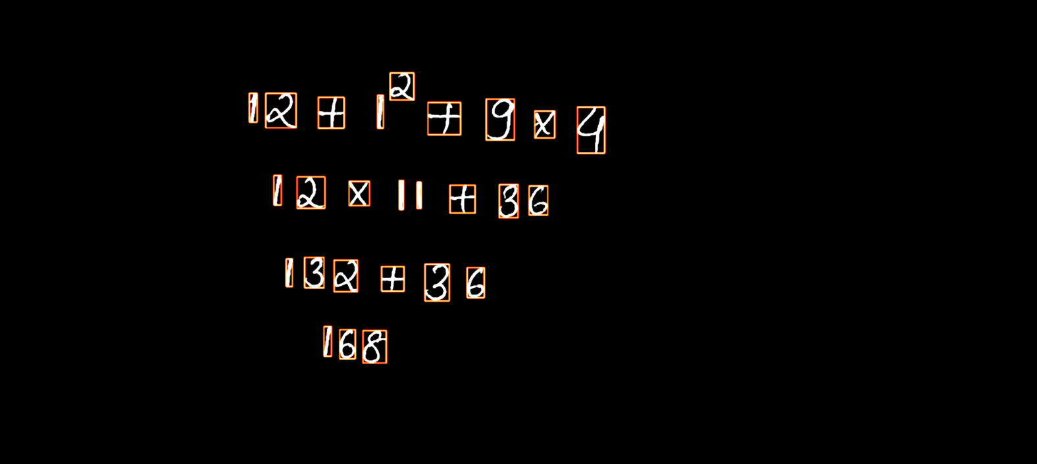
Approach
Character Segmentation
OpenCV for contour finding and bounding boxes
Find the contours and sort (Left-to-Right)
Detect the exponents based on position of contours
Merge bounding boxes for symbol like “=”
Output
Contours sorted left-to right

Slide 8
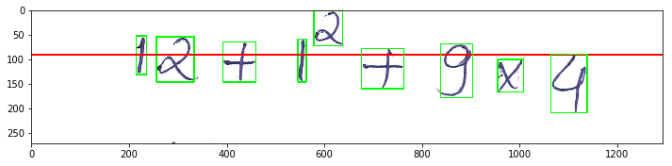
Exponents Detection
Character Segmentation
Red line divides the image in the ratio of 0.5
Any character lying above baseline and starting above previous character is taken as exponential

Slide 9
Thank You

