Slide 1
UNET
TGS Salt Identification

Slide 2
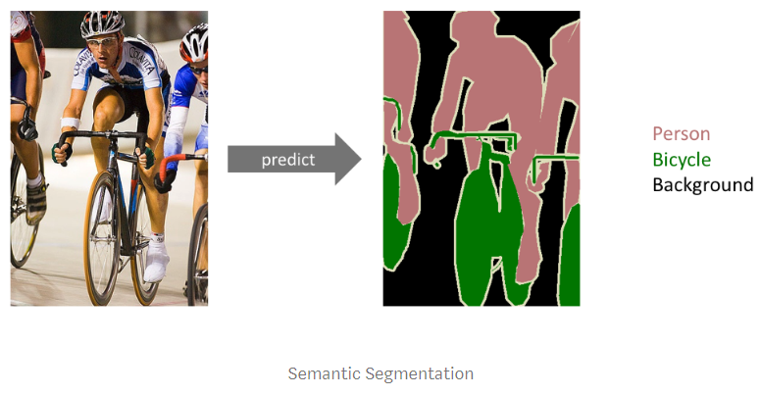
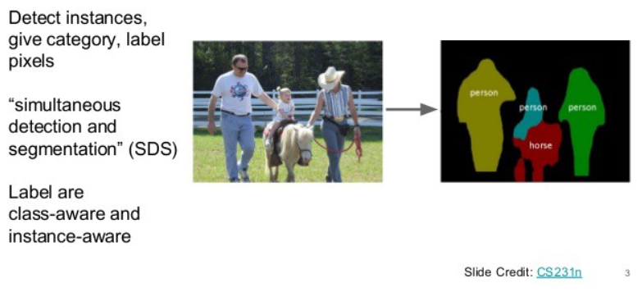
Understanding Semantic Segmentation with UNET
Semantic Segmentation
Instance Segmentation

Slide 3
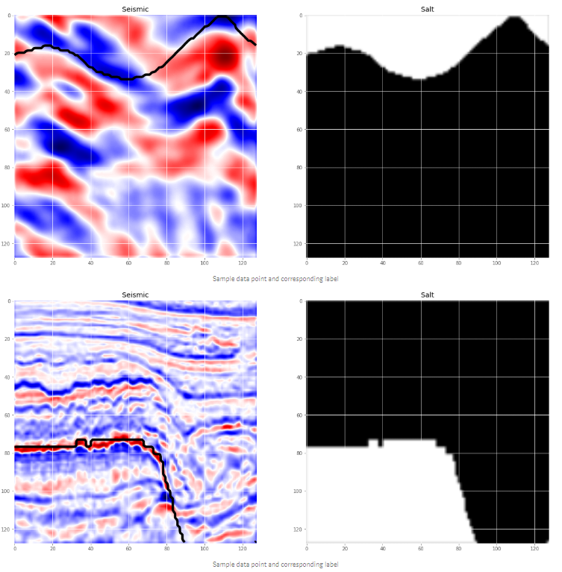
TGS Salt Identification - to predict whether there could be salt deposits in that region or not
About dataset:
images directory - 4000 seismic images
Masks directory - 4000 gray scale images

Slide 4
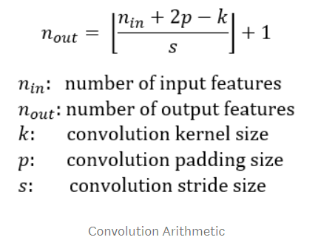
Convolution
Used to apply filter on a matrix by translating sequentially based on stride and padding.
Side of image {square}
Side of image {square}
Side of kernel {square}
Vertical horizontal jump size

Slide 5
Deconvolution
Image deconvolution is used to restore images degraded by blur and noise. Ex Wiener filter
Deconvolution in deep learning is not concerned with restoring a degraded signal or image; it is rather concerned with mapping a set of data values to another larger set of data values, that is up-sampling the data. Deconvolution essentially refers to the operation that gets performed when the computation is being done from the output to input layer during error propagation or segmented image generation as in semantic segmentation.

Slide 6
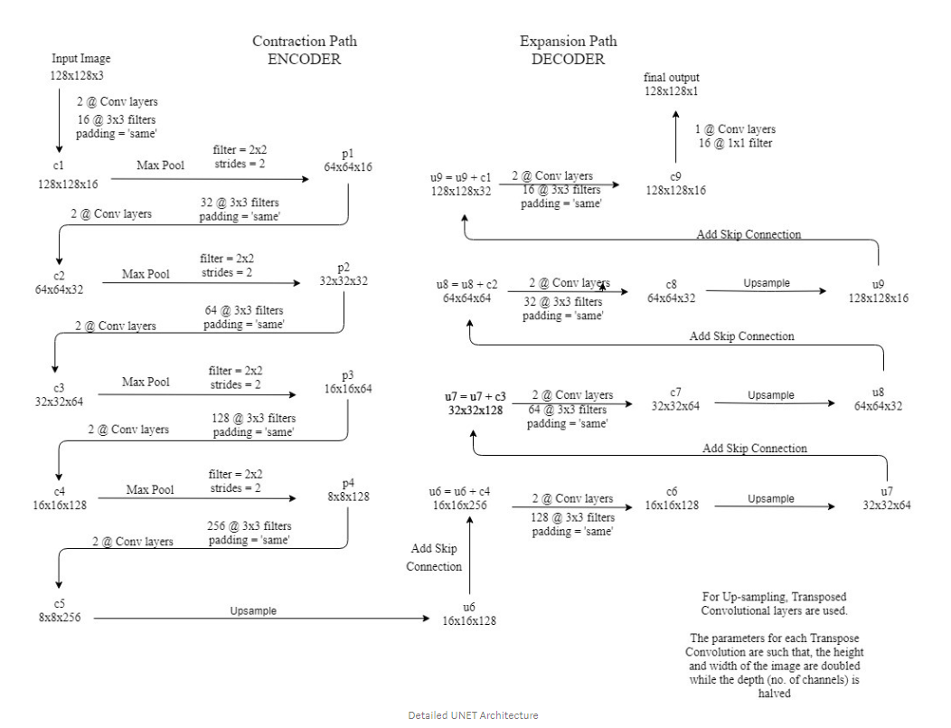
UNET Architecture
Developed by Olaf Ronneberger et al. for Bio Medical Image Segmentation

Slide 7
UNET Architecture
Developed by Olaf Ronneberger et al. for Bio Medical Image Segmentation
In the original paper, the size of the input image is 572x572x3
In tgs challenge we used 128x128x3

Slide 8
Miscellaneous
PixelAnnotationTool for image segmentation dataset creation

