Slide 1
Multi-cloud identity management system
Identity Register
Federation/Trust
IAMs of CSPs
IDPs of CSPs
Identity Provider
Sync/Provision
Principal – CSP/CSU (via SSO, MFA, etc)
Identity Management Authority
Policy / Control
Relying Party Apps
Auditor
Monitoring/Audit
Regulatory Body

Slide 2
Multi-cloud identity management system
CSPs
Identity Register
Federation/Trust
IAM
Identity Providers
Identity Provider
Sync/Provision
Principal – CSP/CSU (via SSO, MFA, etc)
Identity Management Authority
Policy / Control
Relying Cloud Services
Monitoring/Audit
Auditor
Monitoring/Audit
Regulatory Body

Slide 3
IMA
(Policies)
IRA
(Proofing)
Identity Register
Identity Register
(IR)
Credential Register
(CR)
Attribute Repository
(AR)
Metadata and Consent Repository (MR)
Proofing and Verification
Credential Binding
Lifecycle and Sync
Revocation/Status
Privacy Control
Audit and Logging
AuthN
(SSO, MFA)
AuthZ
(Policy Decision)
Federation
(SAML, OIDC)

Slide 4

Principal : CSP-CSU
CSN: Auditor
Requests to validate identity
Identity management authority
Identity Information
authority
Manage Policies, compliance, incidents and audits
Authorizes identity information for relying parties
Multi-cloud identity management system
Manage updates in identity register
Collect, maintain, update identity attributes
Identity registration
authority
Identity information
provider
Establish validity of identity information
Process and store identity information for a particular CSP in compliance with policies
Verifier
Regulatory Body
Relying Party : CSP

Slide 5
Cloud Service User (CSU)
Uniform User interface
Mult-cloud Identity Management
Metadata Management
Identity Provisioning Service
Identity Assertion Provider
Authentication
SSO
MFA
Perform Audit
Identity Discovery Service
Authorization
Access Authorization Policies
Metadata Upload
Authentication Delegation
User Management
Principal and Credential Management
Metadata Feed
Identity Register
Relying Service : Cloud Service Provider (CSP)
Metadata Export
Metadata Consumer
Identity Provisioning
Request Authentication
Identity information provider
Audit Repository
Request IDP Discovery

Slide 6
Cloud Service Customer (CSC)
Cloud Service Partner (CSN)
Mult-cloud Identity Management
Centralized Identity Register
Internal Governance and Trust
Cloud Service Provider (CSP) - A
Cloud Service Provider (CSP) - B
Cloud Service Provider (CSP) - C

Slide 7
Cloud Service Customer (CSC)
Cloud Service Partner (CSN)
Mult-cloud Identity Management
Identity Federation
Trust relationship established via
Common protocols and assurance levels
Enables Single Sign On across CSPs
Identity Management: CSP-A
Identity Management: CSP-B
Identity Management: CSP-C

Slide 8
Cloud Service Customer (CSC)
Cloud Service Partner (CSN)
Mult-cloud Identity Management
Identity-As-A-service
Integration
API Based Identity Provisioning and Verification
SLAs and Trust Mechanism
Identity Management: CSP-A
Identity Management: CSP-B
Identity Management: CSP-C

Slide 9
Cloud Service User (CSU) -A
Cloud Service User (CSU) -B
Credential Issuer - A
Credential Issuer -B
Mult-cloud Identity Management
Credential Specification Assurance Level
Credential Interoperability
Decentralized Identities
Risk Based Acceptance
Identity Management: CSP-A
Identity Management: CSP-B
Identity Management: CSP-C

Slide 10
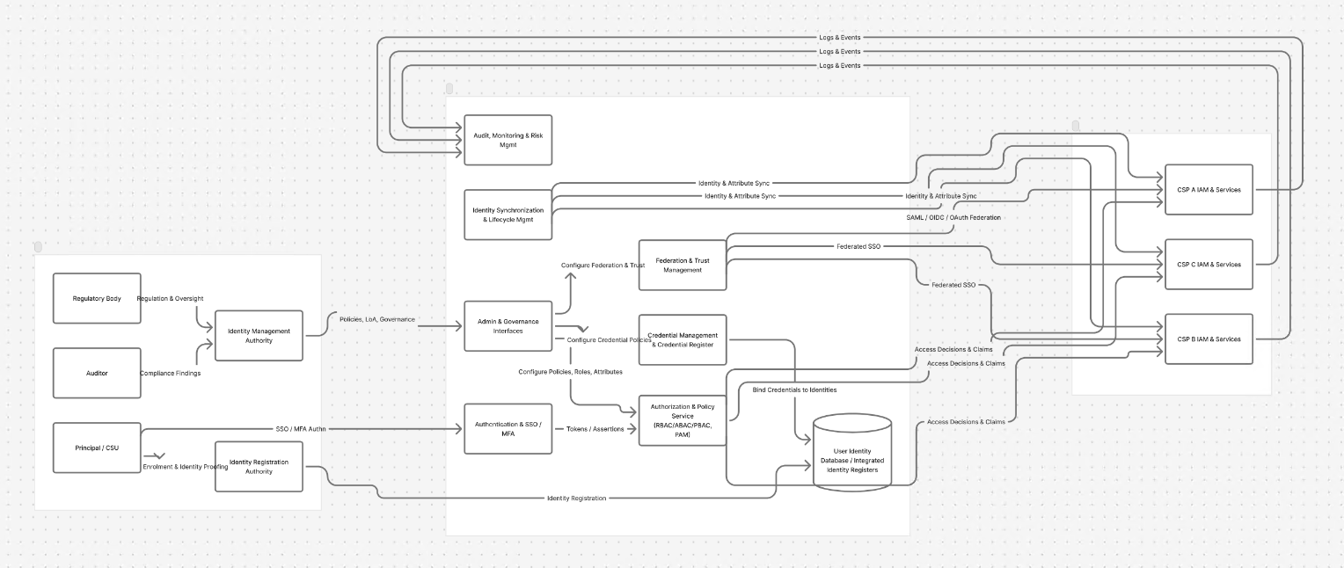

Slide 11
Logs and events
Logs and events
Logs and events
Audit, monitoring and trust management
Identity synchronization and lifecycle
Identity and Attribute Sync
CSP-A IAM services
Access decisions and claims
Configure federation/trust
Federation and trust management
Federated SSO
Identity and Attribute Sync
CSP-B IAM services
Regulatory body
Regulation, oversight
Access decisions and claims
Identity management authority
Policies, governance
Admin and governance interfaces
Configure credential policies
Credential management and credential register
Identity and Attribute Sync
CSP-C IAM services
Author
Compliance findings
Bind credential to identities
Access decisions and claims
Principle/CSU
SSO/MFA AuthN
Authorization and SSO/MFA
Configure policies, roles, attributes
Authorization and policy service (RBAC/ABAC/PBAC/PAM)
Token/assertions
Enrollment and Identity Proofing
User identity database/integrated identity register
Identity registration authority
Identity registration

