Slide 1

Department of
Computer Applications
Welcome to Interim Project Presentation
QuickBite: A Food Ordering & Subscription Application
Submitted By
Bijoy Laxmi Behera (SIC. No. 24MMCD79)
Rojalin Mohanty (SIC. No. 24MMCD86)
Aradhana Mohanty (SIC. No. 24MMCD89)
Group #
MCA 07
4th Semester MCA
Under the Supervision of
Prof.(Dr) Bhagwat Prasad Chaudhary
Sr. Assistant Professor, Department of Computer Science and Engineering

Slide 2
Background of the Study
India’s online food delivery market is growing rapidly.
Traditional ordering methods are inefficient and error-prone.
Existing platforms lack subscription meal plans.
No unified system for ordering, subscriptions, and provider management.
Objective
Develop a MERN-based food ordering and subscription platform.
Implement secure authentication (JWT + OTP).
Provide a user-friendly interface for ordering and subscriptions.
Create an admin dashboard for management and monitoring.

Slide 3
Problem Statement
Existing food ordering apps do not support subscription-based meal plans (weekly/monthly) essential for college students and daily meal services
Food providers lack a dedicated portal to manage their menus, track orders, and communicate with customers efficiently
No integrated delivery tracking or partner assignment system within a single lightweight MERN application
Manual processes lead to order mismatches, payment delays, and lack of real-time status updates for customers

Slide 4
Work Flow Diagram
Problem Identification & Requirement Analysis
System Design (Architecture & Database Design)
Frontend Development using React.js
Backend Development using Node.js, Express.js, MongoDB
Module Development (Customer, Vendor, Admin, Delivery Partner)
System Testing & Debugging
Deployment & Real-Time Usage

Slide 5
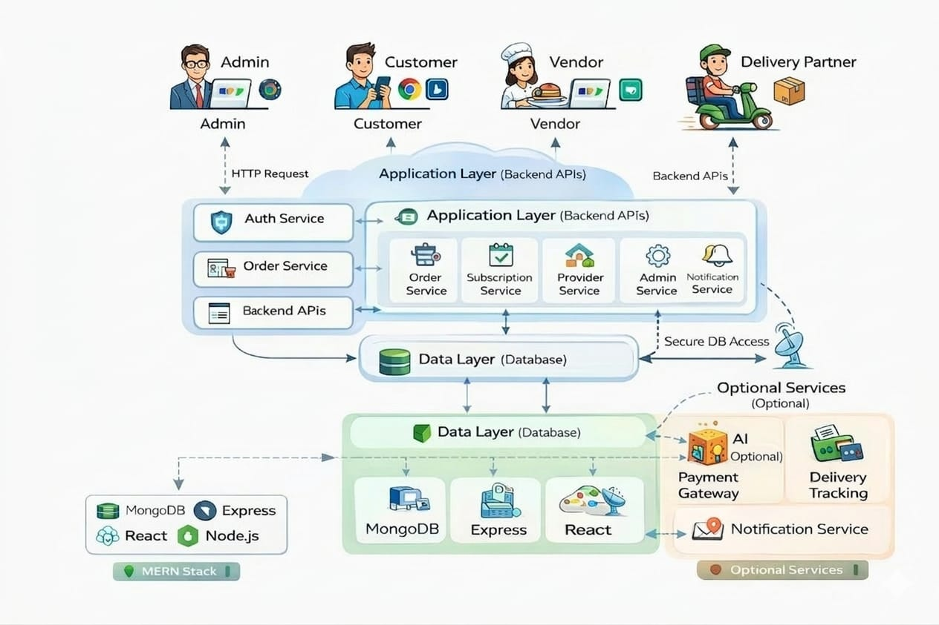
Architecture Diagram

Slide 6
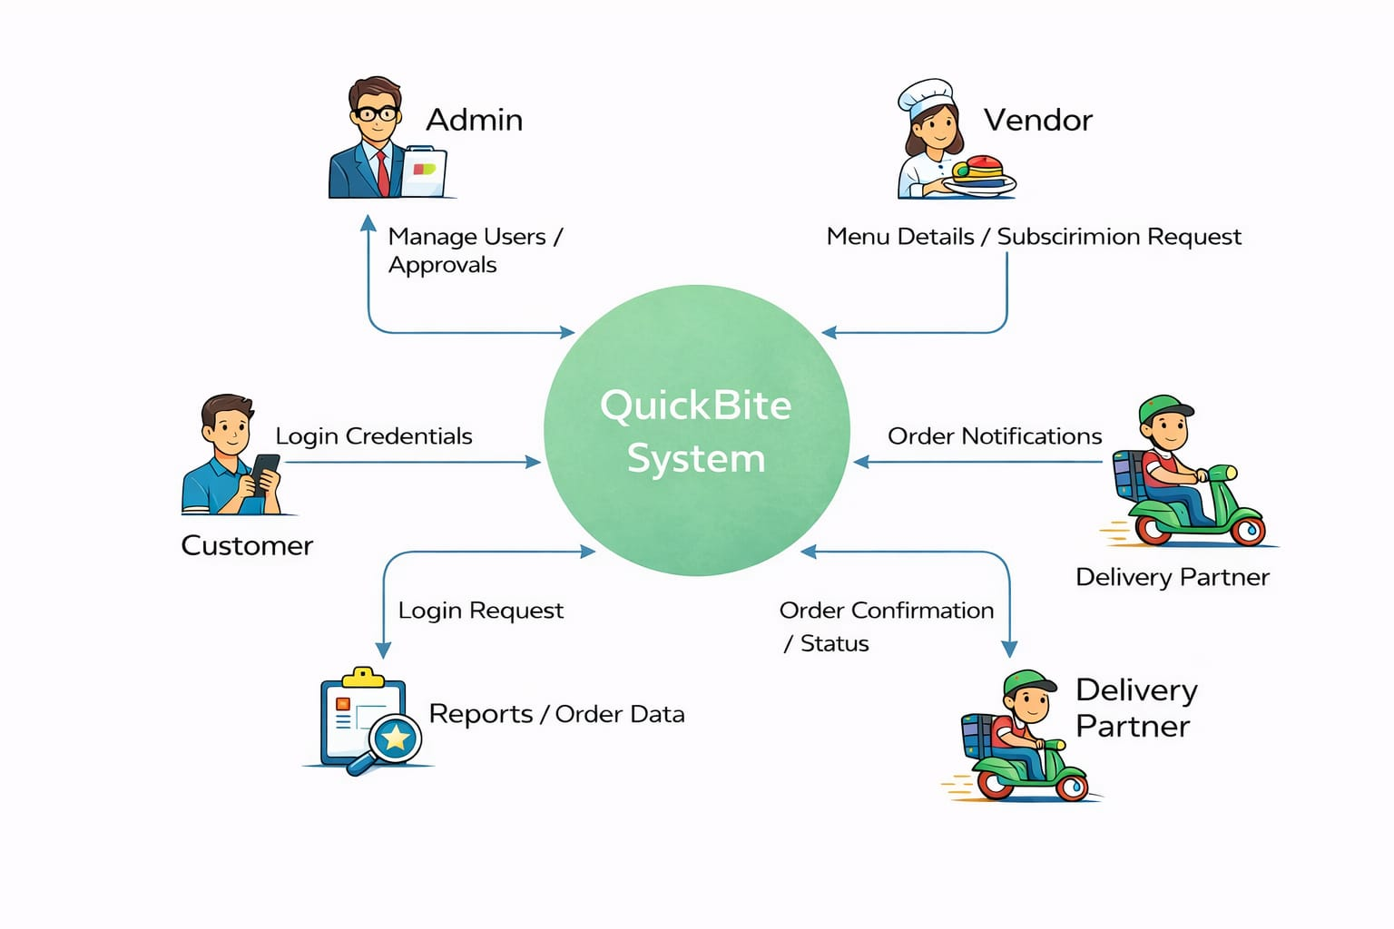
DFD LEVEL 0
Menu details/Subscription Request

Slide 7
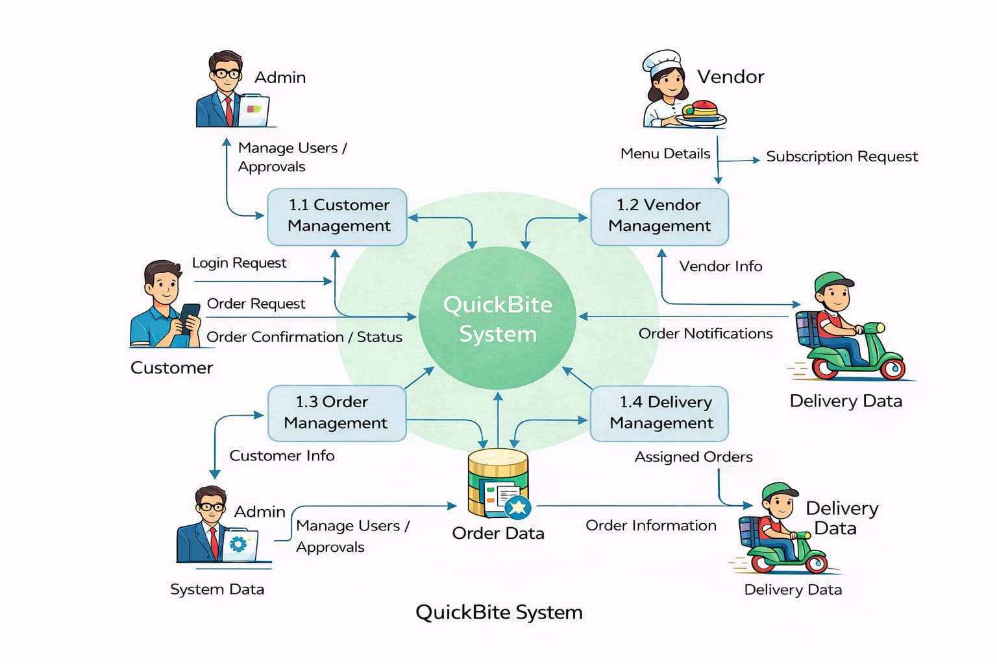
DFD LEVEL 1

Slide 8
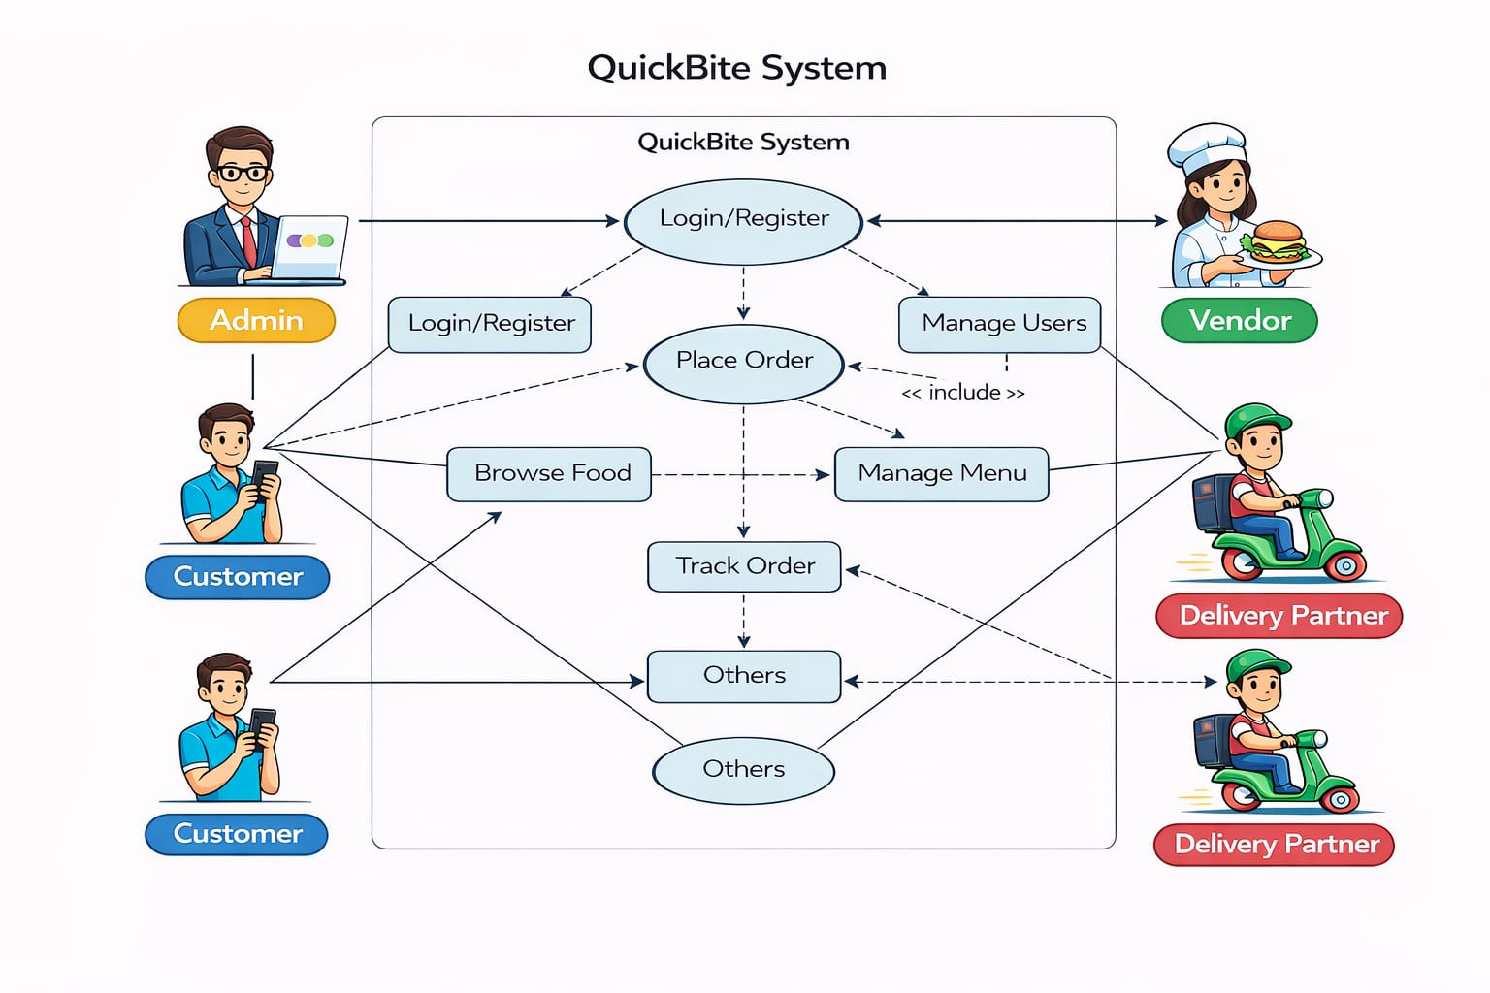
USE CASE DIAGRAM

Slide 9
Technology Used:
MongoDB — NoSQL document database; stores Users, Orders, Food Items, Subscriptions, Delivery Partners
Express.js — Lightweight Node.js framework; RESTful API routing, middleware, JWT auth & error handling
React + Vite — Modern frontend SPA; role-based dashboards, cart, real-time order tracking UI
Node.js — JavaScript runtime environment; handles async requests, OTP emails & backend logic
Core Modules: Auth & JWT • Menu Management • Cart & Orders • Subscriptions • Admin Panel • Reviews & Ratings

Slide 10
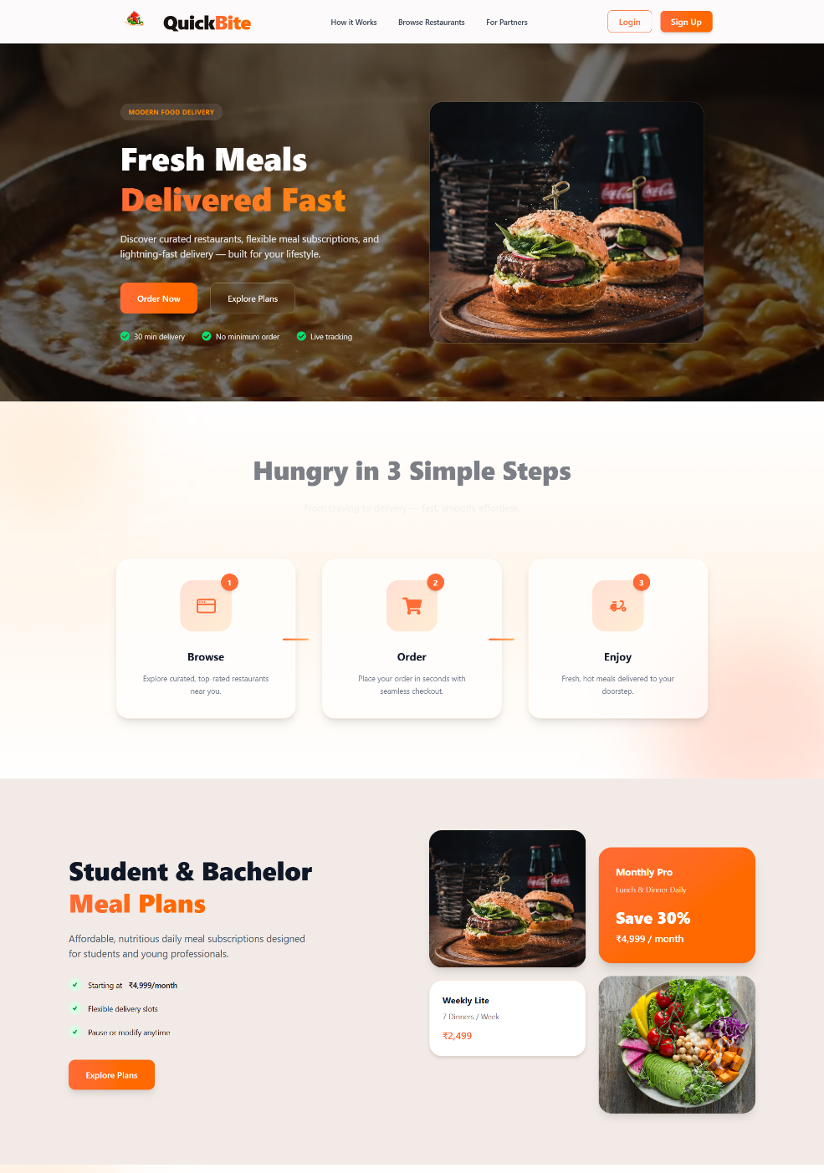
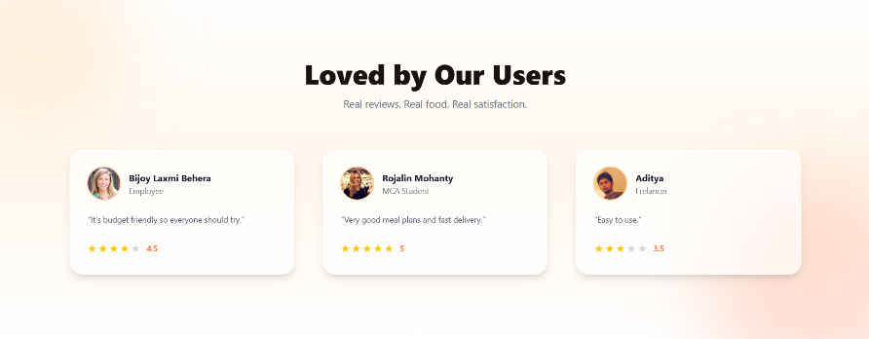
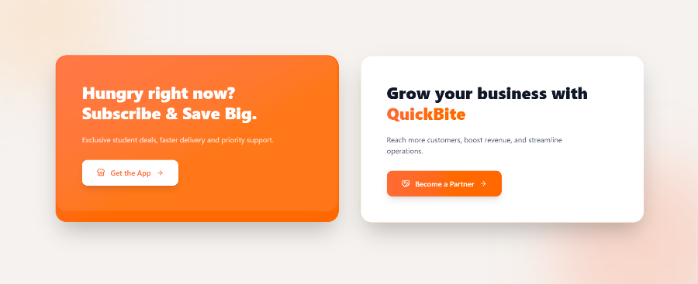
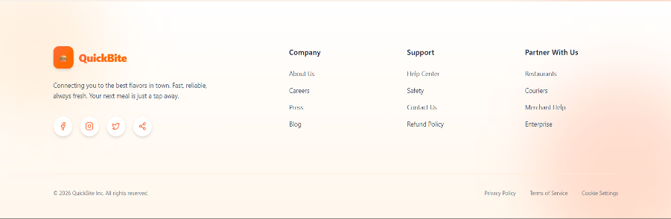
Results Obtained
Landing Page

Slide 11
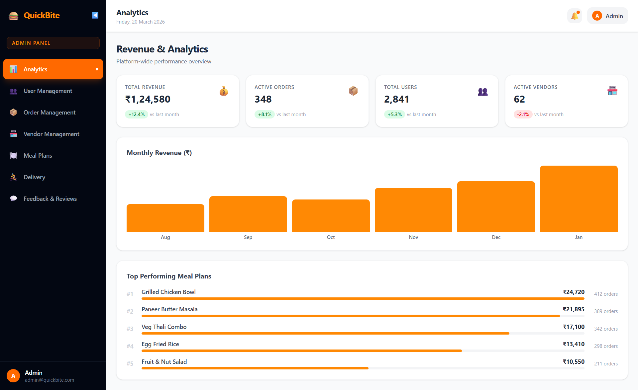
Admin Side Dashboard

Slide 12
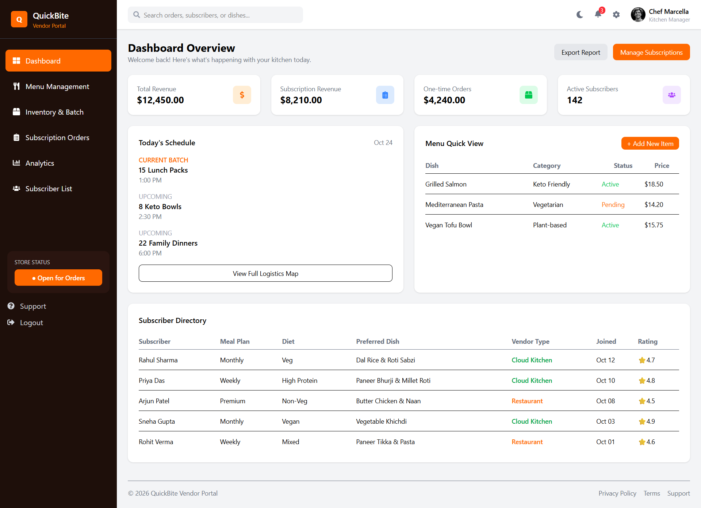
Vendor Side Dashboard

Slide 13
Our Contribution
Unified MERN platform for food ordering + subscription meal plans with role-based access (Customer, Provider, Delivery, Admin) targeting hostels, offices & tiffin services.
Secure & scalable system with JWT authentication, OTP-based password reset, and admin-driven provider approval workflow.
IMPACT ON SOCIETY
Empowers small food businesses & home cooks to reach a wider digital customer base
Simplifies daily meal management for students, working professionals, and hostel residents
Reduces food wastage through predictable subscription orders and better provider planning

Slide 14
Conclusion and Future works
- QuickBite successfully addresses gaps in existing food delivery platforms by integrating subscription-based meal plans with conventional ordering
The MERN-stack architecture ensures a scalable, maintainable, and performant full-stack application
Comprehensive system design phase (ER, UML, DFD, Sequence & Use Case diagrams) provides a solid blueprint for implementation
The Work Ahead
Advanced features : real-time tracking(Socket.io) , AI –based recommendations, and payment gateway integration(Razor pay/Stripe)
Scalable deployment: mobile app (React Native)+ cloud deployment (AWS/Render) with CI/CD and Docker

Slide 15
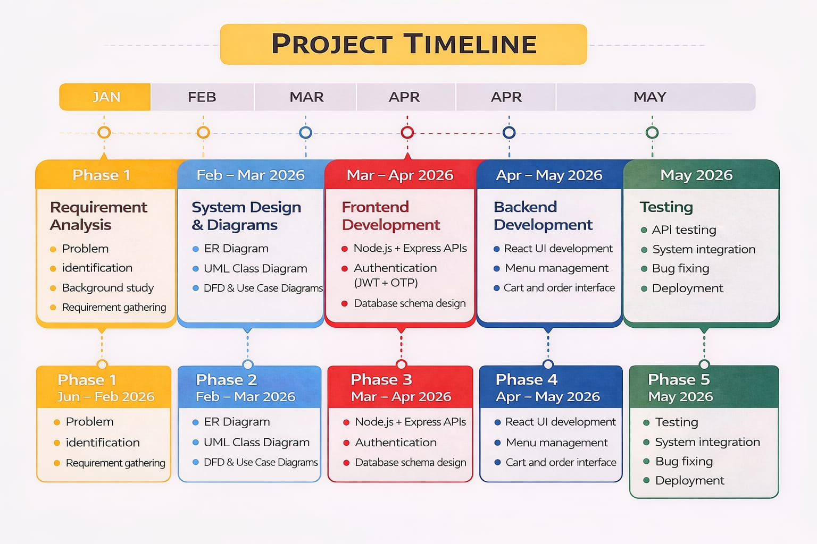
APR
Jan-Feb

Slide 16
References
[1] Stitch AI, "Stitch AI — For UI Ideas.". Available: https://stitch.withgoogle.com/
[2] Express.js, "Express — Node.js Web Application Framework.". Available: https://expressjs.com/
[3] Meta Open Source, "React — A JavaScript Library for Building User Interfaces.". Available: https://reactjs.org/
[4] OpenJS Foundation, "Node.js Documentation.". Available: https://nodejs.org/en/docs/
[5] MongoDB Inc., "Mongoose ODM Documentation.". Available: https://mongoosejs.com/docs/
[6] Auth0, "JWT Introduction.". Available: https://jwt.io/introduction/
[7] W3Schools, "MongoDB Tutorial.". Available: https://www.w3schools.com/mongodb/

Slide 17




