Slide 1
Clean Code

Slide 2
Agenda
Introduction
Some practices
What we found
What can be done
Discussion
Notes:
.

Slide 3
Introduction
Set of common coding practices
Because coding is an art
Maintainable code is always a joy to see
Readable code is a double bonus
Some common practices
  Avoid white-space and comments
  DRY
  Readability over reducing LOC
  Avoid unnecessary complexity
  Modular programming
  Self explanatory code

Slide 4
….because someone once said....

Slide 5
“... think of systems as stories to be told rather than programs to be written...”

Slide 6
Some practices we follow:
Coding Convention PDF

Slide 7

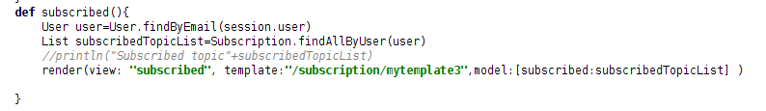


What we found!
Naming

Slide 8
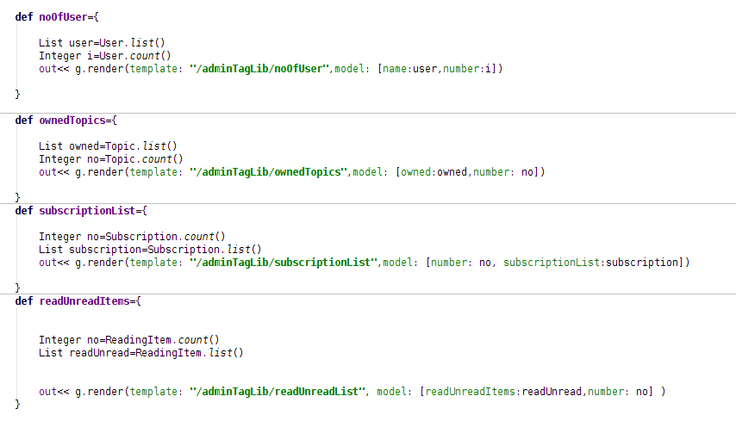
What we found!
Naming

Slide 9
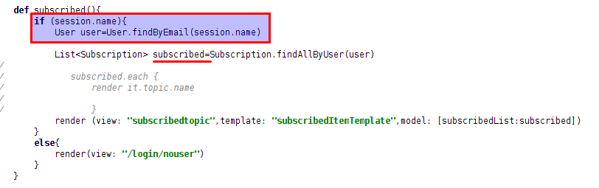
What we found!
Naming

Slide 10
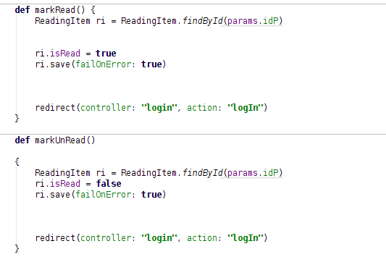
What we found!
DRY

Slide 11
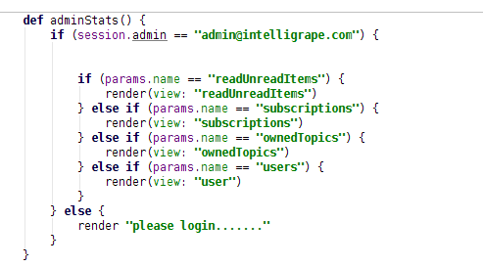
What we found!
DRY

Slide 12
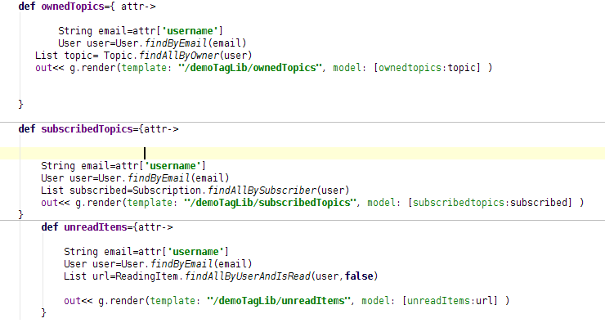
What we found!
DRY

Slide 13
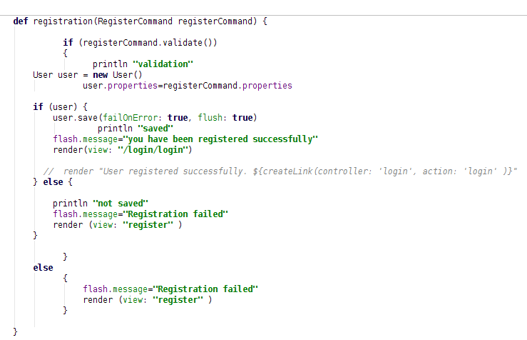
What we found!
Whitespace and Indentation

Slide 14
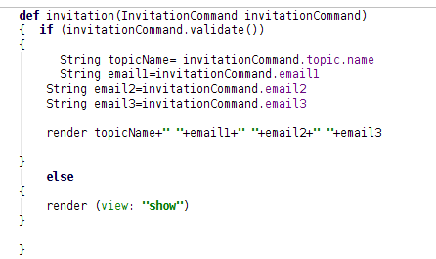
What we found!
Whitespace and Indentation

Slide 15
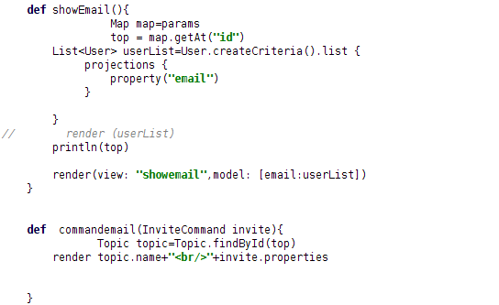
What we found!
Whitespace and Indentation

Slide 16
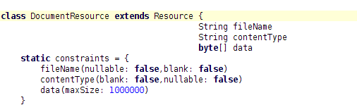
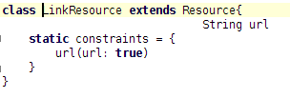
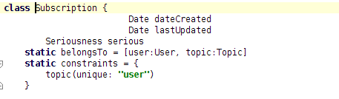
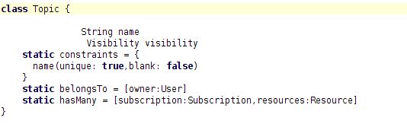
What we found!
Whitespace and Indentation

Slide 17

What we found!
Whitespace and Indentation
… and so on...

Slide 18
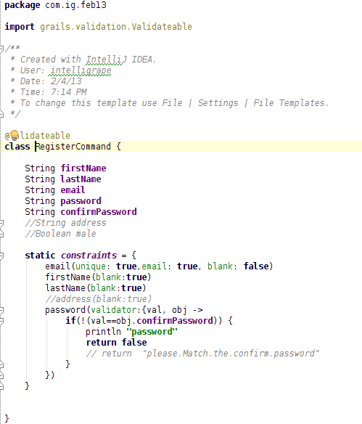
What we found!
Miscellaneous

Slide 19
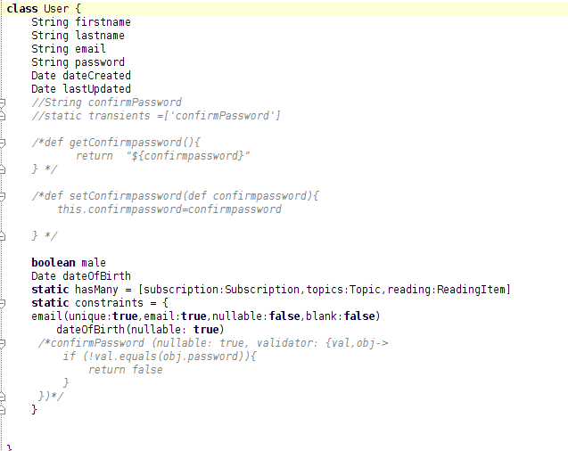
What we found!
Miscellaneous

Slide 20
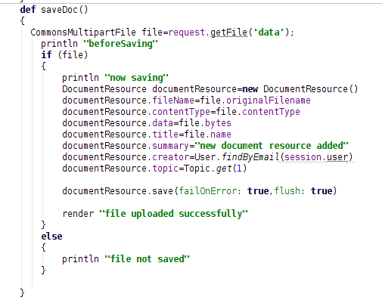
What we found!
Miscellaneous

Slide 21
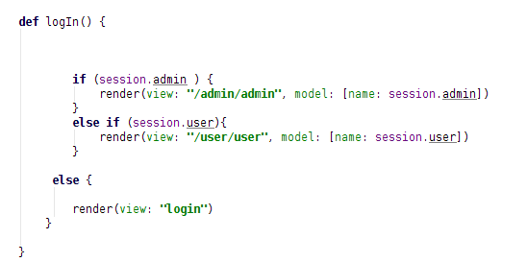

What we found!
Miscellaneous

Slide 22
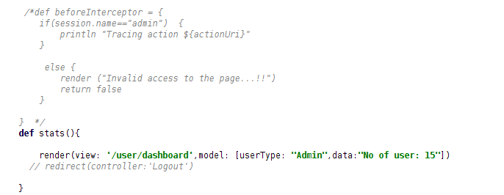
What we found!
Miscellaneous

Slide 23
What can be done?
Refactor whenever you can
IDEA helps you in refactoring
Modularize your code if it gets too complex
Do not write methods that are too long (10 lines is the maximum)
Controllers should be thin
Business logic in services
No GORM calls on views
Take care of naming conventions
Self explanatory code – no comments

Slide 24
Discussion

