Slide 1

PRESENTED BY: 1905046 – NIAZ RAHMAN GroUp MembErs: 1905038 1905042 1905046 1905047 1905048 1905052

Slide 2
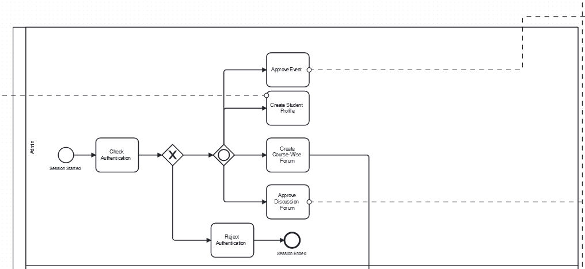
Admin

Slide 3
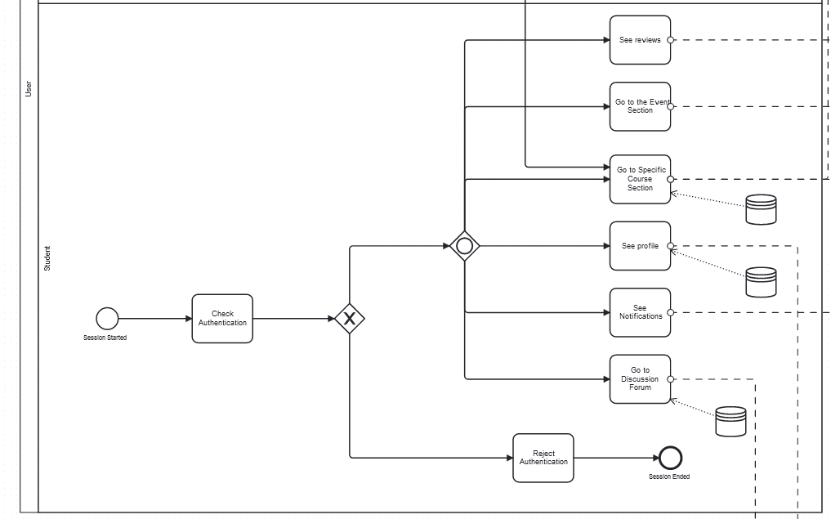
Student

Slide 4
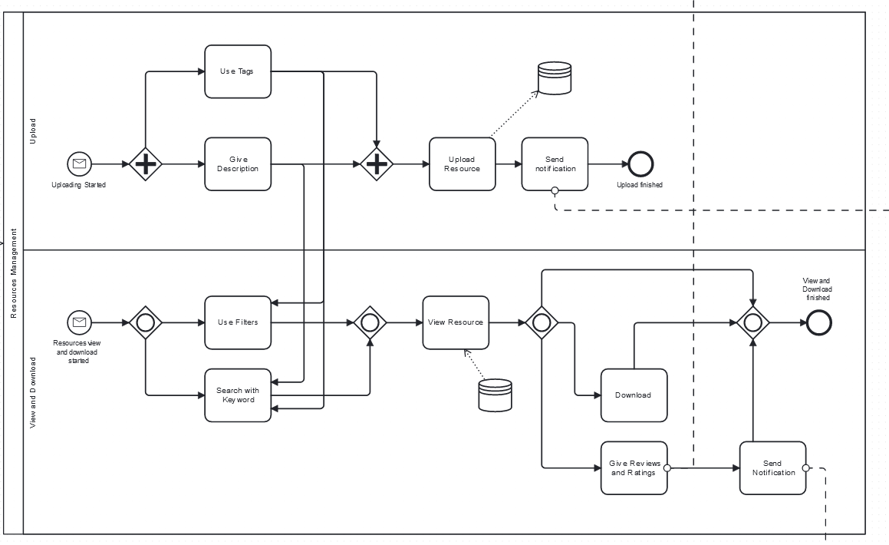
Resources Upload and Management

Slide 5
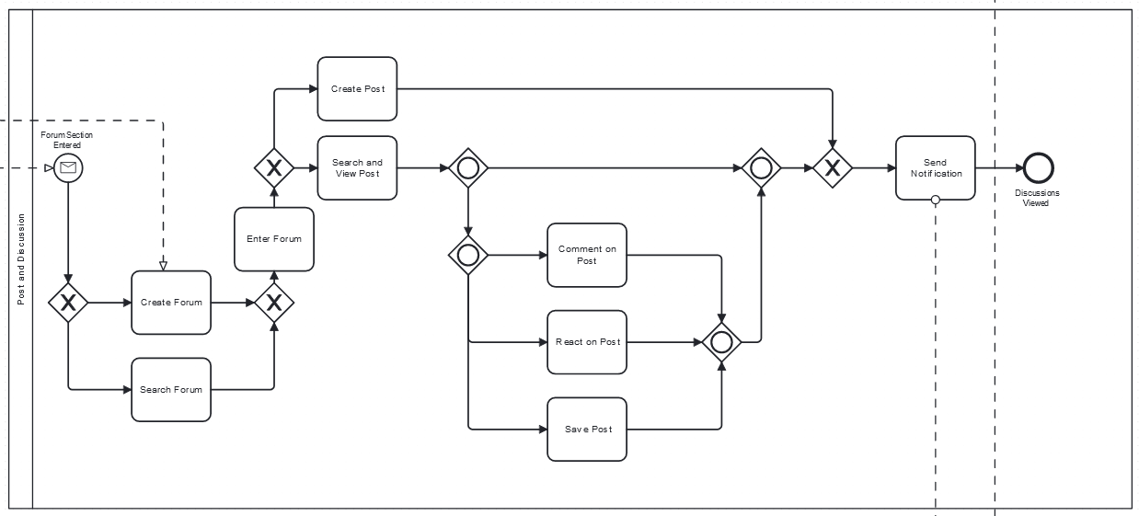
Discussion Forums

Slide 6
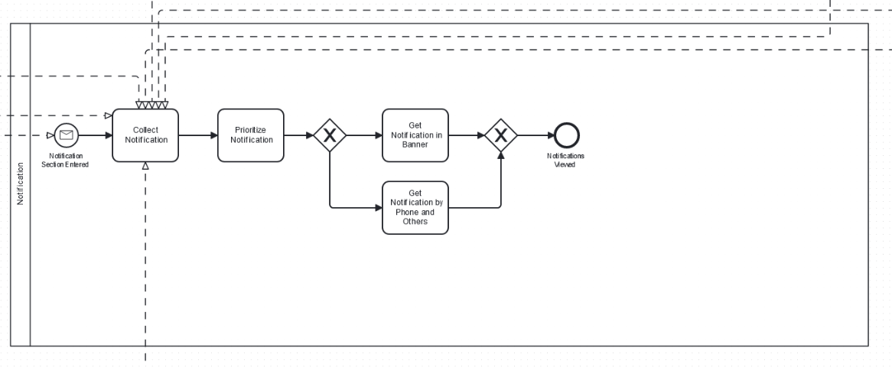
Notifications and Alerts

Slide 7
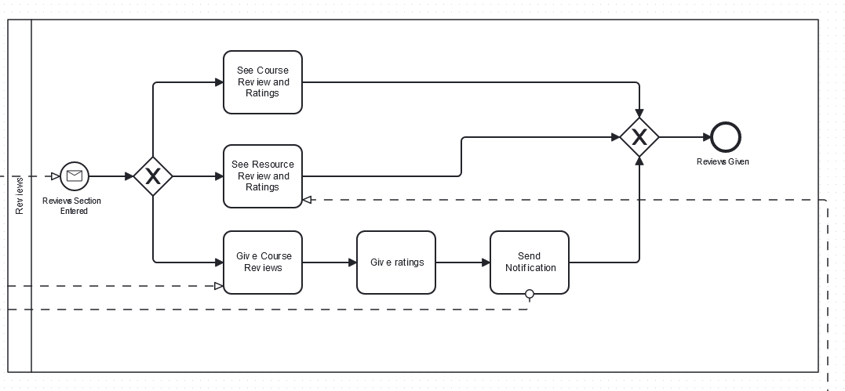
Peer Reviews and Rating Systems

Slide 8
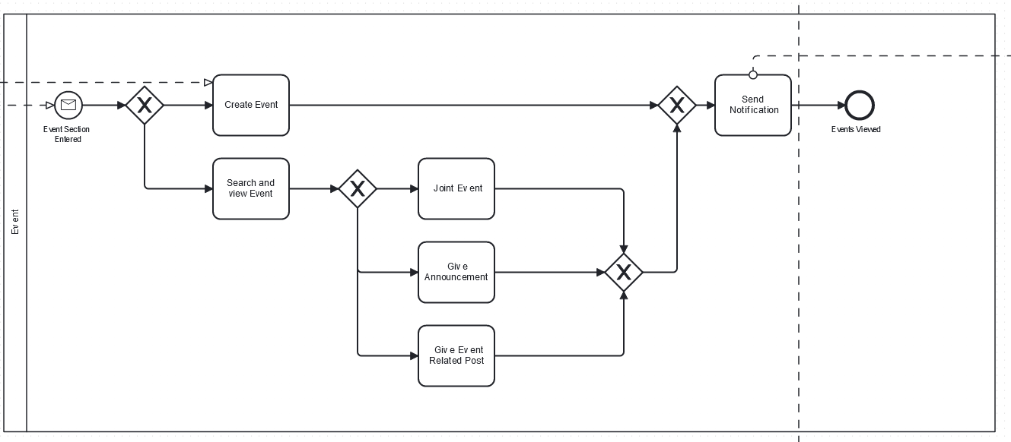
Event Management

Slide 9
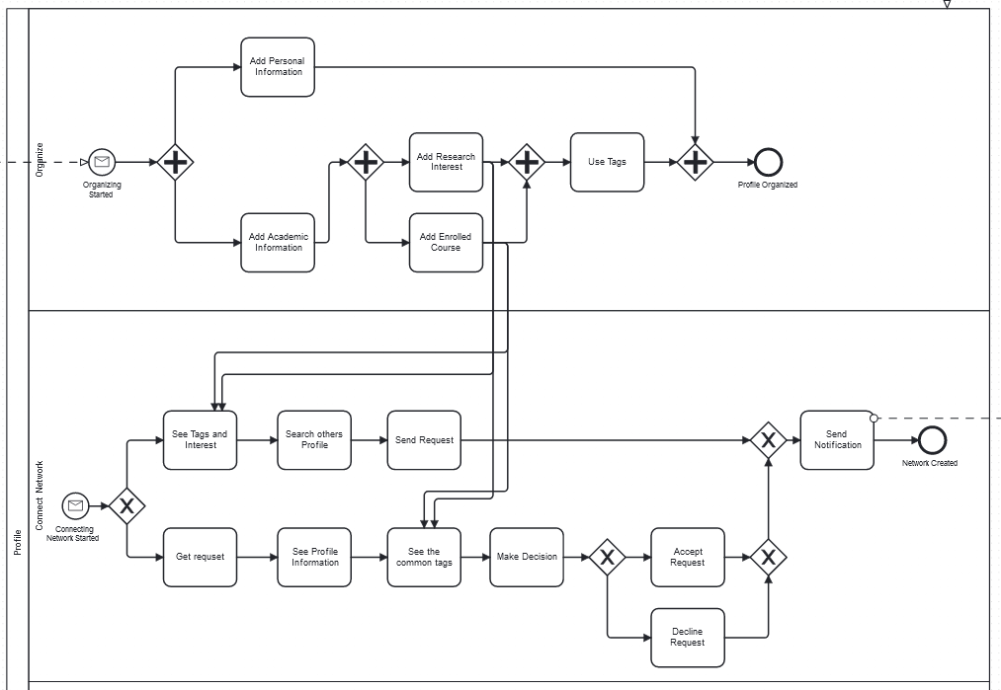
User Profiles and Networking

Slide 10
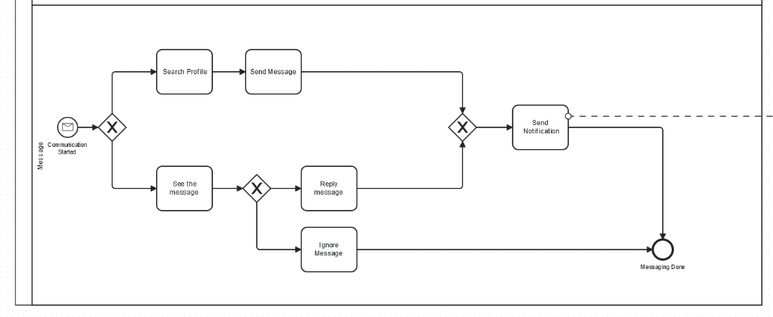
Messaging

Slide 11


