Slide 1



BNIFTY
Last data refresh:
2/11/2023 1:40:03 PM UTC
Downloaded at:
2/11/2023 4:38:39 PM UTC

Slide 2
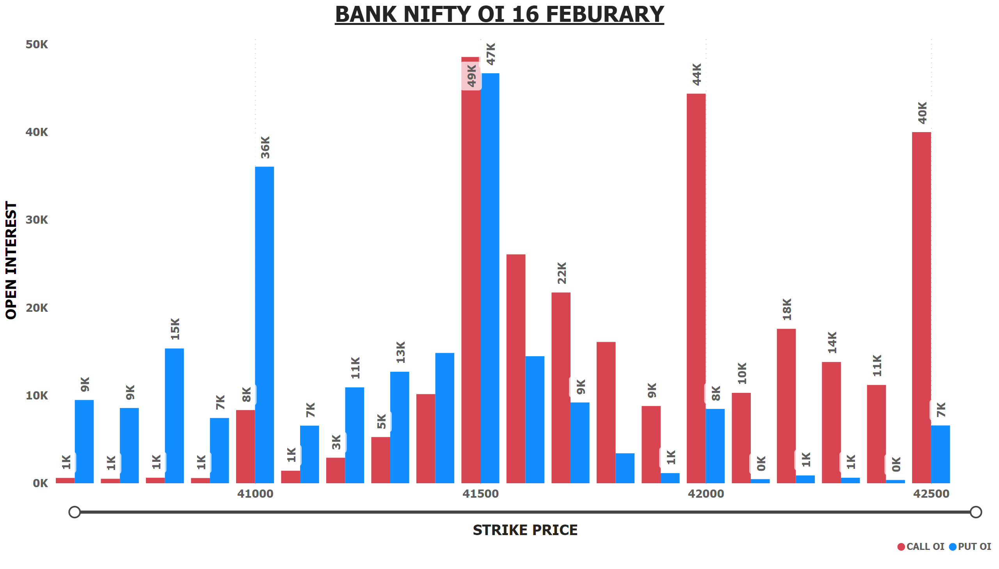
BNIFTY OI 16 FEB
Notes:
BANK NIFTY OI 16 FEBURARY
No alt text provided

Slide 3
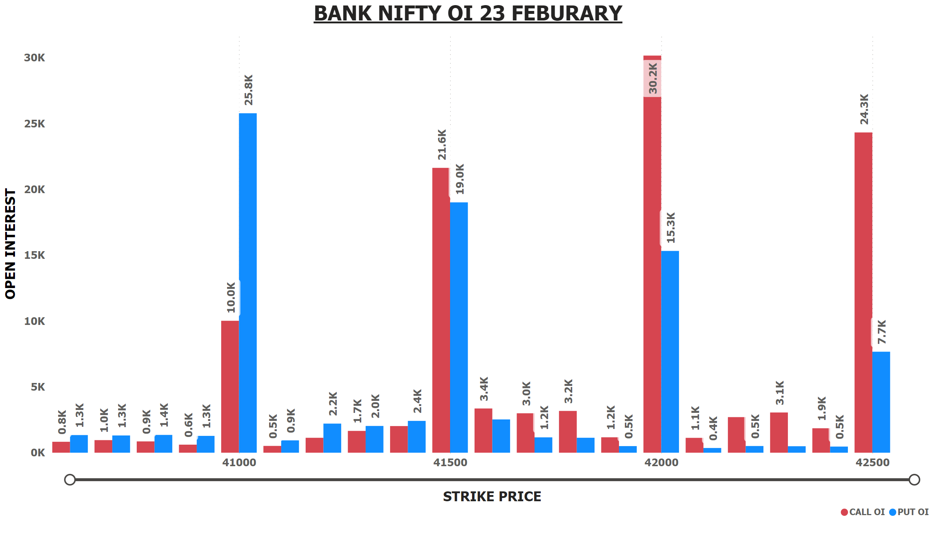
BNIFTY OI 23 FEB
Notes:
BANK NIFTY OI 23 FEBURARY
No alt text provided

Slide 4
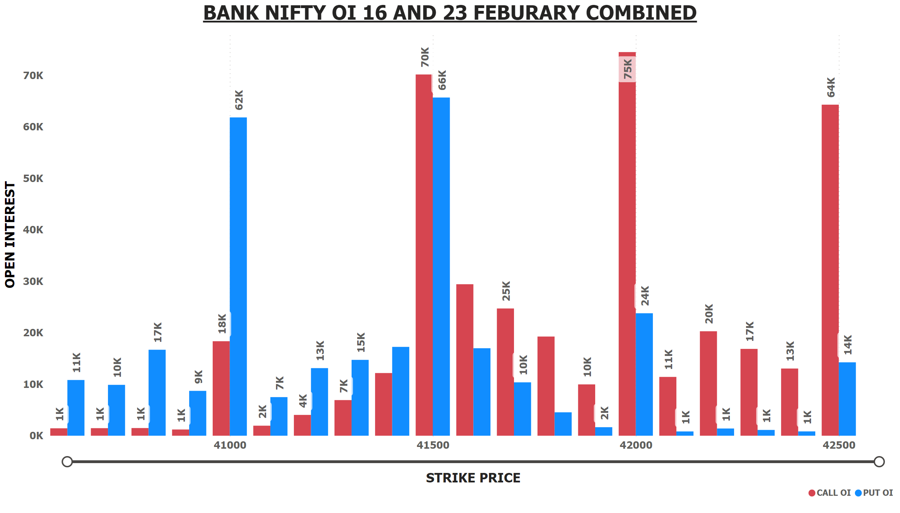
BNIFTY OI 16+23 FEB
Notes:
BANK NIFTY OI 16 AND 23 FEBURARY COMBINED
No alt text provided

Slide 5
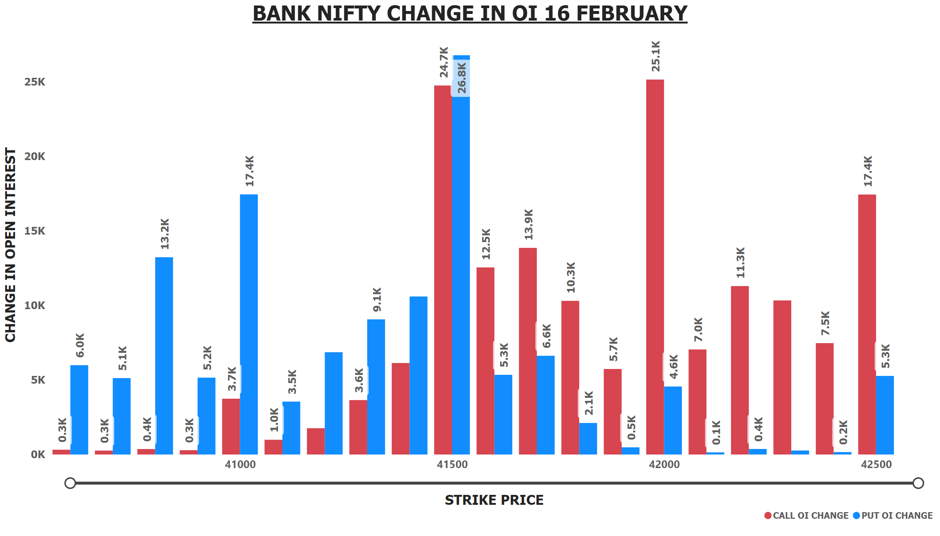
BNIFTY OI CHANGE 16 FEB
Notes:
BANK NIFTY CHANGE IN OI 16 FEBRUARY
No alt text provided

Slide 6
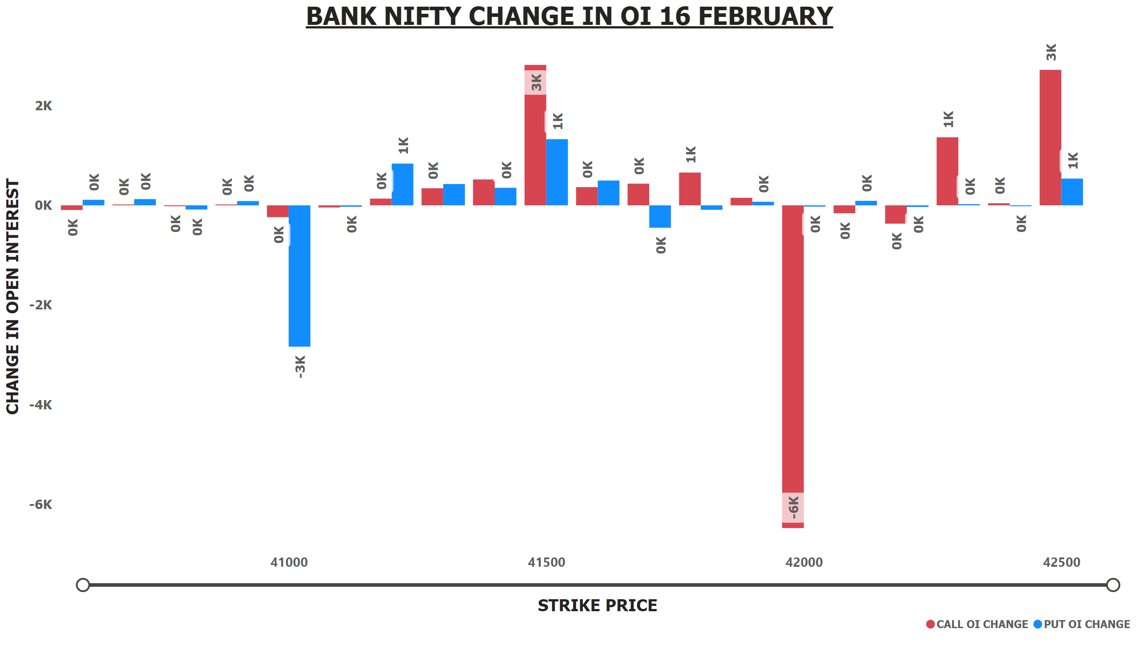
BNIFTY OI CHANGE 23 FEB
Notes:
BANK NIFTY CHANGE IN OI 16 FEBRUARY
No alt text provided

Slide 7
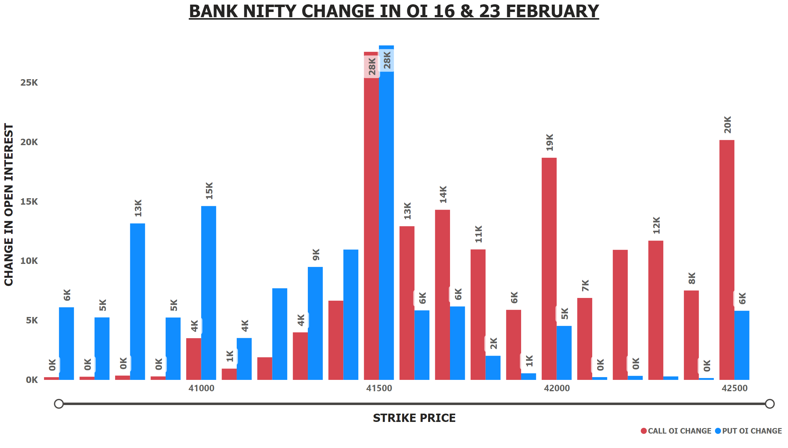
BNIFTY OI CHANGE 16+23 FEB
Notes:
BANK NIFTY CHANGE IN OI 16 & 23 FEBRUARY
No alt text provided

Slide 8
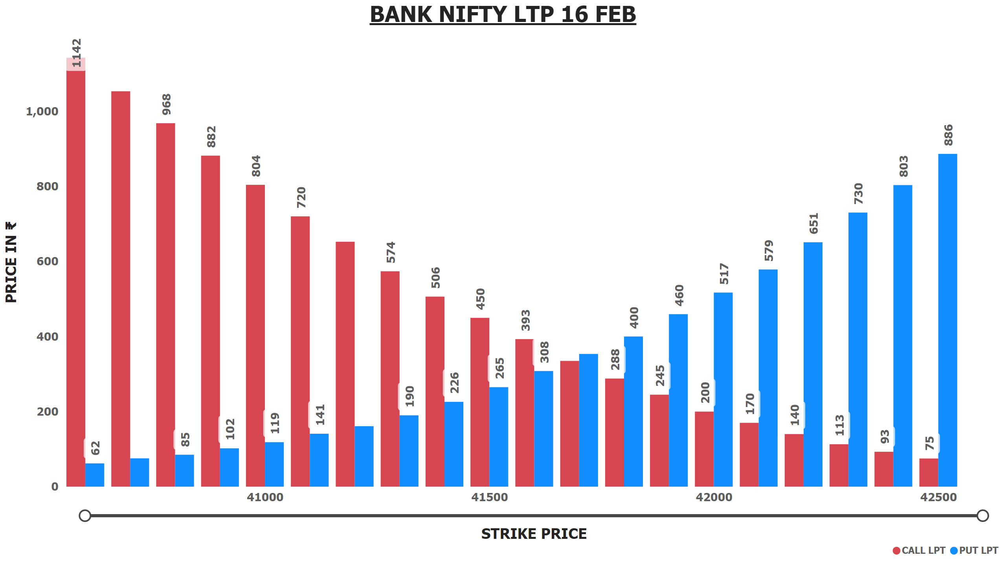
BNIFTY LTP 16 FEB
Notes:
BANK NIFTY LTP 16 FEB
No alt text provided

Slide 9
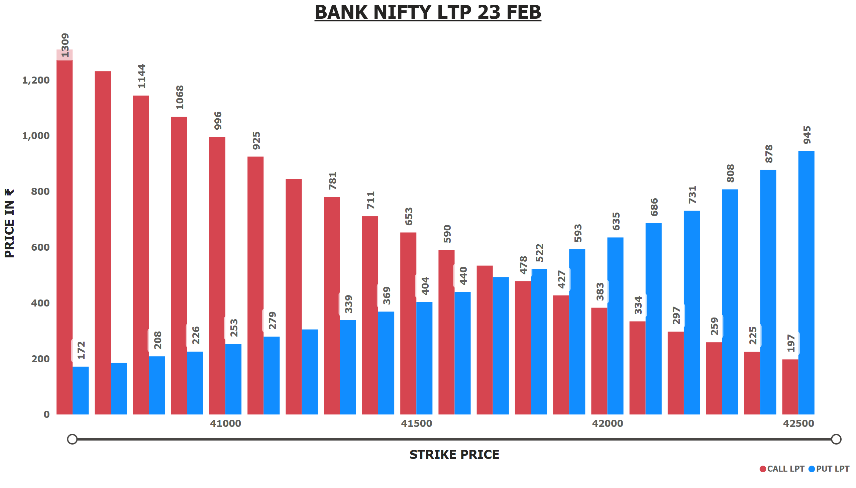
BNIFTY LTP 23 FEB
Notes:
BANK NIFTY LTP 23 FEB
No alt text provided

Slide 10
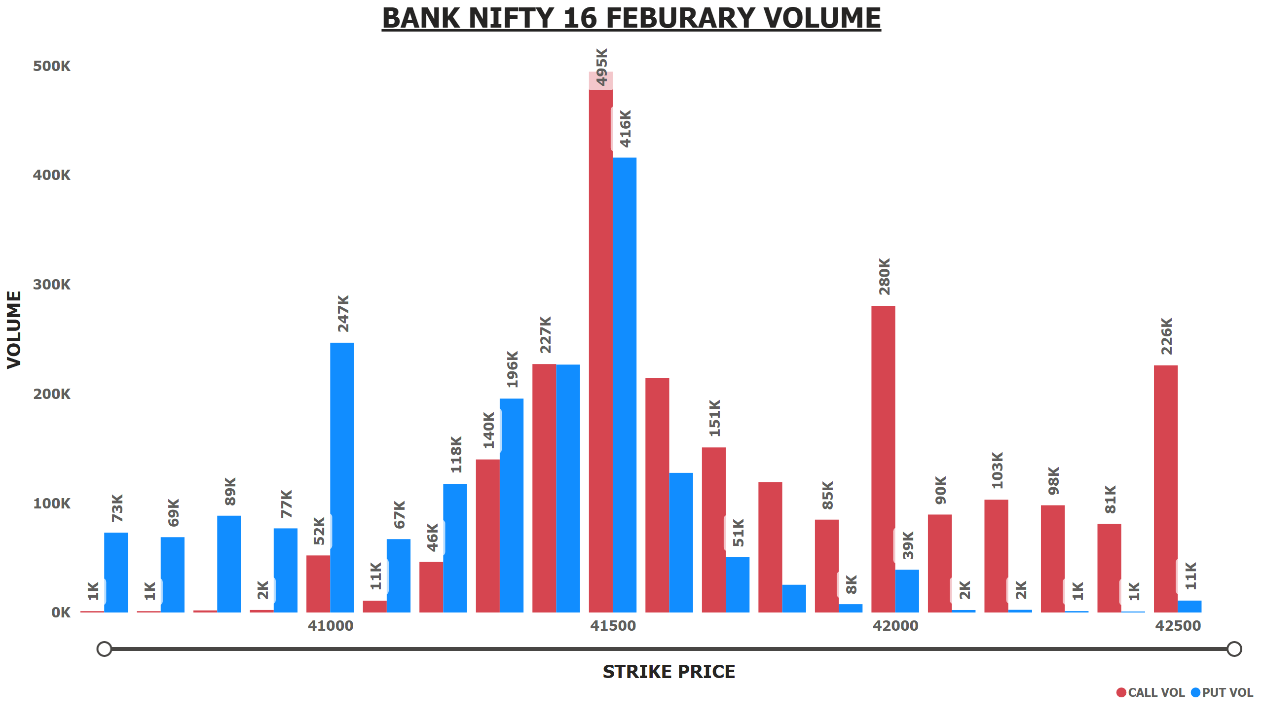
BNIFTY 16 FEB VOLUME
Notes:
BANK NIFTY 16 FEBURARY VOLUME
No alt text provided

Slide 11
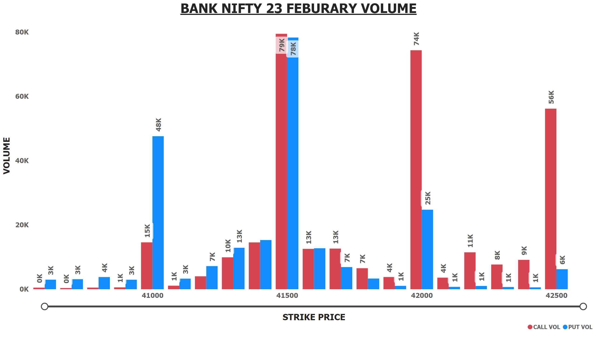
BNIFTY 23 FEB VOLUME
Notes:
BANK NIFTY 23 FEBURARY VOLUME
No alt text provided

Slide 12
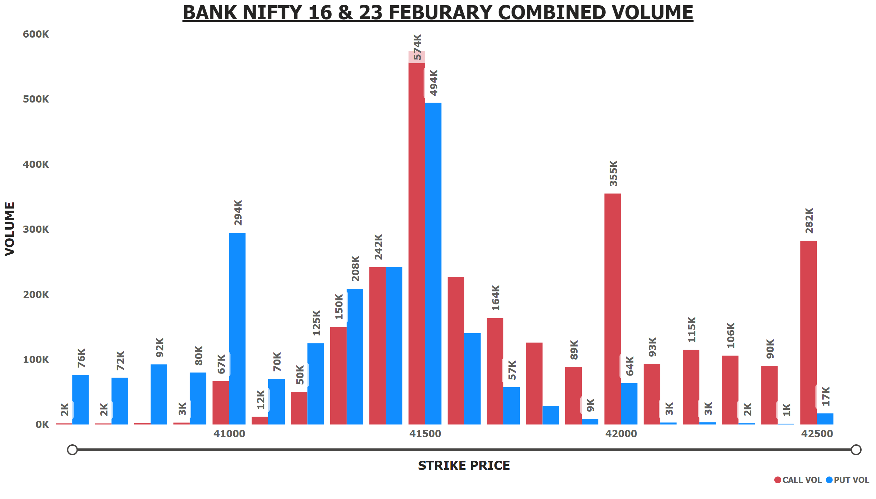
BNIFTY 16+23 FEB VOLUME
Notes:
BANK NIFTY 16 & 23 FEBURARY COMBINED VOLUME
No alt text provided

Slide 13
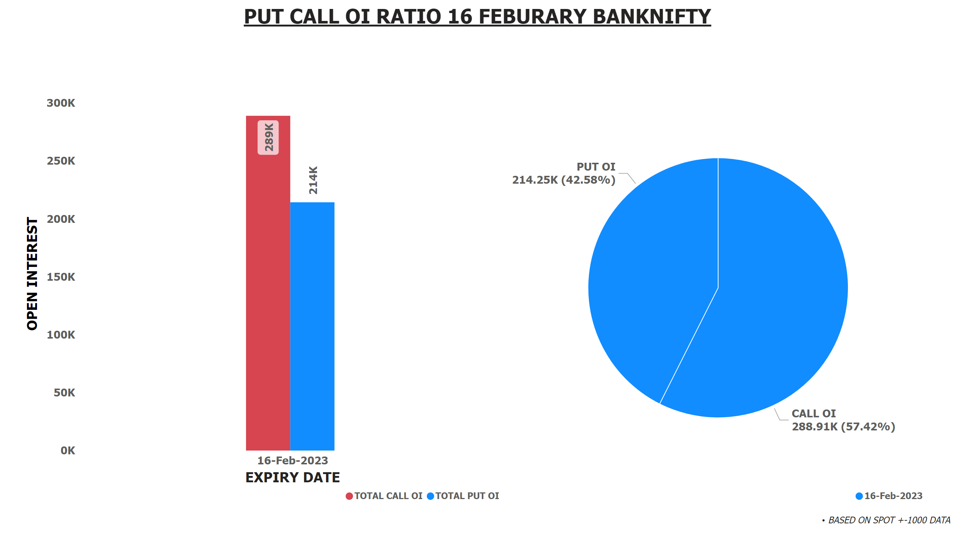
PCR BNIFTY OI 16 FEB
Notes:
textbox
No alt text provided
textbox
No alt text provided
lineClusteredColumnComboChart
No alt text provided
pieChart
No alt text provided

Slide 14
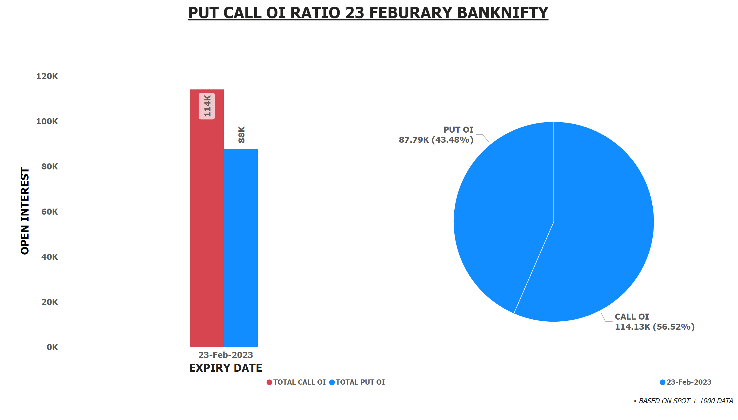
PCR BNIFTY OI 23 FEB
Notes:
textbox
No alt text provided
textbox
No alt text provided
pieChart
No alt text provided
lineClusteredColumnComboChart
No alt text provided

Slide 15
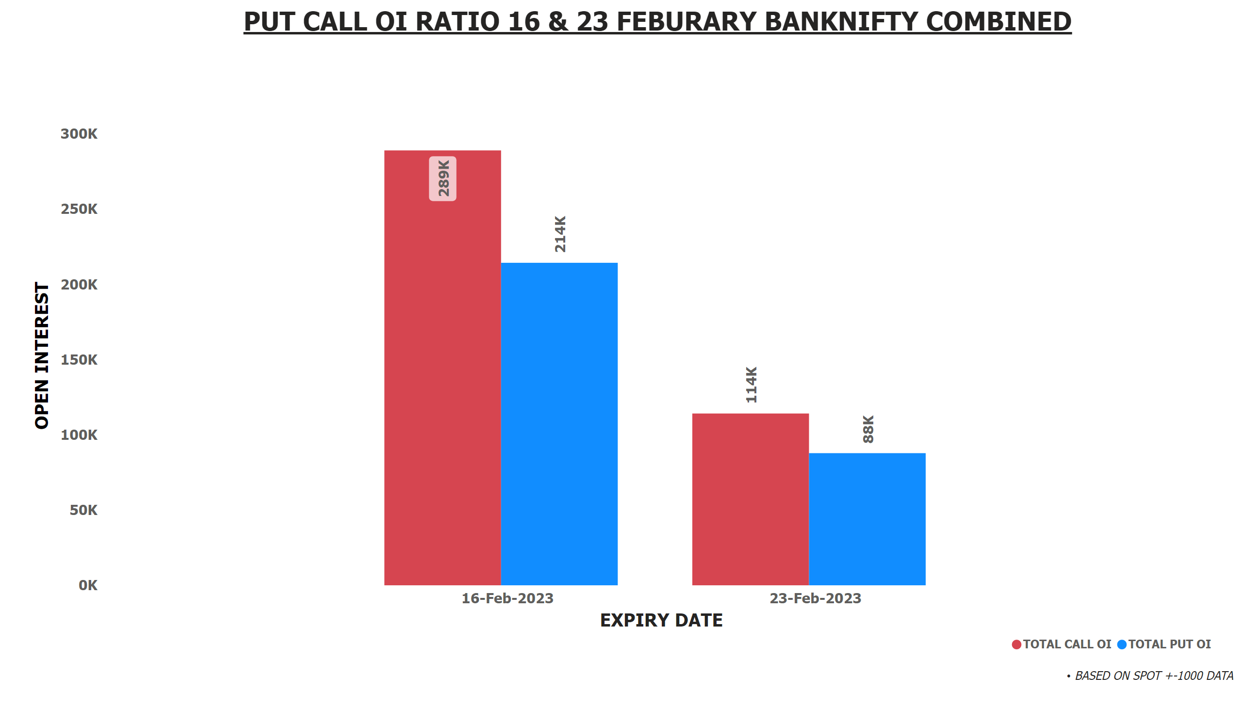
PCR BNIFTY OI 16+23 FEB
Notes:
textbox
No alt text provided
textbox
No alt text provided
lineClusteredColumnComboChart
No alt text provided

Slide 16
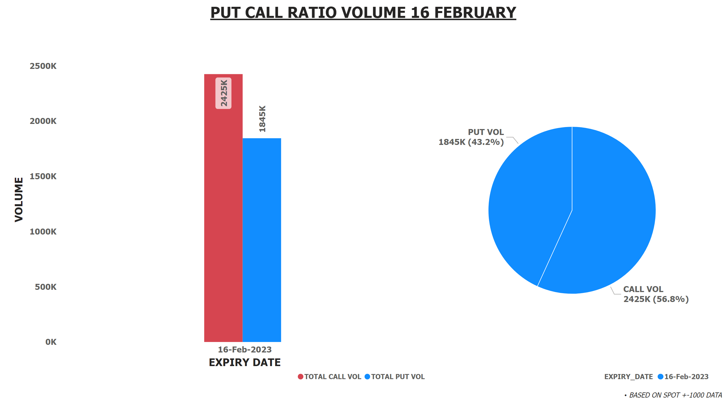
PCR BNIFTY VOL 16 FEB
Notes:
textbox
No alt text provided
pieChart
No alt text provided
textbox
No alt text provided
lineClusteredColumnComboChart
No alt text provided

Slide 17

PRC BNIFTY VOL 23 FEB
Notes:
textbox
No alt text provided
pieChart
No alt text provided
textbox
No alt text provided
lineClusteredColumnComboChart
No alt text provided

Slide 18
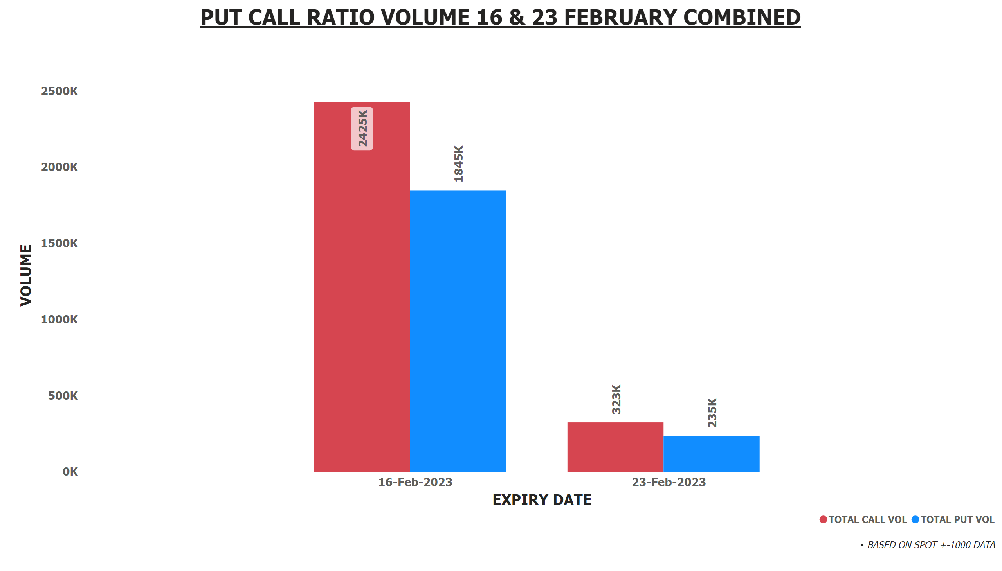
PRC BNIFTY VOL 16+23 FEB
Notes:
textbox
No alt text provided
textbox
No alt text provided
lineClusteredColumnComboChart
No alt text provided

