Slide 1



FNIFTY
View in Power BI
Last data refresh:
2/10/2023 9:59:13 AM UTC
Downloaded at:
2/11/2023 4:49:14 PM UTC

Slide 2
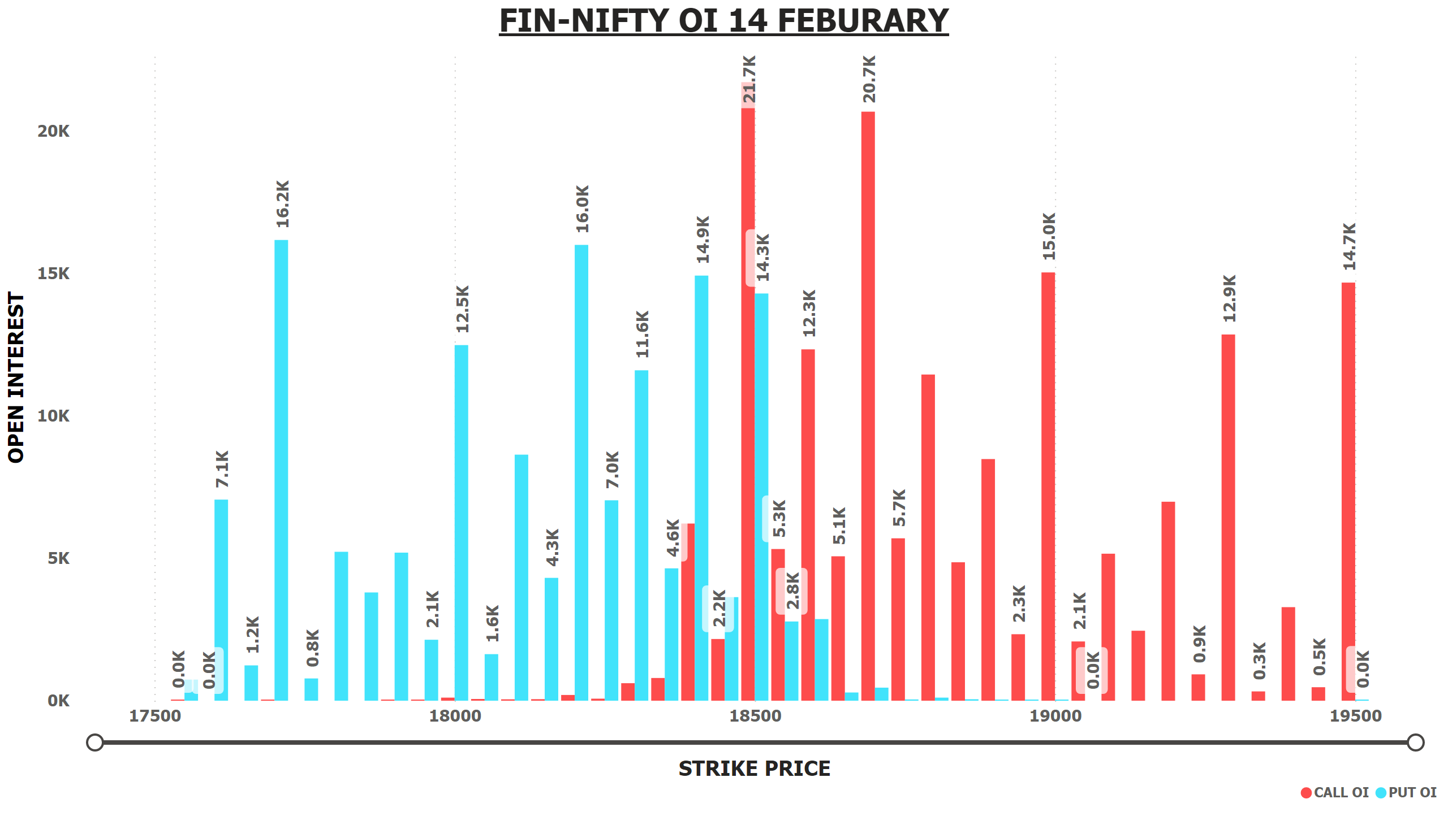
FNIFTY OI 14 FEB
Notes:
FIN-NIFTY OI 14 FEBURARY
No alt text provided

Slide 3
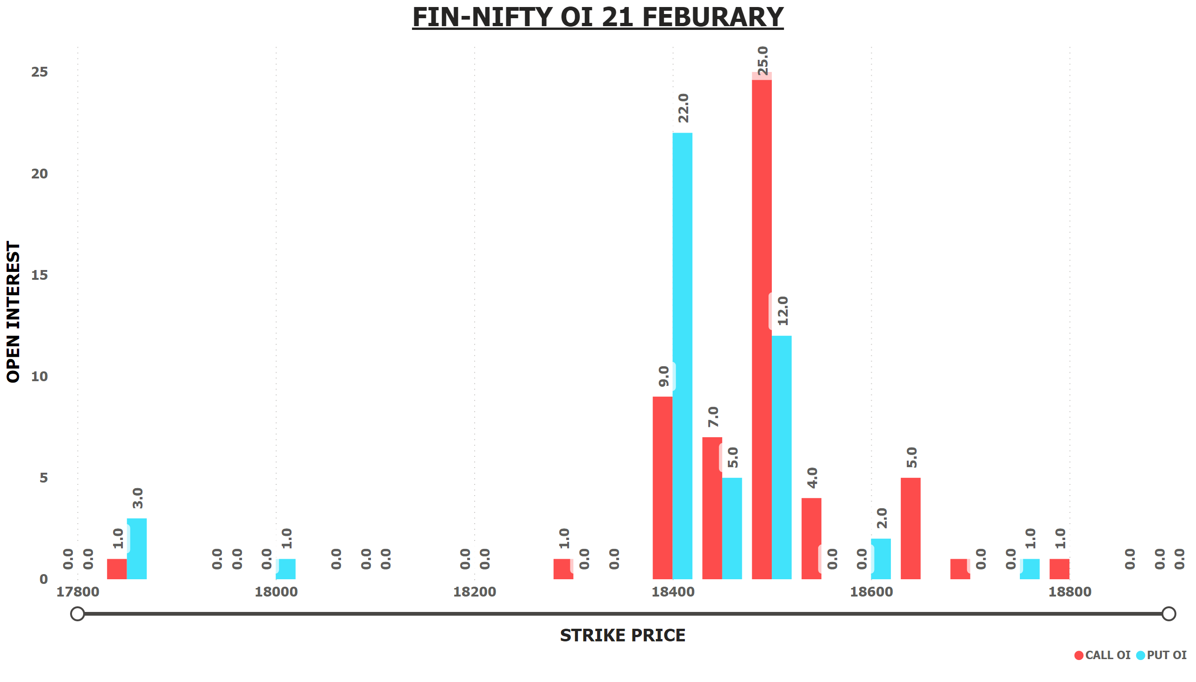
FNIFTY OI 21 FEB
Notes:
FIN-NIFTY OI 21 FEBURARY
No alt text provided

Slide 4
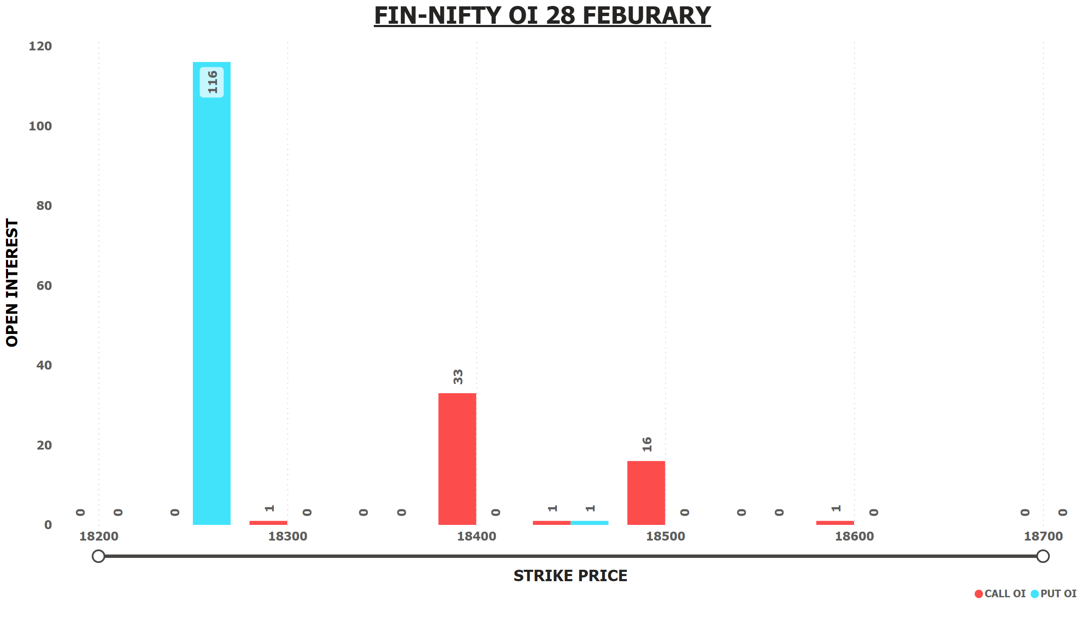
FNIFTY OI 21 FEB
Notes:
FIN-NIFTY OI 28 FEBURARY
No alt text provided

Slide 5
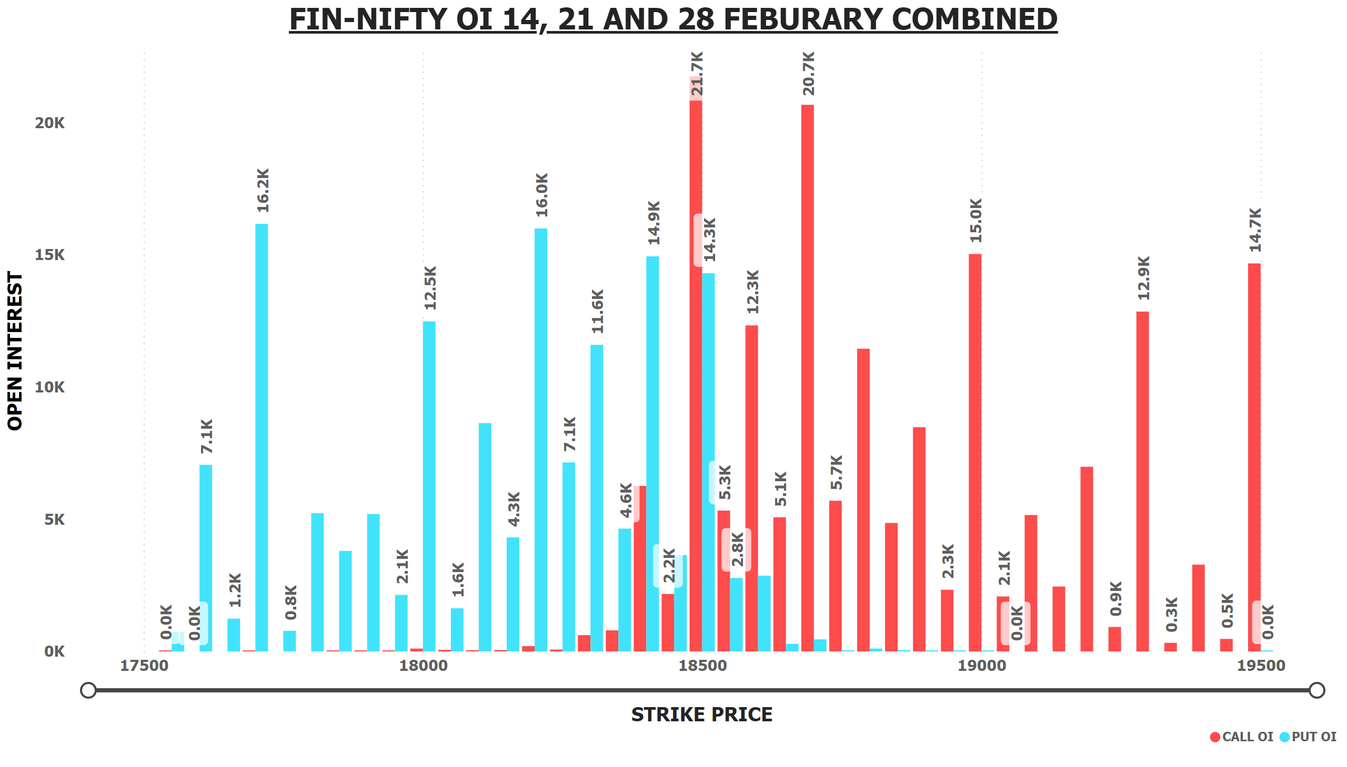
FNIFTY OI 14+21+28 FEB
Notes:
FIN-NIFTY OI 14, 21 AND 28 FEBURARY COMBINED
No alt text provided

Slide 6
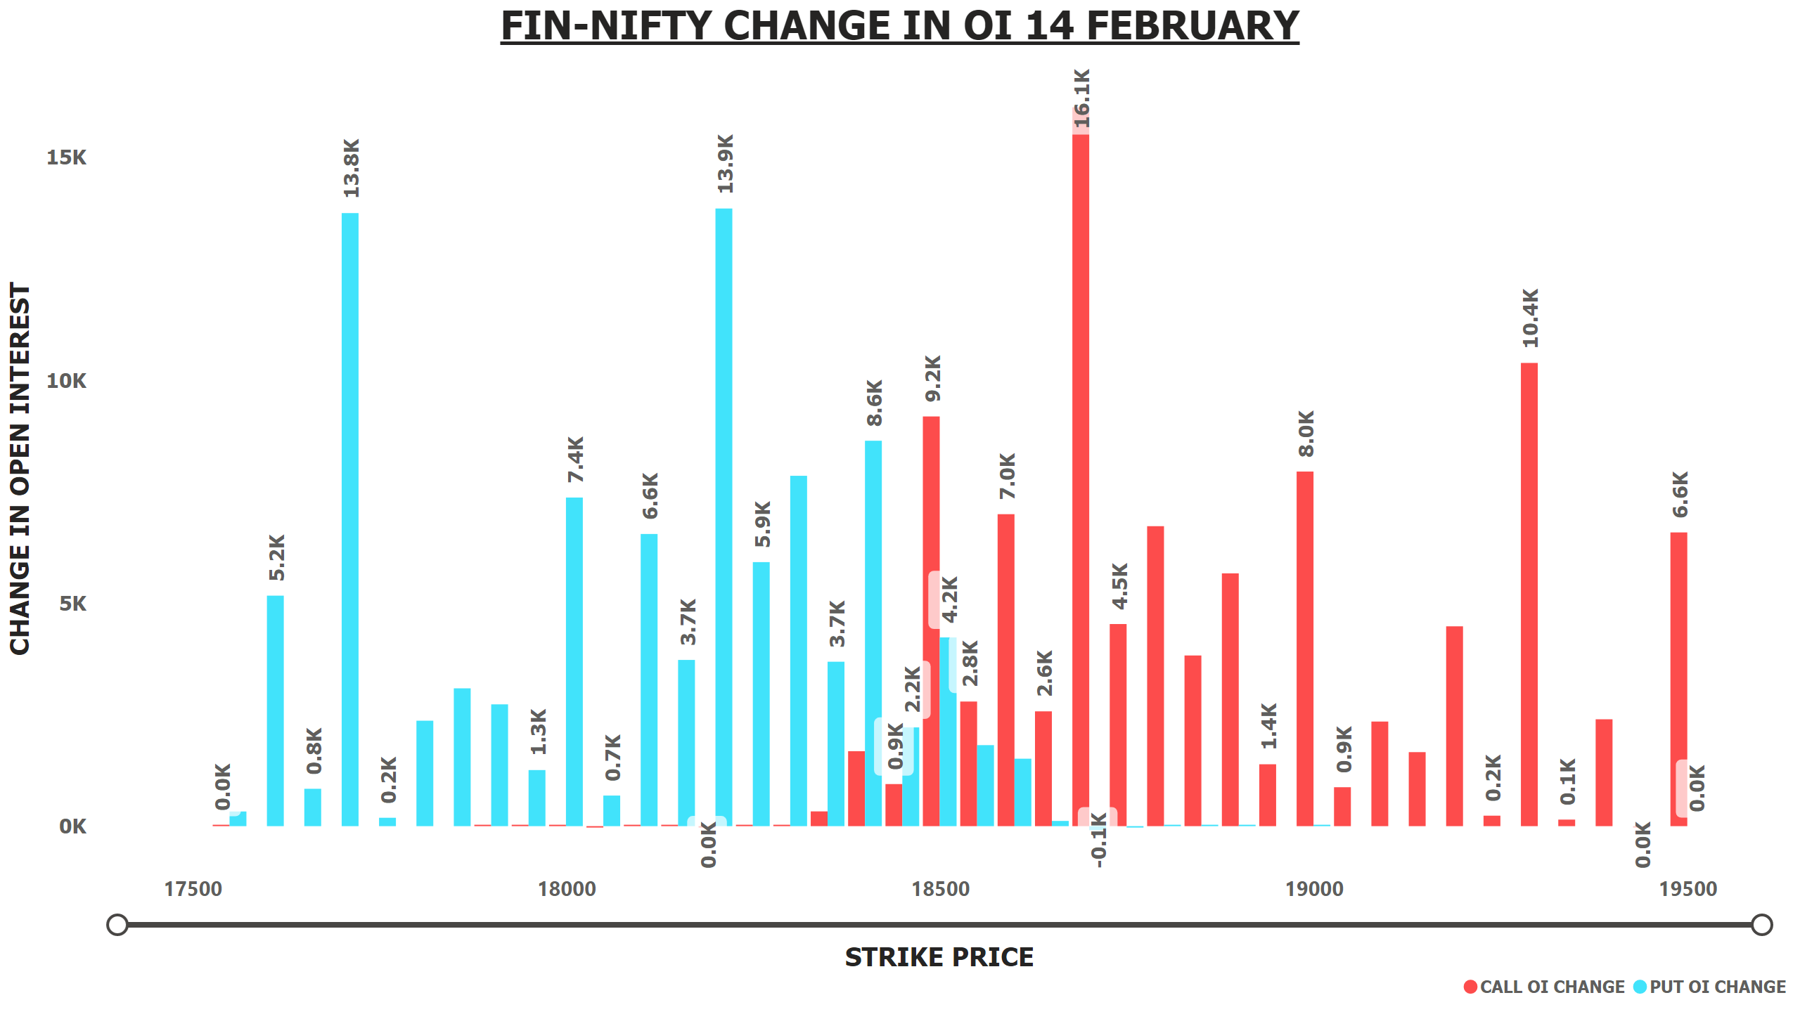
FNIFTY OI CHANGE 14 FEB
Notes:
FIN-NIFTY CHANGE IN OI 14 FEBRUARY
No alt text provided

Slide 7
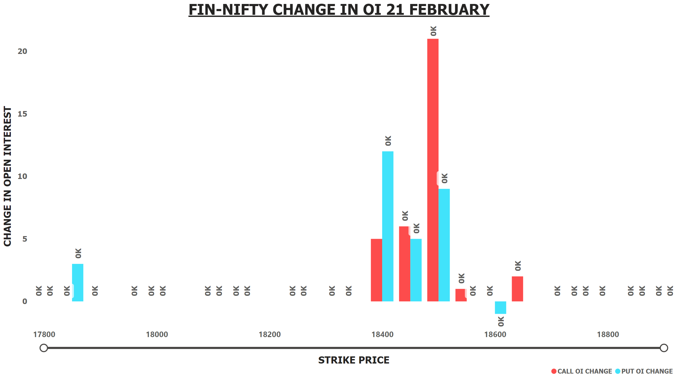
FNIFTY OI CHANGE 21 FEB
Notes:
FIN-NIFTY CHANGE IN OI 21 FEBRUARY
No alt text provided

Slide 8
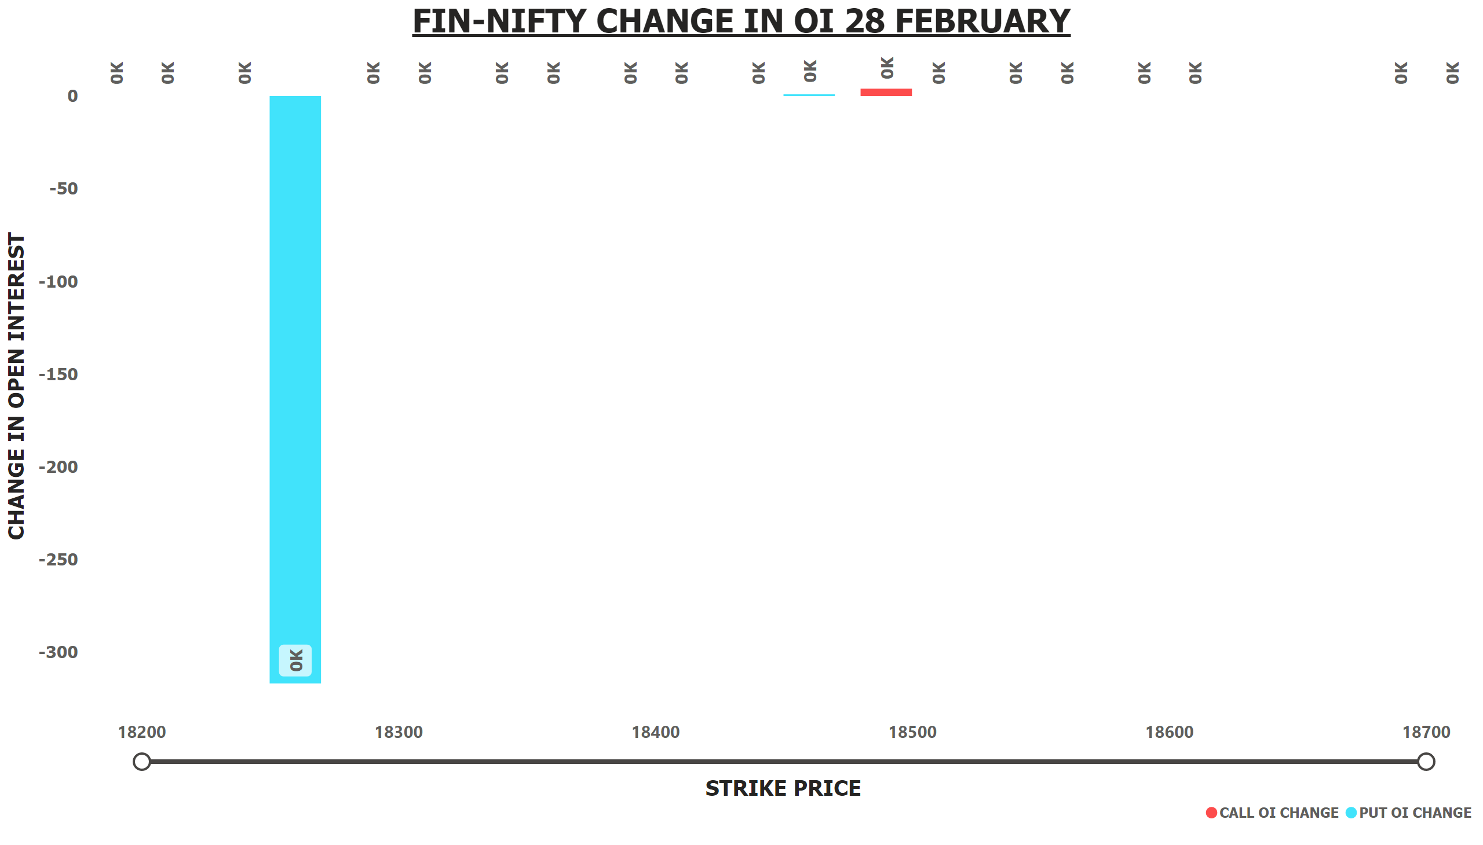
FNIFTY OI CHANGE 28 FEB
Notes:
FIN-NIFTY CHANGE IN OI 28 FEBRUARY
No alt text provided

Slide 9
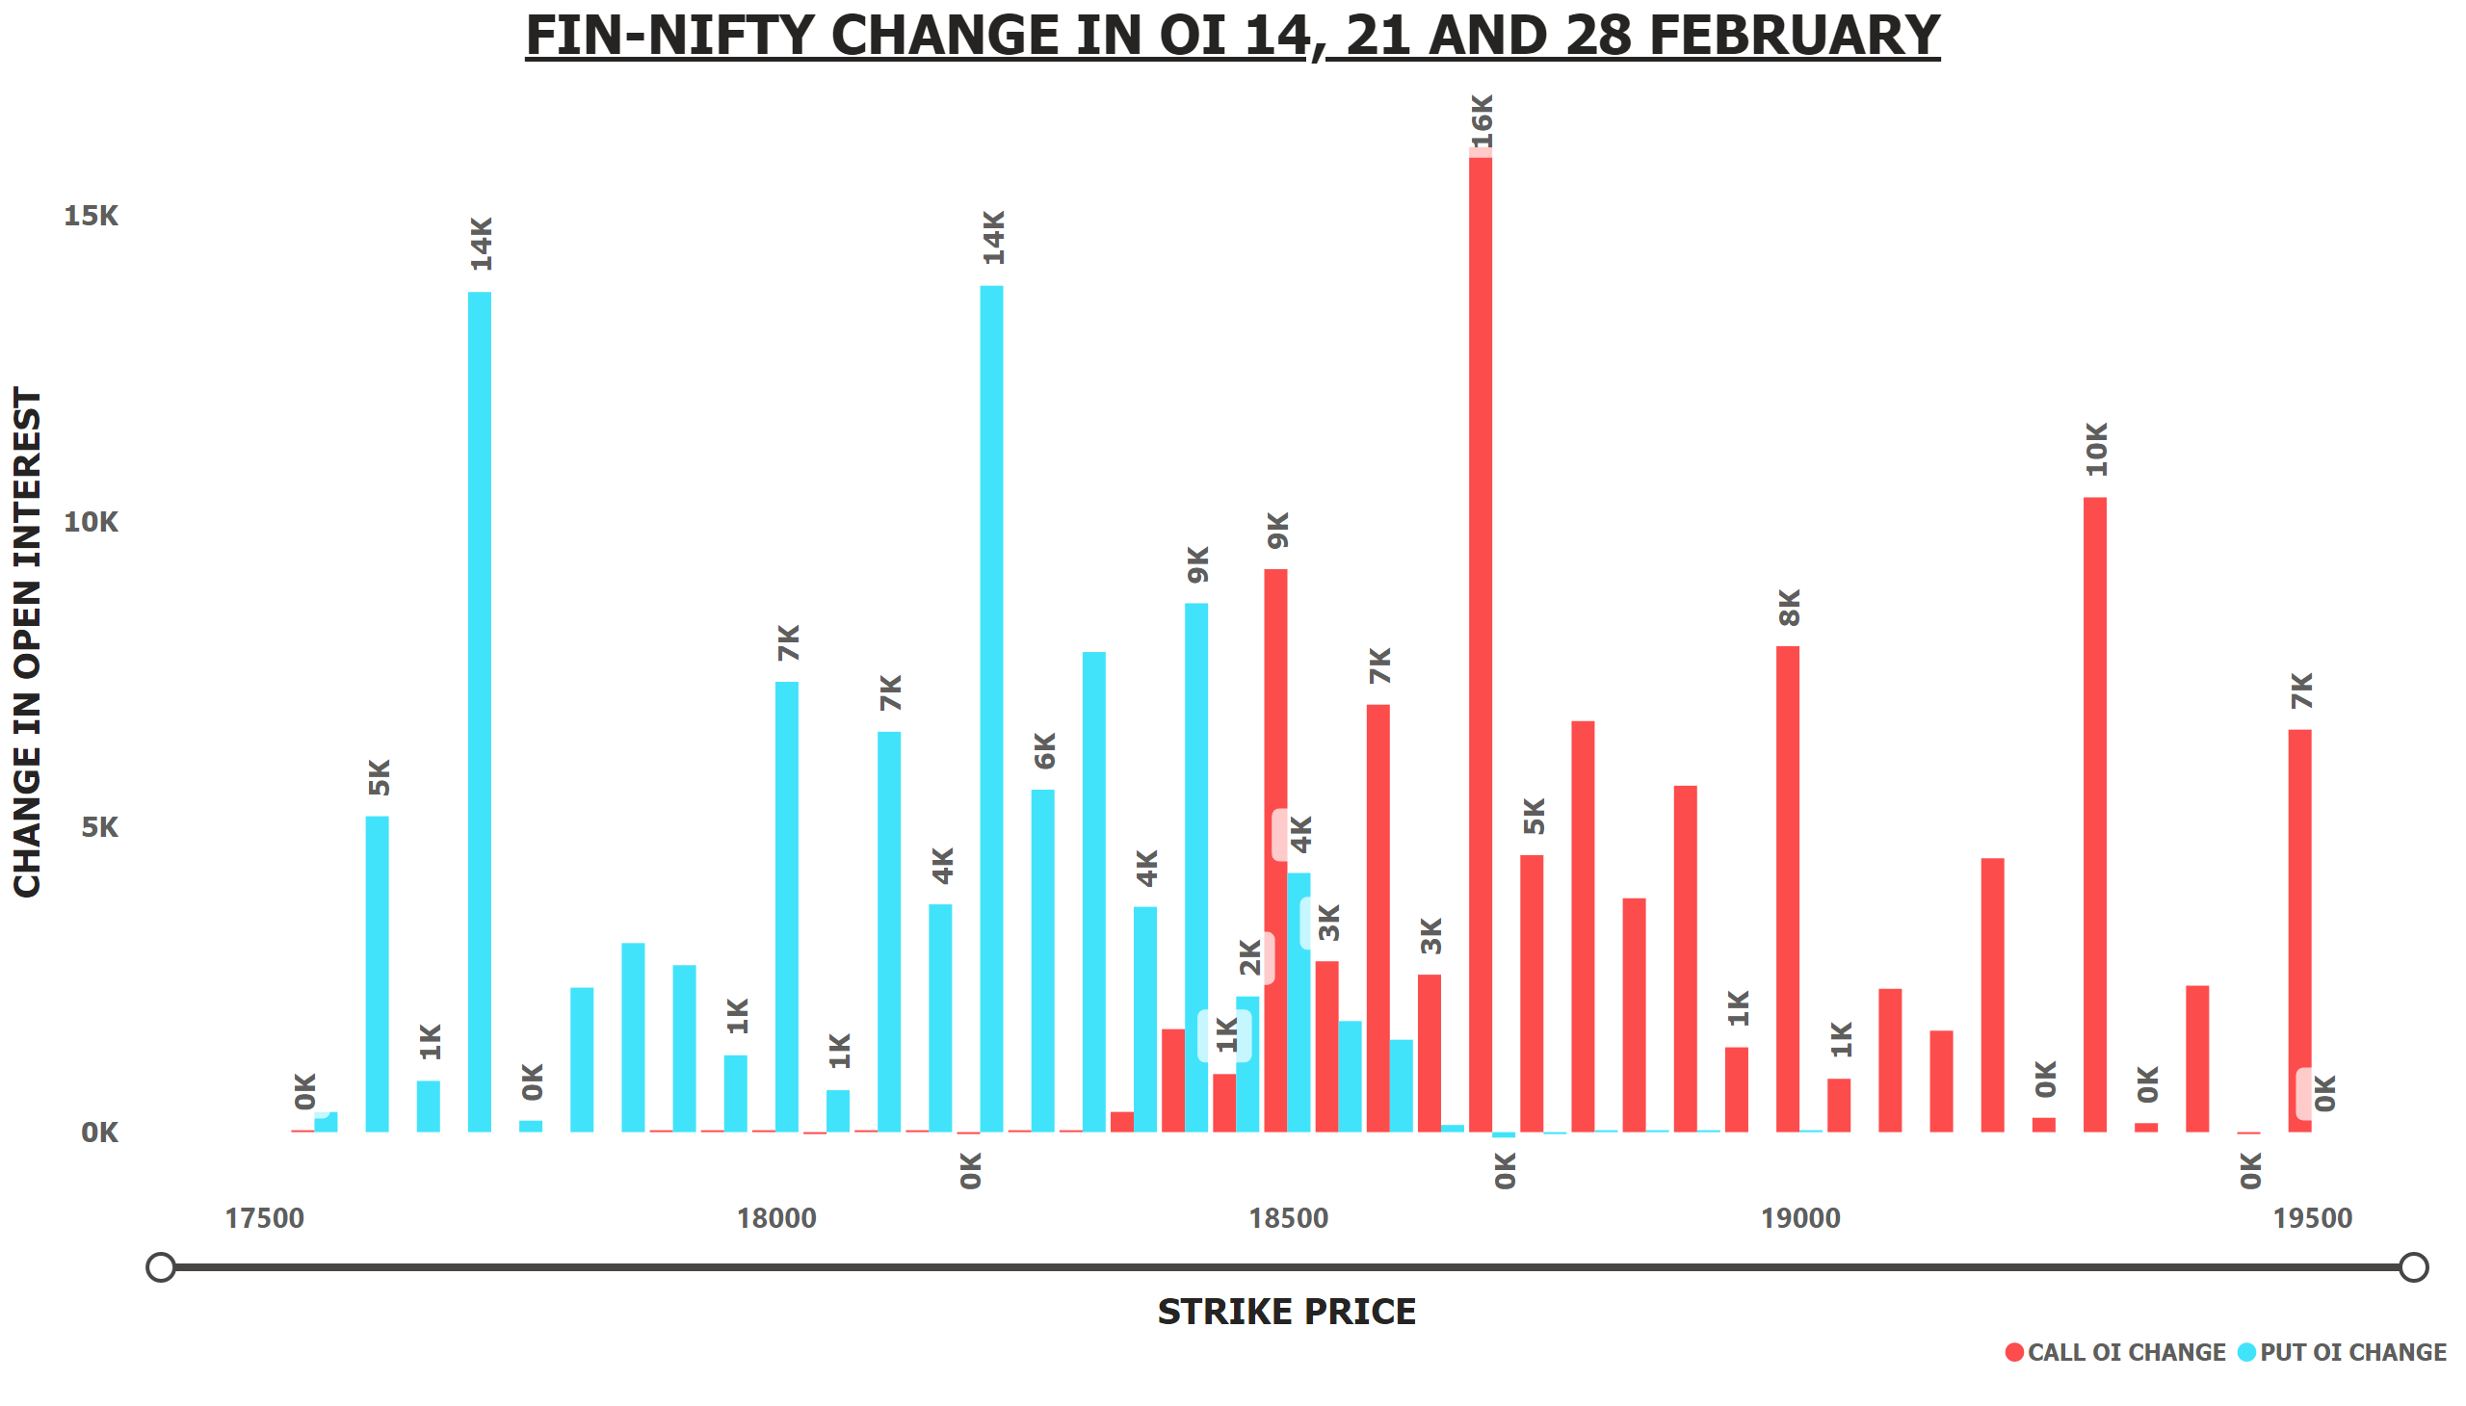
FNIFTY OI CHANGE 14+21 +28 FEB
Notes:
FIN-NIFTY CHANGE IN OI 14, 21 AND 28 FEBRUARY
No alt text provided

Slide 10
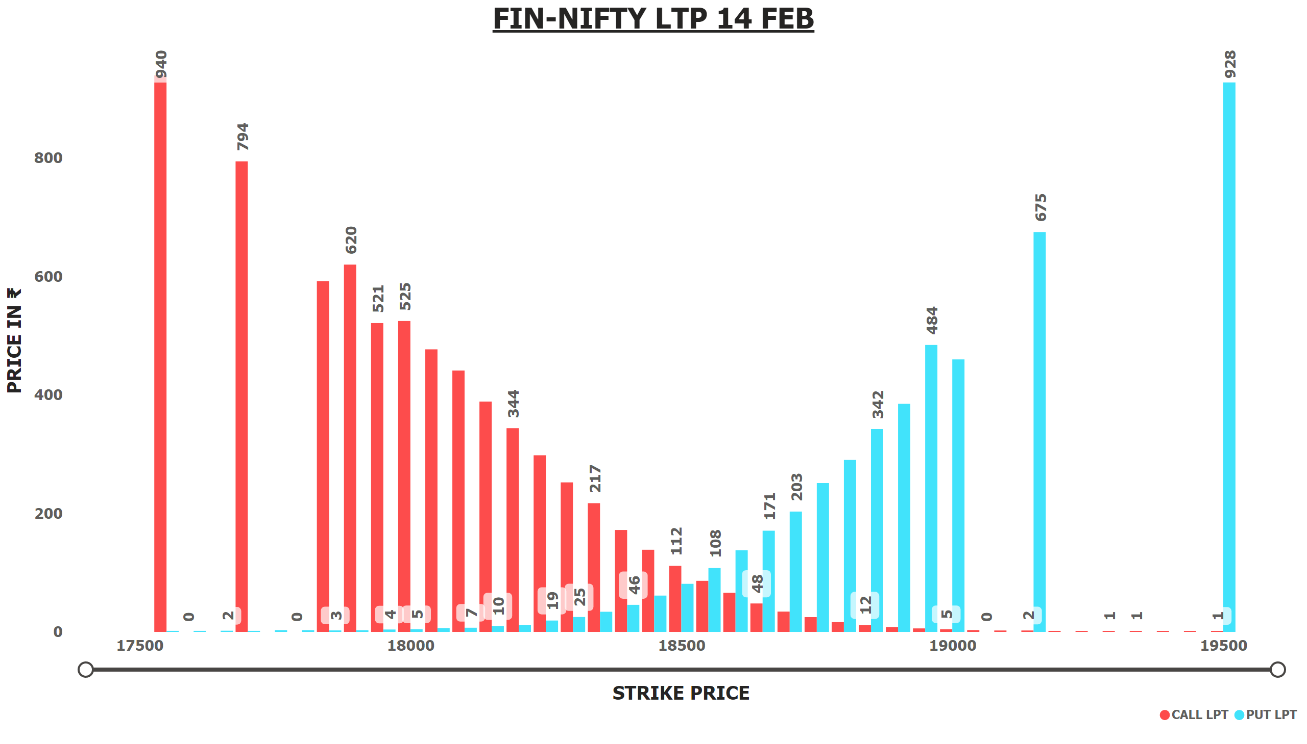
FNIFTY LTP 14 FEB
Notes:
FIN-NIFTY LTP 14 FEB
No alt text provided

Slide 11
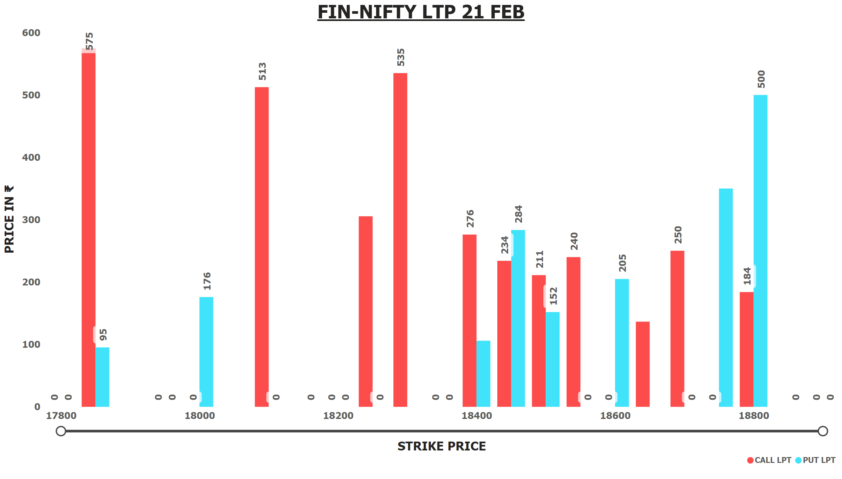
FNIFTY LTP 21 FEB
Notes:
FIN-NIFTY LTP 21 FEB
No alt text provided

Slide 12
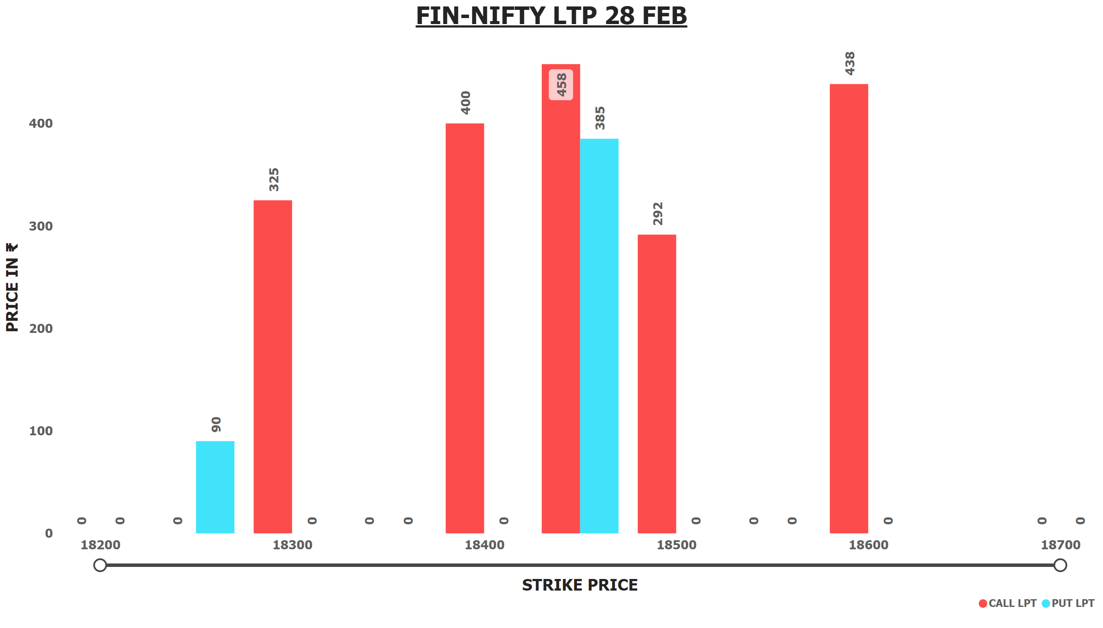
FNIFTY LTP 28 FEB
Notes:
FIN-NIFTY LTP 28 FEB
No alt text provided

Slide 13
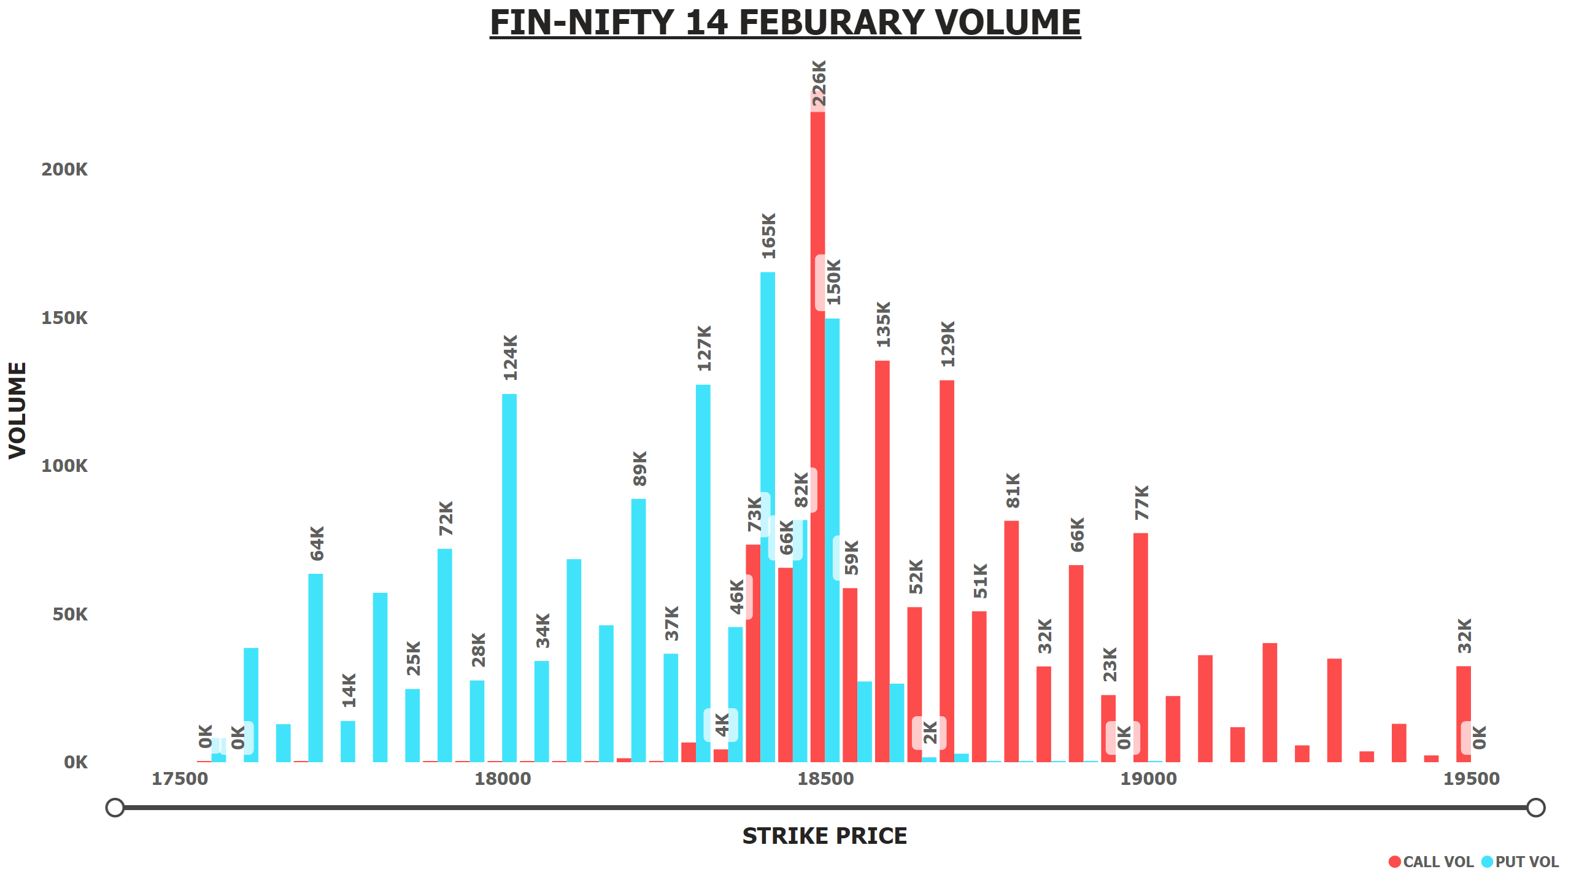
FNIFTY 14 FEB VOLUME
Notes:
FIN-NIFTY 14 FEBURARY VOLUME
No alt text provided

Slide 14
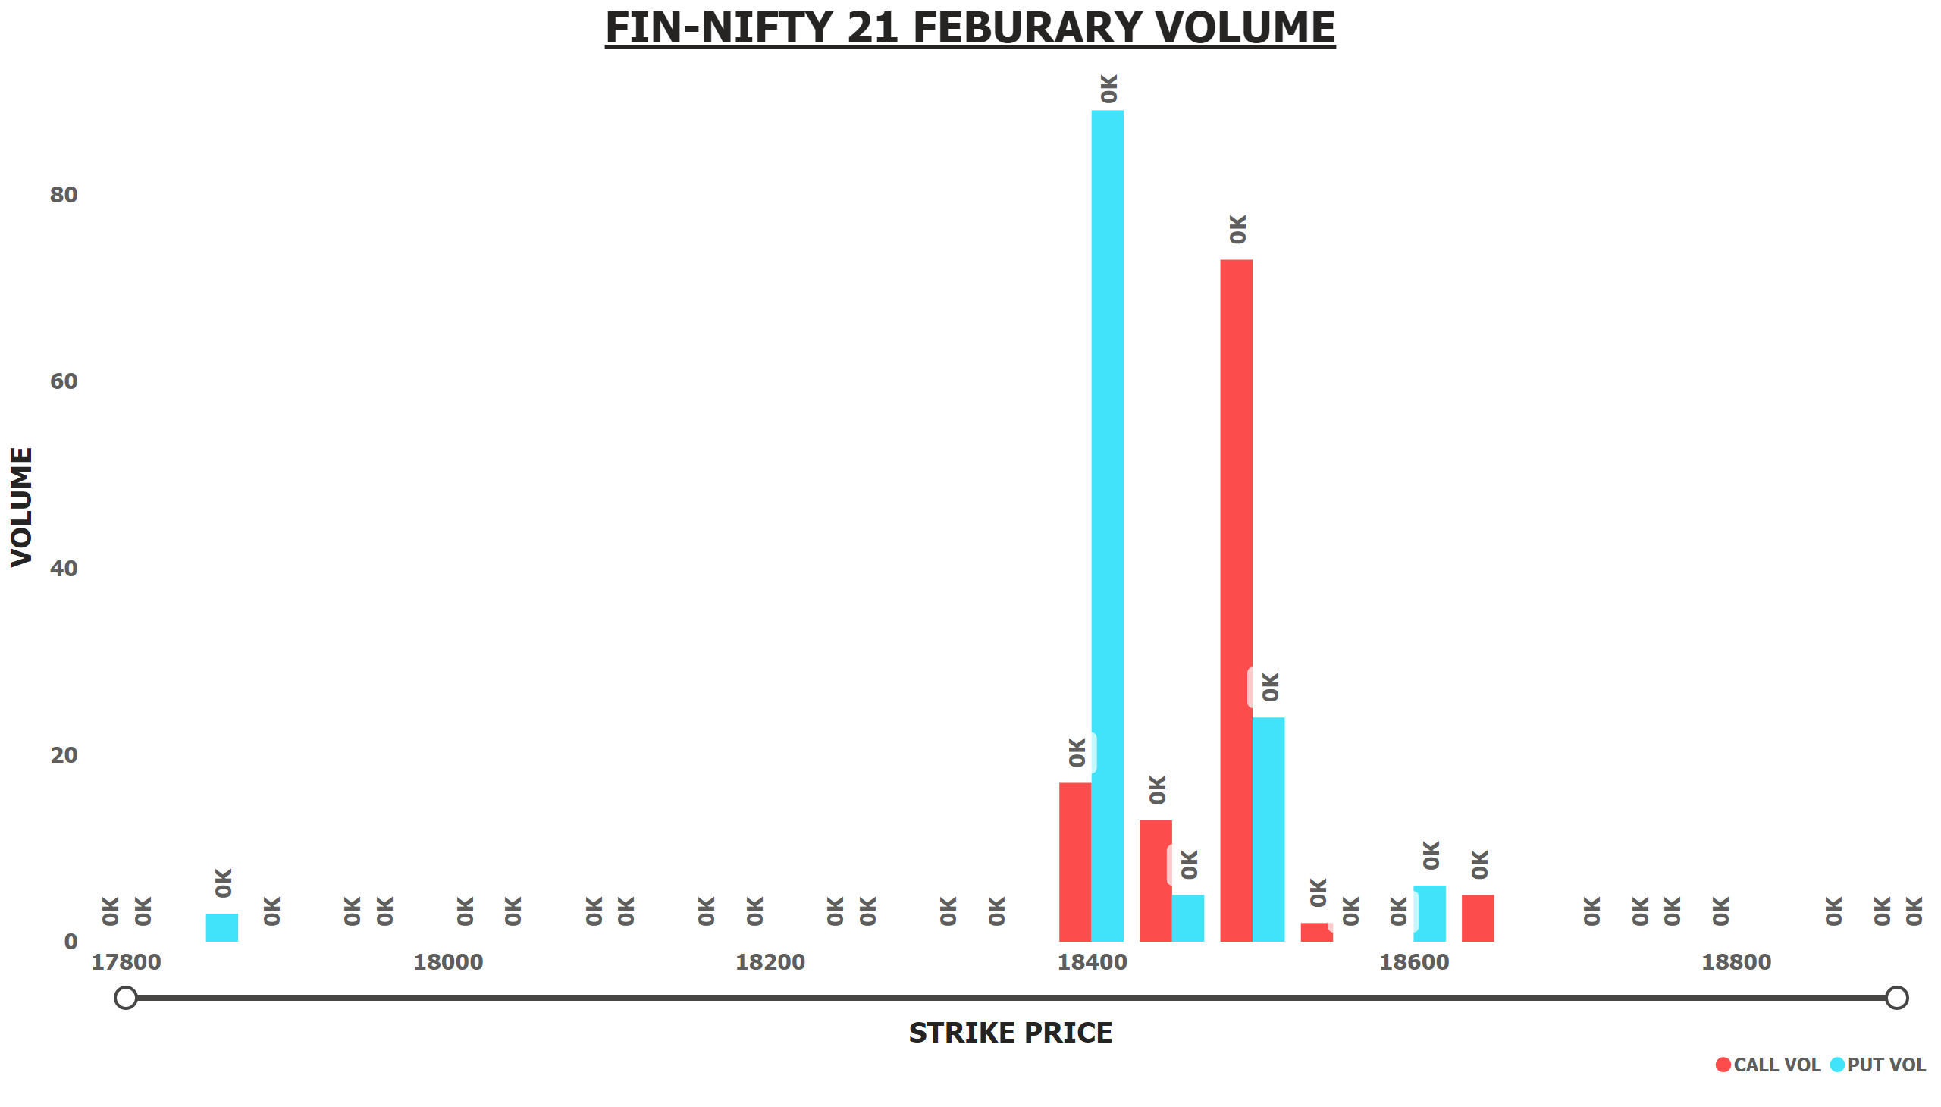
FNIFTY 21 FEB VOLUME
Notes:
FIN-NIFTY 21 FEBURARY VOLUME
No alt text provided

Slide 15
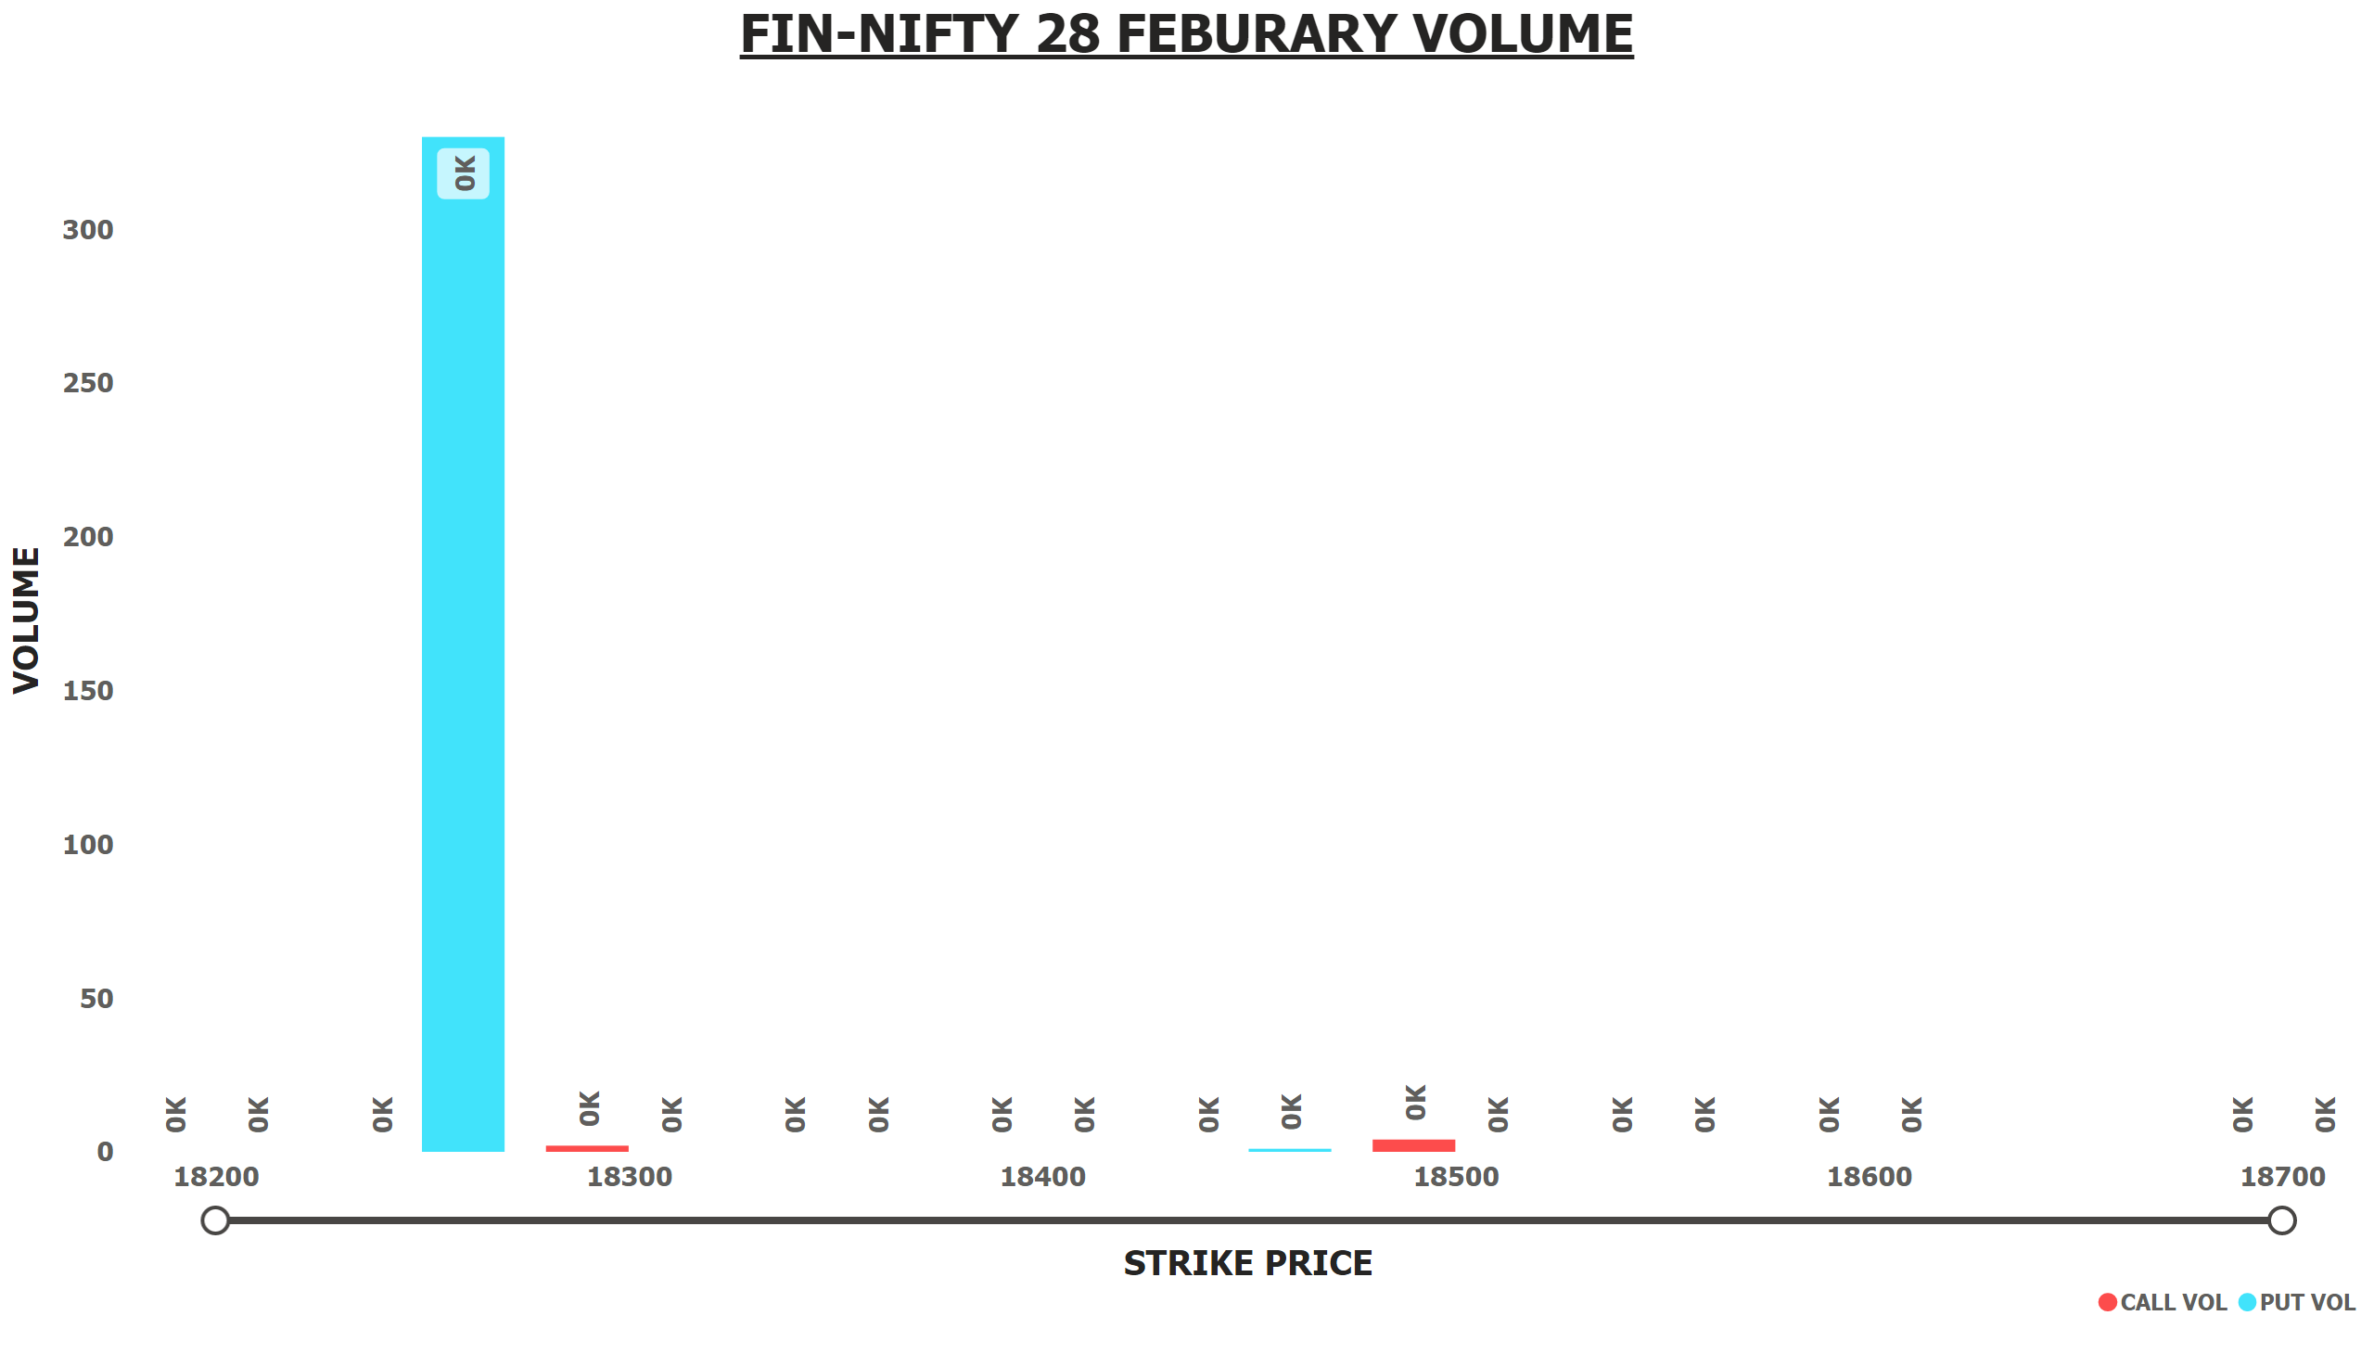
FNIFTY 28 FEB VOLUME
Notes:
FIN-NIFTY 28 FEBURARY VOLUME
No alt text provided

Slide 16
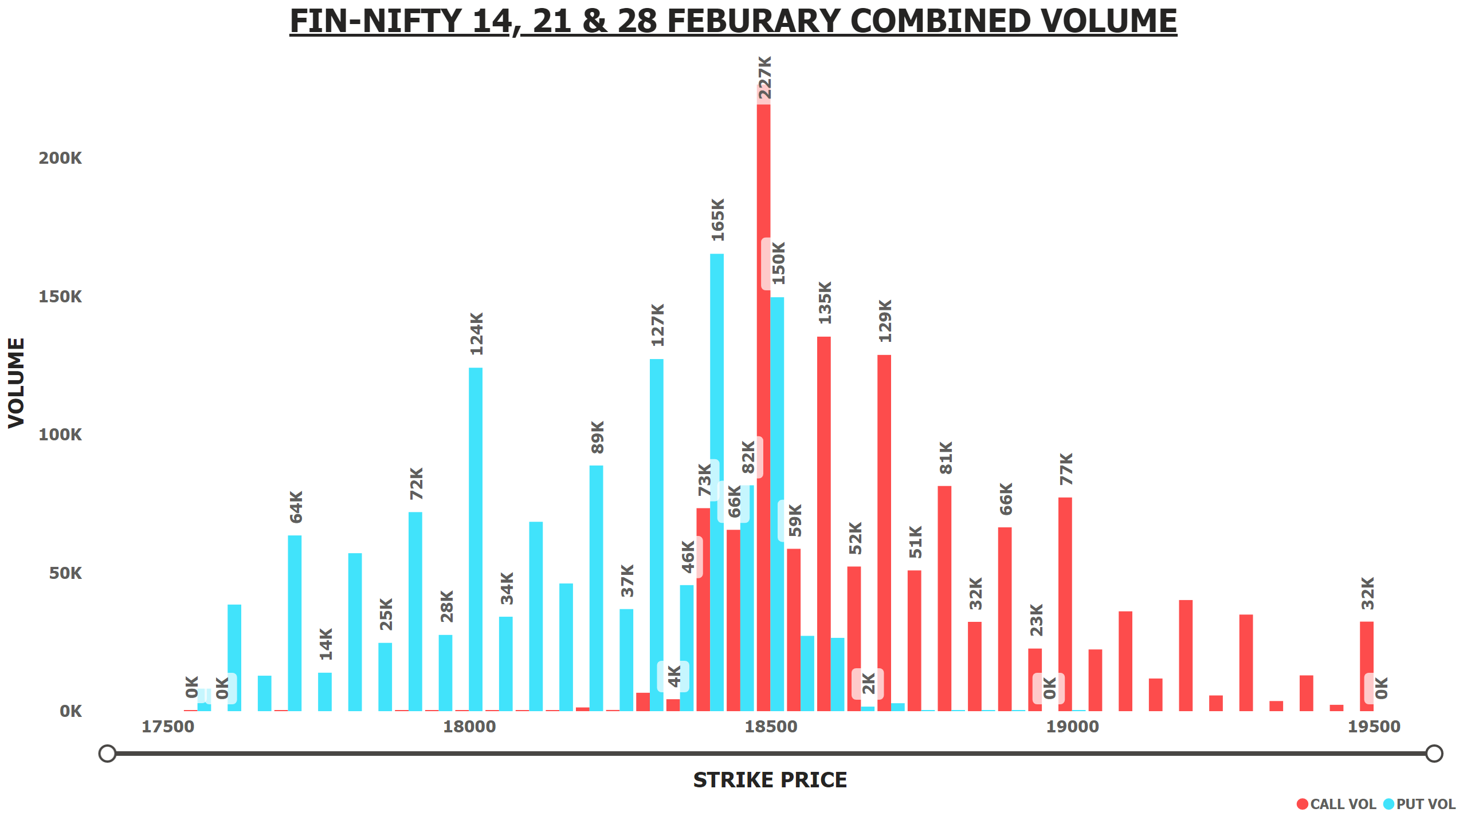
FNIFTY 14+21+28 FEB VOLUME
Notes:
FIN-NIFTY 14, 21 & 28 FEBURARY COMBINED VOLUME
No alt text provided

Slide 17
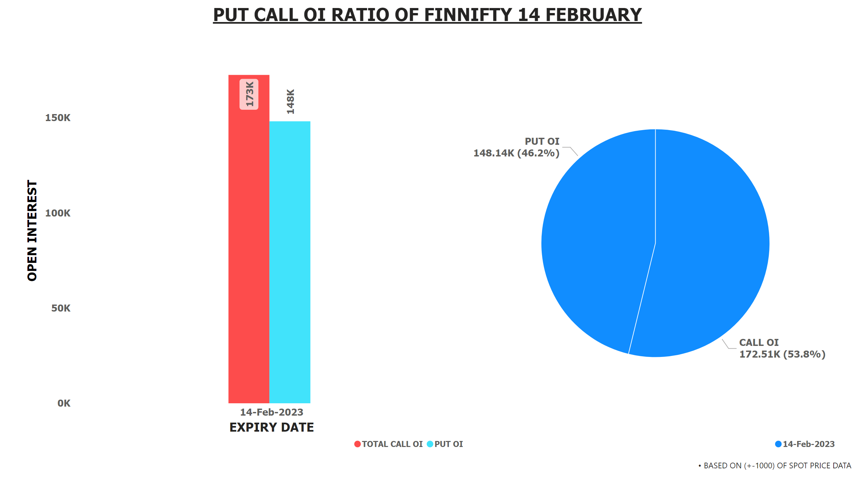
PCR FNIFTY OI 14 FEB
Notes:
textbox
No alt text provided
textbox
No alt text provided
lineClusteredColumnComboChart
No alt text provided
pieChart
No alt text provided

Slide 18
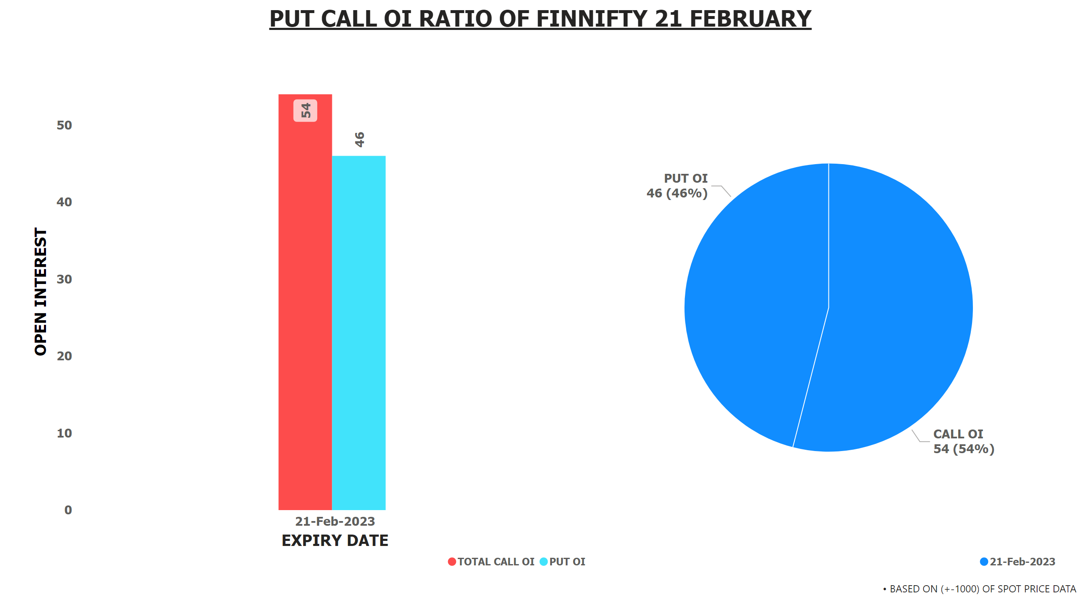
PCR FNIFTY OI 21 FEB
Notes:
textbox
No alt text provided
textbox
No alt text provided
pieChart
No alt text provided
lineClusteredColumnComboChart
No alt text provided

Slide 19
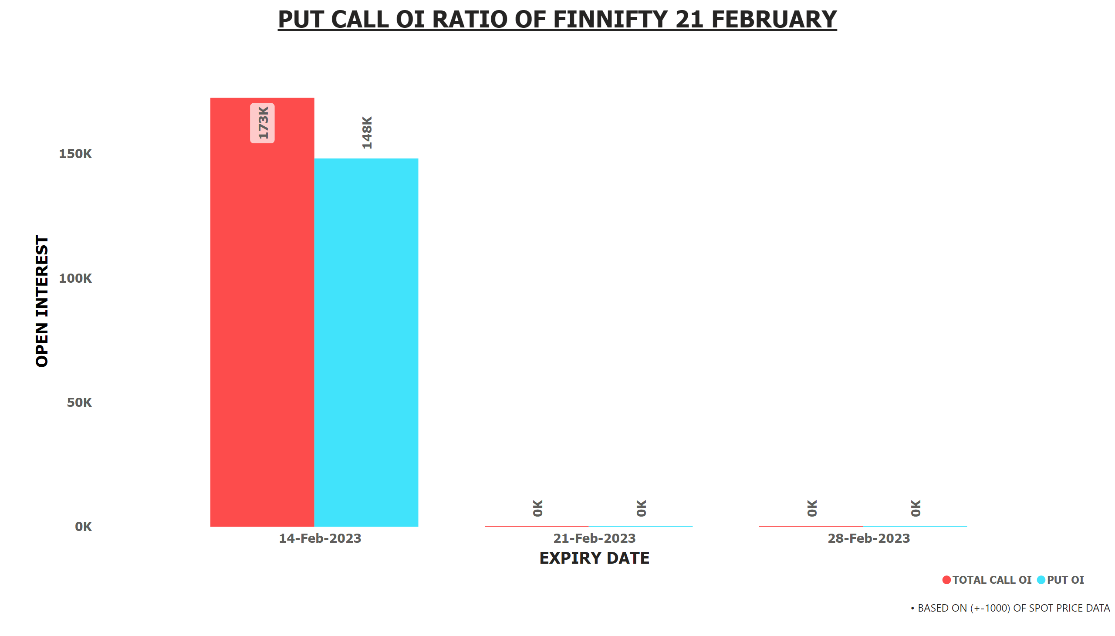
PCR FNIFTY OI 14+21+28 FEB
Notes:
textbox
No alt text provided
textbox
No alt text provided
lineClusteredColumnComboChart
No alt text provided

Slide 20
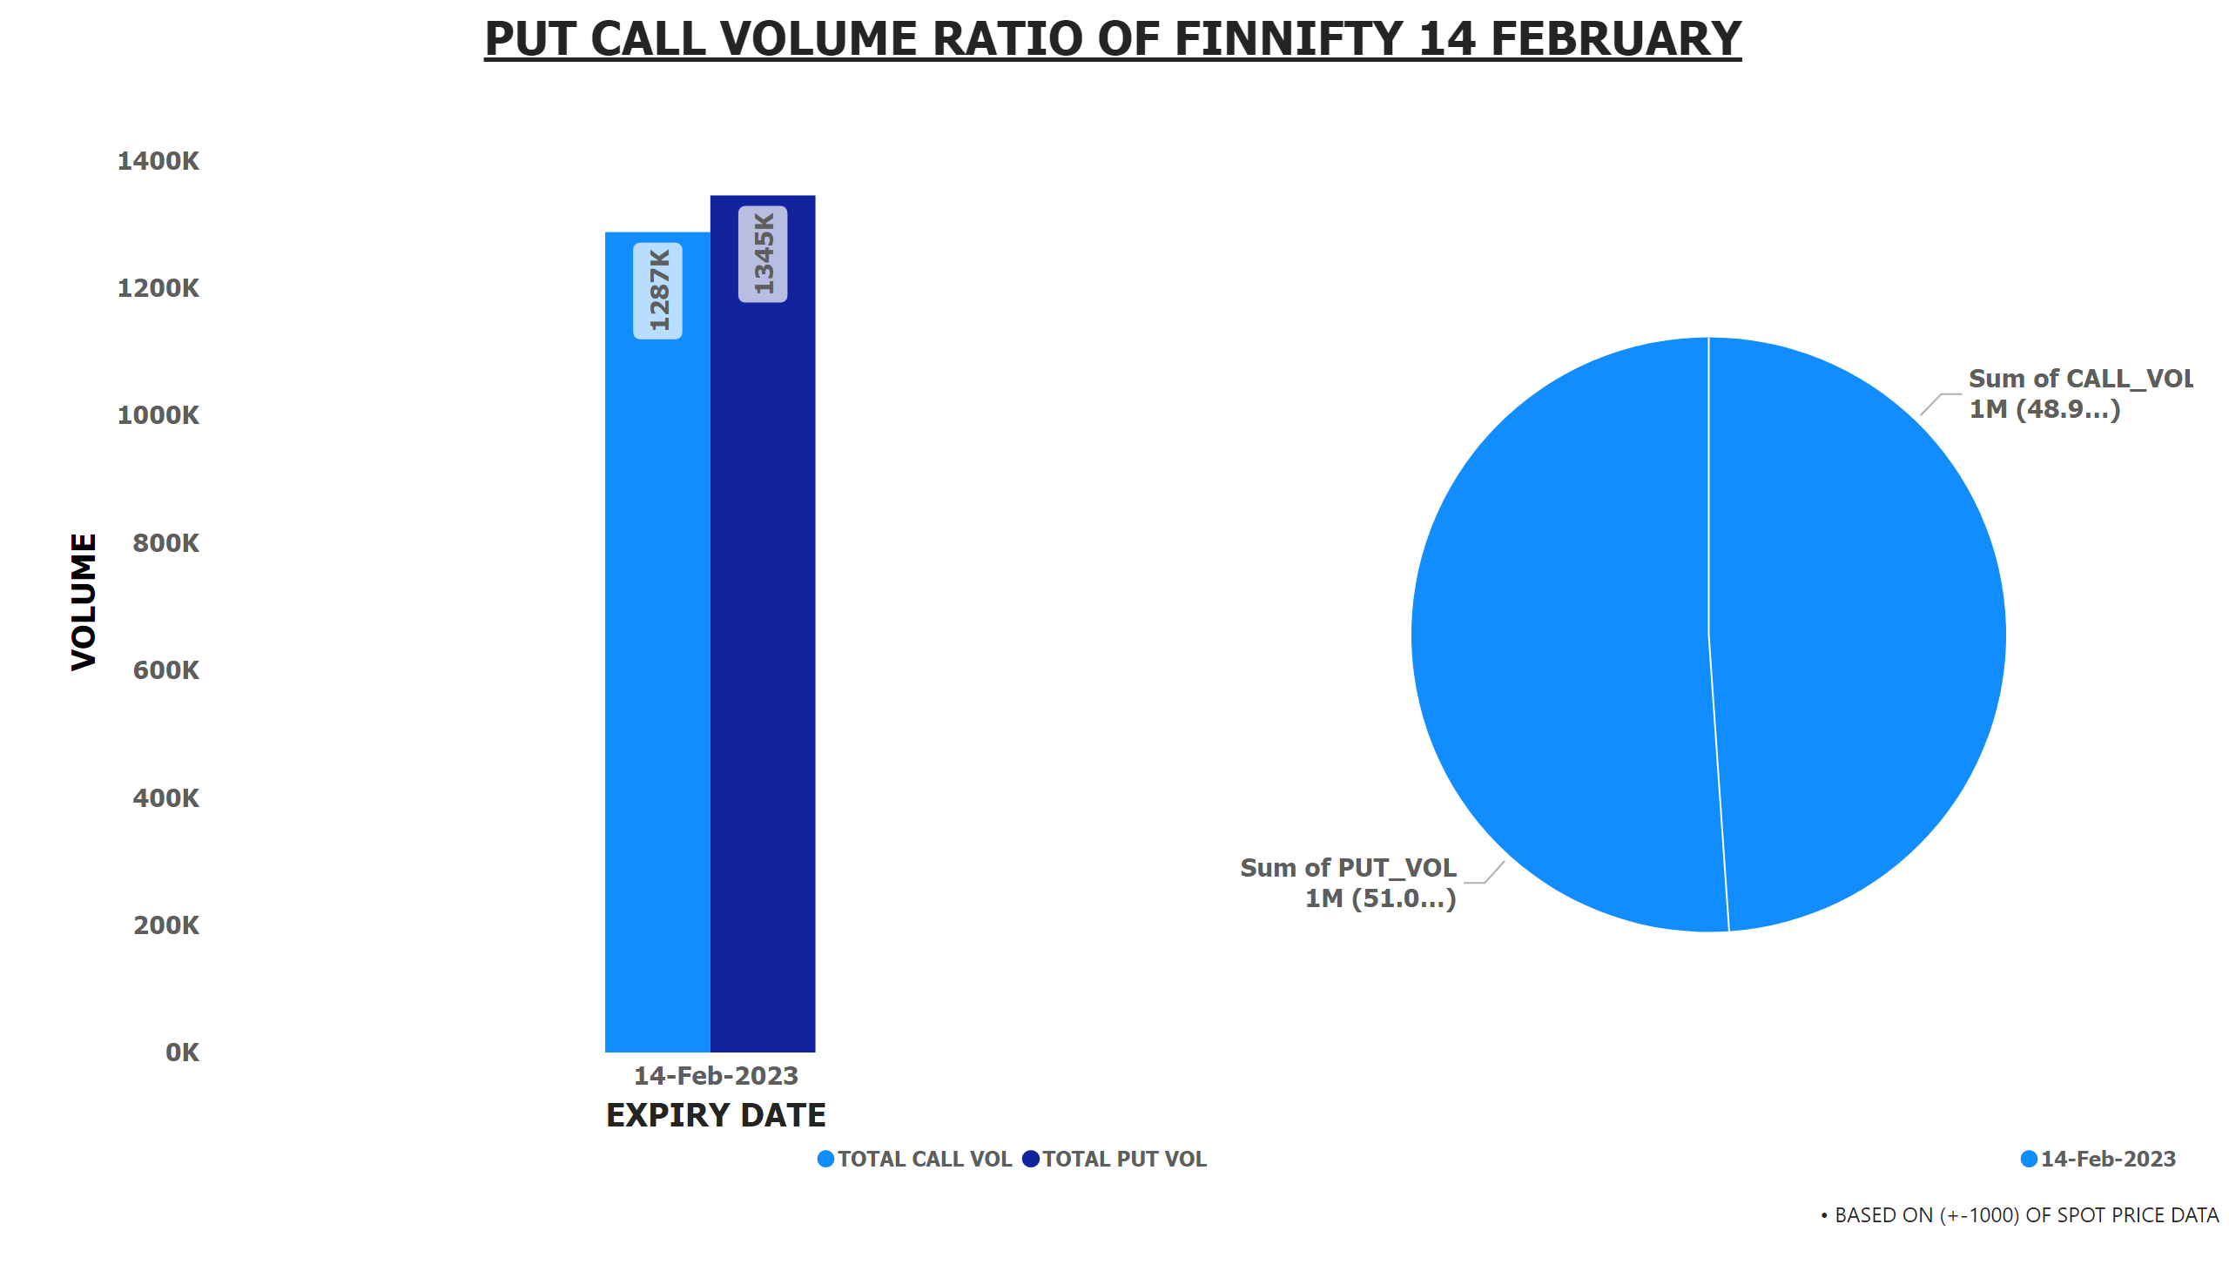
PCR FNIFTY VOL 14 FEB
Notes:
textbox
No alt text provided
textbox
No alt text provided
pieChart
No alt text provided
lineClusteredColumnComboChart
No alt text provided

Slide 21
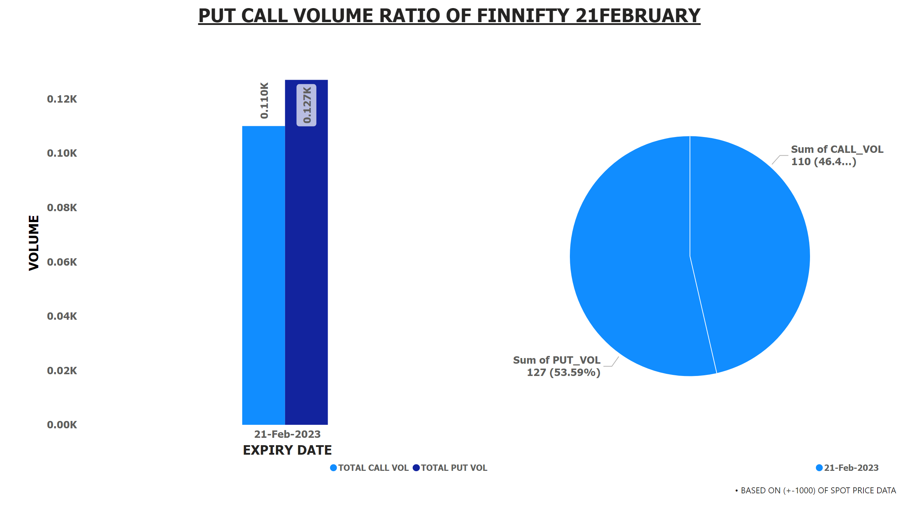
PCR FNIFTY VOL 21 FEB
Notes:
textbox
No alt text provided
textbox
No alt text provided
pieChart
No alt text provided
lineClusteredColumnComboChart
No alt text provided

Slide 22
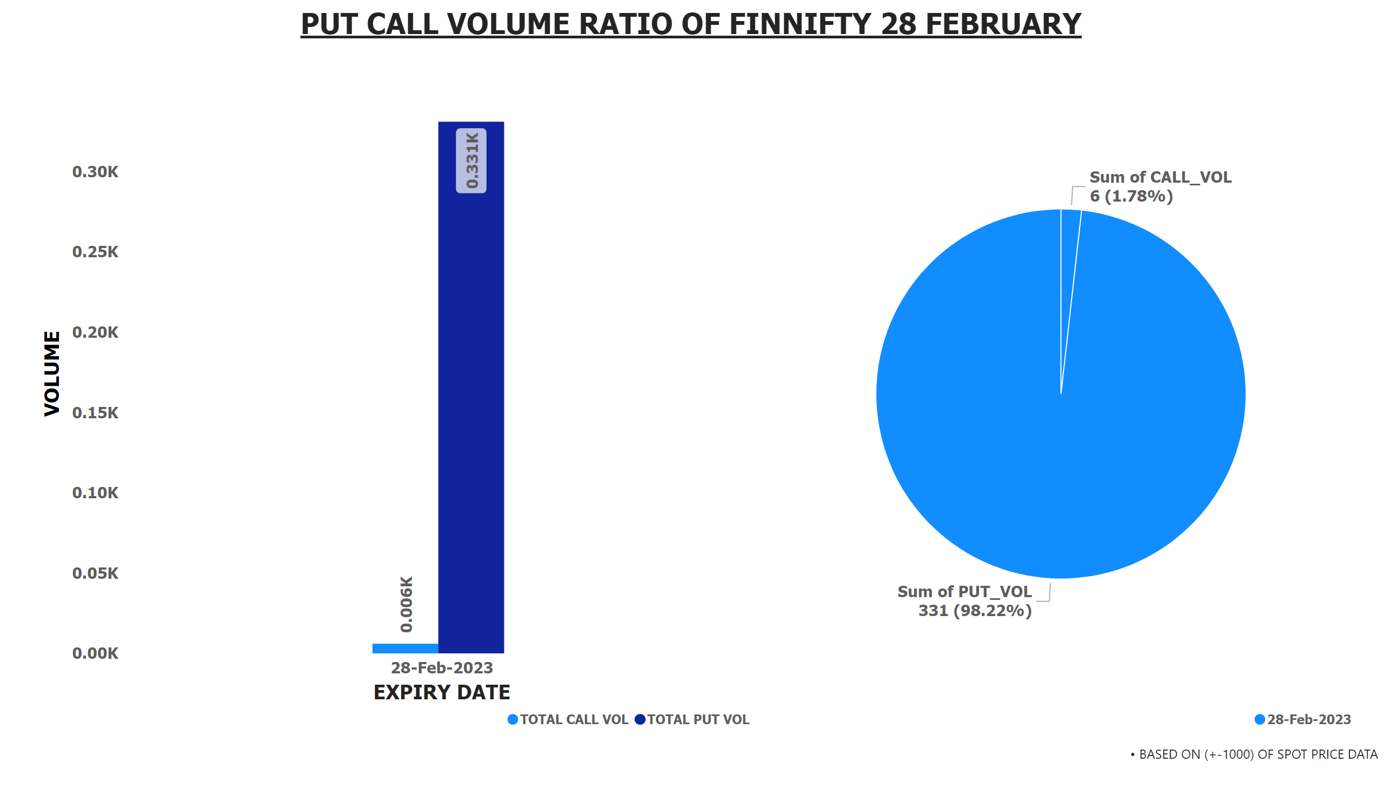
PCR FNIFTY VOL 28 FEB
Notes:
textbox
No alt text provided
textbox
No alt text provided
pieChart
No alt text provided
lineClusteredColumnComboChart
No alt text provided

Slide 23
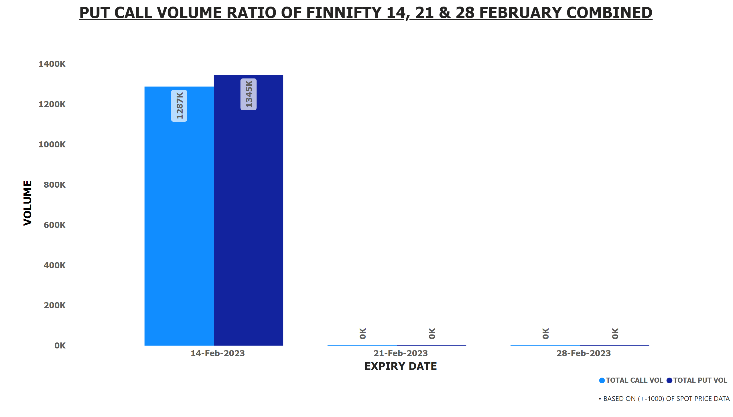
Duplicate of PCR FNIFTY VOL 28 FEB
Notes:
textbox
No alt text provided
textbox
No alt text provided
lineClusteredColumnComboChart
No alt text provided

