Slide 1



NIFTY
Last data refresh:
2/9/2023 9:57:30 PM UTC
Downloaded at:
2/11/2023 4:58:08 PM UTC

Slide 2
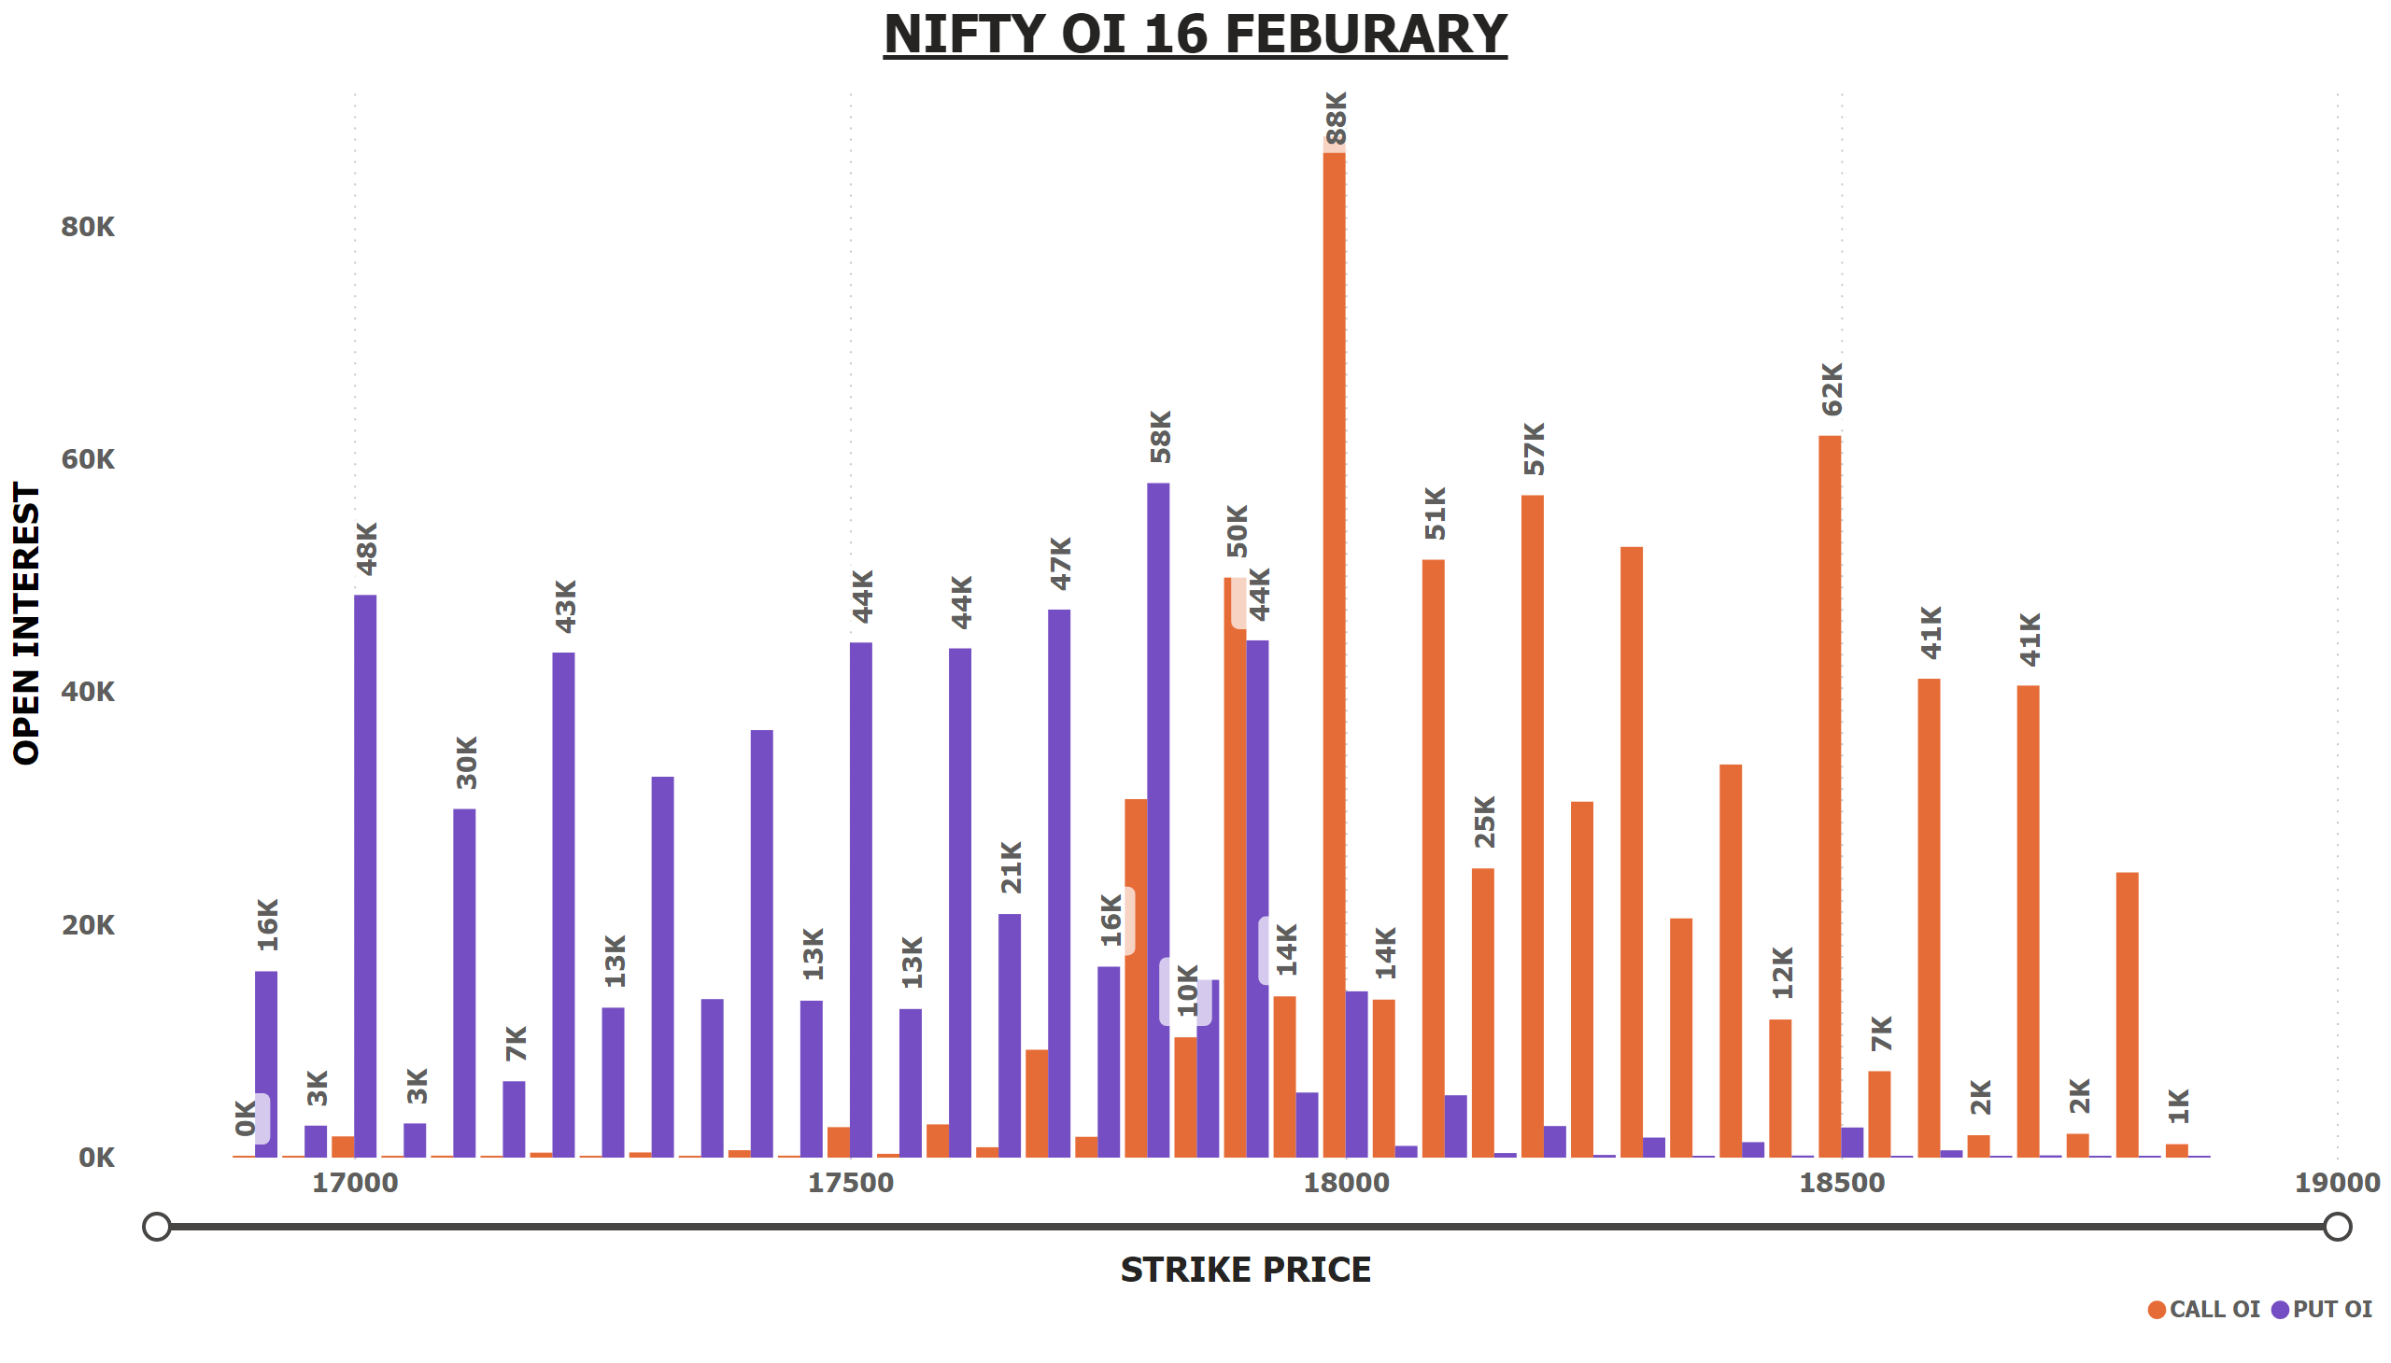
NIFTY OI 16 FEB
Notes:
NIFTY OI 16 FEBURARY
No alt text provided

Slide 3
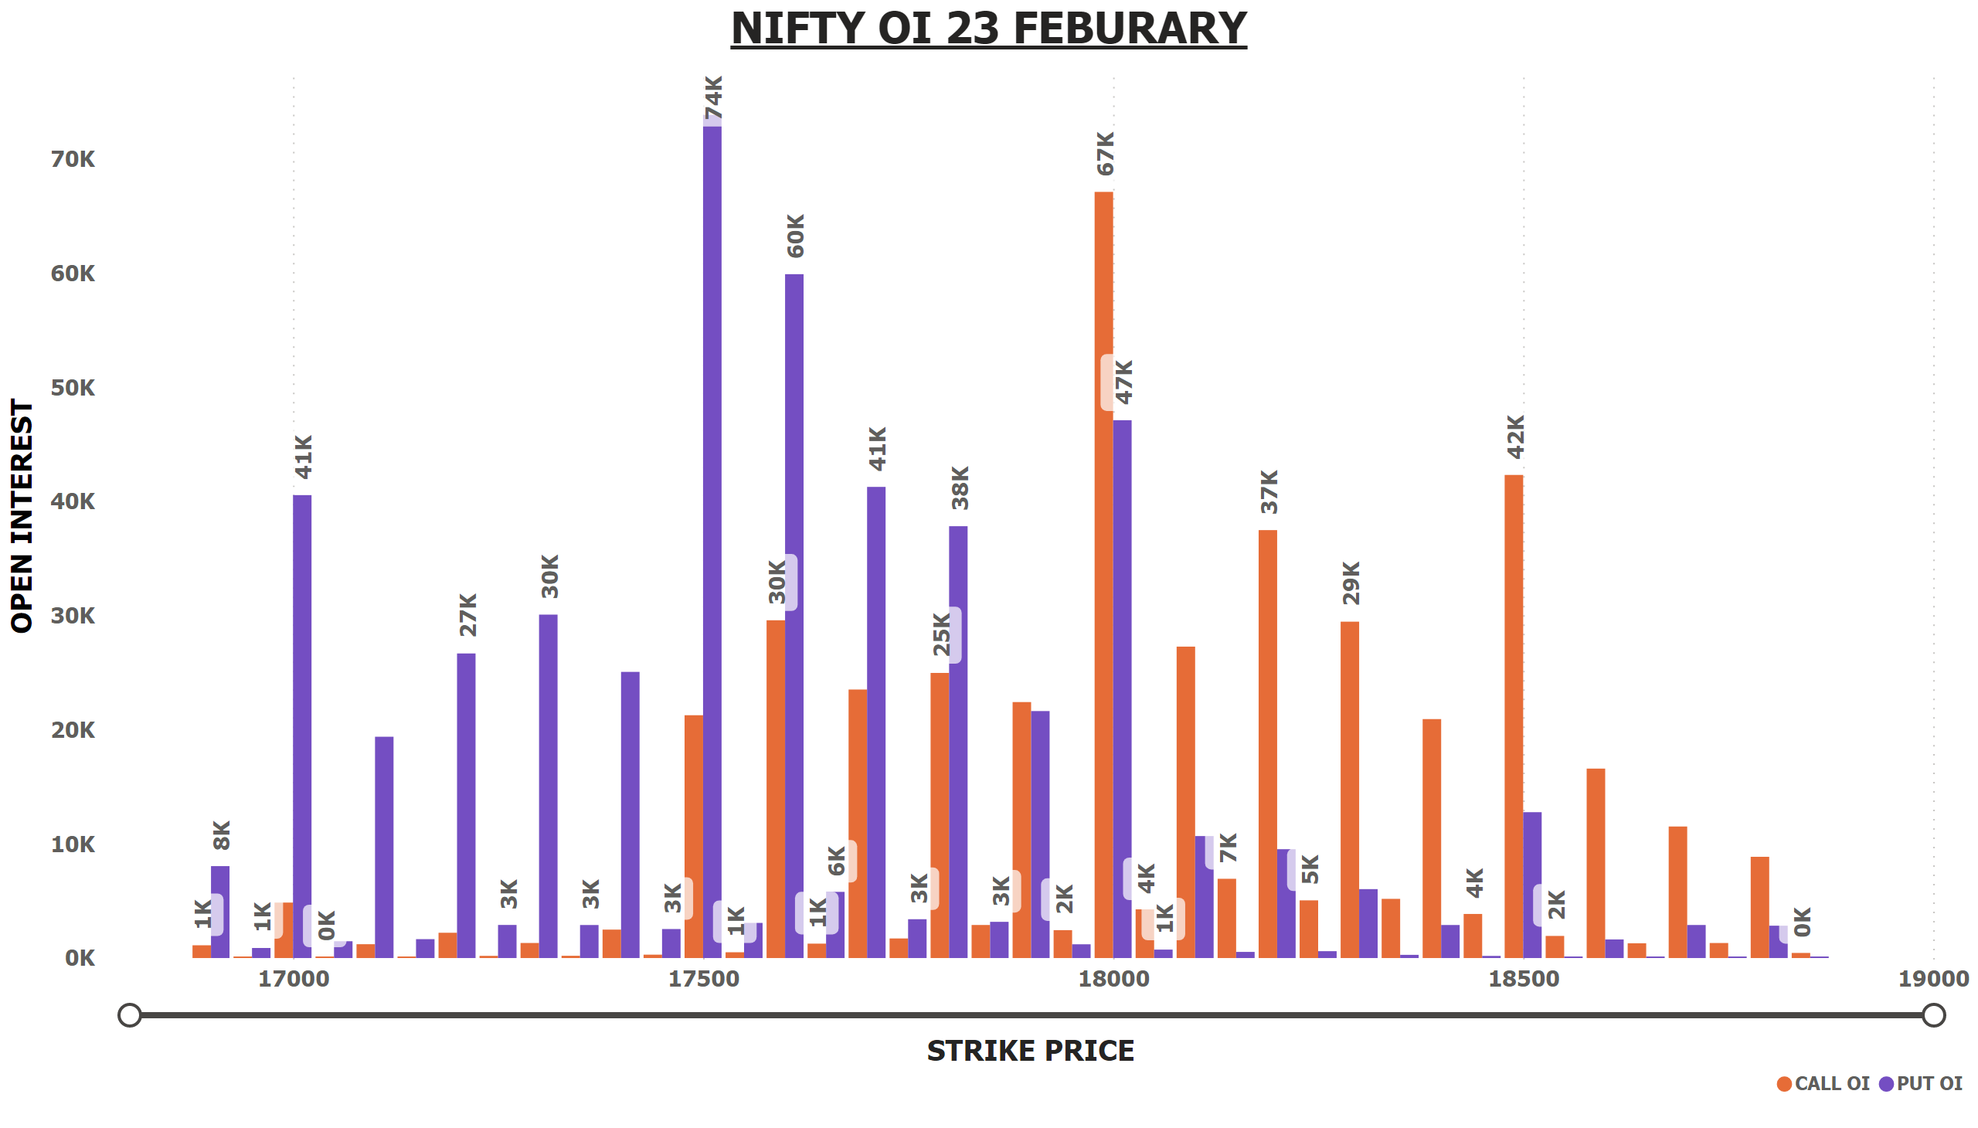
NIFTY OI 23 FEB
Notes:
NIFTY OI 23 FEBURARY
No alt text provided

Slide 4
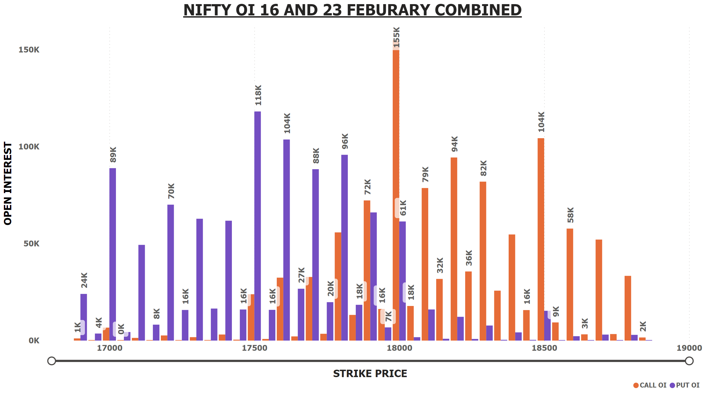
NIFTY OI 16+23 FEB
Notes:
NIFTY OI 16 AND 23 FEBURARY COMBINED
No alt text provided

Slide 5
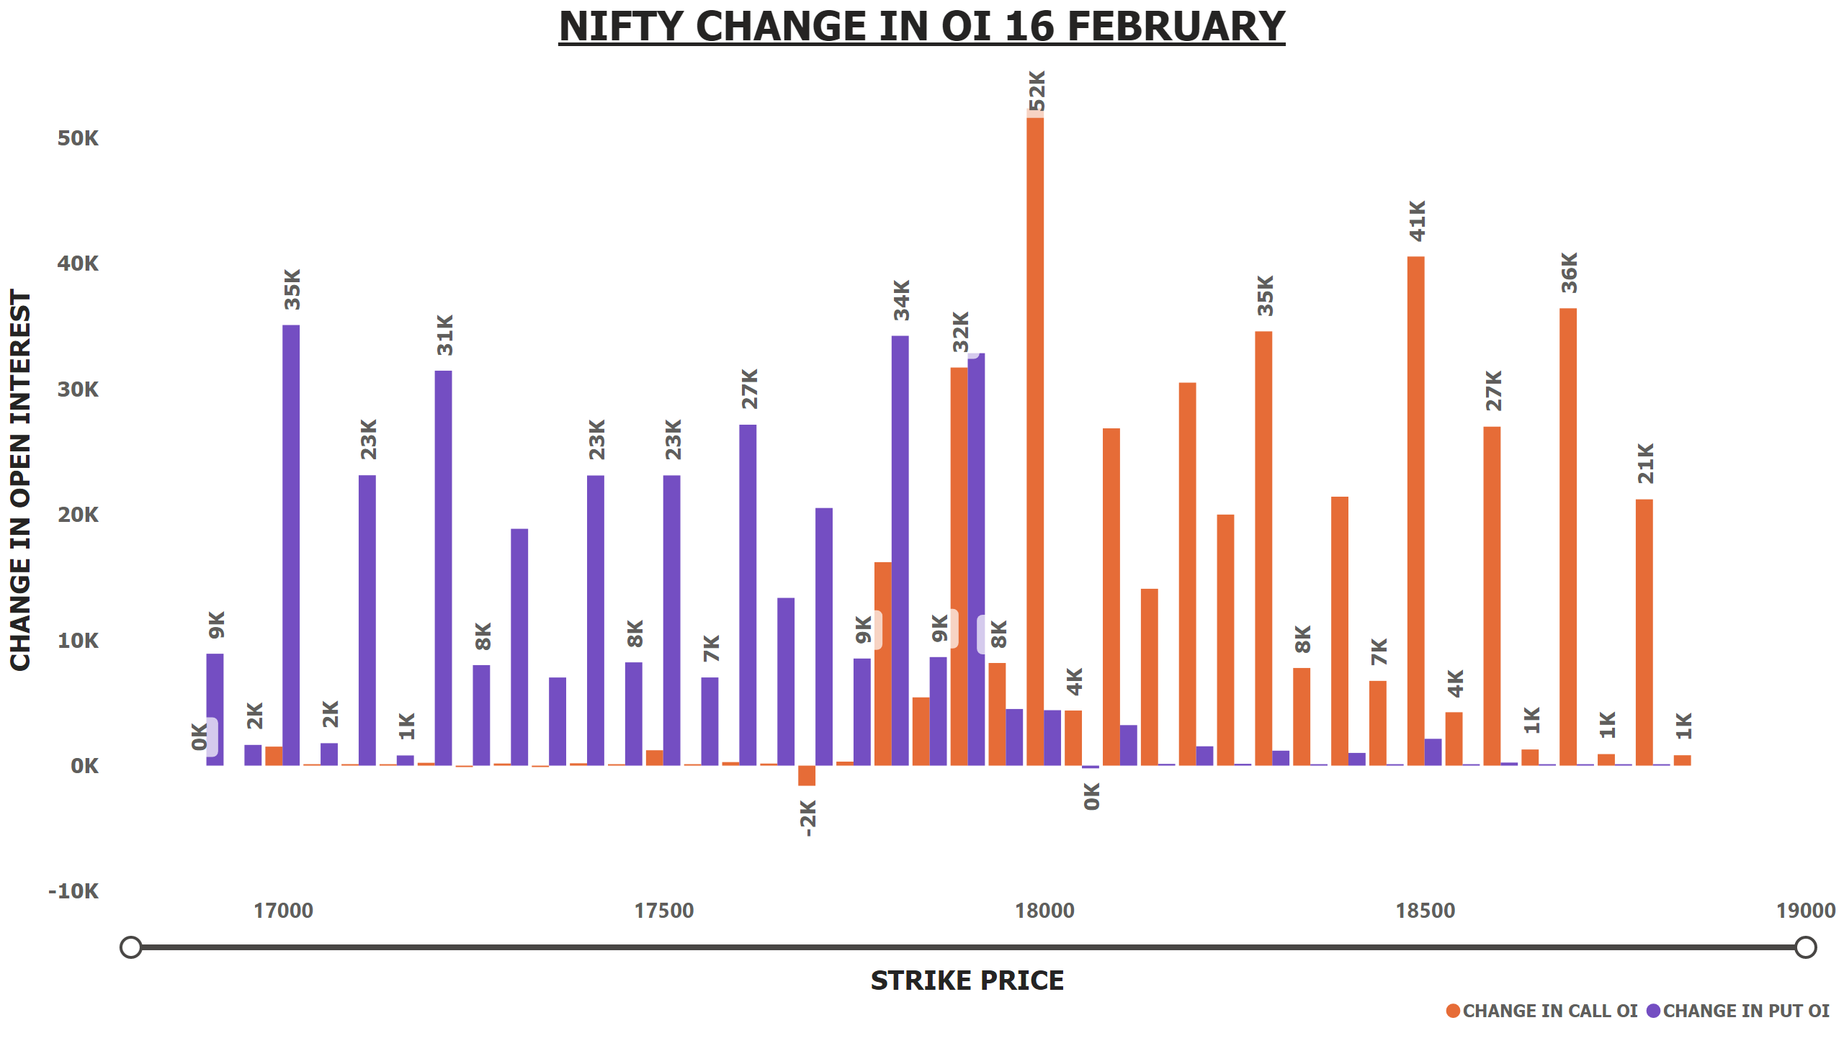
NIFTY OI CHANGE 16 FEB
Notes:
NIFTY CHANGE IN OI 16 FEBRUARY
No alt text provided

Slide 6
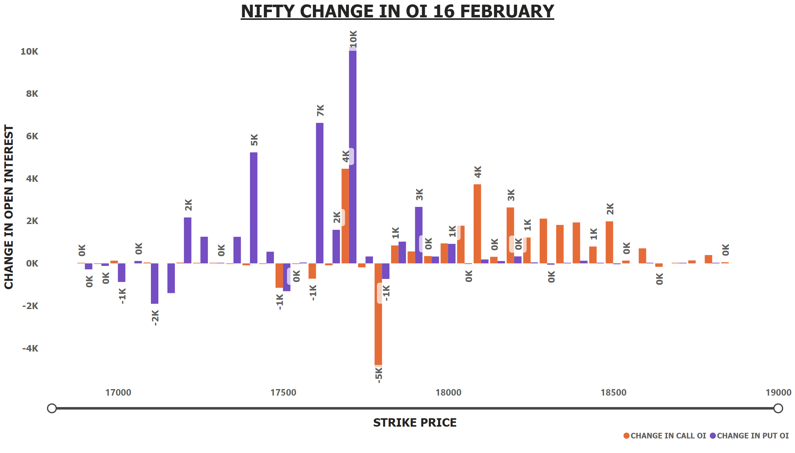
NIFTY OI CHANGE 23 FEB
Notes:
NIFTY CHANGE IN OI 16 FEBRUARY
No alt text provided

Slide 7
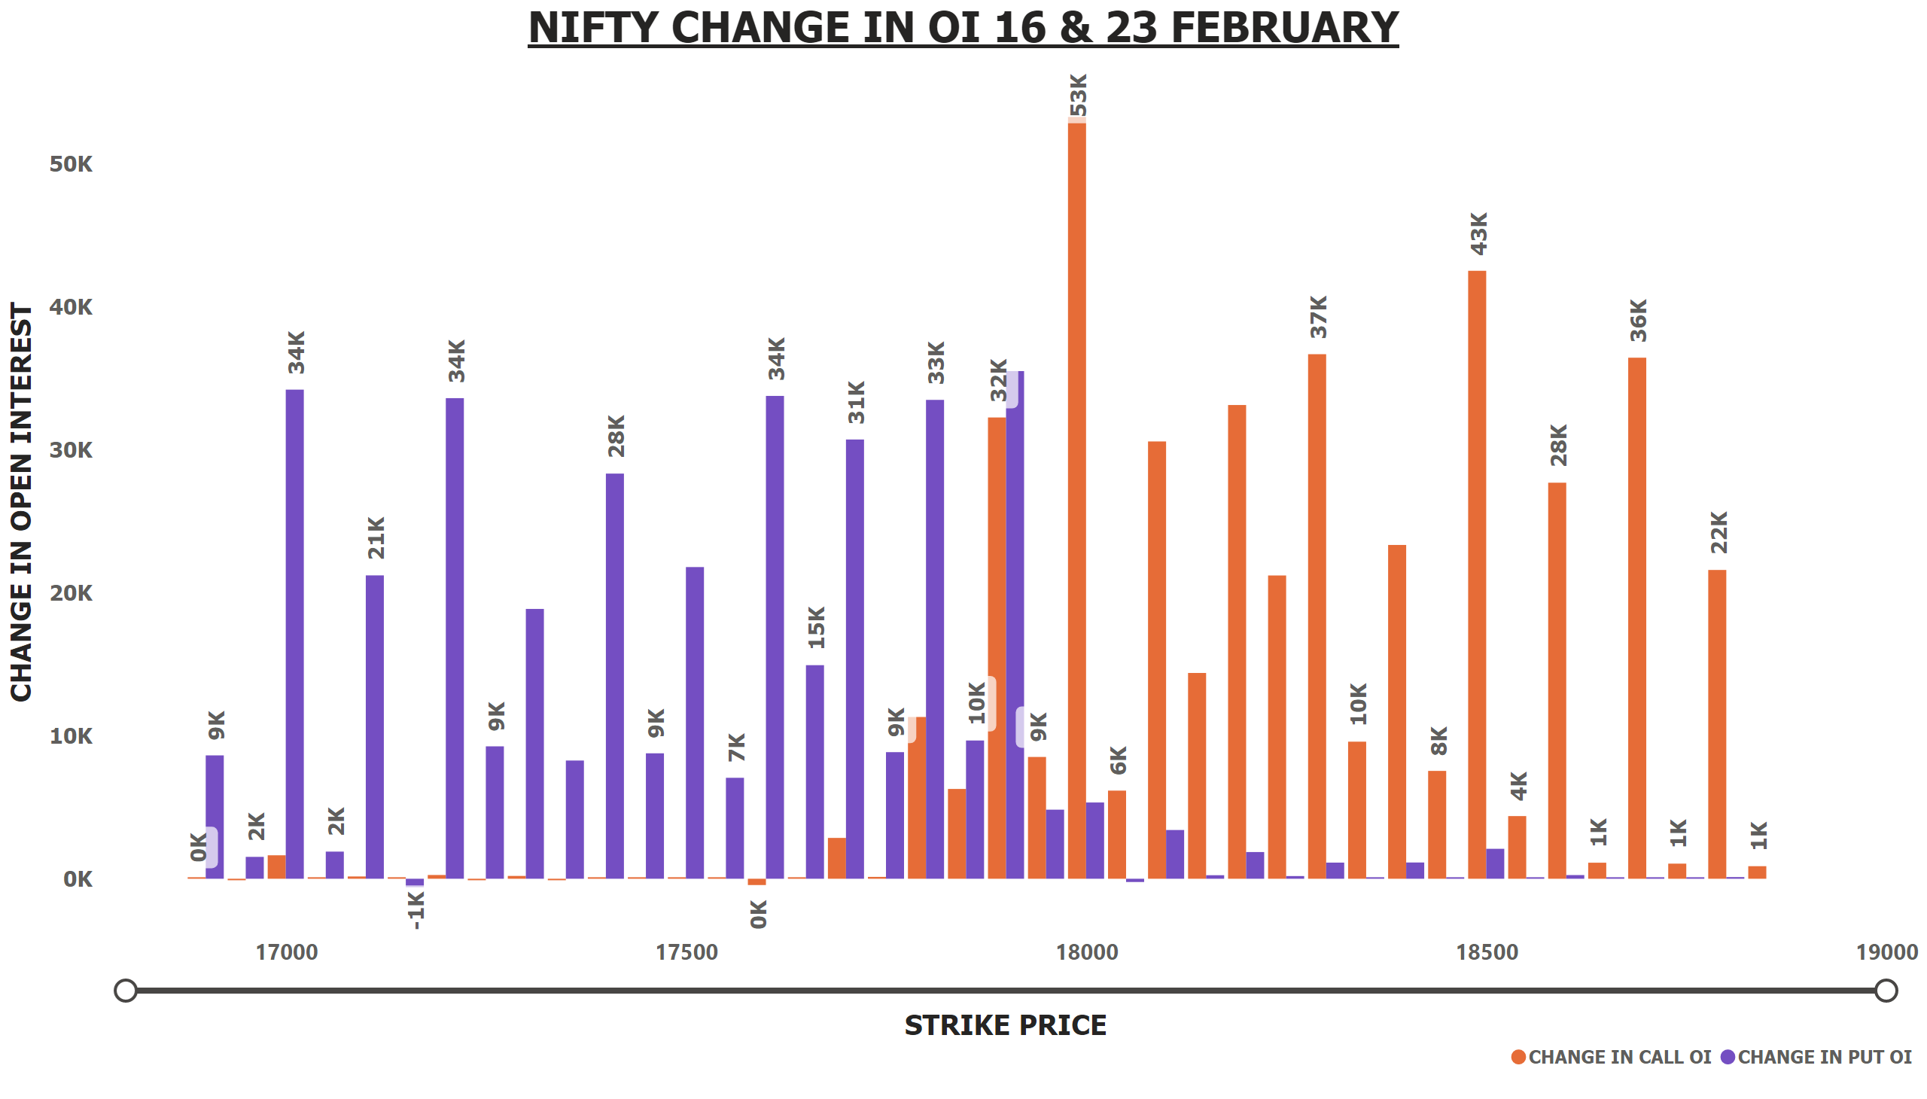
NIFTY OI CHANGE 16+23 FEB
Notes:
NIFTY CHANGE IN OI 16 & 23 FEBRUARY
No alt text provided

Slide 8
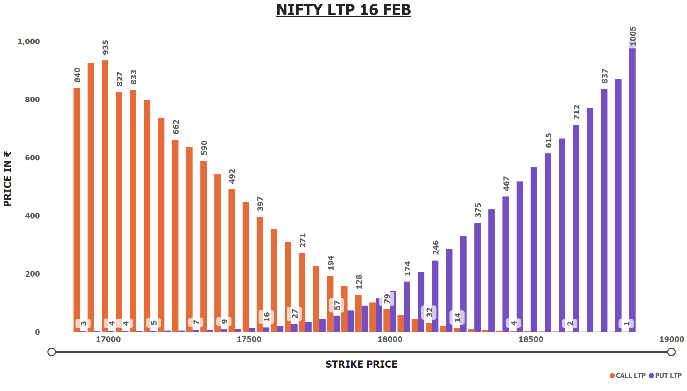
NIFTY LTP 16 FEB
Notes:
NIFTY LTP 16 FEB
No alt text provided

Slide 9

NIFTY LTP 23 FEB
Notes:
NIFTY LTP 23 FEB
No alt text provided

Slide 10
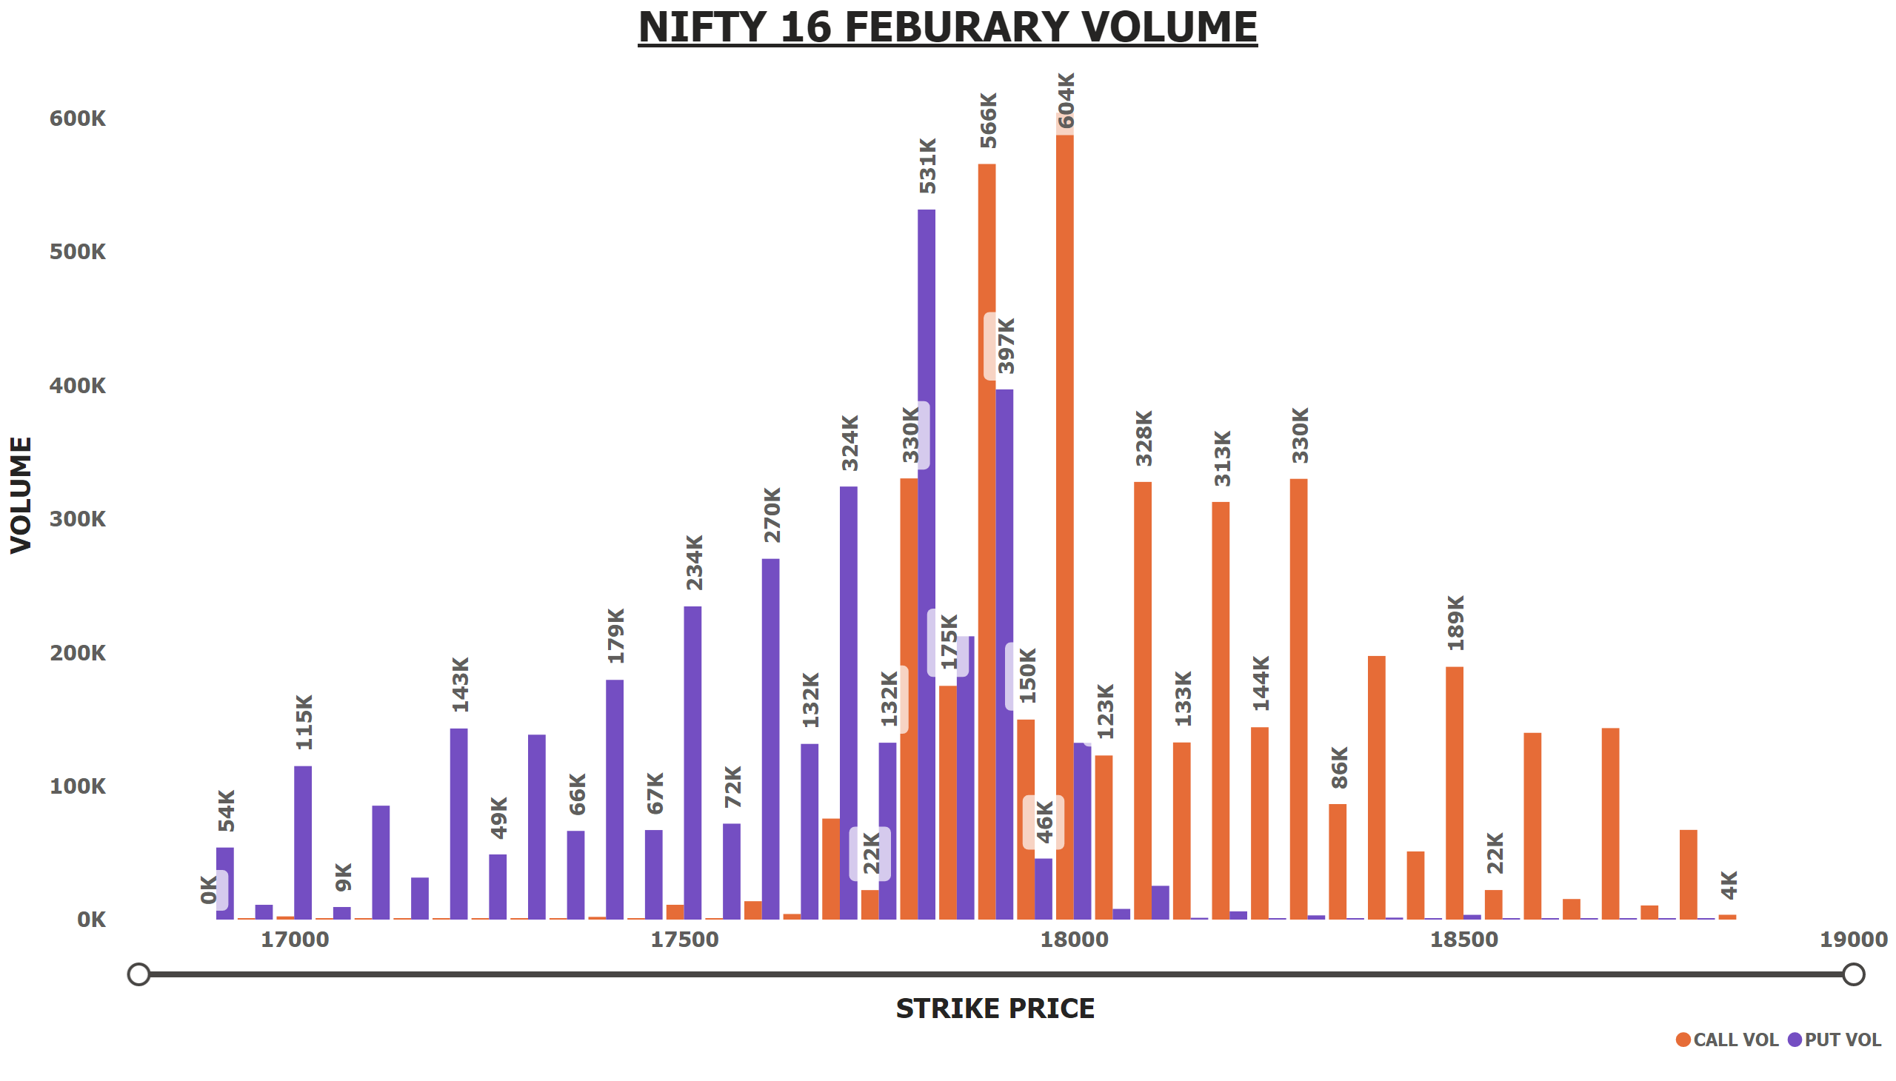
NIFTY 16 FEB VOLUME
Notes:
NIFTY 16 FEBURARY VOLUME
No alt text provided

Slide 11
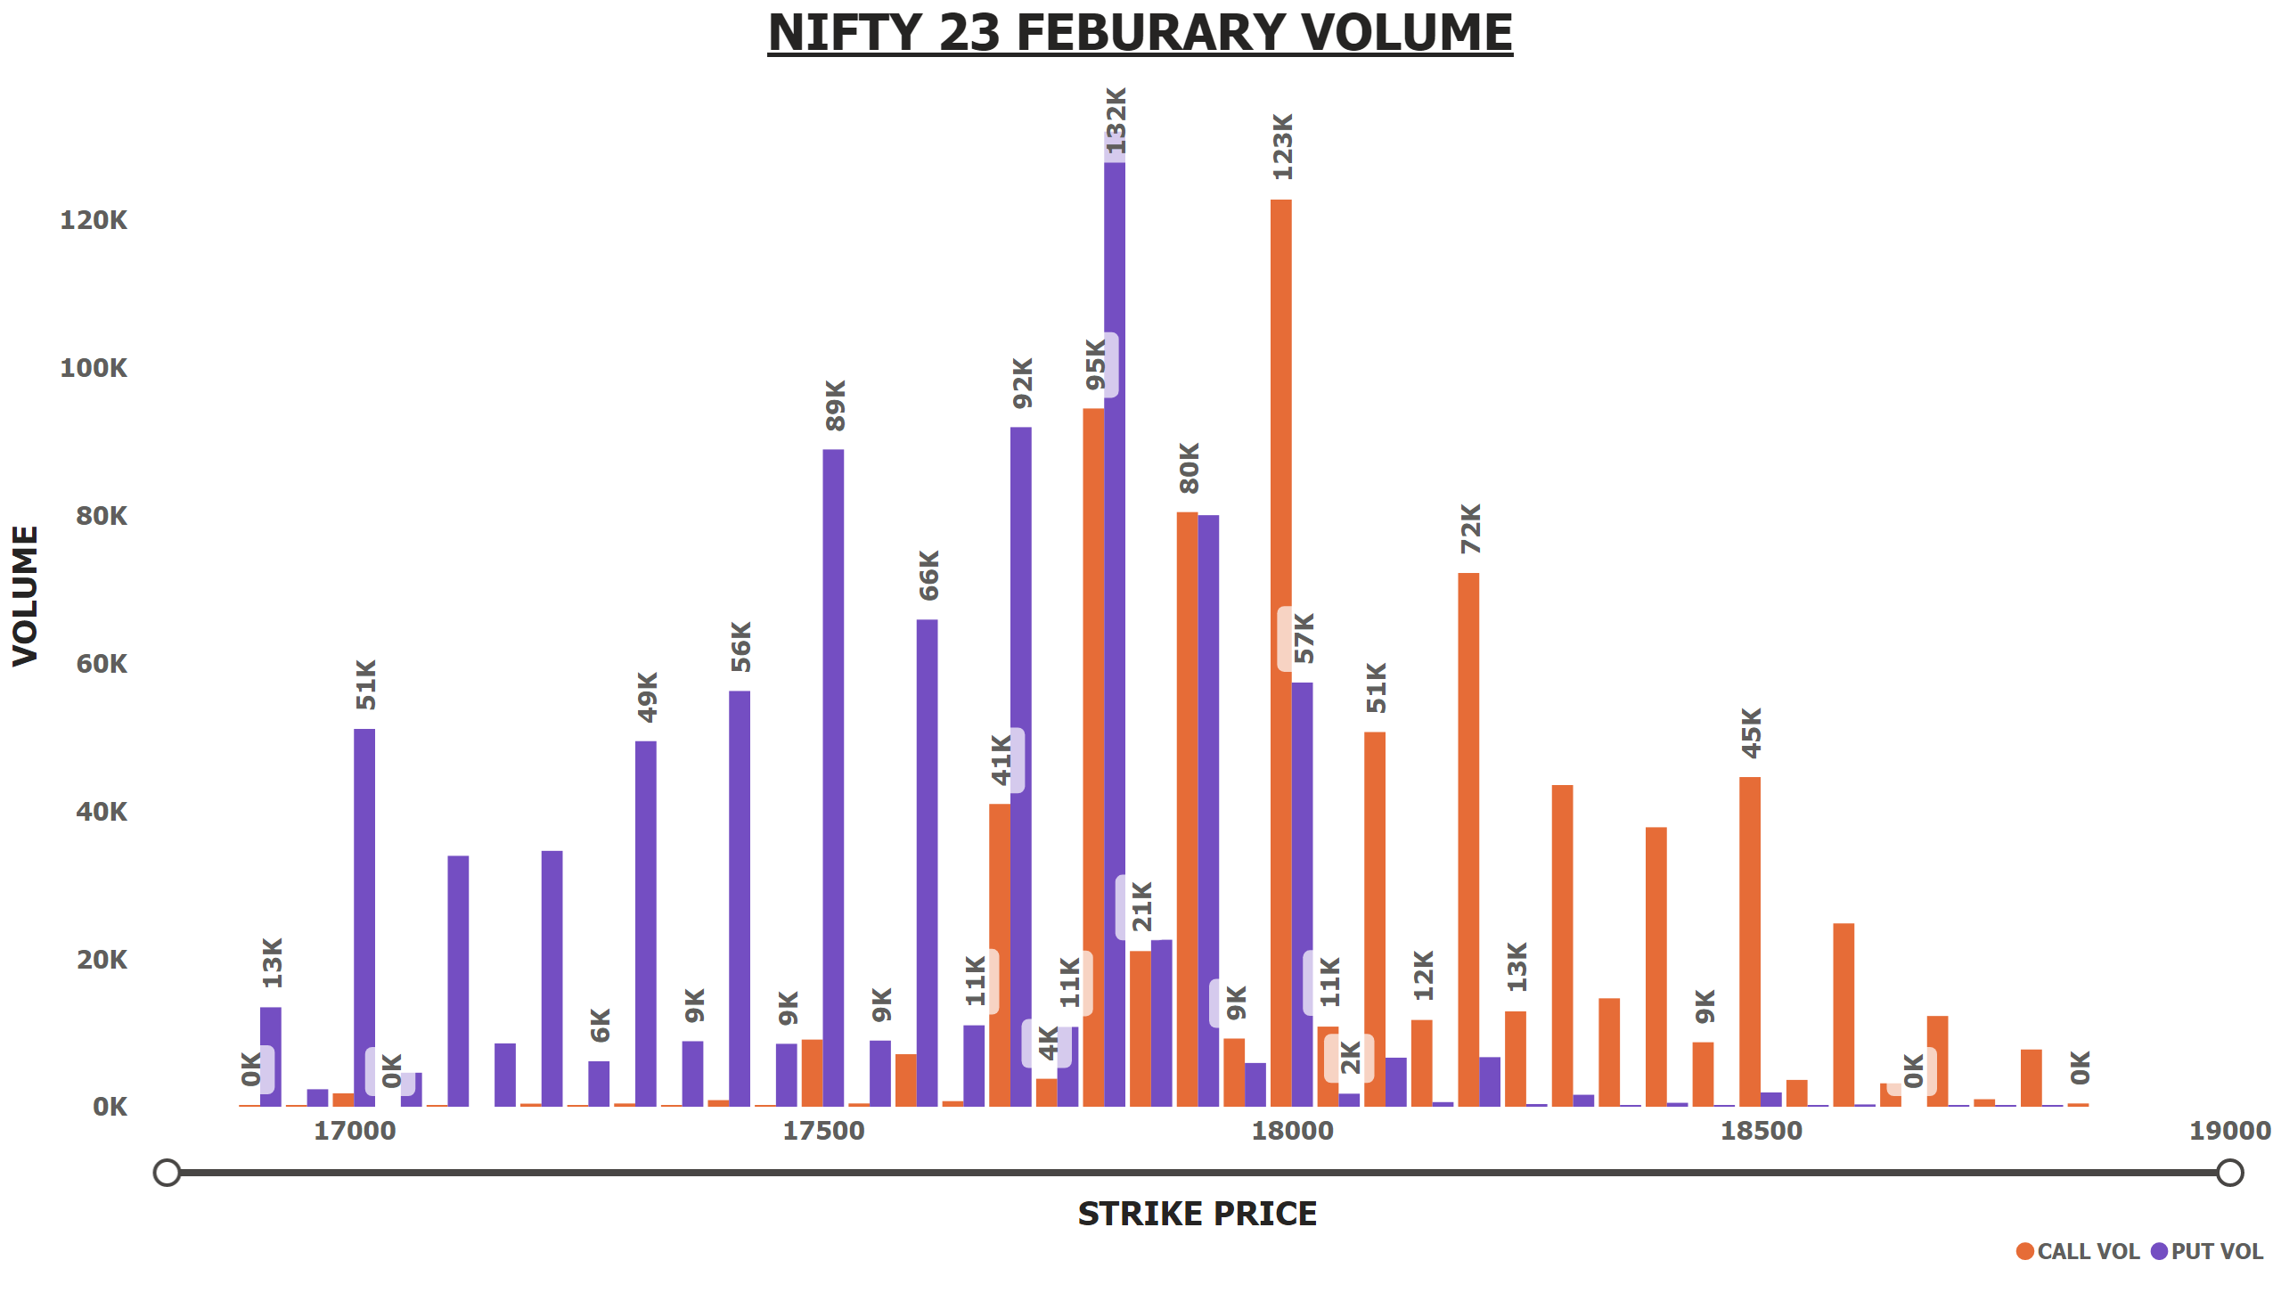
NIFTY 23 FEB VOLUME
Notes:
NIFTY 23 FEBURARY VOLUME
No alt text provided

Slide 12
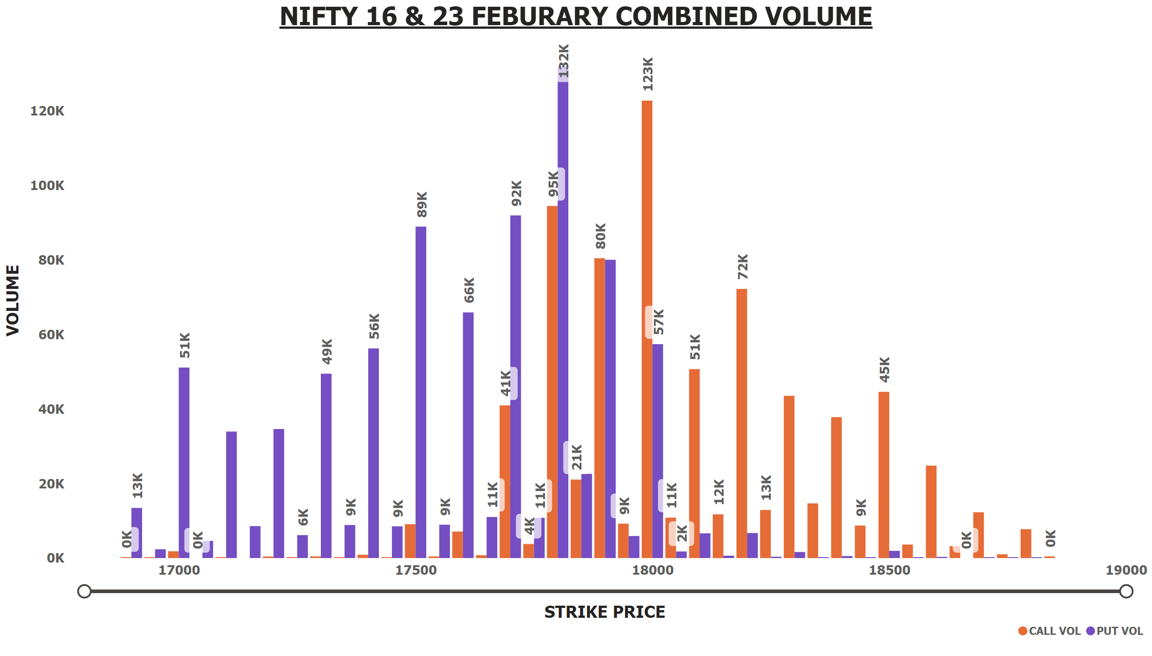
NIFTY 16+23 FEB VOLUME
Notes:
NIFTY 16 & 23 FEBURARY COMBINED VOLUME
No alt text provided

Slide 13
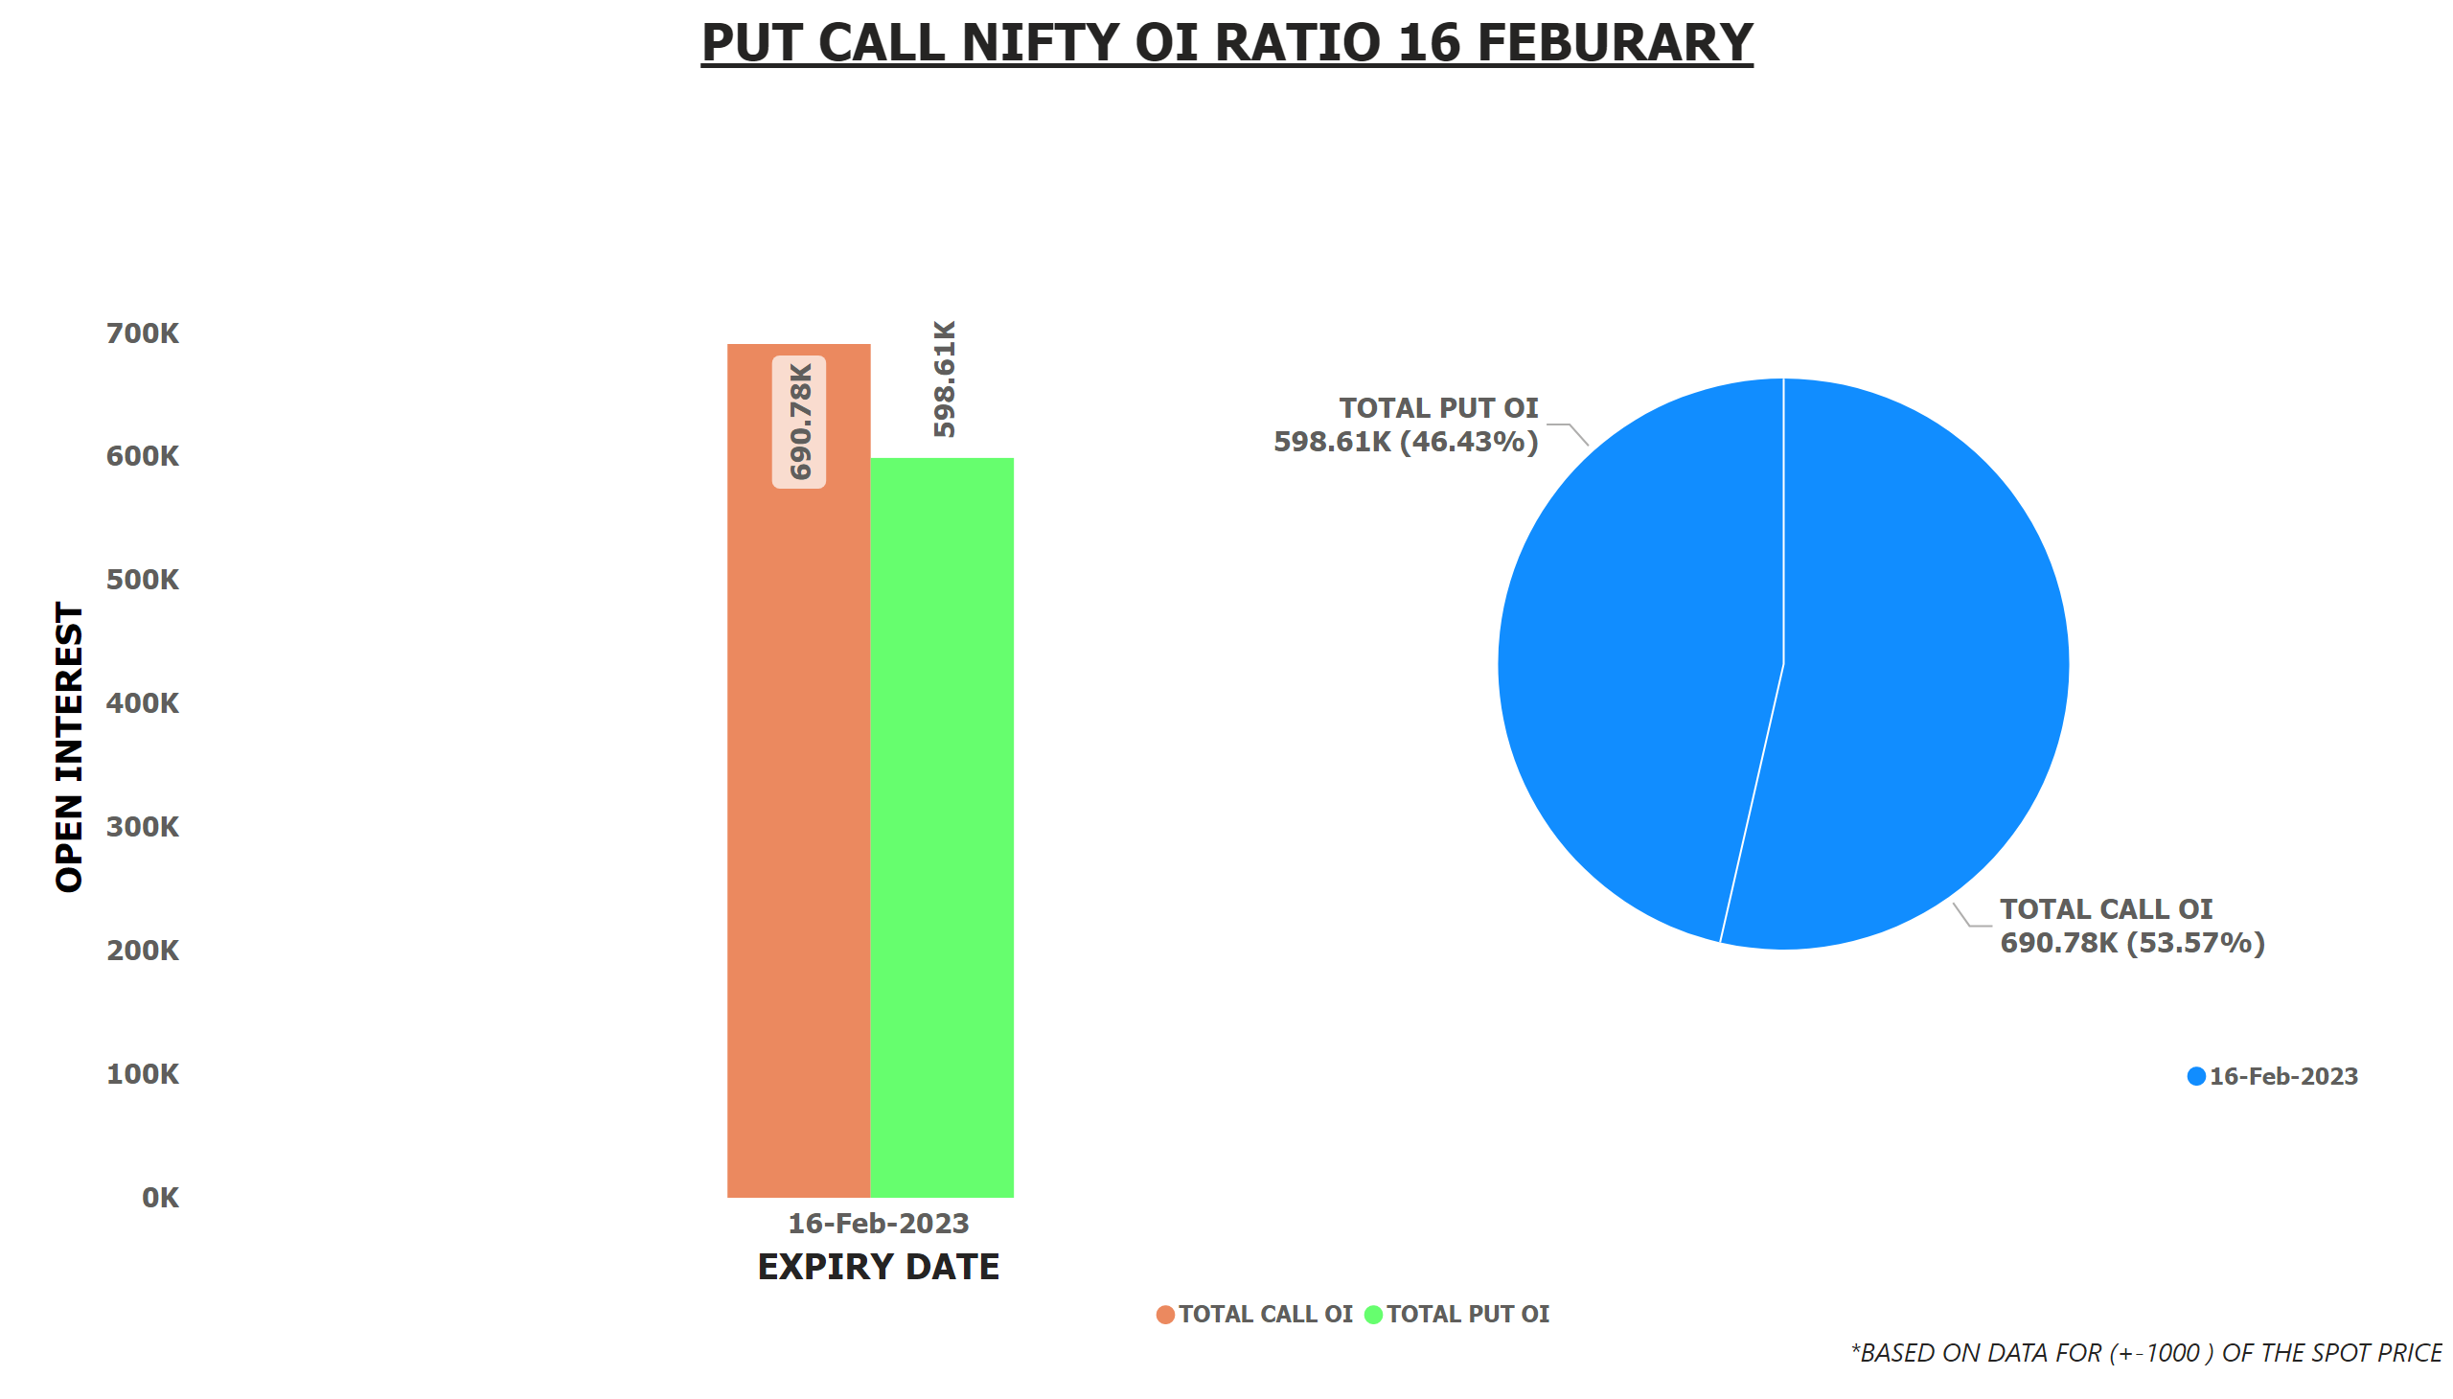
PCR OI NIFT 16 FEB
Notes:
textbox
No alt text provided
pieChart
No alt text provided
textbox
No alt text provided
lineClusteredColumnComboChart
No alt text provided

Slide 14
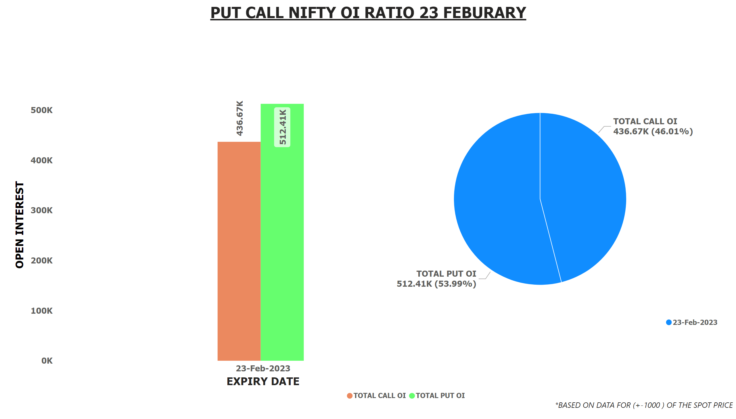
PCR OI NIFT 23 FEB
Notes:
textbox
No alt text provided
pieChart
No alt text provided
lineClusteredColumnComboChart
No alt text provided
textbox
No alt text provided

Slide 15
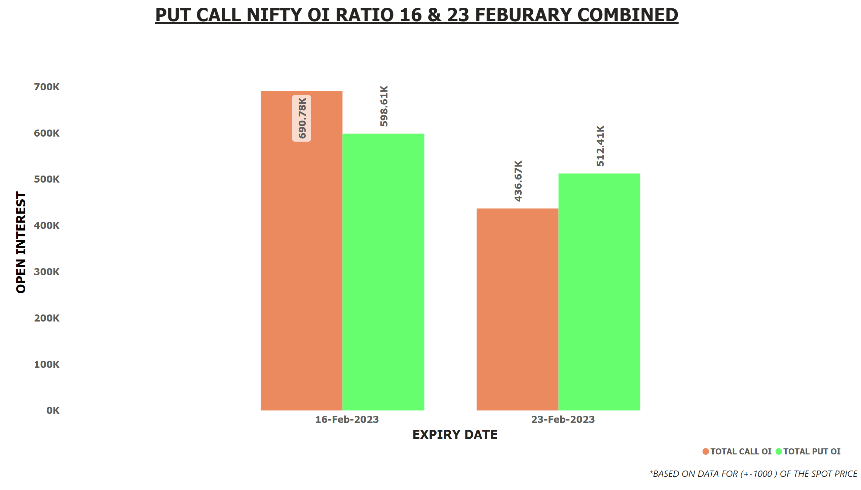
PCR OI NIFT 16+23 FEB
Notes:
textbox
No alt text provided
lineClusteredColumnComboChart
No alt text provided
textbox
No alt text provided

Slide 16
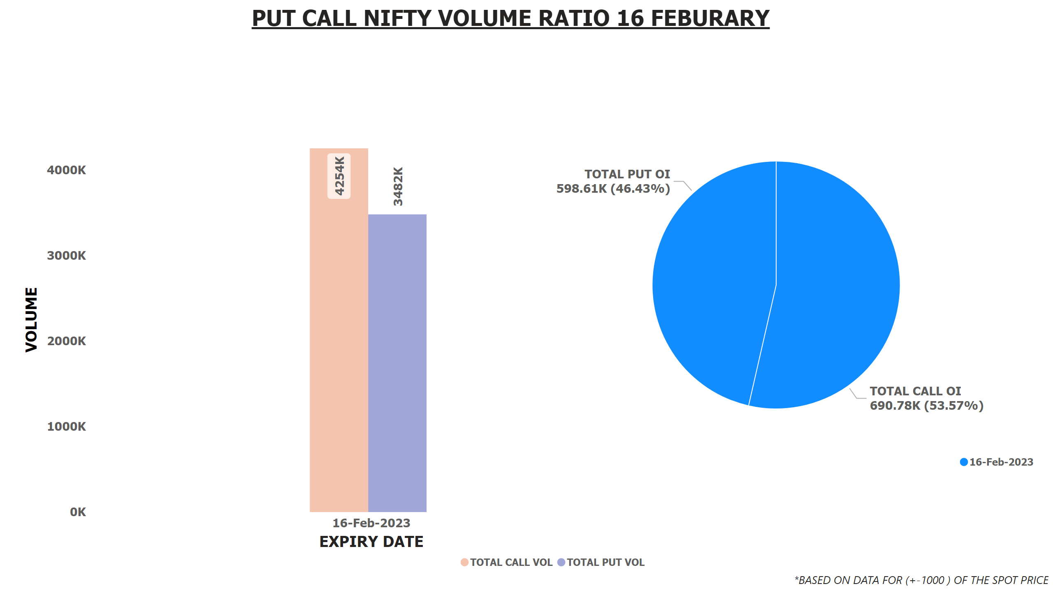
PCR VOL NIFT 16 FEB
Notes:
textbox
No alt text provided
pieChart
No alt text provided
lineClusteredColumnComboChart
No alt text provided
textbox
No alt text provided

Slide 17
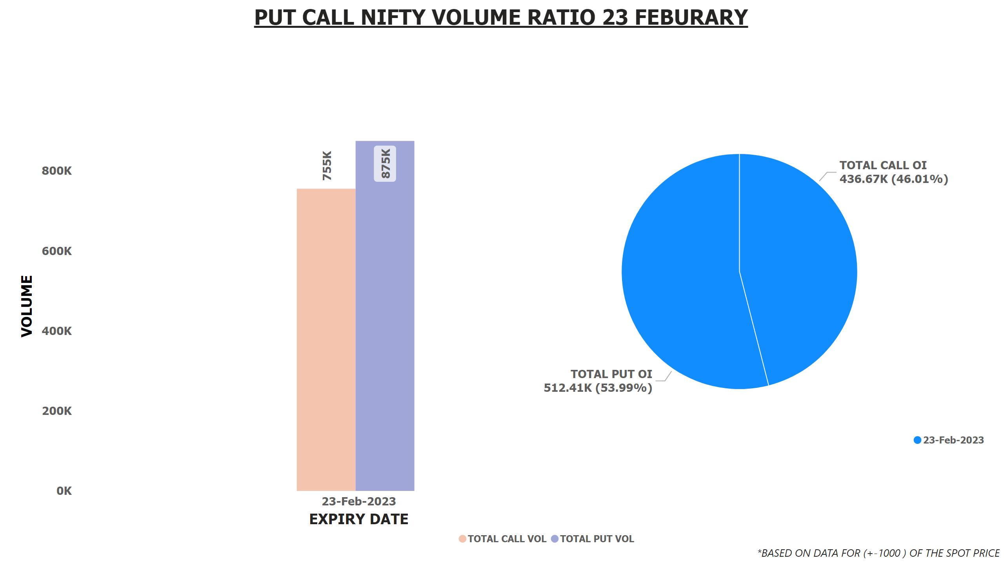
PCR VOL NIFT 23 FEB
Notes:
textbox
No alt text provided
pieChart
No alt text provided
lineClusteredColumnComboChart
No alt text provided
textbox
No alt text provided

Slide 18
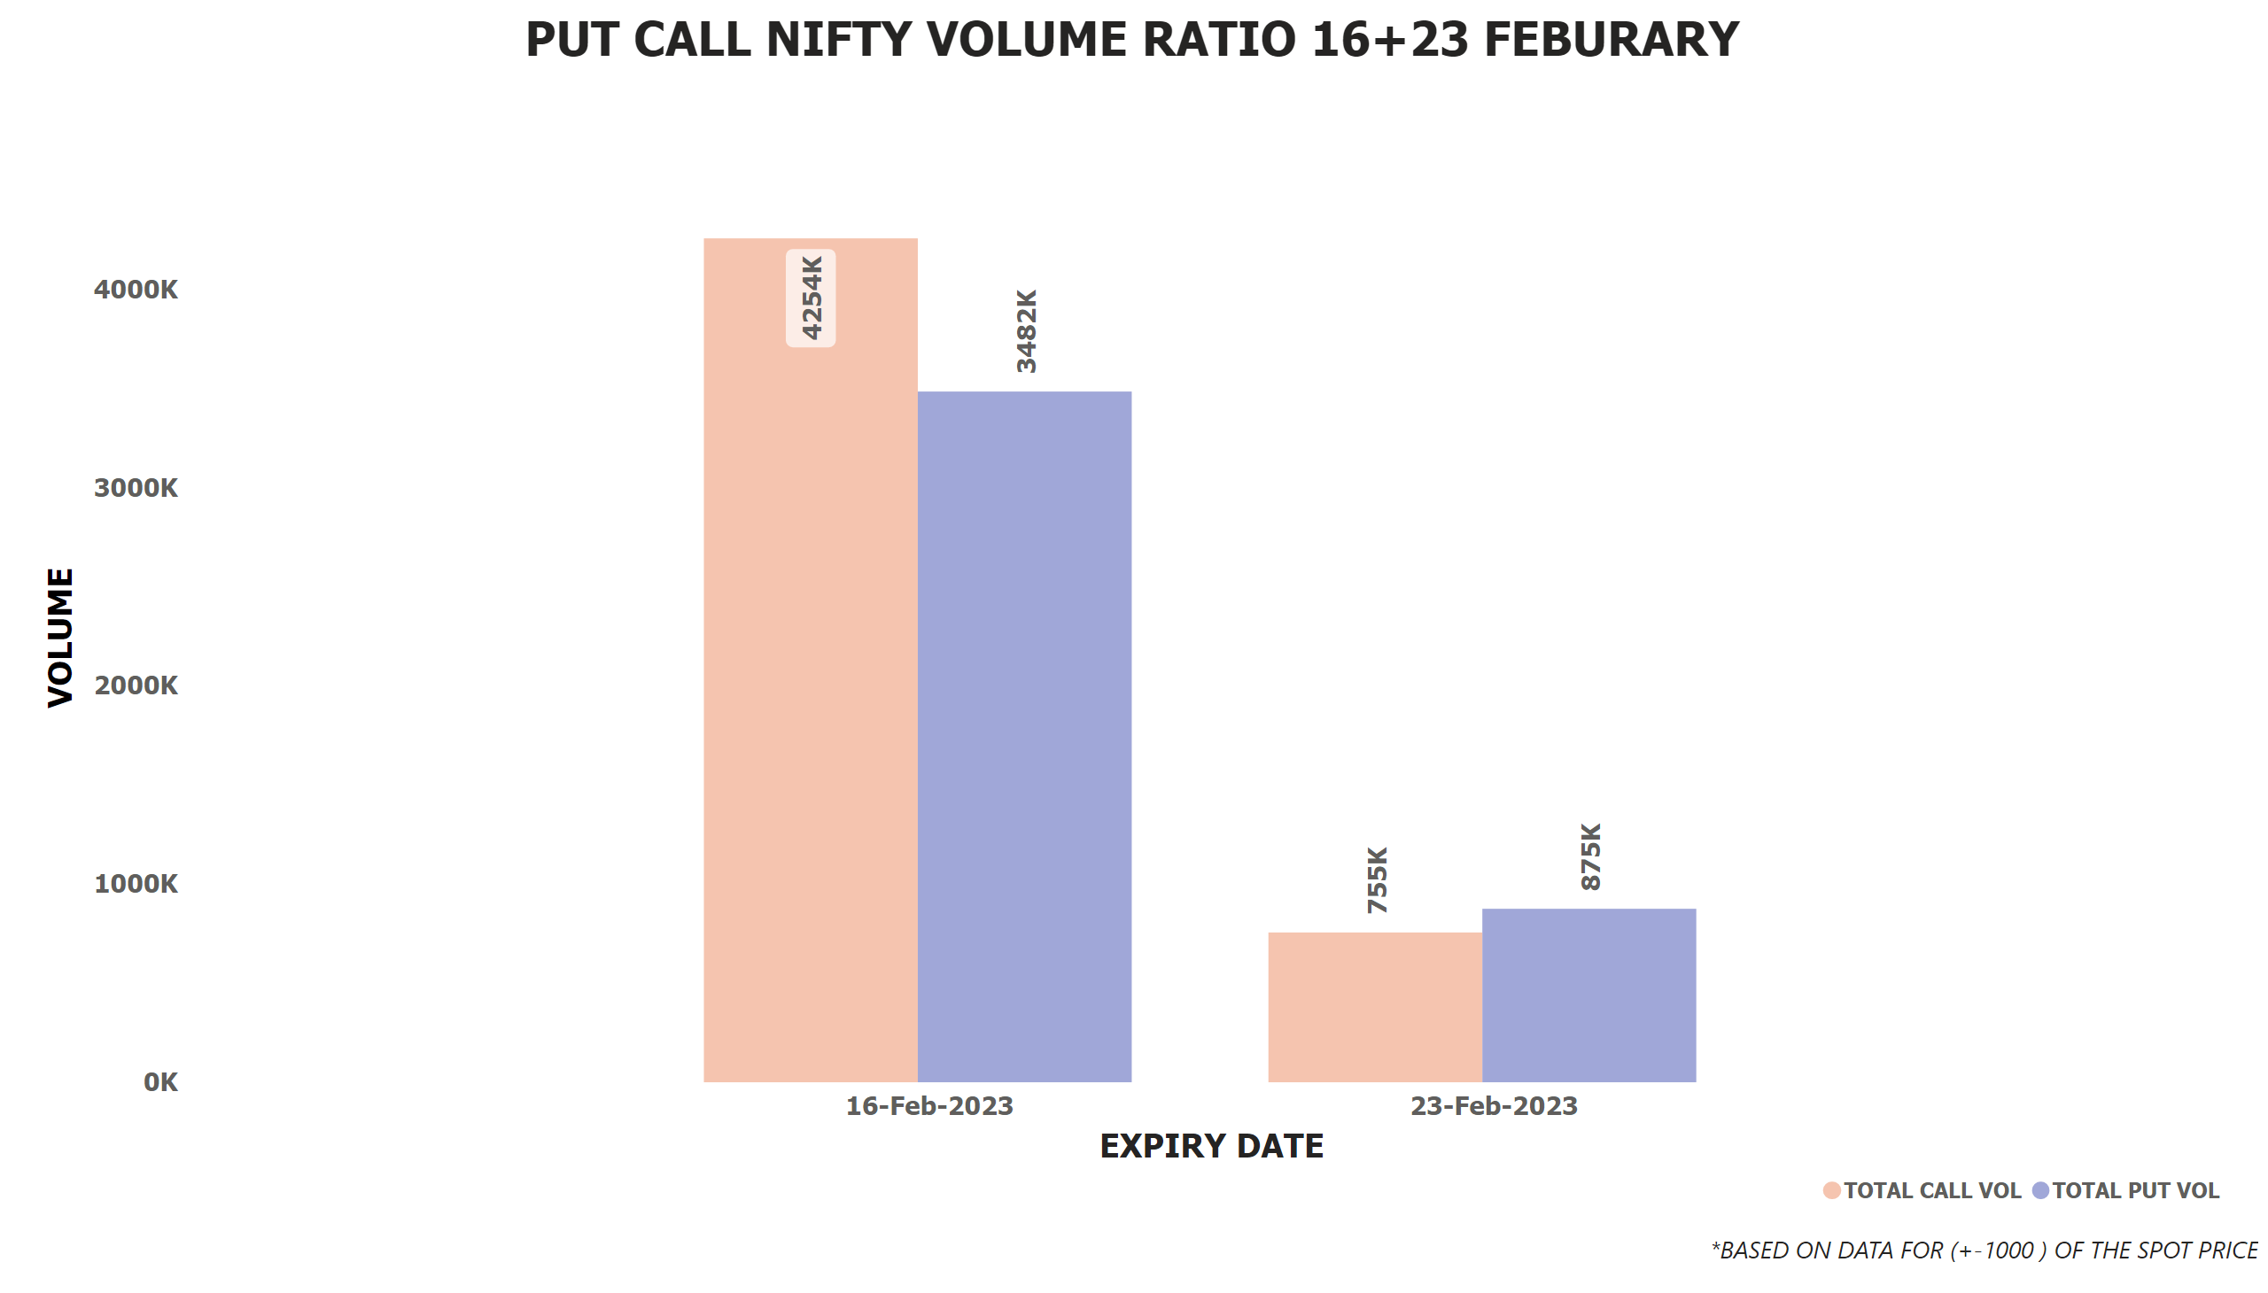
PCR VOL NIFT 16+23 FEB
Notes:
textbox
No alt text provided
lineClusteredColumnComboChart
No alt text provided
textbox
No alt text provided

