Slide 1

Make, Makefile
Bijan Mousavi

Slide 2
Introduction to Makefile - Motivation
Makefile Philosophy and Core Ideas
Python Project Structure Overview
Setting Up pyproject.toml for Dependencies
Virtual Environments in Python
Makefile Basics - Structure and Anatomy
Special Directives in Makefile
Variables and Automatic Variables in Makefile
Creating the venv Target
Implementing the Clean Target
Adding Install and Test Targets
Lint and Build Targets
Run and All Targets for Orchestration
Hands-On Lab and Everyday Use
Best Practices, Troubleshooting, and Next Steps

Slide 3
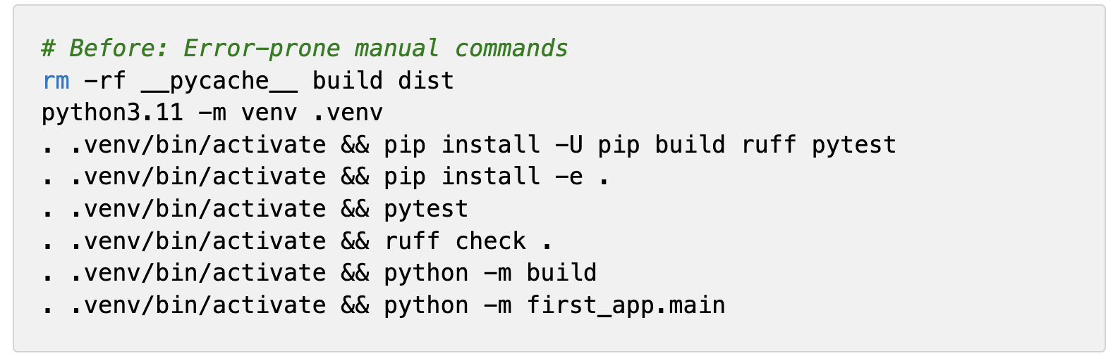
Introduction to Makefile - Motivation
Daily development often involves repetitive shell commands like cleaning, installing, and testing.
A single typo or missed step can lead to hours of debugging and frustration.
Makefiles provide a single file to automate these tasks reliably.
They turn chaotic scripts into structured, reproducible workflows.
The goal is to create an efficient pipeline for Python projects.

Slide 4
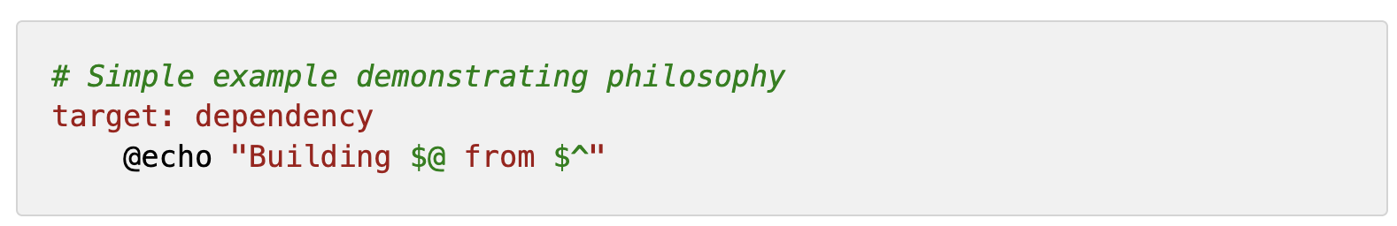
Makefile Philosophy and Core Ideas
Makefiles follow a declarative approach: define what needs to be done, not how.
They manage dependencies automatically, ensuring correct execution order.
Incremental builds only re-execute changed parts, saving time.
Idempotence makes repeated runs safe without side effects.
Philosophy rooted in Unix tools for build automation and reproducibility.

Slide 5
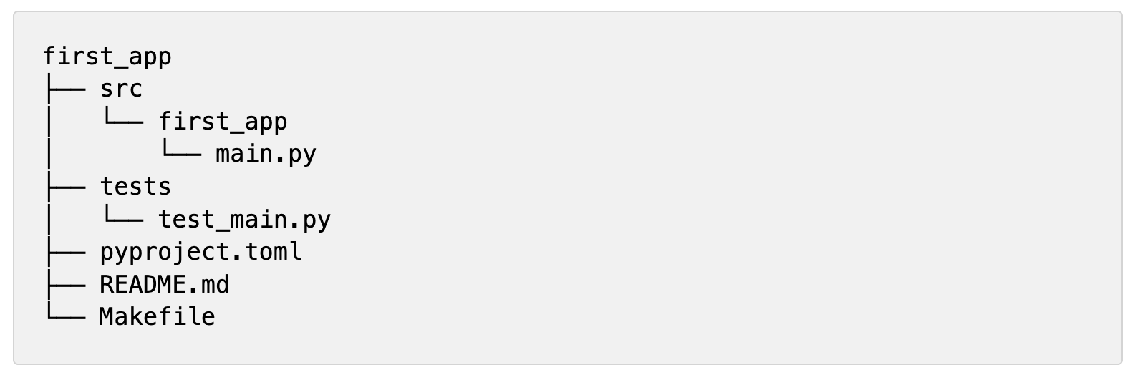
Python Project Structure Overview
Use src-layout to separate code from artifacts and tests.
Root level for configs like pyproject.toml and README.md.
src directory houses the package code, e.g., main.py.
Tests directory for unit tests [and beyond] to ensure code quality.
Makefile at root to orchestrate the workflow.

Slide 6
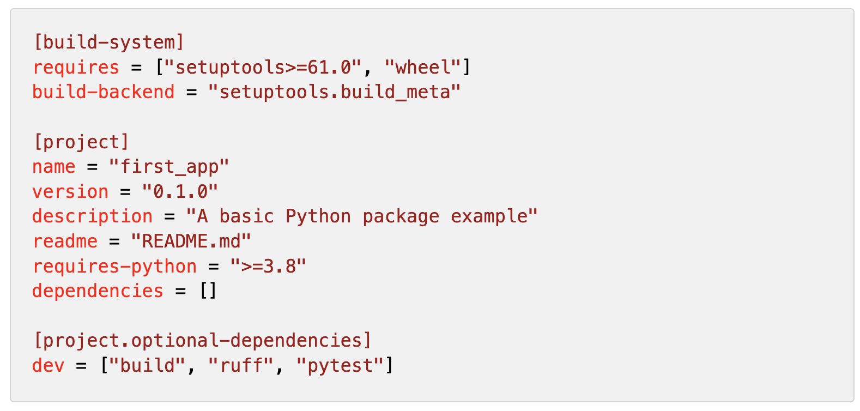
Setting Up pyproject.toml for Dependencies
Replaces older setup.py for modern packaging.
Defines build system like setuptools.
Specifies project metadata: name, version, description.
Handles dependencies: runtime and optional dev tools.
Enables PEP 517/518 compliant builds.

Slide 7
Virtual Environments in Python
Isolates project dependencies from system Python.
Prevents version conflicts across projects.
Created using python -m venv .venv.
Activated to run commands in isolation.
Essential for reproducible environments.

Slide 8
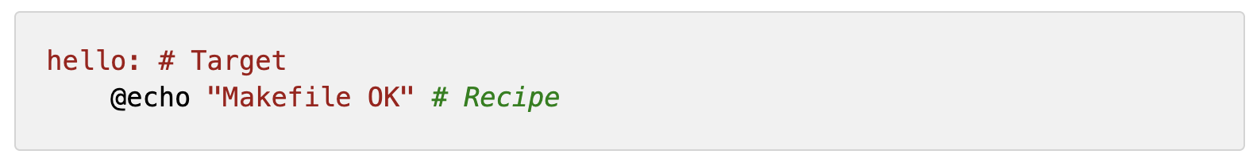
Makefile Basics - Structure and Anatomy
Consists of rules: target, prerequisites, recipes.
Recipes must be tab-indented.
First target is default unless specified.
Make executes based on file timestamps.
Links to philosophy through dependency graphs.

Slide 9
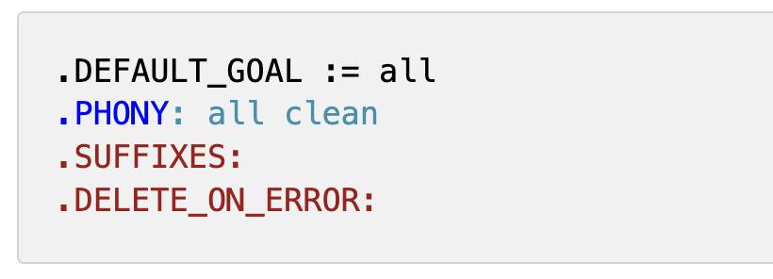
Special Directives in Makefile
.DEFAULT_GOAL := all — sets the target Make runs by default when you type make with no arguments.
.PHONY: all clean — marks targets as “not files,” so they always run and aren’t confused with real files of the same name.
.SUFFIXES: — erases Make’s old automatic file-conversion rules, so only the rules you write yourself are used.
.DELETE_ON_ERROR: — if a recipe fails, delete the (possibly corrupt) target file so it won’t pollute future builds.
These ensure safe and predictable behavior.

Slide 10
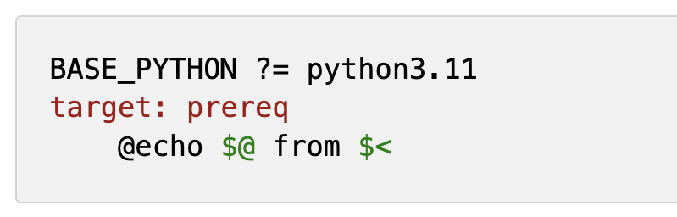
Variables and Automatic Variables in Makefile
?= for conditional assignment if unset.
:= for immediate evaluation.
= for recursive evaluation.
$@ represents the target name.
$< is the first prerequisite.

Slide 11
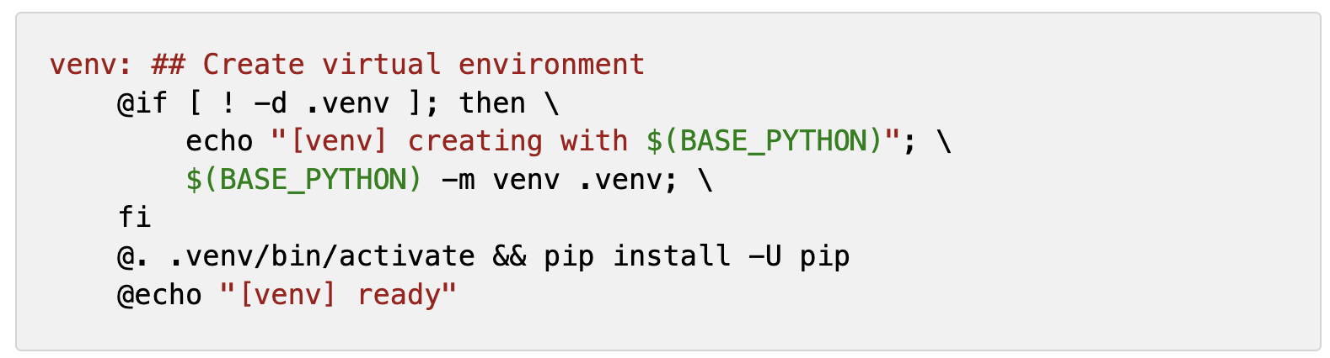
Creating the venv Target
Checks if .venv exists to avoid recreation.
Uses BASE_PYTHON to create the env.
Upgrades pip for reliability.
Activates and prepares for installs.
Prerequisite for other targets.

Slide 12
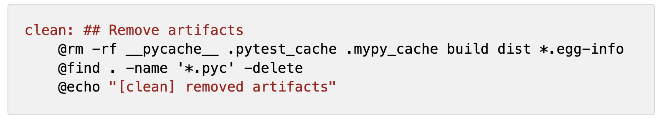
Implementing the Clean Target
Removes caches like pycache.
Deletes build and dist directories.
Finds and removes .pyc files.
Avoids deleting source or venv.
Ensures fresh starts.

Slide 13
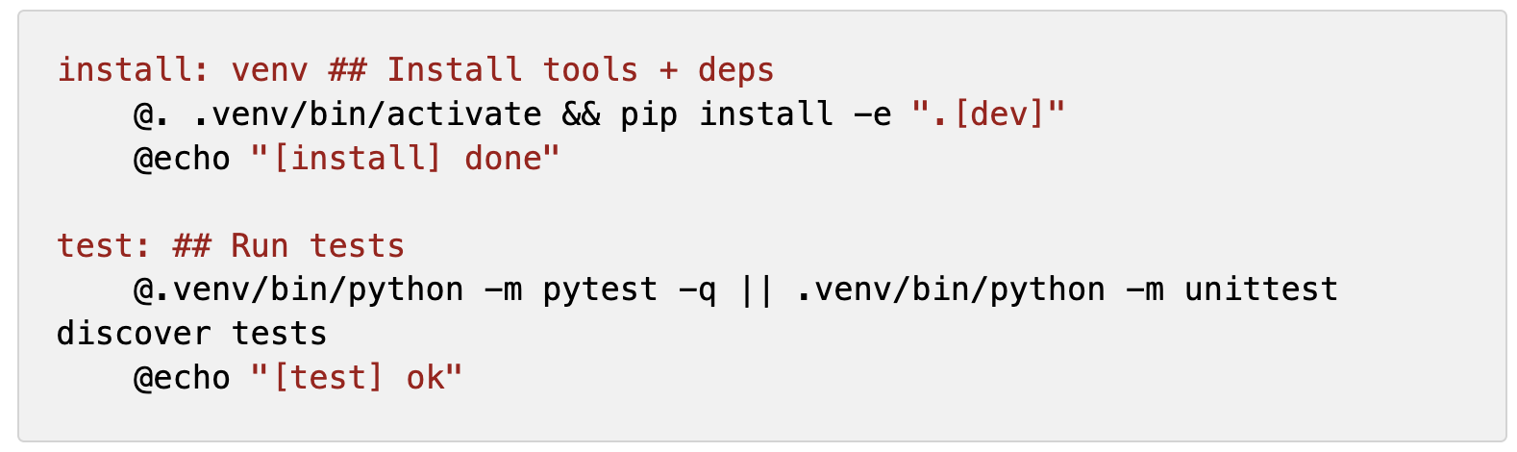
Adding Install and Test Targets
Install depends on venv.
Uses editable install with dev extras.
Test prefers pytest with fallback.
Discovers tests in tests/.
Quiet mode for clean output.

Slide 14
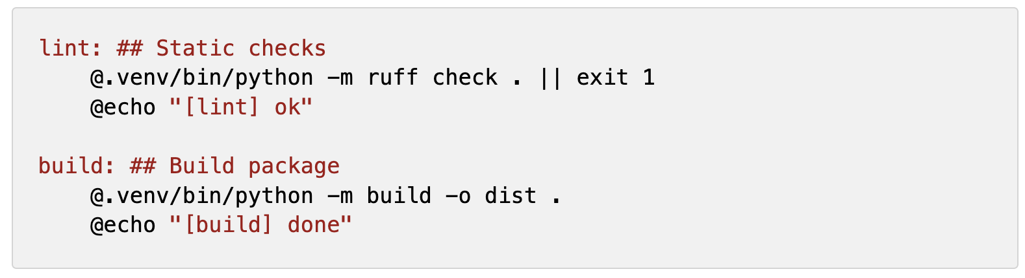
Lint and Build Targets
Lint uses ruff and fails on errors.
Build creates wheel/sdist via PEP 517.
Outputs to dist directory.
Uses pyproject.toml for config.
Fail-fast for quality.

Slide 15
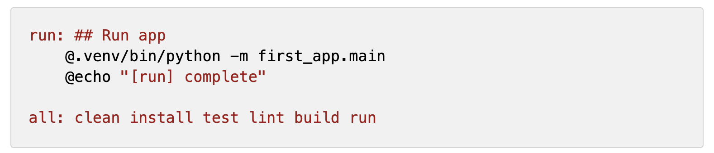
Run and All Targets for Orchestration
Run executes as module.
All chains all targets.
Safe re-runs due to incrementality.
Default goal for make command.
Provides full pipeline.

Slide 16
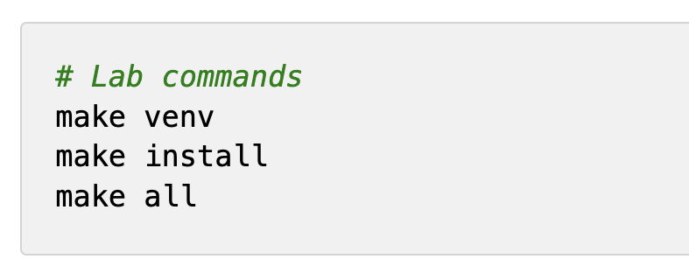
Hands-On Lab and Everyday Use
Set up structure and files.
Copy full Makefile.
Run make for pipeline.
Use make test lint daily.
Override with make BASE_PYTHON=...

Slide 17
Best Practices, Troubleshooting, and Next Steps
Use .PHONY for actions.
Variables for flexibility.
@ for silent execution.
Integrate with CI/CD.
Add help target.

