Slide 1
BCPR301 Advanced Programming Assessment 3
Jignesh Patel

Slide 2
Self-Marking sheet
Student Name : Jignesh Patel
Marking Guide |  | Mark
The class diagram before your modification (2 * N marks) | 2 * 2 | 4
The locations of code involved (2 * N marks) | 2 * 2 | 4
The name of the design pattern applied (2 * N marks) | 2 * 2 | 4
The reasons why applying this design pattern is suitable (2 * N marks) | 2 * 2 | 4
The class diagram after your modification (2 * N marks) | 2 * 2 | 4
Applying the design pattern proposed (10 * N marks) | 10 * 2 | 20
Total |  | 40

Slide 3
Factory-Method

Slide 4
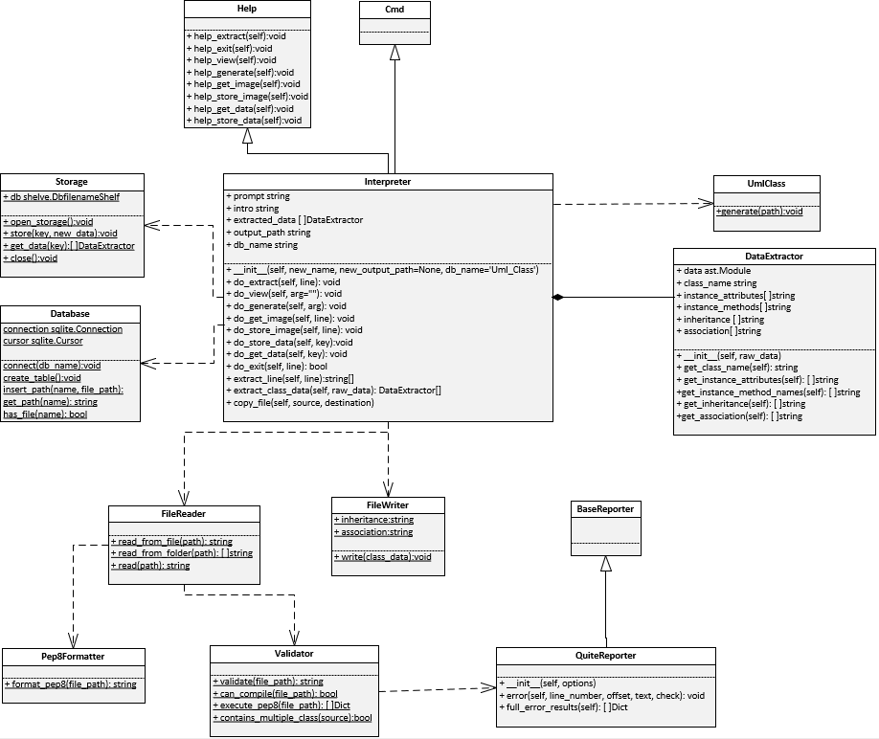
1. The class diagram before modification

Slide 5
2. The locations of code involved
Folder : PythonInterpreter
Module : main.py
Class : Not Available
Methods : Monolithic approach of creating Interpreter Instance
Lines : 176 - 202
3. The name of the design pattern applied
Factory-Method

Slide 6
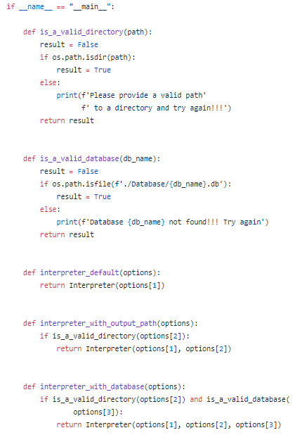
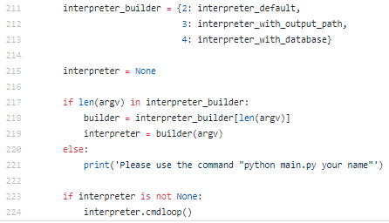
4. The reasons why applying this design pattern is suitable
Existing Problem: Currently there are three different way of instantiating the Interpreter class with different parameters supplied by the users. The code is provided below:
Client Code
This code is used for selecting how to instantiate the Interpreter class based on the arguments provided by the user.
Continued…

Slide 7
4. The reasons why applying this design pattern is suitable
The reasons why Factory method is suitable for the problem mentioned above is the Intent of the Factory method. The Intent of the factory method says:
Define an interface for creating an object, but let subclasses decide which class to instantiate. Factory Method lets a class defer instantiation to subclasses.
Factory method is very useful for the current problem as my current method of instantiating the Interpreter class is Monolithic.
With the help of factory method design pattern I can put my common methods like is_a_valid_directory and is_a_valid_file in an abstract class and create an abstract method called create_interpreter() which can be overwritten by the subclasses and put the three different instancation method in three different class.
By using the factory method design pattern, the factory method create_interpreter() can hide the implementation details of instantiating the Interpreter class from the other code. To support a new Instancation type, I will only need to create a new subclass and override the create_interpreter() factory method in it.

Slide 8
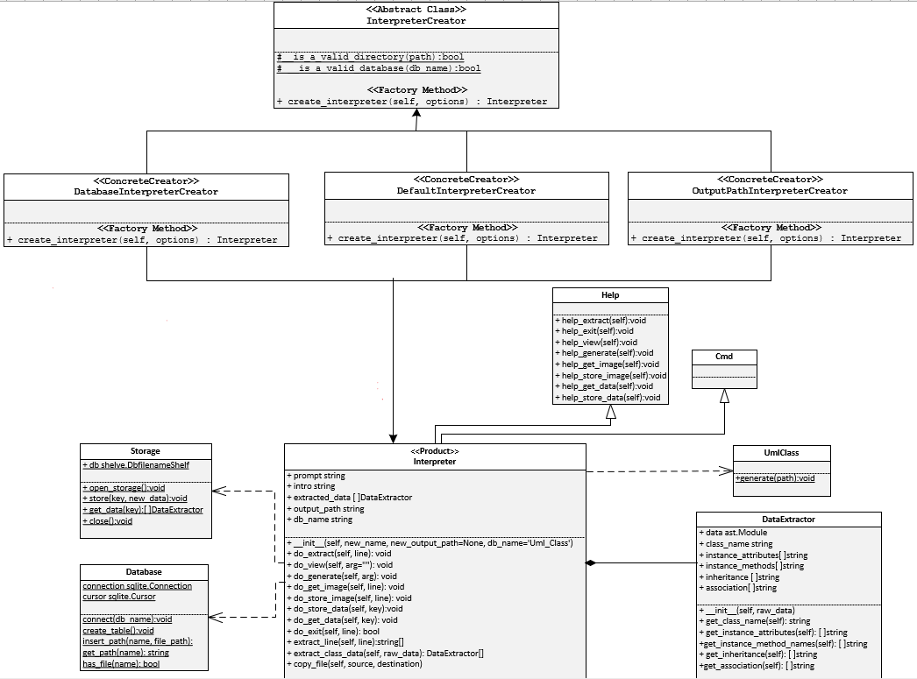
5. The class diagram After modification
Continued…

Slide 9
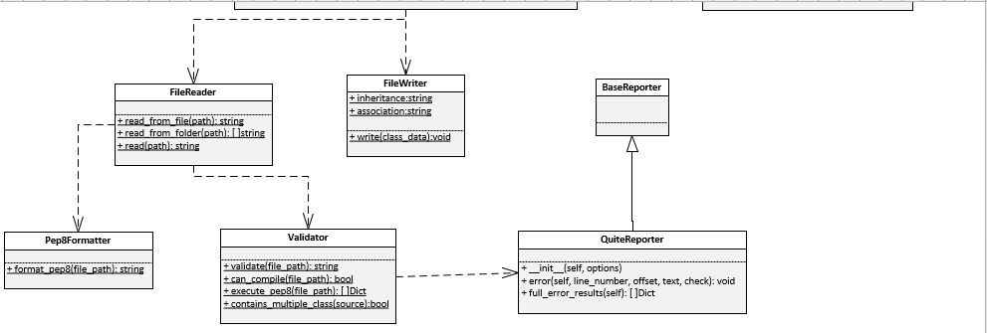

Slide 10
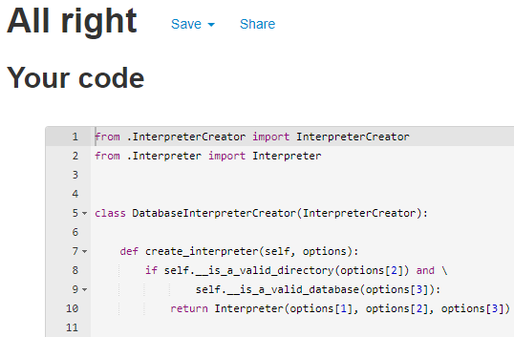
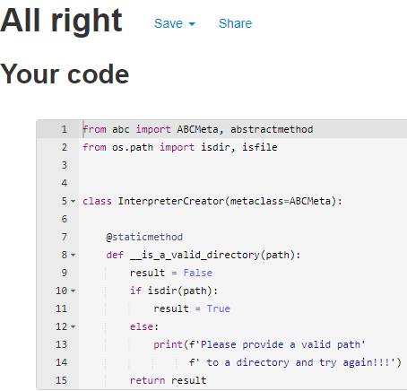
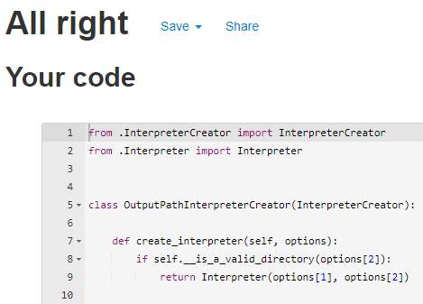
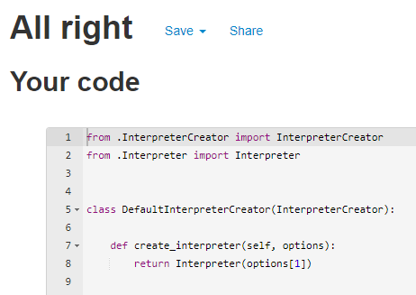
6. Applying the design pattern proposed and PEP 8 Validation

Slide 11
Template-Method

Slide 12
1. The class diagram before modification
Continued…

Slide 14
2. The locations of code involved
Folder : PythonInterpreter/object_store
Module : Storage.py
Class : Storage
Lines : 5 - 28
3. The name of the design pattern applied
Template-Method

Slide 15
4. The reasons why applying this design pattern is suitable
Existing Problem: Currently my program is using Shelve persistent storage for data sterilization. This means that my program is tightly coupled with the Shelve storage.
For my next iteration I want my program to support additional persistent storage for object sterilization called Pickle.
Both Shelve and Pickle should be interchangeable.
There two main task when using any of the persistent storage object are mentioned below:
Store the data with the associated key:
open storage
store the key and data
close the storage
Get the stored data based on the key:
open storage
get the data based on the key provided
close the storage

Slide 16
4. The reasons why applying this design pattern is suitable
The reasons why Template method is suitable for the problem mentioned above is the Intent of the Template method. The Intent of the Template method says:
Define the skeleton of an algorithm in an operation, deferring some steps to subclasses. Template Method lets subclasses redefine certain steps of an algorithm without changing the algorithm's structure.
“Define the skeleton of an algorithm in an operation”. Define the skeleton for set_data() and get_data() in parent class called storage.
“Template Method lets subclasses redefine certain steps of an algorithm without changing the algorithm's structure.” The subclasses PickleStorage and ShelveStorage will redefine the open the storage, store and retrieve the data based on persistent storage.
The Template Method will turn the monolithic algorithm of get_data and set_data into a series of individual steps, which can be easily extended by subclasses PickleStorage and ShelveStorage, while keeping the structure, defined in a superclass, intact.

Slide 17
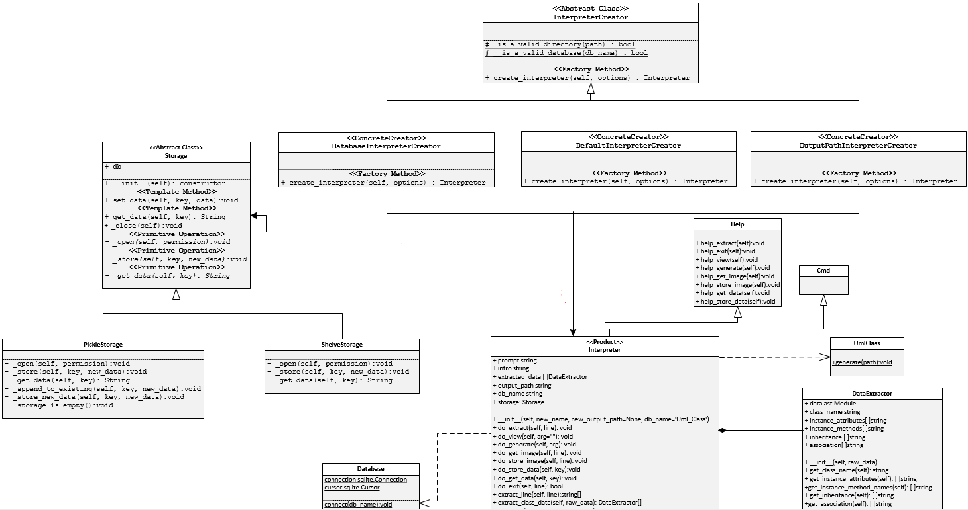
5. The class diagram After modification
Continued…

Slide 18
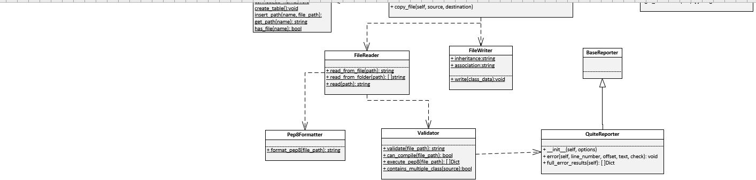

Slide 19
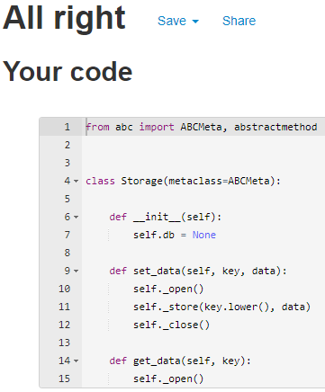
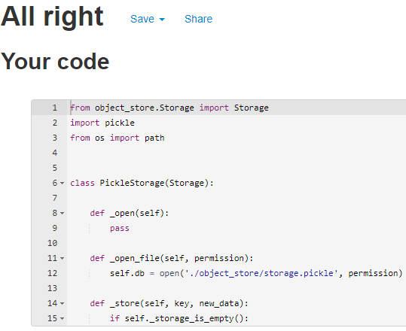
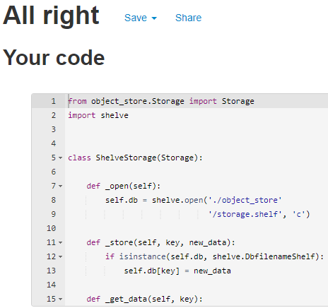
6. Applying the design pattern proposed and PEP 8 Validation

Slide 20
facade

Slide 21
1. The class diagram before modification

Slide 22
2. The locations of code involved
3. The name of the design pattern applied

Slide 23
4. The reasons why applying this design pattern is suitable

Slide 24
5. The class diagram After modification

Slide 25
6. Applying the design pattern proposed and PEP 8 Validation

