Slide 1
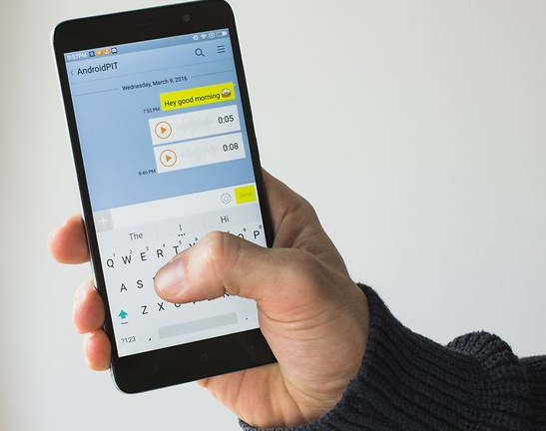
"क़ुरा-क़ानि"
Submitted By:
Bikalpa Sangat
Grishma Shrestha
Kilika Tami Shrestha

Slide 2
Table of Content
Introduction
Literature Review
Objectives
Features
Gantt Chart
DFD
Use Case Diagram
Tools and Technology
Future Enhancement
Conclusion

Slide 3
Introduction
It is an Online chat application build using React18 On the front end and ExpressJs in the backend.
It is a real-time chat system that uses websockets from socket.io package.

Slide 4


Literature Review
Viber Whatsapp

Slide 5
Objectives
To provide users with an instant messaging tool that has the ability to handle a lot of users simultaneously
Define and implement a “chat” protocol for interaction between a chat server and a chat client.

Slide 6
Features
Simple Login and registration
Cloud backup
Data security
Push Notification
Group Chat

Slide 7
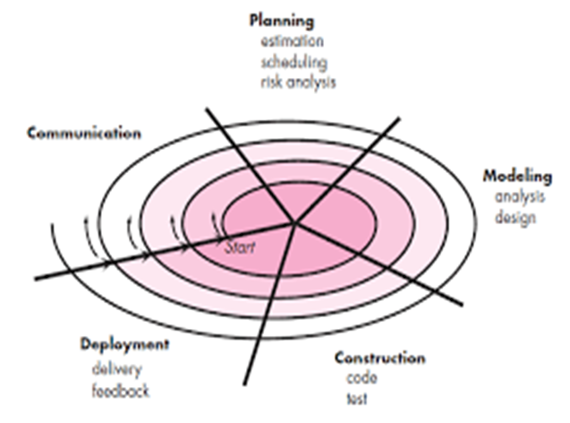
SDLC
Spiral Model

Slide 8
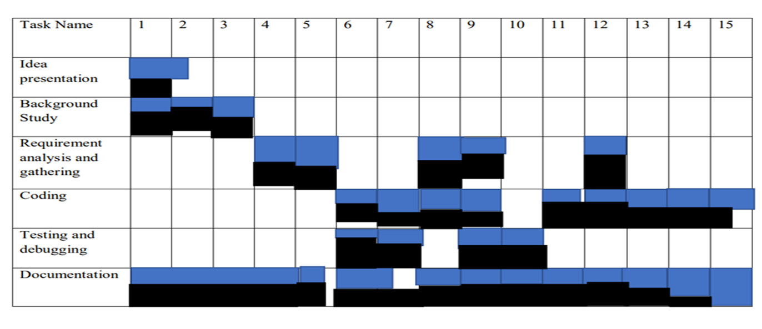
Gantt Chart

Slide 9
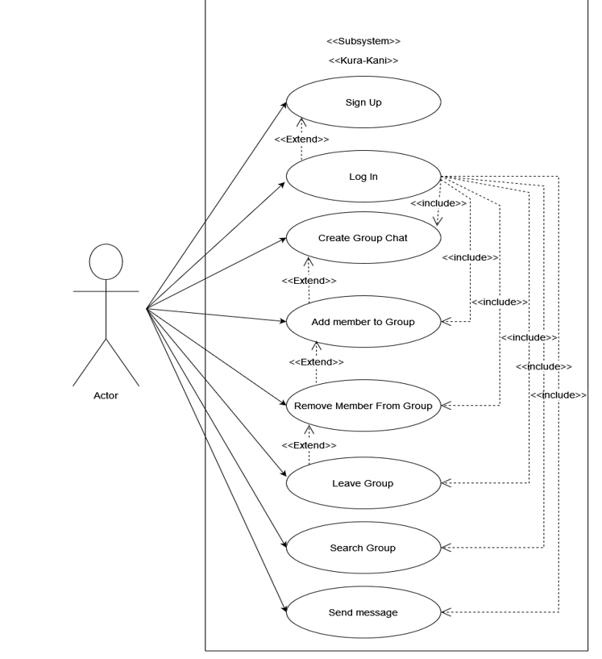
Use Case Diagram

Slide 10
Tools and Technology
React(For Frontend)
ChakraUI(For User Interface Design)
ContextAPI(For State Management)
Nodejs(As Runtime Env)
ExpressJs(Backend)
MongoDb Altas(Cloud Backup and Database)
Cloudinary (Image hosting)
SocketIo(For Realtime communication)
Git (Version control)

Slide 11
Future Enhancement
Build android/iOS app
Add audio/video calling feature using webRtc
Add feature to send files,images and short videos

Slide 12


